Slide 1


Indira college of commerce and science, Wakad, Pune
Project Presentation
Ganesh Londhe
M.Sc.(CS) -II 11490

Slide 2
Efficient clustering algorithm to segregate tests on their execution behavior
Ganesh Londhe
Intern R&D GS & Tools

Slide 3

Agenda
What is this project about?
Why this project is needed?
H/W & S/W Requirements
UML Diagrams
Output
Future Enhancements
References

Slide 4
What is this project about?
Regretion tests
Automation
Machine Learning

Slide 5
BY the Numbers
1
Product
1
Project
6
Versions
172677
Tests
48295
Useful Tests
4
months

Slide 6
Why this project?
Related to my work
Existing system
Limitations
Manual
I’m curious about
Artificial Intelligence
Data Science
Machine Learning
Next generation job opportunities
Artificial Intelligence
Bio-technology
Nano-technology

Slide 7
H/W & S/W Requirements
Hardware:
8 GB RAM
Intel 4th generation processor
Operating System:
Windows/Linu
Tools:
Jupitor notebook
matplotlib
Languages:
Python 3.6 or greater

Slide 8
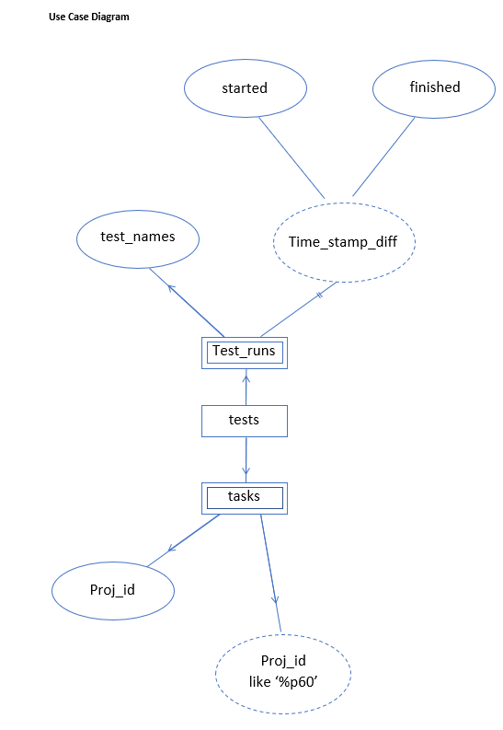
UML Diagrams – use case

Slide 9
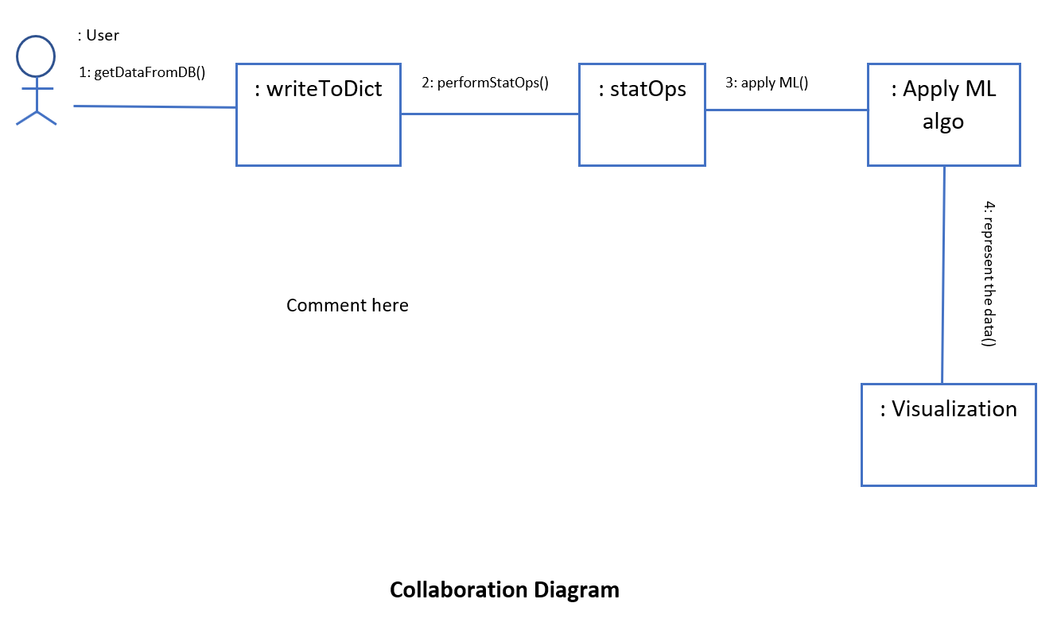
UML Diagrams - collaboration

Slide 10
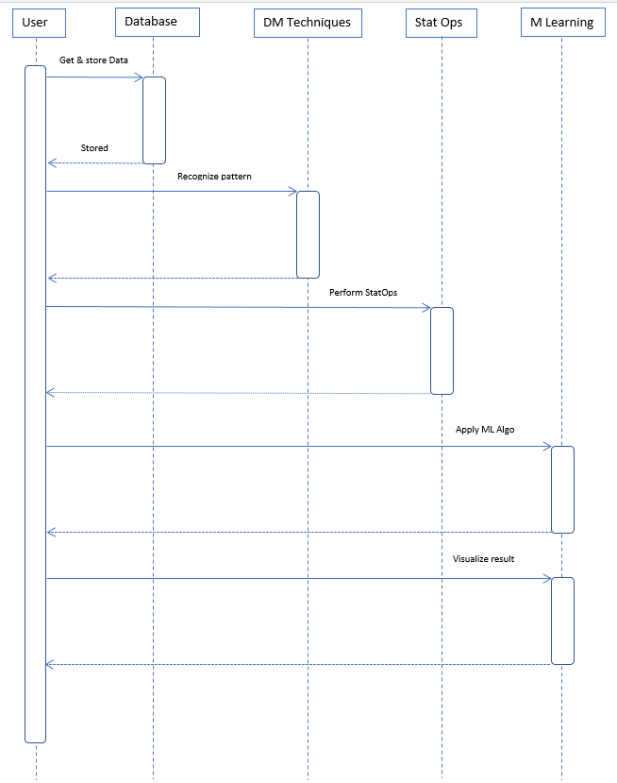
UML Diagrams - sequence

Slide 11
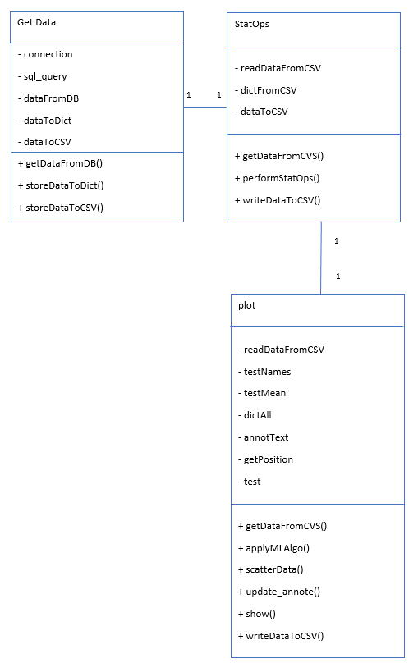
UML Diagrams - class

Slide 12
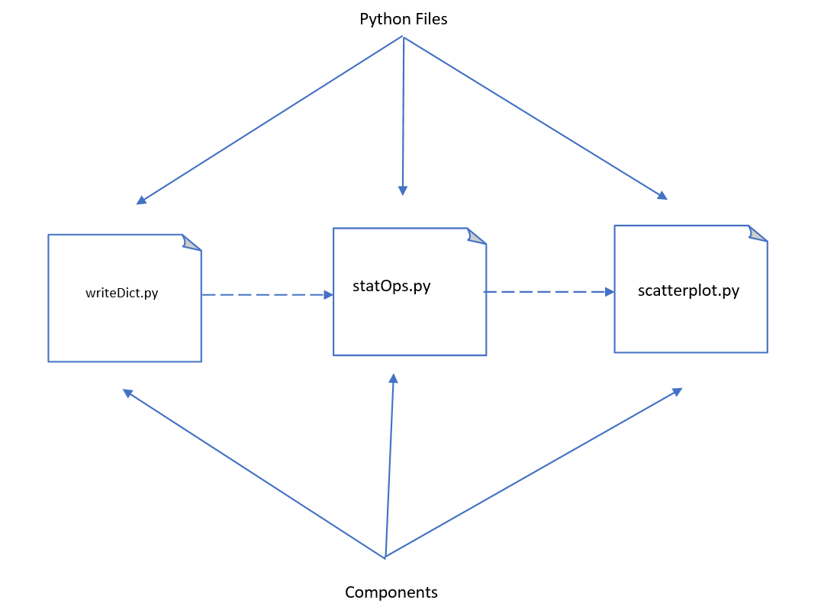
UML Diagrams - component

Slide 13
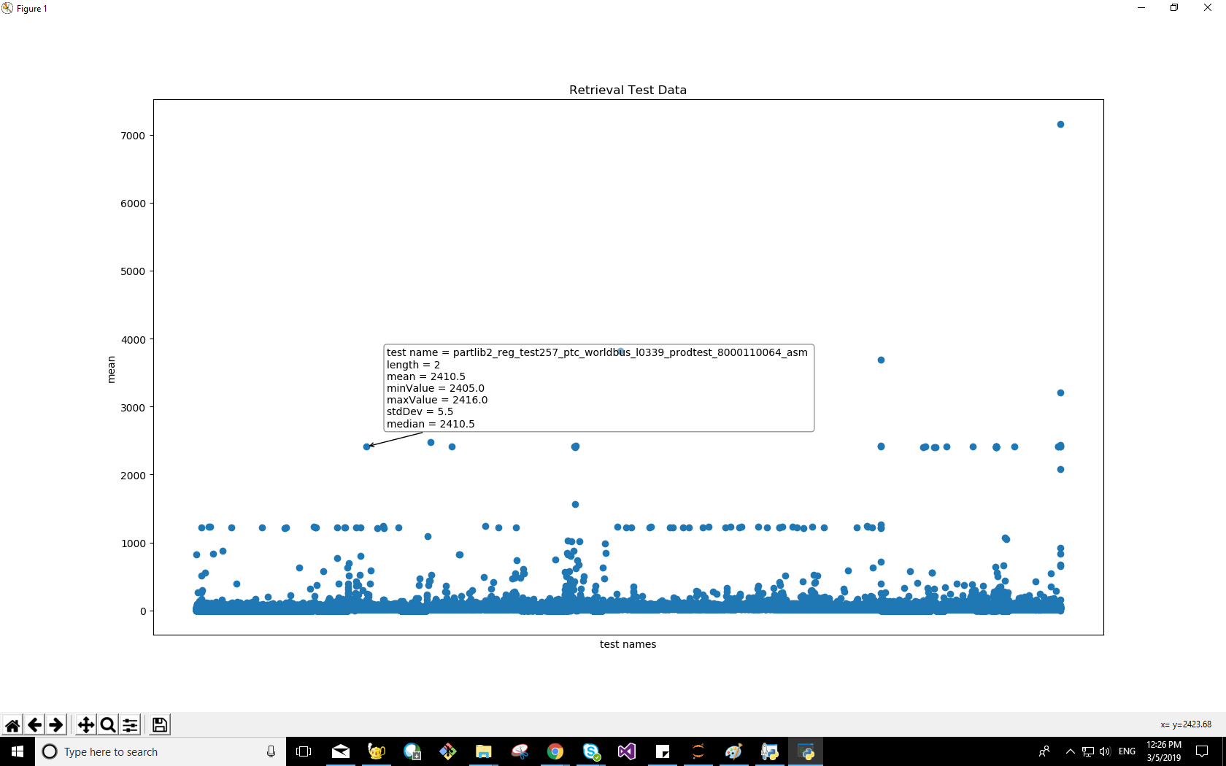
Output – (124,382)

Slide 14
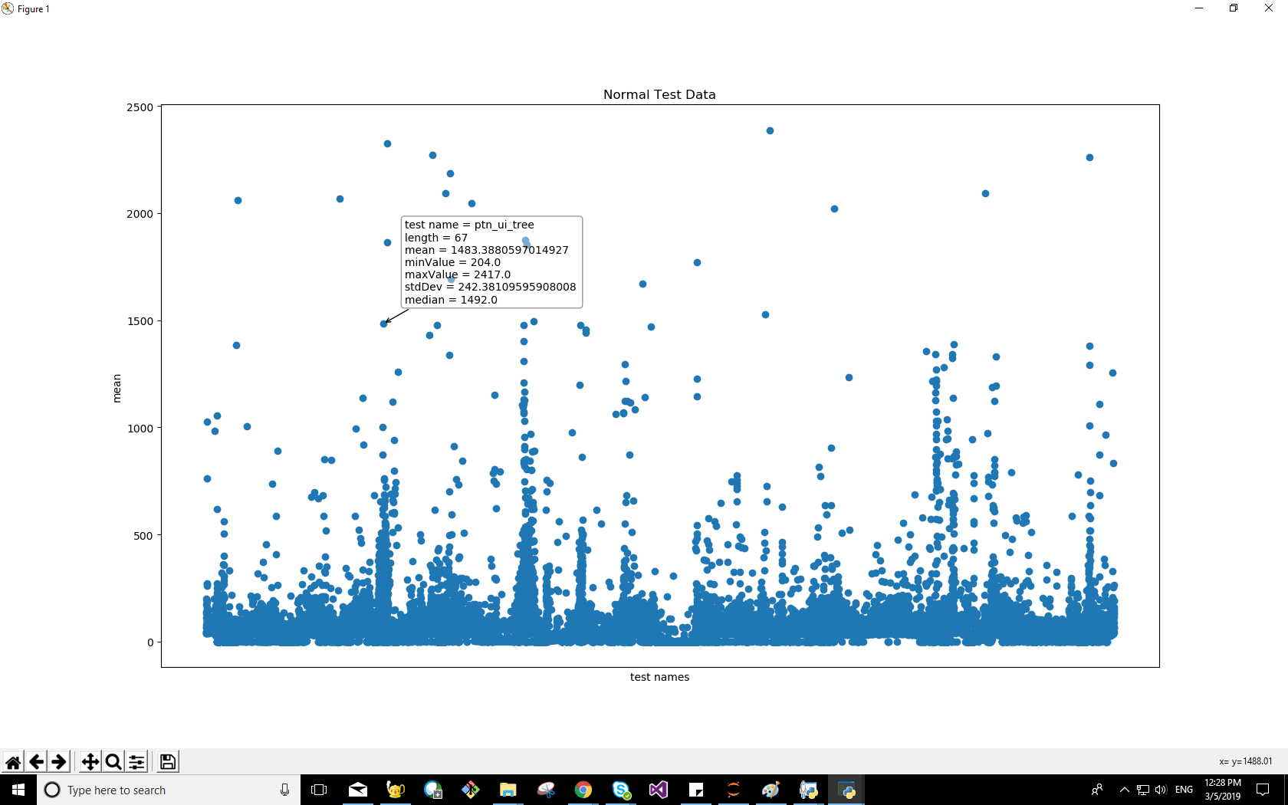
Output – (48,295)

Slide 15
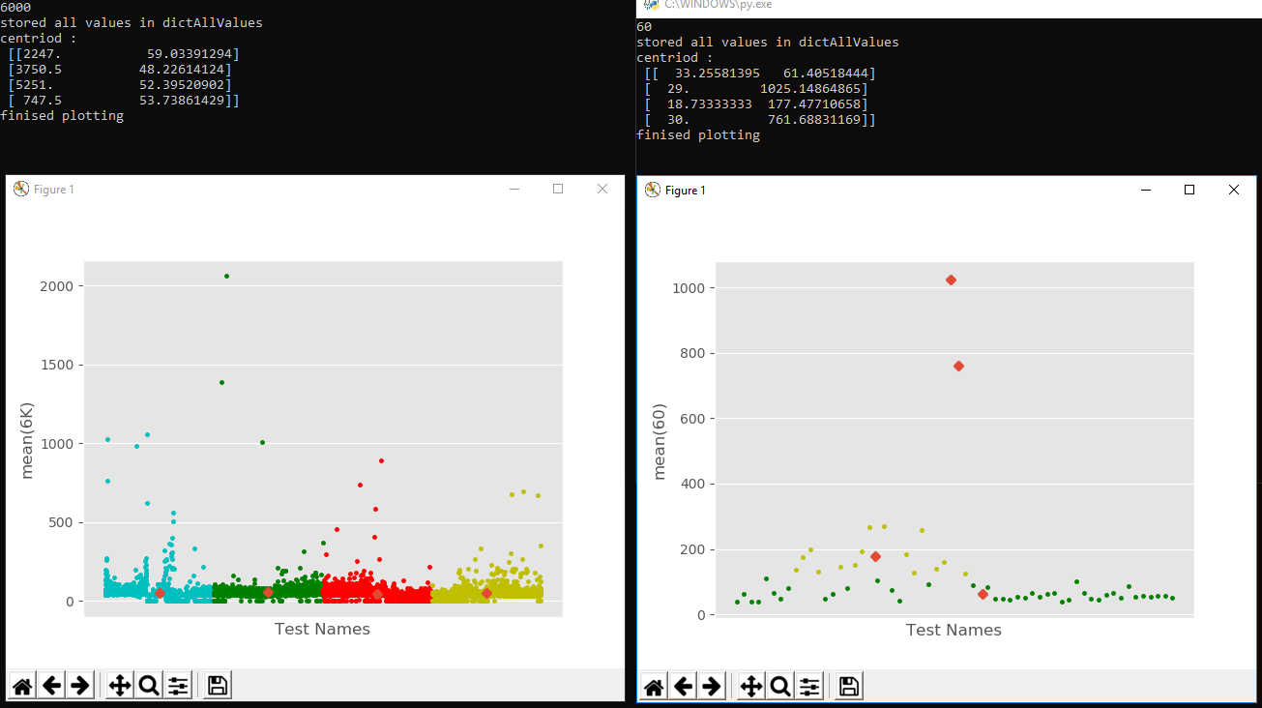
Output

Slide 16
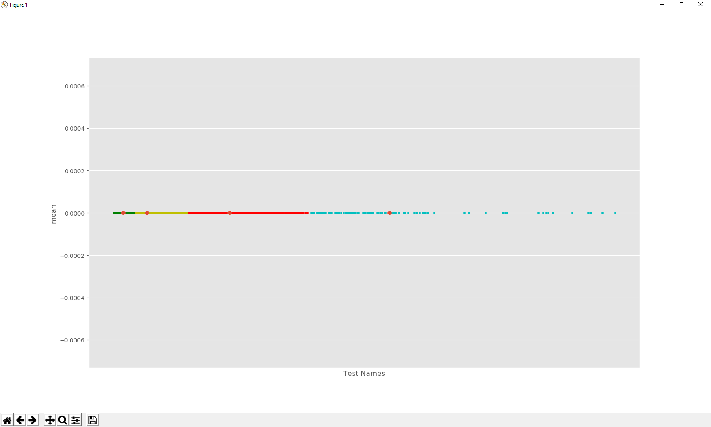
Output – (48,295)

Slide 17
Future Enhancements & references
Prediction of the test
Daily, weekly, monthly and yearly report can be generated
Python.com
youtube.com/sentdex
Lynda.com
Wikipedia.com
Scikit-learn.com

Slide 18
Where to get more info
github.com/gkalidas/Python/tree/master/MCS_project_sem_III

Slide 19
?

Slide 20
Thank You!

