Slide 1


Shree Chanakya Education Society’s
Indira College of Commerce & Science, Wakad, Pune
Project Presentation
“Pocket Fitness”
By,
Swapnil Pradip Panadi
Vaibhav Vijay Vaidya
M.Sc.(CS)-II

Slide 2
What is Pocket Fitness?
Pocket Fitness is a weight management application, designed to
map user weight overtime & give feedback as well as graphical
view of weight fluctuation.
Pocket Fitness also provides reminder functionality to alert users
daily at their preferred time.
Pocket Fitness also provides backup & restore utility of the
database to the phone’s SD card.

Slide 3
Why it’s needed ?
Indians are now adopting western culture along with western diet
such as fast food, readymade food.
“Tasty” food presented to us is in reality unhealthy for the body.
Weight Management is a necessity as well as watching our intake
to all people, not just athletes.
India is currently ranked as the third most obese country in the world,
awareness to obesity is a must.

Slide 4
H/W & S/W Requirements
Hardware Requirements :
Android Cell Phone
Minimum 1MB Storage Space.
256 MB RAM
Intel x86 system image/architecture type
Software Requirements :
Android O.S. Éclair 2.1(API 7) to Android O.S. 4.2.2 Jelly Bean (API 17)
Eclipse JavaEE Luna release 4.4
Android SDK standalone tools

Slide 5
UML Diagrams
Use Case Diagram :
Pocket Fitness App
Choose option
Insert corresponding data
Calculate and show results
System
User
Save result to DB
Database

Slide 6
UML Diagrams
Collaboration Diagram :
: User
1. Start the Application 2.Enter values
: System
3. Calculate and show results
4.Save results
6. Response
5. Request for previous data
: Database

Slide 7
UML Diagrams
Sequence Diagram :
: User
: System
: Database
Input the values
Save details in Database
Calculate and show result
Save result in Database
Request for charts
Get all entries previous stores
Return entries
Display data as a chart
Save all The Changes
Application closed

Slide 8
UML Diagrams
Class Diagram :
Measure
Weight: text
Height: text
OnDateSet()
OnTimeSet()
saveMeasurement()
updateMeasureValue ()
System
Weight: text
Height: text
displayMeasurement ()
displayDate()
DisplayBMI ()
displayComment()
M
1

Slide 9
UML Diagrams
Component Diagram :
.java
.xml
DVM

Slide 10
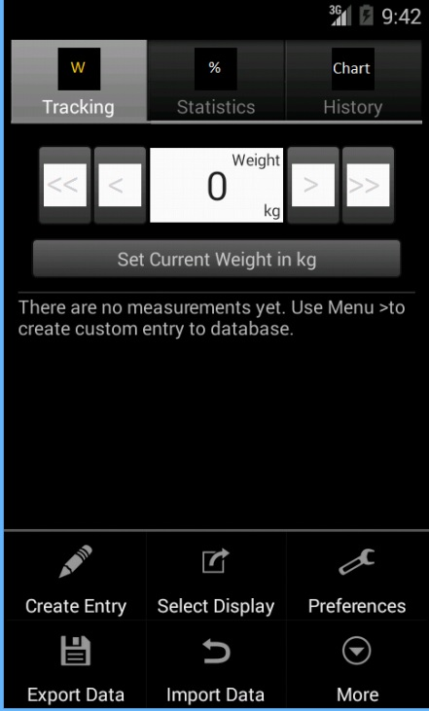
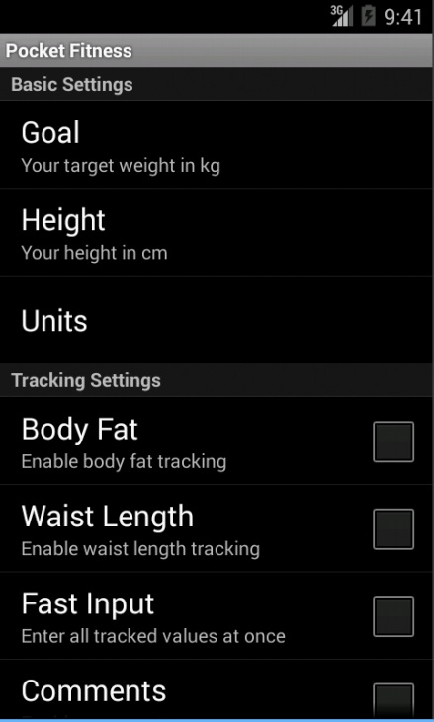
Pocket Fitness Layouts
Input Screens :

Slide 11
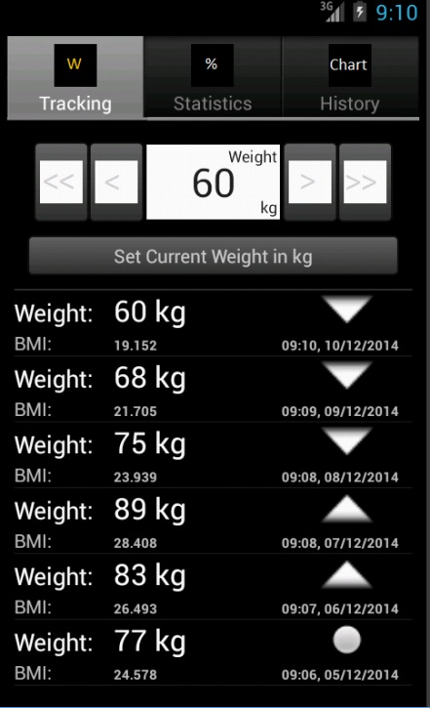
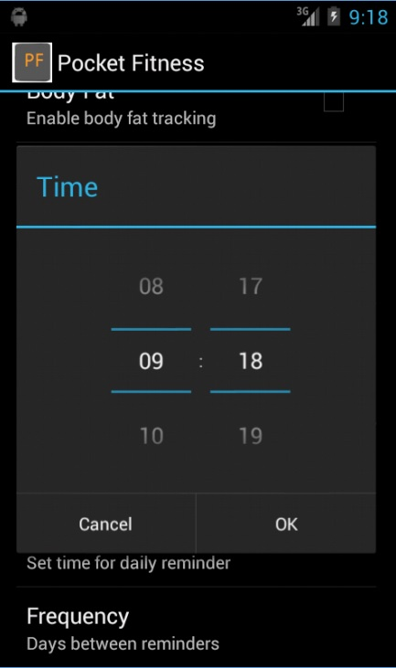
Pocket Fitness Layouts
Input Screens :

Slide 12
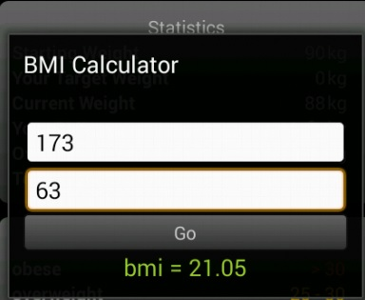
Pocket Fitness Layouts
Output Screens :

Slide 13
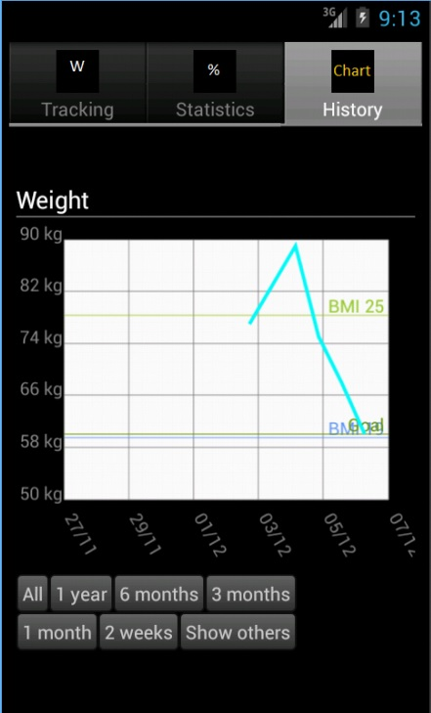
Pocket Fitness Layouts
Output Screens :

Slide 14
Future Enhancement
References

Slide 15
Thank You…

