Slide 1
Hello Everyone!
Vaibhav Jagtap
ICCS, Pune
Ganesh Londhe
ICCS, Pune
@ganesh_kalidas
Not so funny!

Slide 2
Introduction
What?
Why?
How?

Slide 3
PART ONE
Introduction

Slide 4
PART TWO
WHAT IS THIS?

Slide 5
Quiz app

Slide 6
WHAT IS THIS?
Quiz application
Different Subjects
MCQ tests

Slide 7
PART THREE
Why Quiz app?

Slide 8
PART FOUR
Why Quiz app?

Slide 9
Why Quiz app?
To learn new technology
To learn how android works

Slide 10
PART THREE
How?

Slide 11
How?
Sign up
Sign in
Choose subject
End the test
See result
1

Slide 12


Add Text, an Image, or Both

Slide 13
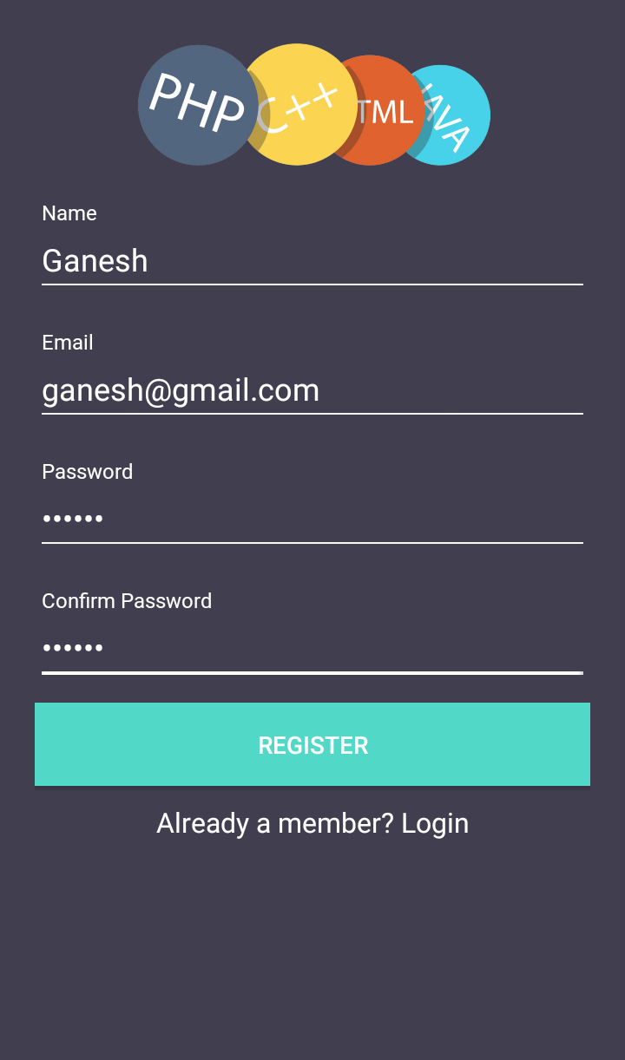
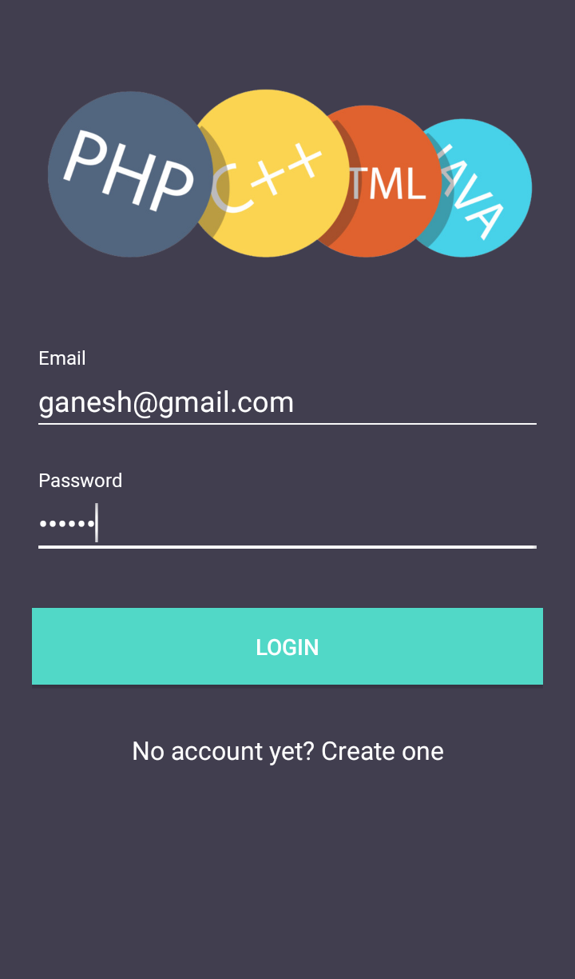
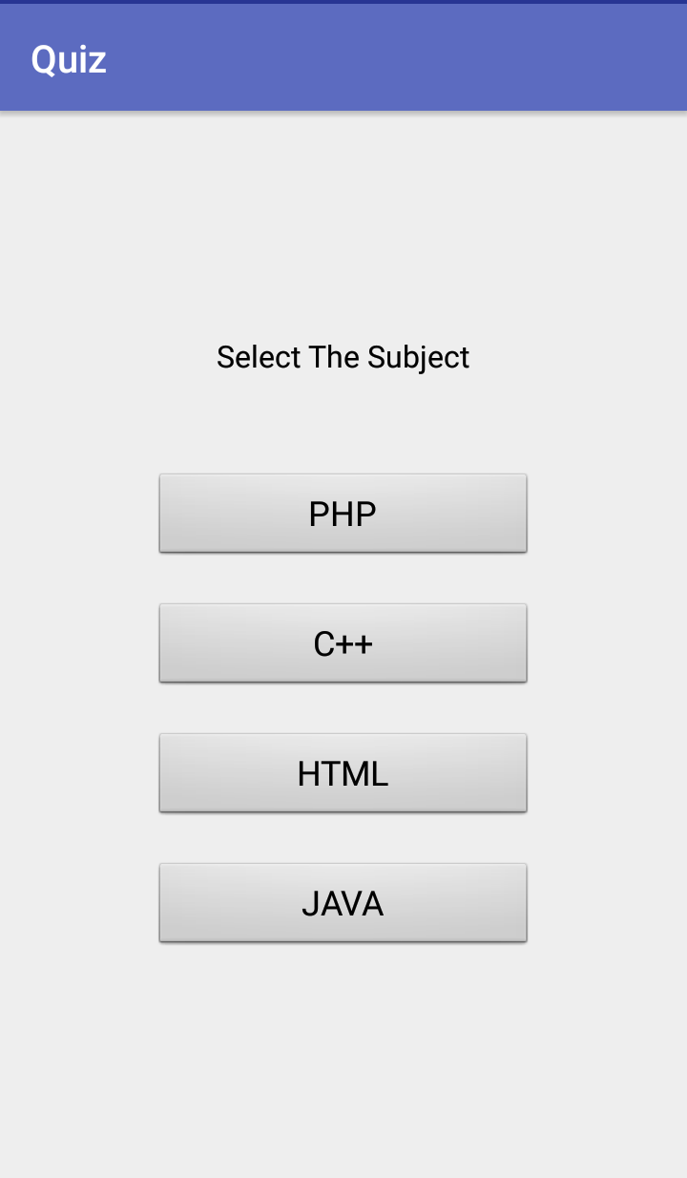

Slide 14
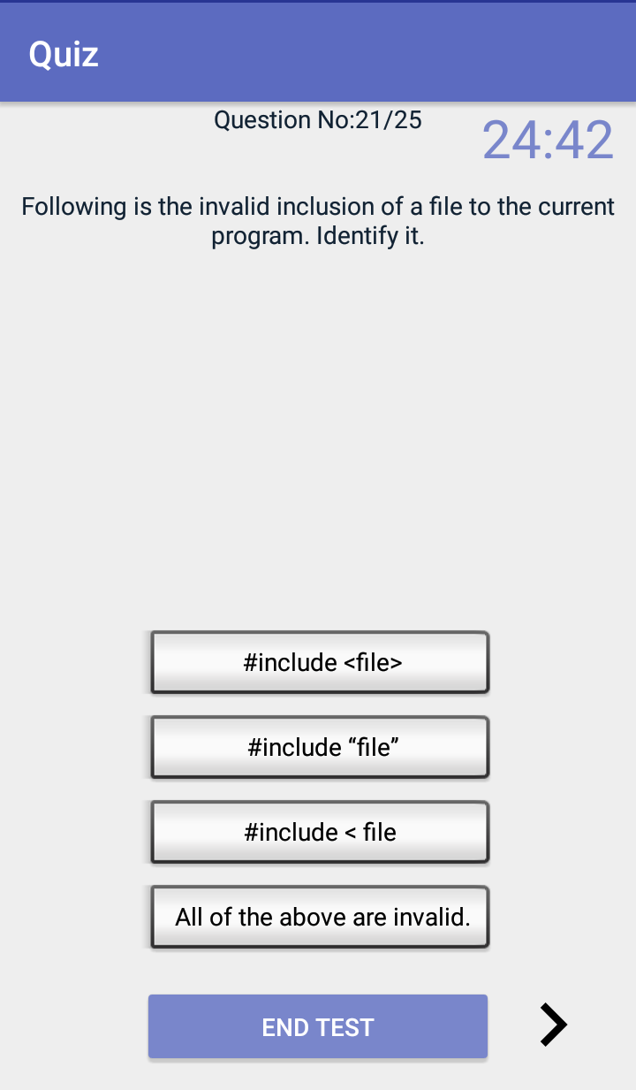
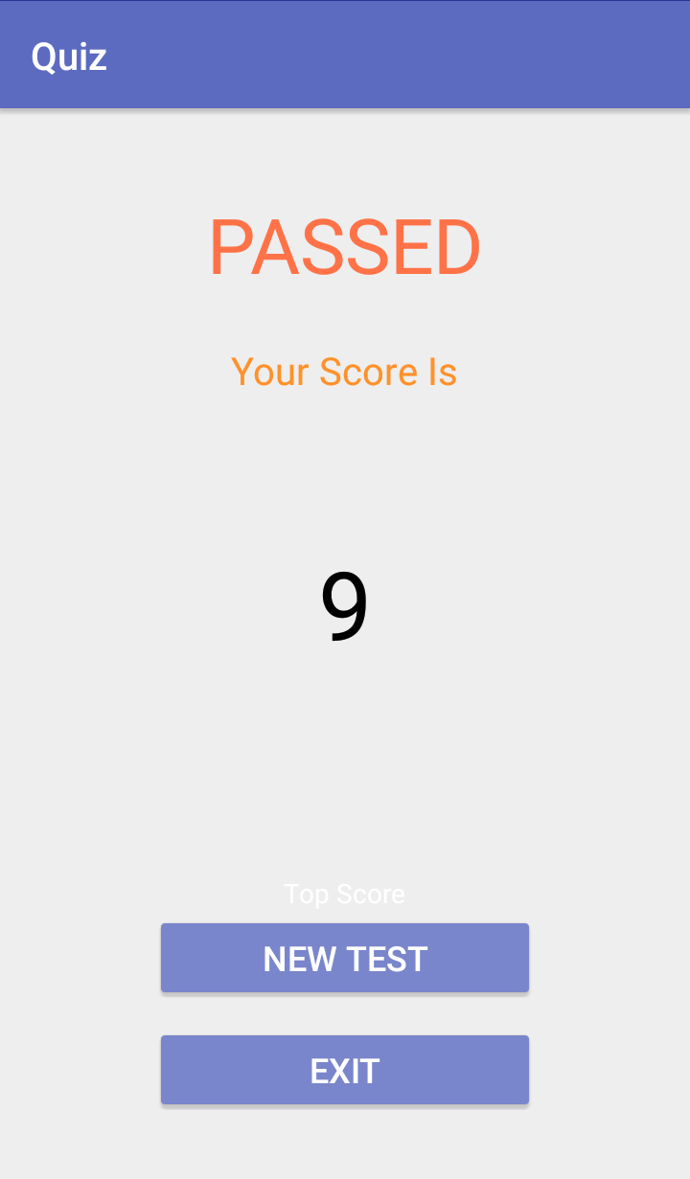
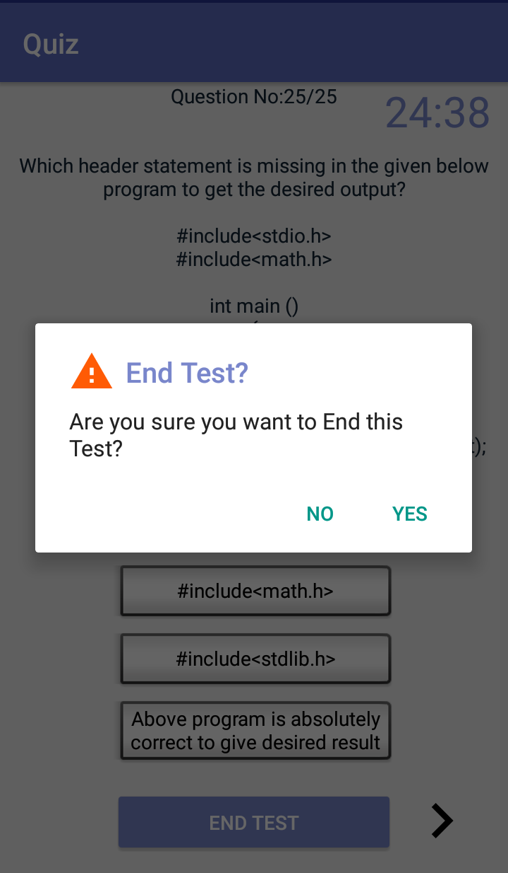

Slide 15
The crucial issue is not about asking questions,
It is the spirit in which
questions are asked.

Slide 16
The crucial issue is not about asking questions,
It is the spirit in which
questions are asked.

Slide 17
?

Slide 18
THANK YOU!

