Slide 1








$$X$$
$$X_{fake}$$
$$Y$$
기존연구
compare distribution
$$X$$
$$X$$
$$O_{fake}$$
StarGAN
$$Y$$
$$Y$$

Slide 2



$$D_{src}\left(x\right)=0.7$$
Image
$$D$$
$$D_{cls}\left(x\right)=\left[0.5, 0.3, 0.1, 0.9\right]$$

Slide 3
Dataset A
Dataset B
label
[금발, 흑발, 중년, 청년, 단발]
[행복, 슬픔, 분노]

Slide 4
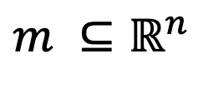

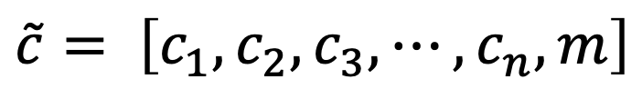




Dataset 1
Dataset 2
Dataset 3
Dataset n
$$⋯$$
label
$$c_{1}$$
$$c_{2}$$
$$c_{3}$$
$$c_{n}$$
$$\tilde{c}= \left[c_{1}, c_{2}, c_{3}, ⋯, c_{n}, m\right]$$
$$m ⊆ℝ^{n}$$

