Slide 1

2

Slide 2

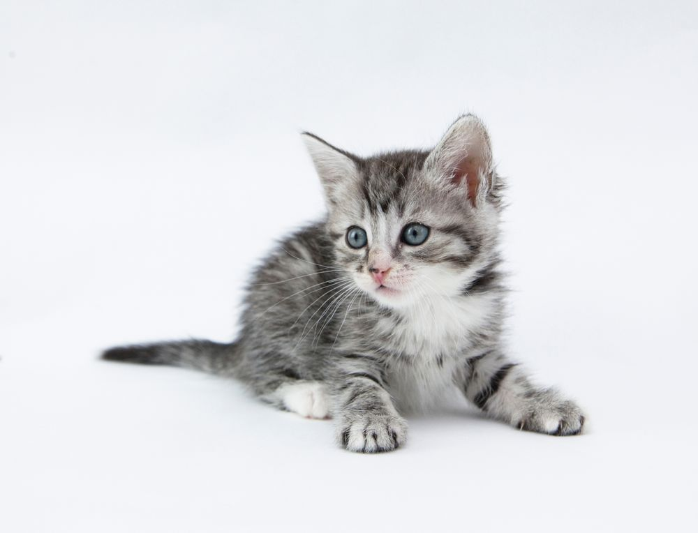

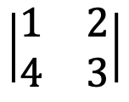



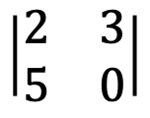
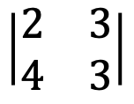
확률측도
가측공간
$$X$$
$$\left|\begin{matrix}1 & 2 \\ 4 & 3\end{matrix}\right|$$
$$X$$
$$\left|\begin{matrix}2 & 3 \\ 4 & 3\end{matrix}\right|$$
$$X$$
$$\left|\begin{matrix}2 & 3 \\ 5 & 0\end{matrix}\right|$$

Slide 3
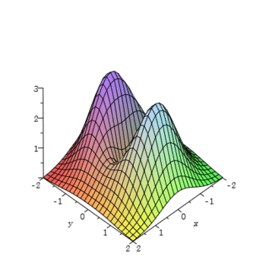
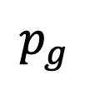



$$p_{z}$$
근사시켜야함
$$p_{g}$$
$$p_{data}$$
$$G(Z)$$

Slide 4

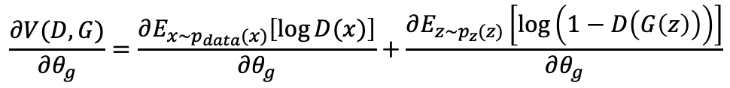


$$\frac{∂V(D, G)}{∂θ_{d}}$$
D
$$V(D, G)$$
G
$$\begin{matrix}|z_{1} & z_{2} & z_{3}|\end{matrix}$$
$$\frac{∂V(D, G)}{∂θ_{g}}=\frac{∂E_{x\sim p_{data}(x)}\left[\log{D(x)}\right]}{∂θ_{g}}+\frac{∂E_{z\sim p_{z}(z)}\left[\log\left(1−D\left(G\left(z\right)\right)\right)\right]}{∂θ_{g}}$$

Slide 5
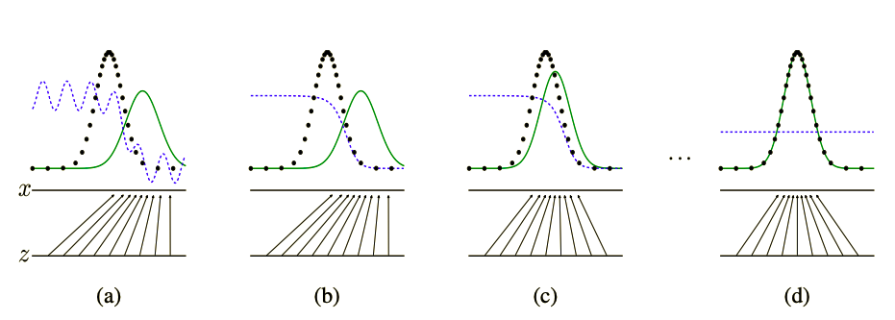




$$G(Z)$$
$$G(Z)$$
$$G(Z)$$
$$G(Z)$$

Slide 6
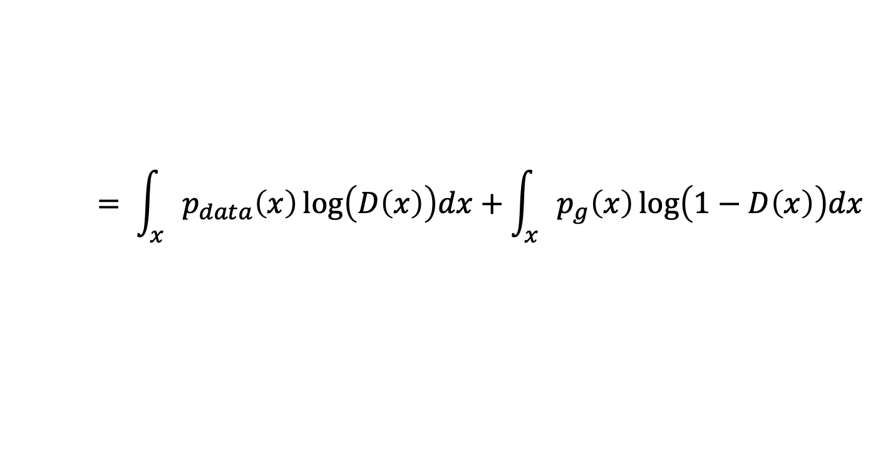
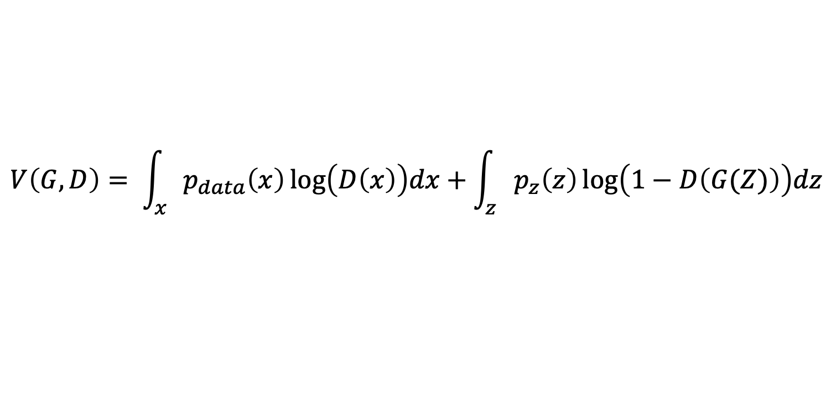
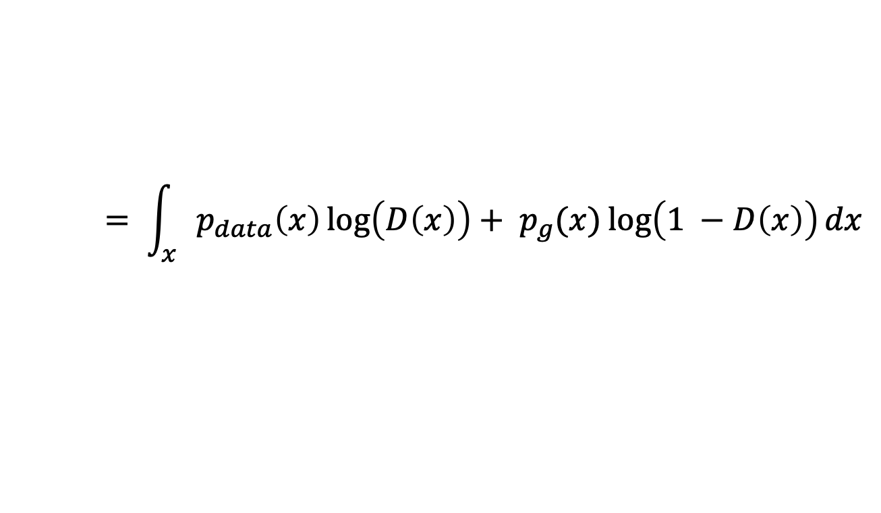
$$V\left(G, D\right)= \int_{x}{p_{data}\left(x\right)\log\left(D\left(x\right)\right)dx}+\int_{z}{p_{z}\left(z\right)\log\left(1−D\left(G(Z)\right)\right)dz}$$
$$= \int_{x}{p_{data}\left(x\right)\log\left(D\left(x\right)\right)dx}+\int_{x}{p_{g}\left(x\right)\log\left(1−D\left(x\right)\right)dx}$$
$$= \int_{x}{p_{data}\left(x\right)\log\left(D\left(x\right)\right)+ p_{g}(x)\log\left(1 −D\left(x\right)\right)dx}$$
$V\left(G, D\right)$를 최대로 만들기 위해선 $p_{data}\left(x\right)\log\left(D\left(x\right)\right)+ p_{g}(x)\log\left(1 −D\left(x\right)\right)$ 가 최대가 되야한다.

Slide 7
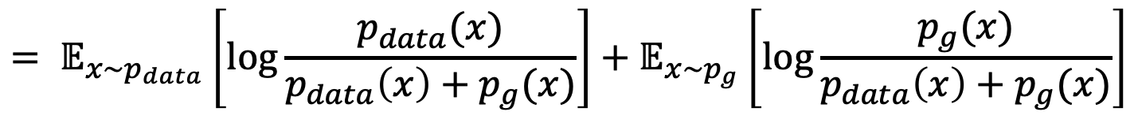
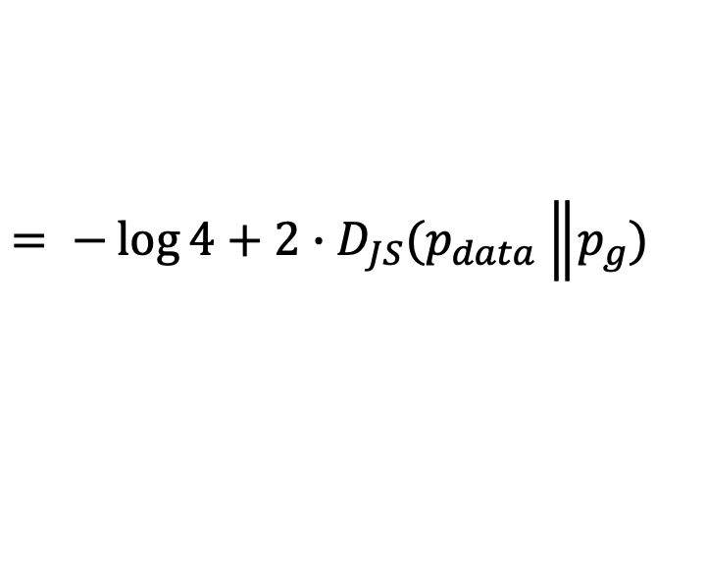

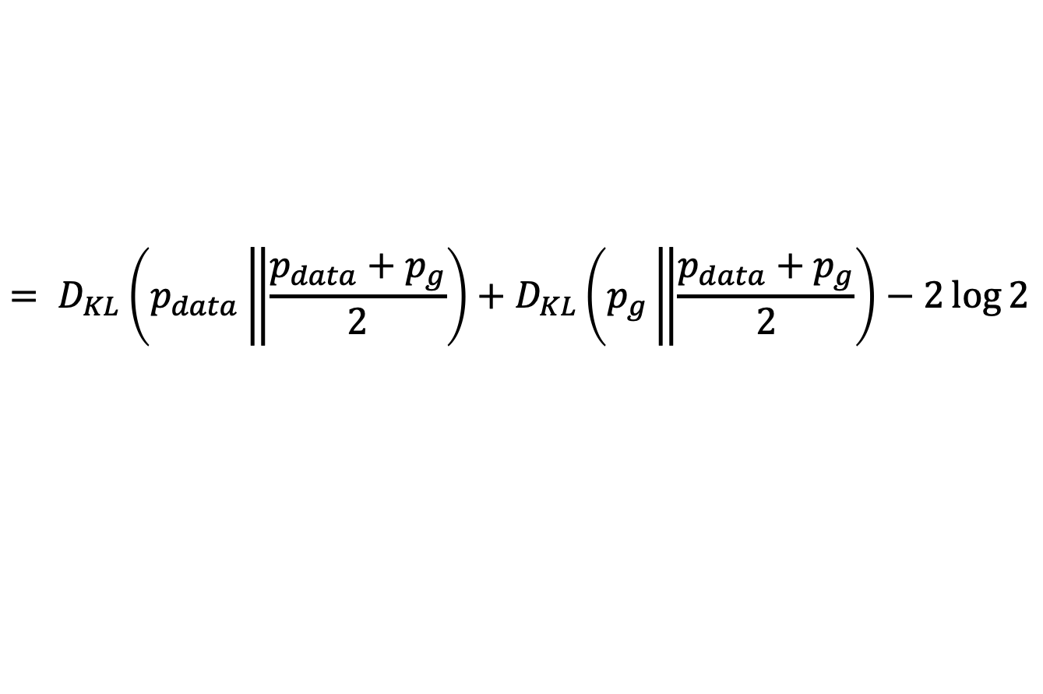
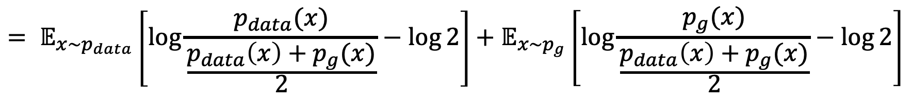
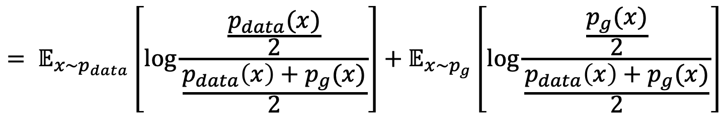
$$C\left(G\right)= \max_{D}{V(G, D)}$$
$$= 𝔼_{x\sim p_{data}}\left[\log{\frac{p_{data}(x)}{p_{data}\left(x\right)+p_{g}(x)}}\right]+𝔼_{x\sim p_{g}}\left[\log{\frac{p_{g}(x)}{p_{data}\left(x\right)+p_{g}(x)}}\right]$$
$$= 𝔼_{x\sim p_{data}}\left[\log{\frac{\frac{p_{data}(x)}{2}}{\frac{p_{data}\left(x\right)+p_{g}(x)}{2}}}\right]+𝔼_{x\sim p_{g}}\left[\log{\frac{\frac{p_{g}(x)}{2}}{\frac{p_{data}\left(x\right)+p_{g}(x)}{2}}}\right]$$
$$= 𝔼_{x\sim p_{data}}\left[\log{\frac{p_{data}(x)}{\frac{p_{data}\left(x\right)+p_{g}(x)}{2}}}−\log{2}\right]+𝔼_{x\sim p_{g}}\left[\log{\frac{p_{g}(x)}{\frac{p_{data}\left(x\right)+p_{g}(x)}{2}}}−\log{2}\right]$$
$$= D_{KL}\left(p_{data}\left\|\frac{p_{data}+p_{g}}{2}\right.\right)+D_{KL}\left(p_{g}\left\|\frac{p_{data}+p_{g}}{2}\right.\right)−2\log{2}$$
$$= −\log{4}+2∙D_{JS}(p_{data}\left\|p_{g}\right.)$$

