Slide 1
1
2
3
4
5
6
개인 단위 특징 : [키 : 186, 몸무게 : 85, 사는곳 : 서울, 직업 : 프로그래머]
집단 단위 특징 : [왼쪽에서 4번째 순서, 3번째로 키가 큼, 가장 학력이 좋음]

Slide 2
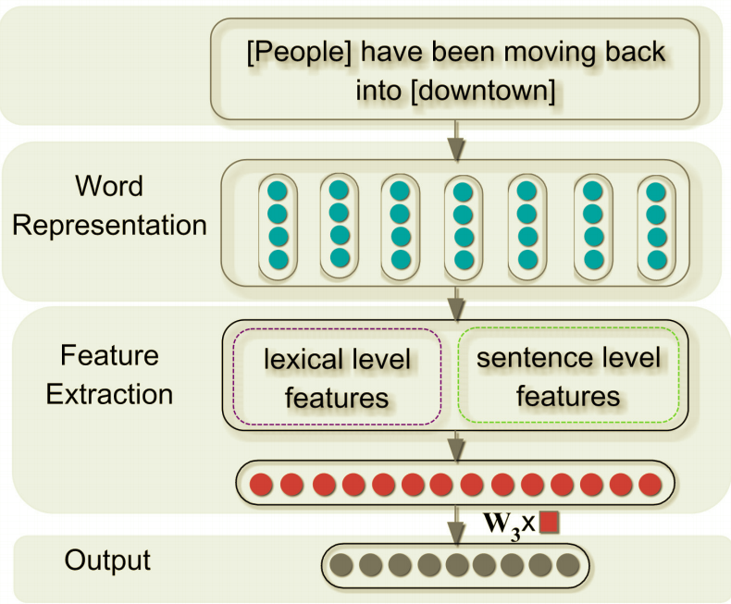
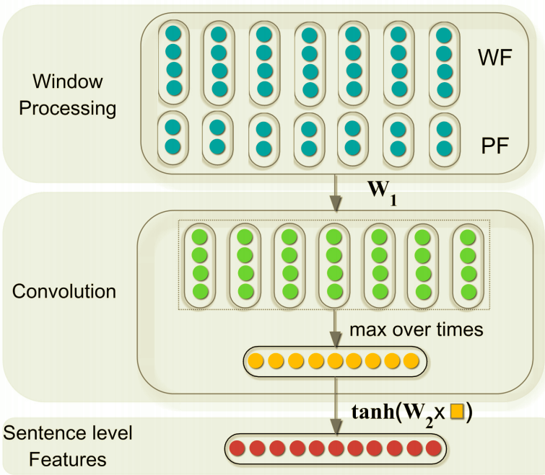
Entire Architecture
Sentence Extract Architecture

Slide 3
People
have
been
moving
back
into
downtown
[<start>, People, have , 0, 6]
[People, have, been , 1, 5]
[have, been, moving, 2, 4]
[been, moving, back, 3, 3]
[moving, back, into, 4, 2]
[back, into, downtown, 5, 1]
[into, downtown, <end>, 6, 0]

Slide 4

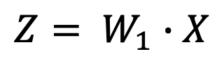



People have been moving back into downtown
word embedding
$${[x}_{1} x_{2} x_{3} { x}_{4} x_{5} x_{6}]$$
WF & PF
$$t$$
$$n_{0}×t$$
$$X$$
Convolution
$$Z= W_{1}∙X$$

Slide 5






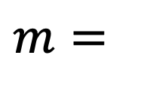


$$t$$
$$Z$$
max pooling
max pooling
$$n_{1}$$
$$m=$$
$$m_{1}$$
$$m_{2}$$
$$m_{3}$$
$$m_{4}$$
. . .
$$m_{n_{1}}$$
max pooling

Slide 6
