Slide 1
1
2
3
4
5
6
개인 단위 특징 : [키 : 186, 몸무게 : 85, 사는곳 : 서울, 직업 : 프로그래머]
집단 단위 특징 : [왼쪽에서 4번째 순서, 3번째로 키가 큼, 가장 학력이 좋음]

Slide 2
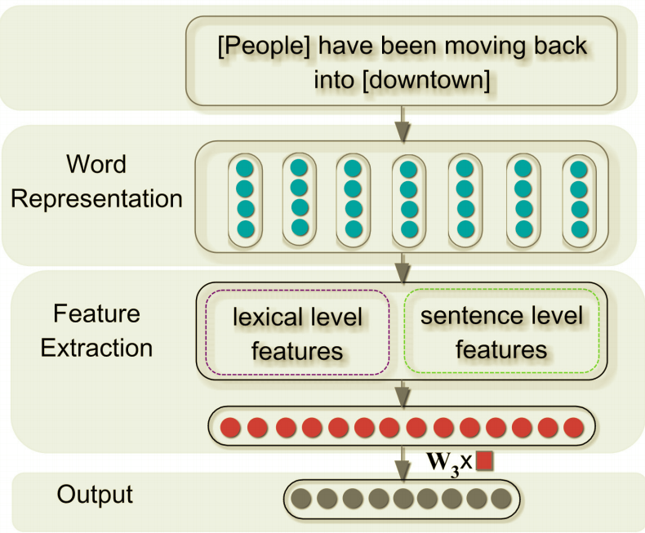
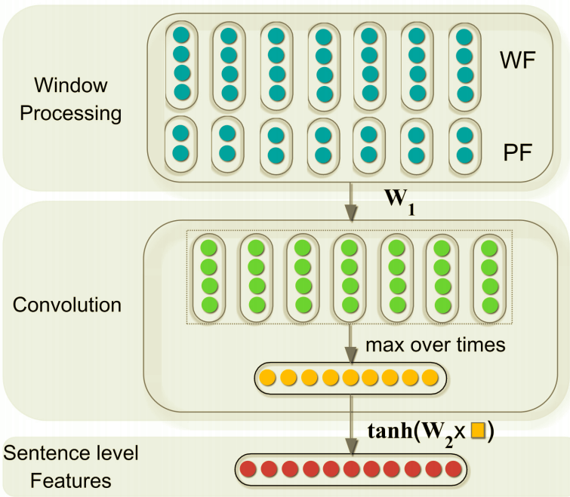
Entire Architecture
Sentence Extract Architecture

Slide 3
People
have
been
moving
back
into
downtown
[<start>, People, have , 0, 6]
[People, have, been , 1, 5]
[have, been, moving, 2, 4]
[been, moving, back, 3, 3]
[moving, back, into, 4, 2]
[back, into, downtown, 5, 1]
[into, downtown, <end>, 6, 0]

