Slide 1
1
1
2
4
5
6
8
7
6
8
max-pool
2
3
1
0
3
4
1
2
3
4
not similar
4
7
0
4
2
8
1
3
8
4
max-pool
1
6
3
2
6
3
1
5
2
1

Slide 2
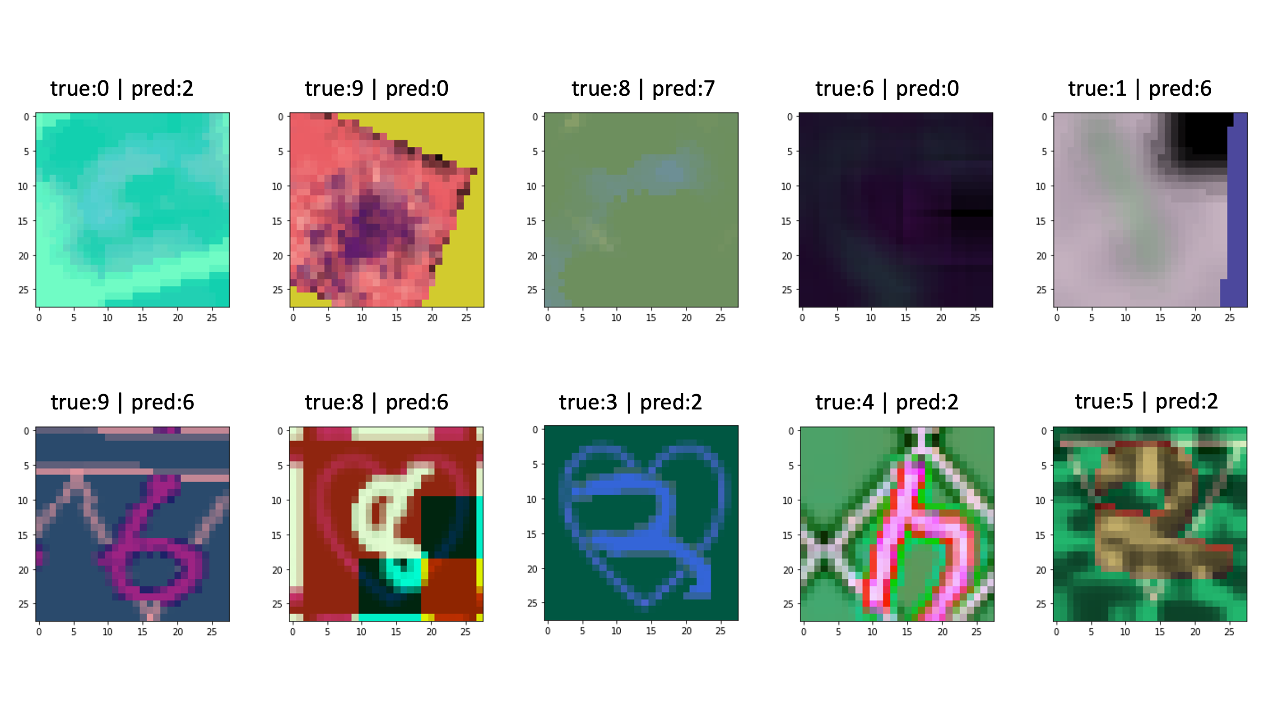

Slide 3
capsule
capsule
capsule
capsule
capsule
capsule
capsule

Slide 4
yellow = 0
green = 1
blue = 2
red = 3
purple = 4
. . .
inv_rendering
[20, 40, 40, 3]

Slide 5
5D vector
5D vector
Boat
House

Slide 7












$$u_{1}$$
$${W_{1}∙u}_{1}$$
$${\hat{u}}_{1}$$
$$u_{2}$$
$${W_{2}∙u}_{2}$$
$${\hat{u}}_{2}$$
$$u_{3}$$
$${W_{3}∙u}_{3}$$
$${\hat{u}}_{3}$$
$${W_{4}∙u}_{4}$$
$$u_{4}$$
$${\hat{u}}_{4}$$

Slide 8

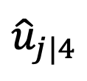



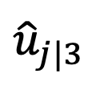




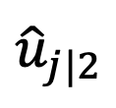

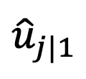

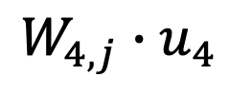


$$u_{1}$$
$${W_{1,j}∙u}_{1}$$
$${\hat{u}}_{j|1}$$
$$b_{1}$$
$${W_{2,j}∙u}_{2}$$
$$c_{1}$$
$$u_{2}$$
$${\hat{u}}_{j|2}$$
$$c_{2}$$
$$b_{2}$$
$$c_{3}$$
$${W_{3,j}∙u}_{3}$$
$$c_{4}$$
$$v_{j}$$
$$u_{3}$$
$${\hat{u}}_{j|3}$$
$$b_{3}$$
$$b_{4}$$
$${W_{4,j}∙u}_{4}$$
$$u_{4}$$
$${\hat{u}}_{j|4}$$

Slide 9
$$u_{1}$$
$${W_{1,j}∙u}_{1}$$
$${\hat{u}}_{j|1}$$
$$b_{1}$$
$${W_{2,j}∙u}_{2}$$
$$c_{1}$$
$$u_{2}$$
$${\hat{u}}_{j|2}$$
$$c_{2}$$
$$b_{2}$$
$$c_{3}$$
$${W_{3,j}∙u}_{3}$$
$$c_{4}$$
$$v_{j}$$
$$u_{3}$$
$${\hat{u}}_{j|3}$$
$$b_{3}$$
$$b_{4}$$
$${W_{4,j}∙u}_{4}$$
$$u_{4}$$
$${\hat{u}}_{j|4}$$

Slide 10
$$u_{1}$$
$${W_{1,j}∙u}_{1}$$
$${\hat{u}}_{j|1}$$
$$b_{1}$$
$${W_{2,j}∙u}_{2}$$
$$c_{1}$$
$$u_{2}$$
$${\hat{u}}_{j|2}$$
$$c_{2}$$
$$b_{2}$$
$$c_{3}$$
$${W_{3,j}∙u}_{3}$$
$$c_{4}$$
$$v_{j}$$
$$u_{3}$$
$${\hat{u}}_{j|3}$$
$$b_{3}$$
$$b_{4}$$
$${W_{4,j}∙u}_{4}$$
$$u_{4}$$
$${\hat{u}}_{j|4}$$

Slide 11
$$u_{1}$$
$${W_{1,j}∙u}_{1}$$
$${\hat{u}}_{j|1}$$
$$b_{1}$$
$${W_{2,j}∙u}_{2}$$
$$c_{1}$$
$$u_{2}$$
$${\hat{u}}_{j|2}$$
$$c_{2}$$
$$b_{2}$$
$$c_{3}$$
$${W_{3,j}∙u}_{3}$$
$$c_{4}$$
$$v_{j}$$
$$u_{3}$$
$${\hat{u}}_{j|3}$$
$$b_{3}$$
$$b_{4}$$
$${W_{4,j}∙u}_{4}$$
$$u_{4}$$
$${\hat{u}}_{j|4}$$

Slide 12
0
length of capsule 0.1에 가깝게
1
length of capsule 0.1에 가깝게
2
length of capsule 0.1에 가깝게
3
3
length of capsule 0.9에 가깝게
4
length of capsule 0.1에 가깝게
5
length of capsule 0.1에 가깝게
6
length of capsule 0.1에 가깝게
input
7
length of capsule 0.1에 가깝게
8
length of capsule 0.1에 가깝게
9
length of capsule 0.1에 가깝게

Slide 13
0
1
Sigmoid
ReLU
ReLU
2
3
3
4
reshape
5
6
7
8
512
1024
784
9

Slide 14
8
32x6x6
reshape
PrimaryCaps

