Slide 1








Input
hidden
output
$$x_{1}$$
$$a_{1}^{1}$$
$$x_{2}$$
$$a_{2}^{1}$$
$$a_{1}^{2}$$
$$x_{3}$$
$$a_{h}^{1}$$
$$x_{m}$$

Slide 2











$$b_{1}$$
$$x_{1}$$
$$w_{1}$$
$$x_{2}$$
$$w_{2}$$
$$x_{3}$$
$$w_{3}$$
$$Z= X∙W+b$$
$$a=activate(Z)$$
$$w_{m}$$
$$x_{m}$$

Slide 3







$$x_{1}$$
$$x_{2}$$
$$a_{1}^{1}$$
$$a_{2}^{1}$$
$$x_{3}$$
$$a_{h}^{1}$$
$$x_{m}$$

Slide 4



$$a_{1}^{1}$$
$$a_{2}^{1}$$
$$a_{1}^{2}$$
$$a_{h}^{1}$$

Slide 5


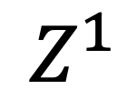
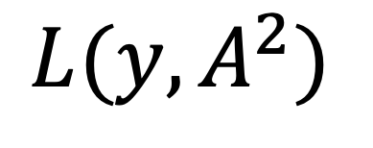



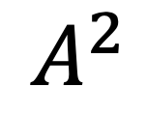

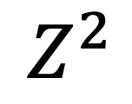


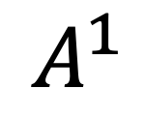


$$X$$
$$Z^{1}$$
$$A^{1}$$
$$Z^{2}$$
$$A^{2}$$
$$L(y, A^{2})$$
$$W^{1}X+b^{1}$$
$$φ(Z^{1})$$
$$W^{2}A^{1}+b^{2}$$
$$φ(Z^{2})$$
$$Loss$$
$${Z^{1}= W}^{1}X+b^{1}$$
$$A^{1}=φ(Z^{1})$$
$${Z^{2}= W}^{2}A^{1}+b^{2}$$
$$A^{2}=φ(Z^{2})$$
$$L\left(y, A^{2}\right)=−(y_{i}lnA^{2}+\left(1−y_{i}\right)ln⁡(1−A^{2}))$$

Slide 6

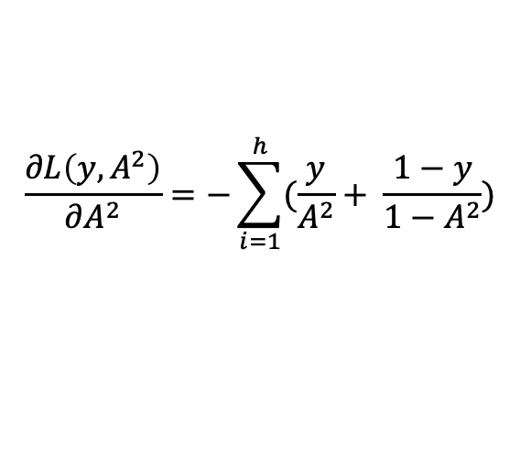
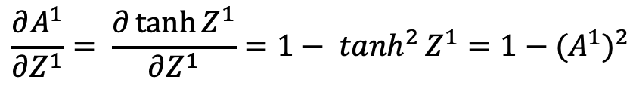

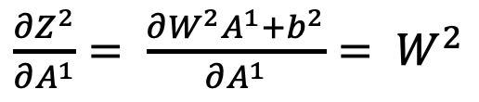
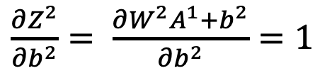
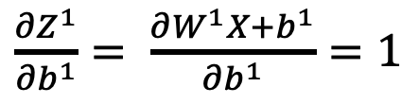

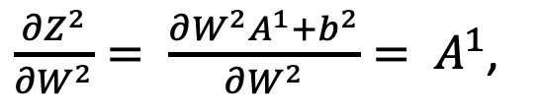

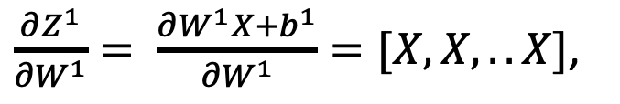

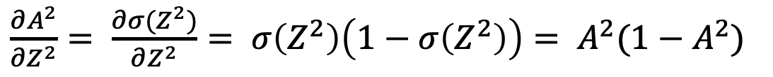
제곱아니고 2번째 layer의 매트릭스라는 뜻
$$X$$
$$Z^{1}$$
$$A^{1}$$
$$Z^{2}$$
$$A^{2}$$
$$L(y, A^{2})$$
$$∂W^{1}, ∂b^{1}$$
$$∂Z^{1}$$
$$∂W^{2}, ∂b^{2}$$
$$∂Z^{2}$$
$$∂A^{2}$$
$$\frac{∂L\left(y, A^{2}\right)}{∂A^{2}}=−\sum_{i=1}^{h}{(\frac{y}{A^{2}}+ \frac{1−y}{1−A^{2}})}$$
$\frac{∂A^{2}}{∂Z^{2}}= \frac{∂σ(Z^{2})}{∂Z^{2}}= σ\left(Z^{2}\right)\left(1−σ\left(Z^{2}\right)\right)= A^{2}(1−A^{2})$
$\frac{∂Z^{2}}{∂W^{2}}= \frac{∂W^{2}A^{1}+b^{2}}{∂W^{2}}= A^{1}$,
$\frac{∂Z^{2}}{∂b^{2}}= \frac{∂W^{2}A^{1}+b^{2}}{∂b^{2}}=1$
$\frac{∂Z^{2}}{∂A^{1}}= \frac{∂W^{2}A^{1}+b^{2}}{∂A^{1}}= W^{2}$
$$\frac{∂A^{1}}{∂Z^{1}}= \frac{∂\tanh{Z^{1}}}{∂Z^{1}}=1− \tanh^{2}{Z^{1}}=1−{(A^{1})}^{2}$$
$\frac{∂Z^{1}}{∂W^{1}}= \frac{∂W^{1}X+b^{1}}{∂W^{1}}=[X, X, ..X]$,
$\frac{∂Z^{1}}{∂b^{1}}= \frac{∂W^{1}X+b^{1}}{∂b^{1}}=1$
h개의 X

Slide 7





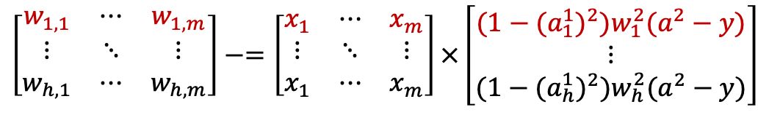




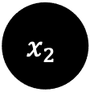

$$x_{1}$$
$$a_{1}^{1}$$
$$x_{2}$$
$$a_{2}^{1}$$
$$a_{1}^{2}$$
$$x_{3}$$
$$a_{h}^{1}$$
$$x_{m}$$
$$\left[\begin{matrix}w_{1,1} & ⋯ & w_{1,m} \\ ⋮ & ⋱ & ⋮ \\ w_{h,1} & ⋯ & w_{h,m}\end{matrix}\right]−=\left[\begin{matrix}x_{1} & ⋯ & x_{m} \\ ⋮ & ⋱ & ⋮ \\ x_{1} & ⋯ & x_{m}\end{matrix}\right]×\left[\begin{matrix}(1−{{(a}_{1}^{1})}^{2})w_{1}^{2}(a^{2}−y) \\ ⋮ \\ (1−{{(a}_{h}^{1})}^{2})w_{h}^{2}(a^{2}−y)\end{matrix}\right]$$
$$(h × m)$$
$$(h × m)$$
$$(h × 1)$$

