Slide 1

AtliQ Hospitality
Geetha

Slide 2
Portfolio footprint
ATLIQ HOSPITALITY
PROPERTY PRESENCE BY CITY
Four cities.
6
7
6
5
PROPERTIES
PROPERTIES
PROPERTIES
PROPERTIES
One portfolio.
Bangalore
Mumbai
Hyderabad
Delhi
AtliQ properties across Bangalore, Mumbai, Hyderabad and Delhi.
AtliQ Bay
AtliQ Blu
AtliQ City
AtliQ Exotica
AtliQ Grands
AtliQ Palace
AtliQ Bay
AtliQ Blu
AtliQ City
AtliQ Exotica
AtliQ Grands
AtliQ Palace
AtliQ Seasons
AtliQ Bay
AtliQ Blu
AtliQ City
AtliQ Exotica
AtliQ Grands
AtliQ Palace
AtliQ Bay
AtliQ Blu
AtliQ City
AtliQ Grands
AtliQ Palace
04
CITY MARKETS
ATLIQ HOSPITALITY • PORTFOLIO OVERVIEW

Slide 3
Dataset details
ATLIQ HOSPITALITY
BOOKING DATA + ANALYSIS INPUTS
Three months.
05
01
DIM
Dim_date
SUPPORTING INPUTS
EXCEL
DATA FILES
Every hotel.
02
DIM
Dim_hotels
Metric list
3 DIMENSIONS
Excel file
2 FACT TABLES
Booking-detail data across the full AtliQ hotel portfolio.
03
DIM
Dim_rooms
Mock-up
dashboard
02
Fact_aggregated_bookings
SUPPORTING
INPUTS
04
FACT
05
FACT
Fact_bookings
03
MONTHS OF DATA
ATLIQ HOSPITALITY • DATASET OVERVIEW

Slide 4
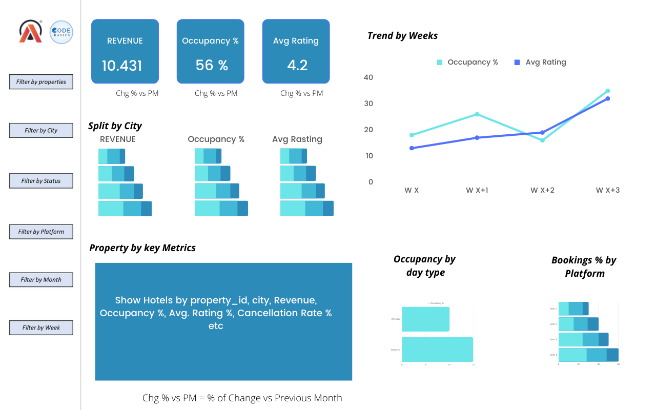
Mockup Dashboard
ATLIQ HOSPITALITY
REFERENCE LAYOUT
Dashboard
mock-up.
Reference view of the proposed reporting experience.
01
VISUAL PROTOTYPE
ATLIQ HOSPITALITY • DASHBOARD MOCK-UP

Slide 5
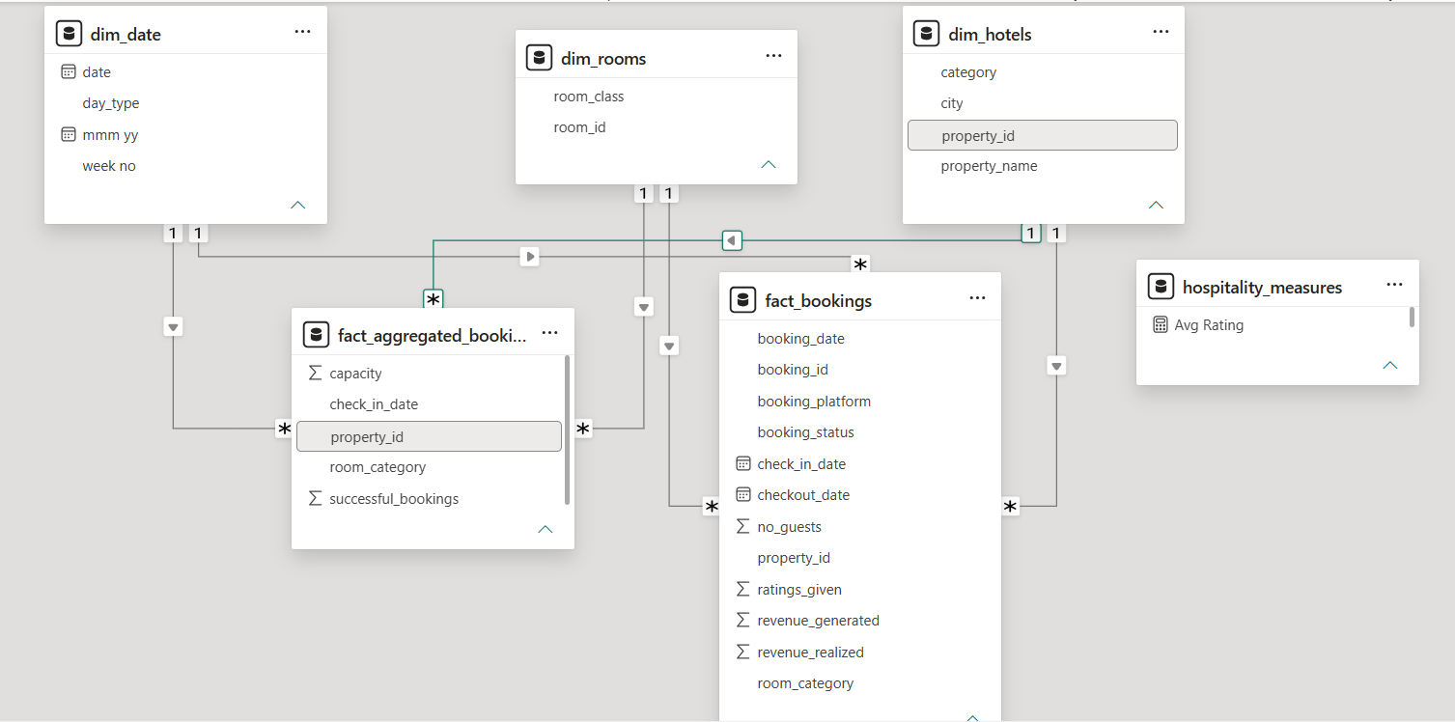
Data Model
ATLIQ HOSPITALITY
TABLE RELATIONSHIPS
Data
model.
Relationship view across dimensions, bookings and measures.
01
CONNECTED MODEL
ATLIQ HOSPITALITY • DATA MODEL

Slide 6
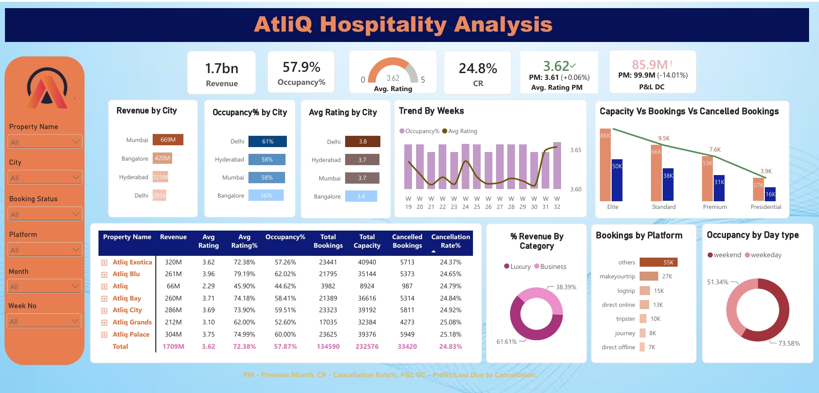
My Design
ATLIQ HOSPITALITY
DASHBOARD OUTPUT
Dashboard
design.
Final analytical view for hospitality performance reporting.
01
FINAL DESIGN
ATLIQ HOSPITALITY • FINAL DASHBOARD

Slide 7
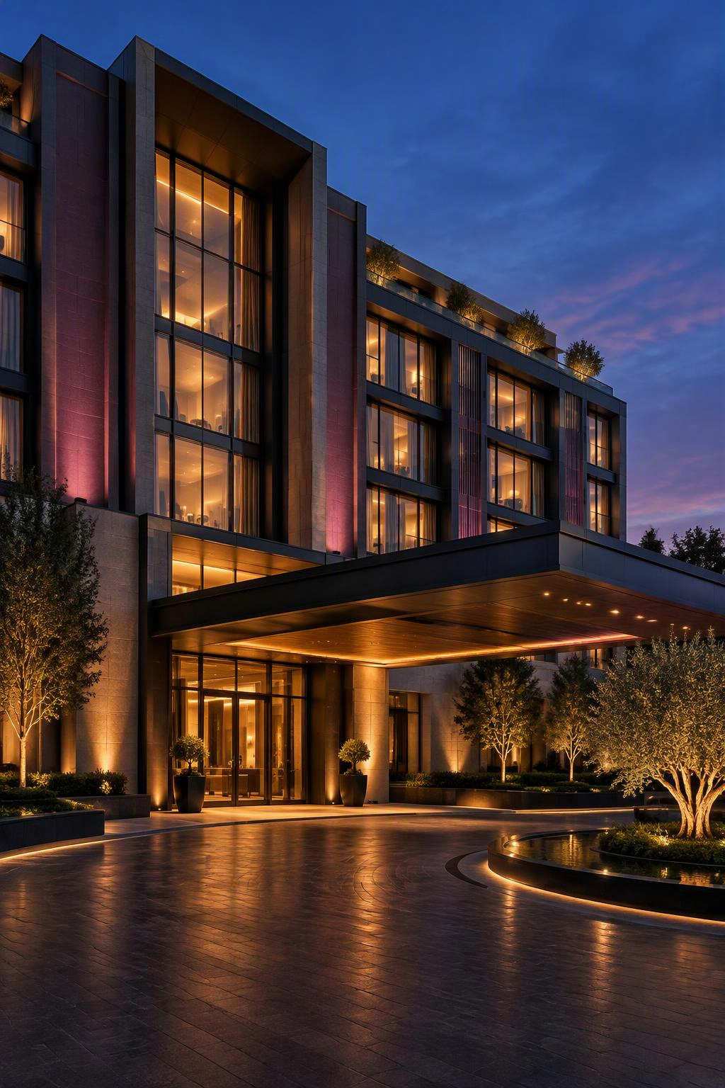
Thank You
ATLIQ HOSPITALITY

