Slide 1
Employee Attrition insights
8/12/2019
Team Data Overload

Slide 2
Outline
Goal
Exploratory Data Analysis
Factors considered
Attrition trends
Summary

Slide 3
Goal
Identify factors leading to and not leading to attrition
Highlight top three factors leading to attrition
Other trends related to job satisfaction, attrition.

Slide 4
Data Analysis : factors Considered
Work Profile
Personal
Field of Work
Business travel
Department
Employee count
Employee number
Environment Satisfaction
Job involvement
Job level
Job role
Job satisfaction
Over time
Standard hours
Years at company
Years in current role
Years since last promotion
Years with current manager
Work life balance
Age
Gender
Marital Status
Education field
Compensation
Professional Proficiency
Monthly income
Monthly rate
Hourly rate
Daily rate
Percent salary hike
Performance rating
Stock option level
Education
Total working years
Number of companies worked
Training times last year

Slide 5
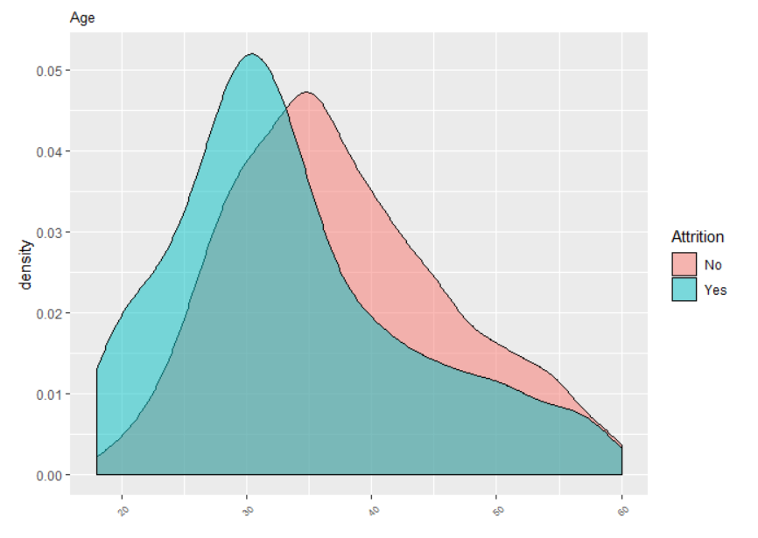
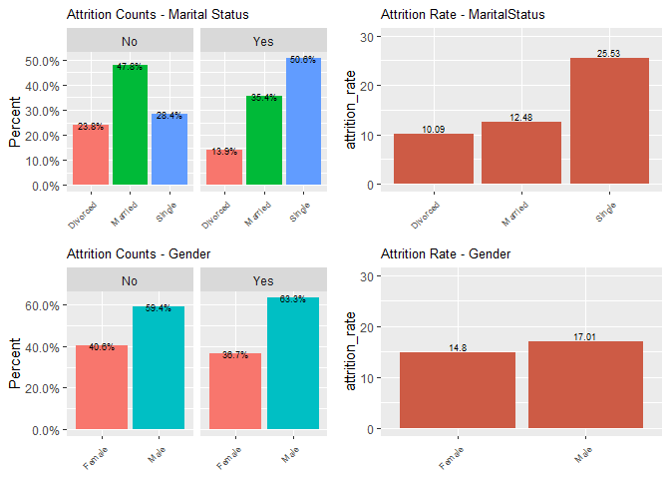
Personal
Age
Marital Status
(attrition rate)
YES
Males have higher attrition rate. Difference not large.
density
NO
Gender
(attrition rate)
Median
Age
32y
36y
20
30
40
50
60
Younger population has high attrition rate
Single / Unmarried have clear high attrition rate
Young (under 30yr) Single Males leading cause of high attrition rates

Slide 6
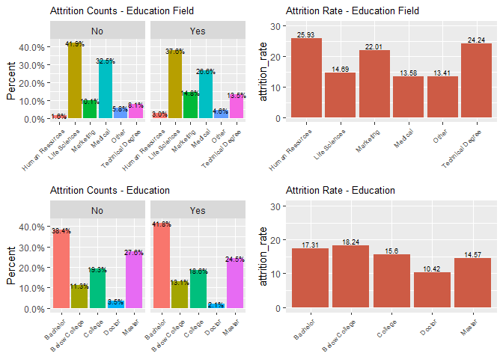
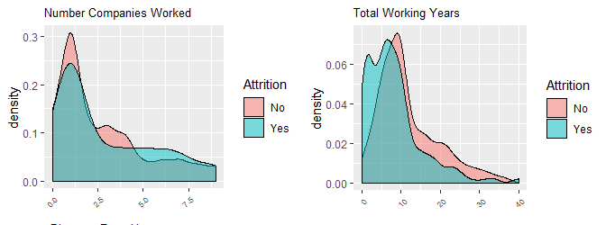
Professional proficiency
Attrition Rate | Education Level
High | Below College, Bachelors
Low | Doctors
Number of companies worked a weak indicator
Less work experience ➔ higher attrition
Lesser education, and low work experience most likely to leave company
Doctorates likely to stay.

Slide 7
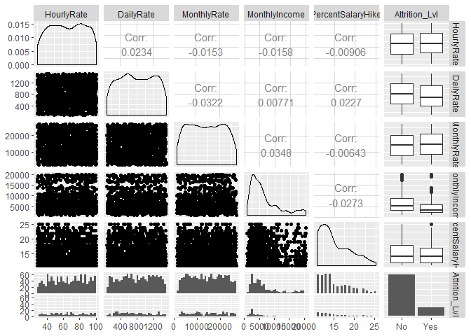
Compensation - Rate
Lower monthly income associated with higher attrition
No correlation between following
Hourly rate
Daily rate
Monthly rate
Monthly income
% salary hike
Attrition Level | MEDIAN Income
Yes | 3202
No | 5204

Slide 8
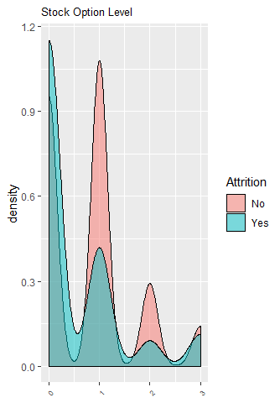
Compensation – stock options
Higher attrition in professionals at stock option category ‘0’
Lesser attrition in professionals with stock option category ‘1’, ‘2’, 3’
Providing stock options a clear way to retain talent

Slide 9
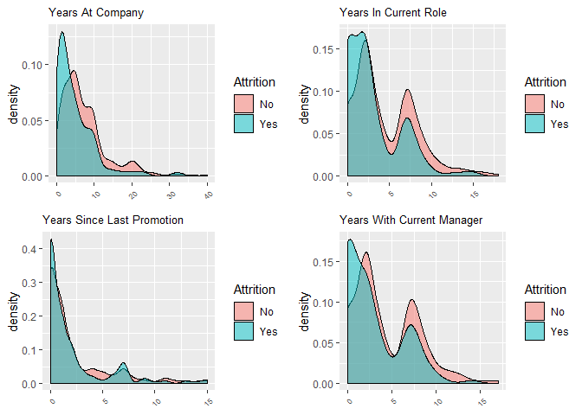
Work profile – Duration in Role
Professionals young in a role in a company or with current manager more likely to leave
‘Years since last promotion’ doesn’t appear to play a factor.
Trends consistent with idea that professionals that stick will tend to stay longer and contribute to company.
Focus of talent management team should be younger members in team

Slide 10
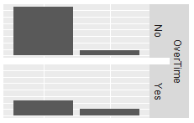
Overtime and work life balance
Work Life Balance | Attrition Information
 | No | Yes | Attrition Rate
1 (Bad) | 55 | 24 | 43.6%
2 (Good) | 286 | 58 | 20.3%
3 (Better) | 765 | 127 | 16.6%
4 (Best) | 126 | 27 | 21.4%
944
110
127
289
More then half (53.5%) population ,that left jobs, did overtime; as compared to 23.4% that stayed on.
Highest Attrition Rate amongst employees with poorest work life balance
Talent management team’s focus should be employees that do overtime ( possibly leading to poorer work life balance )
Training for work & time management should be considered

Slide 11
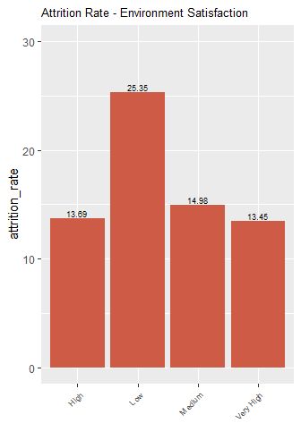
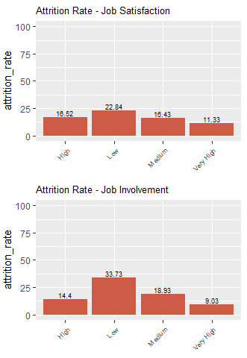
Job engagement
Direct correlation between high attrition rate, and following
Low job satisfaction
Low job involvement
Low environment satisfaction
Note that smallest attrition rate also correlates with highest job involvement, satisfaction, etc.
Will be good for HR/Talent Management to
Come up with metrics that identify employee engagement / job satisfaction
Improve engagement through different programs, e.g. rotation, conferences, improved work life balance, trainings etc.

Slide 12
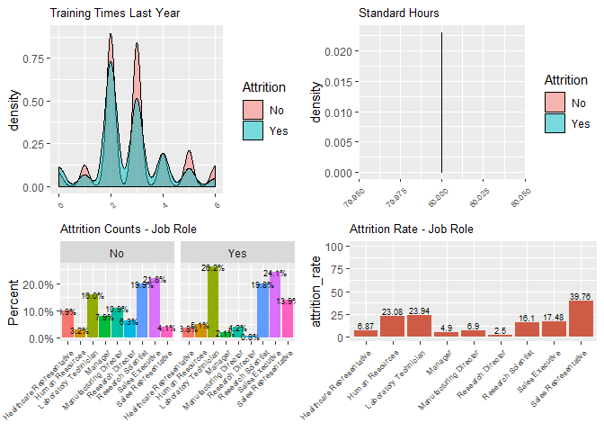
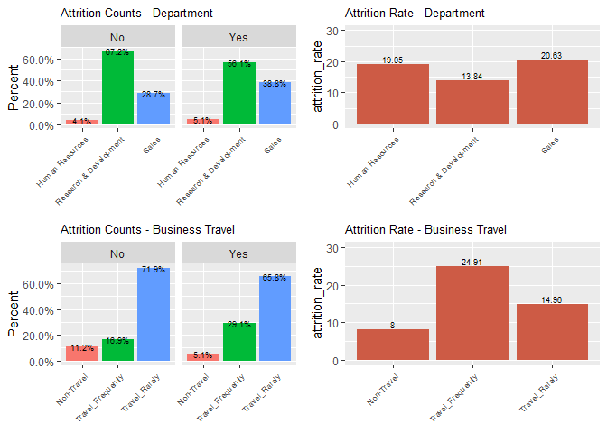
Training and travel
On job trainings may appear improve attrition
May not be big impact.
Highest attrition rate amongst frequent travelers
Lowest attrition rate amongst NO TRAVEL jobs!
Frequent Travel a strong marker for high attrition

Slide 13
Department Specific trends
Professionals with background in HR, Marketing tend to have high attrition
Jobs in Sales department, HR are prone to high attrition. Attrition in R&D is less
Directors, Manager roles have least attrition (high salary?), while sales representatives, lab technicians, and HR have highest

Slide 14
Summary - attrition Trends
Factors (value) leading to high attrition
Factor Strength / Impact | Category (Value)
 | Personal | Work | Work life balance
Strong | Age (young) Marriage (unmarried) Education (below college) | Job satisfaction (low) Monthly income (low) | Overtime (high) Travel (frequent)
Weak | Gender (males) | Work experience (low) Tenure (low) Training (less)
Our top 3 factors leading to high employee turn over :
Job satisfaction,
Work life balance
Marital status

