Slide 1
United States Brewery Market & Beer Composition Report
Gautam Kapila
MSDS 6306: Doing Data Science - Case Study 01

Slide 2
Outline
Goal
Brewery count per state
Beer alcohol content statistics by state
Beer bitterness statistics by state
Beer alcoholic content and bitterness relationship
Conclusions

Slide 3
Goal
The work summarizes US brewery market and beer composition per state
Following data is summarized :
Number of breweries present per state
Alcoholic content of craft beers per state
Bitterness of the beers per state
State with beer having maximum alcoholic content and bitterness
Relationship between beer alcoholic content and beer bitterness
The work can be foundational to additional studies to understand US beer market when starting a new brewery or introducing new beer into US beer market

Slide 4
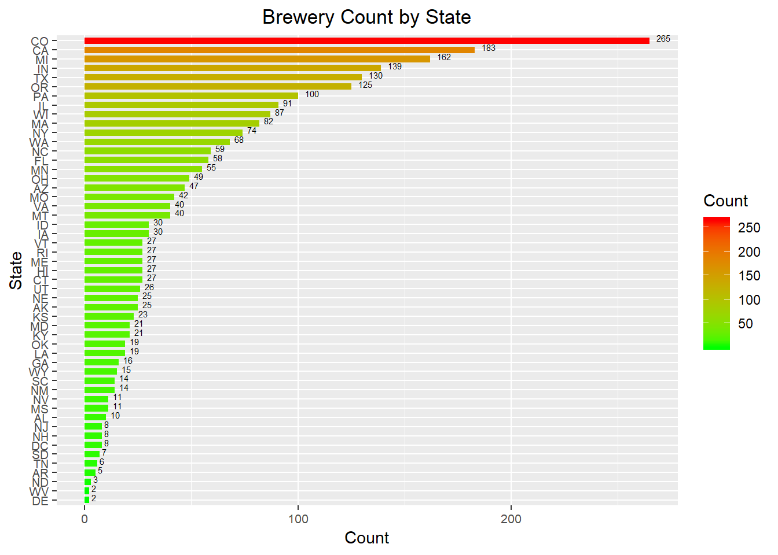
Brewery Count Per State
Colorado has maximum number of breweries!
California is a distant 2nd with other states on heels.

Slide 5
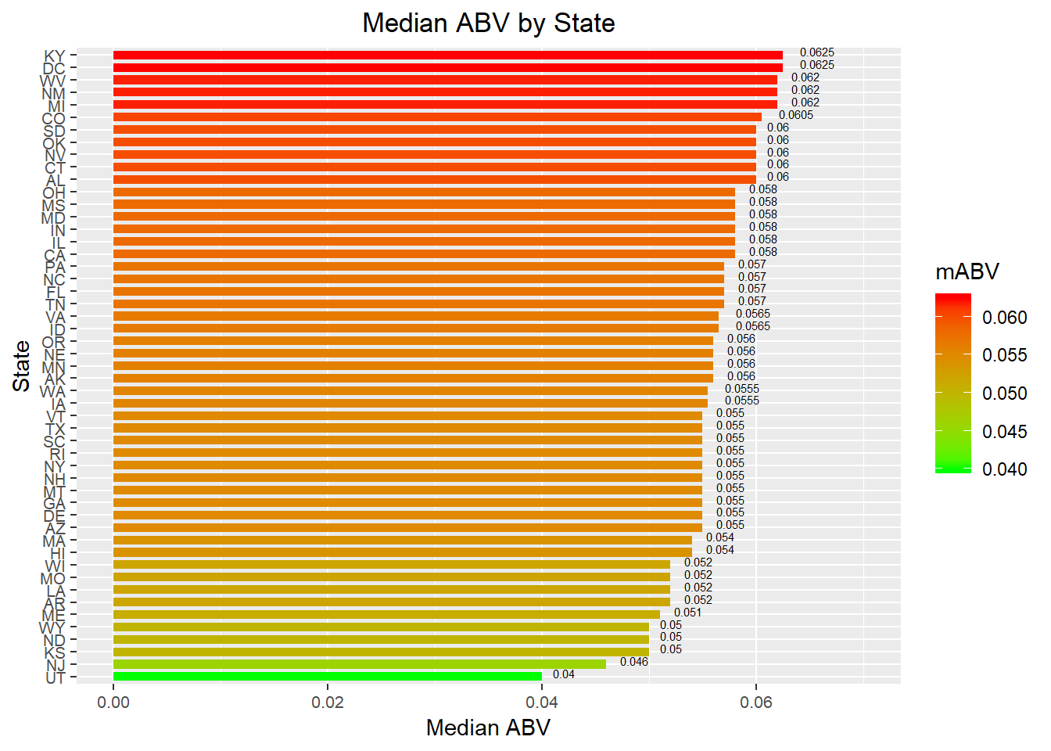
Beer Alcohol Content by State
ABV : alcoholic content by volume
States with maximum alcoholic content of their beers
KY, DC, WV, NM, MI, CO …

Slide 6
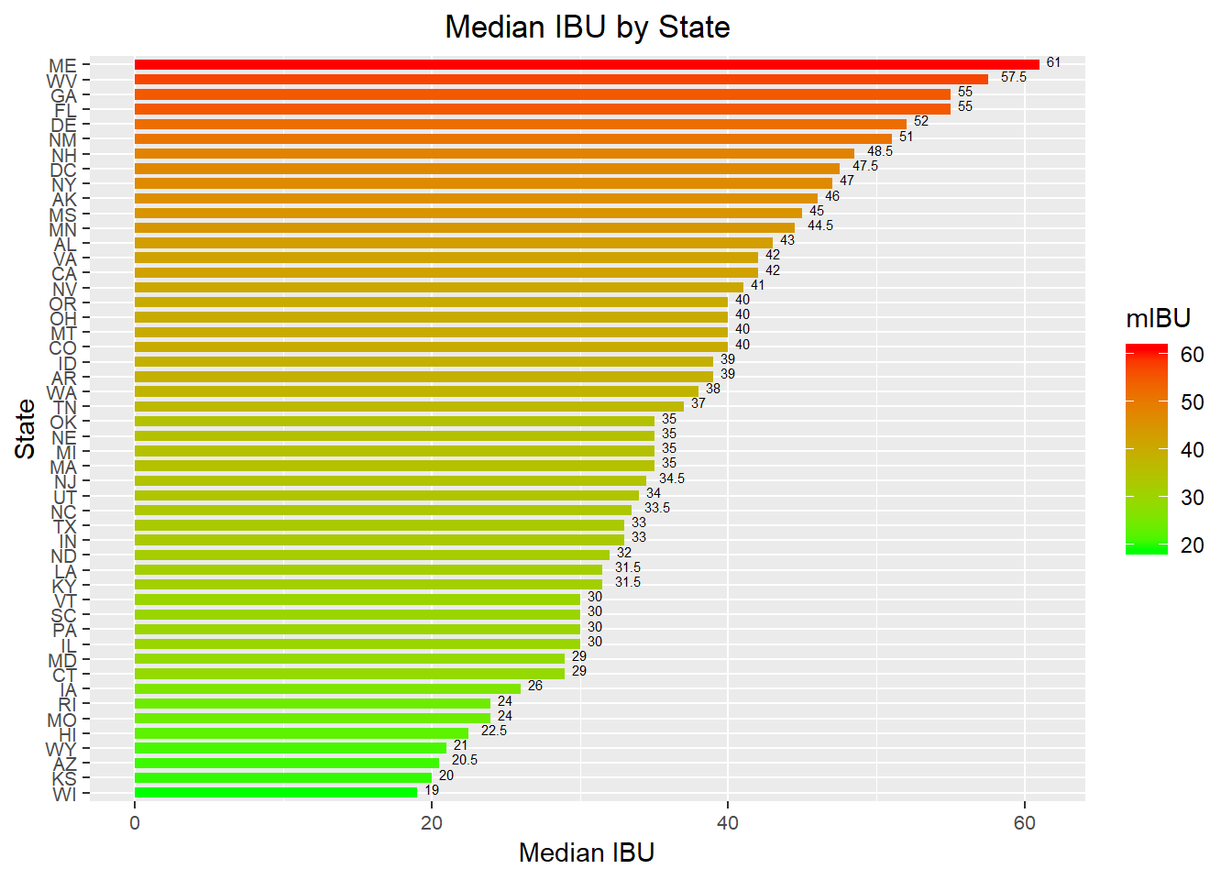
Beer Bitterness Level by State
IBU : international bitterness unit
States with beers that are high on bitterness
ME, WV, GA, FL, DE, NM…

Slide 7
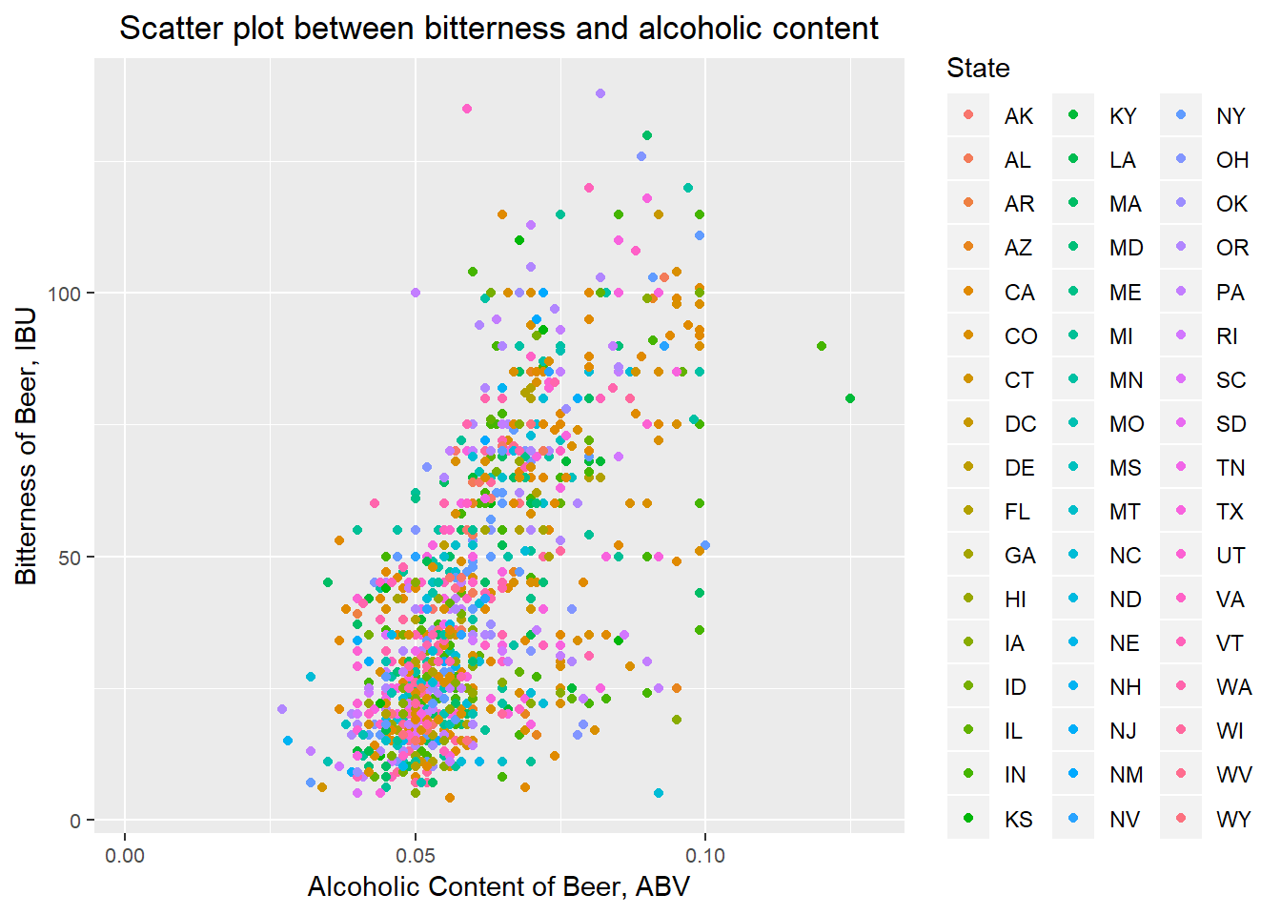
Alcoholic Content vs. Bitterness
In general, higher bitterness tracks with higher alcoholic content.
However, range of bitterness possible for a given alcoholic content
There is more to getting the right bitterness (IBU) for a beer than just it’s alcoholic content (ABV)

Slide 8
Conclusions
Colorado by far has the largest number of breweries.
CA, MI, IN, TX are other states with high density of breweries.
Targeting these states for additional opening of brewery should be considered.
Co ranks 6th in list of states with highest alcohol content producing states.
However, it produces beer with highest alcoholic content.
There is likely additional appetite in market to absorb higher alcholic content beer.
Clearly bitterness and alcoholic content track each other.
However, beers with different amount of bitterness can be produced at any given alcoholic content.
One can be flexible in tailoring beer composition to suite what's popular in local market

