Slide 1
GADTs meet their match
George Karachalias (Ghent University, Belgium)
Tom Schrijvers (KU Leuven, Belgium)
Dimitrios Vytiniotis (Microsoft Research Cambridge, UK)
Simon Peyton Jones (Microsoft Research Cambridge, UK)

Slide 2
Checking Pattern Matching
Exhaustiveness
Does a match cover all cases?
Redundancy
Do all equations have an accessible right hand side?
Laziness
How does left-to-right evaluation order affect the above?
Reasoning about more exotic features?

Slide 3

Pattern Matching

Slide 4
Checking Pattern Matching
zip :: [a] -> [b] -> [(a,b)]
zip [] [] = []
zip (x:xs) (y:ys) = (x,y) : zip xs ys

Slide 5
Checking Pattern Matching
zip :: [a] -> [b] -> [(a,b)]
zip [] [] = []
zip (x:xs) (y:ys) = (x,y) : zip xs ys
Prelude> zip [] [True]
*** Exception: <interactive>:8:7-59:
Non-exhaustive patterns in function zip

Slide 6
Checking Pattern Matching
zip :: [a] -> [b] -> [(a,b)]
zip [] [] = []
zip (x:xs) (y:ys) = (x,y) : zip xs ys

Slide 7
Checking Pattern Matching
zip :: [a] -> [b] -> [(a,b)]
zip [] [] = []
zip (x:xs) (y:ys) = (x,y) : zip xs ys
<interactive>:12:7: Warning:
Pattern match(es) are non-exhaustive
In an equation for `zip':
Patterns not matched:
[] (_ : _)
(_ : _) []

Slide 8
Pattern Matching with GADTs
data Nat = Z | S Nat
data Vec :: Nat -> a -> * where
VN :: Vec Z a
VC :: a -> Vec n a -> Vec (S n) a
vzip :: Vec n a -> Vec n b -> Vec n (a,b)
vzip VN VN = VN
vzip (VC x xs) (VC y ys) = VC (x,y) (vzip xs ys)

Slide 9
Pattern Matching with GADTs
data Nat = Z | S Nat
data Vec :: Nat -> a -> * where
VN :: Vec Z a
VC :: a -> Vec n a -> Vec (S n) a
vzip :: Vec n a -> Vec n b -> Vec n (a,b)
vzip VN VN = VN
vzip (VC x xs) (VC y ys) = VC (x,y) (vzip xs ys)

Slide 10
Pattern Matching with GADTs
vzip :: Vec n a -> Vec n b -> Vec n (a,b)
vzip VN VN = VN
vzip (VC x xs) (VC y ys) = VC (x,y) (vzip xs ys)

Slide 11
Pattern Matching with GADTs
vzip :: Vec n a -> Vec n b -> Vec n (a,b)
vzip VN VN = VN
vzip (VC x xs) (VC y ys) = VC (x,y) (vzip xs ys)
<interactive>:12:7: Warning:
Pattern match(es) are non-exhaustive
In an equation for `vzip':
Patterns not matched:
VN (VC _ _)
(VC _ _) VN

Slide 12
Pattern Matching with GADTs
vzip :: Vec n a -> Vec n b -> Vec n (a,b)
vzip VN VN = VN
vzip (VC x xs) (VC y ys) = VC (x,y) (vzip xs ys)
False warning! ☹

Slide 13
Pattern Matching with GADTs
vzip :: Vec n a -> Vec n b -> Vec n (a,b)
vzip VN VN = VN
vzip (VC x xs) (VC y ys) = VC (x,y) (vzip xs ys)
vzip _ _ = error “vzip”
No warning!
☹

Slide 14

Laziness

Slide 15
Laziness
f :: Bool -> Bool -> Int
f _ True = 1
f True True = 2
f _ _ = 3
<interactive>:12:7: Warning:
Pattern match(es) are overlapped
In an equation for `f':
f True True = ...

Slide 16
Laziness
f :: Bool -> Bool -> Int
f _ True = 1
f True True = 2
f _ _ = 3
Prelude> f undefined False
*** Exception: Prelude.undefined

Slide 17
Laziness
f :: Bool -> Bool -> Int
f _ True = 1
f True True = 2
f _ _ = 3
Prelude> f undefined False
3

Slide 18
Laziness
f :: Bool -> Bool -> Int
f _ True = 1
f True True = 2
f _ _ = 3
<interactive>:12:7: Warning:
Pattern match(es) have
inaccessible right hand side
In an equation for `f':
f True True = ...

Slide 19



Uniform Solution
GADTs
Guards
Laziness

Slide 20
Abstract interpretation of pattern matching

Slide 21
Abstractions
Value Abstractions u ::= x | K u1 … un Value abstractions v ::= Γ Ⱶ u1 … un ▹ Δ Value vector abstractions S ::= {v1, …, vm} Value set abstractions
Constraints
Δ ::= τ ~ τ Type constraints
| x ≈ e Term equalities
| x ≈ ⊥ Strictness constraints

Slide 22
Algorithm Structure
All possible values
SU0
Covered1
p11 … p1n
P11 ... P1n
desugar
patVectProc
Divergent1
SU1
Uncovered1

Slide 23
Algorithm Structure
SU0
Covered1
p11 … p1n
P11 ... P1n
desugar
patVectProc
Divergent1
SU1
Covered2
p21 … p2n
P21 ... P2n
desugar
patVectProc
Divergent2
…
…
…
…
Coveredn
pm1 … pmn
Pm1 ... Pmn
desugar
patVectProc
SUn
Divergentn
Uncovered

Slide 24
Modular Constraint Solving
Covered
Uncovered
Γ Ⱶ us ▹ Δ
Divergent
Type Constraints
τ ~ τ, …
Term Equalities
x ≈ e
Strictness Constraints
x ≈ ⊥

Slide 25
Interpretation of Results
Covered | Divergent | Warning
Ø | Ø | Redundant
Ø | {…} | Inaccessible rhs
{…} | Ø | -
{…} | {…} | -
Final Uncovered Set | Warning
Ø | -
{…} | Non-exhaustive

Slide 26
Example
vzip :: Vec n a -> Vec n b -> Vec n (a,b)
vzip VN VN = VN
vzip (VC x xs) (VC y ys) = VC (x,y) (vzip xs ys)
vzip _ _ = error “vzip”

Slide 27

Example
vzip :: Vec n a -> Vec n b -> Vec n (a,b)
a b ▹ {}
VN VN ▹ {n ~ Z, n ~ Z}
VN VN
a b ▹ {a ≈ ⊥} VN b ▹ {n ~ Z, b ≈ ⊥}
(VC c cs) b ▹ {n ~ S k}
VN (VC c cs) ▹ {n ~ Z, n ~ S k}

Slide 28
Example
vzip :: Vec n a -> Vec n b -> Vec n (a,b)
(VC c cs) b ▹ {n ~ S k}
(VC x xs) (VC y ys)
▹ {n ~ S k, n ~ S l}
(VC x xs) (VC y ys)
(VC c cs) b ▹ {b ≈ ⊥, n ~ S k}
(VC c cs) VN ▹ {n ~ S k, n ~ Z}
Exhaustive! ☺

Slide 29
Example
vzip :: Vec n a -> Vec n b -> Vec n (a,b)
{}
{}
_ _
{}
{}
Redundant! ☺

Slide 30
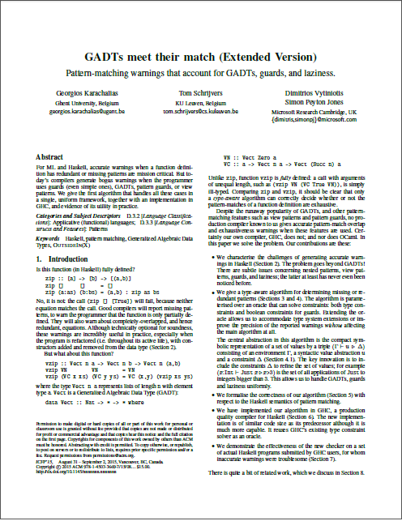
There is more…
Full algorithm
Pattern translation
Guard handling
Abstract interpretation
Motivating examples
Meta-theory
Related work

Slide 31
Implementation

Slide 32
ghc-stage1: panic! (the 'impossible' happened)
(GHC version 7.11.20150824 for x86_64-unknown-linux):
checkMatches
Please report this as a GHC bug: http://www.haskell.org/ghc/reportabug

Slide 33
Implementation
GHC branch (wip/gadtpm)
504 LoC (vs. 588 LoC)
GHC Bug reports / Feature requests:
GADTs: #3927, #4139, #6124, #8970
Literals: #322, #2204, #5724, #8016, #8853
(#1307, #5762, #7669, #8494, #9113, #9951)

Slide 34
Solver Instantiation
Covered
Uncovered
Γ Ⱶ us ▹ Δ
Divergent
OutsideIn(X)
Minimal Solver
Type Constraints
τ ~ τ, …
Term Equalities
x ≈ e
Strictness Constraints
x ≈ ⊥

Slide 35
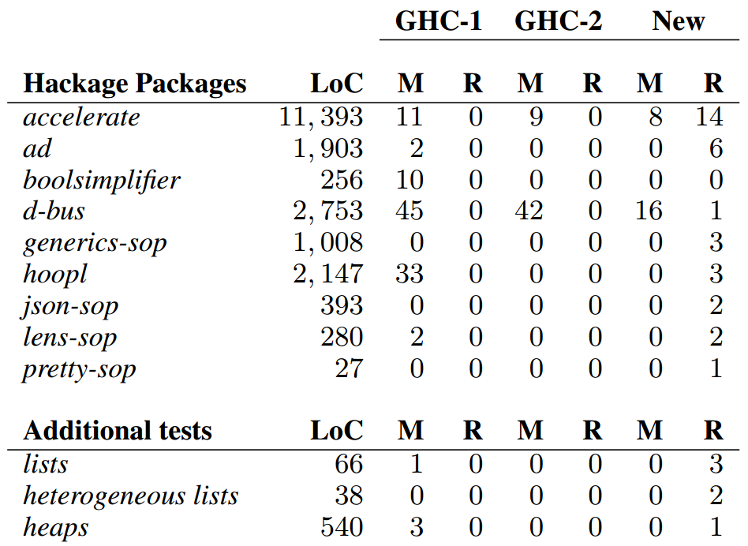
Resolve
107 51 24

Slide 36
Resolve
0 0 38

Slide 37
Performance
data T = A | B | C
f A A = …
f B B = …
f C C = …
Maximum set size | Pattern matches | (%)
1 – 9 | 8702 | 97.90%
10 – 99 | 181 | 2.04%
100 – 2813 | 5 | 0.06%
54 x 54 = 3025

Slide 38
Summary
Uniform framework for GADTs, Guards & Laziness
Abstract Interpretation of Pattern Matching
Modularity in Constraint Solving
Implementation in Glasgow Haskell Compiler
Kind polymorphism, Associated Types, Closed Type Families, etc.
Closed several bug reports

Slide 39
Related Work
Dependent Pattern Matching & GADTs
Coquand, Norell, Xi, Dunfield, etc.
Compilation of Pattern Matching
Augustsson, Laville, Maranget, etc.
Lazy Pattern Matching
Maranget, Sestoft, etc.
Krishnaswami, Garrigue & Normand, etc.

Slide 40
Future Work
Improve reasoning about term level equalities
External SMT solver (Z3, Zeno, HipSpec, etc)?
Undecidable in the general case
Application to Closed Type Families

Slide 41

GADTs meet their match
George Karachalias
Tom Schrijvers
Dimitrios Vytiniotis
Simon Peyton Jones

