Slide 1
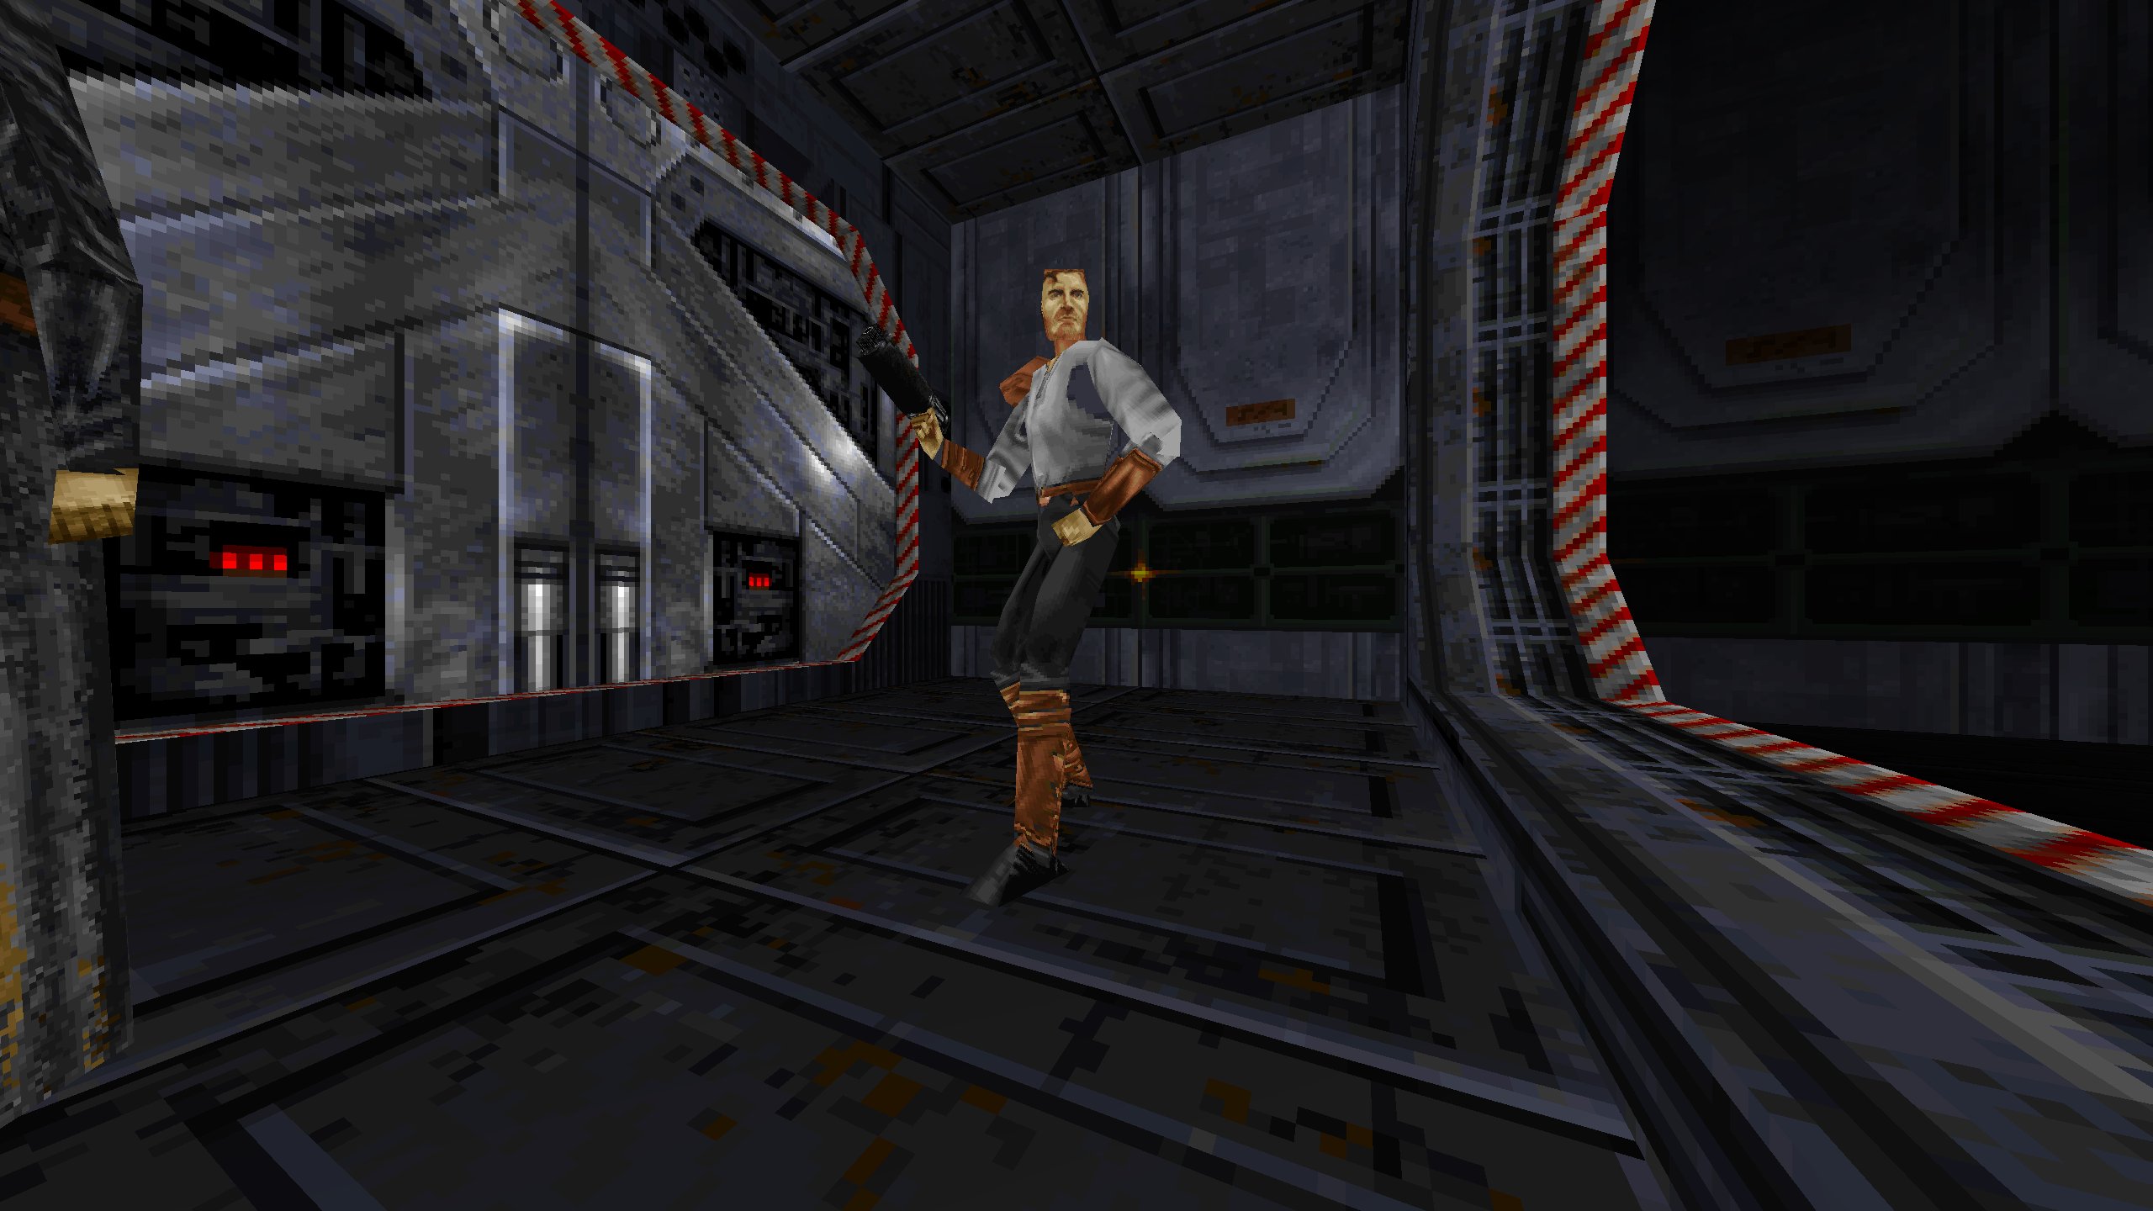
OPENJKDF2 AMD ENHANCED
A MODERN WINDOWS
EDITION FOR A
1997 CLASSIC
Built on OpenJKDF2. Refined for modern controls, native borderless display, safer switching and a verified public release.
VERSION 1.0 / APPROXIMATELY FIVE DAYS OF CODEX-ASSISTED ENGINEERING

Slide 2
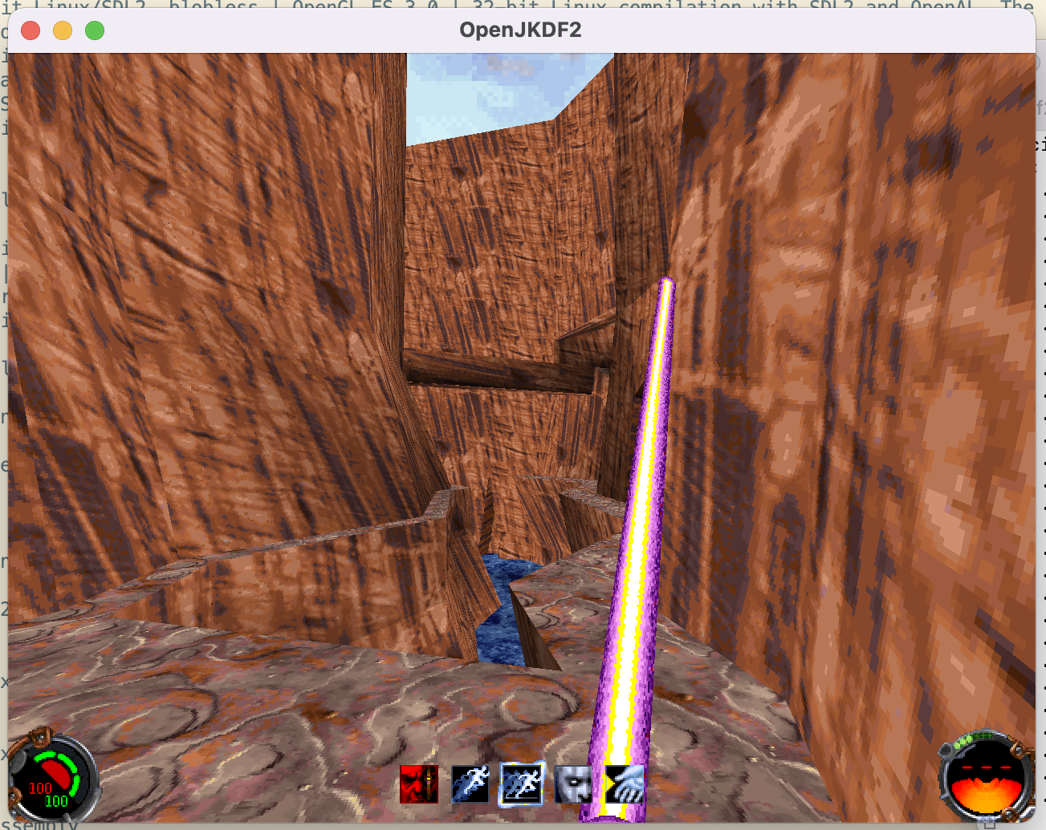
WHY THE 1997 ENGINE NEEDED A MODERN PORT
THE 1997 ASSUMPTIONS
DirectX 5-era DirectDraw and Direct3D behavior
16-bit colour and legacy texture formats
Old fullscreen and resolution-switching methods
Driver behavior modern GPUs no longer reproduce exactly
Timing assumptions from 1990s hardware
UPSTREAM OPENJKDF2 SOLVED THE CORE PORT
It replaced the old DirectX stack with SDL2, OpenAL and OpenGL 3.3 across modern platforms.
Source: shinyquagsire23/OpenJKDF2 README
02

Slide 3
THE FORK ADDS A WINDOWS 11 PRODUCT LAYER
Upstream provides the engine foundation. This release concentrates on modern defaults, recovery, packaging and evidence.
UPSTREAM OPENJKDF2
AMD ENHANCED FORK
General-purpose, cross-platform engine
Opinionated Windows 11 gaming package
Traditional JK control configuration
Modern FPS controls by default, with Modern/Classic switch
Standard SDL display behavior
Native borderless default with complete display options
General OpenGL 3.3 support
Renderer validation, diagnostics and fallbacks tested on RX 7900 XTX
Primarily a technical source-port release
Installer, desktop shortcut, portable mode and uninstaller
User arranges the game files
Automatic Steam/GOG discovery and folder fallback
Normal failure behavior
Display watchdog, confirmation, recovery and safe-mode support
Broad platform focus
Frame-pacing, VSync, refresh-rate and Windows presentation focus
Developer-oriented documentation
Consumer installation guide, screenshots, checksums and provenance
Sources: upstream OpenJKDF2 README; OpenJKDF2 AMD Enhanced README and release 1.0
03

Slide 4
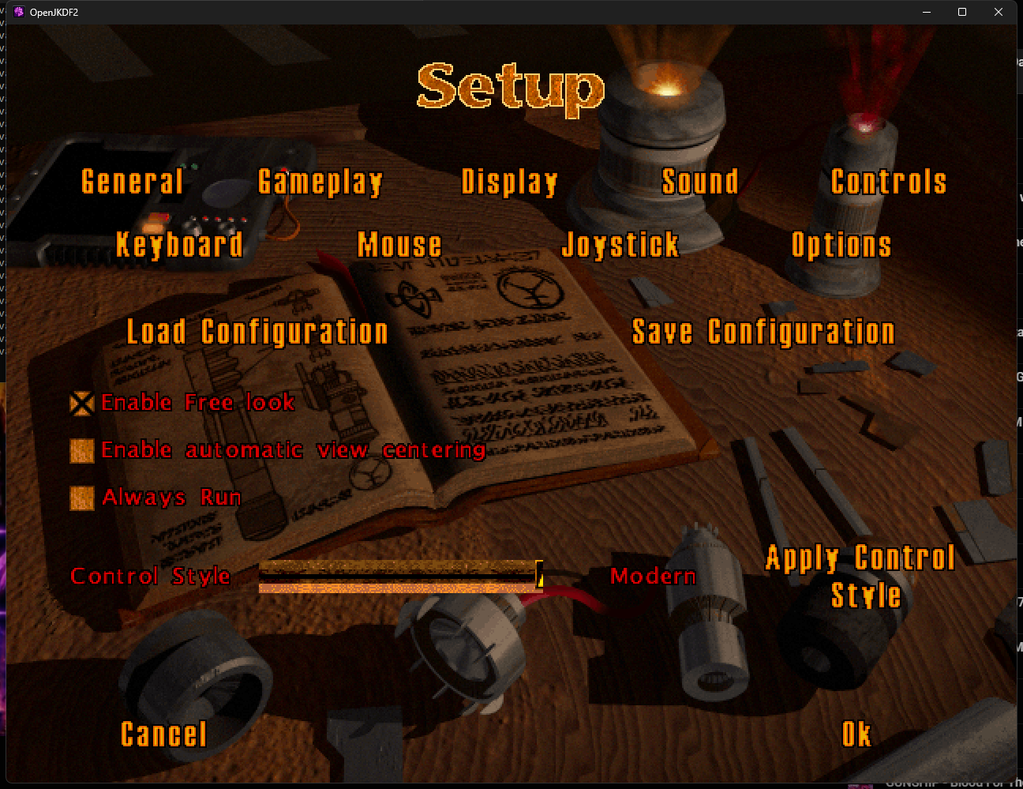
MODERN FPS CONTROLS ARE THE DEFAULT
MODERN BY DEFAULT
MOVE / LOOK
WASD / mouse
PRIMARY / SECONDARY
Left mouse / right mouse
JUMP / CROUCH
Space / Ctrl or C
RUN / USE
Shift / E
WEAPONS / MAP
Wheel or numbers / Tab
Original bindings remain available through the Modern/Classic switch.
04

Slide 5
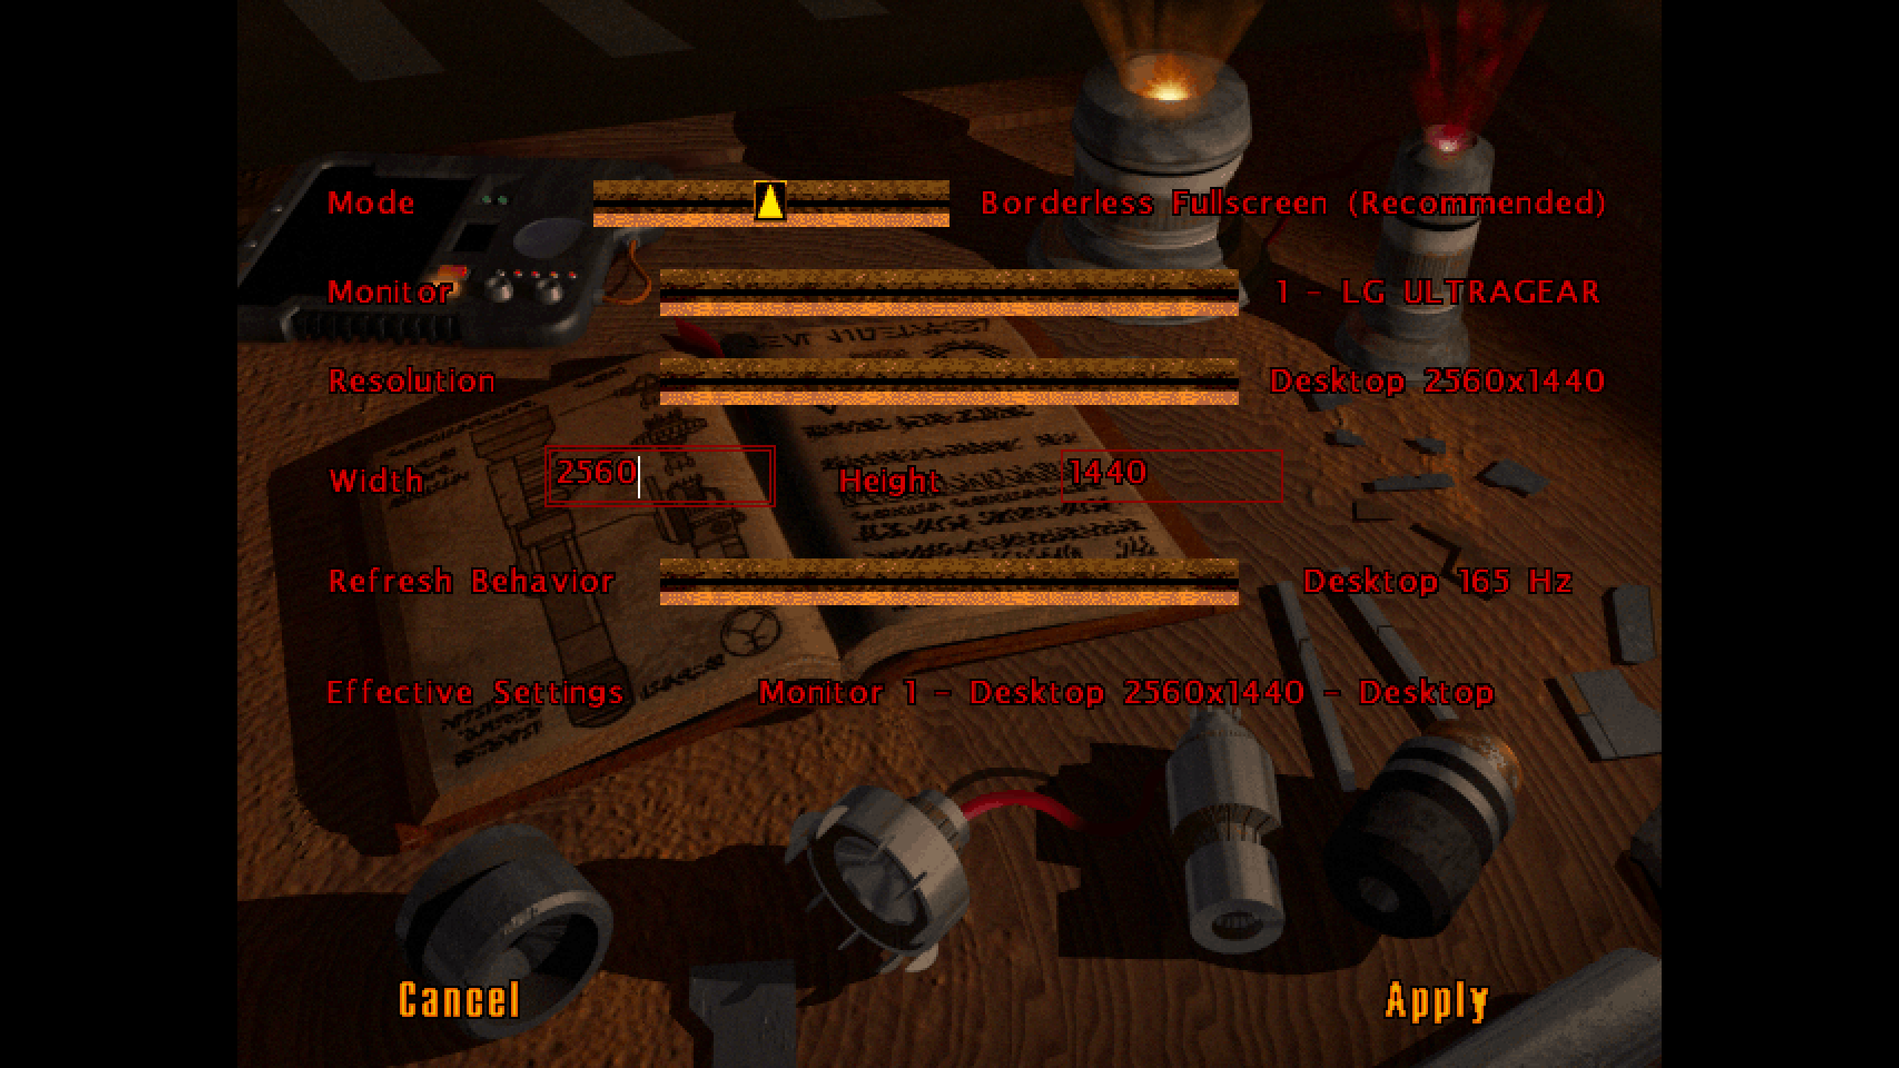
NATIVE BORDERLESS FULLSCREEN BY DEFAULT
DEFAULT
Primary monitor, native desktop pixel count and borderless fullscreen.
CHOICE
Borderless, Windowed and safety-gated Exclusive Fullscreen modes.
SAFETY
Confirmation, previous-state recovery and a dedicated display watchdog.
05

Slide 6
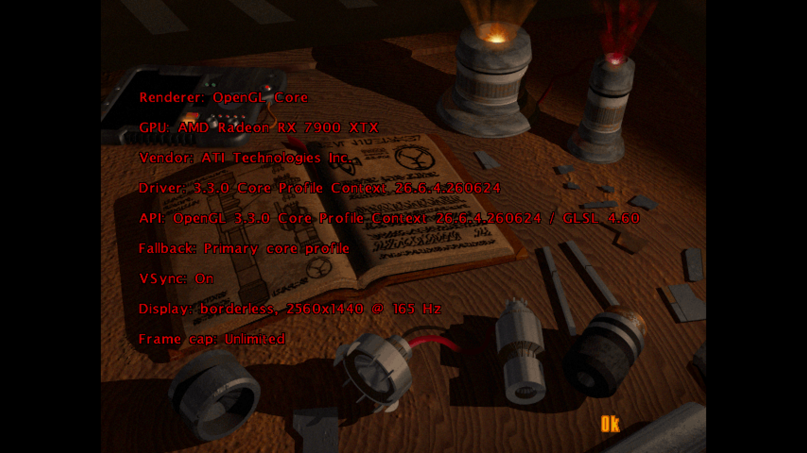
VISIBLE FAILURES, SAFER RECOVERY
VALIDATE
OpenGL 3.3 shaders, textures and framebuffers are checked explicitly.
ADAPT
Capability-based fallbacks avoid GPU vendor-name branches.
RECOVER
GPU, driver, timing and swap-policy logs support diagnostics and safe mode.
06

Slide 7
A REPRODUCIBLE PUBLIC RELEASE
Installer, portable launcher, Steam/GOG discovery, uninstaller, manifests, legal notices and matching tagged source.
92
4.4 MB
SHA-256
TEST EXECUTIONS
ENGINE-ONLY ZIP
INTEGRITY VERIFIED
46 Debug + 46 Release checks passed.
No original game assets are distributed.
The live download matches the published checksum.
Users provide a legally owned Steam or GOG installation.
Release 1.0 - main branch - engine-only package
07

Slide 8
OUTCOME
READY TO INSTALL -
NOT JUST READY TO COMPILE.
Modern controls. Native borderless. Safer recovery. Public, rights-safe release.
georgekaragioules.com/openjkdf2-enhanced
github.com/gkaragioul/OpenJKDF2-AMD-Enhanced

