Slide 1



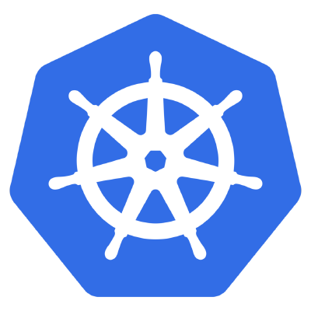
Develop( ), Deploy( ) and Monitor Cloud-Native App in Kubernetes

Slide 2


About me
Karthik is a CNCF Speaker, DevOps Architect and Cloud Native App Developer who is passionate about Cloud and Cloud-Native Infrastructure, Developer Tools & Experience and Open-Source Enthusiast.
He is also a passionate writer who writes about the technologies and technology challenges.
Karthikeyan Govindaraj
Know more about me!!!
@gkarthics

Slide 3
What is Cloud-Native
Cloud-native is an approach to building and running applications that exploit the advantages of the cloud computing delivery model.
CNCF defines cloud-native as “scalable applications” running in “modern dynamic environments” that use technologies such as containers, microservices, and declarative APIs.
@gkarthics

Slide 4
GoLang
open-source programming language by Google
highly performant
highly expressive
good readability
both statically and dynamically typed
features of C++ , Java and Python
a large part of tools for cloud (Docker, Kubernetes) is also written in Go
@gkarthics

Slide 5

OpenTelemetry
OpenTelemetry is a collection of tools, APIs, and SDKs. Use it to instrument, generate, collect, and export telemetry data (metrics, logs, and traces) to help you analyze your software’s performance and behavior.
@gkarthics

Slide 6
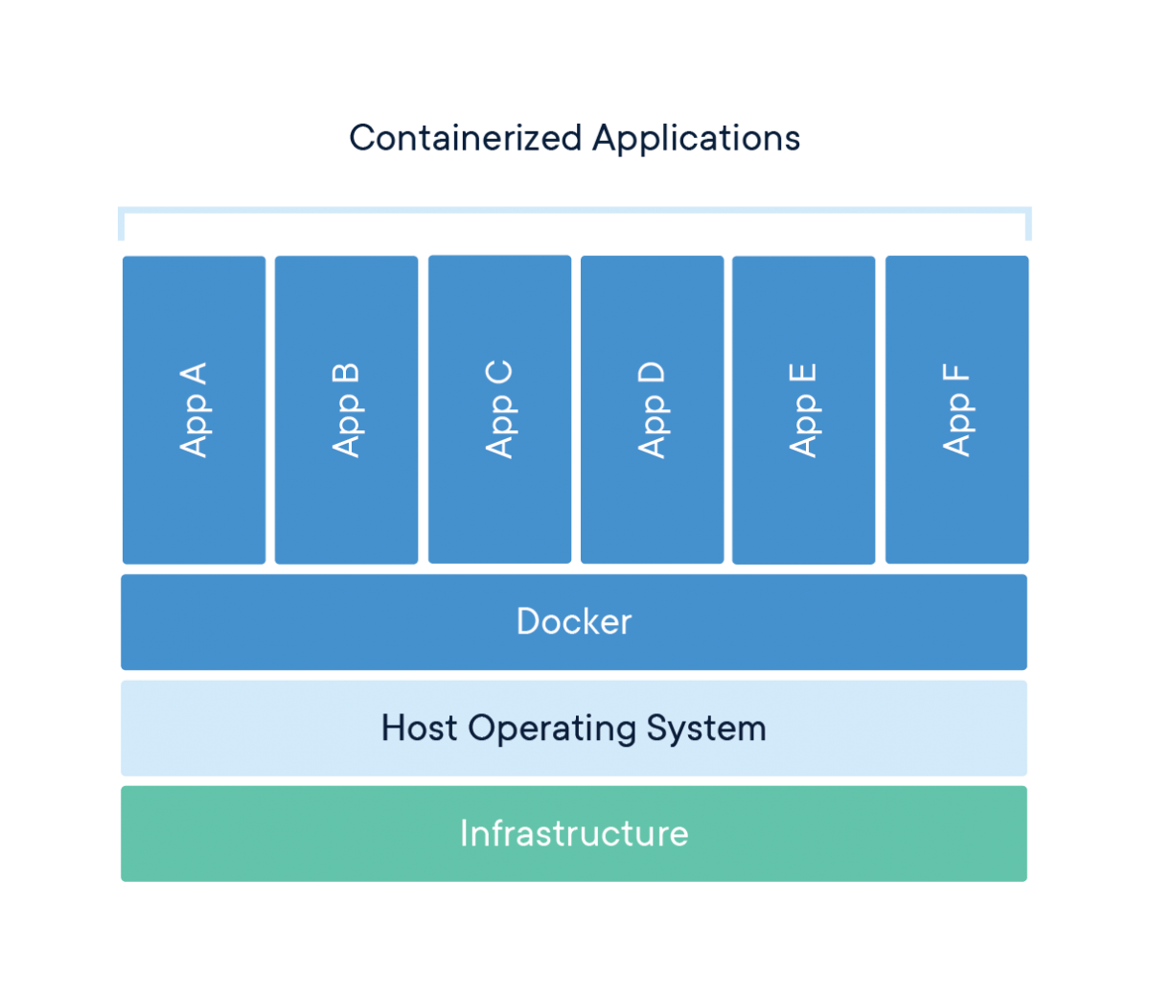
Container
A container is a standard unit of software that packages up code and all its dependencies, so the application runs quickly and reliably from one computing environment to another.
Agility
Portability
Rapid scalability
@gkarthics
Notes:
When developers build and package their applications into containers and provide them to IT to run on a standardized platform, this reduces the overall effort to deploy applications and can streamline the whole dev and test cycle. This also increases collaboration and efficiency between dev and operations teams to ship apps faster.
Containers provide a standardized format for packaging and holding all the components necessary to run the desired application. This solves the typical problem of “It works on my machine” and allows for portability between OS platforms and between clouds. Any time a container is deployed anywhere, it executes in a consistent environment that remains unchanged from one deployment to another. You now have a consistent format, from dev box to production.
Since containers do not have the overhead typical of VMs, including separate OS instances, many more containers can be supported on the same infrastructure. The lightweight nature of containers means they can be started and stopped quickly, unlocking rapid scale-up and scale-down scenarios.

Slide 7
Kubernetes
Kubernetes is a portable, extensible, open-source platform.
Service discovery and load balancing
Storage orchestration
Automated rollouts and rollbacks
Self-healing
Secret and configuration management
minikube is local Kubernetes, focusing on making it easy to learn and develop for Kubernetes.
Manages containerized workloads and services.
Facilitates both declarative configuration and automation
@gkarthics
Notes:
Service discovery and load balancing Kubernetes can expose a container using the DNS name or using their own IP address. If traffic to a container is high, Kubernetes is able to load balance and distribute the network traffic so that the deployment is stable.
Storage orchestration Kubernetes allows you to automatically mount a storage system of your choice, such as local storages, public cloud providers, and more.
Automated rollouts and rollbacks You can describe the desired state for your deployed containers using Kubernetes, and it can change the actual state to the desired state at a controlled rate. For example, you can automate Kubernetes to create new containers for your deployment, remove existing containers and adopt all their resources to the new container.
Automatic bin packing You provide Kubernetes with a cluster of nodes that it can use to run containerized tasks. You tell Kubernetes how much CPU and memory (RAM) each container needs. Kubernetes can fit containers onto your nodes to make the best use of your resources.
Self-healing Kubernetes restarts containers that fail, replaces containers, kills containers that don't respond to your user-defined health check, and doesn't advertise them to clients until they are ready to serve.
Secret and configuration management Kubernetes lets you store and manage sensitive information, such as passwords, OAuth tokens, and SSH keys. You can deploy and update secrets and application configuration without rebuilding your container images, and without exposing secrets in your stack configuration.

Slide 8
Helm
The package manager for Kubernetes
Helm Charts help you define, install, and upgrade even the most complex Kubernetes application.
Charts are easy to create, version, share, and publish
@gkarthics

Slide 9
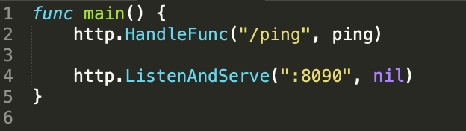
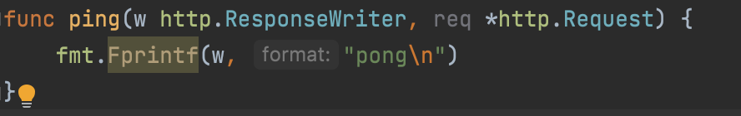
Let’s start the Simple Webserver
@gkarthics

Slide 10
Add otel modules
go get
go.opentelemetry.io/otel/sdk/trace
go get
go.opentelemetry.io/otel/exporters/stdout/stdouttrace
go get
go.opentelemetry.io/otel/propagation
go get
go.opentelemetry.io/otel/semconv
https://github.com/open-telemetry/opentelemetry-go/tree/main/exporters/
@gkarthics

Slide 11
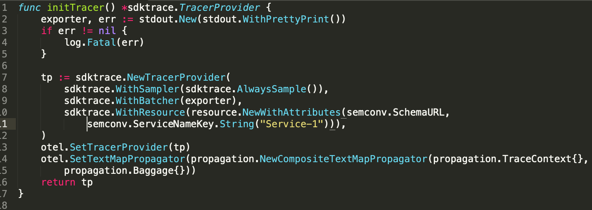
Create a tracer
@gkarthics

Slide 12
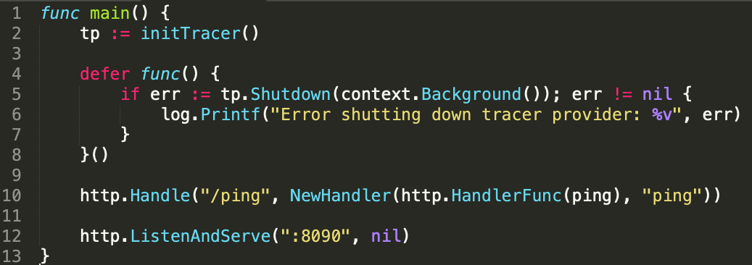
Add tracer to main function
@gkarthics

Slide 13
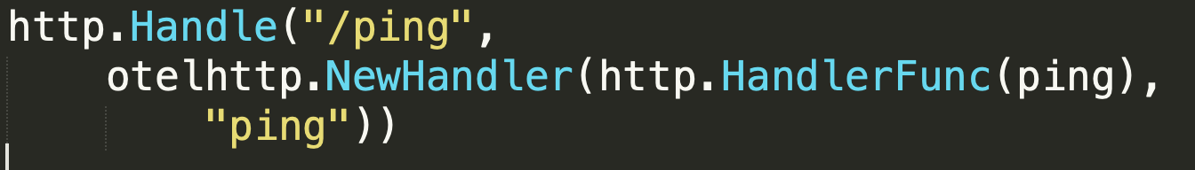
Handle the HTTP Func via OTEL
@gkarthics

Slide 14
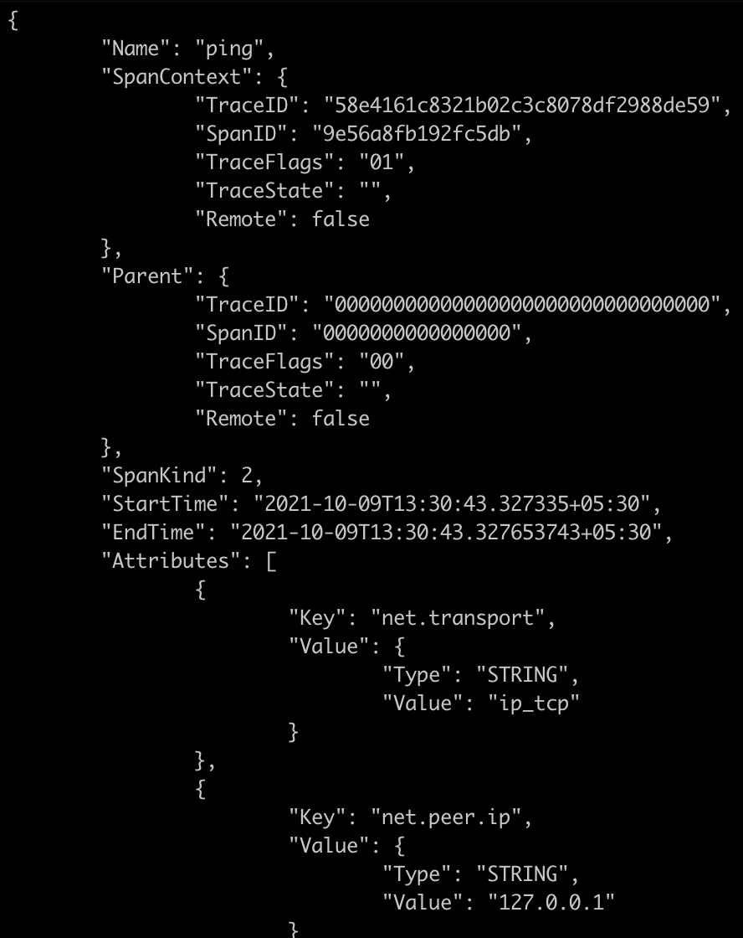
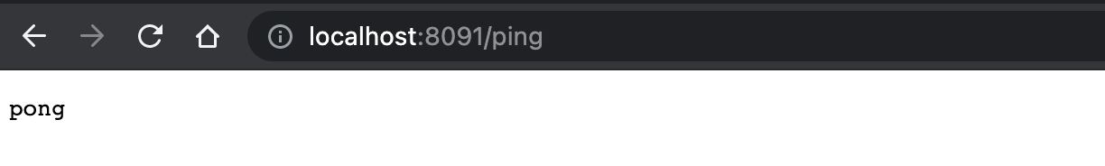
…response
@gkarthics

Slide 15
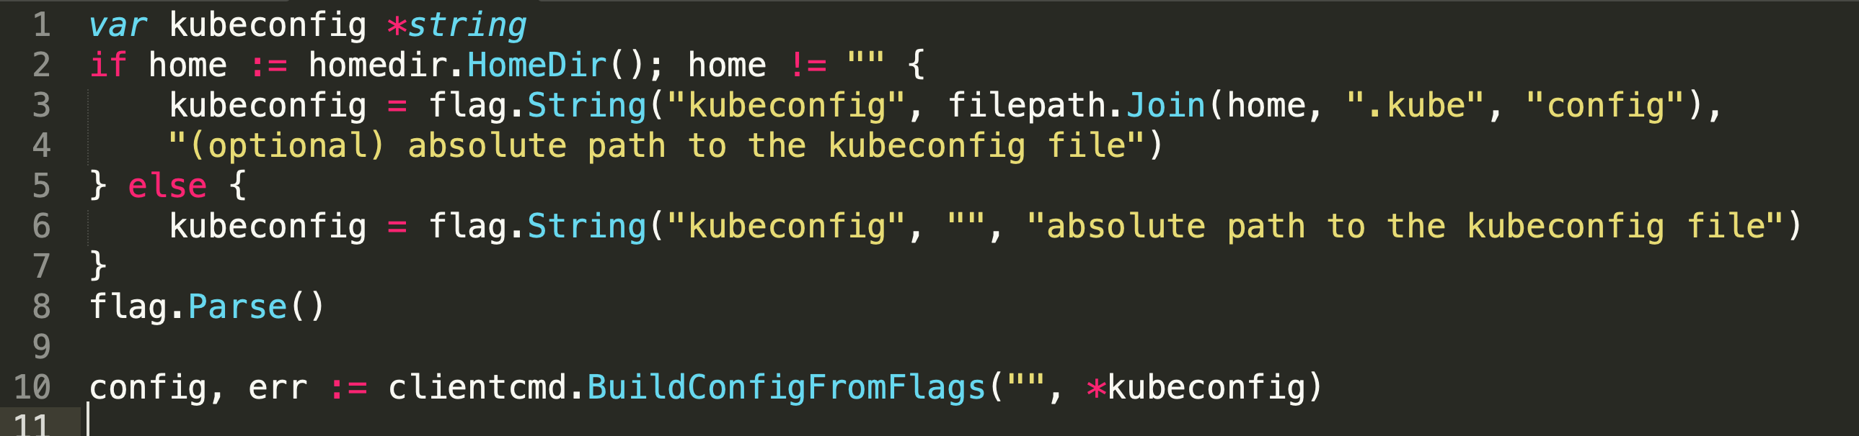
Let’s talk to Kubernetes
client-go: Go client for talking to a kubernetes cluster
in-cluster
config, err := rest.InClusterConfig()
out-of-cluster
@gkarthics

Slide 16
k8s-discovery
go get github.com/gkarthiks/k8s-discovery
Avoids the boiler plate code for the client-go
Auto configures the in-cluster or out-of-cluster configuration
k8s, _ := discovery.NewK8s()
Provides a client attached to the targeted Kubernetes cluster from local or running host cluster if from within a pod
type K8s struct { Clientset coreClient.Interface MetricsClientSet *metricsClient.Clientset RestConfig *restClient.Config }
@gkarthics

Slide 17
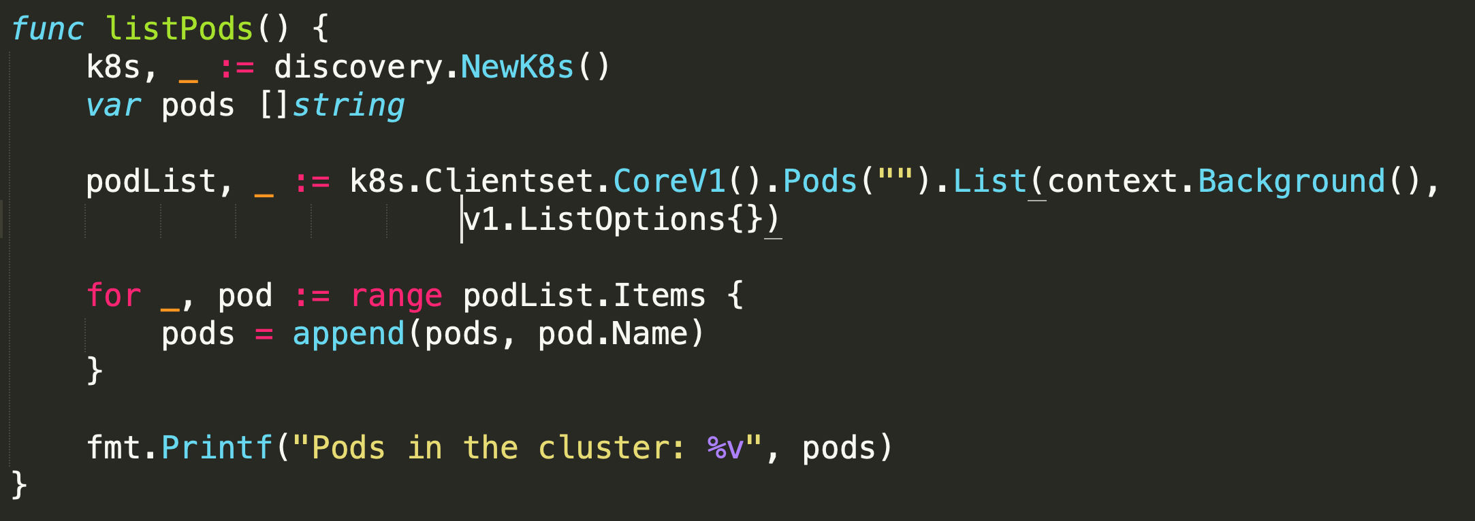
List all pods in a cluster
@gkarthics

Slide 18
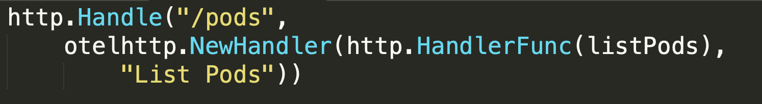
Add this to the HTTP Handler via OTEL
@gkarthics

Slide 19
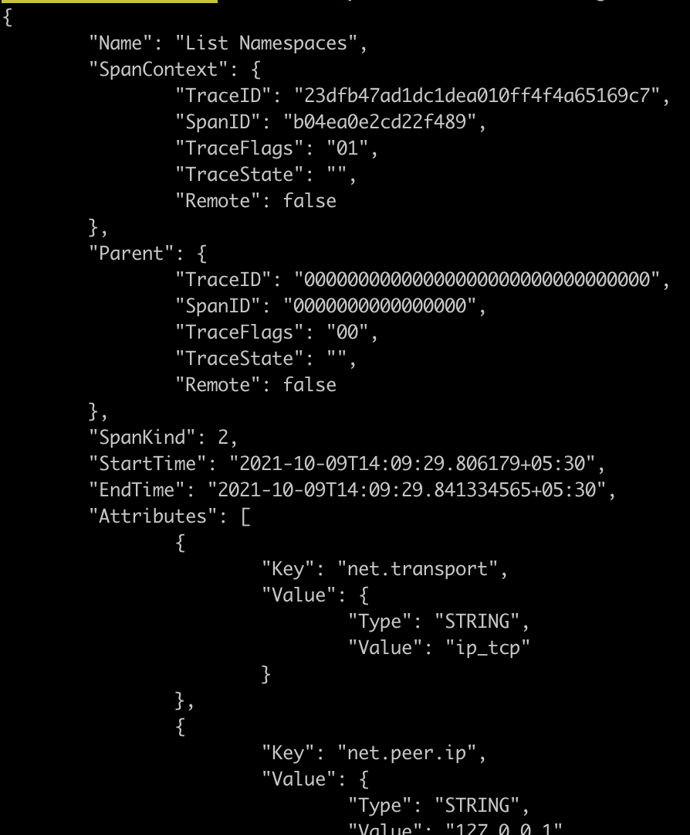
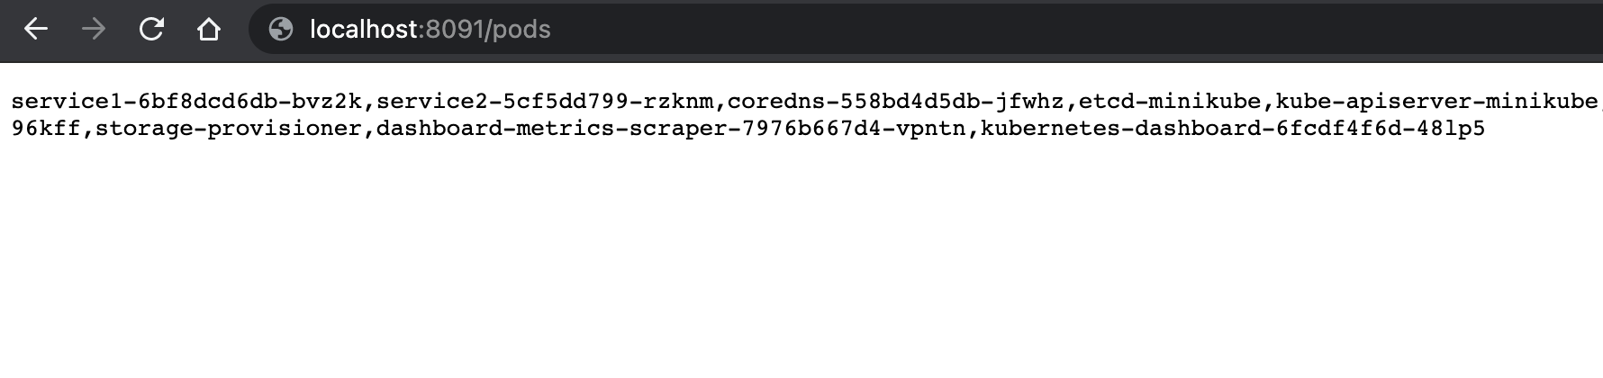
…response
@gkarthics

Slide 20
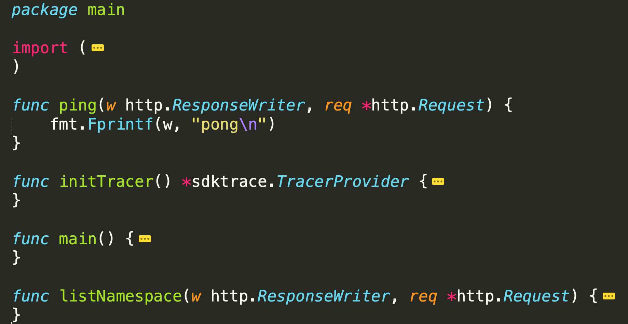
@gkarthics

Slide 21
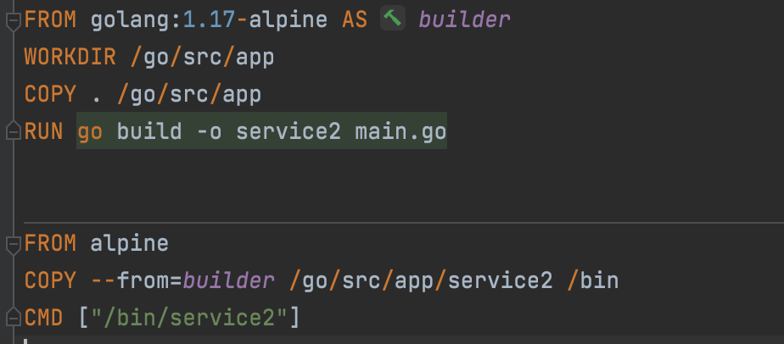
Containerize
@gkarthics

Slide 22
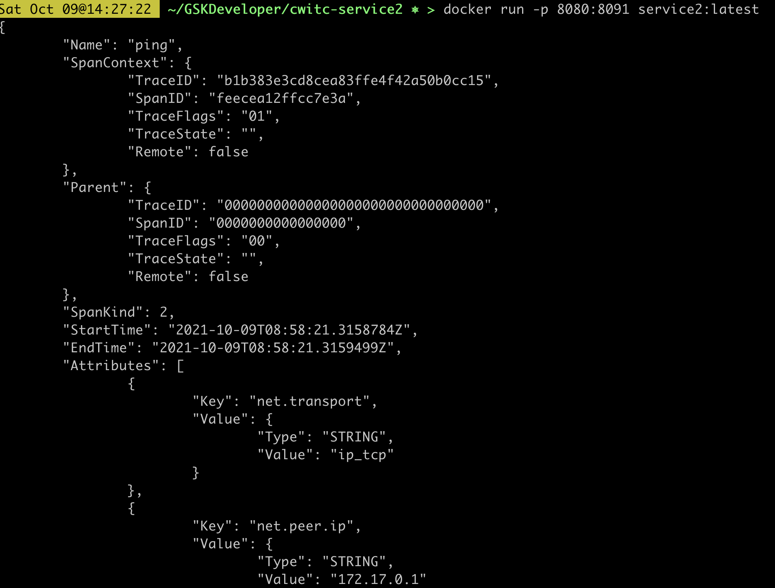
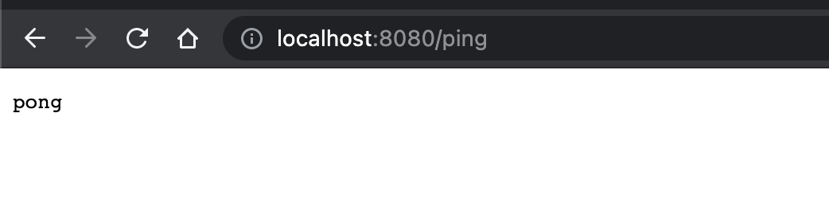
…response
@gkarthics

Slide 23
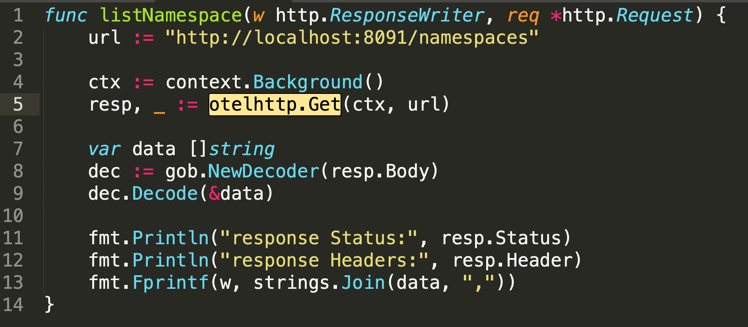
Let’s create a parent service
@gkarthics

Slide 24
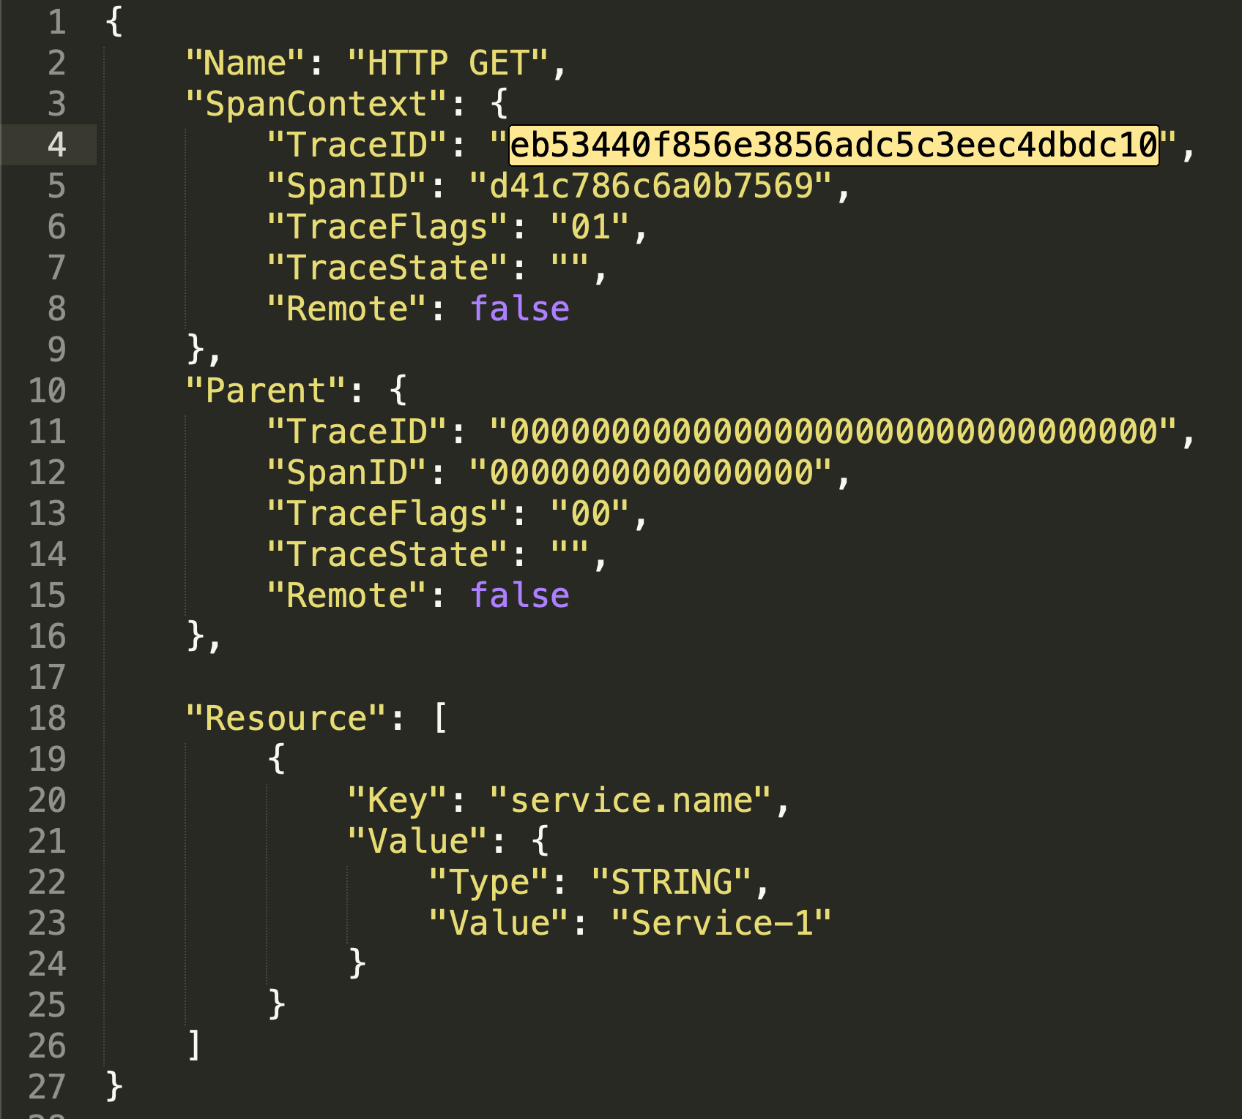
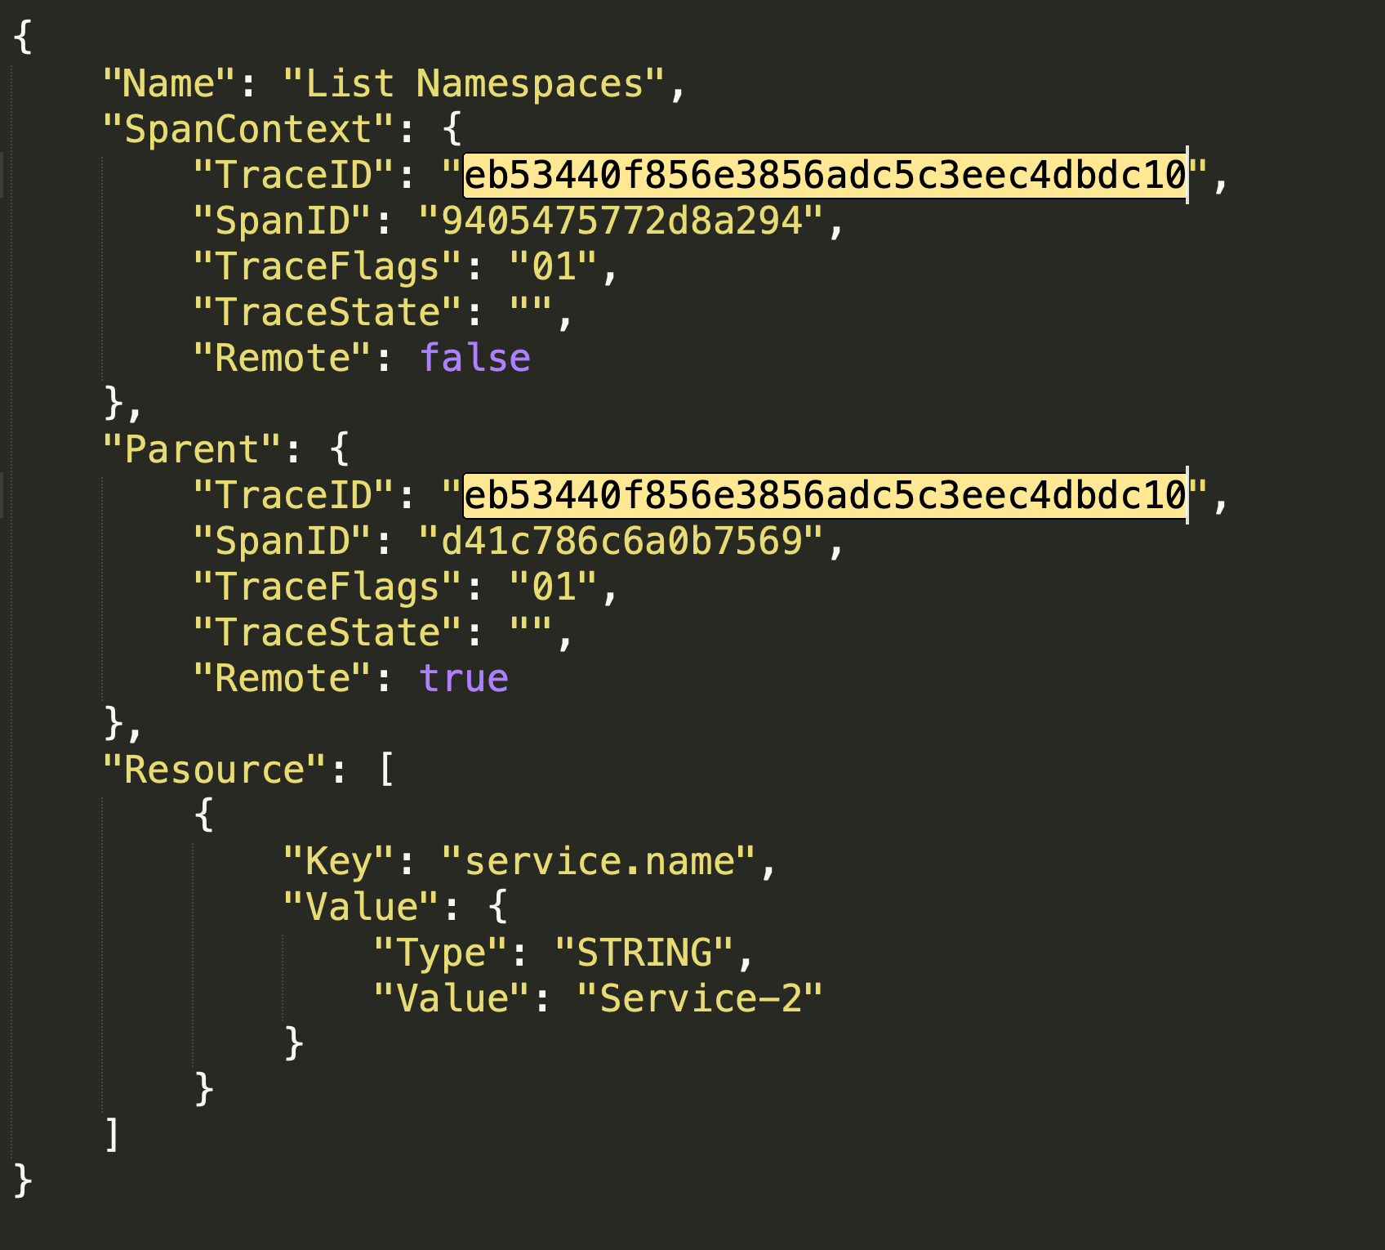
Running a GET namespace from s1 to s2
@gkarthics

Slide 25
Let’s prepare to deploy
minikube
eval `minikube docker-env`
Build images inside the minikube machine.
helm create service1
specify image as service1:latest in values.yaml
containerPort as 8090 in deployment.yaml
Readiness and liveness path as /ping
helm create service2
specify image as service2:latest in values.yaml
containerPort as 8091 in deployment.yaml
Readiness and liveness path as /ping
Start minikube
@gkarthics

Slide 26
Demo!!!
@gkarthics

