Slide 1

Web Development

Slide 2
Web Development
PHP: Hypertext Preprocessor

Slide 3







Where
HTTP
HTTP
(HTML, CSS, JS)
SQL
PHP, JAVA
ASP.NET

Slide 4
Where
HTTP
HTTP
(HTML, CSS, JS)
SQL
PHP, JAVA
ASP.NET

Slide 5
What
Scripting language

Slide 6
What
Scripting language
Dynamic pages

Slide 7

How

Slide 8

How

Slide 9

How

Slide 10
Hello
<?php
echo “Hello DI”;
?>

Slide 11
Hello
<?php
echo “Hello DI”;
?>
<?php
phpinfo();
?>

Slide 12
Types
Primitives
boolean
int
float
string

Slide 13
Types
Primitives
Complex
boolean
array
int
float
object
string

Slide 14
Types
Primitives
Complex
Special
boolean
array
resource
int
float
object
null
string

Slide 15
Variables
Not bound to types

Slide 16
Variables
Not bound to types
Initialized to empty string

Slide 17
Variables
Not bound to types
Initialized to empty string
Can refer to other vars

Slide 18
Variables
<?php
$foo = “A string”;
$foo = 1;
echo $bar;
$bar = &$foo;
$bar = TRUE;
echo $foo;
?>

Slide 19
Strings
<?php
$foo = 'single quotes';
$foo = “double quotes”;
$bar = 'one ' . 'two ';
$bar .= 'three';
echo “OK: \t tab”;
echo 'not OK: \t tab';
?>

Slide 20
Strings – Variable Parsing
Only inside double quotes
<?php
$great = 'awesome';
echo “This is $great”;
echo “Age {$person->age}”;
echo “Time ” . time();
?>

Slide 21
Arrays
<?php
$simple = array(1, 13, 7);
$assosiative = array(
“foo” => 2,
“bar” => 39,
9 => 42);
$assosiative['lala'] = 0;
echo $simple[2];
echo $assosiative['bar'];
?>

Slide 22
Types
Type Juggling

Slide 23
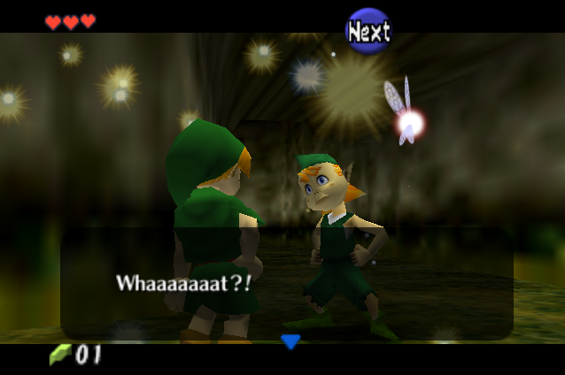
Type Juggling

Slide 24
Type Juggling
Determine var type from context
Automatic type conversions
Type casts

Slide 25
Type Juggling
<?php
// string (ASCII 48)
$foo = "0";
// integer (2)
$foo += 2;
// float (3.3)
$foo = $foo + 1.3;
// integer (15)
$foo = 5 + "10 Words";
?>

Slide 26
Type Juggling
<?php
$foo = 10;
$bar = (boolean) $foo;
?>

Slide 27
Boolean Conversions
The following are considered FALSE
boolean FALSE
empty string
integer 0
string “0”
float 0.0
zero element array
special type NULL

Slide 28
Equal OR Identical ?
equal operator ==
OR
identical operator ===

Slide 29
Functions
<?php
function printAge($person)
{
echo $person->age;
}
printAge($person);
?>

Slide 30
Combine source files
include ('filepath');

Slide 31
Combine source files
include
require
include_once
require_once

Slide 32
foreach
<?php
$fruits = array(
“banana” => “yellow”,
“apple” => “red”,
“coconut” => “brown”);
foreach($fruits as $f => $c)
echo “Fruit $f : $c”;
?>

Slide 33

Questions

Slide 34
References
http://www.php.net/manual/

Slide 35
Contact Us
https://foss.uoa.gr/
https://foss.uoa.gr/forum/
https://twitter.com/FossUoA
https://www.facebook.com/groups/foss.uoa/
foss.uoa@gmail.com

