Slide 1




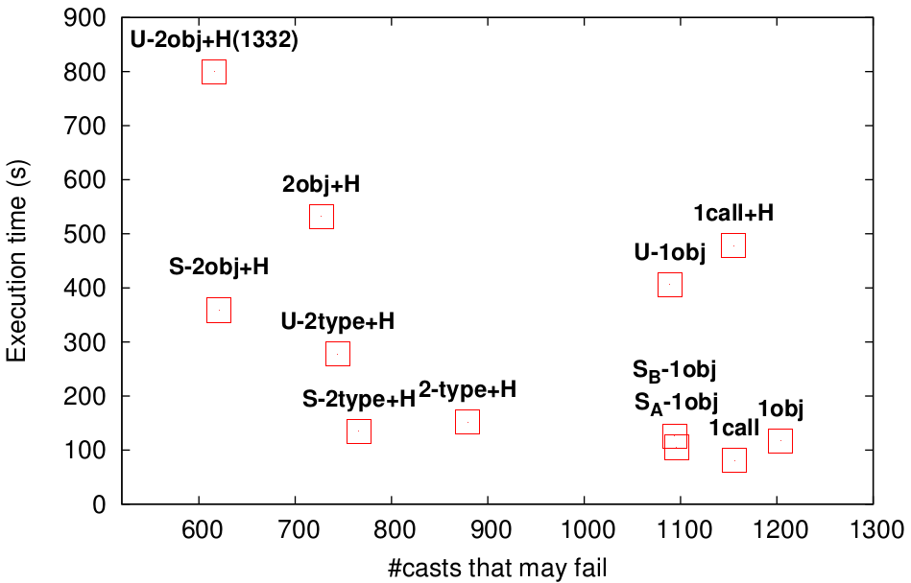



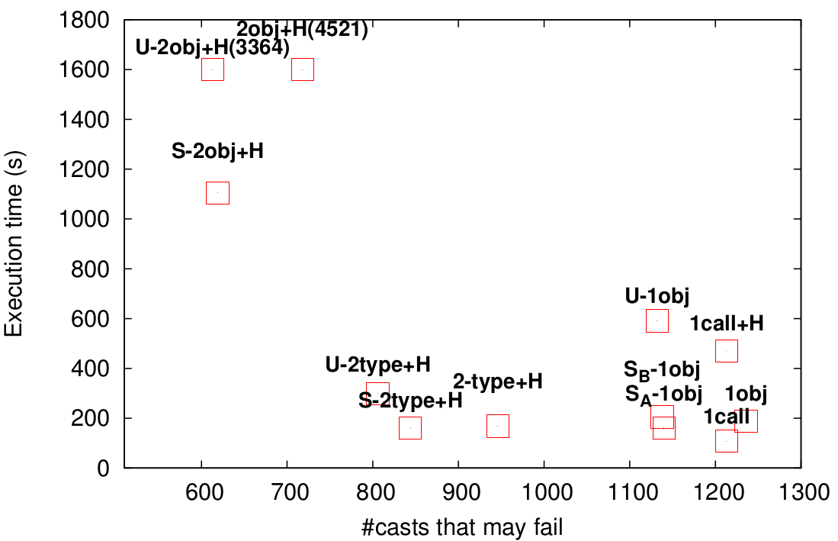
Hybrid Context-Sensitivity for Points-To Analysis
University
of ATHENS
(gkastrinis@di.uoa.gr) George Kastrinis & Yannis Smaragdakis (smaragd@di.uoa.gr)
How to combine Call-Site and Object-Sensitivity for better pointer analysis
Points-To Analysis
Call-Site Sensitivity
Object Sensitivity
What objects may a variable point to?
Use Allocation Site of receiver as context
Use Invocation Sites as context
class A {
Obj id(Obj i) {return i;}
}
class B {
void bar (A a1, A a2) {
Obj o1 = new ■
Obj c = a1.id(o1);
Obj o2 = new ▲
Obj d = a2.id(o2);
}
}
a1 → ★
inv1
o1 → ■
o2 → ▲
i → ■, ▲
c → ■, ▲
d → ■, ▲
Obj c = a1.id(o1);
o1 → ■
o2 → ▲
i(★) → ■
i(★) → ▲
i(♦) → ▲
c → ■, ▲
d → ▲
Obj c = a1.id(o1);
o1 → ■
o2 → ▲
i(inv1) → ■
i(inv2) → ▲
c → ■
d → ▲
inv2
a2 → ★,♦
Obj d = a2.id(o2);
Obj d = a2.id(o2);
Hybrid Context-Sensitivity
Experiments
Naively keeping both context
kinds → quickly non-scalable
keeping both contexts
eclipse
previous sweet-spot
Datalog for
Favor each kind in different places
e.g. Call-Site-Sens for static methods
void foo (...) {
A a = new ▲
a.bar (...);
A.sbar (...);
}
ctx1 = [♦, ★]
objCtx1 = ♦
favor call-site-sens for static calls
inv1
ctx2 = [▲ , ♦]
Virtual Methods
ctx3 = [♦, inv1, ★]
Object Allocation
first part always allocation site
→ precision in RECORD
xalan
static void A::sbar (...) {
B.sfoo (...);
C c = new ■
c.baz (...);
}
RECORD (...) = first(ctx)
MERGE (...) = [obj, objCtx]
MERGESTATIC (...) = [first(ctx), invo, second(ctx)]
Run 12
analyses on
10 benchmarks
inv2
ctx4 = [♦, inv2, inv1]
static calls inside static
→ simulate call-site sens
objCtx2 = ♦
ctx5 = [■, ♦]
avg. speedup of 1.53x
dynamic calls inside static
→ revert back to object sens
Static Methods
Context Constructors
Example
Selective 2-Object Sensitive +1-Heap

