Slide 1


HYBRID
CONTEXT-SENSITIVITY
FOR POINTS-TO ANALYSIS
George Kastrinis
Yannis Smaragdakis
Summer Intern @
University
of Athens
Notes:
Today we will talk about …

Slide 2
EXECUTIVE SUMMARY
Hybrid: Combine Call-Site & Object sensitivity
Naively keeping both contexts not scalable
Favor each kind in different places
e.g. Call-Site Sens for Static Methods
The precision from both, the cost of only one

Slide 3
HYBRID
CONTEXT-SENSITIVITY
FOR POINTS-TO ANALYSIS
Notes:
Now, we are interested in PointsTo analysis. That is the analysis that tries to answer the following question:

Slide 4
HYBRID
CONTEXT-SENSITIVITY
FOR POINTS-TO ANALYSIS
What objects may a variable point to?
(statically, object = allocation site)
Notes:
Now, we are interested in PointsTo analysis. That is the analysis that tries to answer the following question:

Slide 5


HYBRID
CONTEXT-SENSITIVITY
FOR POINTS-TO ANALYSIS
Notes:
Now, we are interested in PointsTo analysis. That is the analysis that tries to answer the following question:

Slide 6
Simple Example
Obj A::id(Obj i) {return i}
void B::bar(A a1, A a2) {
Obj o1 = new ■
Obj c = a1.id(o1)
Obj o2 = new ▲
Obj d = a2.id(o2)
}

Slide 7
Points-To Sets
Obj A::id(Obj i) {return i}
void B::bar(A a1, A a2) {
Obj o1 = new ■
Obj c = a1.id(o1)
Obj o2 = new ▲
Obj d = a2.id(o2)
}
o1 → ■
o2 → ▲
i → ■, ▲
c → ■, ▲
d → ■, ▲

Slide 8
Points-To Sets
Obj A::id(Obj i) {return i}
void B::bar(A a1, A a2) {
Obj o1 = new ■
Obj c = a1.id(o1)
Obj o2 = new ▲
Obj d = a2.id(o2)
}
o1 → ■
o2 → ▲
i → ■, ▲
c → ■, ▲
d → ■, ▲
Can we do better?

Slide 9
HYBRID
CONTEXT-SENSITIVITY
FOR POINTS-TO ANALYSIS
Notes:
Now, we are interested in PointsTo analysis. That is the analysis that tries to answer the following question:

Slide 10
HYBRID
CONTEXT-SENSITIVITY
FOR POINTS-TO ANALYSIS
Qualify variables (and objects)
with context information
Notes:
Now, we are interested in PointsTo analysis. That is the analysis that tries to answer the following question:

Slide 11
Call-Site Sensitivity
Obj A::id(Obj i) {return i}
void B::bar(A a1, A a2) {
Obj o1 = new ■
Obj c = a1.id(o1)
Obj o2 = new ▲
Obj d = a2.id(o2)
}
o1 → ■
o2 → ▲
i(inv1) → ■
i(inv2) → ▲
c → ■
d → ▲
inv1
inv2

Slide 12
Call-Site Sensitivity
Obj A::id(Obj i) {return i}
void B::bar(A a1, A a2) {
Obj o1 = new ■
Obj c = a1.id(o1)
Obj o2 = new ▲
Obj d = a2.id(o2)
}
o1 → ■
o2 → ▲
i(inv1) → ■
i(inv2) → ▲
c → ■
d → ▲
inv1
inv2
#contexts?
statically known

Slide 13
Object Sensitivity
Obj A::id(Obj i) {return i}
void B::bar(A a1, A a2) {
Obj o1 = new ■
Obj c = a1.id(o1)
Obj o2 = new ▲
Obj d = a2.id(o2)
}
a1 → ★
a2 → ♦

Slide 14
Object Sensitivity
Obj A::id(Obj i) {return i}
void B::bar(A a1, A a2) {
Obj o1 = new ■
Obj c = a1.id(o1)
Obj o2 = new ▲
Obj d = a2.id(o2)
}
o1 → ■
o2 → ▲
i(★) → ■
i(♦) → ▲
c → ■
d → ▲
a1 → ★
a2 → ♦

Slide 15
Object Sensitivity
Obj A::id(Obj i) {return i}
void B::bar(A a1, A a2) {
Obj o1 = new ■
Obj c = a1.id(o1)
Obj o2 = new ▲
Obj d = a2.id(o2)
}
o1 → ■
o2 → ▲
i(★) → ■
i(♦) → ▲
c → ■
d → ▲
a1 → ★
a2 → ♦
#contexts?
depends on analysis

Slide 16
Call-Site Sensitivity
#contexts?
statically known
≠
not comparable
Object Sensitivity
#contexts?
depends on analysis

Slide 17
Natural Idea: Combine The Two

Slide 18
Uniform Combination
(add extra Call-Site information)

Slide 19

Uniform Combination
(add extra Call-Site information)

Slide 20
Our Approach: Hybrid Combination
(don't keep both, switch to best)

Slide 21
Why You Care:
Serious Practical Benefit
Run 12
analyses on
10 benchmarks

Slide 22
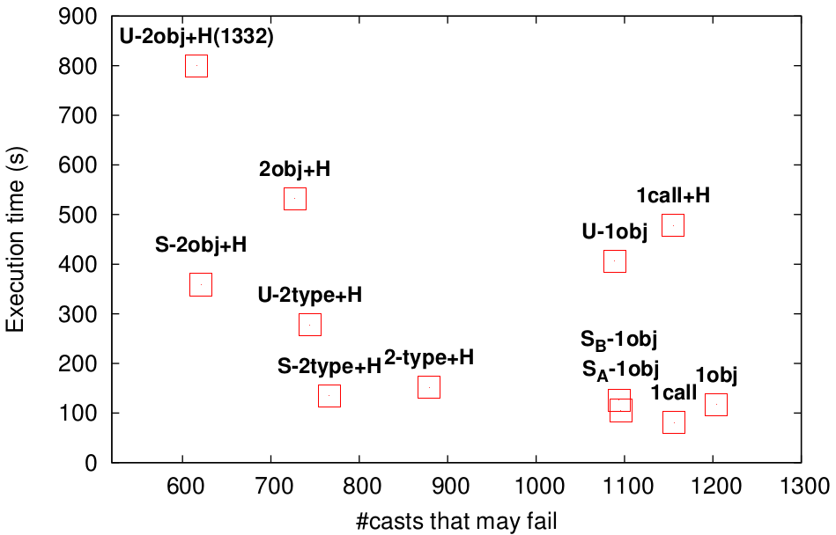
Performance VS Precision
eclipse

Slide 23
Performance VS Precision
keeping both contexts
eclipse
previous sweet-spot
favor call-site-sens for static calls

Slide 24
Performance VS Precision
eclipse
avg. speedup of 1.53x

Slide 25
Performance VS Precision
eclipse
slightly more precise
than selective

Slide 26
OK, How???
(the technical part)

Slide 27
Our Setting:
Analysis as Datalog rules

Slide 28
Example Datalog Rule
P (x),
Q (x, z) ← R (x, y, w),
S (y, z).

Slide 29
Example Datalog Rule
then...
P (x),
Q (x, z) ← R (x, y, w),
S (y, z).
if...

Slide 30
Analyzing Java with Datalog

Slide 31
Get from this
v = new A()
to = from
to = base.fld
base.fld = from
base.sig(...)
A.sig(...)

Slide 32
Get from this
To this
v = new A()
to = from
to = base.fld
base.fld = from
base.sig(...)
A.sig(...)
ALLOC (var, obj, meth)
OBJTYPE (obj, type)
MOVE (to, from)
LOAD (to, base, fld)
STORE (base, fld, from)
VCALL (base, sig, invo)
SCALL (sig, invo)

Slide 33
Get from this
To this
v = new A()
to = from
to = base.fld
base.fld = from
base.sig(...)
A.sig(...)
ALLOC (var, obj, meth)
OBJTYPE (obj, type)
MOVE (to, from)
LOAD (to, base, fld)
STORE (base, fld, from)
VCALL (base, sig, invo)
SCALL (sig, invo)

Slide 34
Rules in our Analysis

Slide 35
Static Method Calls
A.sfoo(...);
REACHABLE (inMeth, callerCtx),
SCALL (toMeth, invo, inMeth).

Slide 36
Static Method Calls
A.sfoo(...);
REACHABLE (toMeth ),
CALLGRAPH (invo, callerCtx, toMeth ) ←
REACHABLE (inMeth, callerCtx),
SCALL (toMeth, invo, inMeth).

Slide 37
Static Method Calls
A.sfoo(...);
Construct a new calling context
MERGESTATIC (invo, ctx) = calleeCtx,
REACHABLE (toMeth, calleeCtx),
CALLGRAPH (invo, callerCtx, toMeth, calleeCtx) ←
REACHABLE (inMeth, callerCtx),
SCALL (toMeth, invo, inMeth).

Slide 38
Virtual Method Calls
a.foo(...);
MERGE (obj, objCtx, invo, ctx) = calleeCtx,
REACHABLE (toMeth, calleeCtx),
CALLGRAPH (invo, callerCtx, toMeth, calleeCtx) ←
REACHABLE (inMeth, callerCtx),
VCALL (base, sig, invo, inMeth),
VARPOINTSTO (base, callerCtx, obj, objCtx),
OBJTYPE (obj, objT), LOOKUP (objT, sig, toMeth).
Same Logic

Slide 39

3 functions to rule all contexts
RECORD (...) = newObjCtx
MERGE (...) = newCtx
MERGESTATIC (...) = newCtx
Object Allocation
Virtual Methods
Static Methods
Use the information available at
each point to create a new Context

Slide 40
1 Object Sensitive + 1 Heap
Allocation Site
of Receiver
a.foo(...);
MERGE (obj, objCtx, invo, ctx) = obj
MERGESTATIC (invo, ctx) = ?
A.sfoo(...);
Need an Allocation Site
We are in a Static Method!

Slide 41
1 Object Sensitive + 1 Heap
Allocation Site
of Receiver
a.foo(...);
MERGE (obj, objCtx, invo, ctx) = obj
MERGESTATIC (invo, ctx) = ctx
A.sfoo(...);
Copy that of
the Caller...

Slide 42
HYBRID
CONTEXT-SENSITIVITY
FOR POINTS-TO ANALYSIS
Notes:
Now, we are interested in PointsTo analysis. That is the analysis that tries to answer the following question:

Slide 43
HYBRID
CONTEXT-SENSITIVITY
FOR POINTS-TO ANALYSIS
Combine different context kinds
Notes:
Now, we are interested in PointsTo analysis. That is the analysis that tries to answer the following question:

Slide 44
HYBRID
CONTEXT-SENSITIVITY
FOR POINTS-TO ANALYSIS
Combine different context kinds
WHERE?
HOW?
Notes:
Now, we are interested in PointsTo analysis. That is the analysis that tries to answer the following question:

Slide 45
HYBRID
CONTEXT-SENSITIVITY
FOR POINTS-TO ANALYSIS
Combine different context kinds
WHERE?
HOW?
look at one example; many more in the paper
Notes:
Now, we are interested in PointsTo analysis. That is the analysis that tries to answer the following question:

Slide 46
Selective Combination
(favor call-site sens. e.g. in static methods)

Slide 47
e.g. of Selective Combination
A a = new A();
RECORD (obj, ctx) = first(ctx)
Current Context of
allocating method

Slide 48
e.g. of Selective Combination
a.foo(...);
RECORD (obj, ctx) = first(ctx)
MERGE (obj, objCtx, invo, ctx) = [obj, objCtx]
Allocation Site
of Receiver
Allocation Site
of Receiver's
Receiver

Slide 49
e.g. of Selective Combination
A.sfoo(...);
RECORD (obj, ctx) = first(ctx)
MERGE (obj, objCtx, invo, ctx) = [obj, objCtx]
MERGESTATIC (invo, ctx) = [first(ctx), invo, second(ctx)]
Allocation Site
of Caller's Receiver
?
Invocation Site

Slide 50
e.g. of Selective Combination
A.sfoo(...);
RECORD (obj, ctx) = first(ctx)
MERGE (obj, objCtx, invo, ctx) = [obj, objCtx]
MERGESTATIC (invo, ctx) = [first(ctx), invo, second(ctx)]
Allocation Site
of Caller's Receiver
?
Invocation Site

Slide 51
Example
Selective Combination Approach
RECORD (obj, ctx) = first(ctx)
MERGE (obj, objCtx, invo, ctx) = [obj, objCtx]
MERGESTATIC (invo, ctx) = [first(ctx), invo, second(ctx)]
void foo (...) {
A a = new ▲
a.bar (...)
A.sbar (...)
}

Slide 52
Example
Selective Combination Approach
RECORD (obj, ctx) = first(ctx)
MERGE (obj, objCtx, invo, ctx) = [obj, objCtx]
MERGESTATIC (invo, ctx) = [first(ctx), invo, second(ctx)]
ctx1 = [■, ★]
void foo (...) {
A a = new ▲
a.bar (...)
A.sbar (...)
}

Slide 53
Example
Selective Combination Approach
RECORD (obj, ctx) = first(ctx)
MERGE (obj, objCtx, invo, ctx) = [obj, objCtx]
MERGESTATIC (invo, ctx) = [first(ctx), invo, second(ctx)]
ctx1 = [■, ★]
void foo (...) {
A a = new ▲
a.bar (...)
A.sbar (...)
}
objCtx1 = ■

Slide 54
Example
Selective Combination Approach
RECORD (obj, ctx) = first(ctx)
MERGE (obj, objCtx, invo, ctx) = [obj, objCtx]
MERGESTATIC (invo, ctx) = [first(ctx), invo, second(ctx)]
ctx1 = [■, ★]
void foo (...) {
A a = new ▲
a.bar (...)
A.sbar (...)
}
objCtx1 = ■
ctx2 = [▲, ■]

Slide 55
Example
Selective Combination Approach
RECORD (obj, ctx) = first(ctx)
MERGE (obj, objCtx, invo, ctx) = [obj, objCtx]
MERGESTATIC (invo, ctx) = [first(ctx), invo, second(ctx)]
ctx1 = [■, ★]
void foo (...) {
A a = new ▲
a.bar (...)
A.sbar (...)
}
objCtx1 = ■
ctx2 = [▲, ■]
invo2
ctx3 = [■, invo2, ★]
first part of ctx always allocation site → precision in RECORD

Slide 56
Example (cont'd)
Selective Combination Approach
RECORD (obj, ctx) = first(ctx)
MERGE (obj, objCtx, invo, ctx) = [obj, objCtx]
MERGESTATIC (invo, ctx) = [first(ctx), invo, second(ctx)]
ctx3 = [■, invo2, ★]
static void A::sbar (...) {
B.sfoo (...)
C c = new ♦
c.baz (...)
}
invo3
ctx4 = [■, invo3, invo2]
objCtx2 = ■
ctx5 = [♦, ■]
static calls inside static → simulate call-site sens
virtual calls inside static → revert back to object sens

Slide 57
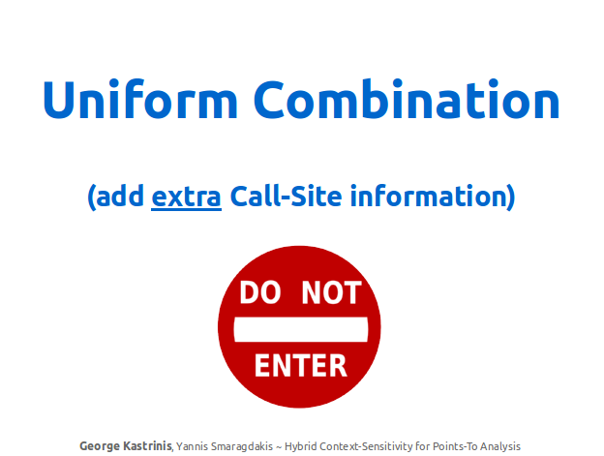
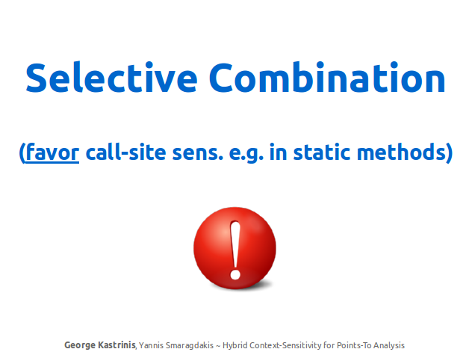
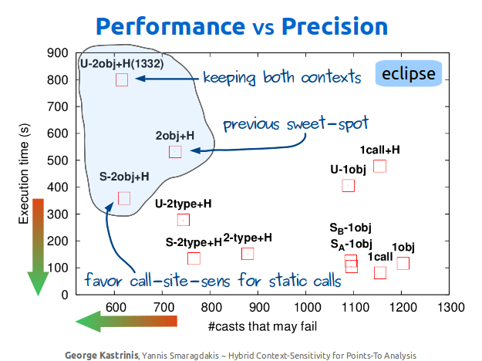
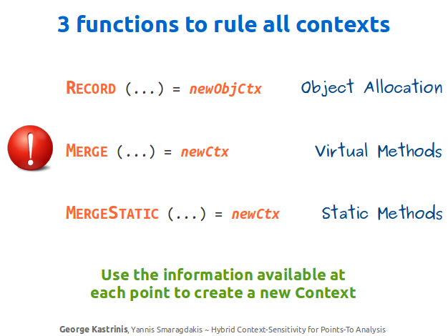
RECAP

Slide 58
Hope you enjoyed!
•
George Kastrinis
http://gkastrinis.info
University
of Athens
Summer Intern @

