Slide 1

CALCULATOR
By: Enoc Gonzalez & Preet Kaur
Professor: Dr. Fatema Nafa
Course: Software Design/Programming II
Department of Computer Science
Salem State University

Slide 2
Project Description
Implement JavaFX to create a GUI calculator which is both simple and fun to use.
Implement Software Design & Programming techniques learned in the course CSC115.
Implement choice of colors for the user.

Slide 3
Login
GUI project
Scene builder
Selected AnchorPane
TextField
Label
Button

Slide 4
JavaFX Package
Created class under JavaFX
Main Class
Multiple fxml file
One main controller

Slide 5
Log Method
Created 3 variable with @FXML
One method public void to add ActionEvent
If else statement to get the text for username and the password if it will take the login.

Slide 6
Connections between Controller, Login Method and fxml files
Change buttonPane to parentRoot to get fxml and change it to my scene builder login file
We also used /fxml file name. Fxml to make the connection

Slide 7
Color Selection
1
Method to switch from Login Scene to Color Selection
2
Method to handle choice of Color
3
Implementation of CSS for aesthetic

Slide 8
Main Control Class
Handles all the logical operations of calculator
Connections to FXML and Calculator
Method to handle close and dragging of Calculator on the screen

Slide 9
FXML & Scene Builder
Implemented Scene Builder to see changes to the calculator in real time
Implemented @FXML to make connections between code and Scene Builder objects

Slide 10
CSS
Color & Design of all Scenes
Main colors
Buttons
Dimensions
Why CSS?
Good design
User friendly

Slide 11
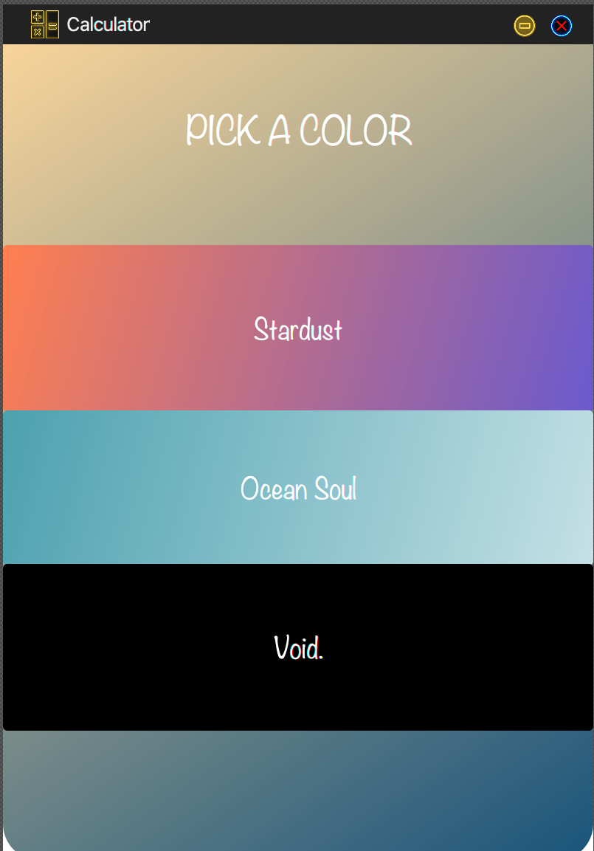
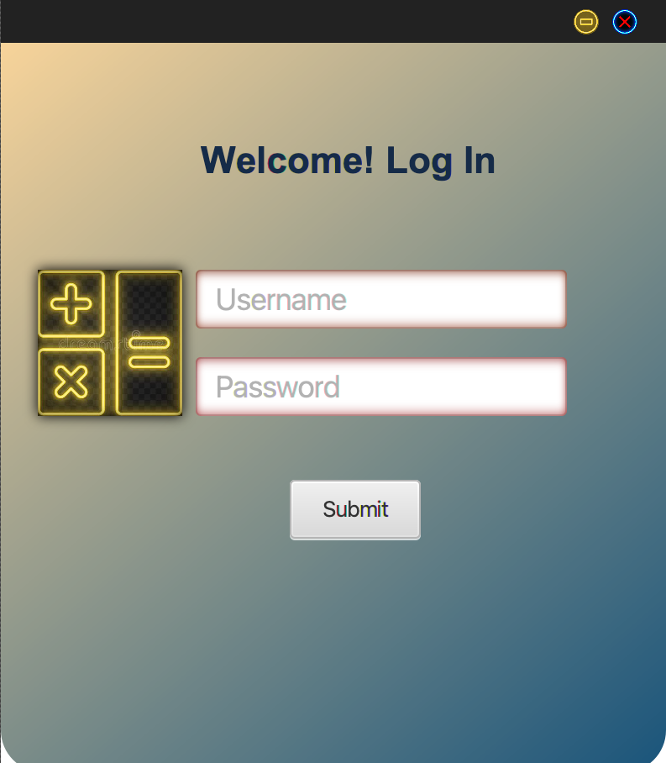
Visual Connections

Slide 12


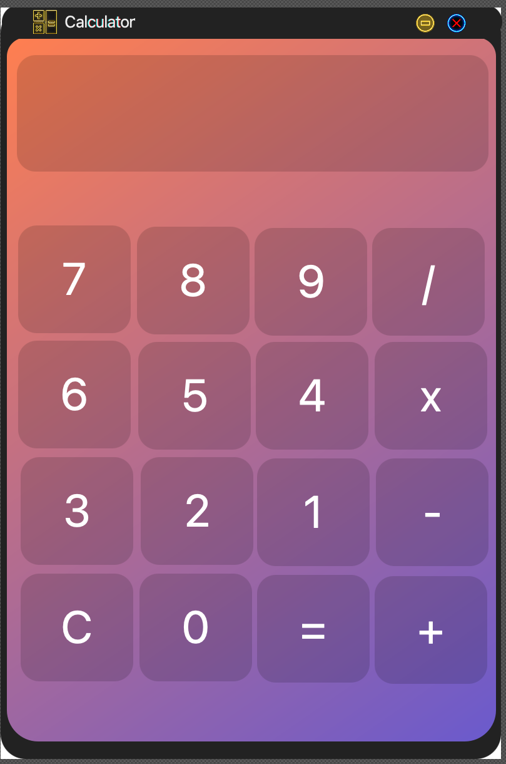

Slide 13
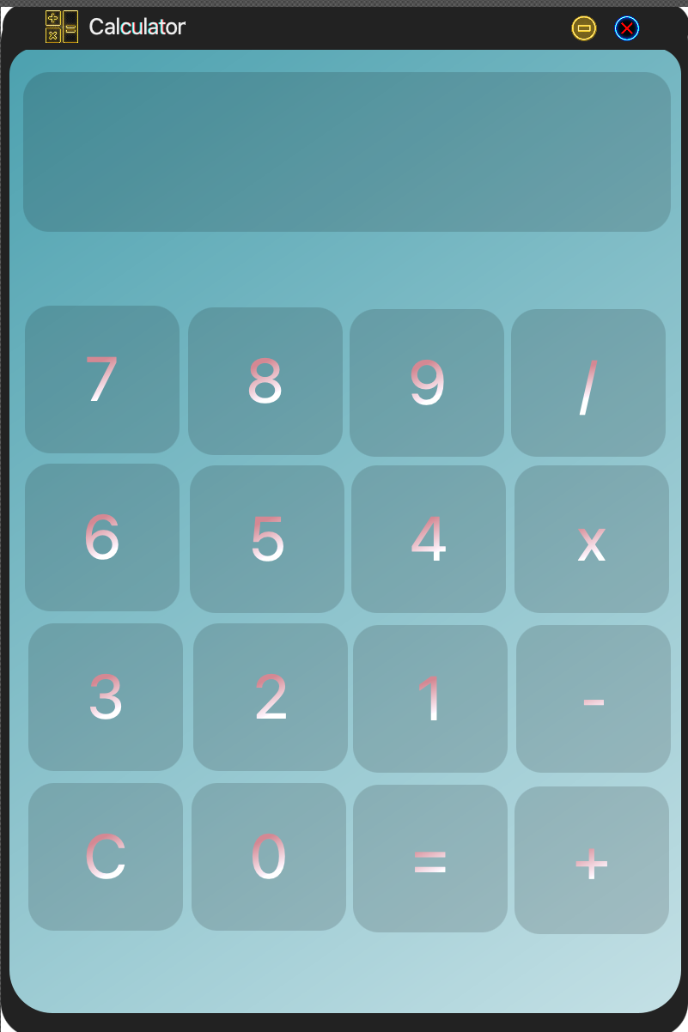

Slide 14
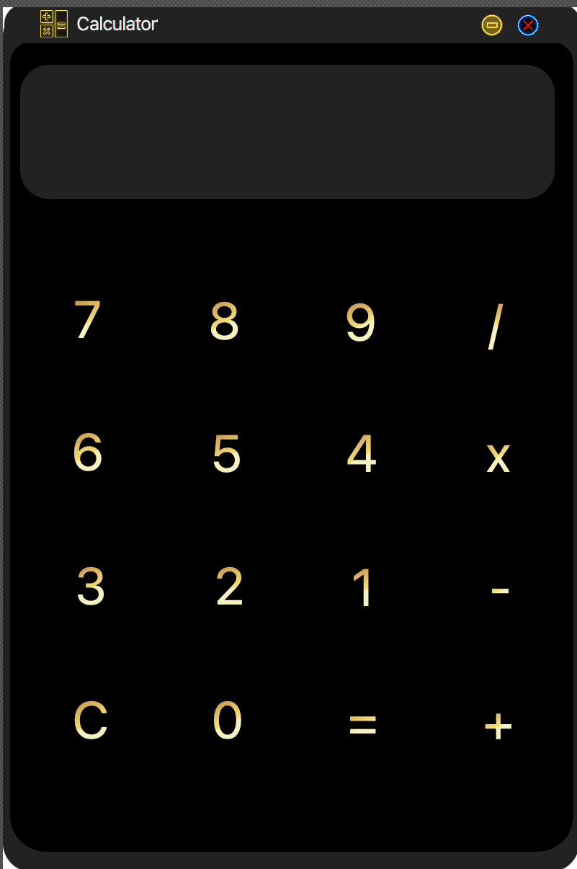

Slide 15




