Slide 1
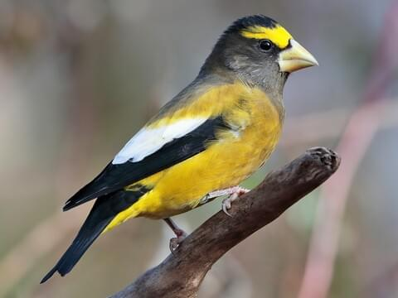
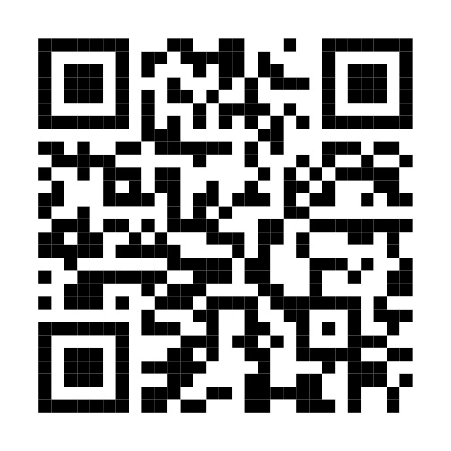
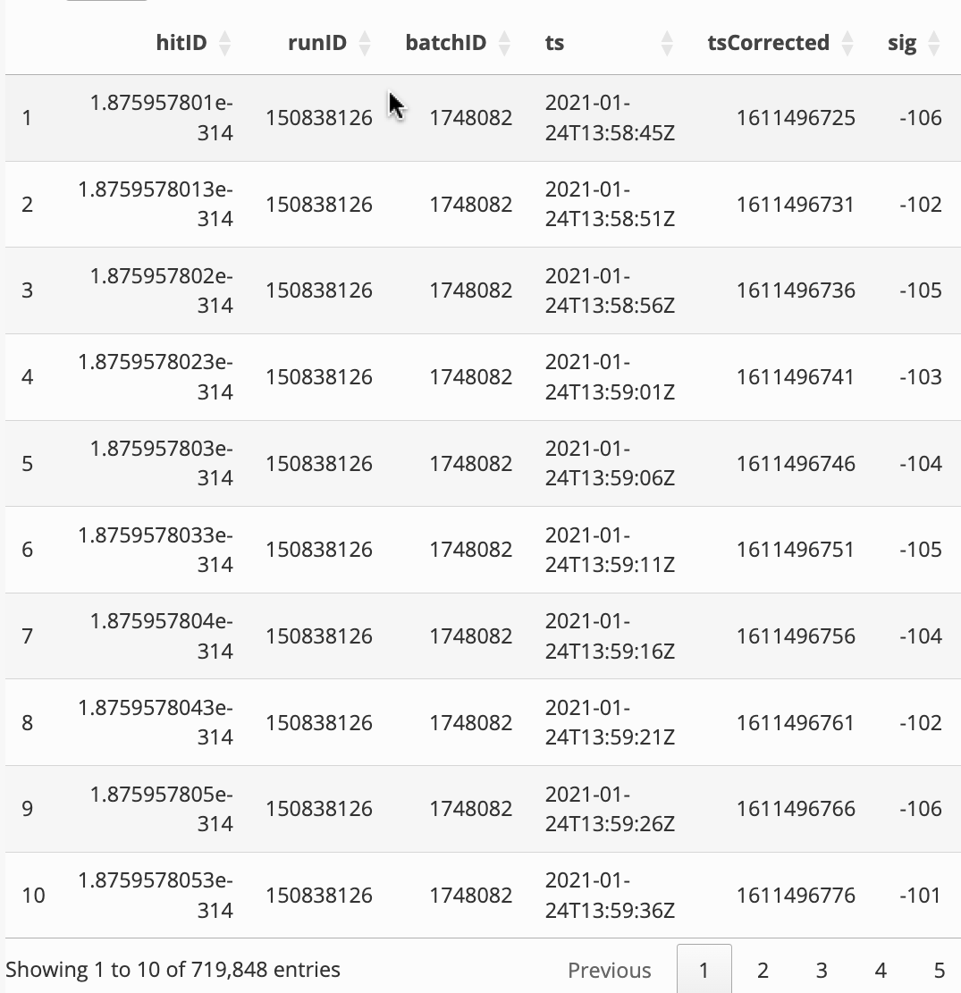
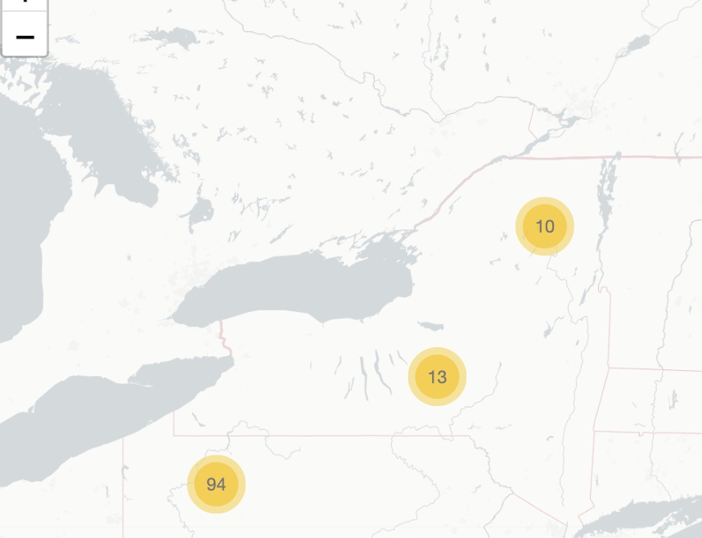
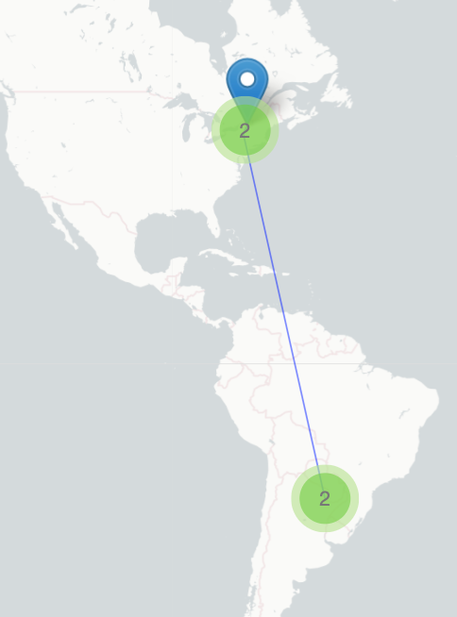
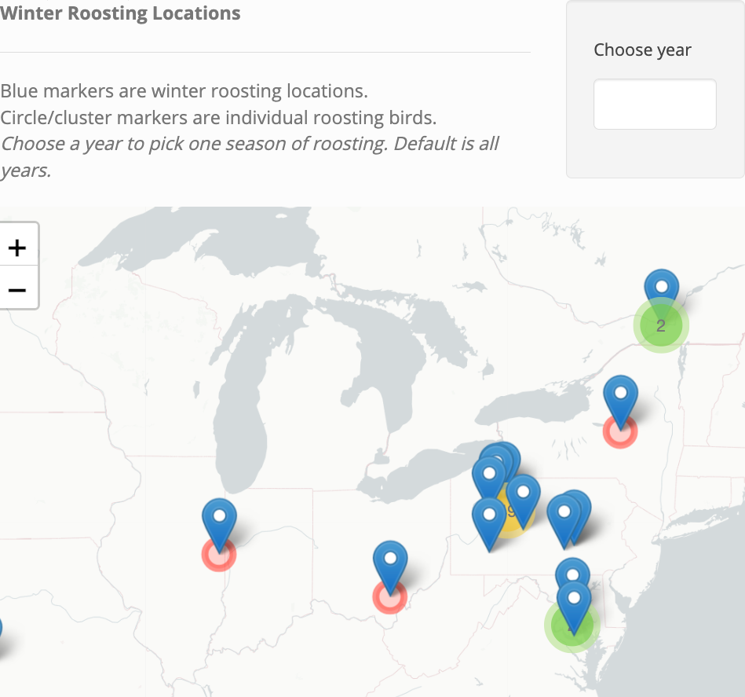
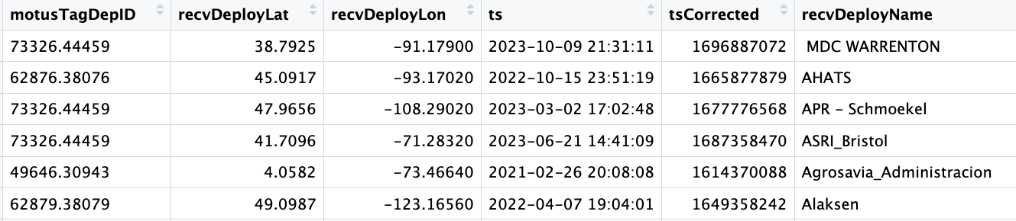
Using Interactive Graphics to Visualize Evening Grosbeak
Movement and Migration Patterns
Grace Bridge ’24 (Data Science)
St. Lawrence University Advisor: Dr. Ivan Ramler
Introduction
Shiny App
Data Tables
This project visualizes the travel patterns of Evening Grosbeaks, a North American finch species.
The shiny app features include:
Interactive map of Evening Grosbeak deployment sites.
Individual bird tracking to understand specific migration paths.
Group bird tracking based on winter roosting locations and deployment sites.
Exploration of all Evening Grosbeak data collected.
Focused view of Evening Grosbeak data from the Adirondack region.
Deployments and Tracking Page
This page allows a user to explore the initial deployments of each bird in the dataset. Clicking on a bird's marker allows the user to move to the next tab that includes data and a map for the individual bird, along with a map of the routes of all birds deployed from the same spot.
The last page (the About page) contains two data tables.
The full dataset of evening grosbeaks used for this project.
The trimmed down dataset for birds deployed out of the Adirondack region.
Data Wrangling
Data Source:
Data was pulled from Motus, a wildlife tracking system. It consists of a network of researchers using radio tagging systems to track various bird species.
Data Cleaning and Manipulating:
The motivation for this project came from the endangered status of evening grosbeaks. So, the data used specifically for this project only consists of that species.
Much of the data consisted of features only important to satellite tagging and batches of deployments,. For the purposes of this app, our data focused on species, locations, timestamps, and unique bird IDs.
Figure 2. Map of bird deployment clusters
Figure 3. Map of individual bird with deployment site marked in blue.
Figure 5. Preview of full dataset.
Future Applications
Winter Roosting Page
This page allows the user to explore the winter roosting locations for this species. If the user wants to investigate the patterns of one winter group/location, the user can click on the location and follow the patterns on the next tab.
This app is an exploration into the visualization possibilities for bird tracking using R. Its features can serve as a jumping off point for a researcher looking to dive deeper into migration patterns and analytics.
While this app is applied specifically for evening grosbeaks, anyone with access to Motus data can easily transform these features to a different species.
The structure of this app can be replicated and expanded upon for further bird migrations studies.
Acknowledgements and References
Figure 1. Preview of evening grosbeak data
I would like to thank Dr. Ivan Ramler for his support and guidance throughout this project.
I would also like to thank Dr. Susan Willson for the motivation behind this project.
https://motus.org/
https://www.shinyapps.io/
https://cran.r-project.org/web/packages/leaflet/readme/README.html
This data was manipulated for the outcome of each leaflet interactive map, table, and filtering of more specific data.
See the Understanding the Data tab in the About section to understand the variables used for this project and what they mean.
Figure 4. Map of roosting locations (in blue) and the birds that roost in each (circle markers)
Notes:
Choose year –slider menu (change menu)
Add figure descriptions

