Slide 1
Quantinuum Inc.
NASDAQ: QNT | Competitive Analysis, Comps & Dual-DCF Valuation
Priced $60 (Jun 3, 2026) above $53–55 range | Trading $68 | Post-money ~$15.6B
Honeywell parent ~48% voting | Pre-profit | Apollo (FTQC) target 2029
Investment workup using 7-skill financial-analysis pipeline
Decision-framing only. Not investment advice.
June 4, 2026

Slide 2
Executive summary — what does $68 mean?
2
$68 ≈ 2.75× our traditional DCF and ≈ 2.34× the FY35 revenue we model in base case.
Stock prices a 15.4% share of the 2035 quantum-computing TAM. Achievable, but the bar is high.
Framework 1 — Traditional DCF
Framework 2 — Reverse-engineered to $68
• WACC: 15.85% (rf 4.3% + beta 2.1 × ERP 5.5%)
• Terminal growth: 4.0%
• 12-year horizon (FY24A → FY35E)
• FCF crossover: FY2029E (Apollo year)
• FY2035E FCF: $1,307M (10-yr CAGR ~75%)
• PV of explicit FCF: $1,372M
• PV of terminal value: $2,835M
• Enterprise value: $4,207M
• + Cash $2,080M = Equity $6,287M
• → Intrinsic $24.76 / share
• → Stock at +175% premium
• $68 × 253.9M shares = $17.3B mkt cap
• Less $2.1B cash → $15.2B EV
• Assumed FY35 mature EV/Rev: 8.0×
• Solve: FY35E rev needed = $7,680M
• Model base case FY35E rev: $3,280M
• Implied gap: +134% above model
• Implied 2035 share of $50B QC TAM: 15.4%
• 10-yr revenue CAGR required: ~75%
• Required: full Apollo (FTQC) success
• → 'Optionality is mostly priced in'
• → Asymmetry skews DOWN at $68
Decision call: HOLD with downside skew. Buy zone <$45 (peer-median footing). Refresh after Q2'26 print.
Quantinuum (QNT) — Competitive Analysis | Jun 4, 2026
2

Slide 3
The IPO event — June 3, 2026
3
Priced above range, upsized, ~20x oversubscribed — first major dedicated quantum IPO at scale
IPO mechanics
Cap-table post-IPO (voting)
Item | Value
Initial range (filed) | $45–50
Revised range (May 26) | $53–55
Final priced (Jun 3) | $60.00 — above range
Shares offered (final) | 28,000,000 (upsized from 21M)
Gross proceeds | $1.68B
Underwriters | JPM, MS (joint book) + Jefferies, Evercore ISI
Oversubscription | ~20× (reported)
Day-1 open (Jun 4) | $68.00 (+13.3% vs IPO)
Post-money mkt cap (FD) | ~$15.6B
Public float | ~8.3% (very thin)
• Honeywell: ~48.1% voting power
• - Plus Transaction Committee veto on M&A > $10M
• - Plus operating supplier to QNT ('H2 powered by Honeywell')
• Cambridge Quantum Holdings: ~32.5% voting
• - Aggregates founder Ilyas Khan (~23%), IBM, JSR
• Combined HON + CQH: ~82% voting
• Public free float: ~8.3% economic, similar voting
•
• Use of proceeds: working capital, R&D,
• general corporate purposes. No specific earmark for
• Helios/Sol/Apollo named in S-1.
•
• Implied multiple at $60: ~485× EV/FY25 rev
• At $68 open: ~491× — peer median ~383× (FY25 basis)
Quantinuum (QNT) — Competitive Analysis | Jun 4, 2026
3

Slide 4
Company profile — and the Honeywell parent angle
4
QNT is the merged Honeywell Quantum Solutions + Cambridge Quantum (Nov 2021)
Quantinuum Inc. (NASDAQ: QNT)
Honeywell parent angle (HON)
• CEO: Ilyas Khan (founder, ex-Cambridge Quantum)
• HQ: Cambridge UK + Broomfield CO
• Modality: trapped-ion (QCCD architecture)
• Tech generations: H1 → H2 → Helios → Sol → Apollo
•
• Funding history
• Nov '21: Honeywell-Cambridge merger ($300M Honeywell)
• Jan '24: $300M raise @ $5B pre-money (JPMC led)
• Sep '25: $600M raise @ $10B pre-money (NVIDIA +)
• Jun '26: IPO at $60 → post-money ~$15.6B
• Cumulative raised: $2.5B+ over 5 years
•
• Financials (S-1)
• FY24 revenue $23.0M | net loss $144.1M
• FY25 revenue $30.9M (+34%) | net loss $192.6M
• Q1'26 revenue $5.2M | net loss $136.6M
• Pre-IPO cash $677M → post-IPO ~$2.1B (~4-year runway)
• Pre-IPO ownership: ~54%
• Post-IPO ownership: ~48.1% voting
• (sold down slightly through offering)
•
• Value to HON shareholders
• QNT stake at $68 = ~$7.5B (122M shares × $68)
• HON market cap ~$138B
• → QNT = ~5.4% of HON value
• Modest positive catalyst, NOT transformative
•
• Asymmetries for HON shareholders
• Upside: monetization optionality (secondary offering)
• Upside: showcase R&D culture
• Risk: ongoing related-party supplier obligations
• Risk: QNT brand reputation flows back to HON
•
• HON multi-industrial peers
• GE Aerospace, RTX, EMR, ITW
• HON SOTP: QNT carve-out adds ~3-5% to NAV [E]
Quantinuum (QNT) — Competitive Analysis | Jun 4, 2026
4

Slide 5
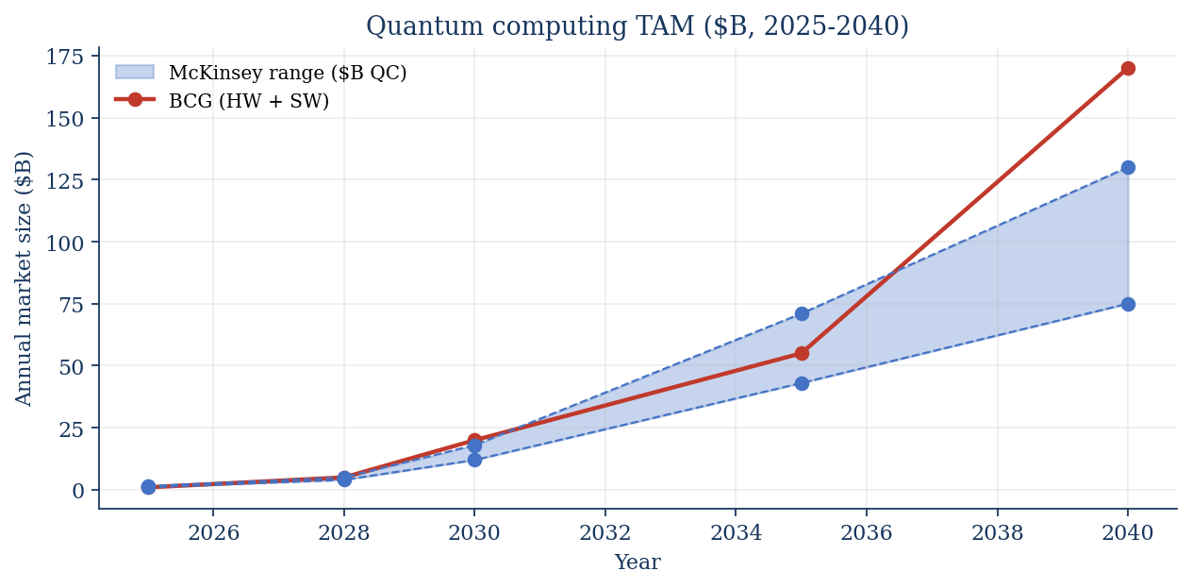
Market — quantum computing TAM
5
McKinsey $43-71B by 2035; BCG sees $90-170B HW+SW by 2040
Why we use $50B
• McKinsey QTM 2026: $43-71B QC by 2035
• We use the midpoint ($50B) for the reverse-engineered DCF
•
• Splits within $50B:
• ~40% hardware ($20B)
• ~35% cloud + services ($17B)
• ~25% software / apps ($12B)
•
• Real wild card:
• Total economic value $2.7T by 2035
• (downstream usage, not vendor revenue)
• Risk of mistaking 'value created' for
• 'value captured' — vendor margin is
• the tractable thesis.
Quantinuum (QNT) — Competitive Analysis | Jun 4, 2026
5

Slide 6
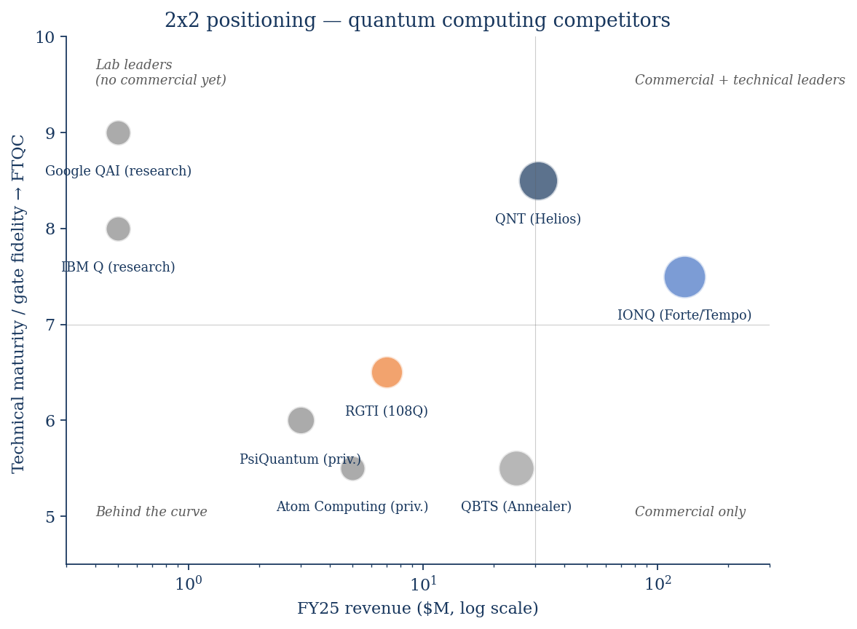
Competitive landscape — modality + 2x2 positioning
6
Trapped-ion (QNT, IONQ) currently leads on fidelity; superconducting (IBM, Google, RGTI) on scale
Modality scorecard
• Trapped-ion (QNT, IONQ)
• + Highest gate fidelity in industry
• + Long coherence times
• - Slower gate speeds; scaling unproven beyond ~100q
•
• Superconducting (IBM, Google, RGTI)
• + Largest qubit counts (Condor 1121q)
• + Fast gates; semis-style scale-up
• - Lower fidelity, shorter coherence
•
• Neutral atoms (Atom, QuEra, Pasqal)
• + Excellent scaling potential
• + Reconfigurable arrays
• - Earlier commercial maturity
•
• Photonic (PsiQuantum, Xanadu)
• + Room-temperature operation
• + Excellent for networking
• - Loss problem, gate speed
•
• Annealing (QBTS)
• + Real customers, optimization niche
• - Not universal gate-model — different category
Quantinuum (QNT) — Competitive Analysis | Jun 4, 2026
6

Slide 7
Peer set — 3 public quantum pure-plays + HON memo
7
As of Jun 3-4, 2026 close
Ticker | Modality | Market cap | EV | FY25 rev | Q1'26 YoY | EV/FY25 | EV/TTM
QNT | Trapped-ion | $17.3B | $15.2B | $30.9M | — | ~491× | ~466×
IONQ | Trapped-ion | $25.5B | $22.4B | $130.0M | +755% | ~172× | ~120×
RGTI | Superconducting | $7.8B | $7.3B | $7.1M | +199% | ~1,023× | ~726×
QBTS | Annealing | $10.0B | $9.4B | $24.6M | −81% | ~383× | ~754×
HON (memo) | Conglomerate | $138B | $149B | $38,500M | +4% | ~3.9× | ~3.9×
Key observations
• IONQ is the direct comp (trapped-ion, similar TAM exposure) — but has 6× QNT's revenue and 7.5× YoY growth.
• QNT trades at a +28% premium to peer median on FY25 revenue (~491× vs ~383×) — but at a −36% DISCOUNT on TTM (~466× vs ~726×).
• The 'rich vs peers' narrative is wrong vs RGTI/QBTS, correct only vs IONQ.
• RGTI revenue is so small ($7M) that any multiple looks distorted — peer-set median has high noise.
• QBTS is annealing, not gate-model — not a pure technology comp; trading on Quantum Circuits acquisition optionality.
• HON memo: at $7.5B (~$68), QNT stake is ~5.4% of HON market cap. Modest catalyst.
Quantinuum (QNT) — Competitive Analysis | Jun 4, 2026
7

Slide 8
IONQ — the trapped-ion direct comp
8
More mature commercial revenue; lower multiple; faster growth — the credibility benchmark
Financial profile
QNT vs IONQ comparison
Metric | IONQ
Market cap | $25.5B
Enterprise value | $22.4B
FY25 revenue | $130.0M (+202%)
Q1'26 revenue | $64.7M (+755% YoY)
TTM revenue | $187M
Cash & investments | $3,100M (Q1'26)
Q1'26 Adj. EBITDA | ($96.8M)
EV/FY25 revenue | ~172×
EV/TTM revenue | ~120×
Latest system | Forte / Tempo (5th gen)
Customers | AWS, AstraZeneca, NVIDIA, AFRL, ORNL, DARPA (HARQ)
• IONQ trades at LESS than half QNT's EV/Rev:
• IONQ: ~172× FY25 vs QNT ~491×
• IONQ: ~120× TTM vs QNT ~466×
•
• …despite better fundamentals:
• 6× the revenue base ($130M vs $31M)
• Far higher Q1 growth rate (+755% vs +34% trailing)
• AWS distribution + NVIDIA partnership
• More diversified customer base
•
• …and superior tech credentials:
• 99.99% 2Q fidelity (lab) — best in industry
• #AQ 64 achieved (commercial benchmark)
• DARPA HARQ heterogeneous architecture
•
• The IONQ multiple is the 'sanity anchor'
• At IONQ's 172× FY25 mult, QNT implied ~$50-55
• Suggests QNT IPO range $53-55 was 'fair vs IONQ'
• Trading at $68 = ~30% premium to that anchor
Quantinuum (QNT) — Competitive Analysis | Jun 4, 2026
8

Slide 9
RGTI and QBTS — small-revenue peers (use with care)
9
Tiny denominators distort multiples; both are noise more than signal for QNT pricing
Rigetti Computing (RGTI)
D-Wave Quantum (QBTS)
• Superconducting modality
• FY25 revenue: $7.1M (extremely small)
• Q1'26 revenue: $4.4M (+199% YoY)
• Market cap $7.8B; EV $7.3B
• EV / FY25 rev: ~1,023× (very distorted by low denominator)
• EV / TTM rev: ~726×
•
• Latest milestone:
• Cepheus-1-108Q general availability (Apr 2026)
• 12 chiplets × 9 qubits each
• 99.1% median 2Q fidelity (target 99.5% 2H'26)
•
• Roadmap (deferred to 2H'26):
• Formal update expected late 2026
• Targeting 'quantum advantage' in ~3 years
•
• Verdict: RGTI multiple is unusable for sizing QNT; tech is roughly 6-12 months behind QNT Helios
• Quantum annealing modality (NOT universal gate-model)
• FY25 revenue: $24.6M (+179% YoY)
• Q1'26 revenue: $2.9M (−81% YoY vs Q1'25 system sale)
• Market cap $10.0B; EV $9.4B
• EV / FY25 rev: ~383×
• EV / TTM rev: ~754× (also distorted)
•
• Latest system: Advantage2 (May 2025)
• 4,400+ qubits, Zephyr topology
• 20-way connectivity
• 2× coherence vs Advantage1
•
• Strategic move:
• Acquired Quantum Circuits ($250M cash)
• Adds gate-model optionality
• Diversifies modality bet
•
• Verdict: annealing is a different category from QNT's gate-model. Multiple comp is misleading; technology comp irrelevant.
Quantinuum (QNT) — Competitive Analysis | Jun 4, 2026
9

Slide 10
Technology scoreboard — gate-model quantum computers
10
By 2Q gate fidelity, qubit count, and FTQC roadmap year
 | QNT (Helios) | IONQ (Tempo) | RGTI (Cepheus) | IBM (Quantum Sys 2) | Google (Willow)
Modality | Trapped-ion | Trapped-ion | Superconducting | Superconducting | Superconducting
Physical qubits | 98 | 64+ AQ | 108 | 1,121 (Condor) | 105 (Willow)
2Q gate fidelity | 99.921% | 99.99% (lab) | 99.1% (target 99.5%) | ~99.5% (Heron r2) | 99.4%
Connectivity | All-to-all | All-to-all | Limited (chiplet) | Heavy hex | 2D grid
Quantum Volume | 2^25 | n/d | n/d | 1024+ | n/d
Logical qubits demoed | 12 (w/ MSFT) | 0 (lab) | 1 | 1 | Below threshold
FTQC target year | 2029 (Apollo) | 2028 functional | Unclear | Beyond 2030 | Beyond 2030
Latest commercial system | Helios (Nov 2025) | Forte/Tempo (2026) | Cepheus-108Q (Apr'26) | Quantum System 2 | Research only
Public / Private | Public (QNT) | Public (IONQ) | Public (RGTI) | IBM segment | Alphabet segment
Read
• QNT's edge is logical qubits demoed (12 with Microsoft — Sept 2024) — closest to commercial fault-tolerance demonstrations.
• IONQ has slightly higher peak fidelity in lab but lower commercial track record on logical qubits.
• Google Willow proved error-suppression-at-scale (Dec 2024) but is not commercial; QNT-Microsoft is the commercial analog.
• QNT roadmap to Apollo (2029) is the most aggressive timeline to fault-tolerant universal QC of any pure-play public name.
Quantinuum (QNT) — Competitive Analysis | Jun 4, 2026
10

Slide 11
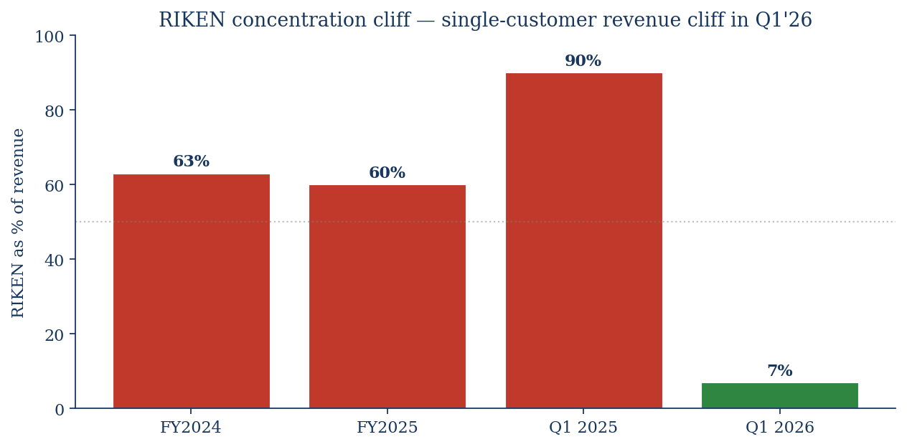
RIKEN concentration cliff — the underwritten risk
11
Single Japanese government customer was 60-90% of recent revenue; collapsed to 7% in Q1'26
What happened
• RIKEN bought a QNT on-prem system
• Lumpy hardware delivery revenue
• +ongoing maintenance/service
•
• Q1'26: install complete → 7% of rev
• Helios was supposed to fill the gap
• Helios commercial launch Nov 2025
• Launch customers ramping in 2H'26
•
• Risk:
• Q2/Q3 26 prints could show revenue
• decline YoY before Helios ramp
• Market may react harshly to first
• reported quarter as public co.
•
• Mitigant:
• Quantum Origin SaaS (recurring)
• Helios cloud + on-prem expanding
• $100M CHIPS LOI (govt)
Quantinuum (QNT) — Competitive Analysis | Jun 4, 2026
11

Slide 12
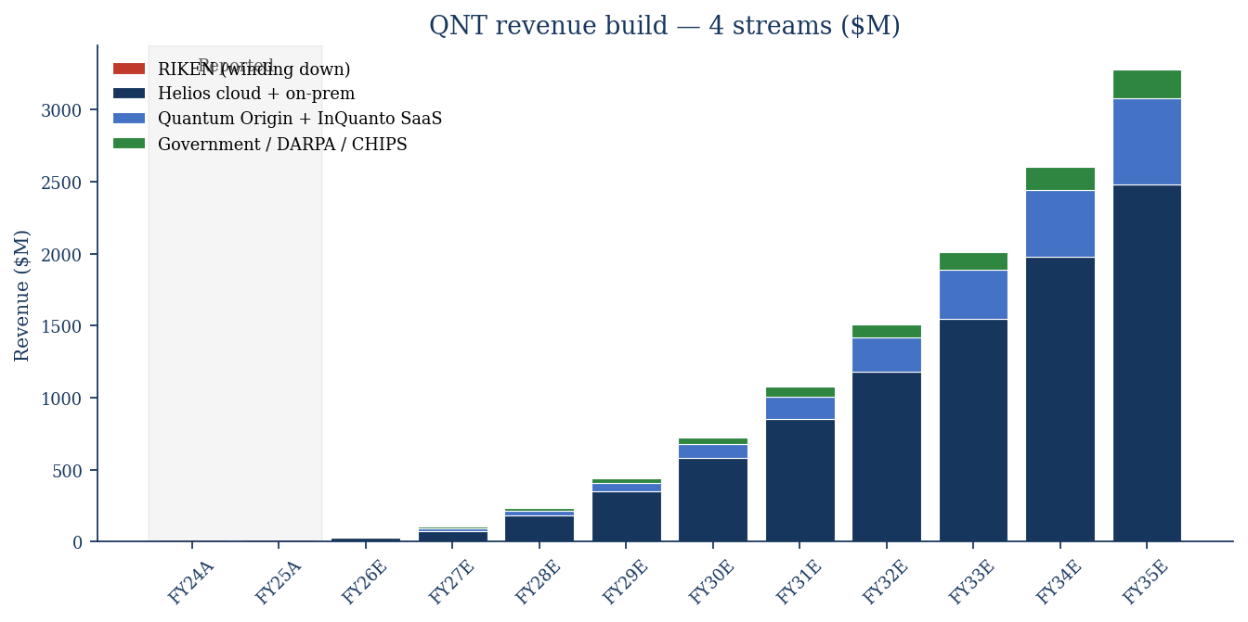
Revenue build — 4 streams, 10-year horizon
12
Helios cloud + on-prem becomes the primary growth engine; RIKEN runs off
Base case assumptions
• RIKEN: runs off to $0 by FY2030E
•
• Helios cloud + on-prem:
• $22M (FY26E) → $580M (FY30E)
• → $2,480M (FY35E)
• ~60% CAGR base case
•
• Quantum Origin + InQuanto SaaS:
• $8M (FY26E) → $600M (FY35E)
• Higher gross margin (~70%)
•
• Government / DARPA / CHIPS:
• $6M (FY26E) → $200M (FY35E)
• DARPA QBI Stage B + CHIPS LOI
•
• Total FY35E revenue: $3,280M
• Implied 2035 QC market share: ~6.6%
• (of $50B mid-case TAM)
Quantinuum (QNT) — Competitive Analysis | Jun 4, 2026
12

Slide 13
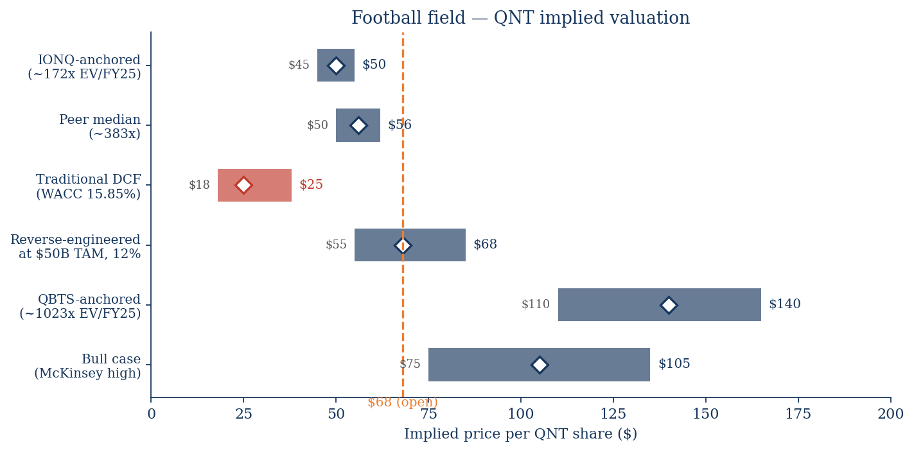
Football field — implied price ranges
13
Traditional DCF anchors low; QBTS-comp anchors high; current $68 sits in lower-mid
Method ranges
• Traditional DCF: $18-38
• honest intrinsic
• mid $25
•
• IONQ-anchored: $45-55
• applies IONQ ~172× FY25
•
• Peer median: $50-62
• median of 3 quantum peers
•
• Reverse-engineered: $55-85
• what $50B TAM + 12% share gets
•
• Bull case: $75-135
• McKinsey high + Apollo execution
•
• QBTS-anchored: $110-165
• applies QBTS ~1,023× FY25
• distorted by tiny denominator
•
• → $68 sits below peer median
• → but well above intrinsic DCF
Quantinuum (QNT) — Competitive Analysis | Jun 4, 2026
13

Slide 14
Dual DCF — traditional vs reverse-engineered
14
Both frameworks land in different places; the gap is the optionality premium
Traditional DCF (intrinsic)
Reverse-engineered (at $68 trading)
Line | Value
WACC | 15.85%
Terminal growth | 4.0%
Sum PV(FCF) FY26E-FY35E | $1,372M
Terminal value (Gordon) | $11,472M
PV of TV @ 15.85%, 9.5 yrs | $2,835M
Enterprise value | $4,207M
+ Cash post-IPO | $2,080M
- Debt | $0
Equity value | $6,287M
÷ Shares (M) | 253.9
Implied price ($) | $24.76
Current price | $68.00
Premium to intrinsic | +175%
Line | Value
Current price ($) | $68.00
× Shares (M) | 253.9
= Market cap | $17,265M
- Cash | $2,080M
= EV (today) | $15,185M
Mature multiple (FY35E) | 8.0× EV/Rev
Discount factor (9.5 yrs) | 4.16×
Implied FY35E revenue | $7,680M
Model FY35E revenue | $3,280M
Gap (implied / model) | +134%
Implied 2035 QC TAM share | 15.4% of $50B
Required 10-yr CAGR | ~75%
Quantinuum (QNT) — Competitive Analysis | Jun 4, 2026
14

Slide 15
Bull / base / bear scenarios
15
What needs to be true at each price level — for the next 12-18 months
 | Bull ($110+) | Base ($60-75) | Bear ($25-45)
FY30E revenue | $1.0B+ | $725M | $300-450M
FY35E revenue | $5.5B+ | $3.3B | $1.5-2.0B
2035 QC market share | ~11% | ~6.6% | ~3-4%
FCF crossover year | 2028 | 2029 | 2031+
Helios ramp | Beats Hololens-style launch | Hits launch-customer guidance | Slips by 6-12 months
Sol (2027) delivery | On time, 192 fully connected qubits | On time, mostly | Slips to 2028
Apollo (2029) FTQC | On time, demonstrated fault-tolerance | Slips ~6 months | Slips >12 months or partial
Competitor displacement | IONQ Tempo underperforms | No change | IONQ scales faster on AWS
Macro for pre-profit tech | Rate cuts; ERP compresses | Stable rates | Recession / risk-off
HON sells down | Orderly secondary, no overhang | Held flat through 2027 | Forced sale, overhang
Implied EV / FY25 | ~800x | ~490x (current) | ~200x
Quantinuum (QNT) — Competitive Analysis | Jun 4, 2026
15

Slide 16
Decision & Honeywell SOTP angle
16
QNT: HOLD with downside skew. HON: marginal positive, ~5% NAV contribution
QNT (NASDAQ) — decision matrix
HON (NYSE) — sum-of-parts angle
Price | Read | Action
$25-35 | Trades to intrinsic DCF | BUY
$35-50 | Below peer median; IONQ-comparable | BUY ↓
$50-65 | Peer-median footing | BUY ↓
$65-80 | CURRENT — full optionality priced | HOLD
$80-100 | Premium vs peers + DCF | TRIM
>$100 | Bull case priced in | SELL
Segment | 2025 rev | Multiple | EV
Aerospace Tech | $15.8B | 18× EBITDA | ~$80B
Industrial Auto | $9.2B | 15× EBITDA | ~$35B
Building Auto | $6.1B | 16× EBITDA | ~$22B
Energy & Sustain. | $7.4B | 12× EBITDA | ~$18B
QNT stake (~48%) | — | — | ~$7.5B
Net cash / other | — | — | $(15B)
Total EV | — | — | ~$147B
Implied HON share | — | — | ~$226
Current HON price | — | — | ~$213 [E]
Key catalysts (next 12 months)
• Q2'26 print (Aug 2026) — first as public co.
• RIKEN cliff visibility, Helios ramp narrative
• Sol roadmap update (timing TBC)
• Honeywell secondary offering (likely 6-12 mo)
• Lockup expiry creates supply overhang
• CHIPS Act $100M LOI conversion
• Hyperscaler distribution deal expansions
HON read
• QNT IPO adds ~$5/share to HON SOTP (~2.4%)
• Real upside if HON markets a clean SOTP story
• Industrial-conglomerate discount may compress
• Verdict for HON shareholders: modest positive
Quantinuum (QNT) — Competitive Analysis | Jun 4, 2026
16

