Slide 1
NASDAQ: AVGO — Investment Decision Frame
Broadcom Inc.
Competitive Landscape, Comps & DCF Valuation
As of June 3, 2026 (post-Q2 FY26 print)
Peer set: NVIDIA · AMD · Marvell · Qualcomm · Texas Instruments + Oracle (software anchor)
Built with deep-research + competitive-analysis + comps-analysis + 3-statement-model + dcf-model skills
Companion files: AVGO-Comps-Analysis.xlsx · AVGO-Model.xlsx (3-statement + DCF)

Slide 2
Q2 print confirms the franchise — but at ~$482, even after the move, the price still embeds bull AI
1. The franchise
AVGO is the #1 custom AI-silicon (XPU/ASIC) design house (~70% share) + leading AI networking (Tomahawk/Jericho). Q2 FY26: revenue $22.2B (+48%), AI revenue $10.8B (+143%), adj. EBITDA $15.2B (69%), FCF $10.3B (46% margin). Q3 guide $29.4B (+84%). $73B AI backlog; 6 committed hyperscaler customers.
2. The FCF engine
VMware turned Infrastructure Software into a ~$27B/yr, ~78%-operating-margin annuity. Consolidated TTM FCF ~$33B+ (~44% margin) after Q2's $10.3B print. Net debt down to ~$49B from a ~$74B post-VMware peak; dividend $0.65/qtr (+10%).
3. The valuation problem
Hock Tan REITERATED — did NOT raise — the FY27 'AI $100B+' guide despite the Q2 beat. Our base-case DCF (now haircut ~15% to $85B FY27 AI) yields ~$264/share. The ENTIRE WACC×g grid ($200–$311) sits below the ~$482 market price; bull corner ~$395.
4. The read
The Q2 beat closed some of the gap (stock +4.7% on the print) — but the structural finding holds: to justify $482 you still need the full mgmt FY27 AI delivered AND a low discount rate. High-quality compounder; no margin of safety. Long on pullbacks; pair vs MRVL; trim into strength.
Sources: AVGO Q2 FY26 IR (June 3, 2026); AVGO-Model.xlsx (base-case DCF); The Information (May 2026, OpenAI financing). Research, not investment advice.

Slide 3
The question this analysis answers
"Broadcom Q2 FY26 (June 3) printed +48% revenue, AI +143%, with Q3 guided +84% — but the stock is at ~$482 (~$2.3T, ~29x fwd). How much of the AI bull case is already in the price post-print, and what has to be true to justify owning it here?"
We test that across five lenses:
(1) Market — is the hyperscaler AI-capex cycle still supportive?
(2) Competitive — how durable is AVGO's custom-ASIC + networking position vs NVDA, AMD, MRVL?
(3) Financial (comps) — how does AVGO screen vs the semis cohort + ORCL software anchor?
(4) Intrinsic (DCF) — what is AVGO worth on a base case, and what does $460 imply?
(5) Decision — bull/base/bear and the cleanest way to express a view.
Framework per the `competitive-analysis` skill; valuation per `3-statement-model` + `dcf-model`.

Slide 4
Hyperscaler AI capex ~$630–725B in 2026, $1T+ by 2027 — mix shifting to custom silicon
Driver | Data point | Source / note
Big-4 capex 2025A | ~$388–410B (record) | MSFT, GOOGL, AMZN, META
Big-4 capex 2026E | ~$630–725B (+62–77%) | CNBC / Tom's Hardware (range)
Total compute capex 2026E | ~$1.04T (first trillion-$ yr) | incl. Oracle, neoclouds, sovereigns
AI accelerator TAM | ~$200B → $500B+ by late-decade | GPU + ASIC both growing
Custom ASIC growth 2026E | ~+45% units vs ~+16% GPU | ASIC units to surpass GPU by 2027 (Goldman)
AVGO + MRVL share of custom ASIC | ~95% of co-design market | Tom's Hardware / Dell'Oro
The catch
• Capex growing ~46% faster than revenue — wider than the 2001 telecom-bust divergence (Allianz).
• ~$400B/yr implied AI depreciation > Big-4's combined profits.
• Power is the binding constraint: Gartner sees ~40% of AI DCs power-limited by 2027.
• Bull case intact near-term; digestion risk into 2027–28 is the key macro swing factor for AVGO.
Sources: CNBC, Tom's Hardware, Goldman Sachs, Dell'Oro, Allianz, Gartner (2026). Figures are third-party estimates; ranges where sources diverge.

Slide 5
Two businesses under one roof: a ~60% AI-led semis engine and a ~40% software FCF annuity
Segment (Q1 FY26) | Revenue | Mix | Growth | Op margin | Role in thesis
Semiconductor Solutions | $12.5B | ~65% | +52% YoY | ~high | AI ASIC + networking = the growth
of which: AI semiconductors | $8.4B | ~44% of total | +106% YoY | — | The engine; Q2 guide $10.7B (+140%)
of which: non-AI semis | $4.1B | ~21% of total | ~flat | — | Cyclical; Apple Wi-Fi insourcing a headwind
Infrastructure Software | $6.8B | ~35% | +1% YoY | 78% | VMware annuity = the FCF / margin
Total | $19.3B | 100% | +29% YoY | 66% (non-GAAP) | Adj. EBITDA $13.1B (68%)
• The semis engine is what re-rates the stock — AI revenue +106% with a $73B backlog and 'line of sight to $100B+ AI in FY27'.
• The software annuity (78% operating margin, ~$27B/yr) is what de-risks it — recurring, high-margin cash funding debt paydown + buybacks.
• This bifurcation is why the comps need a software anchor (ORCL) alongside the semis cohort — neither lens alone captures AVGO.
• Caveat: AVGO reports ONE Semiconductor segment; the AI / non-AI split is per management commentary, partly estimated.
Source: Broadcom Q1 FY26 earnings release (Mar 2026). Op margins are segment-level; consolidated 66% is non-GAAP.

Slide 6
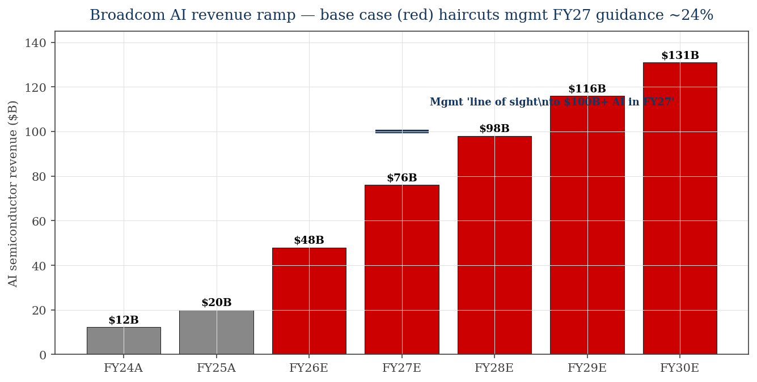
Broadcom profile — AI inflection with a fortress FCF profile and de-levering balance sheet
Metric | Value
Q1 FY26 revenue / Q2 actual | $19.3B (+29%) / $22.2B (+48%)
Q1+Q2 FY26 AI revenue | $8.4B + $10.8B = $19.2B (+143% Q2 YoY)
Q3 FY26 guide (total) | $29.4B (+84%) — beat consensus $28.5B
FY26 revenue consensus [E] | ~$103-105B (raised post-Q2)
Q2 adj. EBITDA / margin | $15.2B / 69%
TTM free cash flow [E] | ~$33B+ (~44% margin); Q2 alone $10.3B
Total debt / cash [E] | ~$65B / ~$16B
Net debt [E] | ~$49B
Market cap / EV [E] | ~$2.28T / ~$2.33T
P/E TTM / forward [E] | ~75x / ~29x
Dividend (FY26) | $0.65/qtr (~0.54% yield, +10%)
• AI revenue: $12.2B (FY24) → $20B (FY25) → base-case $48B/$76B (FY26/27E).
• Red bars = our base case; navy marker = mgmt's $100B+ FY27 line-of-sight we haircut ~24%.
Sources: AVGO Q1 FY26 8-K/IR; StockAnalysis.com (price, shares, debt ~June 1 2026); AVGO-Model.xlsx for projected AI revenue.

Slide 7
Merchant GPU vs custom ASIC — the structural share shift is the heart of the AVGO bull case
Dimension | Merchant GPU (NVDA, AMD) | Custom ASIC / XPU (AVGO, MRVL)
Who buys | All AI builders; flexible, CUDA ecosystem | Hyperscalers with scale to amortize design
2026E unit growth | ~+16% | ~+45% (nearly 3x)
Share of accelerators today | ~70% (NVDA) eroding at margin | ~15–25%, rising toward ~50% by 2027 (Goldman)
Economics | High merchant margin; NVDA ~75% GM | Lower unit margin, but sticky multi-gen design lock-in
AVGO position | n/a (not merchant) | ~70% of custom AI accelerator DESIGN market
• The bull case: as hyperscalers internalize inference on cost-optimized custom silicon, the ASIC pool grows ~3x faster than GPUs — and AVGO + MRVL own ~95% of that design market.
• The bear case: AVGO's AI revenue leans on a handful of programs (Google, Meta, ByteDance, OpenAI, Anthropic, Apple). Google adding MediaTek/Marvell as second sources dilutes per-program content; an OpenAI/program slip is a large hole.
• Networking is the under-appreciated leg: Tomahawk 6 (102.4 Tb/s) + Jericho4 position open-Ethernet against NVIDIA NVLink/Spectrum/InfiniBand — Ethernet has now passed InfiniBand in AI back-end share (Dell'Oro).
Sources: Goldman Sachs, Dell'Oro, Tom's Hardware, The Next Platform (2026). ASIC/GPU mix figures are estimates.

Slide 8
AVGO moat — custom-silicon switching costs + IP + a $73B backlog + VMware lock-in
Layer | Detail / KPI
Custom-silicon design lock-in | Multi-year co-design with hyperscalers; switching cost is a full chip re-spin. ~70% of custom ASIC design market.
AI backlog visibility | ~$73B AI backlog; 'line of sight to $100B+ AI revenue in FY27' across 6 committed customers
Confirmed anchor customers | Google (TPU/Ironwood), Meta (MTIA), ByteDance; + Anthropic (~$21B), OpenAI (~10GW), Apple ('Baltra')
AI networking franchise | Tomahawk 6 (102.4 Tb/s) + Tomahawk Ultra + Jericho4 — open Ethernet vs NVIDIA NVLink/InfiniBand
IP & SerDes leadership | Industry-leading 200G+ SerDes; deep analog/mixed-signal + optical (CPO) IP portfolio
VMware software annuity | ~$27B/yr, ~78% operating margin, recurring; deepens enterprise lock-in and funds capital return
Capital-return discipline | Hock Tan playbook: acquire, raise margins, pay down debt, grow dividend — ~$28.9B TTM FCF
Sources: Broadcom IR & earnings calls; CNBC (Anthropic, Dec 2025); company product releases (Tomahawk/Jericho). Some customer details reported/rumored.

Slide 9
Peer set — semis cohort for the ~60%, an infrastructure-software anchor for the ~40%
Closest competitor — custom silicon
• Marvell (MRVL) — #2 custom-ASIC house; Amazon Trainium, Microsoft Maia
• The cleanest read-through to AVGO's AI ASIC franchise
Merchant-GPU benchmarks
• NVIDIA (NVDA) — AI accelerator leader; the multiple everyone anchors to
• AMD (AMD) — #2 data-center GPU
Mature-semi capital-return refs
• Qualcomm (QCOM) — connectivity; value multiple, low AI-accelerator exposure
• Texas Instruments (TXN) — analog; dividend/quality reference
Software anchor (VMware ~40%)
• Oracle (ORCL) — large-cap infra software, now AI-capex-driven
• Frames the software segment (memo; excluded from semis stats)
Peer framing per `comps-analysis`. Statistics computed over the 5 semis peers; ORCL shown as a software-anchor memo (you don't median a software multiple into a semis set).

Slide 10
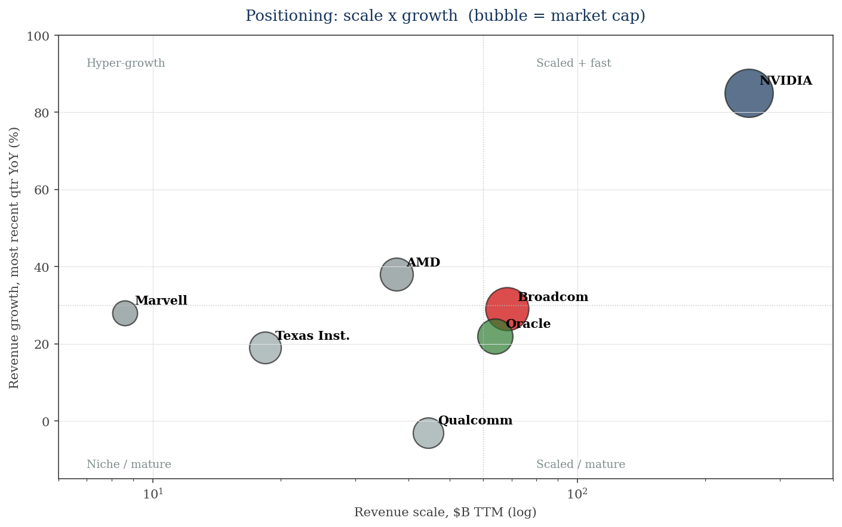
Positioning — NVDA is scaled-and-fast; AVGO is the scaled compounder; MRVL the high-beta proxy
What the matrix says
• NVIDIA: uniquely scaled AND +85% — the outlier; vast profitability justifies a 'low' P/E.
• AVGO: $68B revenue at +29%, with the highest-margin/FCF profile — a scaled compounder, not a hyper-grower.
• Marvell: small but +28% and re-rating — the high-beta way to play the same ASIC theme.
• QCOM/TXN: scaled but mature/cyclical, limited AI-accelerator exposure.
• Oracle: software anchor, +22% on AI-infra demand.
Bubble size = market cap. Growth = most recent reported quarter YoY. Source: companion AVGO-Comps-Analysis.xlsx.

Slide 11
Peer deep dive: NVIDIA — the benchmark; scaled, hyper-profitable, and (optically) not expensive
Metric | Value
Market cap | ~$5.46T
TTM revenue | ~$253.5B
MRQ revenue growth | +85% YoY (Q1 FY27)
Gross margin | 74.9%
TTM EBITDA / margin | ~$174.4B / ~69%
TTM net income | ~$159.6B
Net cash | net cash (debt $8.5B < cash)
P/E TTM / fwd | ~34x / ~26x
EV/EBITDA / EV/Rev | ~31x / ~21x
Category | Assessment
Business | Merchant AI GPU + networking (NVLink, Spectrum-X, InfiniBand); CUDA software moat.
Strengths | • ~70%+ accelerator share • Enormous profitability funds R&D lead • Full-stack (chip+system+software)
Weaknesses | • Custom ASIC share shift is the structural threat • Customer-concentration in a few hyperscalers • Geopolitical/export risk (China)
Read-through to AVGO | NVDA's 'low' P/E sets the ceiling the market pays for AI compute; AVGO trades RICHER on fwd P/E despite slower growth.
Sources: NVIDIA Q1 FY27 newsroom; Macrotrends; GuruFocus; valueinvesting.io (~June 2026).

Slide 12
Peer deep dives: AMD (#2 GPU) and Marvell (closest custom-silicon comp)
AMD (AMD)
Market cap | ~$839B
TTM revenue / growth | $37.5B / +38% YoY
Gross margin | ~53%
Net income (TTM) | ~$5.0B [E] (GAAP ramping)
P/E TTM / fwd | ~150–167x / ~33x
EV/Rev | ~22x
Read | #2 merchant GPU (MI-series); read on EV/Rev + forward, not GAAP TTM
Marvell (MRVL)
Market cap | ~$192B (+51% on NVDA endorsement)
TTM revenue / growth | ~$8.6B [E] / +28% YoY
Gross margin | 52.1% GAAP / 58.9% non-GAAP
Net income (TTM) | ~$0.3B GAAP [E] (amortization-depressed)
P/E TTM / fwd | NM-high / ~48x
Customers | Amazon Trainium/Inferentia, Microsoft Maia
Read | Closest AVGO ASIC comp; smaller, higher-beta, single net-debt name
Sources: AMD Q1 2026 8-K; Marvell Q1 FY27 IR; StockAnalysis.com; GuruFocus (~June 2026).

Slide 13
Peer context: Qualcomm & Texas Instruments — mature-semi valuation anchors
Qualcomm (QCOM)
Market cap / TTM rev | ~$215B / ~$44.5B
MRQ growth | ~-3% YoY (handset soft)
TTM EBITDA / margin | ~$14.0B / ~31%
P/E TTM / fwd | ~20x / ~14x (cheapest fwd)
Read | Value/mature; limited AI-accelerator exposure; sets the cheap end
Texas Instruments (TXN)
Market cap / TTM rev | ~$287B / ~$18.4B
MRQ growth | +19% YoY (industrial + DC)
TTM EBITDA / margin | ~$8.8B / ~48%
P/E TTM / fwd | ~50x / ~30x (trough earnings)
Read | Quality analog/dividend ref; multiples reflect capex-cycle trough
Both frame the mature-semi multiple band (fwd ~14–30x) — useful as the floor under AVGO's non-AI semis, but neither carries AVGO's AI growth.
Sources: Qualcomm Q2 FY26; TI Q1 2026; Macrotrends; GuruFocus (~May–June 2026). QCOM TTM NI excludes one-time tax benefit.

Slide 14
The software side: VMware (within AVGO) vs Oracle — the ~40% the semis comps miss
Dimension | AVGO Infrastructure Software (VMware) | Oracle (ORCL) — anchor
Revenue | ~$6.8B/qtr (~$27B/yr) | ~$64.1B TTM (+22% YoY)
Profitability | ~78% segment operating margin | ~48% EBITDA margin
Growth profile | ~+1% YoY (re-based post-acquisition; margin story) | +22% (OCI +84%) — AI-capex growth story
Balance sheet | Funded within AVGO; group de-levering | ~$96B net debt, rising (+$30B raised Feb 2026)
Multiple lens | Annuity / FCF — high-margin, low-growth | EV/Rev ~12x, EV/EBITDA ~18x (growth premium)
• ORCL is the best LARGE-CAP infra-software anchor, but it's an imperfect proxy: it's now an AI-datacenter capex story (high growth, ballooning debt), whereas VMware is a low-growth, ~78%-margin annuity.
• Net: VMware likely warrants a HIGHER-margin / LOWER-growth multiple than ORCL's blended profile — value it as an FCF annuity, not on ORCL's growth multiple.
• Practical takeaway for the comps: keep ORCL as a memo, not in the semis median — and treat AVGO's software EBITDA as the low-volatility ballast under the AI growth option.
Sources: Broadcom Q1 FY26 (software segment); Oracle Q3 FY26 (Mar 2026); Futurum; Macrotrends.

Slide 15
Comparative scoreboard — AVGO leads on margin/FCF; NVDA on growth; AVGO richest on fwd P/E
Dimension | AVGO | NVDA | AMD | MRVL | QCOM | TXN
Revenue scale (TTM) | ●●○ $68B | ●●● $254B | ●○○ $37B | ●○○ $9B | ●●○ $44B | ●○○ $18B
Revenue growth (MRQ) | ●●○ +29% | ●●● +85% | ●●○ +38% | ●●○ +28% | ●○○ -3% | ●○○ +19%
AI exposure | ●●● ASIC+net | ●●● GPU leader | ●●○ #2 GPU | ●●● ASIC #2 | ●○○ edge | ●○○ content
Margin / FCF quality | ●●● 68% EBITDA | ●●● 69% | ●○○ 22% | ●●○ ~31%[E] | ●●○ 31% | ●●● 48%
Balance sheet | ●●○ $52B net debt | ●●● net cash | ●●● net cash | ●●○ $1.4B nd | ●●○ $5.5B nd | ●●○ $8B nd
Valuation (fwd P/E) | ●○○ ~31x | ●●○ ~26x | ●○○ ~33x | ●○○ ~48x | ●●● ~14x | ●●○ ~30x
Customer concentration | ●○○ few hyperscalers | ●●○ broad | ●●○ broad | ●○○ few | ●●● diversified | ●●● diversified
● = stronger / ○ = weaker on each axis (higher fwd P/E = weaker value score). Calibrated to AVGO-Comps-Analysis.xlsx.

Slide 16
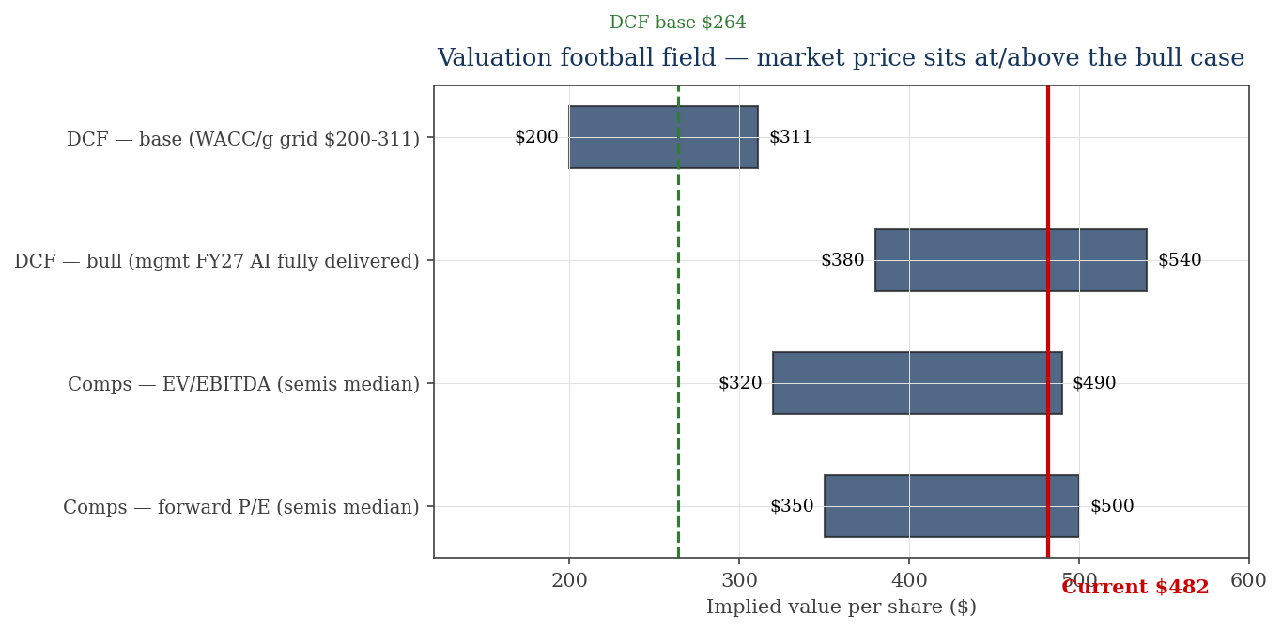
Valuation I — every method puts fair value at or below the $460 market price
How to read it
• DCF base ($264) and the full WACC×g grid ($200–311) sit well below $482.
• Comps (semis-median EV/EBITDA and fwd P/E applied to AVGO) imply ~$320–500 — AVGO trades at/above the cohort post-Q2.
• Only the DCF BULL case (mgmt's FY27 AI fully delivered) reaches the $482 zone.
• Conclusion: even after Q2 +48% & Q3 guide +84%, the market still prices the bull case as the base case.
Football field combines DCF (AVGO-Model.xlsx) and comps (AVGO-Comps-Analysis.xlsx). Ranges are illustrative of method spread.

Slide 17
Valuation II — base-case DCF $264/share; the entire WACC × growth grid is below $482
DCF bridge (base, post-Q2 refresh) | $M / $
PV of explicit FCF (FY26–30) | 269,084
PV of terminal value | 1,030,519
Enterprise value | 1,299,603
(–) Net debt | (49,000)
Equity value | 1,250,603
÷ Diluted shares (M) | 4,730
Implied value / share | $264.40
Current price | $481.62
Upside / (downside) | (45.1%)
Sensitivity — implied $/share (WACC × terminal g)
WACC ↓ / g → | 2.5% | 3.0% | 3.5% | 4.0% | 4.5%
8.5% | 275 | 296 | 323 | 355 | 395
9.0% | 252 | 270 | 291 | 317 | 348
9.5% (base) | 232 | 247 | 265 | 286 | 311
10.0% | 215 | 228 | 243 | 260 | 281
10.5% | 200 | 211 | 224 | 239 | 256
• Center cell ($265) = base case. Terminal value is ~79% of EV — valuation is very sensitive to WACC/g.
• Even the most generous corner (WACC 8.5% / g 4.5%) = $395 on base FCF.
• To reach $482 you ALSO need FCF above base — i.e., mgmt's full $100B+ FY27 AI delivered (the bull case).
Source: AVGO-Model.xlsx (validated, 0 formula errors). Base case haircuts mgmt FY27 AI guidance ~24% for execution / OpenAI-financing risk.

Slide 18
Strategic synthesis — Moat: design lock-in + IP + FCF · Risk: concentration + valuation
Moat type | AVGO | NVDA | MRVL | What it means
Switching costs | Strong | Strong | Mod | Custom-silicon re-spin + VMware lock-in are sticky
Intangibles (IP) | Strong | Strong | Mod | SerDes/optical/analog IP; CUDA is NVDA's equivalent
Scale economies | Strong | Strong | Weak | R&D + supply scale; AVGO + NVDA dominate spend
Network effects | Weak | Strong | Weak | NVDA's CUDA ecosystem is the real network effect
Cost / capital discipline | Strong | Mod | Mod | Hock Tan FCF + de-levering playbook is a differentiator
Net assessment
Durable advantages: (i) ~70% custom-ASIC design share with multi-gen lock-in, (ii) leading open-Ethernet AI networking, (iii) a ~$27B/yr ~78%-margin VMware annuity funding capital return.
Structural vulnerabilities: (i) AI revenue concentrated in a few hyperscaler programs (OpenAI financing snag is live), (ii) Google multi-sourcing dilutes content, (iii) valuation leaves no margin of safety — $460 already prices the bull AI ramp.
Moat framework per `competitive-analysis` Step 9. Strong / Moderate (Mod) / Weak relative to peers.

Slide 19
Bull / base / bear — anchored to the DCF: the market price embeds the bull case
Scenario | Prob. | Key drivers | DCF value / read
Bull | 30% | Mgmt's $100B+ FY27 AI delivered & sustained; OpenAI deal funded; networking share gains; WACC ~8.5%, g ~4.5% | ~$470–520 — justifies (and exceeds) the $460 price; this is what the market currently embeds
Base | 45% | AI FY27 ~$76B (mgmt guidance haircut ~24%); software annuity steady; WACC 9.5%, g 3.5% | ~$264 — high-quality compounder, but ~45% below the current price
Bear | 25% | AI digestion into 2027–28; OpenAI program stalls; Google multi-sourcing erodes content; WACC ~10.5%, g ~2.5% | ~$185–210 — multiple compresses as growth normalizes
Signposts that move the weighting
1) OpenAI $18B financing structure resolved or not 2) Q2/Q3 FY26 AI revenue vs the $10.7B→ramp guide 3) hyperscaler 2027 capex guidance (acceleration vs digestion) 4) any Google/Meta program re-sourcing
Probabilities are author's judgment, not consensus. DCF values from AVGO-Model.xlsx sensitivity + bull-FCF overlay.

Slide 20
Decision frame & sources
Four ways to express a view
Own quality, but wait for a pullback
Best-in-class franchise; no margin of safety at $460. Accumulate toward the base-case zone (high-$200s–low-$300s) or on AI-digestion scares.
Pair trade: long AVGO / short a richer AI name
Express the quality view while hedging the AI-multiple: long AVGO vs short a higher-beta/expensive AI name on relative valuation.
Play the theme via MRVL (higher beta)
Same custom-ASIC thesis with more torque (and more risk); smaller, re-rating, single net-debt name.
Trim / avoid here
If you believe 2027–28 AI digestion + OpenAI-financing risk, the price already discounts the bull case — trim into strength.
Sources & caveats
AVGO Q1 FY26 & FY23–25 SEC filings/IR; NVDA/AMD/MRVL/QCOM/TXN/ORCL latest 10-Q/IR; StockAnalysis/GuruFocus/Macrotrends (~June 2026); CNBC, The Information, Goldman, Dell'Oro, Allianz for AI-capex & customer detail.
MCP terminal connectors (CapIQ/FactSet) NOT configured — public sources used, [E] flags in workbooks. AI/non-AI segment split partly estimated. Research & decision-framing only — NOT investment advice; cross-check a primary terminal before acting.
Built per competitive-analysis + comps-analysis + 3-statement-model + dcf-model skills. Companions: AVGO-Comps-Analysis.xlsx, AVGO-Model.xlsx.

