Slide 1
NASDAQ: GOOG / GOOGL — Investment Decision Frame
Alphabet Inc.
Competitive Landscape, Comps & DCF Valuation
As of June 3, 2026
Mega-cap cohort: META · MSFT · AMZN · NFLX + TTD, RDDT (ads-pure memo)
Built with deep-research + competitive-analysis + comps-analysis + 3-statement-model + dcf-model skills
Companion: GOOG-Comps-Analysis.xlsx · GOOG-Model.xlsx

Slide 2
Cheap on fwd P/E (~24x), but $185B FY26 capex compresses FCF — DCF $213 vs $358
1. The franchise
Alphabet Q1 CY26: revenue $109.9B (+22%), Cloud $20B (+63%), Services $89.6B (+16%). Cloud op margin reaccelerated to 32.9% (from 17.8% YoY). Cloud backlog $460B (~2x QoQ). $4.35T market cap on ~$425B TTM revenue.
2. The capex shock
Capex ramps from $92B (FY25) to $180-190B (FY26 guide) — a ~$95B step. Q1 actual was $22.4B (back-end loaded). Combined with ~$85B June equity raise (incl. Berkshire private placement), this is a structural posture shift from self-funding capital return.
3. The DCF problem
Base case ($213/share, -40% vs $358) is heavy because Year-1 unlevered FCF compresses to ~$4B as capex outruns D&A; FCF normalizes to $200B+ by FY30. Even the bull corner (WACC 8.0% / g 4.0%) only reaches $334. The market is pricing aggressive Cloud margin + capex payback.
4. The read
GOOG screens cheap on fwd P/E (24x — cheapest mega-cap ex-META) but expensive on intrinsic given the capex cycle and equity raise. Patient long — wait for capex peak signal. DOJ remedies (no Chrome) is a relief; Apple TAC remains the live P&L risk.
Sources: Alphabet Q1 CY26 8-K/IR; GOOG-Model.xlsx (validated DCF); company press releases (June 2026 equity raise FWP). Research, not investment advice.

Slide 3
The question this analysis answers
"Alphabet has the best AI infrastructure franchise (TPU, Cloud +63%) and trades at the cheapest mega-cap forward P/E (~24x), but is committing ~$185B of FY26 capex and raising ~$85B of equity. What is the intrinsic value through the cycle, and is $358 a reasonable entry?"
We test that across five lenses:
(1) Market — Cloud demand, AI capex sustainability, ads resilience.
(2) Competitive — vs MSFT/Azure, AMZN/AWS, META on ads, AI infra winners.
(3) Financial (comps) — how cheap is GOOG vs the mega-cap median?
(4) Intrinsic (DCF) — what is fair value through the capex cycle?
(5) Decision — bull/base/bear and the cleanest expression.

Slide 4
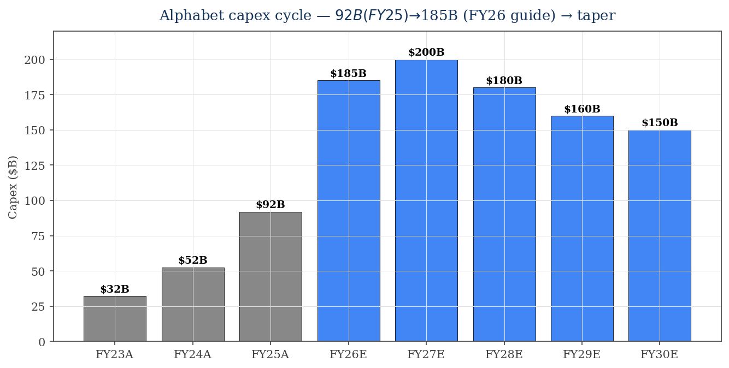
The defining number for FY26-27: capex doubles — funding via equity, not just cash
What this means
• FY25 capex ~$92B (already 6x 2022). FY26 guide $180-190B — a ~$95B step.
• Q1 CY26 only $22.4B — implies $50B+/qtr in H2 to hit the guide range.
• ~$85B June 2026 equity raise (Berkshire pp + ATM + common) funds this — first major issuance in years.
• My base assumes capex tapers from FY28 ($180B) to FY30 ($150B). Reasonable but a real risk if Cloud demand exceeds capacity.
• D&A lag means FCF crushed in FY26, normalizing by FY28.
Sources: Alphabet 10-Ks FY23-25; Q1 CY26 8-K; June 2026 FWP (Berkshire pp); CNBC.

Slide 5
Three businesses: Services (~$343B cash cow), Cloud (re-accel to +63%), Other Bets (Waymo)
Segment (FY25) | Revenue | YoY | Op income | Op margin | Q1 26 trend
Google Services | $342.7B | ~+12% | ~$154B (45%) | ~45% | +16% YoY
of which Search | ~$220B [E] | ~+13% | — | — | Resilient w/ AI Overviews
of which YouTube Ads | ~$36B [E] | +15-18% | — | — | Ad reaccel
Google Cloud | $58.7B | +36% | $13.9B | 24% | +63% rev / 32.9% margin
Other Bets | $1.5B | ~flat | ($7.5B) | (488%) | Waymo $16B raise @ $126B val
Total Alphabet | $402.8B | +15% | ~$129B | ~32% | Q1: $109.9B (+22%)
• Services is the cash engine (~45% op margin), and the AI Overviews integration is preserving Search query share.
• Cloud is the marginal growth story — margin expansion from 5% (FY23) to 24% (FY25) to 32.9% (Q1 26) is the leverage that justifies the capex.
• Other Bets is a long-dated option — Waymo $16B raise in Feb 2026 at ~$126B implied valuation marks the position.
• Anthropic + Broadcom 3.5GW TPU deal (April 2026) extends GOOG's third-party AI accelerator franchise — a Cloud-backlog anchor.
Sources: Alphabet 10-K FY25; Q1 CY26 8-K segment disclosures; February 2026 Waymo funding round (TSG / press); April 2026 Anthropic-Google-Broadcom announcement.

Slide 6
Alphabet profile — Q1 CY26 prints + balance-sheet restructuring underway
Metric | Value | Note
Q1 CY26 revenue | $109.9B (+22%) | Beat consensus; +19% cc
Cloud Q1 26 revenue / margin | $20.0B / 32.9% | Margin up from 17.8% YoY (huge)
Cloud backlog (Q1 26) | $460B | ~2x QoQ; ~50% recognized in 24 mo
Q1 CY26 net income / EPS | $62.6B / $5.11 | +81% YoY (incl. Anthropic gains)
Q1 capex / annual guide | $22.4B / $180-190B | Back-end loaded ramp
June 2026 equity raise (announced) | ~$84.75B | Berkshire pp + $40B ATM + $40B common
Net cash (Q1 26) | ~$80B | Cash+sec $126.8B – LT debt $46.5B (after Q1 $31B senior notes)
FY25 buybacks / div | $45.7B / ~$10B | Buybacks down from ~$62B FY24 as capex absorbs
Market cap / share | ~$4.35T / ~$358 | 12.12B diluted shares
P/E TTM / Fwd | ~32x / ~24x | Cheapest mega-cap fwd P/E ex-META
Sources: Alphabet Q1 CY26 8-K/IR; FWP for June 2026 equity raise; StockAnalysis market data.

Slide 7
Cloud + ads landscape — GOOG is the #3 cloud catching #2, and the AI infra premium is real
Dimension | Alphabet | Microsoft | Amazon
Cloud revenue Q1 26 | $20.0B (+63%) | Azure +40% (within IC $34.7B) | AWS $37.6B (+28%)
Cloud op margin | 32.9% (Q1 26) | 39.7% (IC segment) | 37.7% (AWS)
Cloud backlog | $460B | ~$298B (RPO; Q3 FY26) | ~$200B+ [E]
AI angle | TPU + Anthropic 3.5GW | OpenAI 27% stake + Azure | Bedrock + Anthropic $8B deal
FY26 capex | $180-190B | ~$190B (calendar) | ~$200B+ (Q1 alone $44B)
AI revenue run-rate | Cloud + Search AI surfaces | $37B AI ARR (+123%) | Bedrock + ads
• All three are racing to spend ~$200B+/yr on AI infra; the differentiator is monetization economics on each $ of capex.
• Google's TPU + Anthropic relationship is the cleanest case for owning the inference workload at lower unit cost than NVDA GPUs.
• Microsoft has the OpenAI moat (and a $228B implied stake). Amazon has scale + cash. Alphabet has cost (TPU) + breadth (Search + YouTube + Cloud).
Sources: MSFT Q3 FY26 IR; AMZN Q1 CY26 IR; Alphabet Q1 CY26 IR; SemiAnalysis (TPU v7 Ironwood).

Slide 8
Alphabet moat — Search distribution + TPU cost + YouTube data + Anthropic anchor + Waymo option
Layer | Detail
Search distribution | ~90% global query share; AI Overviews preserving query stream; Chrome 60%+ browser share — DOJ DID NOT order divestiture (Sept 2025 ruling)
TPU + Anthropic anchor | Ironwood TPU v7 shipping 2026; Anthropic 3.5GW commit (April 2026); ~1M TPU chips to Anthropic — third-party validation
YouTube + first-party data | ~2B+ users; richest video + interest graph; ad business +15-18%
Cloud backlog | $460B (~2x QoQ); RPO recognized over 24 mo provides revenue visibility
Waymo (option value) | $16B Feb 2026 raise at ~$126B implied valuation; Alphabet's majority owner
Cash + debt access | Pre-raise net cash ~$80B + investment-grade credit + capacity to raise (proven June 2026)
GDM / Gemini | Frontier AI model (Pro 1.5+); Search integration; consumer Gemini subs growing
Sources: Alphabet IR; DOJ remedies ruling (Sept 2025, Hughes Hubbard summary); Waymo funding round (Feb 2026); Anthropic-Broadcom-Google deal (April 2026).

Slide 9
Peer set — mega-cap cohort for the platform comparison; ads-pure for the Search/YouTube lens
Mega-cap cohort (main stat set)
• Meta (META) — cheapest fwd P/E (~18x); Reality Labs $4B/qtr drag
• Microsoft (MSFT) — Azure + OpenAI moat; ~$190B FY26 capex
• Amazon (AMZN) — AWS reaccel +28%; ads $70B+ TTM
• Netflix (NFLX) — streaming premium ~26x P/E
Ads-pure memo set (Search/YouTube reference)
• The Trade Desk (TTD) — programmatic; decelerating (+12%)
• Reddit (RDDT) — hyper-growth ad surface (+69%); data-licensing
Stats over the 4 mega-cap peers; TTD + RDDT are memo (you don't median them into a mega-cap set).

Slide 10
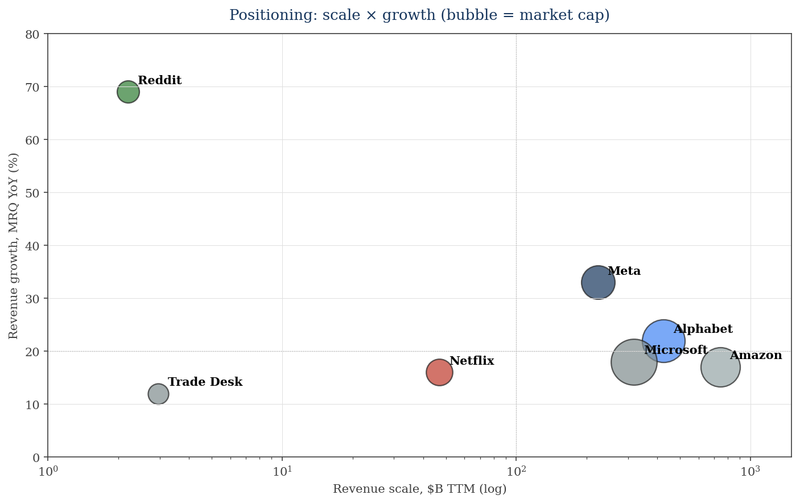
Positioning: META has the smallest scale + fastest growth; GOOG and AMZN cluster
What this says
• META is unusual: smaller revenue base (~$223B) but fastest growth (+33%); justifies its lower fwd P/E being a buying opportunity if the AI ads thesis works.
• MSFT and AMZN are the scale benchmarks (~$300-700B revenue) at +17-18% growth.
• GOOG sits between — $425B at +22% — a sweet spot on scale × growth.
• NFLX is a smaller premium streaming play; RDDT is the hyper-growth outlier (+69%).
Bubble = market cap. Source: GOOG-Comps-Analysis.xlsx.

Slide 11
Peer deep dive: Meta — cheapest mega-cap on fwd P/E (~18x); Reality Labs the structural drag
Metric | Value
Market cap | ~$1.55T
TTM revenue | ~$223B
Q1 26 growth | +33% YoY
Gross margin | ~82%
TTM EBITDA / margin | ~$110B / ~51%
TTM net income | ~$71B
P/E TTM / Fwd | ~22x / ~18x
EV/EBITDA / EV/Rev | ~12x / ~7x
Reality Labs (Q1 26) | Loss $4.03B on $402M rev (cumulative >$90B)
Category | Assessment
Business | Family of Apps (FB, IG, WhatsApp, Threads) + Reality Labs (Quest, Ray-Ban Meta, AR).
Strengths | • Cheapest mega-cap fwd P/E • Family of Apps op margin >40% • Llama open-source moat • 3.5B+ DAUs
Weaknesses | • RL drag persistent • Apple ATT exposure ongoing • Capex $125-145B FY26 (raised) — margin pressure
Read-through to GOOG | META multiple compression bounded GOOG's downside on ads; META's AI-spend mix more focused on inference (similar to GOOG's TPU bet)
Sources: Meta Q1 CY26 8-K; multiples.vc; StockAnalysis. RL: 10-Q.

Slide 12
Peer deep dives: Microsoft (the cloud benchmark) + Amazon (the FCF whale)
Microsoft (MSFT)
Market cap / TTM rev | ~$4.72T / ~$318B
Fiscal Q3 FY26 growth | +18% YoY
Azure growth / Intelligent Cloud margin | +40% / 39.7%
AI ARR / Copilot seats | $37B (+123%) / >20M
P/E TTM / Fwd | ~26x / ~23x
OpenAI stake | ~27% at ~$228B (vs $13B invested = ~17x MoIC)
FY26 capex | ~$190B (calendar)
Read | The benchmark for cloud + AI. Owns the OpenAI relationship economics.
Amazon (AMZN)
Market cap / TTM rev | ~$2.7T / ~$743B
AWS Q1 26 | $37.6B (+28%) — fastest in 15Q; $14.2B op income (37.7%)
NA retail / Intl op margin | 9.0% / 3.6%
Ads Q1 26 / TTM | $17.2B (+24%) / $70B+
P/E TTM / Fwd | ~30x / ~28x
FY25 net debt | ~$66B (incl. lease)
Q1 capex | $44B (annualized ~$175B+)
Read | AWS reaccel is the standout; retail margin lifting. Highest fwd P/E in the cohort.
Sources: MSFT Q3 FY26 IR; AMZN Q1 CY26 IR; Bloomberg (OpenAI stake May 2026).

Slide 13
Comparative scoreboard — GOOG leads on Cloud growth + multiple value; trails on near-term FCF
Dimension | GOOG | META | MSFT | AMZN | NFLX
Revenue scale | ●●○ $425B | ●○○ $223B | ●●○ $318B | ●●● $743B | ●○○ $47B
Growth (MRQ) | ●●○ +22% | ●●● +33% | ●○○ +18% | ●○○ +17% | ●○○ +16%
Cloud growth | ●●● +63% | ○○○ n/a | ●●○ Azure +40% | ●●○ AWS +28% | ○○○ n/a
AI infra moat | ●●● TPU + Anthropic | ●●○ Llama | ●●● OpenAI 27% | ●●○ Bedrock | ○○○ limited
FCF margin | ●○○ compressed FY26 | ●●○ ~25% | ●●○ ~32% | ●●○ ~10% | ●●● ~25%
Balance sheet | ●●● net cash $80B | ●●● net cash $40B | ●●○ slight cash | ●○○ net debt $66B | ●○○ net debt $4B
Value (fwd P/E) | ●●○ ~24x | ●●● ~18x | ●●○ ~23x | ●○○ ~30x | ●○○ ~26x
● = stronger; ○ = weaker. Higher fwd P/E = weaker value score. Source: GOOG-Comps-Analysis.xlsx.

Slide 14
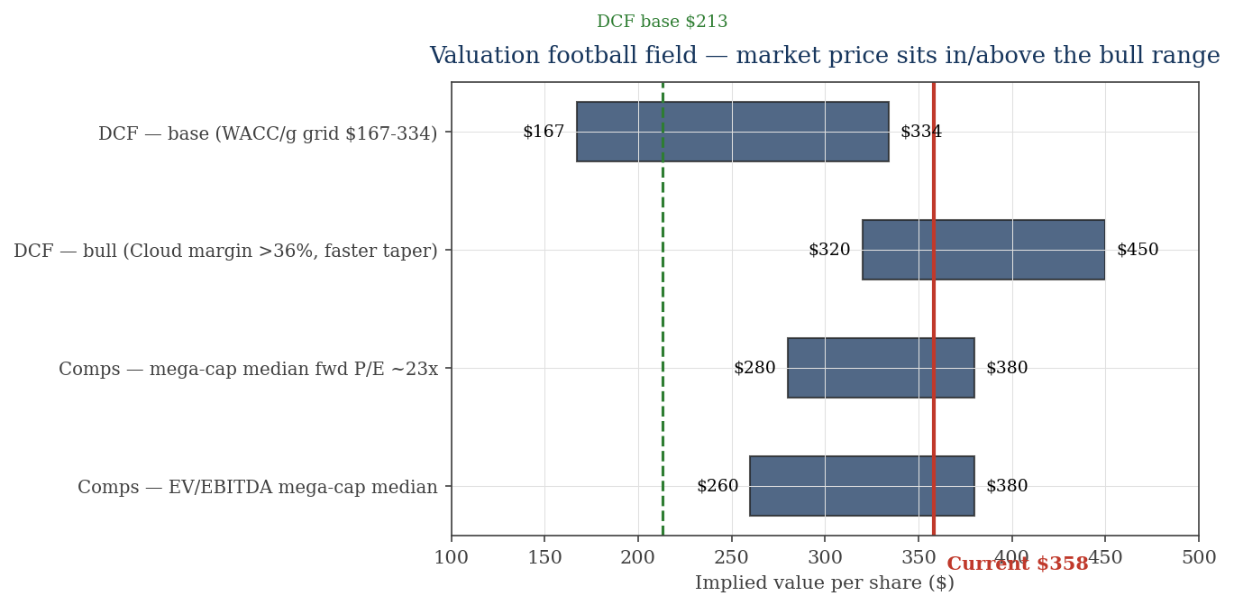
Valuation I — DCF $213 vs $358; comps $260-380; only the bull case touches the price
What this shows
• DCF base ($213) sits well below $358; full grid $167-334.
• Bull DCF (Cloud margin >36%, faster capex taper) reaches ~$320-450 — overlaps the current price.
• Comps (mega-cap median fwd P/E ~23x × FY27 EPS ~$13) imply ~$300-380.
• Conclusion: $358 is priced for the bull capex-payback case.
Source: GOOG-Model.xlsx (DCF); GOOG-Comps-Analysis.xlsx (multiples).

Slide 15
Valuation II — base DCF $213; sensitivity grid $167-334; only bull WACC/g exceeds price
DCF bridge (base) | $M / $
PV of explicit FCF (FY26-30) | 343,877
PV of terminal value | 2,162,879
Enterprise value | 2,506,757
(+) Net cash | 80,300
Equity value | 2,587,057
÷ Diluted shares (M) | 12,120
Implied value / share | $213.45
Current price | $357.73
Upside / (downside) | (40.3%)
Sensitivity — implied $/share (WACC × g)
WACC ↓ / g → | 2.0% | 2.5% | 3.0% | 3.5% | 4.0%
8.0% | 231 | 250 | 272 | 300 | 334
8.5% | 211 | 227 | 245 | 267 | 294
9.0% (base) | 195 | 208 | 223 | 241 | 263
9.5% | 180 | 191 | 204 | 219 | 237
10.0% | 167 | 177 | 188 | 201 | 215
• TV is ~86% of EV — extremely WACC/g-sensitive (Cloud growth + capex cycle).
• FY26 unlevered FCF compresses to ~$4B as capex outruns D&A; normalizes to $200B+ by FY30.
• Bull (Cloud margin >36%, faster taper) overlays cleanly with ~$320-450 range.
Source: GOOG-Model.xlsx (validated, 0 formula errors, 267 formulas).

Slide 16
Bull / base / bear — anchored to Cloud margin trajectory and capex efficiency
Scenario | Prob. | Key drivers | DCF value
Bull | 30% | Cloud margin >36% by FY28; capex tapers FY27; Waymo achieves commercial monetization; DOJ remedies have no economic impact | ~$320-450 — overlaps the current $358 price
Base | 45% | Cloud margin 30%→36% by FY30; capex stays elevated through FY28; Apple TAC modestly impaired; equity raise dilutive but not repeated | ~$213 (~40% below)
Bear | 25% | Cloud margin plateaus at 32%; capex stays at $200B+ as Anthropic + sovereign deals demand more; Apple TAC eliminated; DOJ remedies bite Search | ~$167-188 (~50% below)
Signposts that move the weighting
1) Q2/Q3 CY26 capex run-rate vs the $180-190B guide 2) Cloud op margin trajectory 3) DOJ appeals / Apple default-payment economics 4) Waymo IPO / direct monetization
Probabilities are author's judgment. Bull DCF requires both capex and margin assumptions to swing favorably.

Slide 17
Decision frame & sources
Four ways to express a view
Patient long — wait for the capex peak signal
Best franchise of the mega-caps but at $358 you're paying for successful payback. Buy on Q2/Q3 capex disappointments or any Cloud growth deceleration scare.
Relative-value pair: long GOOG / short AMZN
Same AI infra exposure; GOOG cheaper on fwd P/E (24x vs 30x) with stronger Cloud growth (+63% vs +28%); cleaner geopolitical / antitrust profile post-Sept 2025 ruling.
Theme play: long META (highest growth, cheapest P/E)
If you want mega-cap AI capex theme with most multiple expansion potential, META at ~18x fwd P/E + 33% growth is the best risk-reward.
Trim / avoid here
If you believe capex doesn't pay back fast enough OR DOJ remedies bite, current price already discounts the bull case.
Sources & caveats
Alphabet Q1 CY26 8-K/IR; FY23-25 10-Ks; June 2026 equity raise FWP (Berkshire pp); peer 10-Q/IR; CNBC/Bloomberg/Reuters for DOJ + Waymo + Anthropic deal.
MCP terminals NOT configured. [E] flags in workbooks. Other Bets revenue is residual. Research only — NOT investment advice.
Built per: deep-research + competitive-analysis + comps-analysis + 3-statement-model + dcf-model. Companions: GOOG-Model.xlsx, GOOG-Comps-Analysis.xlsx.

Slide 18
Primary sources & data-gap caveats
Primary sources
• Alphabet Q1 CY26 8-K & 10-Q (Apr 2026); FY25 10-K (Feb 2026); FY24 10-K; FY23 10-K
• Alphabet FWP filings (June 2026 equity raise — Berkshire Hathaway private placement, ATM, common)
• DOJ v. Google search remedies ruling (Sept 2025); appeals (Jan 2026 GOOG, DOJ cross-appeal)
• Anthropic-Google-Broadcom 3.5GW TPU expansion (April 2026); SemiAnalysis on Ironwood TPU v7
• Waymo $16B funding round (Feb 2026) at ~$126B implied valuation (TSG, press)
• Peer 10-Qs / IR releases: META Q1 26, MSFT Q3 FY26, AMZN Q1 26, NFLX Q1 26, TTD Q1 26, RDDT Q1 26
• Market data: StockAnalysis, companiesmarketcap, GuruFocus, Macrotrends, FinanceCharts (~June 1-3, 2026)
Caveats
• MCP terminal connectors (CapIQ/FactSet/Daloopa) NOT configured — public sources used and [E]-flagged in workbooks.
• GOOG TTM NI inflated by Anthropic-related fair-value gains; conservative GAAP basis used in model.
• DCF assumes capex peaks FY27 and tapers; if Anthropic/sovereign deals demand more, FCF normalization delayed.
• Other Bets revenue (~$1.5B) is largely Waymo; not broken out separately.
• This is research / decision-framing only — NOT investment advice.
Built per competitive-analysis + comps-analysis + 3-statement-model + dcf-model + audit-xls + ib-check-deck skills.

