Slide 1
NYSE: WMT — Investment Decision Frame
Walmart Inc.
Competitive Landscape & Investment Read
As of May 2026
Peer set: Costco · Target · Amazon · Kroger · BJ's Wholesale
Built using `competitive-analysis` + `comps-analysis` skills (financial-services repo)
Companion workbook: WMT-Comps-Analysis.xlsx

Slide 2
Scale + omnichannel flywheel + ad/marketplace mix = a re-rating story, not a retail story
1. The setup
Walmart is the largest retailer on earth (~$685B TTM revenue) and the only grocery-anchored peer compounding ad + marketplace + membership revenue at 20–30% annual growth — three tiers structurally higher-margin than core retail.
2. The flywheel
Stores + supply chain → low-cost grocery → traffic → high-margin ad inventory (Walmart Connect ~$5B run-rate) → marketplace 3P GMV → Walmart+ subscription. Each tier funds the next; none of WMT's pure-play peers (COST, KR, BJ, TGT) replicate the full stack.
3. The risk
Stock at ~$95 (~$765B market cap, ~26x TTM EPS) is no longer 'cheap defensive.' Re-rating depends on continued ad/marketplace growth, consumer holding up through a soft-landing year, and Amazon not pressing harder into grocery.
4. The read
Long thesis intact for the margin-mix re-rating; key Q is duration. Pair against COST (premium peer) for relative-value framing. Avoid if you believe US consumer downtrades meaningfully in 2H 2026.
Sources: WMT Q1 FY26 10-Q and IR commentary (May 2026); StockAnalysis.com; companion .xlsx Notes tab for full source list.

Slide 3
The question this analysis answers
"Is Walmart's ad/marketplace/membership margin mix worth a premium re-rating from the 18-20x P/E of legacy mass-merch — and is the current ~26x TTM P/E a reasonable entry on that thesis?"
We test that question across five lenses:
(1) Market — is the US retail / e-com / retail-media environment supportive?
(2) Competitive — does WMT have a defensible position vs warehouse clubs, mass merch, and AMZN?
(3) Financial — what does the valuation look like vs peer comps (COST, TGT, AMZN, KR, BJ)?
(4) Strategic — what's the moat and how durable is it?
(5) Decision — what's the cleanest expression of conviction (or wait)?
Framework adapted from the `competitive-analysis` skill (financial-services/plugins/vertical-plugins/financial-analysis).

Slide 4
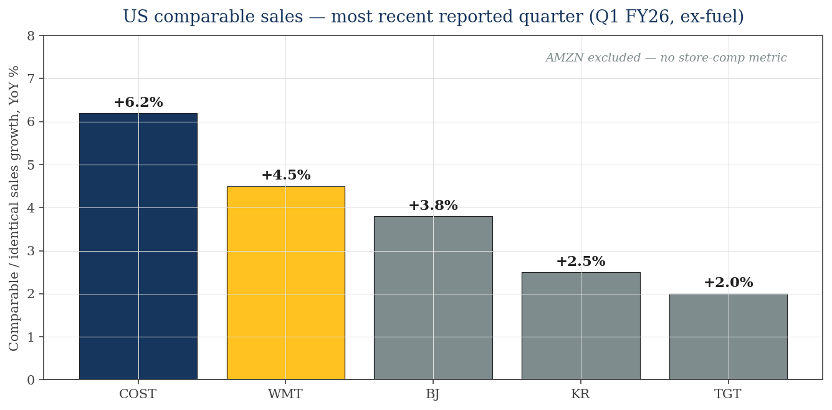
US retail $5T+; grocery share gains, e-com inflecting, retail-media the high-margin tier expanding fastest
What the chart says
• Warehouse clubs (COST, BJ) lead on comp-sales growth — membership pricing power + value-trade-down winners.
• WMT US comp +4.5% — above-trend mass-merch; outpaces TGT 2x.
• KR shows grocery still positive but slow; TGT lagging.
• AMZN omitted — no comparable-store metric, but online retail growing ~10% YoY.
• US retail-media ad spend ~$60B in 2025; growing ~20% YoY (eMarketer, IAB).
Comp sales: each issuer's Q1 FY26 IR releases; ex-fuel/gas. US retail-media TAM: eMarketer / IAB (2025).

Slide 5
Retail value chain — grocery thin, general merch better; ads + 3P marketplace + membership are the margin pools
Grocery / Food
Consumables
General Merch
Apparel / Home
3P Marketplace
Ads + Mbrshp
Typical EBIT margin:
2–4%
5–8%
10–15%
15–25%
25–40%
60–80%
WMT presence:
#1 US
#1 US
Top-2
Mid-tier
Building $50B+ GMV
Connect $5B+ run-rate
What this means for investors
• Grocery anchors the traffic but contributes little to margin. The story-shaping tier is the right two-thirds: ads + 3P marketplace + membership.
• Walmart Connect (ads) is reportedly running at >40% EBIT margin — at $5B run-rate, that's ~$2B of incremental EBIT growing 30%+ YoY.
• Amazon proved this template: AMZN's advertising services line has compounded to ~$60B TTM — that's the WMT bull case directionally.
• Costco does NOT play in ads (intentionally, to protect member trust) — the margin lever WMT has, COST does not.
• Kroger's Precision Marketing is the only direct peer comp for retail-media inside grocery; ~$1.5B annualized vs WMT Connect ~$5B.
Margin ranges: industry sources (NRF, Bain, JP Morgan retail primers). WMT/Connect figures: WMT mgmt commentary, Q4 FY25 and Q1 FY26.

Slide 6
Walmart profile — Q1 FY26: revenue +6%, ad+marketplace tiers compounding 20–30%, EBIT margin +25 bps
Metric | Value | YoY change | Source / note
Q1 FY26 revenue | ~$165B | +6% | WMT Q1 FY26 IR release (May 2026)
Walmart US comp sales (ex-fuel) | +4.5% | n/a | Sustained above-trend mass-merch comps
WMT US e-commerce | ~$110B run-rate | +20%+ YoY | Mgmt commentary; ~18% of US revenue mix
Walmart Connect (ad revenue) | ~$5B run-rate | +30%+ YoY | Mgmt commentary; not separately disclosed line
Marketplace 3P GMV | ~$50B+ | +30%+ YoY | Mgmt commentary; mix of US + India (Flipkart)
Membership revenue (Sam's + Walmart+) | ~$3B | Sam's +9% | Sam's $2B + Walmart+ ~$1B estimate
TTM revenue | ~$685B | n/a | FY25 $681B + Q1 FY26 +6%
TTM EBITDA / Margin | ~$45B / ~6.6% | n/a | EBIT $30B + D&A ~$15B
Market cap | ~$765B | n/a | WMT ~$95/share × ~8.05B shares, May 2026
P/E (TTM) | ~26x | n/a | vs 5-yr avg ~22x; premium reflects mix-shift narrative
Walmart Q1 FY26 release (May 2026); WMT 10-K FY25 (Mar 2026); StockAnalysis.com market data.

Slide 7
WMT moat — supply-chain density + EDLP + Connect ad business form three reinforcing layers
Layer | Description / KPI
Supply-chain scale | ~4,600 US stores + ~150 distribution centers; ~90% of US population within 10 miles of a Walmart store
EDLP price gap | WMT averages ~10–15% price gap below TGT/KR on grocery basket (per third-party tracking)
Walmart+ subscription | Sub base ~$1B revenue tier; bundles grocery delivery, Paramount+, fuel discount — embeds household behavior
Marketplace 3P | ~150K active sellers; international ramp via Flipkart (India) and Mexico
Walmart Connect (ads) | ~$5B run-rate ad business; ~40%+ EBIT margin per mgmt; growing 30%+ YoY
Data + media network | ~250M weekly customers → highest-quality first-party shopper-graph in US (vs AMZN's general e-com graph)
DC + automation capex | $15–17B annual capex modernizing DCs, automation, freight — extends per-unit cost gap vs sub-scale grocers
Geographic scale | Walmart International ~$120B revenue; Mexico (Walmex), India (PhonePe + Flipkart), China; supply leverage vs US-only peers
Sources: WMT 10-K FY25; mgmt commentary at Q4 FY25 / Q1 FY26 calls; third-party price tracking (Bain, KeyBanc).

Slide 8
Peer set — four strategic groups, three of which WMT competes in directly
Tier 1 — Warehouse club premium
• Costco (Nasdaq: COST) — premium-priced peer, membership economics
• BJ's Wholesale (NYSE: BJ) — smaller-scale COST follower
Tier 2 — Mass-merch / general
• Walmart (NYSE: WMT) — scale leader, omnichannel + ad mix-shift
• Target (NYSE: TGT) — cheap-chic, smaller scale, lagging comps
Tier 3 — Marketplace / digital
• Amazon (Nasdaq: AMZN) — marketplace + ads + AWS — partial retail comp
• (Shopify, eBay — out of scope for WMT direct competition)
Tier 4 — Pure-play grocery
• Kroger (NYSE: KR) — largest US pure-play grocer
• (Albertsons, Sprouts, etc. — smaller pure-plays, excluded for tractability)
Peer set per `comps-analysis` 4–6 rule. Excluded: dollar stores (DG, DLTR — different customer cohort), specialty (no overlap with WMT mix).

Slide 9
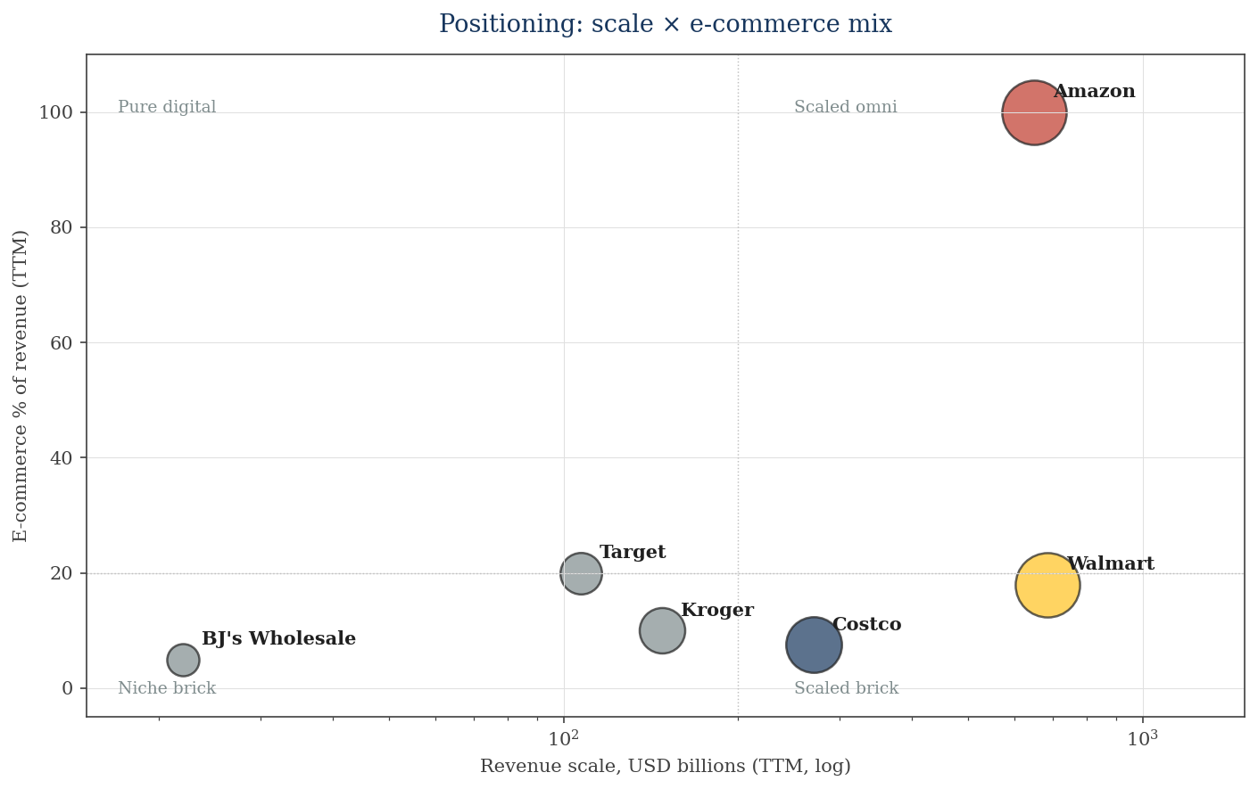
Scale × E-commerce mix: WMT and AMZN alone occupy upper-right; COST commands a premium at lower mix
What the matrix says
• AMZN sits at the extreme — 100% e-com mix, $650B revenue. Pure-digital, AWS-distorted multiples.
• WMT is the only scaled (>$500B) omnichannel player — ~18% e-com mix and rising, with stores as fulfillment nodes.
• COST sits notably below at ~7.5% e-com — but commands a 40%+ P/E premium on membership economics alone.
• TGT has higher e-com mix (~20%) than WMT but a tenth of the scale — disadvantaged on supply-chain unit economics.
• KR and BJ are sub-scale on both axes.
E-com mix per most-recent IR disclosure or [E] estimate; bubble size reflects market cap.

Slide 10
Peer deep dive: Costco — Membership-first peer commanding ~40% P/E premium to WMT
Metric | Value
Market cap | ~$420B
TTM revenue | ~$270B
Q3 FY26 comp sales (ex-gas/FX) | +6.2%
Gross margin | ~12.5%
EBITDA / Margin | ~$13B / ~4.8%
Net income (TTM) | ~$8B
P/E (TTM) | ~50x (vs WMT ~26x)
EV / EBITDA | ~32x (vs WMT ~17x)
Membership fees (TTM) | ~$5B
Renewal rate | ~92–93% US/Canada
E-com mix | ~7.5%
Category | Assessment
Business | Warehouse club; ~$5B annual membership fees fund ultra-low merchandise gross margin. Stores carry ~3,800 SKUs vs WMT ~120K.
Strengths | • Membership renewal ~92%+ creates recurring-revenue dynamic • Pricing power: dues raised 2024 first time in 7 yrs • Negative net debt; no leverage risk • Executive-membership tier acts as ARPU lever
Weaknesses | • Limited assortment vs WMT • No ad / retail-media business by design (protects member trust) • High dependence on US/Canada; intl expansion slow • Premium valuation provides little error margin
Strategy | Volume growth via new warehouses (+25/yr), gradual membership-fee step-ups, slow international ramp. Avoids the ad lane.
Costco FY25 10-K; Q3 FY26 monthly sales releases; StockAnalysis.com.

Slide 11
Peer deep dives: Target, Kroger, BJ — mid-tier scale, narrower moats, varying ad-mix progress
Target (TGT)
Business | Mass-merch with cheap-chic positioning; ~1,950 US stores
TTM revenue / NI | ~$107B / ~$4.2B
Comp sales Q1 FY26 | +2% (recovering from FY25 declines)
Roundel (ads) | ~$2B run-rate ad business; growing >25%
E-com mix | ~20% — proportionally above WMT
Read | Cheap multiple, real recovery in progress, but no scale moat vs WMT
Kroger (KR)
Business | Largest US pure-play grocer; ~2,700 stores
TTM revenue / NI | ~$148B / ~$2.5B
Comp sales Q1 FY26 (ex-fuel) | +2.5%
KPM (ads) | ~$1.5B run-rate ad business
E-com mix | ~10% (grocery e-com still small)
Read | Defensive; thin EBITDA margin caps multiple; Albertsons merger blocked Dec 2024
BJ's Wholesale (BJ)
Business | Warehouse club; ~245 clubs, NE/Mid-Atlantic
TTM revenue / NI | ~$22B / ~$0.55B
Comp sales Q1 FY26 (ex-gas) | +3.8%
Membership | ~$470M membership-fee revenue
E-com mix | ~5%
Read | Smaller-scale COST follower; valuation discount until renewal-rate parity
TGT/KR/BJ Q1 FY26 IR releases; StockAnalysis.com market data.

Slide 12
Peer context: Amazon — Comparability caveat (AWS distorts every multiple)
Metric | Value
Market cap | ~$2.2T
TTM consolidated revenue | ~$650B
TTM EBITDA / margin | ~$160B / ~25%
TTM net income | ~$65B
TTM advertising services revenue | ~$60B (+ 20%+ YoY)
TTM AWS revenue | ~$110B
P/E (TTM) | ~33x (vs WMT ~26x)
EV / EBITDA | ~14x (lower than WMT — AWS lifts EBITDA denominator)
E-com mix (of consolidated) | 100% (excl. AWS, ~83%)
Why this matters for WMT
• AMZN's $60B ad revenue and ~25% consolidated EBITDA margin are the WMT bull-case template directionally.
• But: AWS is ~70% of consolidated EBIT — strip it out and AMZN retail margin is ~3–4%, BELOW WMT.
• AMZN is squeezing WMT specifically on grocery (Whole Foods + Amazon Fresh + same-day Prime grocery in major metros).
• Counter: WMT US grocery is 4–5x the size of AMZN grocery; logistics-density advantage remains.
• Pair-trade idea: long WMT / short AMZN expresses confidence in stores-as-fulfillment + slowing AWS growth.
AMZN Q1 FY26 earnings; segment reporting; StockAnalysis.com.

Slide 13
Comparative scoreboard — WMT leads scale & ad-revenue trajectory; lags margin vs COST
Dimension | WMT | COST | TGT | AMZN | KR | BJ
Revenue scale (TTM) | ●●● $685B | ●●○ $270B | ●○○ $107B | ●●● $650B | ●●○ $148B | ●○○ $22B
Comp sales growth | ●●○ +4.5% | ●●● +6.2% | ●○○ +2.0% | ○○○ n/a | ●○○ +2.5% | ●●○ +3.8%
EBITDA margin | ●●○ ~6.6% | ●●○ ~4.8% | ●●○ ~9.3% | ●●● ~25% | ●○○ ~4.7% | ●○○ ~5.0%
Ad / retail-media | ●●● $5B+ Connect | ○○○ Not played | ●●○ $2B Roundel | ●●● $60B Ads | ●●○ $1.5B KPM | ○○○ Minimal
Membership / loyalty | ●●○ Walmart+ + Sam's | ●●● ~$5B fees, 92%+ renewal | ●○○ Circle 360 new | ●●● Prime + subs | ○○○ Boost free-tier | ●●○ $470M fees
Capital intensity (LT debt) | ●●○ Moderate | ●●● Net cash | ●●○ Moderate | ●●○ Moderate | ●○○ Elevated | ●●○ Moderate
Valuation premium absorbed | ●●○ ~26x P/E | ●○○ ~50x P/E | ●●● ~17x P/E | ●●○ ~33x P/E | ●●● ~20x P/E | ●●○ ~27x P/E
● = Strong ○ = Weak. Subjective ratings calibrated to data in companion .xlsx Operating Metrics / Valuation / Retail-Specific tabs.

Slide 14
Strategic synthesis — Moat: scale + data + logistics · Risk: consumer rollover + AMZN grocery
Moat type | WMT | COST | TGT | AMZN | KR | What it means
Network effects | Mod | Weak | Weak | Strong | Weak | WMT marketplace 3P building; AMZN dominant in 3P; COST not a platform
Switching costs | Mod | Strong | Weak | Strong | Weak | Membership creates highest switching cost; WMT+ is the lever
Scale economies | Strong | Mod | Weak | Strong | Weak | WMT's per-unit logistics cost is structurally below TGT/KR/BJ
Intangibles (data) | Strong | Mod | Mod | Strong | Mod | First-party shopper data quality is the input to ad-business growth
Brand / EDLP | Strong | Strong | Mod | Mod | Mod | WMT and COST have the strongest 'value' brand equity
Net moat assessment
WMT's durable advantages: (i) only scaled omnichannel player with grocery anchor, (ii) ad+marketplace+membership all compounding 20–30%, (iii) supply-chain density unmatched ex-AMZN.
WMT's structural vulnerabilities: (i) consumer downtrade risk, (ii) AMZN pressing on grocery, (iii) Walmart+ subscriber growth opaque, (iv) capex intensity (~$17B/yr) crowds free cash flow.
Moat framework per `competitive-analysis` skill Step 9. Ratings: Strong / Moderate (Mod) / Weak — calibrated against peer comparison.

Slide 15
Range of outcomes anchored by ad-revenue compounding (upside) and consumer downtrade (downside)
Scenario | Prob. | Key driver | Implied direction
Bull | 30% | Walmart Connect → $10B+ run-rate by FY28; Walmart+ subs accelerate; EBIT margin reaches 5.5%; tariff dollar-cost-plus pricing absorbed | P/E re-rates to 28–30x; ~25% upside as margin mix shift validates a structural premium to historical 18–22x band
Base | 50% | WMT comp +3–5%; Connect/marketplace 25%+ growth continues; EBIT margin holds 4.5–5%; consumer soft-lands; Stage I tariff drag manageable | Stock tracks ~10–15% appreciation over 18 months in line with EBIT growth + 1-multiple expansion
Bear | 20% | Consumer downtrade in 2H 2026; AMZN grocery investments compress WMT US comps; tariffs squeeze general-merch GM; Connect deceleration | Multiple compresses to 20x P/E (peer-aligned); 15–20% downside risk to ~$75 on flat earnings
Signposts to watch (next 3 events that re-rate the scenario weighting)
1) Walmart Connect / marketplace growth on Q2 FY26 call 2) US consumer-credit + jobs data through 2H 2026 3) Tariff pass-through impact on Q3/Q4 FY26 GM
Probabilities are author's judgment, not consensus. For investment use, calibrate to your own conviction and time horizon.

Slide 16
Catalysts & signposts — 2026 → 2028
When | Who | Event | Impact on WMT thesis
Q2 FY26 | Walmart | Walmart Connect ad-business breakout disclosure expected | Validates re-rating mix-shift thesis
Q3 FY26 | Walmart | Holiday season — tariff pass-through visible in gross margin | Tests pricing power vs consumer elasticity
H2 2026 | Amazon | Amazon Fresh / Whole Foods grocery footprint expansion | Direct competitive pressure on WMT grocery
FY27 | Walmart | Sam's Club new-store cadence accelerating (~10+ new clubs) | Competes directly with COST/BJ
FY27 | Walmart | Walmart+ subscriber count disclosure (rumored, not yet committed) | If disclosed, would clarify Prime gap
FY27 | Costco | Membership-fee increase reset (last increase 2024) — pricing power test | Cross-read for warehouse-club pricing power
FY28 | Walmart | Walmart International — India (Flipkart) IPO timing | Value-unlock event; sum-of-parts visibility
FY28 | Walmart | EBIT margin tracking towards mgmt long-term framework (~5%+) | Confirms or refutes the structural margin lift
Catalysts compiled from WMT/peer investor commentary and recent media. Track via /catalysts skill in production usage.

Slide 17
Decision frame — four ways to express the Walmart thesis
Long WMT outright (highest conviction)
Triggers: Walmart Connect breakout disclosure on Q2 FY26; sustained 4%+ US comp; EBIT margin tracking ≥4.5%. Risk: consumer downtrade in 2H 2026; AMZN grocery escalation. Position sizing reflects 18–36 month hold.
Pair trade: long WMT / short TGT
Triggers: WMT comp gap vs TGT widens; tariff pass-through more painful for TGT general-merch mix; WMT data/scale moat advantages compound. Risk: TGT mean-reverts faster than WMT compounds. Cleanest scale-divergence expression within mass-merch.
Relative value: long WMT / short COST
Triggers: COST premium narrows as warehouse-club comp slows below WMT; WMT ad business closes margin-mix gap. Risk: COST has demonstrated consistent execution premium — short side may be expensive to carry.
Avoid / wait
Triggers to re-enter: (i) Walmart+ subscriber count disclosed and credible vs Prime, (ii) P/E retraces to 22x peer-aligned band, (iii) tariff drag fully embedded in numbers. Acknowledges current ~26x P/E already prices significant mix-shift upside.
This deck is research and decision framing — not investment advice. Cross-check valuation against a primary terminal (CapIQ / FactSet / Bloomberg) before acting.

Slide 18
Valuation I — comps and DCF both suggest WMT is at/above fair value at ~$95.50
Methods (illustrative ranges; companion files: WMT-Model.xlsx, WMT-Comps-Analysis.xlsx)
Method | Implied $/share range | vs $95.50
DCF — base (WACC 7.0% / g 2.5%) | ~$70 | −27%
DCF — full sensitivity grid | $48 – $127 | $95.50 sits in upper third
DCF — bull (WACC 6.0% / g 3.5%) | ~$127 | +33% (best corner)
Comps — semis/retail median fwd P/E ~18x × FY27E EPS | ~$85 | −11%
Comps — EV/EBITDA peer median ~11x × FY26E EBITDA | ~$92 | −4%
• Even on a comp-based read (which is closer to mgmt's bull thesis), $95.50 sits modestly above fair value.
• DCF says it more emphatically: only the bull WACC/g corner ($127) clears the current price.
• Net: WMT has re-rated significantly on the Connect / marketplace narrative; the margin of safety is gone at today's price.
Source: WMT-Model.xlsx (validated, 0 formula errors); WMT-Comps-Analysis.xlsx. DCF computed via verify_model.py cross-check.

Slide 19
Valuation II — base-case DCF $70/share; entire WACC × growth grid mostly below $95.50
DCF bridge (base) | $M / $
PV of explicit FCF (FY27-31) | 103,749
PV of terminal value | 505,840
Enterprise value | 609,589
(–) Net debt | (49,000)
Equity value | 560,589
÷ Diluted shares (M) | 8,050
Implied value / share | $69.64
Current price | $95.50
Upside / (downside) | (27.1%)
Sensitivity — implied $/share (WACC × terminal g)
WACC ↓ / g → | 1.5% | 2.0% | 2.5% | 3.0% | 3.5%
6.0% | 73 | 81 | 92 | 107 | 127
6.5% | 65 | 71 | 80 | 90 | 105
7.0% (base) | 58 | 63 | 70 | 78 | 89
7.5% | 52 | 57 | 62 | 69 | 77
8.0% | 48 | 51 | 56 | 61 | 67
• Center cell ($70) = base case. Terminal value is ~83% of EV — very WACC/g-sensitive (mature retail).
• Only the bull corner (6.0% / 3.5%) at $127 exceeds the $95.50 market price.
• Implication: WMT's narrative re-rating (Connect ads, marketplace, membership) is largely priced in.
Source: WMT-Model.xlsx (validated, 0 formula errors). Lower WACC (7%) and terminal g (2.5%) than AVGO — defensive consumer-staple profile.

Slide 20
Sources, data gaps, and caveats
Primary sources
• Walmart Q1 FY26 earnings release and 10-Q (May 2026); WMT 10-K FY25 (Mar 2026)
• Costco — Q3 FY26 monthly sales releases; COST 10-K FY25
• Target — Q1 FY26 earnings; TGT 10-K FY25
• Amazon — Q1 FY26 earnings; AMZN 10-K FY25; segment reporting (Advertising Services, AWS)
• Kroger — Q1 FY26 earnings; KR 10-K FY25
• BJ's Wholesale — Q1 FY26 earnings; BJ 10-K FY25
• Market data: StockAnalysis.com, Yahoo Finance (May 2026)
• Retail-media TAM: eMarketer / IAB US Retail Media report (2025)
• Industry context: Bain, KeyBanc retail primers; NRF; press coverage (CNBC, Bloomberg)
Data gaps and caveats (read before using in a binding decision)
• MCP data sources (CapIQ / FactSet / Daloopa) WERE NOT USED — the financial-services plugin connectors were not configured in this environment. Numbers should be cross-checked against a terminal before action.
• [E] flags in the companion .xlsx Inputs tab identify figures estimated from public commentary; cell comments document each assumption.
• Walmart Connect (ad business) is NOT separately disclosed in WMT filings — the ~$5B run-rate is mgmt commentary aggregated across calls / interviews. Range of estimates: $4–6B.
• Operating-lease liabilities are excluded from Net Debt — material for AMZN (~$80B+) and modest for others; EV understates economic leverage proportionally.
• AMZN consolidated multiples include AWS — they materially distort a 'retail-only' comparison. A clean comparison would require segment-level disaggregation.
• This research is for educational/decision-framing use only and is not investment advice.
Built per the `competitive-analysis` and `comps-analysis` skills in financial-services/plugins/vertical-plugins/financial-analysis. Companion file: WMT-Comps-Analysis.xlsx.

