Slide 1

DSC – 500 Intro to Data science Project
Topic – What is the future of e-commerce and will it continue to grow in future?
By– Ganesh Kale
Bellevue University

Slide 2
Agenda
Project Goal and Overview
Global e-Commerce trend comparison
USA Online and in-store sale Trend
Google Trend – online shopping
Google Trend – Google pay vs Apple pay
Google Trend – Buy Car Online
Factors Causing Boost - Online Shopping
Top e-Commerce companies Growth –USA
New Platforms Social Shopping
Technology Helping e-Commerce business
Payment methods – Boosting e-Commerce business model
Ethical concern related to e-commerce business
Conclusion
References

Slide 3
Project Goal and Overview
Problem Statement to be analyzed - What is the future of e-commerce and will it continue to grow in future?
The goal of this project is to implement the Data Science methodologies to find the answer for the problem statement.
Overview: As out analysis is going to be around the e-commerce so we should get some brief about what is it? E-Commerce or electronic commerce is the buying and selling of goods or services on the internet. The term covers a huge range of business processes, from payment processing to shipping and data management. From mobile shopping to online payment encryption and beyond, e-commerce encompasses a wide variety of data, systems, and tools for both online buyers and sellers. There are several e-Commerce models but we are going to focus on Business-to-Consumer (B2C) model.
To understand this problem, we have analyzed the current and past positions of e-Commerce companies and viewed the trend for past few years. We have used CRISP-DM methodology to tackle this problem. To get the supportive evidence, we have understood the business by raising bunch of relevant questions and finding answers to them. All of these analysis we are going to see in upcoming slides.
To understand the Data points to prove theory that e-commerce business will grow in future we have used Google Trend analysis data and few online articles supporting the same, this how we have gathered data for analyzing this problem.
Assumption - As already mentioned above that this research is limited to e-Commerce model B2C, so our analysis is focusing on this area alone and if we perform similar kind of analysis for all other models we can prove overall e-Commerce business trend.

Slide 4
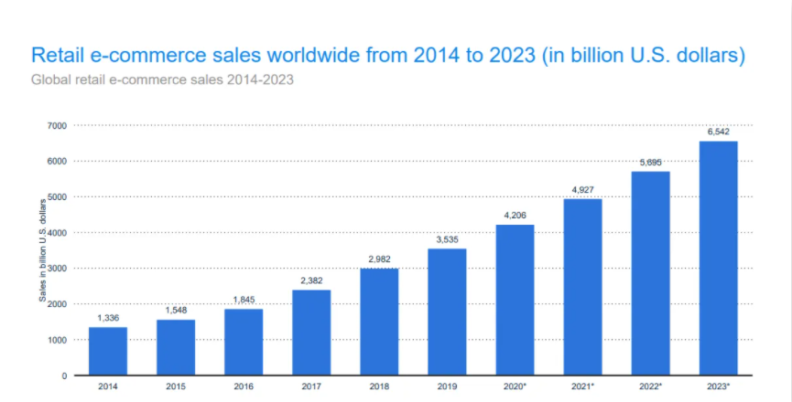
Global e-Commerce trend comparison
New studies projected that the worldwide retail e-Commerce sales will reach a new high by 2023. Ecommerce businesses should anticipate a 200% growth rate, from $1.3 trillion in 2014 to $6.5 trillion in 2023. This shows a future of steady upward trend with no signs of decline.

Slide 5
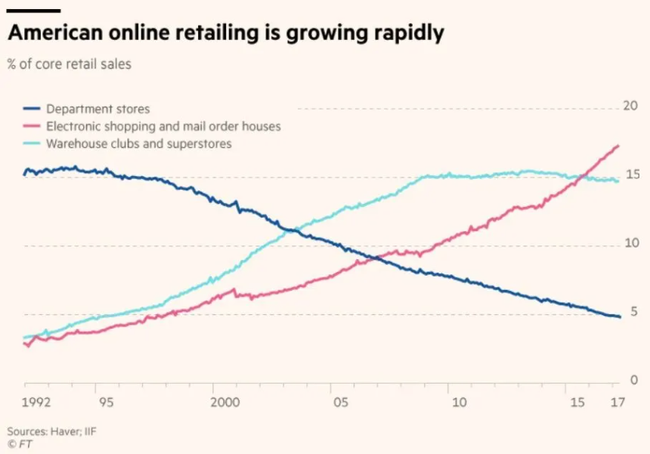
USA Online and in-store sale trend
The data shows that the departmental store sales have been decreasing from 2005 and e-Commerce has exponential growth

Slide 6
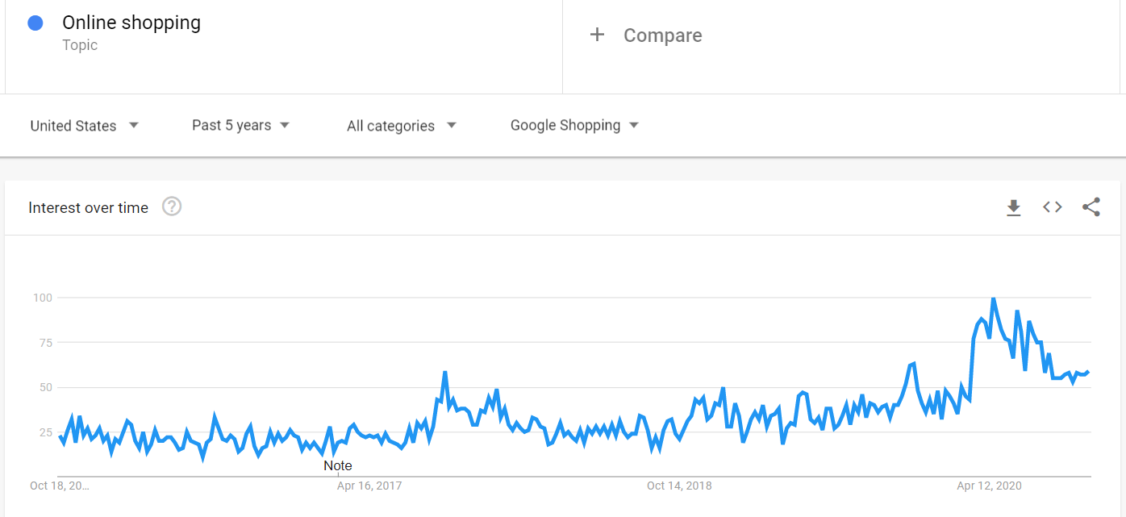
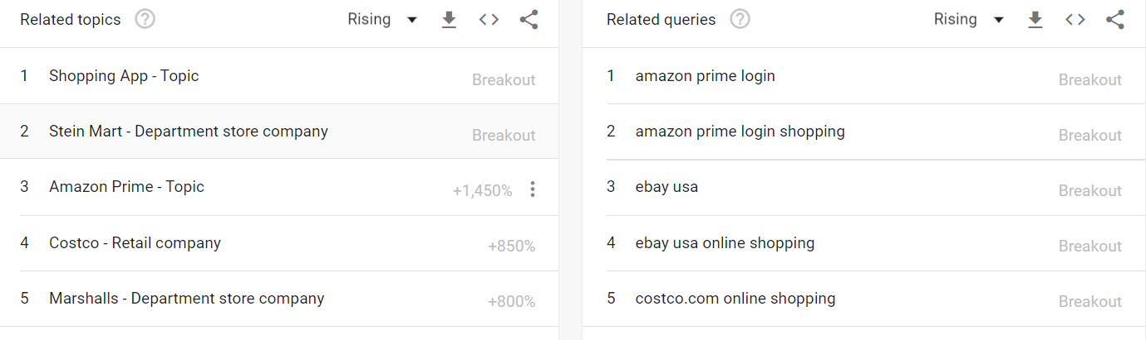
Google Trend – Online Shopping
Google trend for Topic –’online shopping’ shows the exponential trend over the last five years, this trend shows that people interest of online shopping have increased and they prefer to do online shopping.
If we see the related topics and queries we see that e-Commerce giant like Amazon, ebay are on top trending. Even people started to prefer shopping online on constco.com.

Slide 7
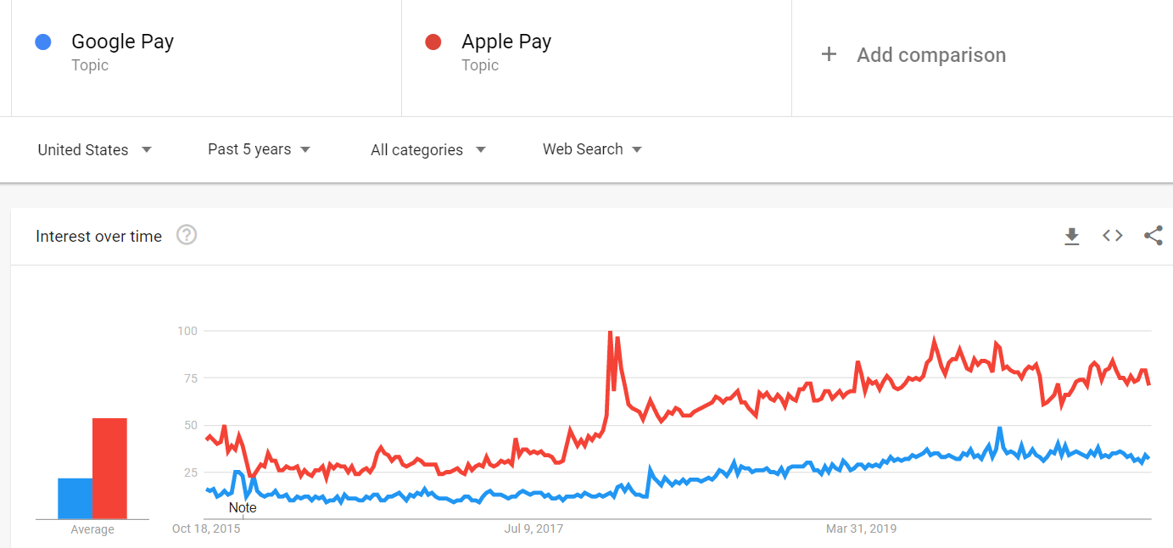
Google Trend – Google pay vs Apple pay
When we compared the top payments methods that can be used for online shopping, we see the upward trend over the last 5 years, We see apple pay is more preferred compared to Google pay, could be the reason iPhone users % is more. Now days most of the online companies app started accepting these payment methods and these are more secure and easy, not need to have card handy all the time when shopping online.
This helps in our analysis that people prefer to perform online shopping using these payment options since it’s usage has gone up over the time.

Slide 8
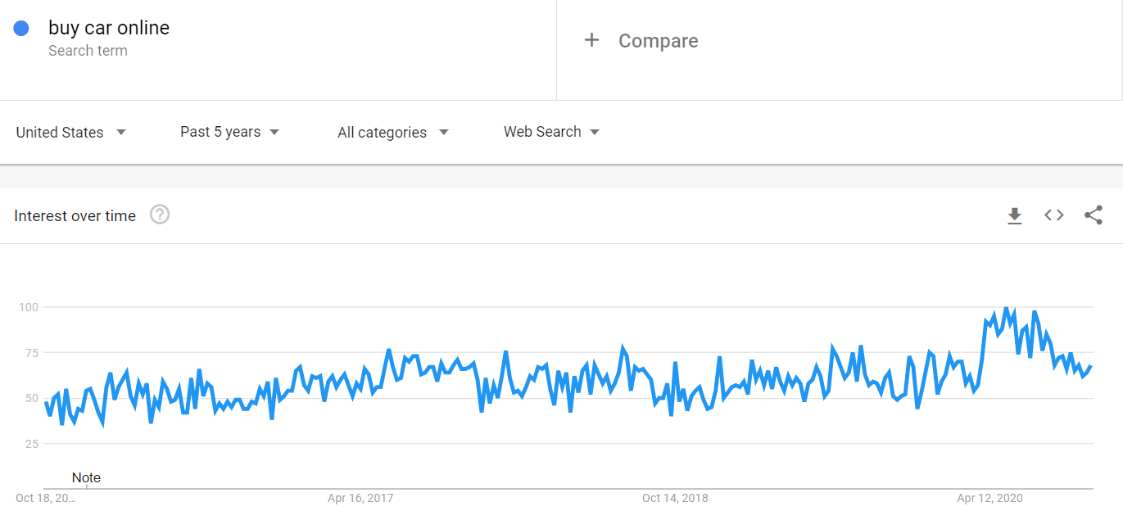
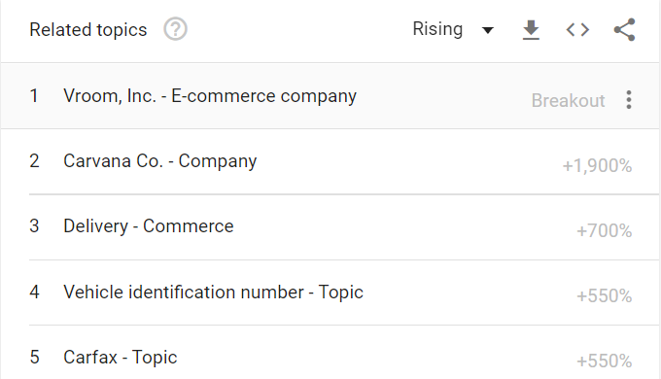
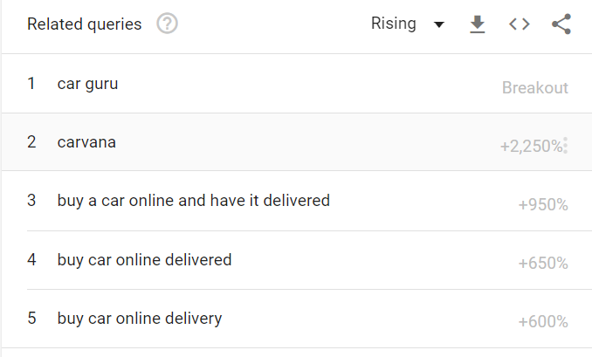
Google Trend – Buying car online
Buying car in person was the case so far but with several companies started offering selling cars online , people have moved to this trend and started searching options for buying car online.
If we see the google trend data , it clearly shows that with this pandemic situation people have preferred buying car online but overall also it shows upwards trend in recent years.
The related topics and queries shows that most of the people were searching for online car selling companies like , Carvana and how to buy car online and get delivered.

Slide 9
Factors Causing Boost IN Online Shopping
People in today’s world are used to go online in order to shop for the products, they can easily access online stores through laptops or mobile devices and order what they want. Online shopping is always convenient compared with in-store shopping because of the way online stores present their products to end users, they upload images, videos and customers feedback, that all are influencing customers to shop online.
Here are the list of top factors people prefer online shopping –
1. It Saves time – Online stores can be accessed from anywhere and on internet enabled devices, so it saves customers time to go to shop during opening hours may not be suitable for everyone. This online shopping enables customer to compare the prices across different stores and get the best deal out of it, this way they can save time shopping around different stores.
2. Shop any time – The Departmental stores are open specific hours so shopping such stores means going to store when they are open but this is not the case with online stores, it can be accessed any time and shopping can be done any time.
3. Saves Traveling expenses– Since online shopping can be done from anywhere, the travelling expenses are saved.
4. No waiting, No crowd –In-stores shopping need to wait for items checkout, stand in queue or items out of stock because of lots of crowd, all of these gets avoided in online shopping and advantage is not all items need to be purchased same time. It can be saved for later and then purchased.
5. Better Deals and Easy to Compare – One advantage of online shopping is that products can be compared with different online stores and bough for better deals.

Slide 10
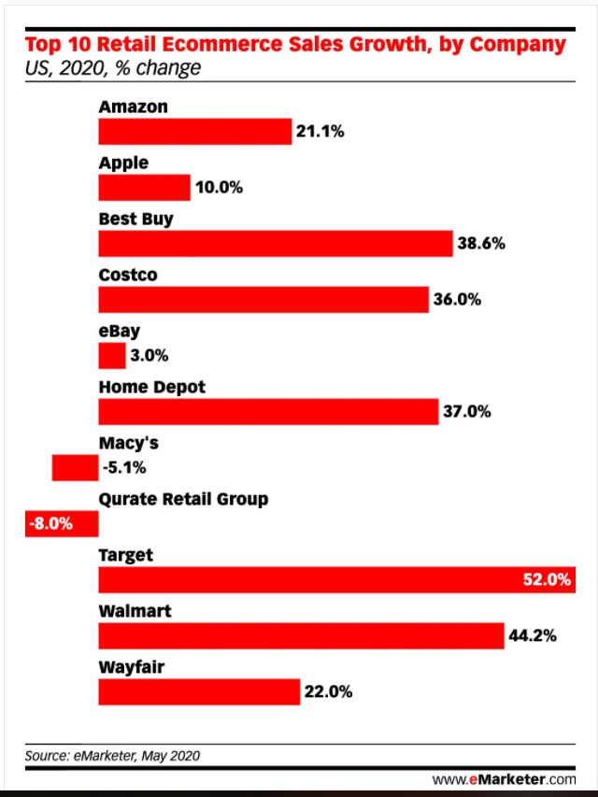
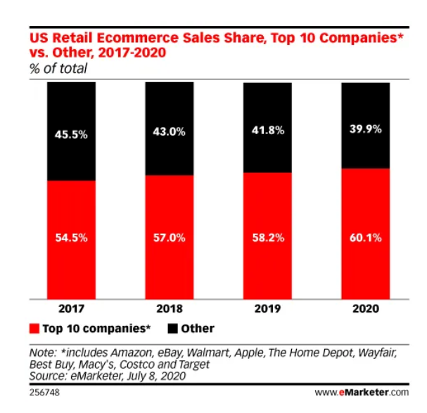
Top e-Commerce companies Growth - USA
According to most recent forecast, the top 10 US ecommerce
players will collectively grow their share of the overall ecommerce
market to 60.1% in 2020.
Amazon is the top position as it increases its e-Commerce market share from
37% in 2019 to 38% in 2020.

Slide 11
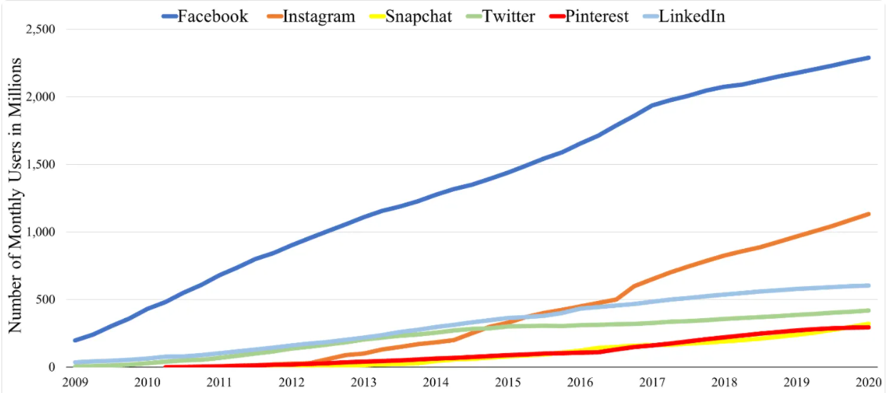
New Platforms - Social Shopping
The social media usage has gone up recently and more and more people are doing their shopping on social media platforms. With the improvement of social media’s selling capabilities, people quickly purchase products on their chosen social media platform such as – Facebook, Snapchat, Pinterest, Instagram, Twitter, LinkedIn etc.
Some of the most common social commerce features include:
Buy buttons within social media posts
Shoppable posts and stories
Ads on social networks including calls to action redirecting to e-commerce sites
Peer-to-peer buying and selling
Social commerce plugins and apps

Slide 12
Technology Helping e-Commerce business
The impact that tech-savvy customers are having on the ecommerce world is not just stronger than ever; it's faster than ever, technology today is helping customers keep track of their purchases, and altering the ways in which those consumers interact with online retailers.
Top Technology shaping e-Commerce business grow –
Mobile apps – Stats shows that US mobile retail revenue is expected to be #339B in 2020, compared to $207B in 2018, Usage of Smart phones are increased globally and consumers uses the mobile apps to research the products they are considering to buy.
eWallet features - With increase of usage of smart phones, merchants enabled consumers to use eWallet feature, boosting the sales and conversion rates for merchants.
eCommerce Subscriptions – Subscriptions are an increasingly common way to buy products online, Over the past year around 15% online shoppers subscribed to an e-commerce service.
Personalized Product Recommendations - 45% of consumers are more likely to shop on a site that offers personalized recommendations, and 56% of online shoppers are more likely to return to a site that offers product recommendations.
AI and VR - Augmented reality (AR) and virtual reality (VR) are helping eCommerce retailers overcome one of their biggest challenges – the fact that their customers cannot try on or experience products before buying them. With AR and VR, customers can virtually try on products, place furniture within rooms of their homes and more.
Voice Search - Amazon Echo or Google Home voice technology are used by consumers to search products online. 50% of all internet searches will be done using voice search and voice shopping is predicted to grow to $40 billion in 2022.
There are several various technologies are used to attract online customers by merchants to grow their business and such technology helps boost the online shopping business.

Slide 13
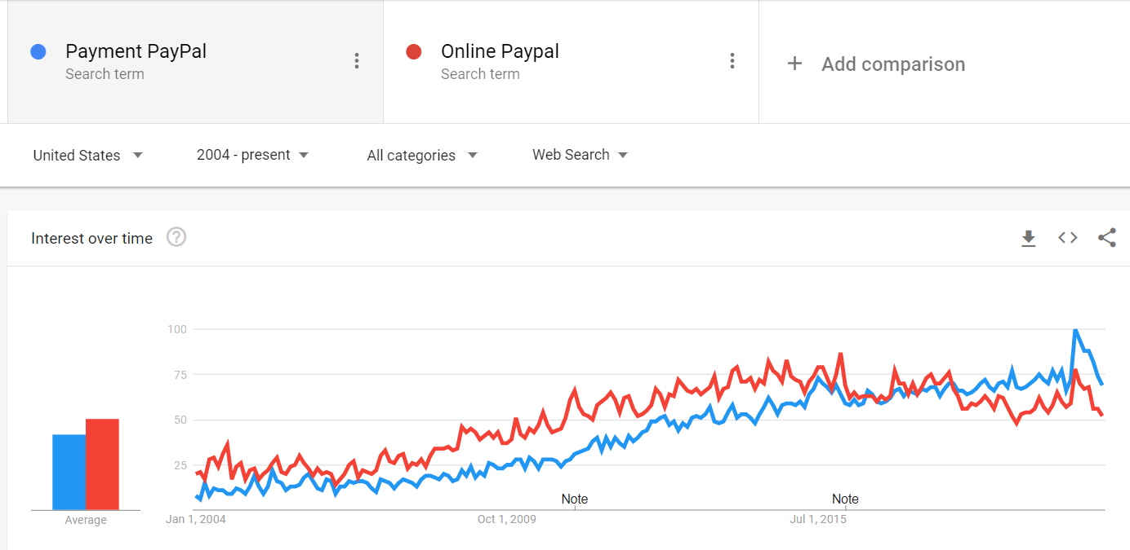
Payment methods – Boosting e-Commerce business model
Today shoppers want flexibility in how they make payments for shopping in store or online, most frequently used payment method is Credit card but with booming the e-commerce business new payment options are being used very frequently and customers has given positive response to these methods such Paypal, Venmo, paytm etc.
There are studies shows that 32% of millennials use PayPal payment option, 67% of millennials and 56% of Gen X shoppers prefer shopping online.
The Google Trend shows that over the time period online search for PayPal has been increased, this shows that trend of online shopping has gone up and such flexible payment methods helps people prefer online shopping.

Slide 14
Ethical concern related to e-commerce business
With the boom of new technologies and payment options increased and improved the eCommerce business, but there are several PII (Personal Identifiable Information) data being tracked and stored by e-Commerce companies to improve and enhance their business. Though government has put in regulation but there is always risk of such data breach causing the Personal information loss.
Secure Payment is another concern with increase of online shopping, many merchants recommends consumers to store their credit card information so it can be used for next purchases, with all payment information merchants can misuse or charge customers using their saved payment methods.
Providing Subscription options to customers to buy products online, this technique to increase conversions but merchants makes consumers to buy their products only.
Fake websites – There are website those steals information, logo fron brand companies and steals consumers PII data.
Email Spamming - using e-mail to send or broadcast unwanted advertisement or correspondence over the Internet.

Slide 15
Conclusion
Ecommerce is an ever-expanding world. With intensifying purchasing power of global consumers, the proliferation of social media users, and the continuously progressing infrastructure and technology, the future of e-Commerce in 2020 and beyond is still more vibrant as ever.
We can conclude this analysis by saying the future of e-Commerce is bright and shine and it will continue to grow fast with this market trend in the future.

Slide 16
References
Slide#4 – https://www.bigcommerce.co.uk/blog/ecommerce-trends/#14-ecommerce-trends-leading-the-way
Slide#5 – https://bsic.it/effects-e-commerce-shopping-malls-consumer-retail-sector-us-case-study/
Slide#09 - https://medium.com/@bomgamer/7-reasons-why-online-shopping-is-better-than-offline-5fd269ada245
Slide#10 - https://www.emarketer.com/content/top-10-ecommerce-retailers-will-grow-their-share-60-2020
Slide#11 - https://www.omnibeat.com/social-media-weather-update-snapchat-and-twitter/
Slide#12 - https://blog.hubspot.com/sales/ecommerce-technology-trends
Slide#13 https://www.business.com/articles/make-more-sales-with-more-ecommerce-payment-options/
Slide#14 - https://blog.qburst.com/2011/03/e-commerce-ethical-and-legal-issues/

