Slide 1
DSC 520 Statistics for Data Science
Exercise 3.2.2 American Community Survey
By Ganesh Kale
Bellevue University

Slide 2
What are the elements in your data (including the categories and data types)? Str()
spec_tbl_df [136 × 8] (S3: spec_tbl_df/tbl_df/tbl/data.frame)
$ Id : chr [1:136] "0500000US01073" "0500000US04013" "0500000US04019" "0500000US06001" ...
$ Id2 : num [1:136] 1073 4013 4019 6001 6013 ...
$ Geography : chr [1:136] "Jefferson County, Alabama" "Maricopa County, Arizona" "Pima County, Arizona" "Alameda County, California" ...
$ PopGroupID : num [1:136] 1 1 1 1 1 1 1 1 1 1 ...
$ POPGROUP.display-label: chr [1:136] "Total population" "Total population" "Total population" "Total population" ...
$ RacesReported : num [1:136] 660793 4087191 1004516 1610921 1111339 ...
$ HSDegree : num [1:136] 89.1 86.8 88 86.9 88.8 73.6 74.5 77.5 84.6 80.6 ...
$ BachDegree : num [1:136] 30.5 30.2 30.8 42.8 39.7 19.7 15.4 30.3 38 20.7 ...
- attr(*, "spec")=
.. cols(
.. Id = col_character(),
.. Id2 = col_double(),
.. Geography = col_character(),
.. PopGroupID = col_double(),
.. `POPGROUP.display-label` = col_character(),
.. RacesReported = col_double(),
.. HSDegree = col_double(),
.. BachDegree = col_double()
.. )

Slide 3
Please provide the output from the following functions: str(); nrow(); ncol()
> nrow(acs)
[1] 136
> ncol(acs)
[1] 8

Slide 4
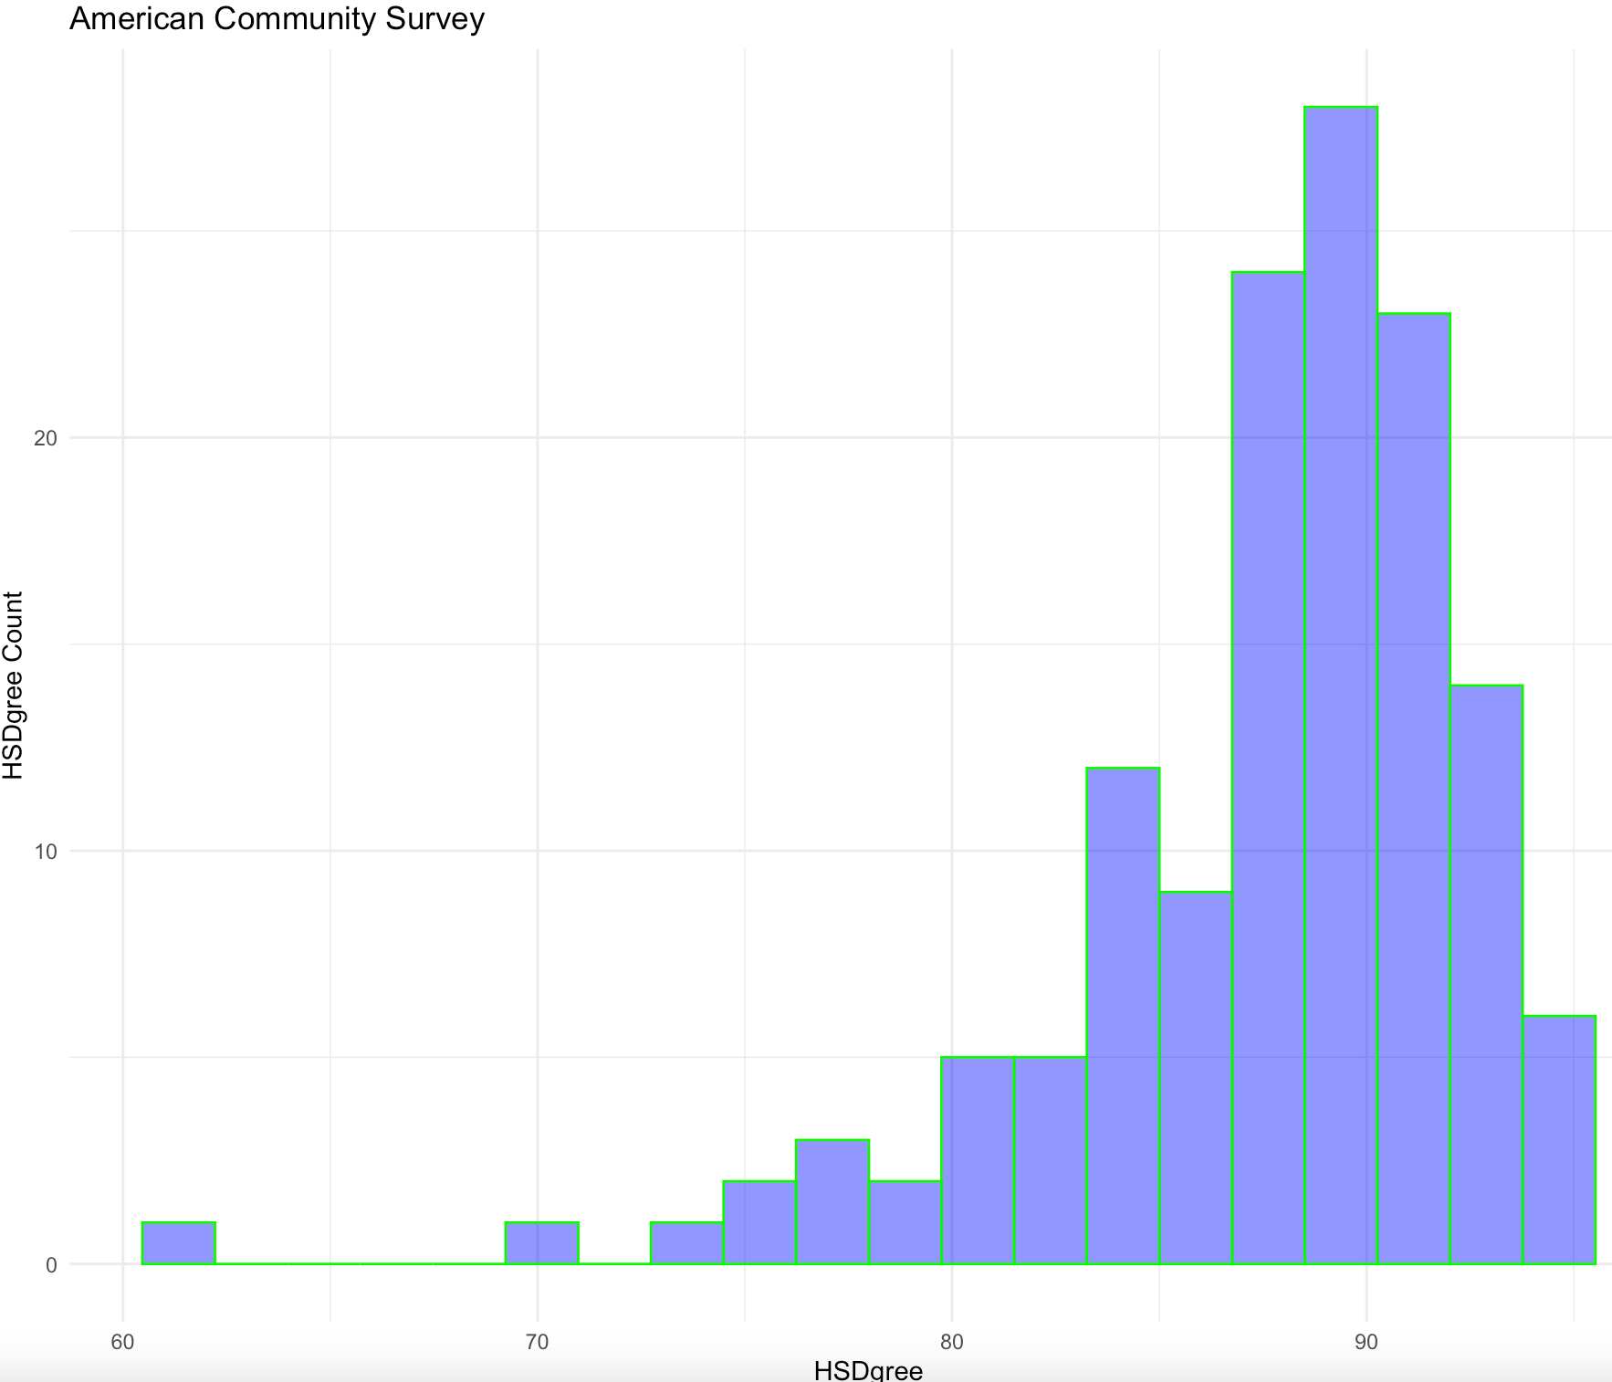
Create a Histogram of the HSDegree variable using the ggplot2 package.

Slide 5
Based on what you see in this histogram, is the data distribution unimodal?
Yes, the data distribution is Unimodal.
Is it approximately symmetrical?
No, the distribution is not approximately symmetrical.
Is it approximately bell-shaped?
No, the distribution is not approximately bell-shaped.
Is it approximately normal?
No, the distribution is not approximately normal.
If not normal, is the distribution skewed? If so, in which direction?
Yes, the distribution is skewed, and it is negatively skewed. Towards right.
Include a normal curve to the Histogram that you plotted.
Attached in next slide
Explain whether a normal distribution can accurately be used as a model for this data.
No, since the distribution is not normal. It will not fit to the normal distribution model to this data.

Slide 6
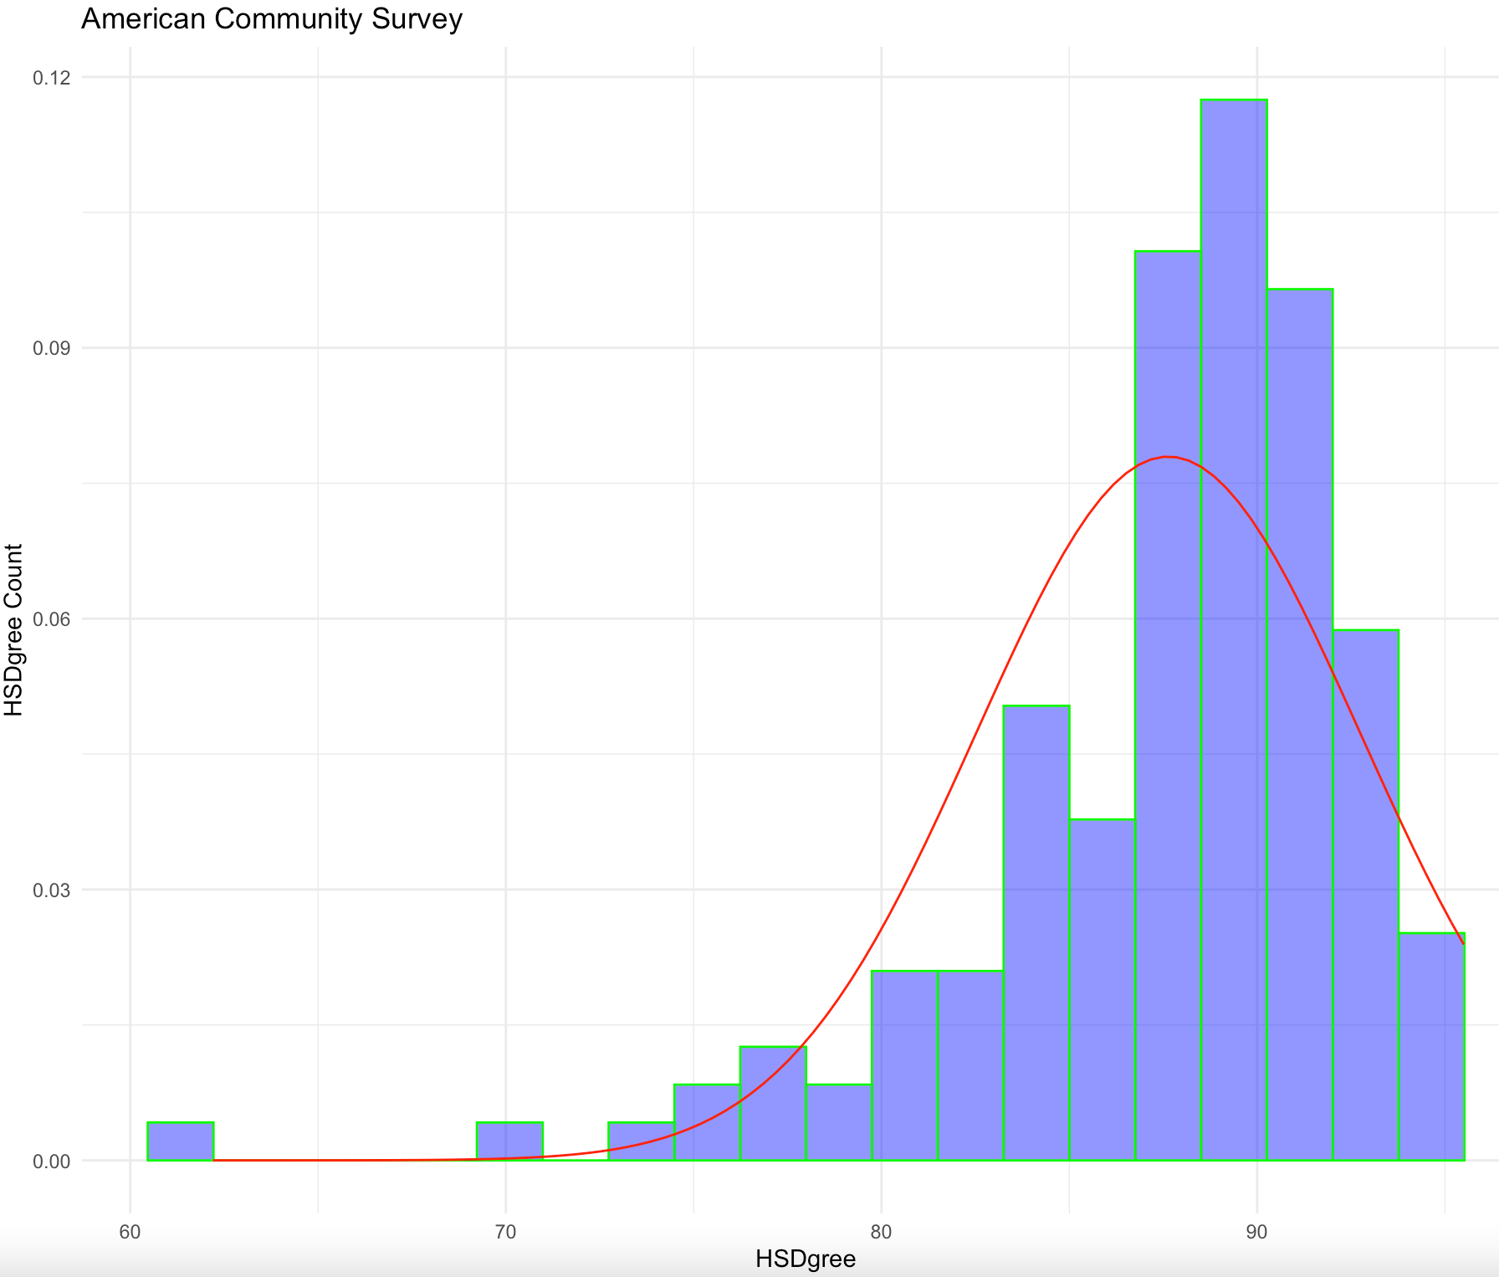
Include a normal curve to the Histogram that you plotted

Slide 7
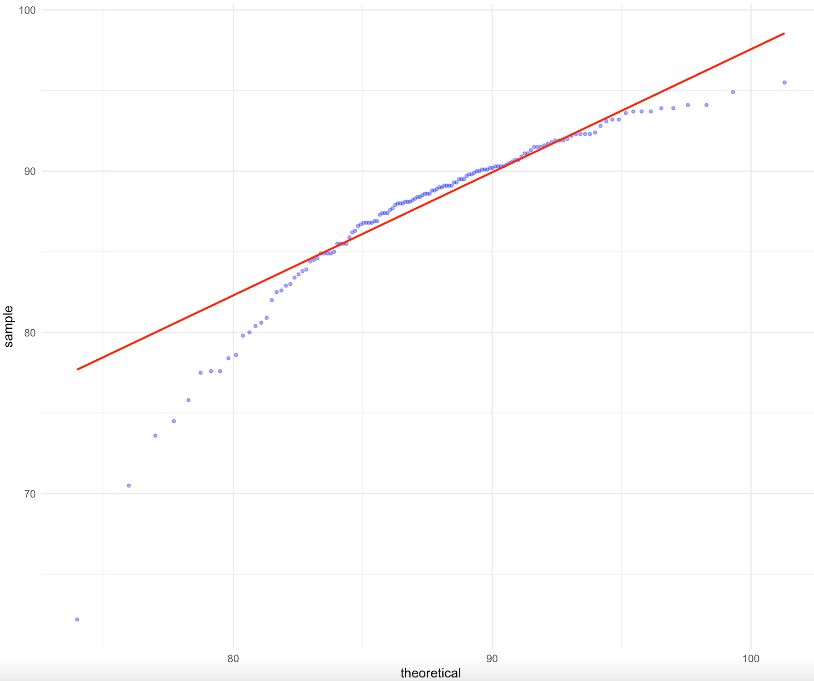
Create a Probability Plot of the HSDegree variable.

Slide 8
Based on what you see in this probability plot, is the distribution approximately normal? Explain how you know.
Based on the probability plot the data points are not falling on or close to the diagonal line, it deviates far from the line. From this deviation we can say the distribution is not normal since the data points are deviating away from the line.
If not normal, is the distribution skewed? If so, in which direction? Explain how you know.
The distribution is not normal and is negatively skewed, because the frequency clustered at the higher end and the tail points towards to lower end or toward negative values.

Slide 9
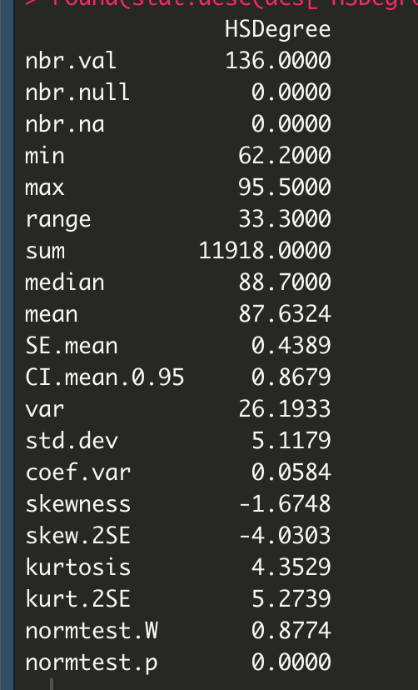
Now that you have looked at this data visually for normality, you will now quantify normality with numbers using the stat.desc() function. Include a screen capture of the results produced.

Slide 10
In several sentences provide an explanation of the result produced for skew, kurtosis, and z-scores. In addition, explain how a change in the sample size may change your explanation?
Skew = -1.6748
In order to have the distribution approximately normal, the skew should be zero, but here the skew value is negative(-1.6748). This skew value indicates that frequency of occurrence is heavy towards right, We have seen on the Histogram chart as well, it is negatively skewed.
Kurtosis = 4.3529
Same as skewness, the value of kurtosis is zero for normal distribution. In this scenario the value of kurtosis is positive (4.3529). The positive value of kurtosis indicates that pointy and heavy tailed distribution.
Z-score, skew.2SE = -4.0303 and kurt.2SE=5.2739.
The stat.desc does not calculate the z-score but can be calculated as S-0/SE i.e. skew minus 0 divided by standard error, or we can interpret the skew.2SE and kurt.2SE values as if these values are greater than 1 (ignoring plus or minus) then we can say there is significant skew and kurtosis. Based on these values we can say there is significant skew and kurtosis in the distribution. These values are good to interpret distribution on small samples.
Based on above values we can certainly say that the distribution is not approximately normal.
As the sample size increases the shape of the distributions tends to be normal distribution. If sample size is changed or increased, then there are chances of skew and kurtosis values tend to zero and it will have shape of normal distribution.

