Slide 1
DSC 530 Exploratory Data Analysis Final Project
Author – Ganesh Kale
Date – June 04 ‘ 2021
Bellevue University

Slide 2
Project Info: Predict churning of bank credit card customers
Information About the Dataset –
A manager at the bank is disturbed with more and more customers leaving their credit card services. They would really appreciate if one could predict for them who is going to get churned so they can proactively go to the customer to provide them better services and turn customers' decisions in the opposite direction.
This dataset was obtained from a website with the URL as https://leaps.analyttica.com/home. The dataset consists of around 10K records that means customers information such as - age, salary, marital status, credit card limit, category etc.
Business Problem -
The objective of this data analysis project is to better understand the attributes that are making impact on customer's decision to leave or retain the credit card company and after finalizing the attributes another goal is to identify such customers who are going to leave.
1. Identify the key features/factors that driving customer to drop off.
2. Identify the customers having high likelihood of attrition.

Slide 3
Feature Selection: Information about variables from the dataset
Attrition_Flag - This is the target variable, which tells us what are customers with bank and what are left the bank.
Customer_Age - This tells us the age of the customer; I am going to keep this to see if age influence the customer to leave. In real world customers who are about to retire or already retired have chances of leaving because they might not be interested in credit because of limited income source.
Income_category - Given income ranges in which customers income falls
Card_category - This columns tells that which card category customers have.
Months_on_book - How long customer is with bank.
Total_relationship_Count - Total number of products held by customer
Months_inactive_12_mon - How many months customer was inactive in last 12 months, means number of months customer did not use credit card
Contacts_Count_12_mon - How many times customer contacted bank in last 12 months
Total_Revolving_Balance - The outstanding balance on the card which gets carried to next month if customer does not pay
Avg_Utilization_Ratio - This measures the how much credit customer is using compared to how much is available.
Avg_Open_To_Buy - It is average credit available allocated to the customers.
Total_Trans_Ct - Total transactions counts made by customer in last 12 months
Total_Trans_Amt - Total transaction amount or amount spent on each transactions in last 12 months

Slide 4
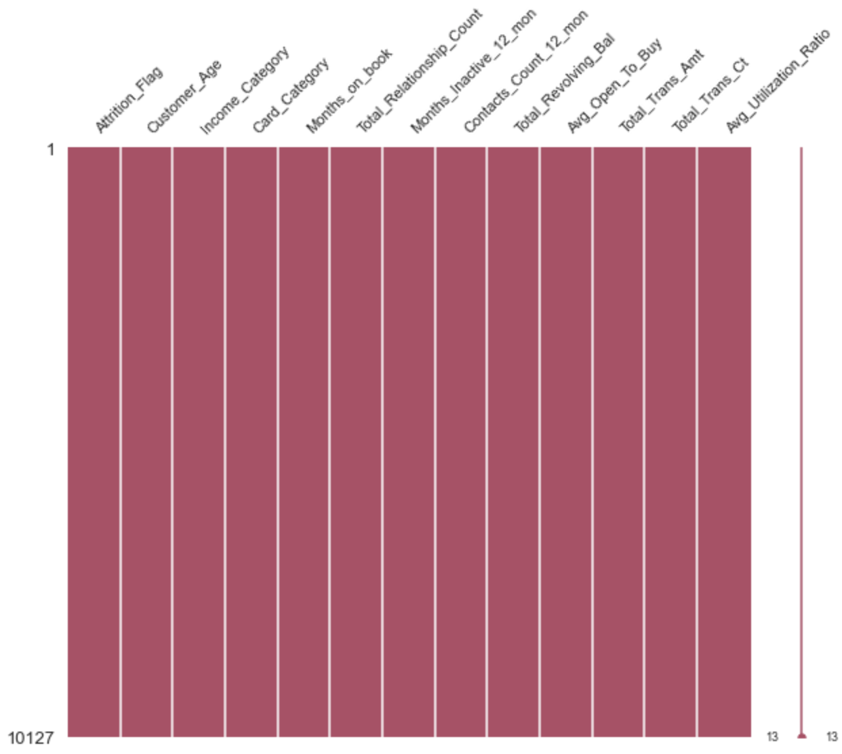
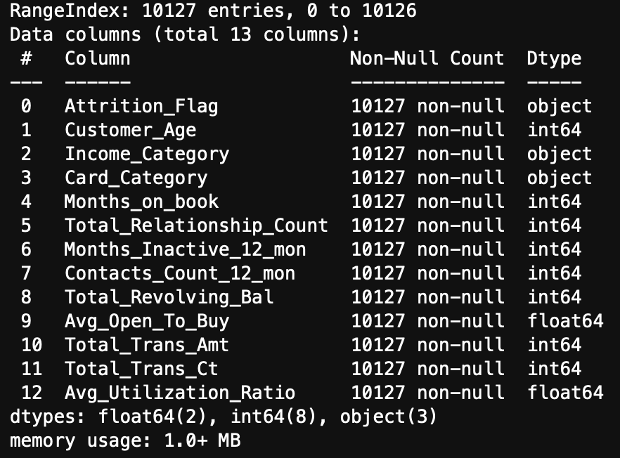
Data Information: Variable's information and Missing values
Below charts shows the variables information about count, null and data type of each variable.
The chart shows no missing values in the data set

Slide 5
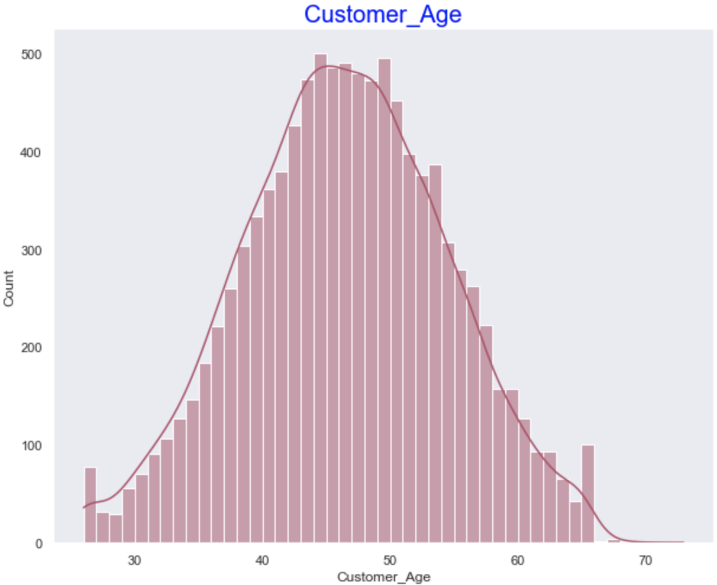
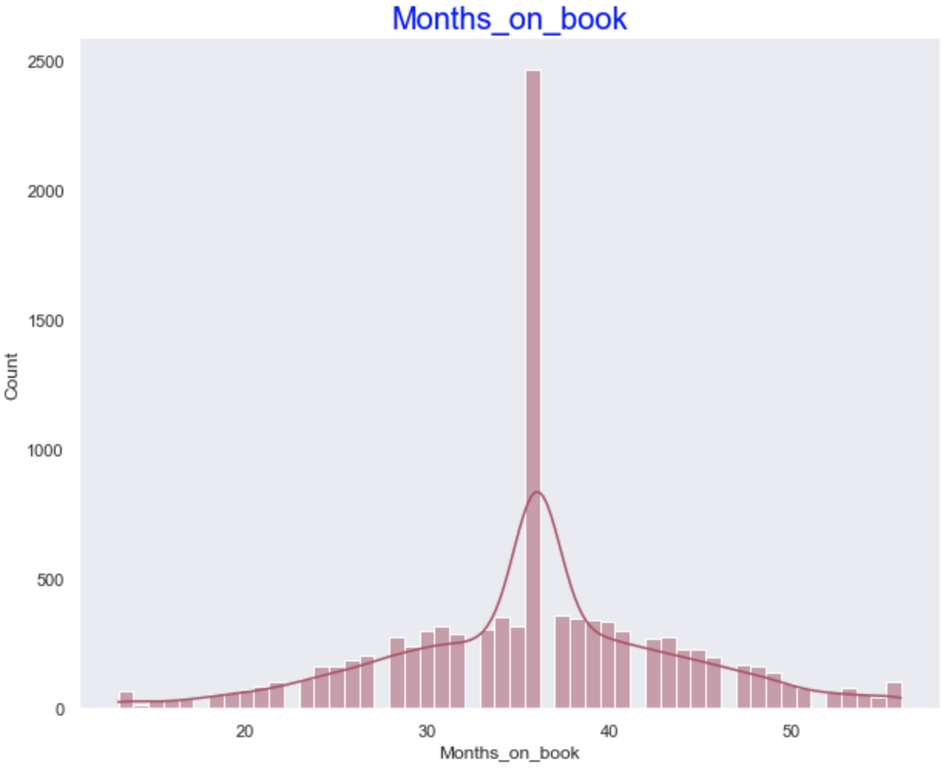
Data Distribution: Histogram of Numerical variables
Based on the below histograms for numerical variables, it seems customer age column has few customers with age greater than 67 years old and their count is very minimal. We can call them as accurate data points but with low count it can be treated as outliers.
Months on Book – there is spike at bin 37 but it is not outlier.

Slide 6
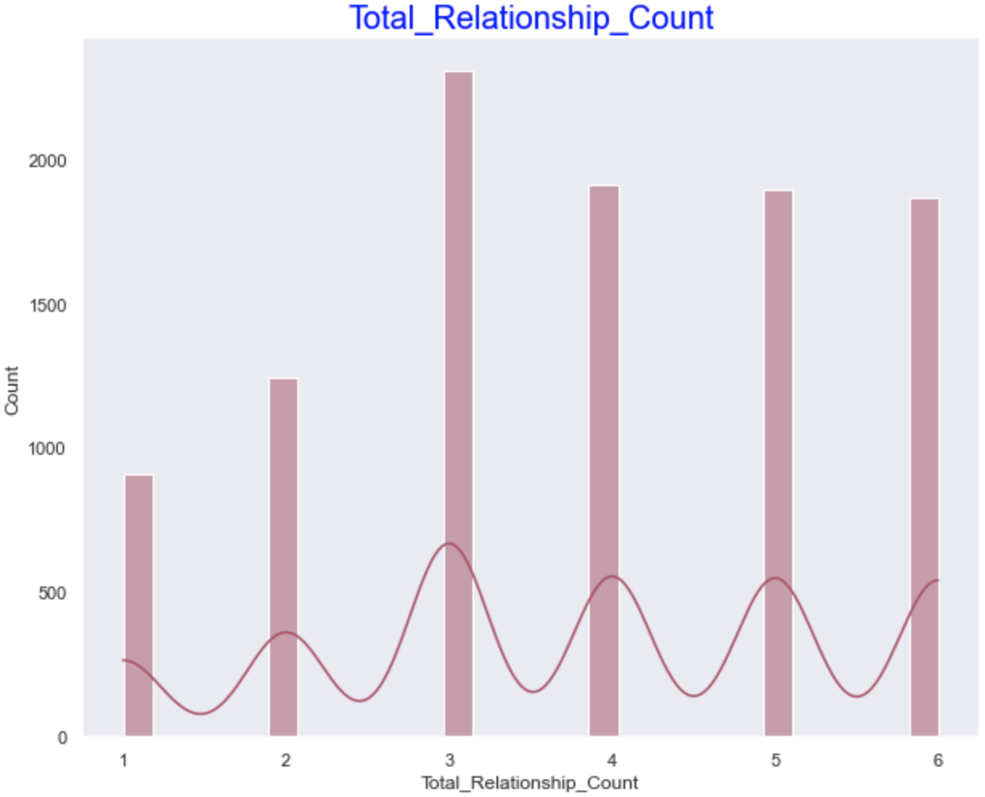
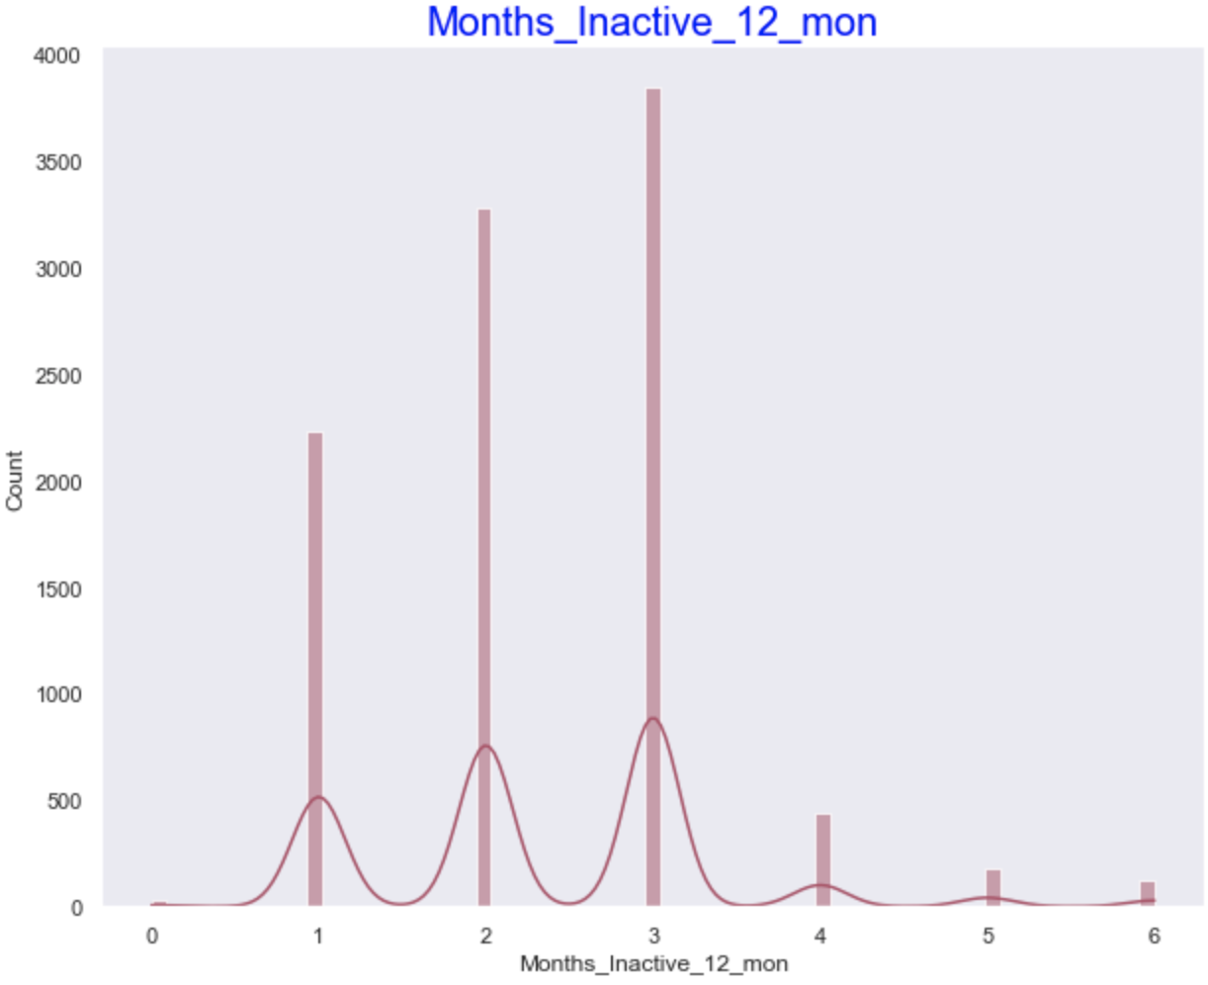
Data Distribution: Histogram of Numerical variables
Histogram of Total Relationship Count – which tells how many product customers holds.
Months Inactive 12 Months – Customer is not using card in last 12 months.
No outliers in these two variables.

Slide 7
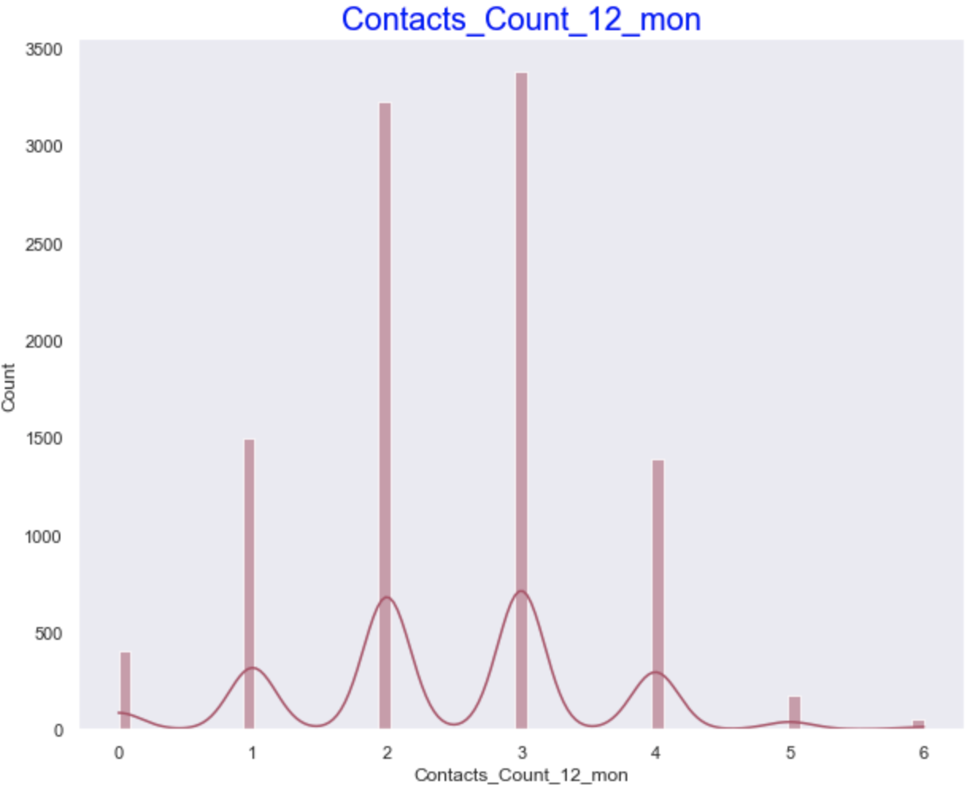
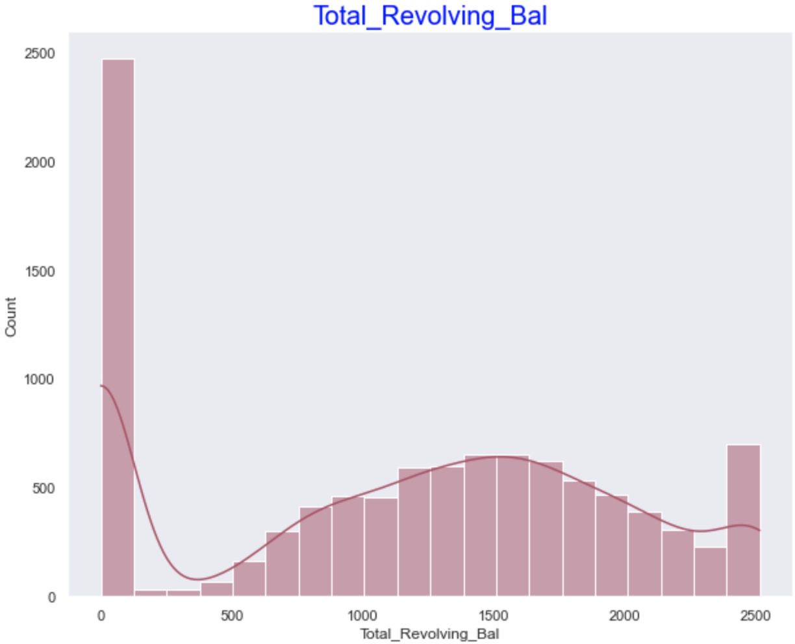
Data Distribution: Histogram of Numerical variables
Histogram of Contacts Count in last 12 months
Total revolving Balance
No outliers in these two variables.

Slide 8
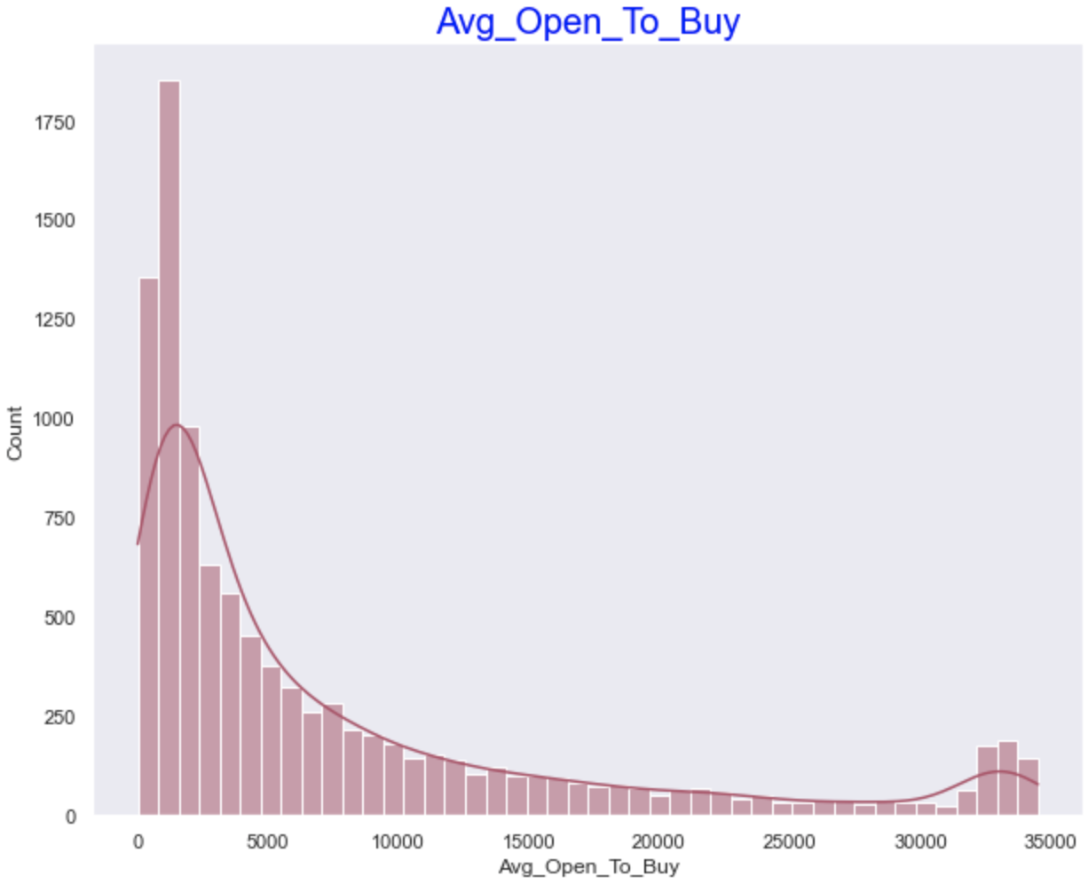
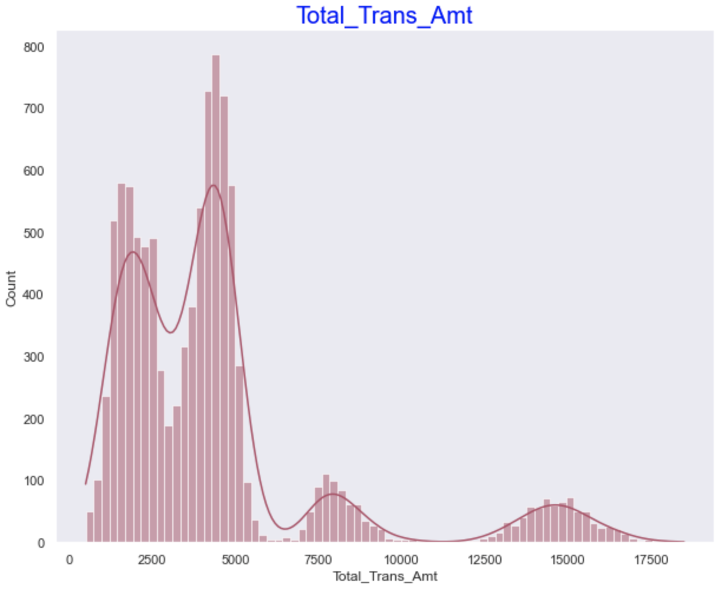
Data Distribution: Histogram of Numerical variables
Histogram of Average of Open to buy balance and
Total Transactions amount in last 12 months
No outliers in these two variables but data is normally distributed.

Slide 9
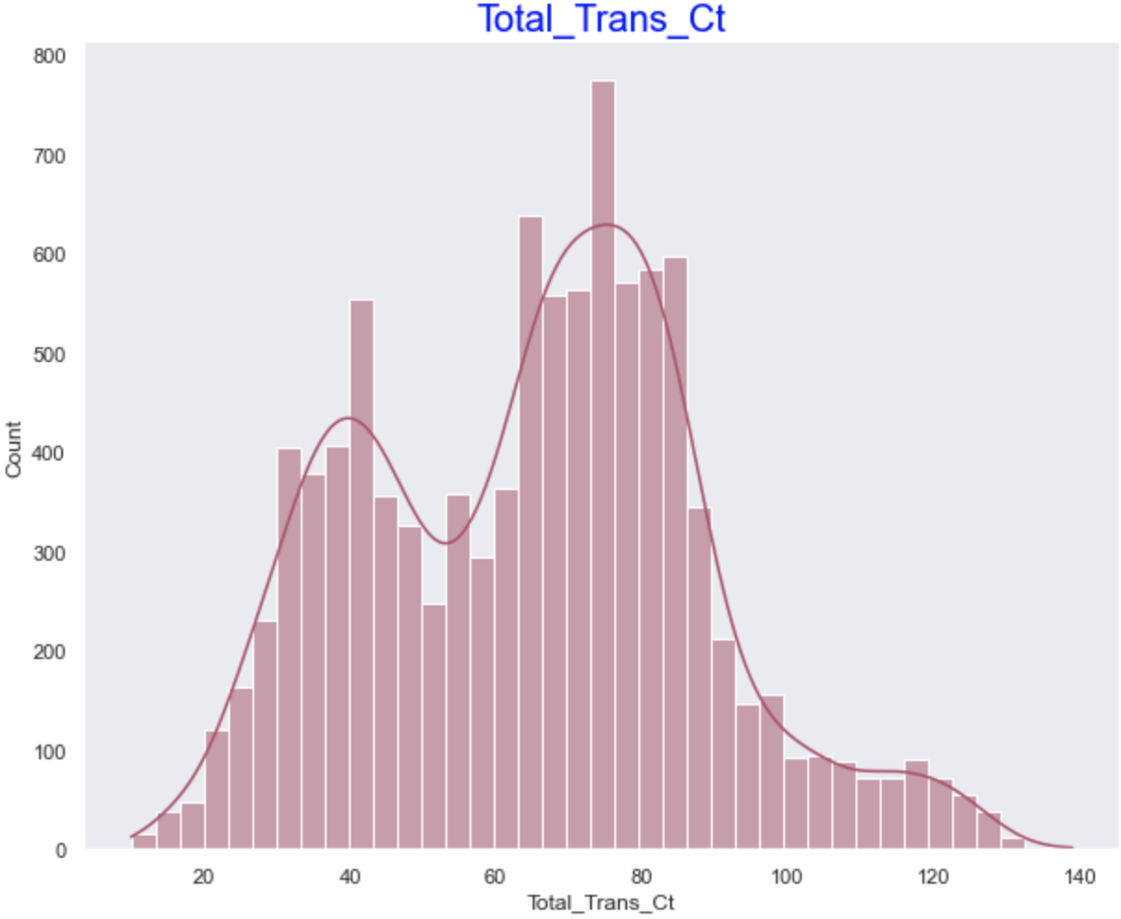
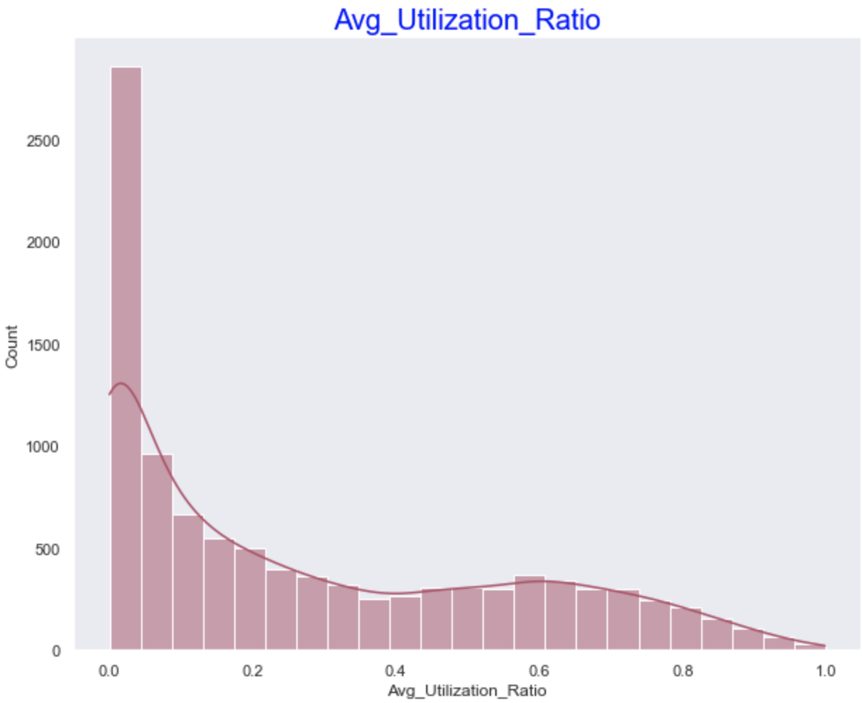
Data Distribution: Histogram of Numerical Variables
Histogram of Total Transactions Count and
Average utilization Ratio
No outliers in these two variables but data is normally distributed.

Slide 10
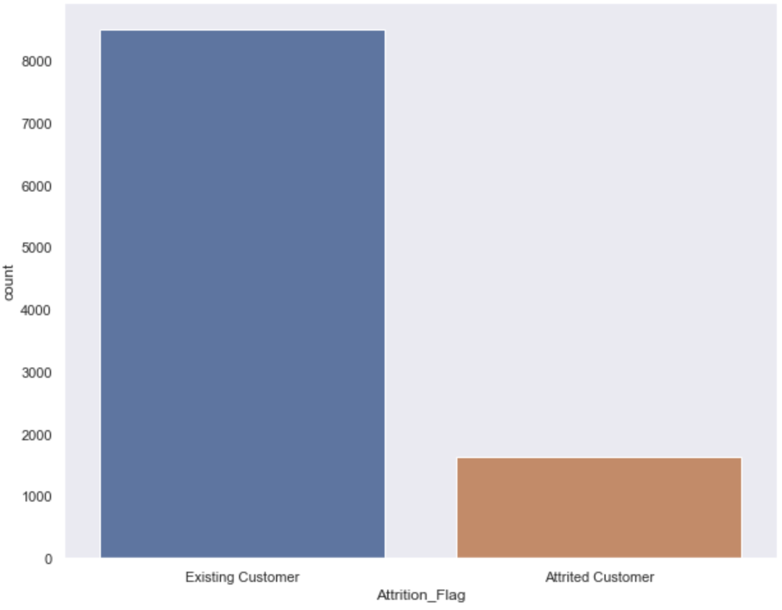
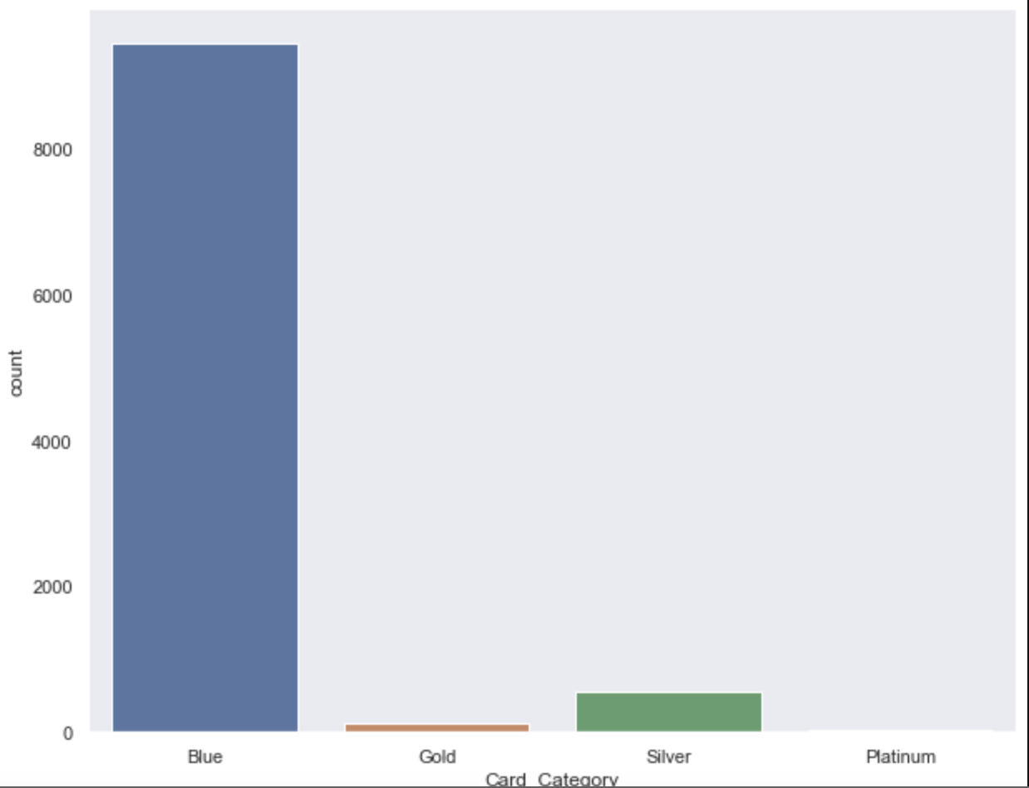
Data Distribution: Bar Charts of Categorical Variables
Bar Charts of Target variable Attrition Flag – This shows that we have 85% existing customers and 15% attrited.
Card Category bar chart shows we have very few customers with Platinum card type and majority are Blue card holders.

Slide 11
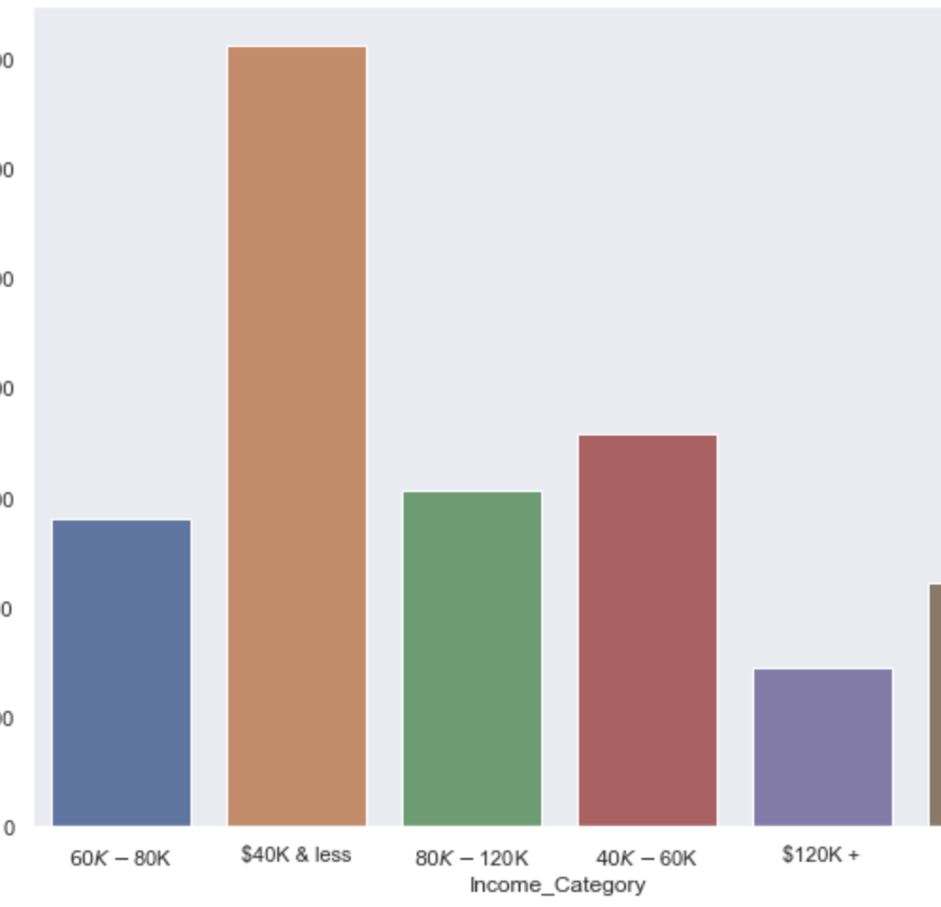
Data Distribution: Bar Charts of Categorical Variables
Bar Charts of Income Category – Her we can see we have Income Category of type ‘Unknown’ which is means income information is not available for few customers, we are going to treat them outliers or missing information and going to remove them from the data set.

Slide 12
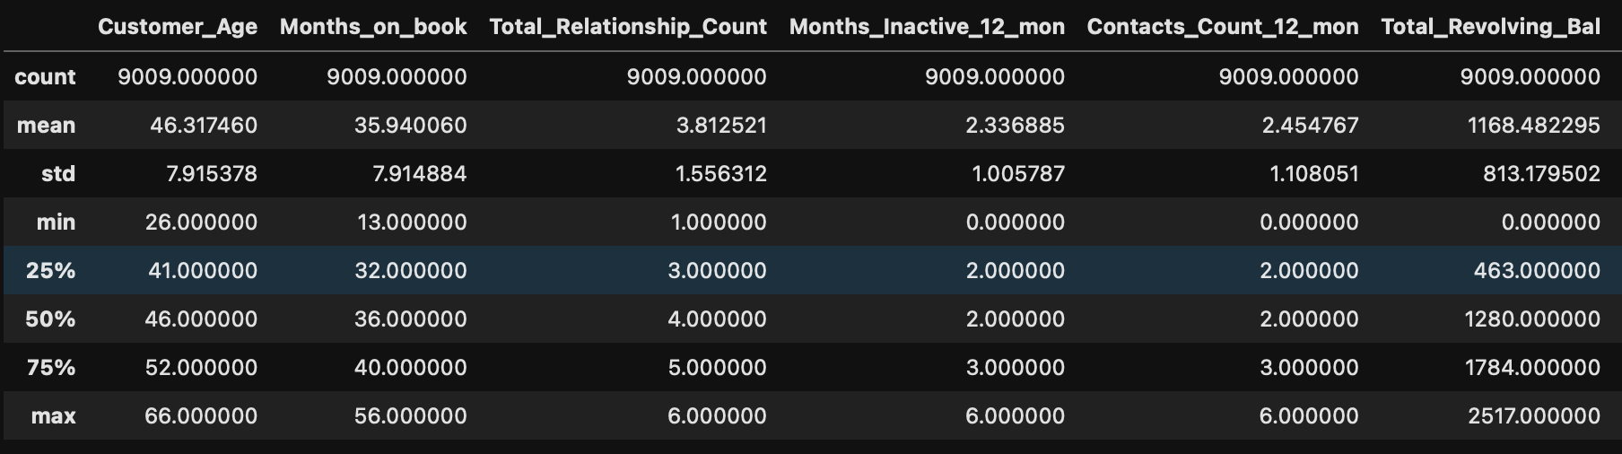
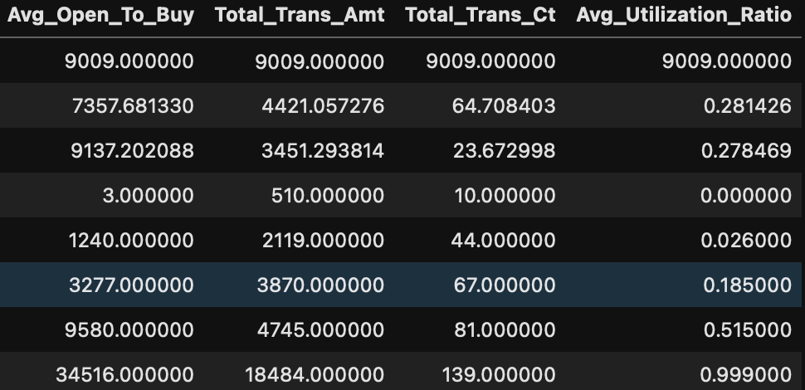
Descriptive Statistical Information about variables:
Below table shows the descriptive statistics information about all the numerical features from the data set
Average age of customers is 46 years, average cards with bank are 4, contacted to bank customer services on average 2-3 times in last 12 months etc.

Slide 13
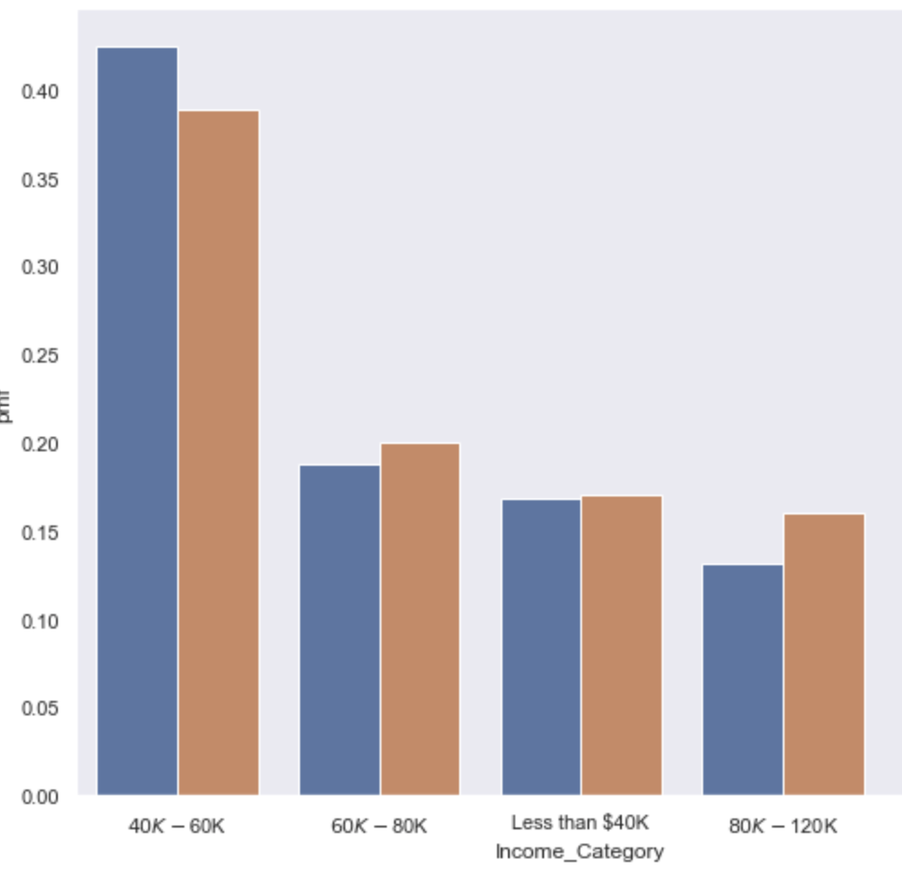
PMF: Comparison of Attrited and not-attrited customers
Based on below charts we can see that attrition is more in customers who are having income less that 40K per annum and higher income $120K + per annum.

Slide 14
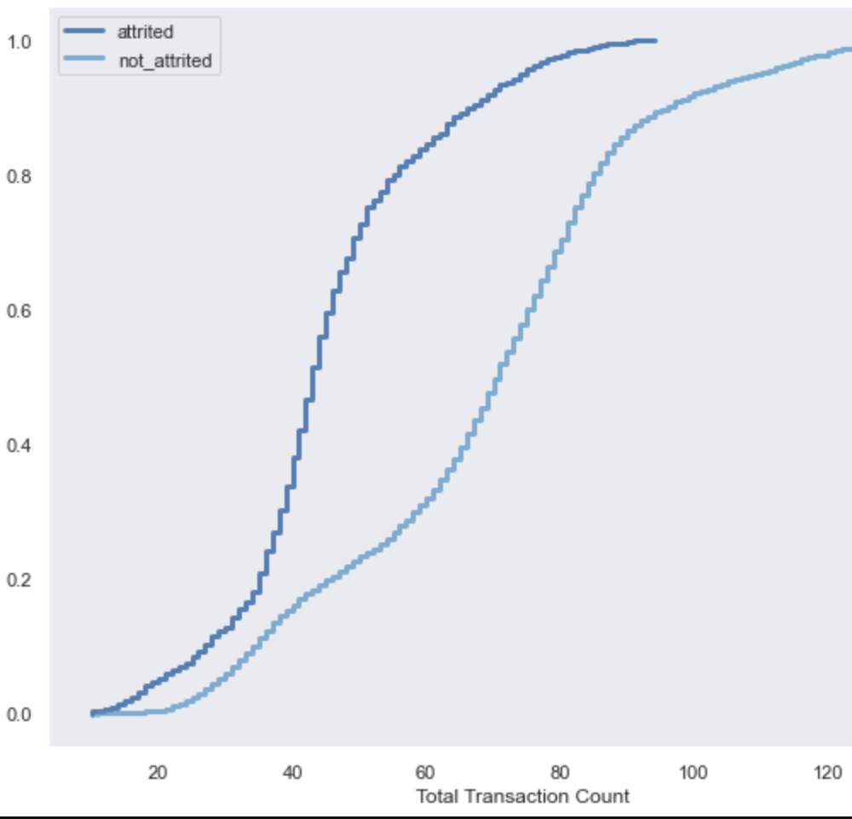
CDF: Comparing the CDFs of attrited customer versus not attrited customers for Income Category and Total Trans Counts
Based on below charts, The total transactions of attrited customers are less compared to not attrited customers. CDF graph shows that 40% of the attrited customers have transaction 40 or less in last 12 months, while not attrited customers have 65 or less transactions in last 12 months, and 90% of the attrited customers having transaction less than 70 on other hand 90% of non attrited customers having transactions 110 or less in last 12 months. Based on this we can say that attrited customers tend to have less transactions compared to not attrited customers.

Slide 15
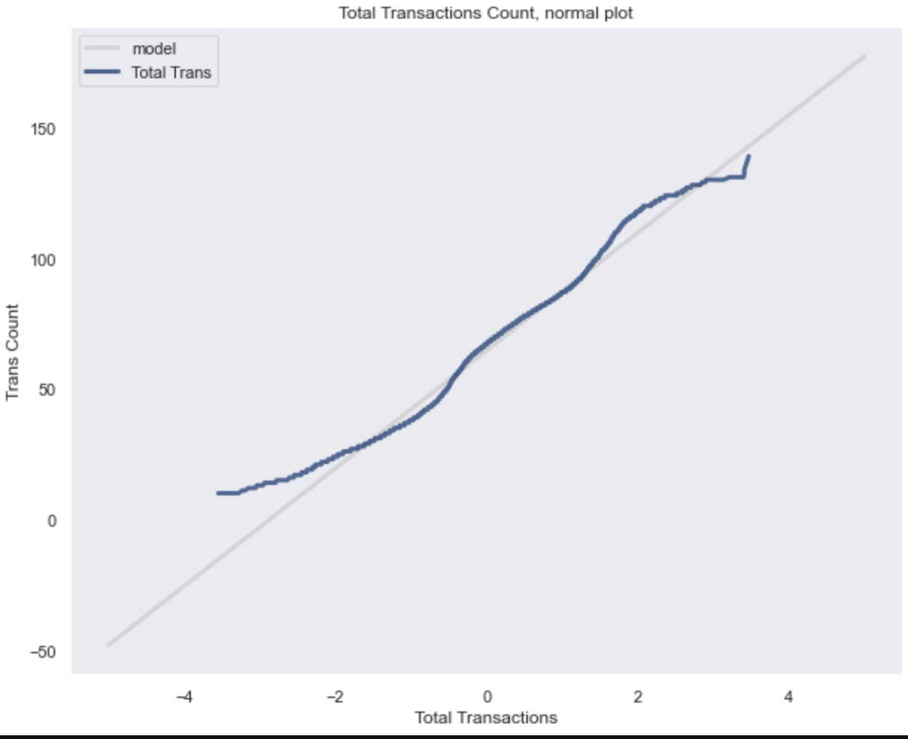
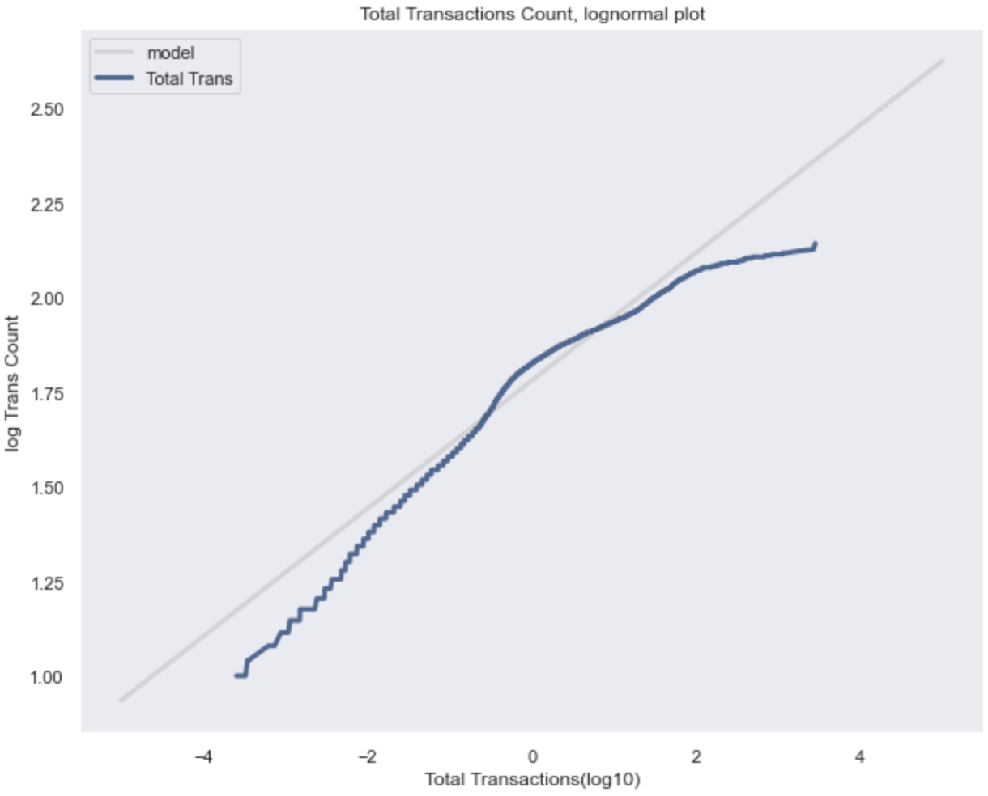
Analytical Distribution: Lognormal Distribution on Total Transactions Count
The first chart shows the normal probability of Total transactions made by both customers; we can see the it deviates from the model at both the ends.
The second chart is same as first but on log scale , it shows that middle portion is fitting with model, but the top and bottom ends are deviating from the model. This could be the attrited customers having less transactions counts.

Slide 16
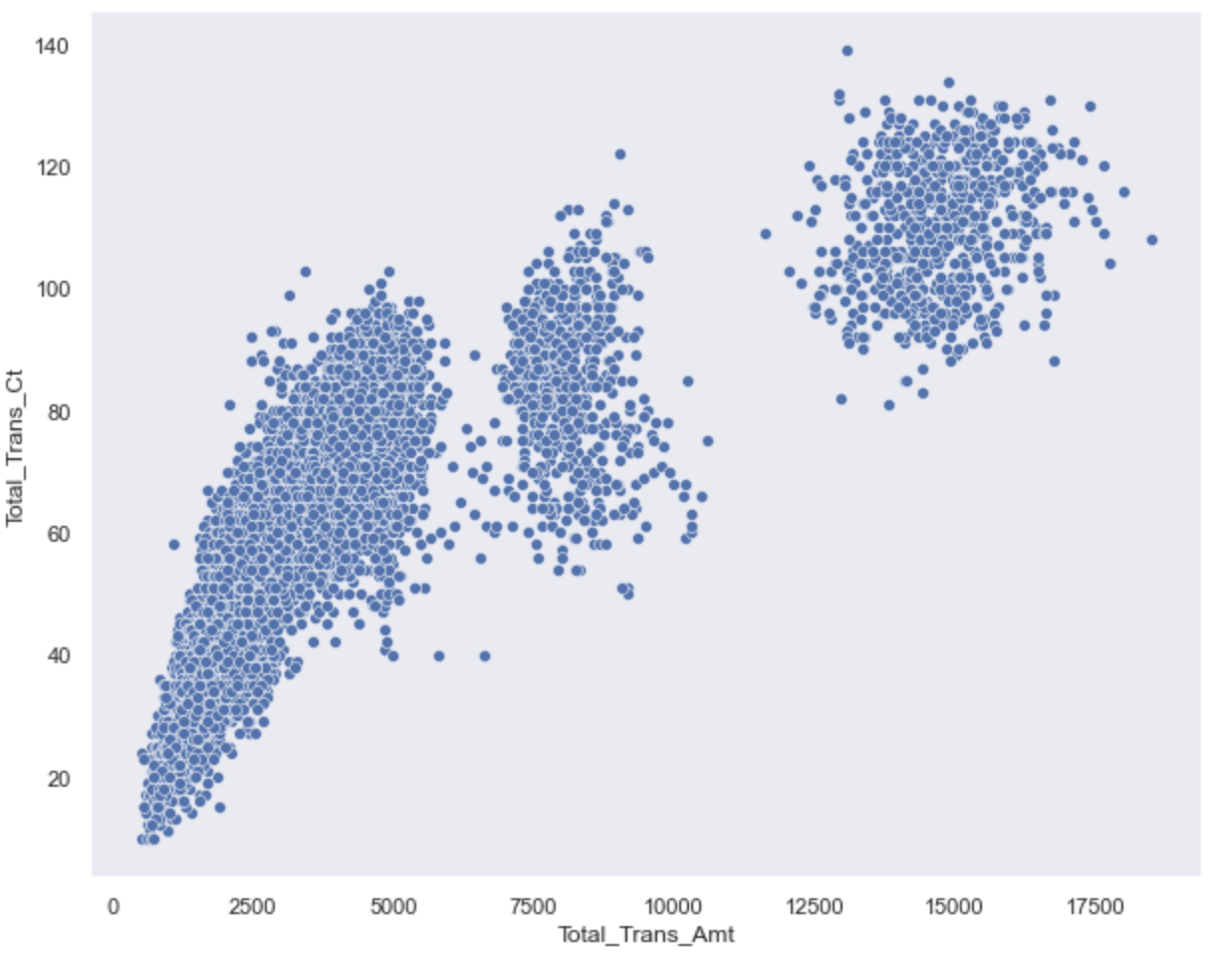
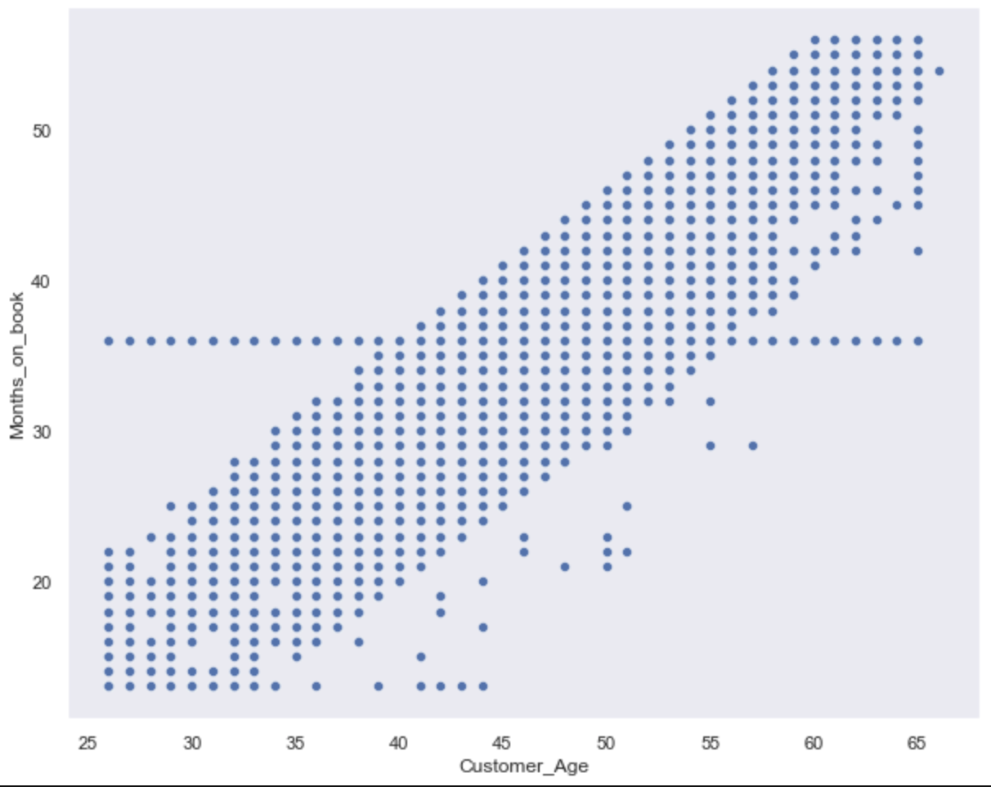
Correlations: Scatter plots to check correlation between variables
The Scatter plot of Total_Trans_Amt and Total_Trans_Ct shows as transaction amount increases as transaction amount, this quite obvisous and we can see the correlation between these two variables is positive.
Total_Trans_Ct and Total_Trans_Amt are positively correlated with Pearson corr value 0.81
The relationship between Customer Age and Months_on_book is positive, and both are strongly correlated. As customer age increase so duration of credit card usage. The Pearson corr value 0.79.
Covariance of these variables are 66188.00 and 49.37 respectively.

Slide 17
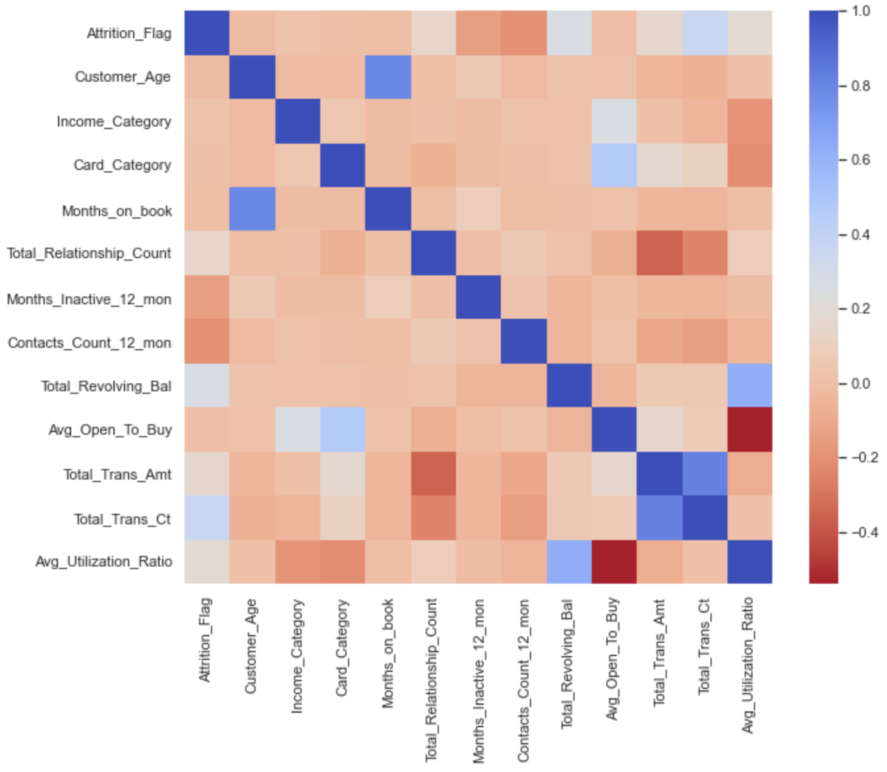
Correlation Matrix: Correlation of All Variables
The below heatmap on correlation matrix shows which pairs of features are correlated, the darker the color the more correlated are the two features.

Slide 18
Hypothesis Testing : Correlation Testing Between Transaction Count and Transaction Amount
The Hypothetical question here is based on analysis we have done so far , the customers who are having less transactions count that means card usage is less tends to close the account or drop-off and customer who uses more card tends to retain the card.
The Null hypothesis in this cases is there is no difference in transaction counts between attrited and non-attrited customers that means transaction counts are same for both customers.
Customers having less transactions meaning they are spending less amount and we saw in above scatter plot that transactions count and transaction amount have positive correlation and the correlation value is:0.81, this means they are strongly correlated.
In this hypothesis test, we are going to test Correlation. Hypothesis Question - There is positive relation between total transactions count and total transactions amount, and both are strongly correlated. This means that existing customers who use card a lot and spend large amount on the other hand attrited customers do not use card much and spend less amount. we will test correlation if it is due to chance or real.
Null Hypothesis - This test to see there is no correlation between total transactions count and total transactions amount and no impact on customers attrition.
Result hypothesis test of correlation performed on the sample , The p-value is 0, which means that after few sample iteration we did not see correlation between these variables, which tells that p-value could be smaller but not 0.
The actual correlation between total transactions count and total transactions amount is 0.81 and the after few iterations the larges simulated correlation is 0.035, though it is small compared to actual, but it is statistically significant.

Slide 19
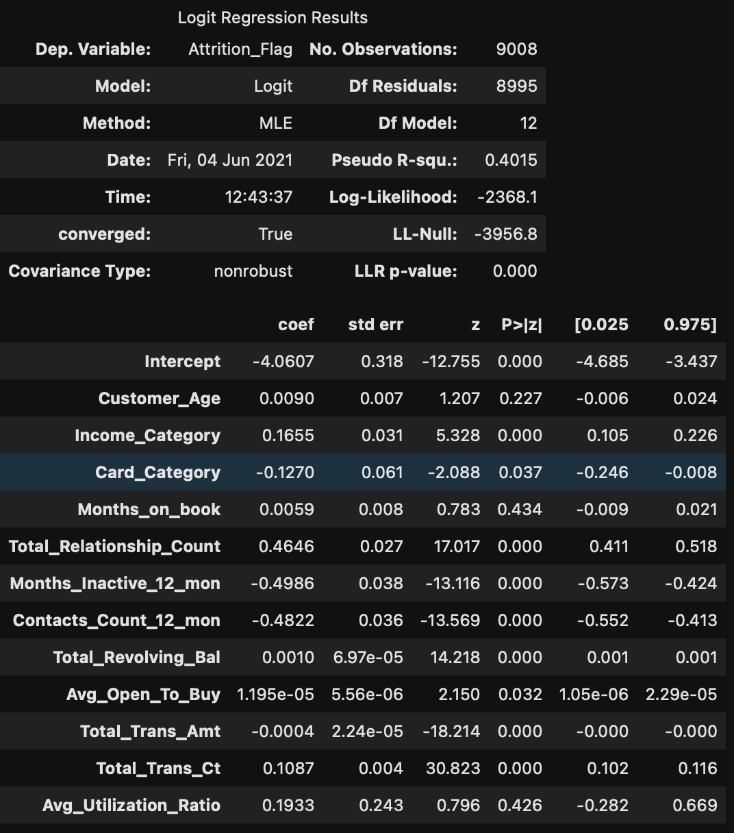
Regression Analysis: Logistic Regression
Since the problem is to identify the customers who are dropping off given the factors (independent variables) that might influence the decision, so this is regression problem and the target or dependent variable is binary, so we are going to perform the logistic regression to predict the customers who are going to churn or not churn.

Slide 20
Regression Result: Analysis Of Result Summary
The method used for this model is - Maximum Likelihood Estimation (MLE), because here our goal is to find the parameter values that maximize the likelihood function. From Above result the Log-likelihood value is -2368.1 and Log-likelihood null value is -3956.8, which tells that LL value when only intercept is the only parameter. when we compare these two values the LLR p-value provides the p-value from a likelihood ratio of the model versus the null model. Here p-value is 0 so we can say that the Log-likelihood value -2368.1 is significant. When we look at the parameters and corresponding p-value, we can conclude that - for each unit increase in the value of below feature (considering all other constant) the log-odds of being classified as non-attrited customer increases by a value of their weight, the p-value is 0.0 or less than 0.05 means statistically significant.
These are the most important features that would impact on customers decision whether to stay or leave.
Income_Category
Total_Trans_Ct
Total_Trans_Amt
Avg_Open_To_Buy
Total_Revolving_Bal
Contacts_Count_12_mon
Months_Inactive_12_mon
Total_Relationship_Count
Card_Category
Income_Category
Also, the 95% confidence interval values for above important features does not cross 0, either positive or negative side and stays with side of 0 which tell that effect of these features on customer decisions in this model is statistically significant.
Lastly, the Pseudo R-squared value is 0.4015, which is the substitute of Least Squares linear regression. It is the ratio of the log-likelihood of the null model to that of the full model.

Slide 21
Regression Analysis: Accuracy of Regression Model
Confusion Matrix -
[[ 724 715]
[ 273 7296]]
The confusion matrix shows how many are True Positive, True Negative and False Positive and False Negative predicted by the model.
Accuracy Score – 0.89 or 89%
Based on above result the accuracy of the model is 0.89 or 89% , which is very good and shows the model is accurate and good for predicting the customer's churn.

