Slide 1
Bellevue University DSC 630 Predictive Analytics
Walmart Sales Forecasting
Nitin Mahajan | Ganesh Kale

Slide 2
Project Introduction:
Intro - Walmart operates Walmart, Walmart Neighborhood Market, Wal-Mart, Walmart.com, and Sam’s Club and retail companies like this commonly having issues with predicting sales accurately throughout the days, months, and years ahead. There are many varying factors that can cause issues with predicting sales.
Goal – Build the Machine Learning model that would learn from past records, events and Predict the Sales forecast for Store and its departments on specific week of the year.
Model - Sales Forecasting is the process of using a company’s sales records over the past few years to predict the short-term or long-term sales performance of the company in the future. This is one of the pillars of proper financial planning. Sales Forecast Model that would learn from the past sales records, events and predict the accurate sales so company will be ready to source appropriate resources before the actual event happens.
Benefits - Business Sales Executives often find themselves scrambling for answers when it comes to sales forecasting during business reviews with their leaderships team. The Sales Forecast Model will help sales executives to find such answers upfront and be ready with numbers and predictions to share with leaderships team. This model would help individual stores to upscale their customer satisfaction by stocking the right products at right time and decrease overstocking and wastage of food products.

Slide 3
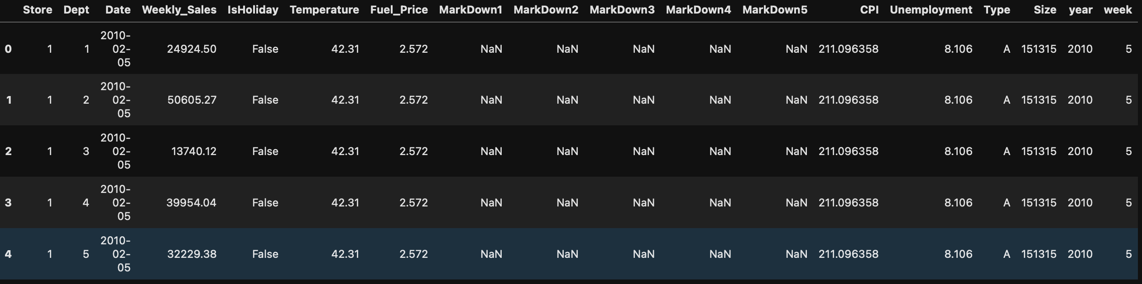
Data Information:
Data Range - The data ranges from February 5, 2010, through November 1, 2012. This file contains anonymized information about the 45 stores, indicating the type and size of store.
Stores Data – This data contains anonymized information about the 45 stores, indicating the store number, type and size of store.
Training Data - This is the historical training data, which covers to 2010-02-05 to 2012-11-01. This would include store number, store department, Date, Weekly Sales of the store for the specific department and holiday or not.
Features data – This data contains additional data related to the store, department, and regional activity for the given dates, such as average temperature in the region, fuel price in that region during that week, promotional markdowns, CPI index value , unemployment rate in the given week.
Data Sample:

Slide 4
Approach:
The goal of the project is to predict Sales value based on different features, here we used Walmart sales records from different stores for different year. To understand the factors impacting Sales Value we followed different methodologies such as understanding the features correlating with sales value, machine learning algorithms to understand what percentage of features account for sale value and Time Series forecasting.
CRISP-DM Methodology - The CRISP-DM methodology is used complete this project.
Feature Correlations - To understand the features driving the sales value, we measured first are there any correlation with features and target variable.
ML Algorithms - There are several Machine Learning(ML) algorithms that are used to predict the value based on historical data. These ML algorithms are used to train the model and evaluated using Root mean Squared error. The model with lowest RMSE score and highest accuracy score is baselined.
Evaluation Metrics –To evaluate each ML model, we used different metrics such as Mean Absolute Error, Mean Squared Error, Root Mean Squared Error and Accuracy.

Slide 5
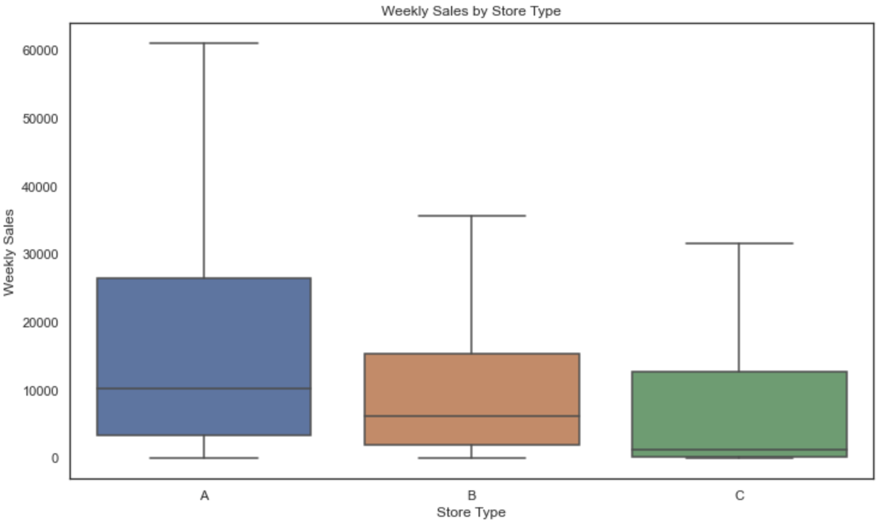
Exploratory Data Analysis:
The Median Weekly Sales for different Store Types.
The Store Type A is having highest Median Weekly Sale compared to other two store types.
Store A’s Median weekly sales is more than 10K
Store A’s 60 Percentile Weekly Sales is higher than 75 Percentile Weekly Sales of other two Stores B & C.
Store Type As Max Median Weekly Sale is higher than other tow stores which is above 60K.

Slide 6
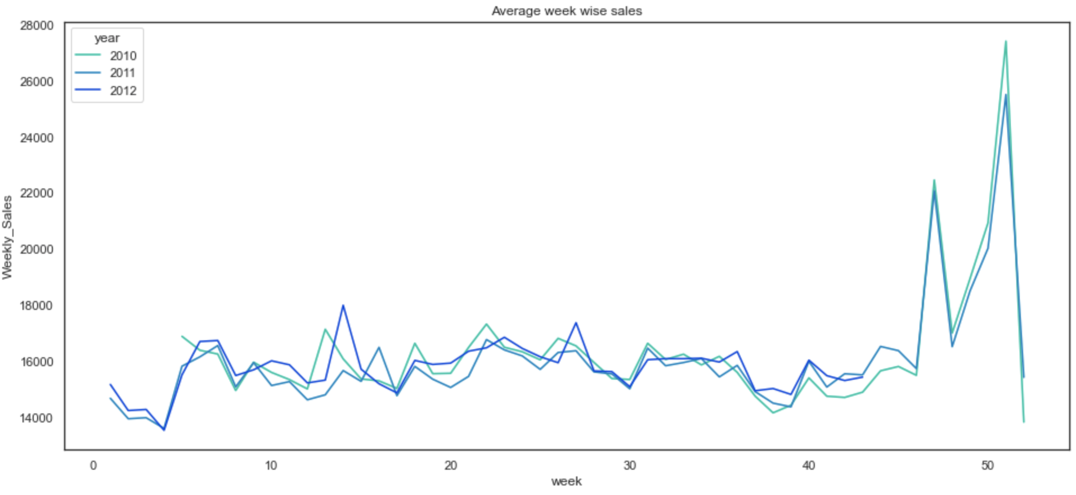
Exploratory Data Analysis:
Average Weekly Sales for 3 different years.
The week of Thanksgiving holiday and one week before Christmas witnessed the highest sales for the years 2010, 2011 and 2012.
In 2012 the week no. 14 recorded the highest sales as compared to other weeks of the year but that doesn't correspond to any holiday or any special event.

Slide 7
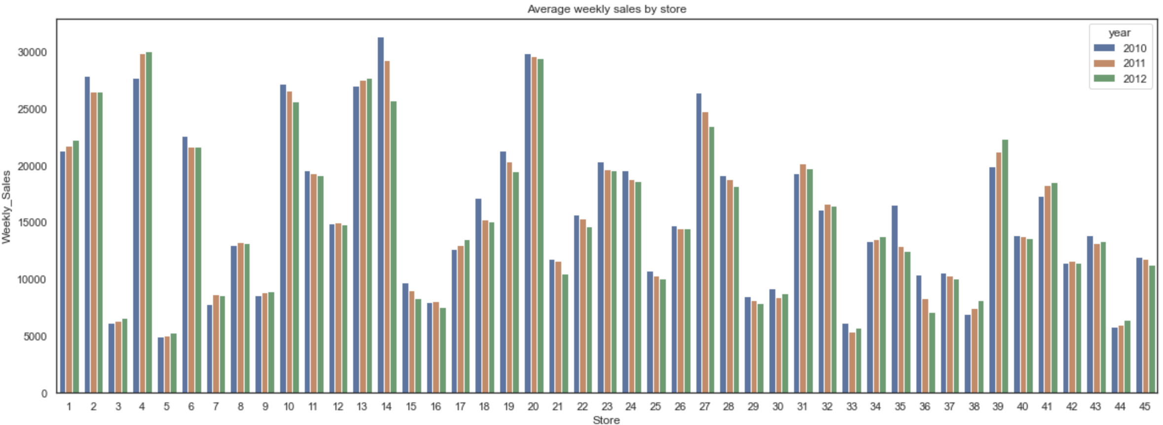
Exploratory Data Analysis:
Average Weekly Sales by Stores for 3 different years.
The stores 2,4,10,13,14 and 20 showed the highest sales in all the 3 years.
There are 10+ stores having average weekly sales less than 10K.
The overall trend of store sales over the 3 years remains the same as it depends on the type of store and its size.

Slide 8
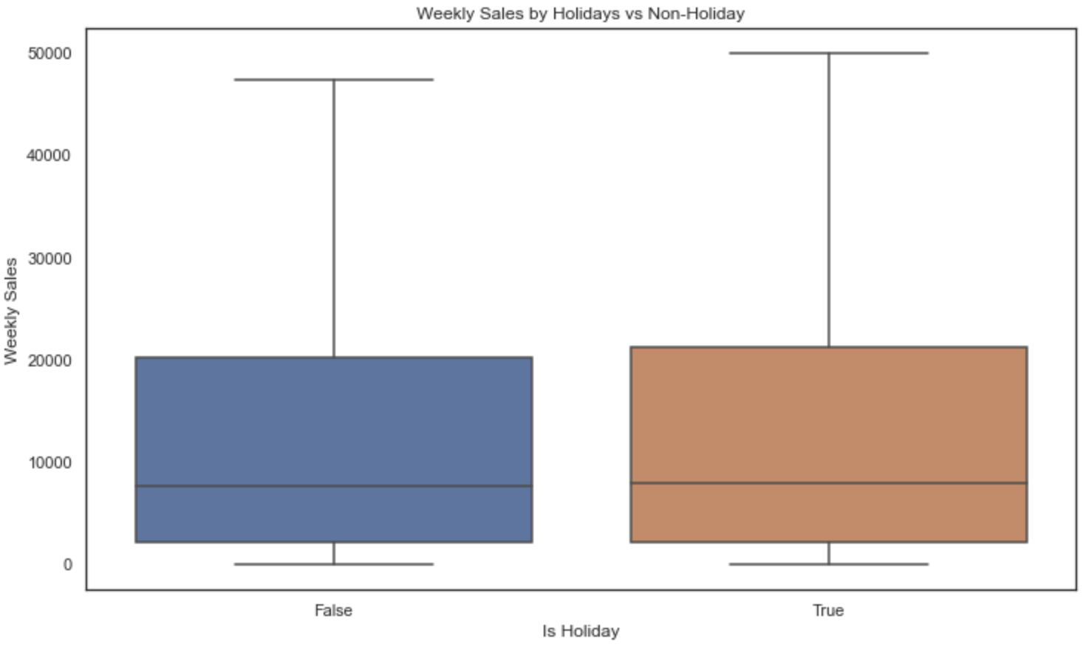
Exploratory Data Analysis:
Weekly Sales by Holiday vs non-holiday weeks.
The median weekly sales for weeks with holiday and without holiday are almost same.
The 75 percentile weekly sales for holidays weeks is slightly higher than non-holidays weeks.
The max weekly sales for holidays is higher than non-holidays weeks.

Slide 9
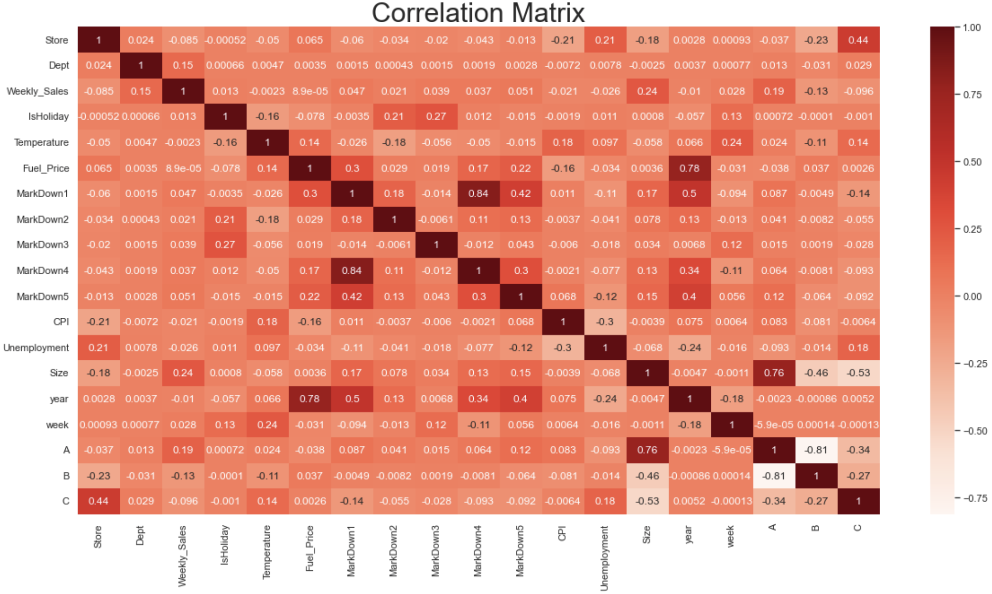
Feature Correlation:
Correlation matrix provides range from 0 to 1 between feature pairs and with target variable. The correlation value if positive and close to 1, then it denotes these two features are having string correlation and vice versa.
Department, Store size and Type have moderate correlation with the weekly sales.
Markdown1-5 have very weak correlation with the weekly sales.
Temperature. Fuel price, CPI and Unemployment are very weakly correlated with the weekly sales.

Slide 10
Modeling:
Why Modeling – Modeling is very important in order understand insights from the data, the Machine Learning models can pick up new patterns from data which human can not recognize.
Since the target variable which is Weekly Sales is numeric data, the regression models are best to predict continuous variables, there are several regressor out, can be used for predicting weekly sales based on certain factors. Below are top 4 ML algorithms used for training data.
KNN Regressor – The KNN algorithm uses 'feature similarity' to predict the values of any new data points. This means that the new point is assigned a value based on how closely it resembles the points in the training set.
Decision Tree Regressor – It breaks down a dataset into smaller and smaller subsets while at the same time an associated decision tree is incrementally developed. The result is a tree with decision nodes and leaf nodes.
Random Forest Regressor – The random forest is a meta estimator that fits a number of classifying decision trees on various sub-samples of the dataset and uses averaging to improve the predictive accuracy and control over-fitting.
XGBoost Regressor – When using gradient boosting for regression, the weak learners are regression trees, and each regression tree maps an input data point to one of its leaf's that contains a continuous score.
Assessment – To baseline model, each model is evaluated using test data set for different metrics such as Mean Absolute Error, Root Mean Squared Error and Accuracy and the model with lowest RMSE and Highest Accuracy will be baselined.

Slide 11
Result Summary:
4 Different algorithms are used to train the data for building Sales Forecasting.
Each Regressor is trained and tested on train and test data. Evaluated for different metrics such as Mean Absolute Error, Root Mean Squared Error and Accuracy.
This table shows the metrics values for each regressor.
Random Forest Regressor and XGBoost Regressor having better accuracy, compared to KNN and Decision Tree regressors.
XGBoost Regressor has lower RMSE compared to other three.
XGBoost Regressor is the baseline model and will be treated as Sales Forecast Model.
Sr# | Model Name | Mean Absolute Error (MAE) | Root Mean Squared Error(RMSE) | Accuracy %
1 | KNN Regressor | 11340.06 | 18415.51 | 34.12%
2 | Decision Tree Regressor | 1874.26 | 4923.54 | 95.29%
3 | Random Forest Regressor | 1448.17 | 3576.67 | 97.51%
4 | XGBoost Regressor | 1717.73 | 3463.60 | 97.67%

Slide 12
Challenges:
Challenges Faced:
The first and fore most challenge was faced in data gathering, since this is Sales Forecast Model, identifying the appropriate stores that would represent other stores was key, since model should learn from these and help to predict for other stores as well.
The second challenge faced was to handle markdown data, Since these are promotions offered by Walmart through out the year, the data was not available for all the stores for all times.
Challenges Resolved:
The data issues was resolved by making sure data is gathered from different stores performing high weekly sales, low weekly sales and medium weekly sales, this way data will have balance and made sure its from different demographics.
The markdown issues was resolved by finding null values and found 70% of the markdowns data was null and compared the average weekly sales during markdowns with non-markdown average weekly sales and found that the markdown average weekly sales are much lower compared with non-markdown average weekly sales so it would not influence the target variable and removed them before modeling.

Slide 13
Next Steps:
ARIMA Model – Projecting Sales forecast is a time series data ARIMA (Auto Regressive Integrated Moving Averages) model is useful on predicting values on time series data. The result of this model will be compared with XGBoost Regressor Model, and the model will be baselines model based on lower RMSE and Higher accuracy score.
Model re-training or Tunning – The baseline Sales Forecast Model will be tested with latest real data for accuracy and based on the score if the data need to be updated with latest data or model will be re-trained or fine tunned by updating the certain hyper parameters.
Deployment – The baseline model with highest accuracy score and lowest RMSE value, will be deployed to production box to predict the stores weekly sales and communicated to respective persons thru proper channel for appropriate actions.
Monitoring – The prediction values and exceptions if any are logged into appropriate system for better performance.
Real Time Evaluation – The predicted sales values are compared with real values after certain months and model prediction will be assessed.

Slide 14
References:
Data Source: https://www.kaggle.com/c/walmart-recruiting-store-sales-forecasting/overview
XGBoost Hyperparameter Tunning: https://towardsdatascience.com/xgboost-fine-tune-and-optimize-your-model-23d996fab663
ARIMA Model Info - https://www.machinelearningplus.com/time-series/arima-model-time-series-forecasting-python/
https://www.analyticsvidhya.com/blog/2018/08/auto-arima-time-series-modeling-python-r/

Slide 15
Thank You !!!

