Slide 1

Bellevue University DSC 640 Data Presentation & Visualization
Ganesh Kale

Slide 2

Background
The main purpose of this analysis was to provide facts on –
Airline travels are safe.
No impact of negative publicity by media on sales.
To understand the airline incidents and fatalities historical data is compared with latest data of worldwide airlines.
Airlines economical data is considered to see if there is any impact of overall profit and public demand.

Slide 3
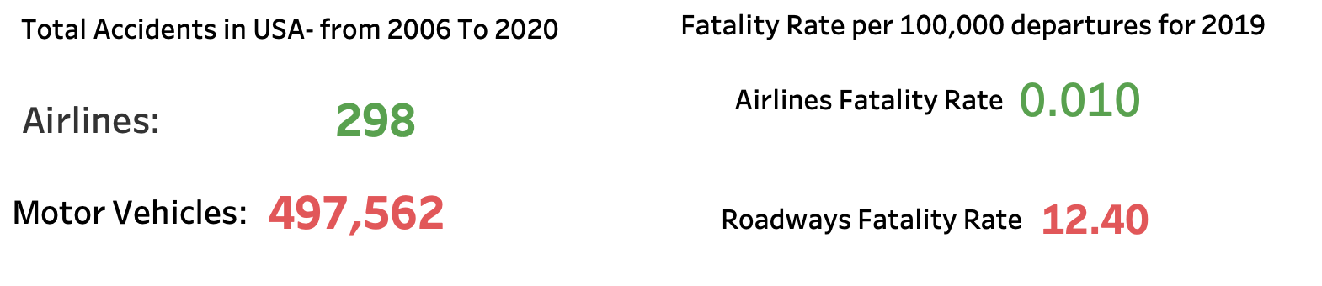
Is air travel safe ?
The Airlines accidents are ONLY 0.06% of motor vehicles
Fatality Rate of Airlines for Year 2019 is much less than Roadways
Based on these numbers Air travel is the safest form of transport

Slide 4
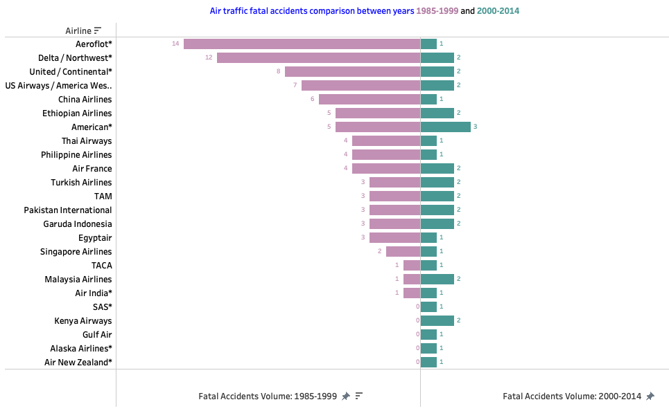
Are air traffic fatal accidents more in recent years ?
The Airlines fatal accidents are very less in recent years (200-2014) compared to prior years(1985-1999)

Slide 5
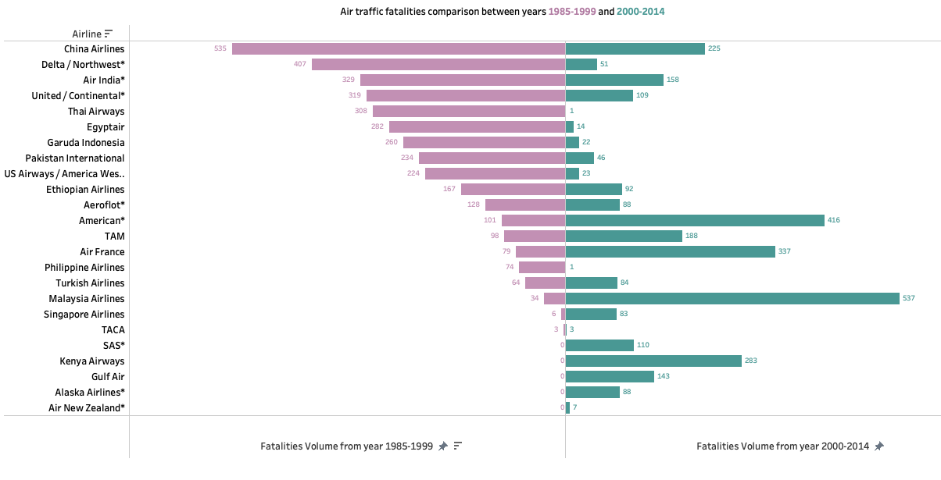
Are air traffic fatalities increased?
The fatalities caused by air traffic accidents are gone down in recent years(200-2014)

Slide 6
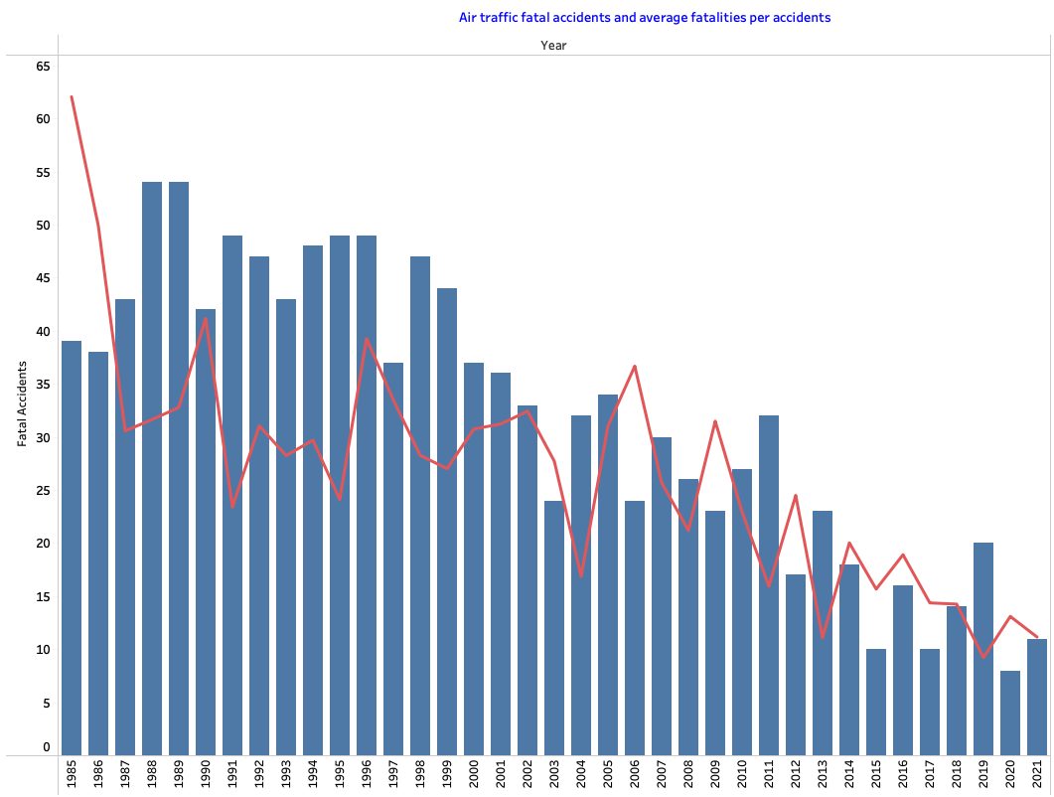
Air traffic fatal accidents and Average Fatalities
The Airlines fatal accidents and fatalities per accidents are going down

Slide 7
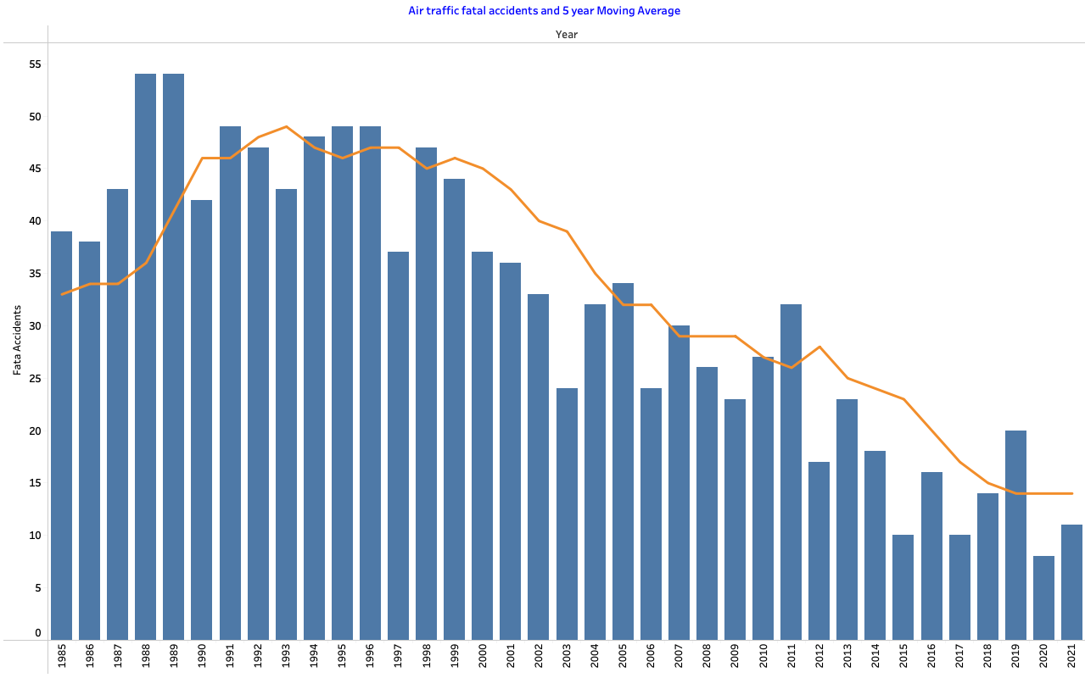
Air traffic fatal accidents and 5 year moving average
The Airlines fatal accidents and 5-year moving average are going down

Slide 8
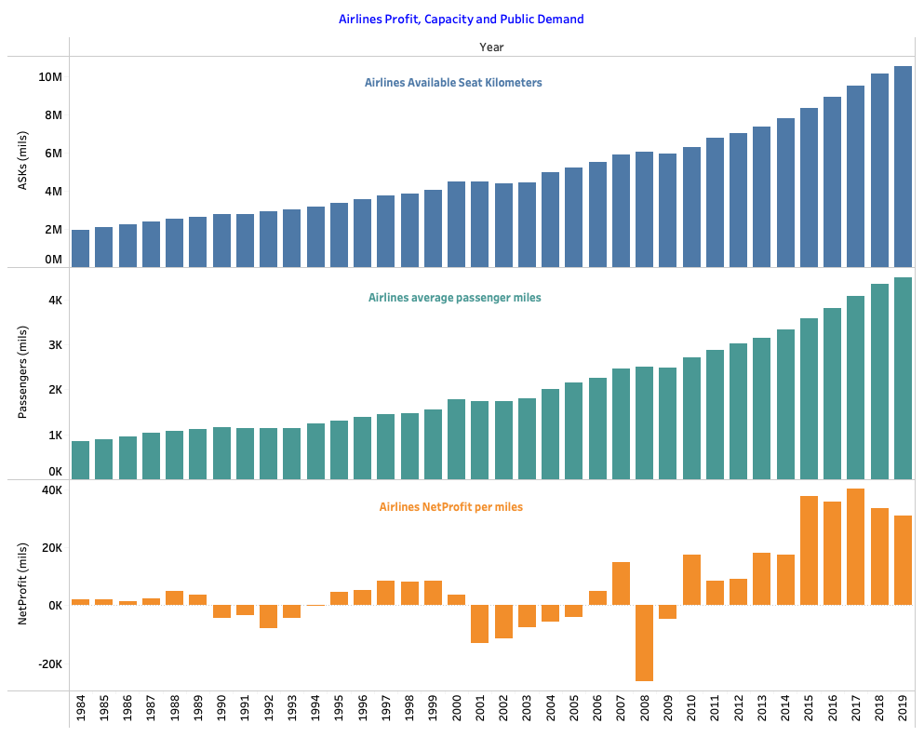
Was there any impact on airlines due to bad publicity ?
Airlines available seat multiplied by air miles is increasing
The Airlines overall profit is growing in recent years
Demand for Air travel is increasing as airlines average passenger miles is increasing
Based on these airlines year over year net profit, its capacity and public demand to air travel increasing

Slide 9
Conclusion
Based on this analysis, we were able to clarify two things are:
Airline travel is still safest way of travel.
There is no impact on net profit and public demand of air travel is increasing and will improve sales.

Slide 10
APPENDIX

Slide 11
Dashboard

