Slide 1
Statistical modeling of ChIP-seq dynamics data
Greg & Austin
05/09/19

Slide 2
Modeling problem
Linear model (LM): y = Xβ + 𝝴
y – outcome
X – matrix of predictors
β – predictor effects
𝝴 – Random noise
Key challenges
Standard linear regression expects noise to be normally distributed
Outcome (y) is a proportion
Noise is assumed to be independent for LM
Longitudinal data results in correlated datapoints
Need to acknowledge this complexity in the statistical model
Generalized Linear Mixed Model (GLMM)
Specifically Beta Regression with random effects
Hard to do this with “classical” statistical tools (Frequentist)
Bayesian tools – Stan
Cutting-edge Bayesian computational tool

Slide 3
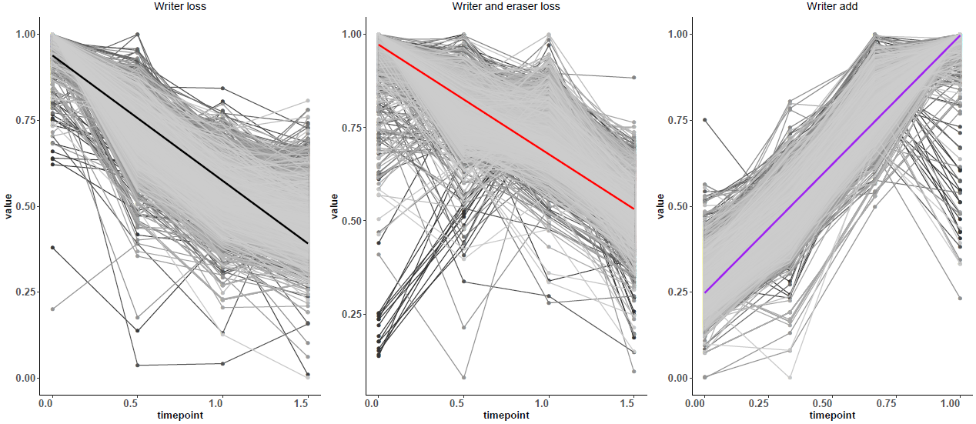
Means at the time points
See some obvious trends
This viewpoint ignores the correlation between experimental units
3 observations of trends with times per gene per assay

Slide 4
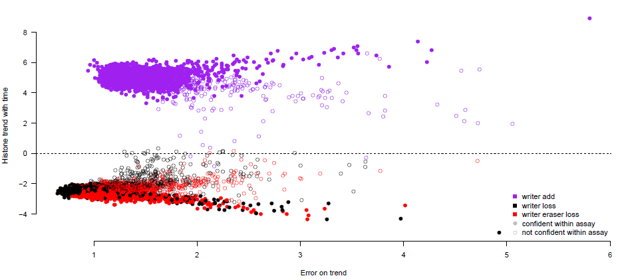
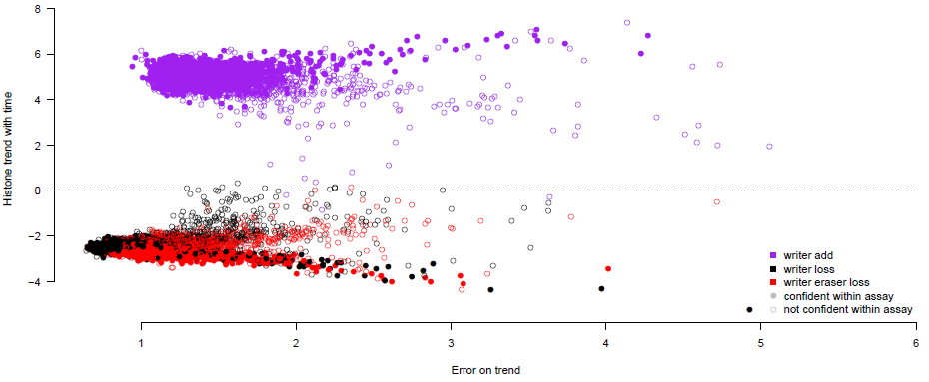
Single gene x assay model results
** Estimates have greatly stabilized -- previously we had some extreme estimates with high error – by increasing the number of samples/iterations
Fit model per gene per assay
E[g(y)] = intercept + β_{time}X_{time} + e
Grab β_{time} and 95% Credible interval (CrI; Bayesian version of a confidence interval)
Genes that have a CrI that don’t include 0 are what we’re calling “confident genes”
Confident within own assay
Confident across all assays

Slide 5
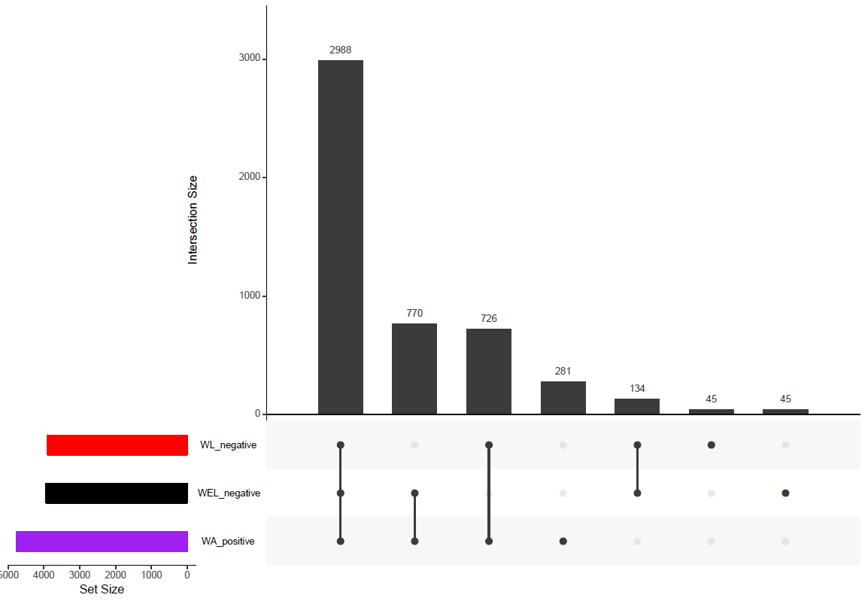
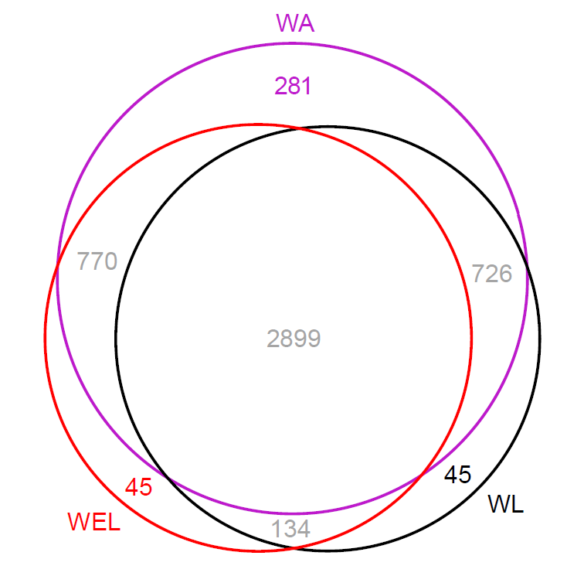
Single gene and assay model results
** For this presentation: Writer add (WA) = set2-gain Writer loss (WL) = set2-loss
Writer-Eraser loss (WEL) = set2-loss;rph1Δ

Slide 6
Single gene and assay model results
** For this presentation: Writer add (WA) = set2-gain Writer loss (WL) = set2-loss
Writer-Eraser loss (WEL) = set2-loss;rph1Δ
High confidence gene set

Slide 7
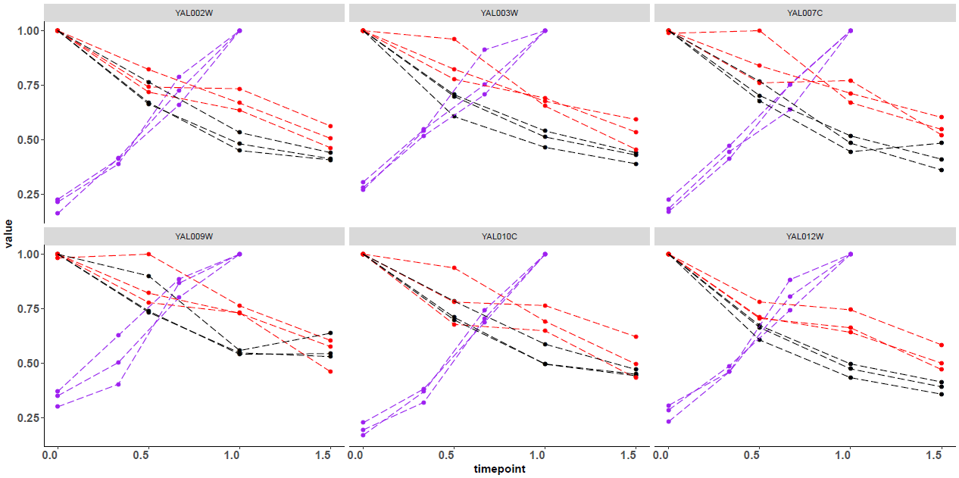
Genes with significant trends (95% CrI do not include 0)

Slide 8
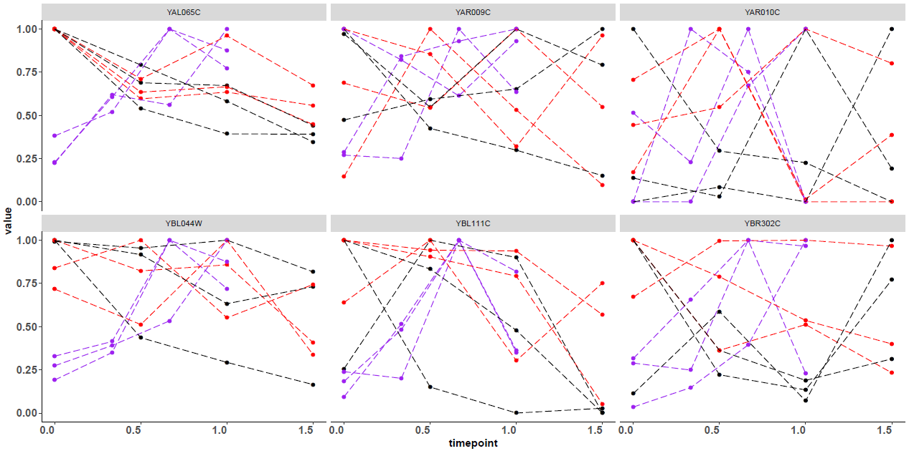
Genes with no trends (95% CrI covers 0)

Slide 9
So now that we have the model and estimates, what is next?
Is there statistical/modeling evidence of a “lag” in H3K36me3 decrease in set2-loss;rph1Δ vs set2-loss?
Correlations in the data (outside of gain/loss estimates, “intrinsic” to yeast):
Gene length vs starting histone levels
Starting histone levels vs Starting transcription levels
Correlations in the model estimates:
Histone estimate vs gene length
Histone estimate vs starting histone levels
Histone estimate vs transcription levels
Histone estimates between assays; WA vs WL

Slide 10
Do we see evidence of a “lag” in WEL compared to WL?
Jointly model, and thus compare WEL and WL
E[g(y)] = intercept + β_{time1}X_{time1} + β_{time2}X_{time2} + β_{time3}X_{time3} +
intercept_{WEL} + β_{time1 x WEL}X_{time1} + β_{time2 x WEL}X_{time2} + β_{time3 x WEL}X_{time3} + e

Slide 11
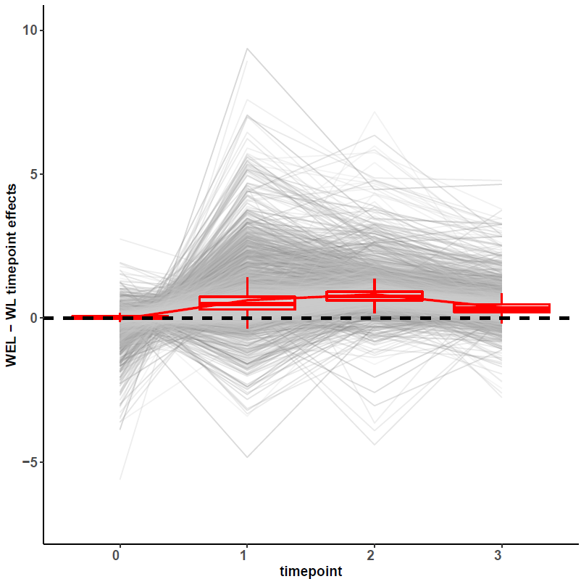
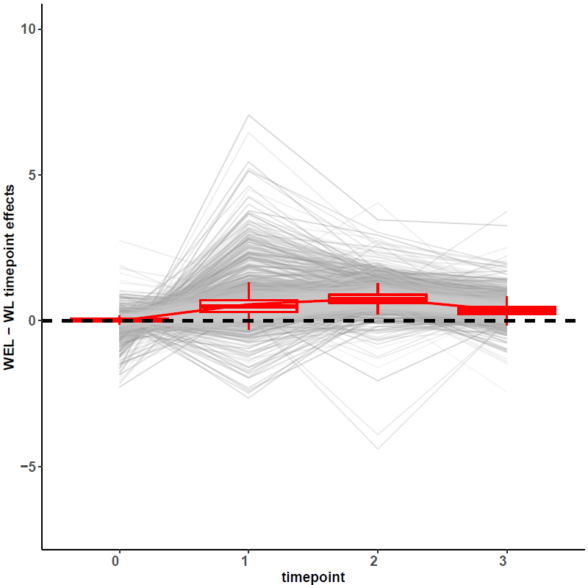
Do we see evidence of a “lag” in WEL compared to WL?
Modeled WL directly to WEL
All genes
High confidence genes

Slide 12
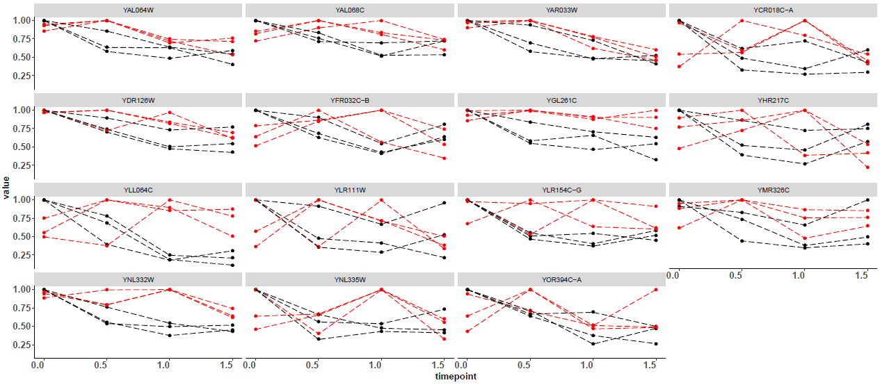
Do we see evidence of a “lag” in WEL compared to WL?
Modeled WL directly to WEL
Significantly lagged genes tend to be “noisier” in regards to following the standard trend.
Based on CrI for β_{time i x WEL}

Slide 13
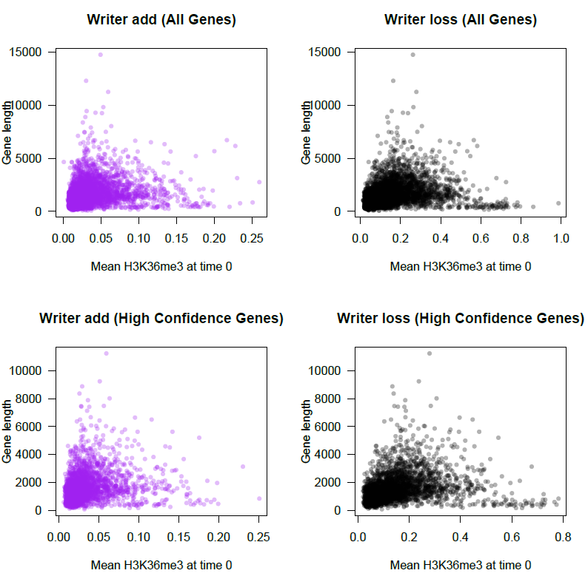
What’s the relationship between gene length and initial histone levels?

Slide 14
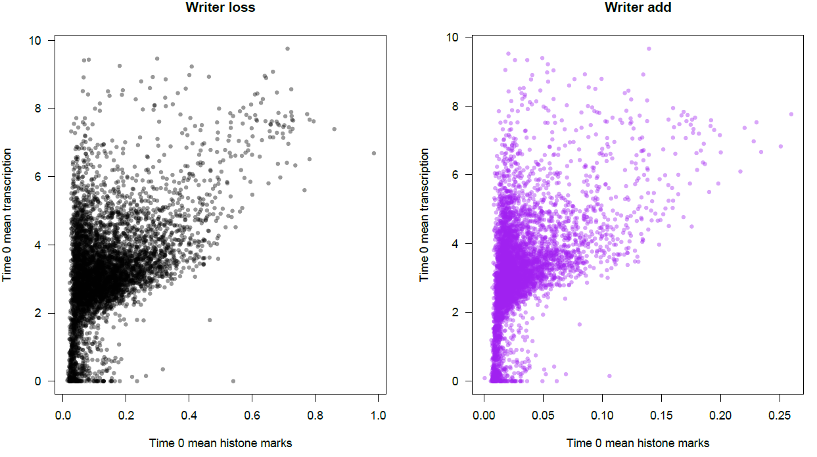
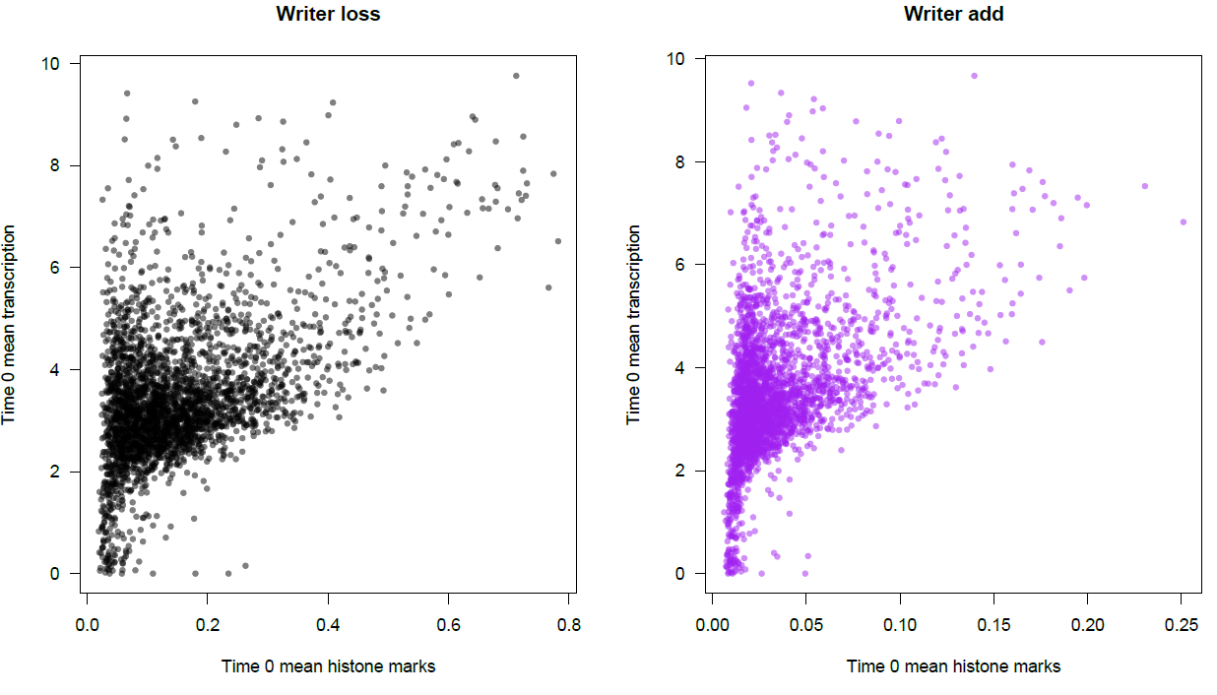
Do we see the expected relationship between histone levels and RNA abundance?
All genes
High confidence genes

Slide 15
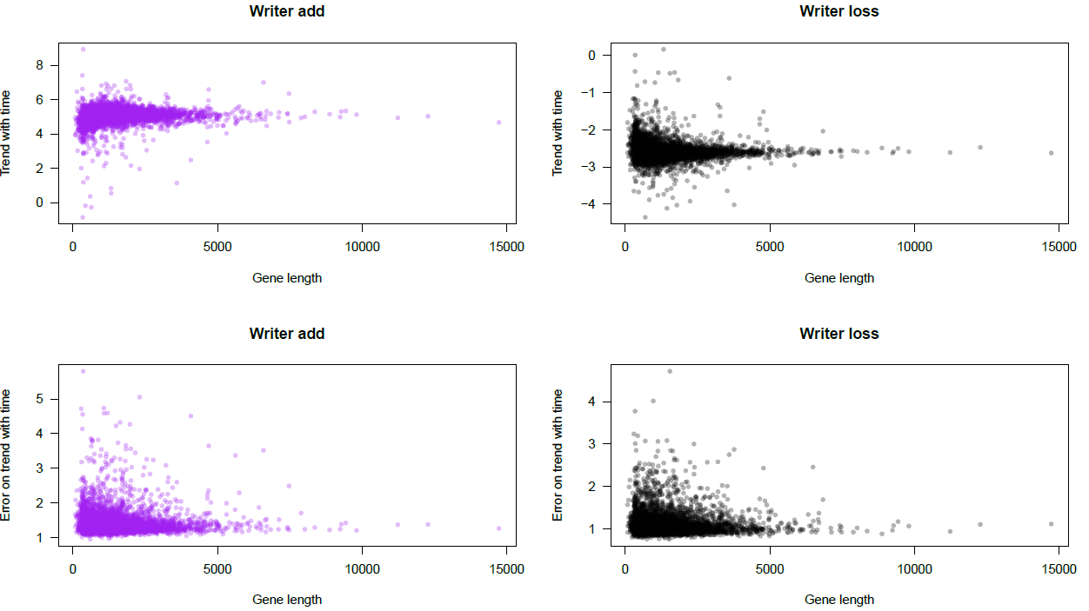
Using the GLMM estimates, is there a relationship to gene length? (All genes)

Slide 16
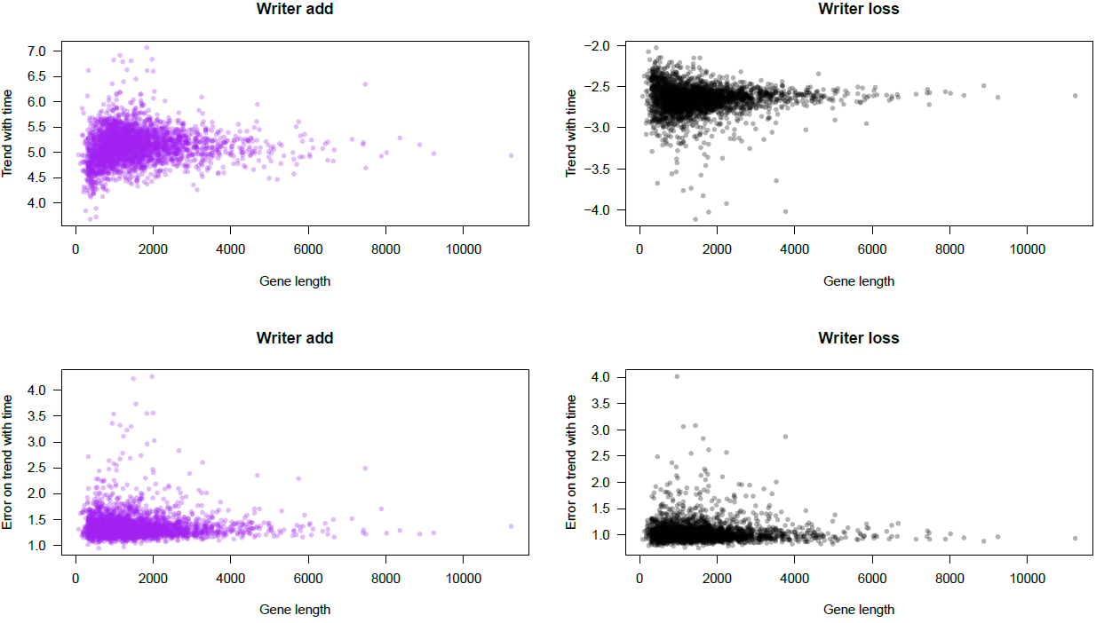
Using the GLMM estimates, is there a relationship to gene length? (High confidence genes)

Slide 17
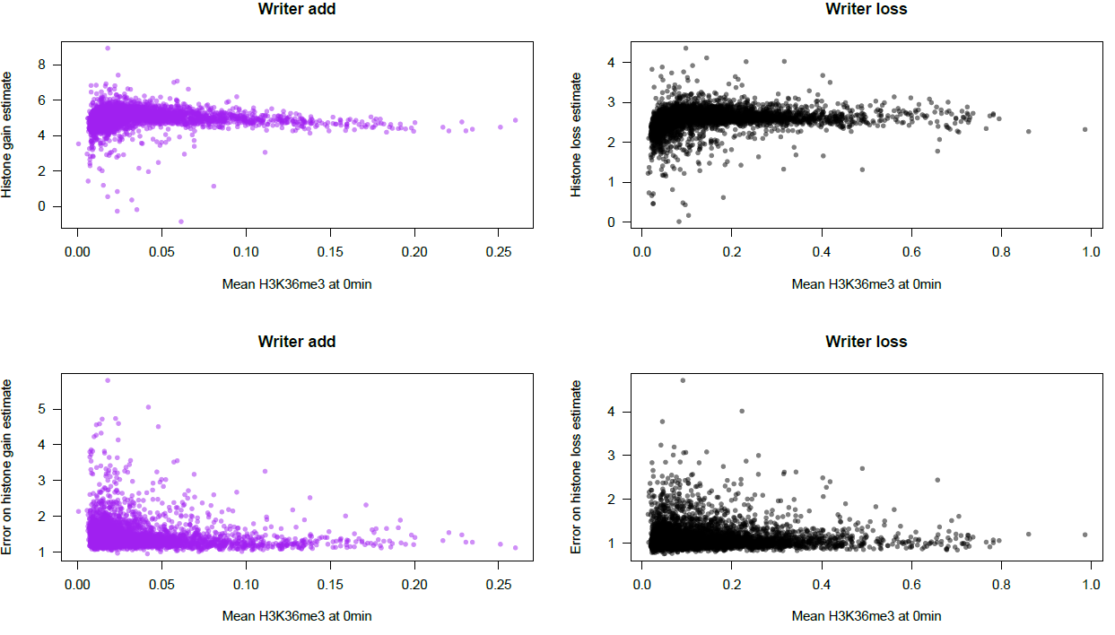
Using the GLMM estimates, is there a relationship to initial histone levels? (All genes)

Slide 18
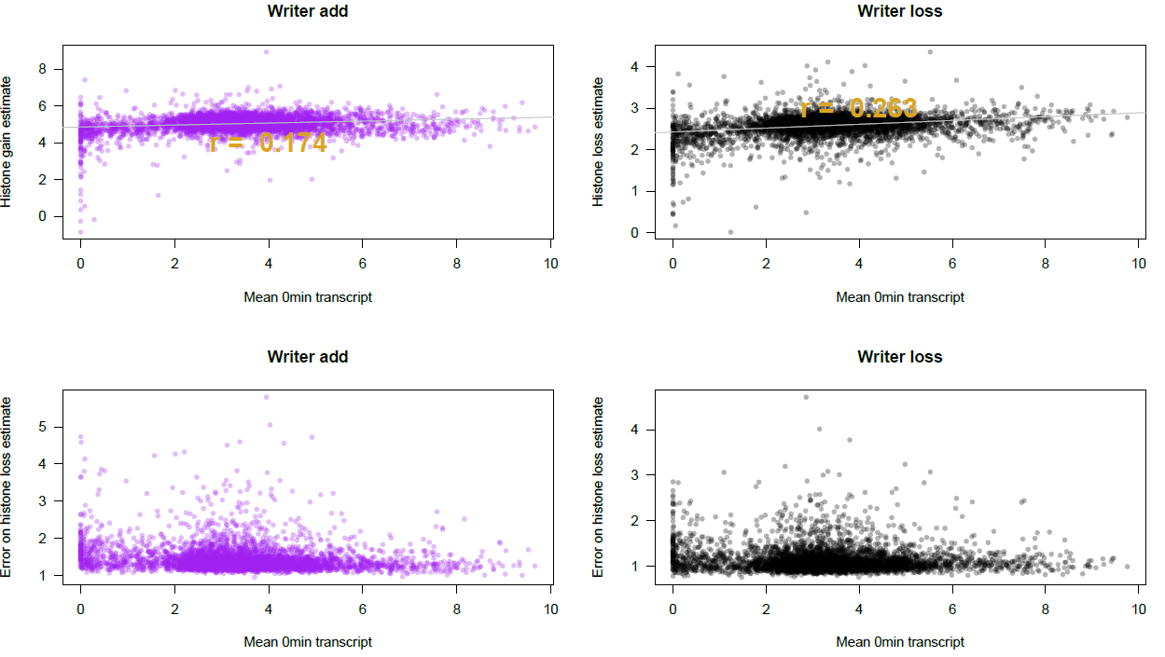
Using the GLMM estimates, is there a relationship to transcription levels? (All genes)

Slide 19
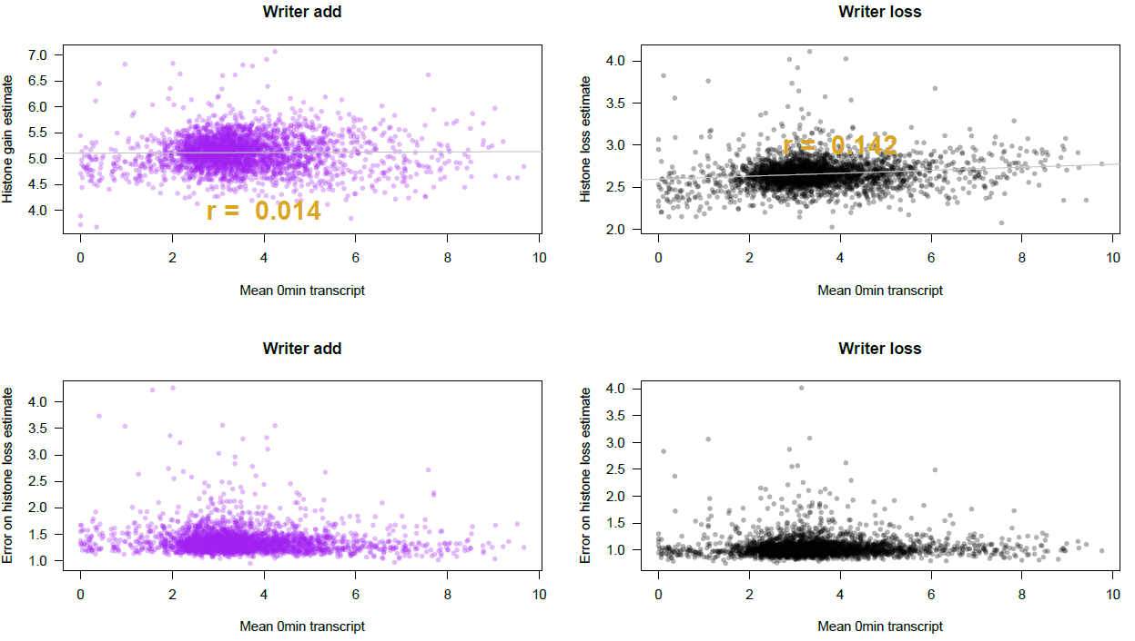
Using the GLMM estimates, is there a relationship to transcription levels? (High confidence genes)

Slide 20
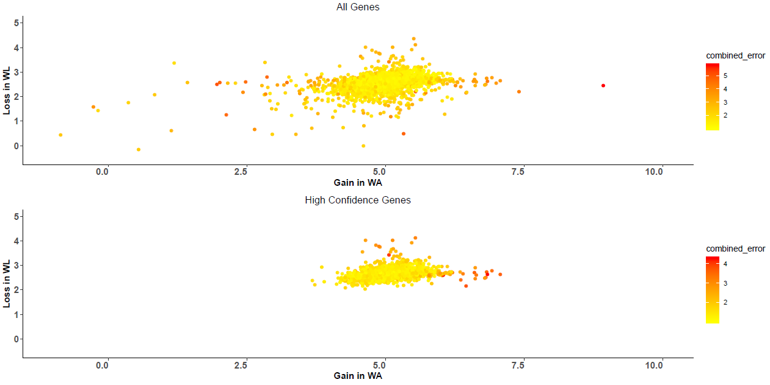
How correlated are GLMM estimates between the two (WA and WL) assays? Do genes tend to have similar gain/loss effects?

Slide 21
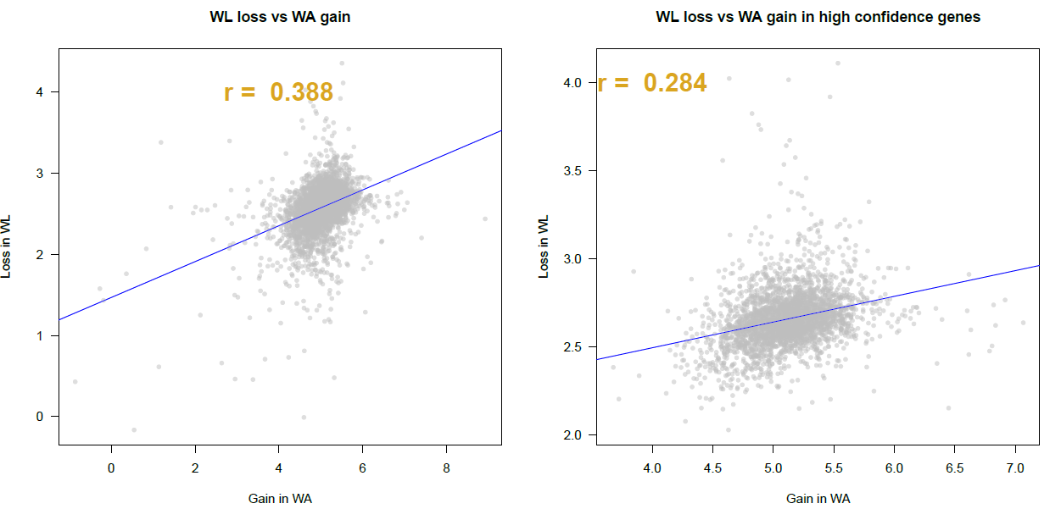
How correlated are GLMM estimates between the two (WA and WL) assays? Do genes tend to have similar gain/loss effects?

Slide 22
We can color plots to visualize three variables at once to see further underlying patterns. Does this affect our previous interpretations?

Slide 23
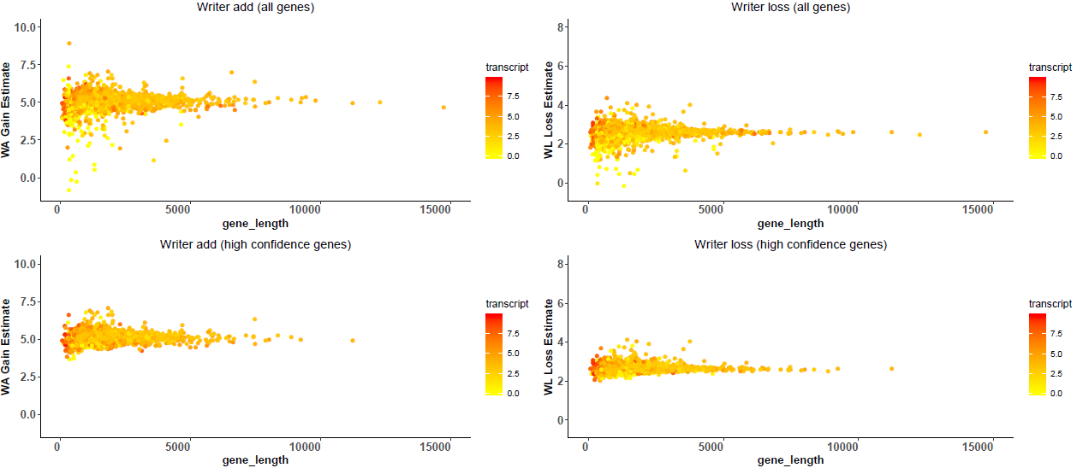
Using the GLMM estimates, is there a relationship to gene length? (Colored by RNA abundance)

Slide 24
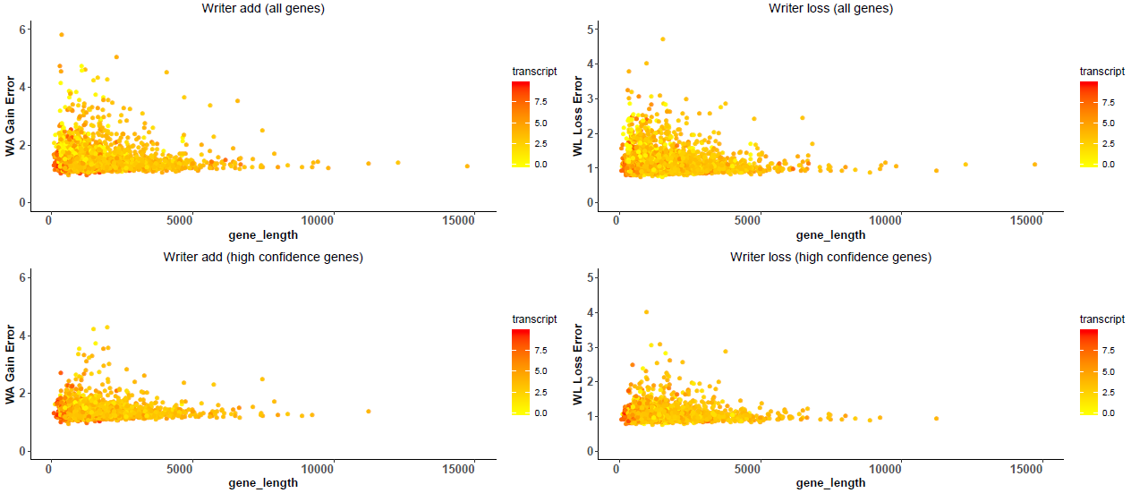
Using the GLMM estimates, is there a relationship to gene length? (Error plots, colored by RNA abundance)

Slide 25
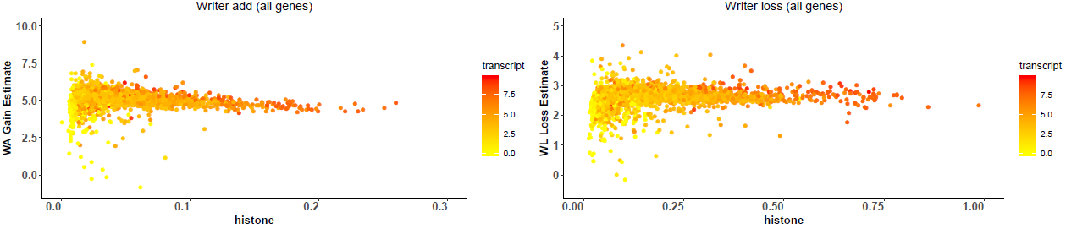
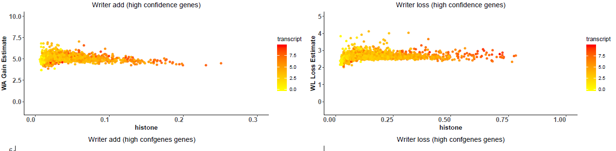
Using the GLMM estimates, is there a relationship to histone levels? (Colored by RNA abundance)

Slide 26
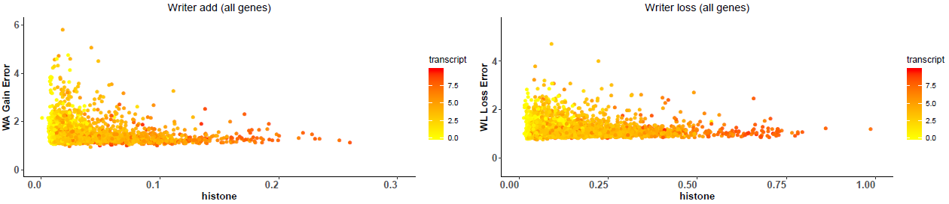
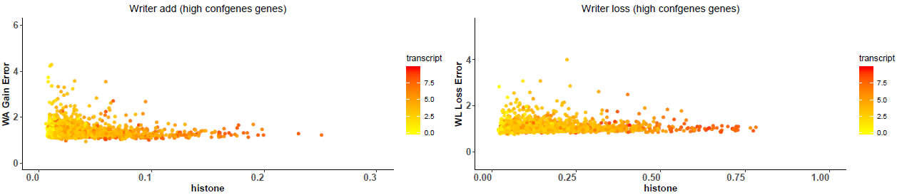
Using the GLMM estimates, is there a relationship to histone levels? (Error plots, colored by RNA abundance)

Slide 27
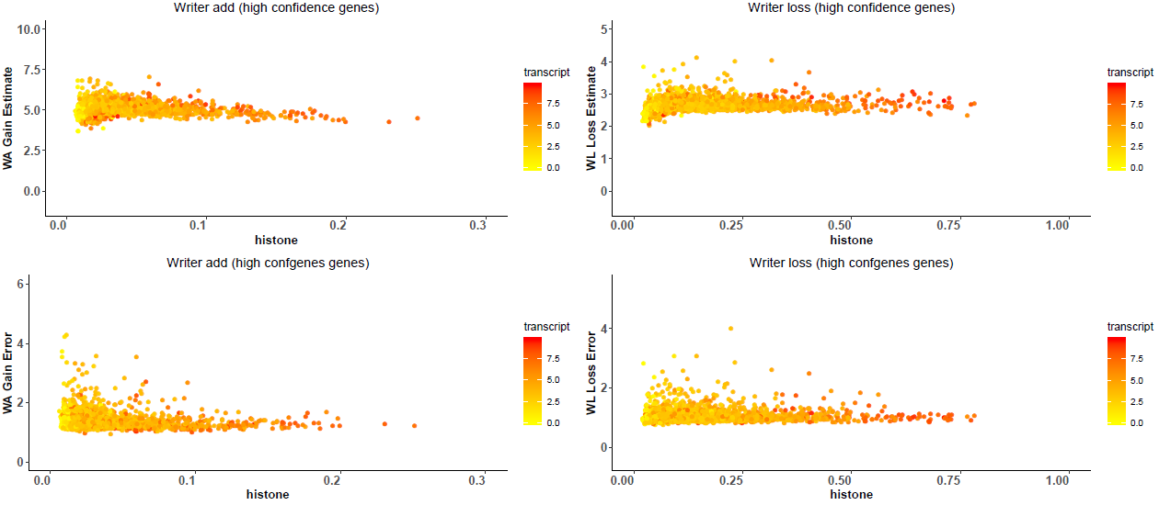
Using the GLMM estimates, is there a relationship to histone levels? (Colored by RNA abundance)

Slide 28
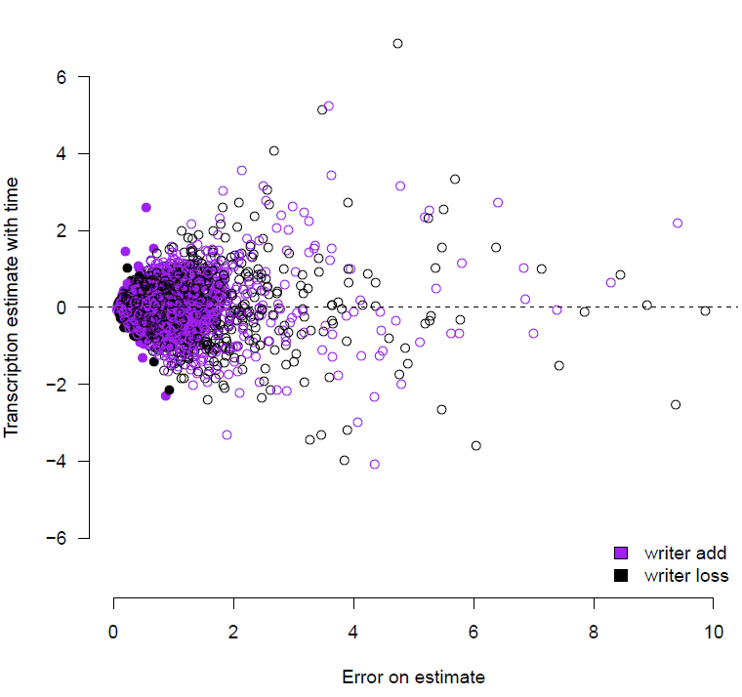
Transcription GLMM
y: transcript levels
y ~ log norm + hurdle
hurdle: allow for 0 inflation
E[g(y)] = intercept + β_{time}X_{time} + β_{histone}X_{time} + e

Slide 29
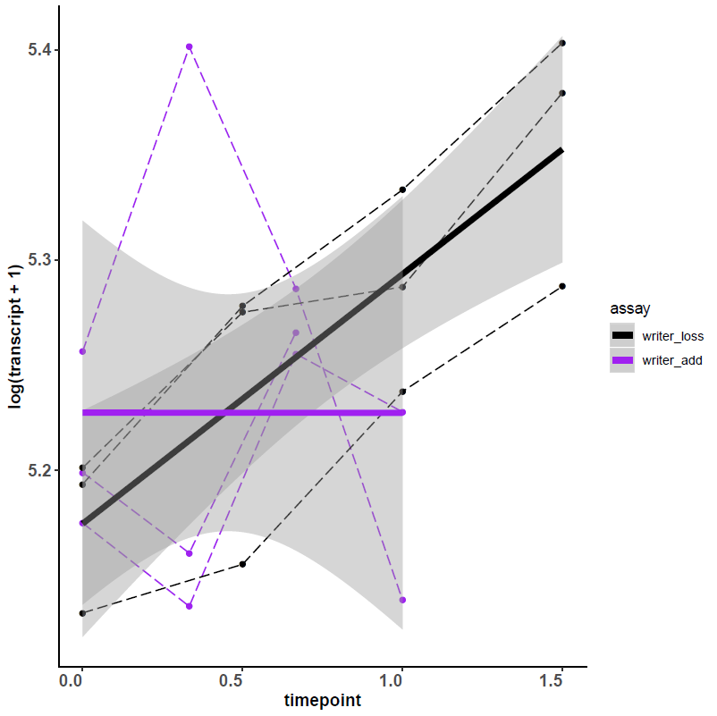
Positive txGLMM estimate example (YFR044C)

Slide 30
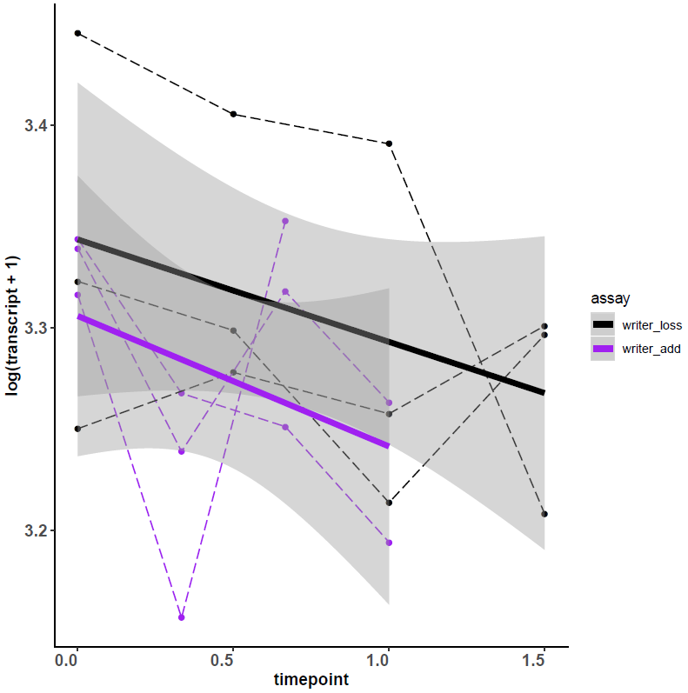
Negative txGLMM estimate example (YCL002C)

Slide 31
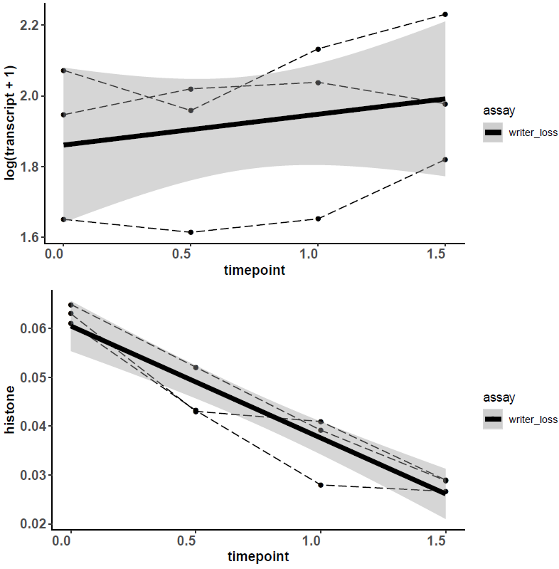
Confident gene example from both txGLMM and histone GLMM (YDL216C)

Slide 32
Modeling Tx and non-proportional histone marks
Want to spend a little more time fine-tuning these GLMMs
Shouldn’t over-interpret beta regression coefficients as the scale is kind of artificial
Valid approach for recognizing patterns
Potentially interesting to see how results differ on a more raw form of the data
Noisier because data is less standardized
Coefficients likely have more meaning

