Slide 1
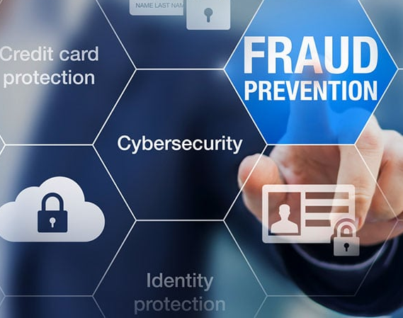
CREDIT CARD FRAUD DETECTION
TEAM MEMBERS:
Gayathri Sundareshwar
Keerthana Gopikrishnan
Deepasha Jenamani
Pallavi Jain

Slide 2
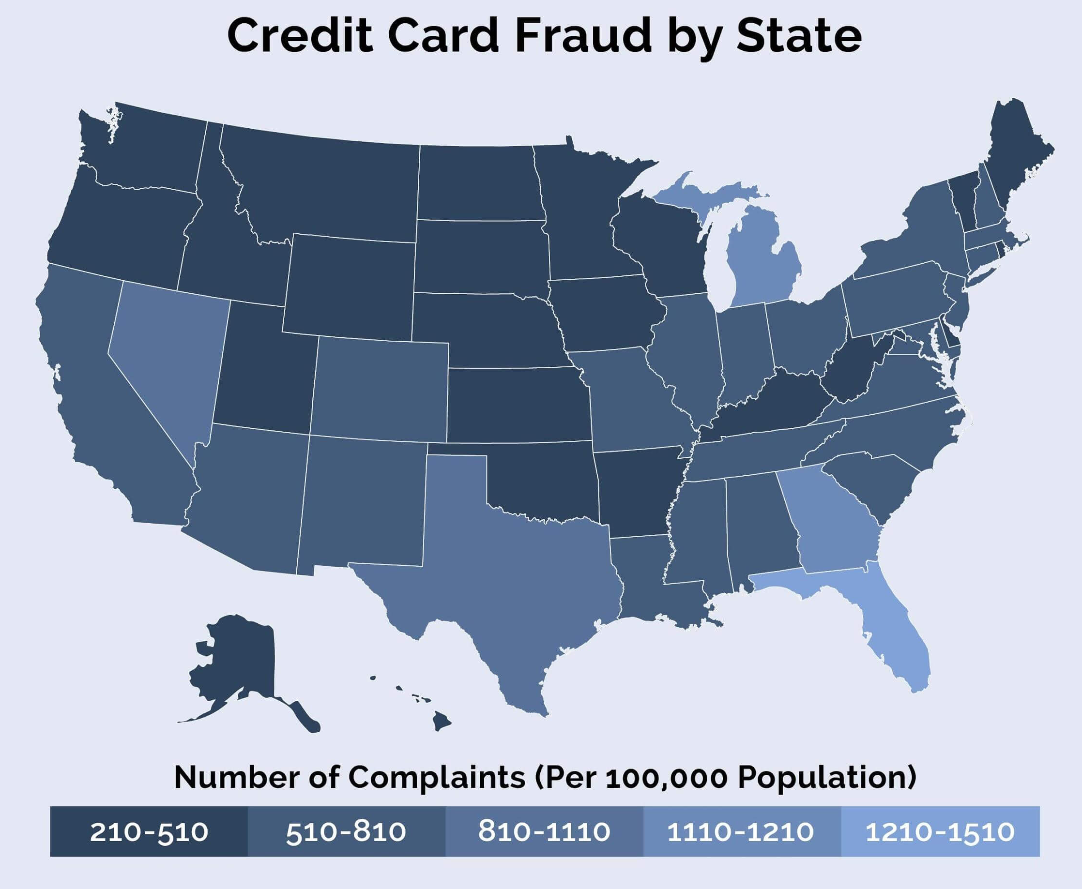
Problem Definition
What is fraud and how common It is?
Why Credit Card Fraud Detection?
Reasons for fraudulent transactions:
No proper method to detect in timely manner.
Anyone with card information can access.
Can be tracked only after occurrence.
Initial approaches for detecting fraudulent transactions

Slide 3
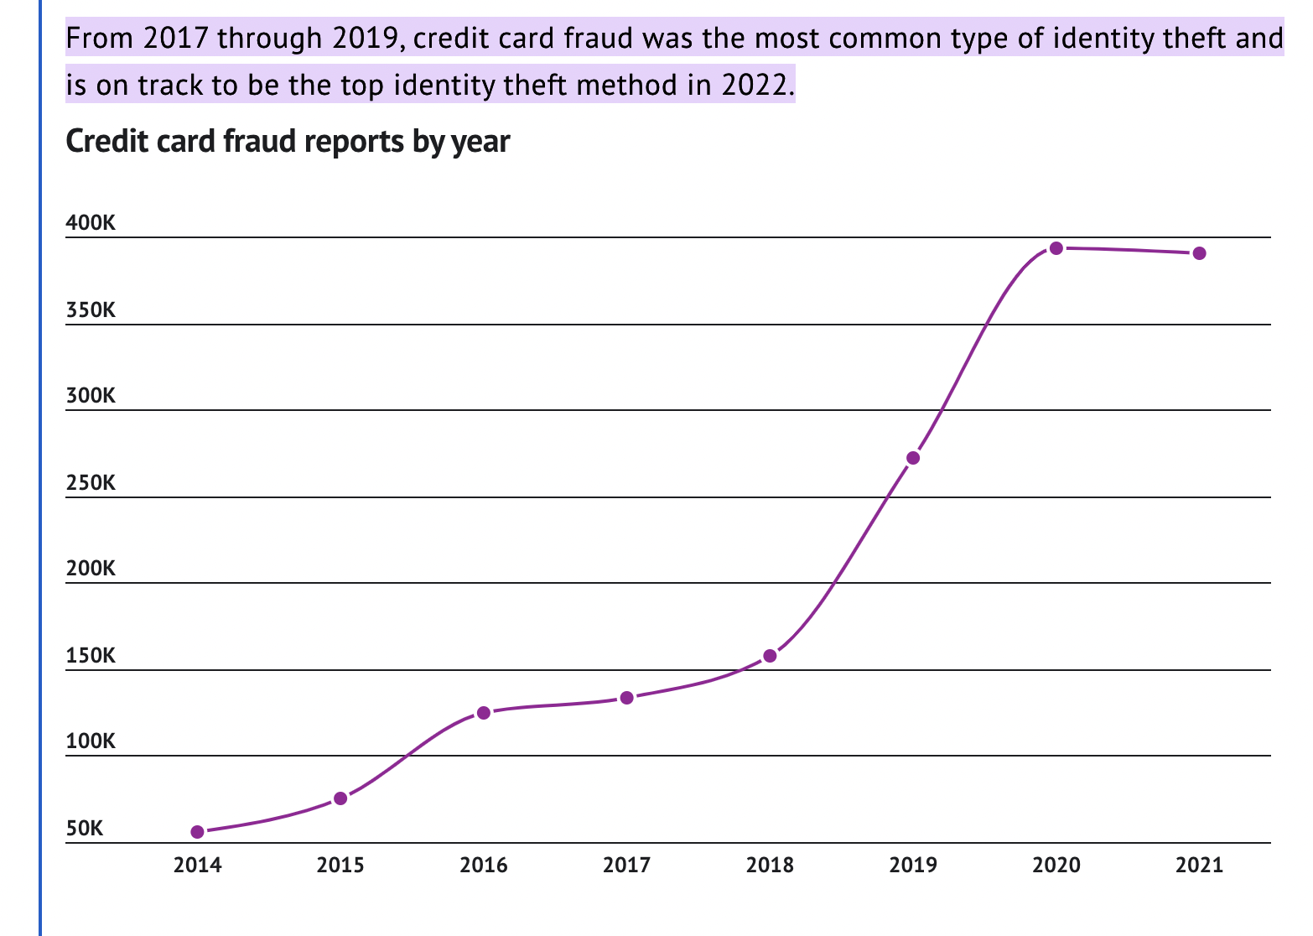
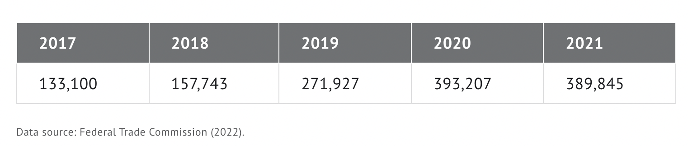
Problem Definition – Cont’d
From 2017 through 2019, credit card fraud was the most common type of identity theft.
In 2022, it is on track to be the top identity theft method in 2022

Slide 4
Business and Data Understanding
Identified Project goals
Timely categorization of fraudulent transactions.
Ability to enhance further and support with timely detection.
Experimenting with various ML Techniques and identifying the best-suited model
Gathering Project and Data Requirements
Identifying the potential data sources.
Finalizing the dataset and exploring it further to enhance its usage.

Slide 5
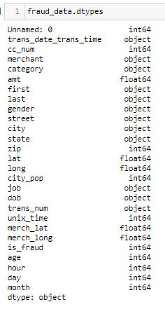
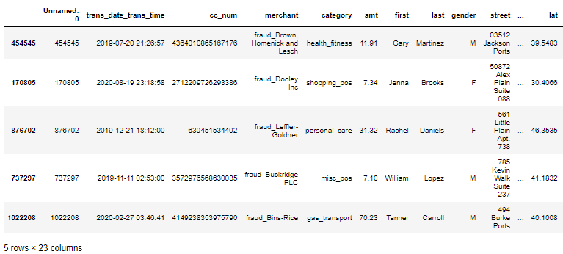
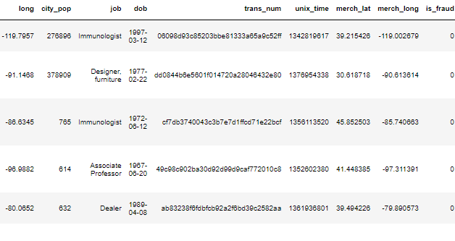
About the Dataset
About the dataset and why was this chosen?
Contains more than a million records
Total Features present: 20+
The figure lists the feature names of the dataset elements

Slide 6
Background research

Slide 7
Background research – Cont’d

Slide 8
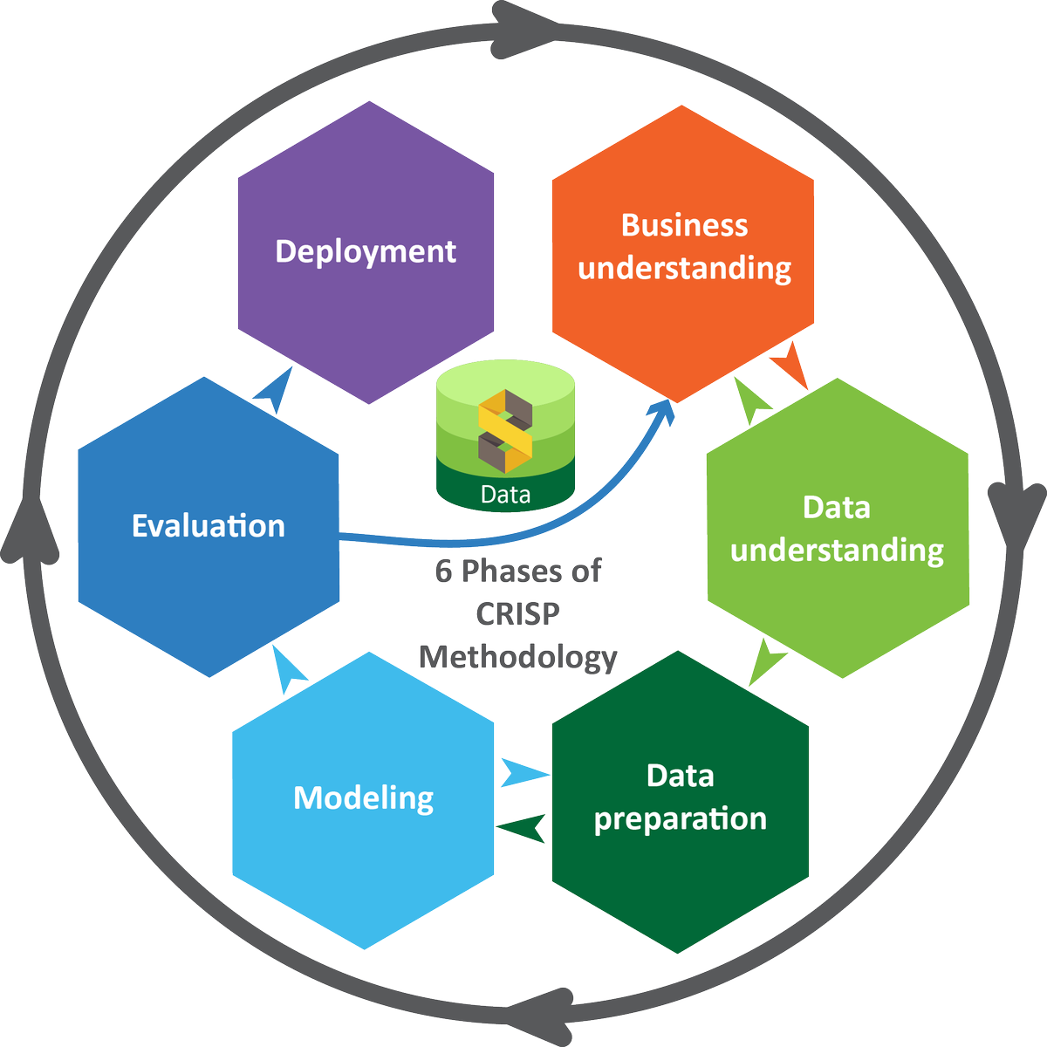
Execution Plan – CRISP-DM
Understanding the business and scope definition
Requirement Gathering:
Hardware, Software, and Data requirements
Finalizing Dataset and performing EDA
Preparing the dataset:
wrangling, transformation, feature extraction
Building the models:
Supervised and Semi-Supervised
Evaluating the performance of the models

Slide 9
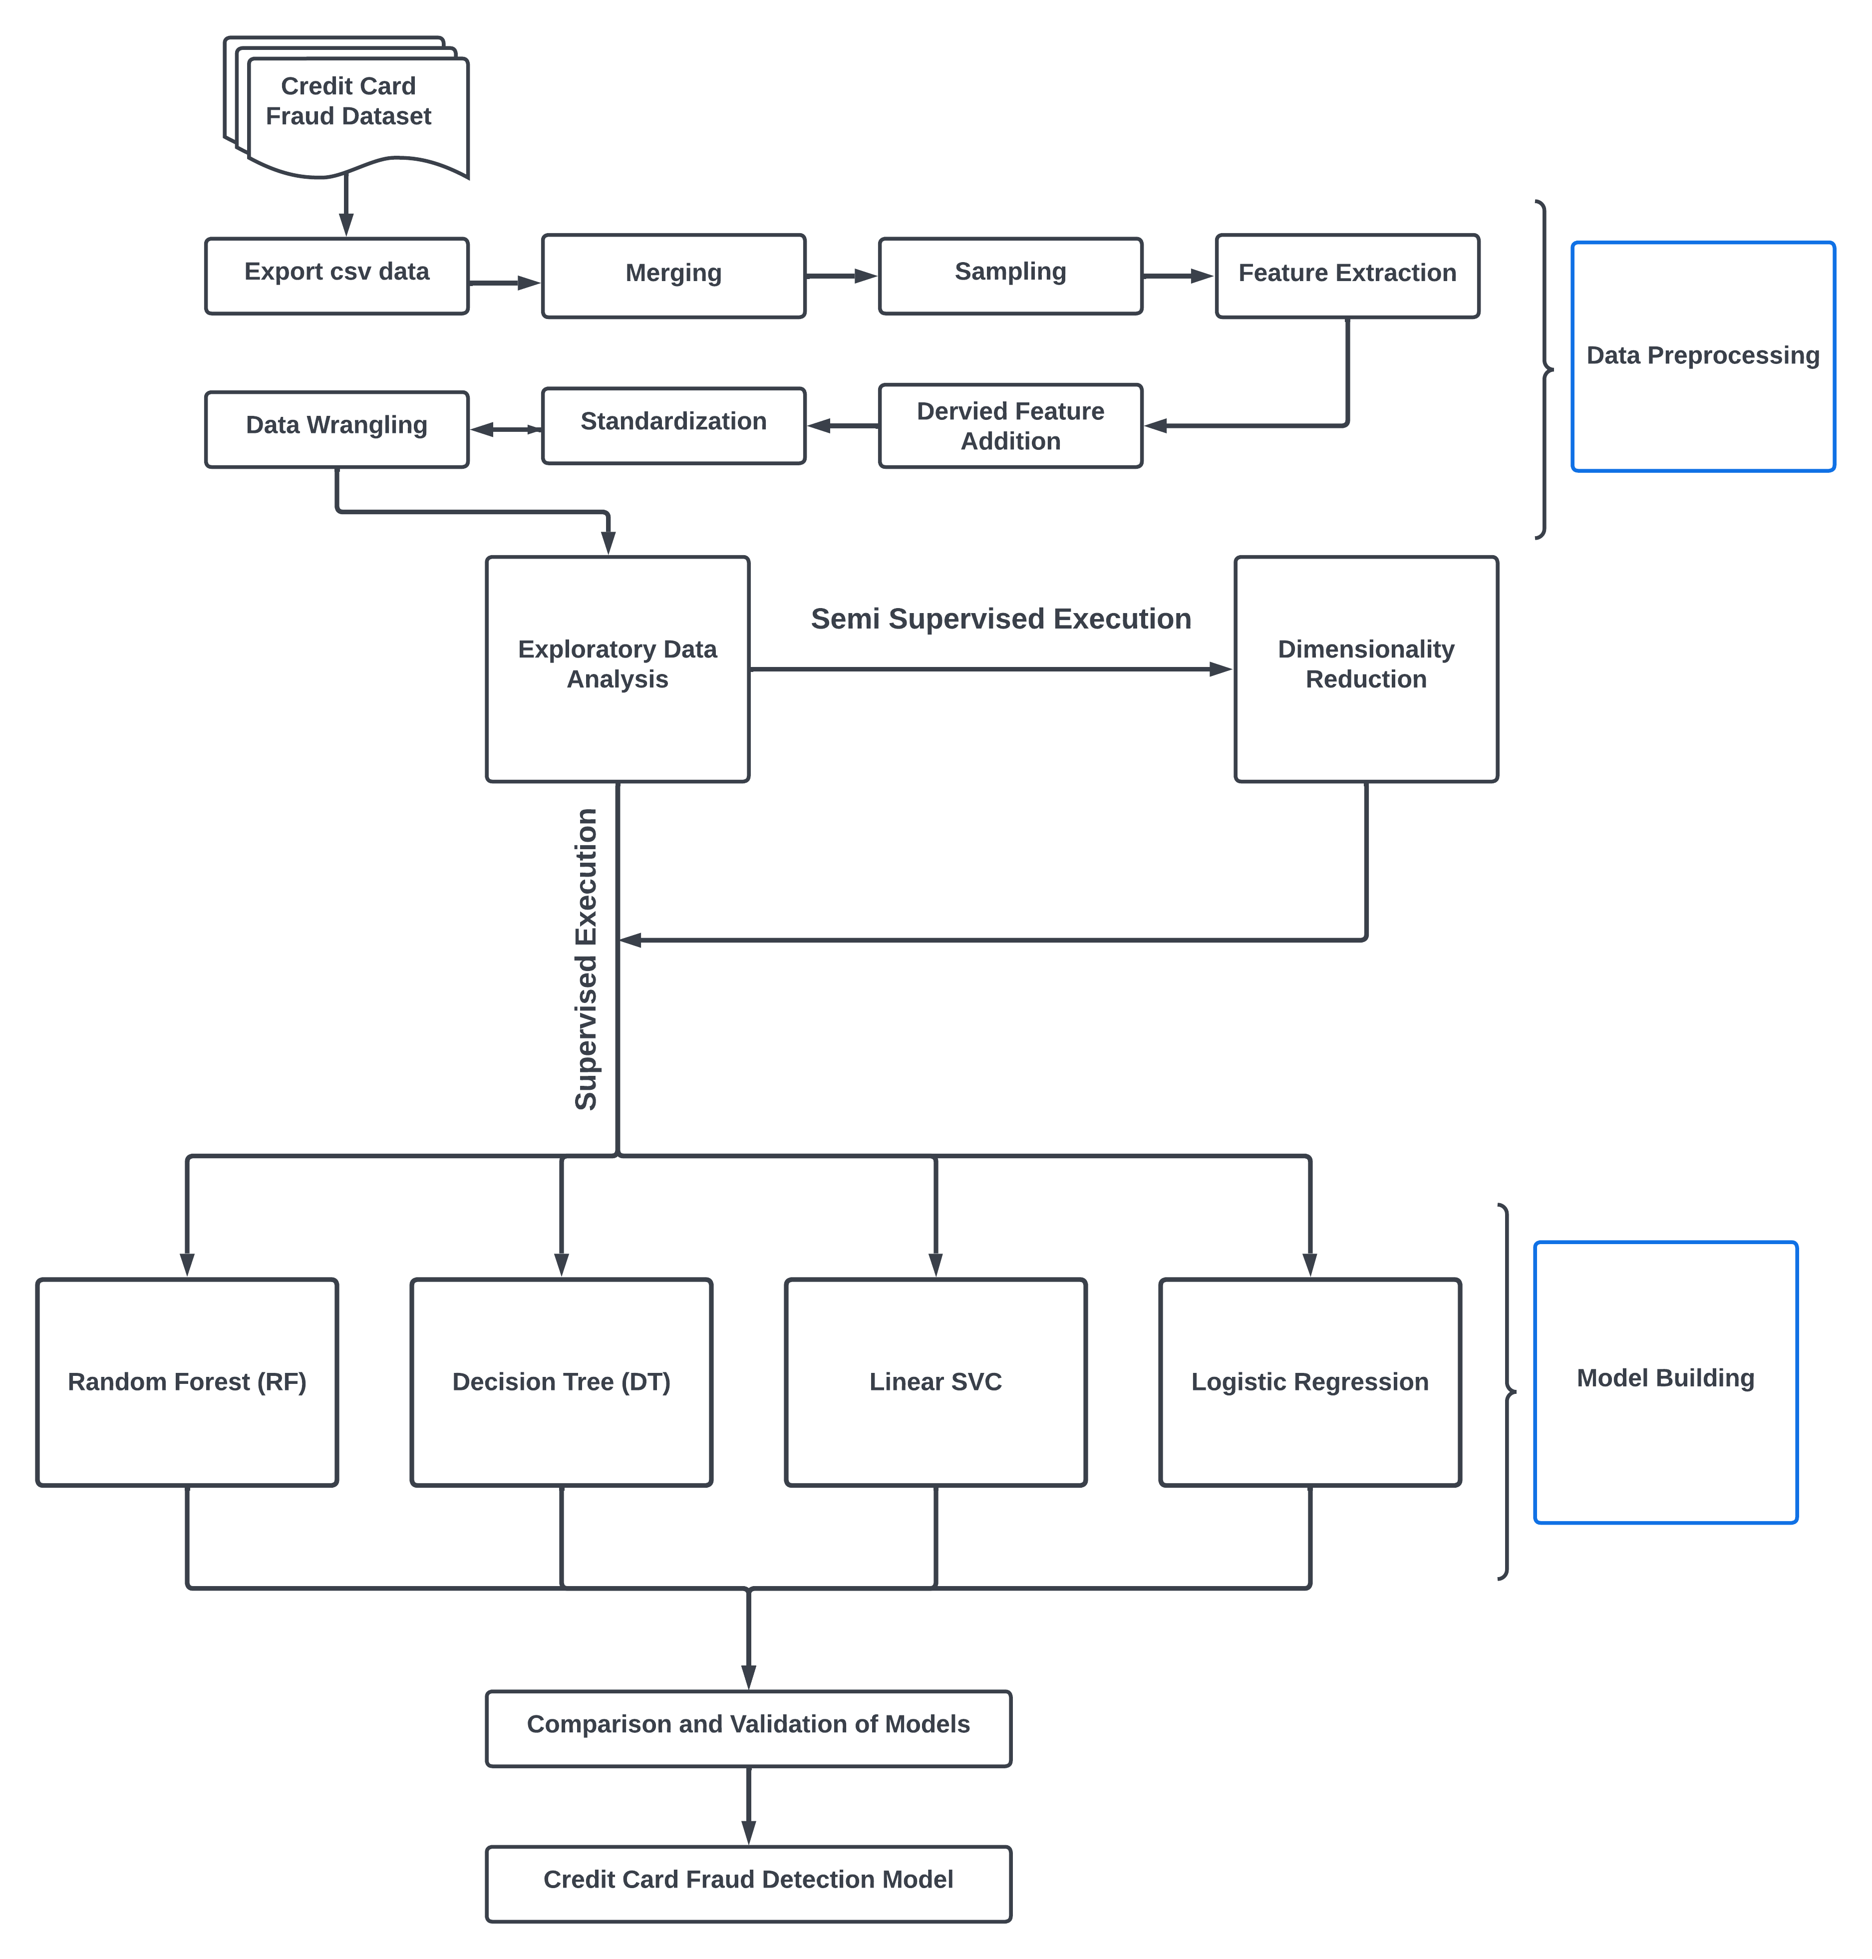
Workflow Diagram

Slide 10
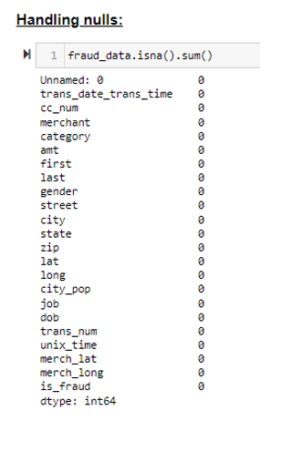
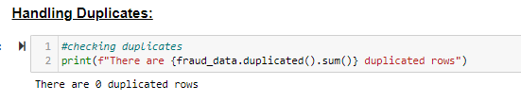
Initial Data Wrangling
Handling Nulls
Checking for the presence of Duplicates
Removing duplicates
Random Sampling of records to suit the needs

Slide 11
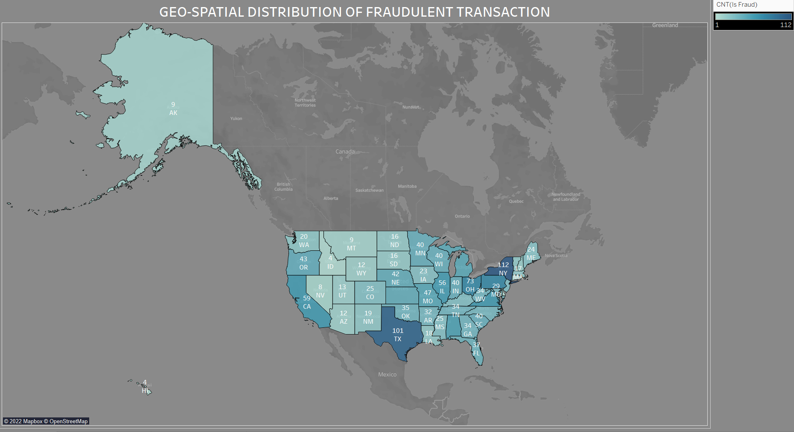
Fraudulent Transactions Per State

Slide 12
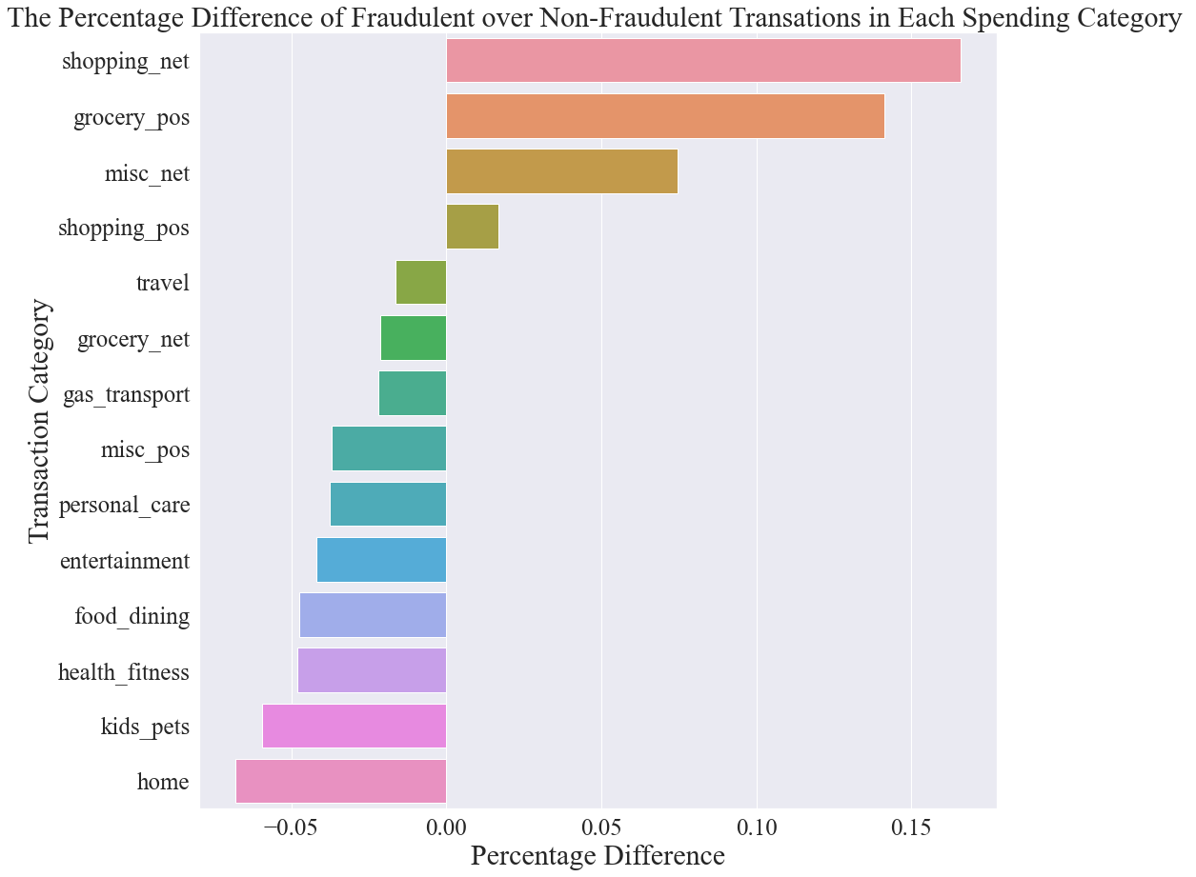
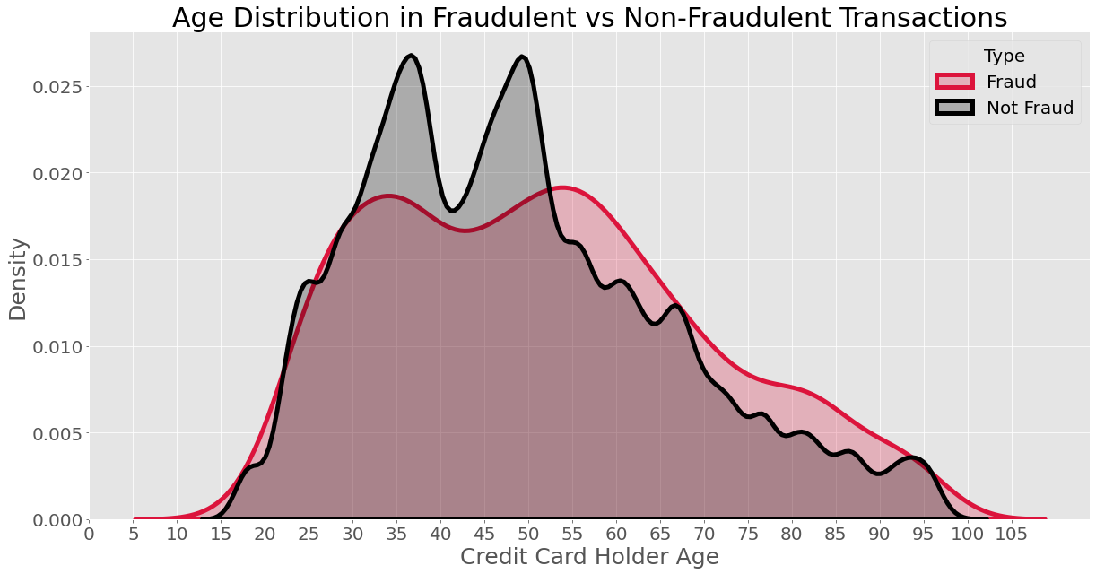
Exploratory Data Analysis - I
To gain insights regarding dataset, some exploratory analysis were done and visualized

Slide 13
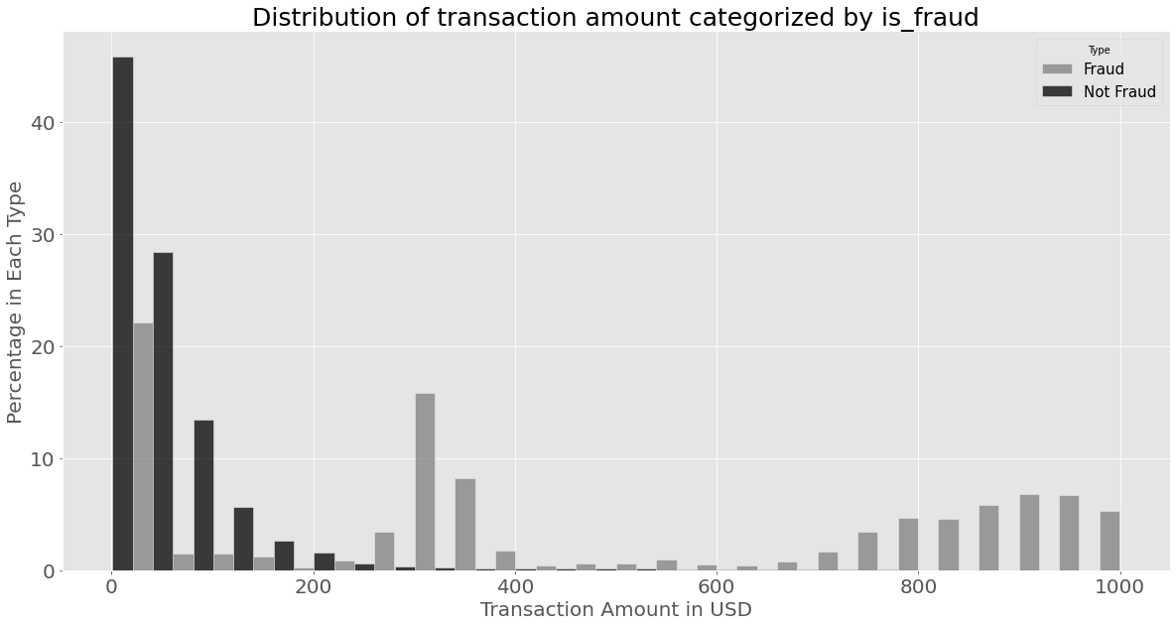
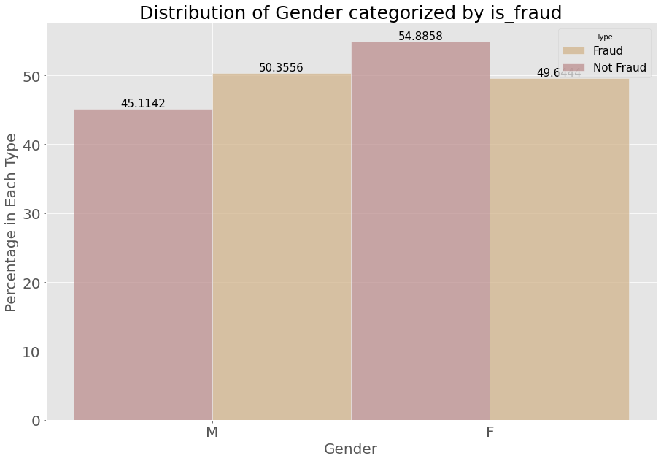
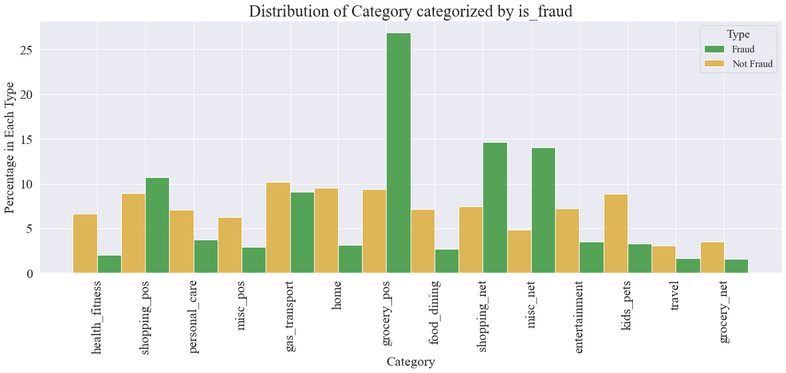
Exploratory Data Analysis - ll Distribution of Transaction Amount, Gender, and Category vs is_fraud

Slide 14
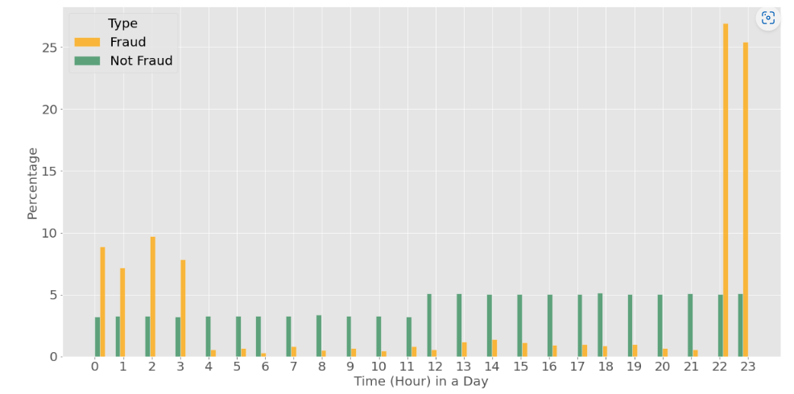
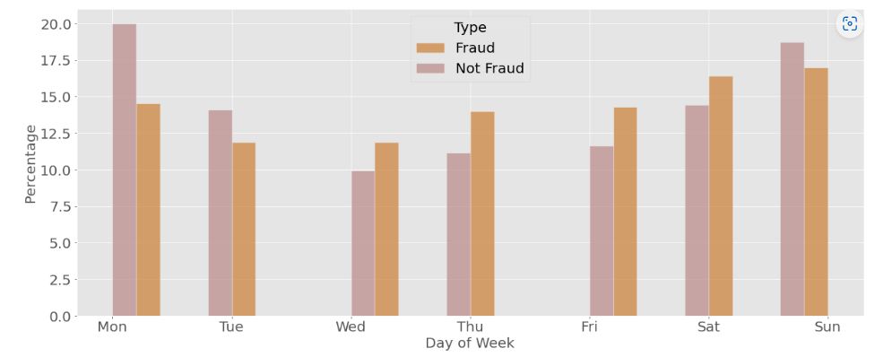
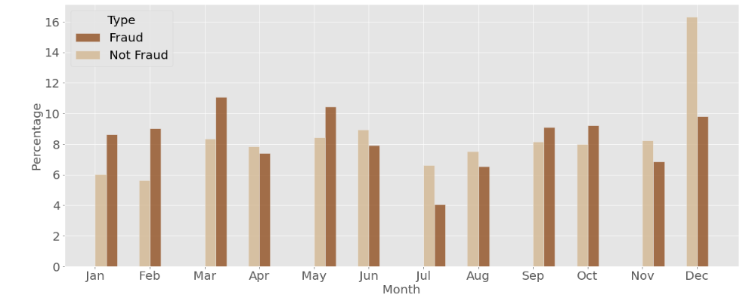
Exploratory Data Analysis - III Daily, Weekly and Monthly trends of fraud

Slide 15
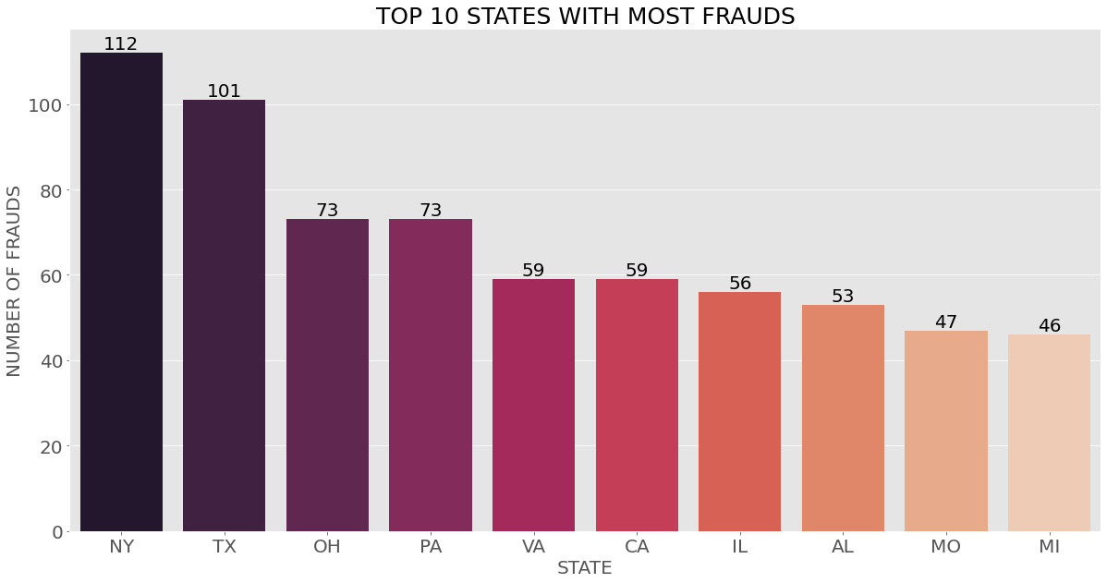
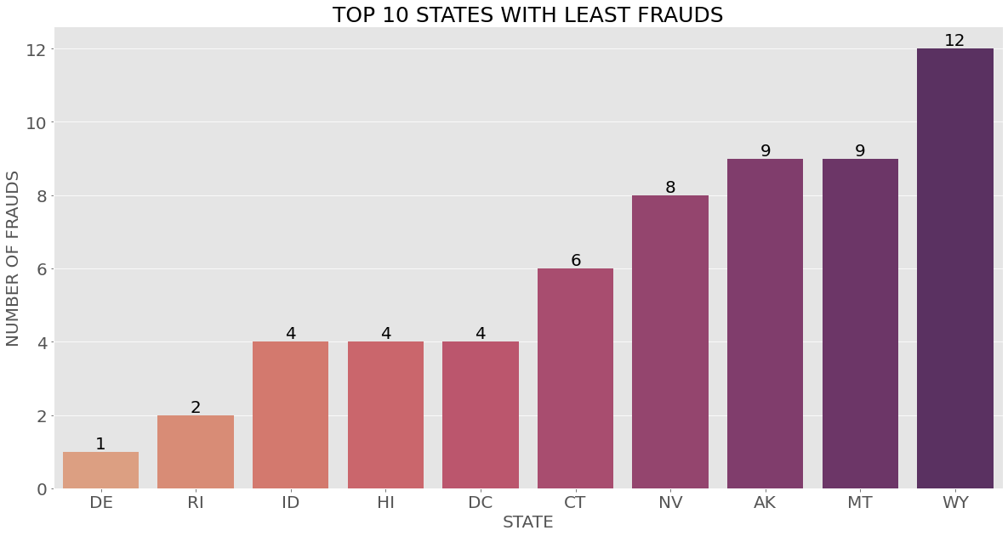
Exploratory Data Analysis - IV 10 states with the most and least fraud
States with the highest fraud count: NY, TX
States with the least fraud count: DE, RI

Slide 16
Insights Attained
As the age range increases, the number of fraudulent transactions increases
Highest percentage of fraudulent transactions happen with shopping_net.
Daily fraud trends show that most fraudulent transactions happen between the 22nd and 23rd hour.
Weekly trends show that fraudulent transactions are less during mid-week and gradually increase towards the weekend.
Similarly monthly trends show that most fraudulent transactions happen during the months of march and December.

Slide 17
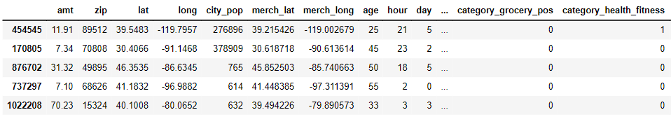
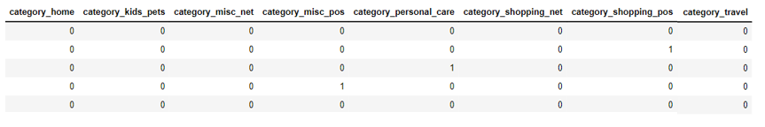
Additional Features Extraction
Apart from the original features present in the dataset, Additional features were derived namely AGE, HOUR, DAY, and MONTH
Dummies were created for the feature category

Slide 18
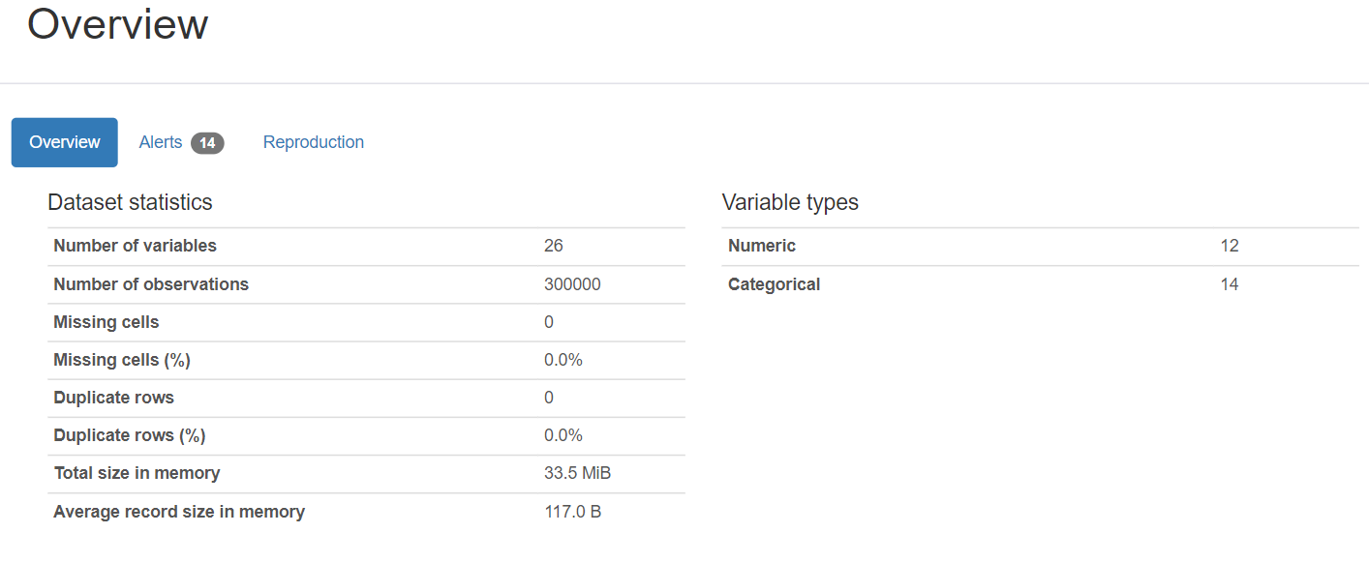
Data Profiling and Analysis

Slide 19
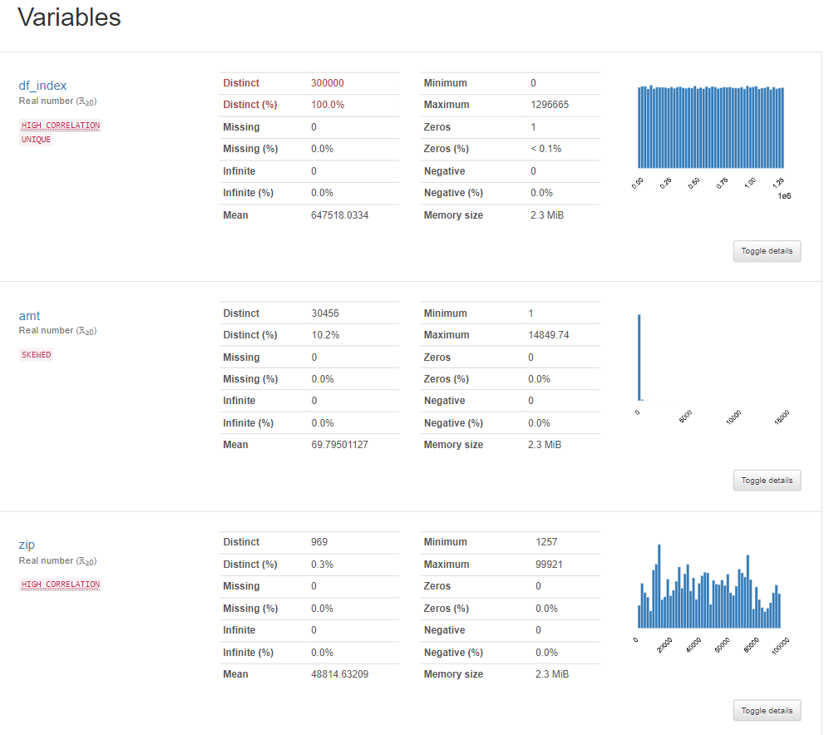
Data Profiling and Analysis

Slide 20
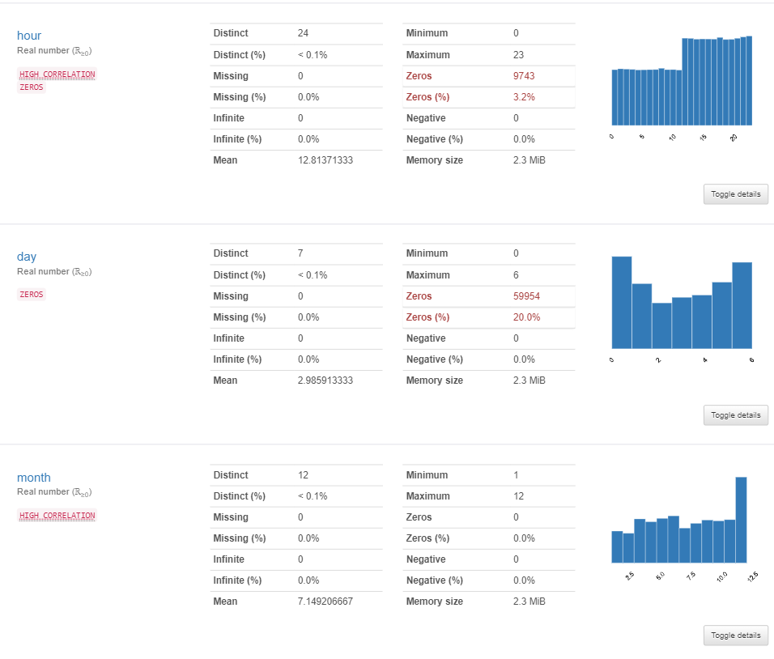
Data Profiling and Analysis

Slide 21
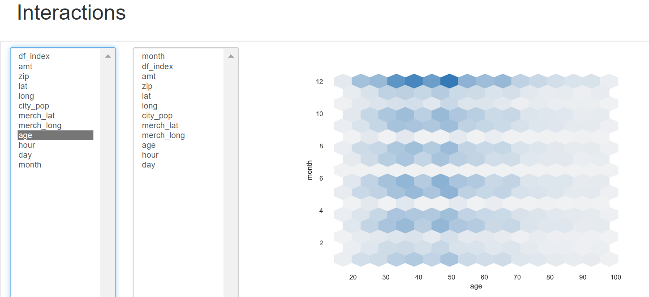
Data Profiling and Analysis

Slide 22
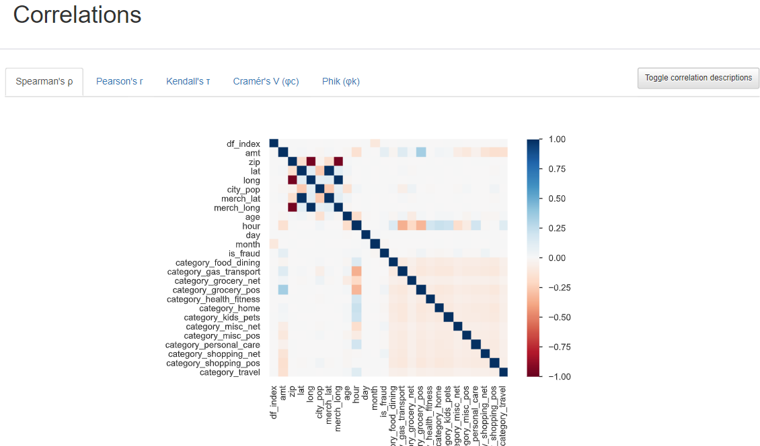
Data Profiling and Analysis

Slide 23


Interim Status Report
The execution that has been completed so far are,
Business Understanding,
Data Understanding,
Data Preparation – wrangling and transformations
Exploratory Analysis – using seaborn, matplotlib, pandas Profiling, and tableau.
Addition of derived columns and dummies

Slide 24
Interim Status Report-Cont’d
The execution that is yet to be completed are
SMOTE to eliminate bias if there exists any,
Test train Split
Implementation of Supervised models
Implementation of Semi-Supervised models
ROC Curve Analysis

Slide 25
Appendix
https://ieeexplore-ieee-org.libaccess.sjlibrary.org/document/9835751
https://ieeexplore-ieee-org.libaccess.sjlibrary.org/document/9057851
https://ieeexplore-ieee-org.libaccess.sjlibrary.org/document/9655848
https://ieeexplore-ieee-org.libaccess.sjlibrary.org/document/9197762
https://ieeexplore-ieee-org.libaccess.sjlibrary.org/document/9432308
https://ieeexplore-ieee-org.libaccess.sjlibrary.org/document/9751922
https://ieeexplore-ieee-org.libaccess.sjlibrary.org/document/9155615
https://ieeexplore-ieee-org.libaccess.sjlibrary.org/document/9676262
https://ieeexplore-ieee-org.libaccess.sjlibrary.org/document/9243602

Slide 26
Thank You

