Slide 1
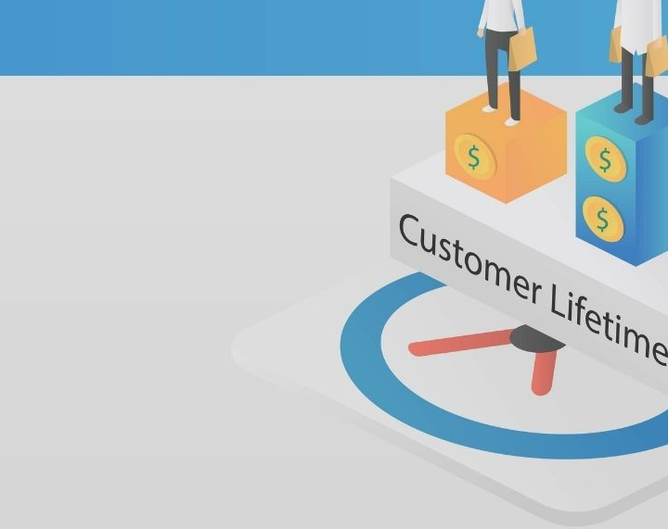
CUSTOMER LIFETIME VALUE PREDICTION
TEAM MEMBERS:
Gayathri Sundareshwar
Keerthana Gopikrishnan
Razan Dababo

Slide 2
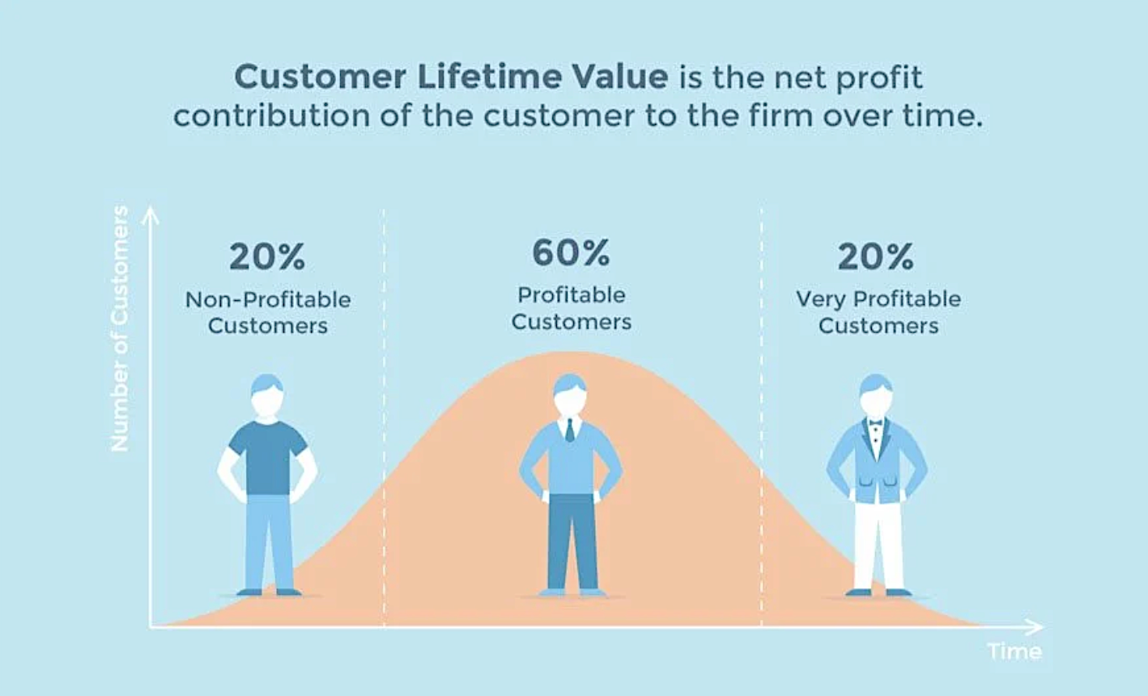
What is Customer Lifetime Value?
The net profit or loss to the business from an individual customer.
CLV =
[Revenue Gained from Customer]
minus
[Cost of Acquiring/Servicing Customer]
Takes into account time value of money
Notes:
Much like the discounted cash flow concept in finance

Slide 3
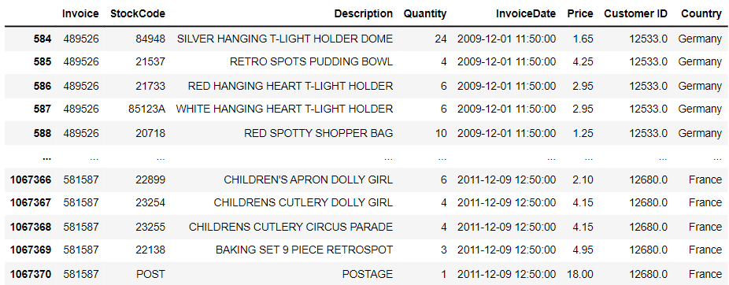
About the Dataset
About the dataset and why was this chosen?
Contains more than a million records
The fields present can be seen in the picture
Notes:
Data Set Information:
This Online Retail II data set contains all the transactions occurring for a UK-based and registered, non-store online retail between 01/12/2009 and 09/12/2011.The company mainly sells unique all-occasion gift-ware. Many customers of the company are wholesalers.
Attribute Information:
InvoiceNo: Invoice number. Nominal. A 6-digit integral number uniquely assigned to each transaction. If this code starts with the letter 'c', it indicates a cancellation. StockCode: Product (item) code. Nominal. A 5-digit integral number uniquely assigned to each distinct product. Description: Product (item) name. Nominal. Quantity: The quantities of each product (item) per transaction. Numeric. InvoiceDate: Invice date and time. Numeric. The day and time when a transaction was generated. UnitPrice: Unit price. Numeric. Product price per unit in sterling (Â£). CustomerID: Customer number. Nominal. A 5-digit integral number uniquely assigned to each customer. Country: Country name. Nominal. The name of the country where a customer resides.

Slide 4
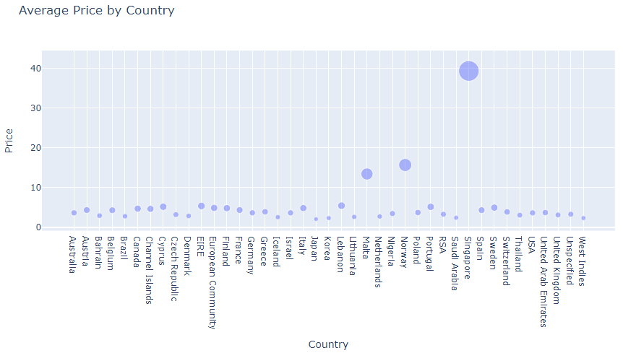
Data Wrangling and Exploratory Analysis
Null records, duplicate rows, and cancelled transactions were dropped
To gain insights regarding dataset, some exploratory analysis was performed and visualized

Slide 5
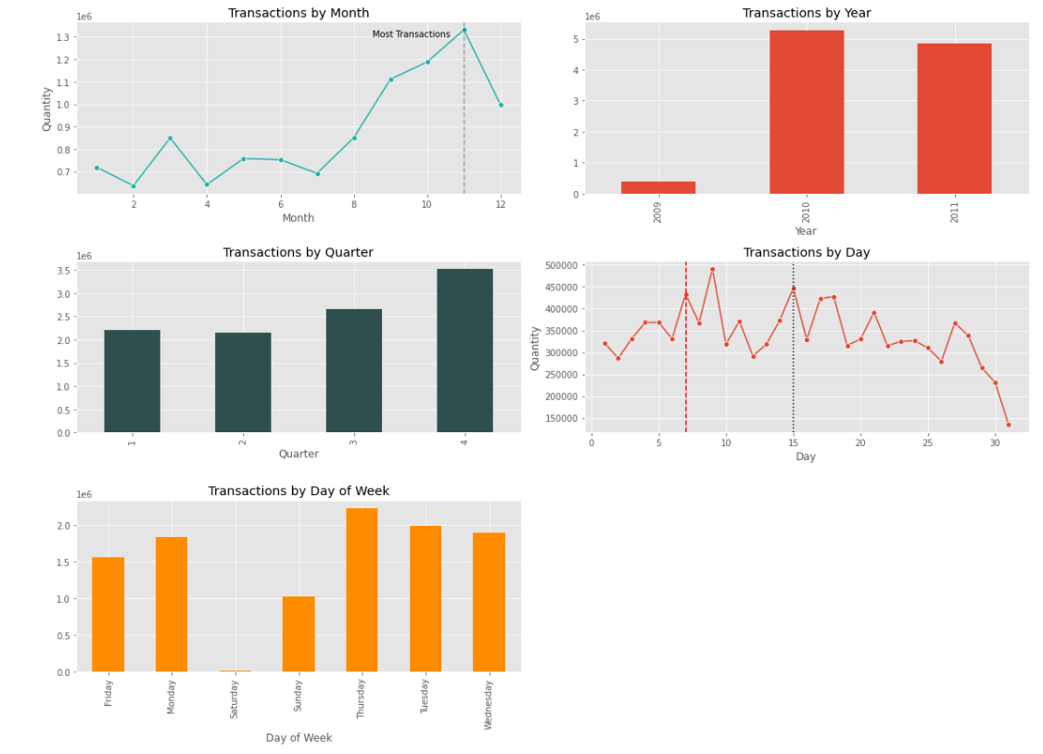
Data Wrangling and Exploratory Analysis (cont’d)

Slide 6
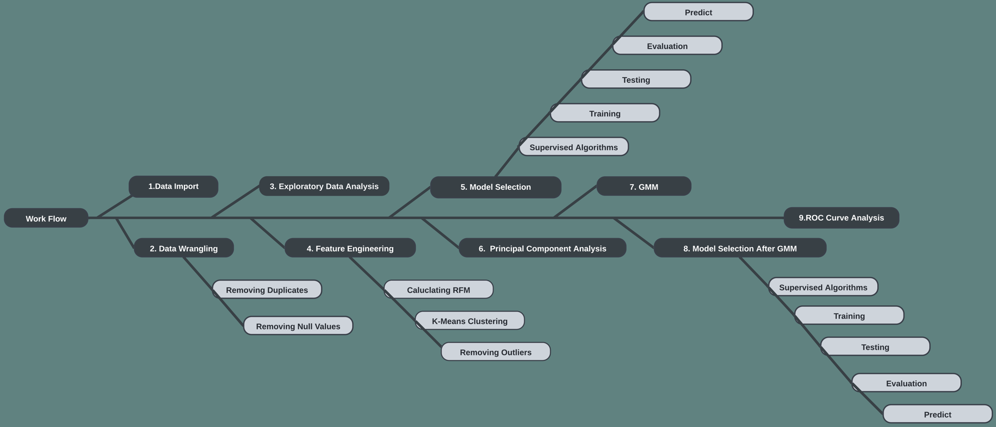
Workflow

Slide 7
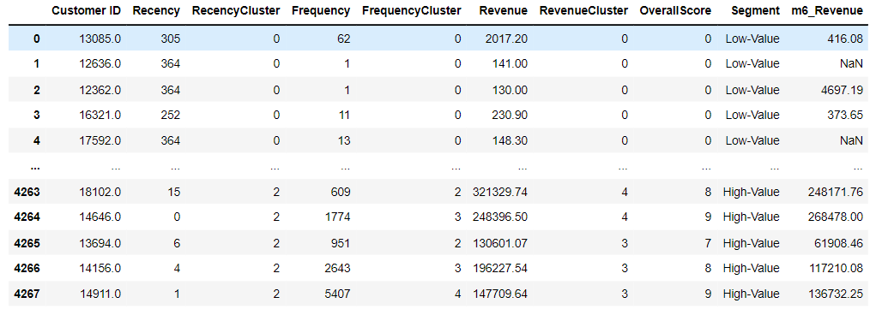
Calculating RFM
RFM - Recency Frequency and Monetary benefits
Overall score recorded after clustering into Recency , Frequency and Monetary Benefits factors using Kmeans

Slide 8
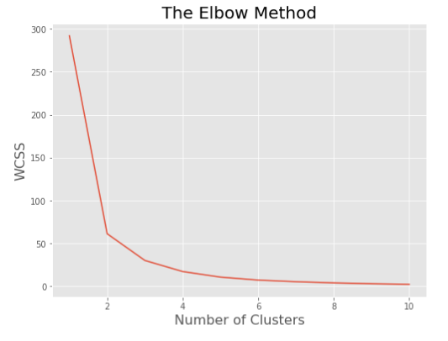
Calculating RFM (cont’d)
Elbow plot is used to determine the no of clusters

Slide 9
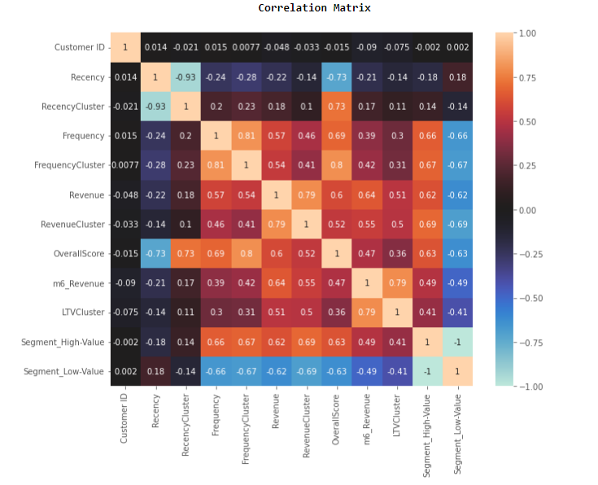
Correlation Matrix

Slide 10
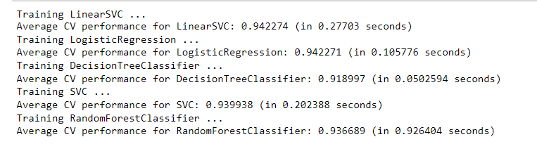
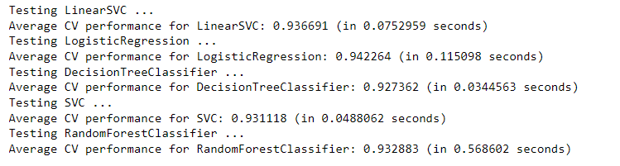
Output Generation and Analysis
Data split into training and test sets
Algorithms Tested:
LinearSVC
SVC
LogisticRegression
DecisionTreeClassifier
RandomForestClassifier

Slide 11
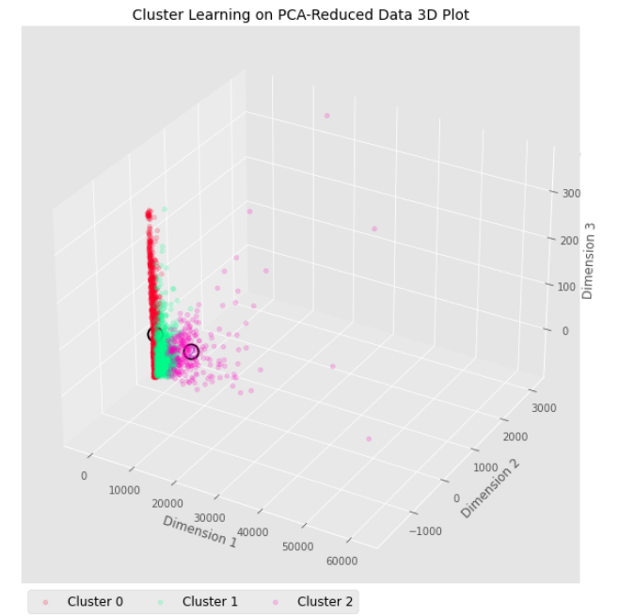
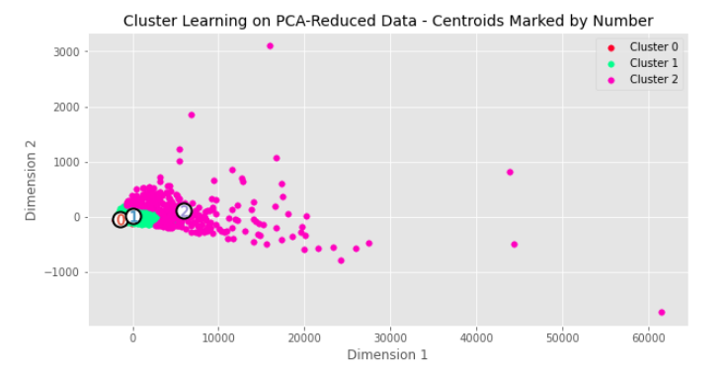
GMM Clustering
GMMs - probabilistic models.
The data points are generated from a mixture of finite numbers without unknown parameters.

Slide 12
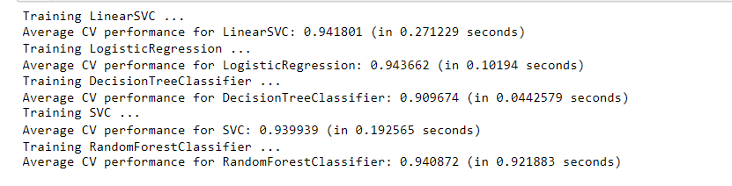
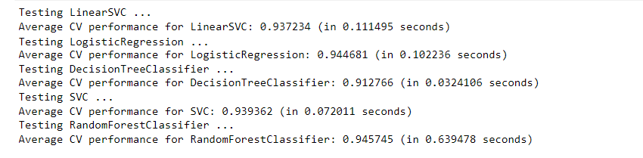
Output Generation and Analysis
Data split into training and test sets
Algorithms Tested:
LinearSVC
SVC
LogisticRegression
DecisionTreeClassifier
RandomForestClassifier

Slide 13
Comparison against Hypothesis
Instead of using single model, multiple models were implemented
The original dataset is changed into clusters by passing through unsupervised model.
Supervised learning implemented on top of Unsupervised model results.
Better performing model from the experimented ones is chosen as the optimal solution.

Slide 14
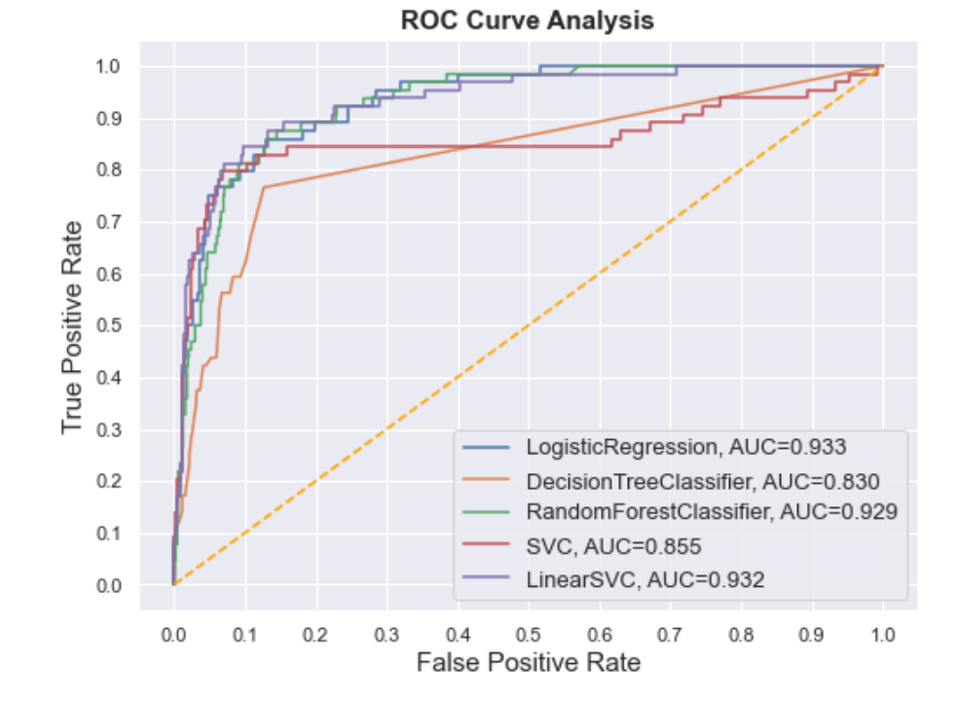
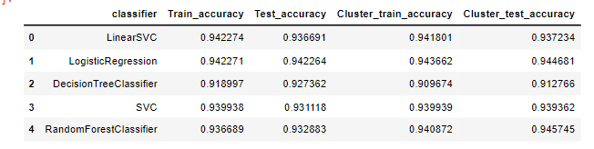
Discussions
Supervised and unsupervised methods are implemented.
Logistic Regression is the most consistent one

Slide 15
Summary & Conclusion
Implemented and evaluated both supervised and un-supervised learning
RFM approach has been implemented
Logistic regression had the most consistent accuracy among all tests
Random Forest recorded the highest accuracy
ROC curve is all on the positive side
Prediction can improve if more training data is used as input.

Slide 16
Recommendations for Future
CLV prediction can be applied not just to the retail industry but also to a variety of other industries, including tech and gaming. Therefore, we recommend extending our modeling into other industries.
Explore Markov Chain probabilistic model for making churn predictions.
Segment our customers not just based on standard RFM scores but also based on their preference features.

Slide 17
Thank You

