Slide 1
XPS data
Gwilherm Kerherve, 07/08/2018

Slide 2
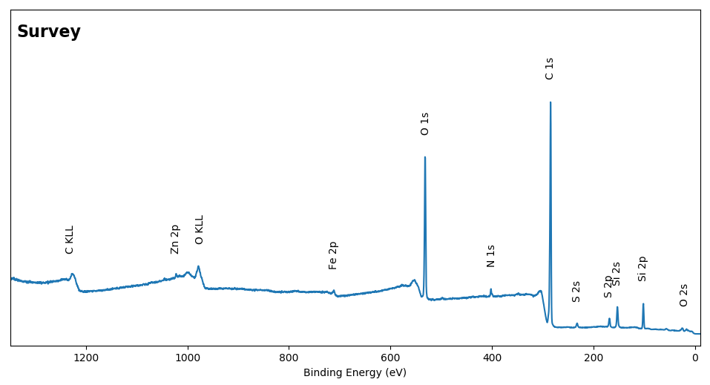
CC-A: Survey

Slide 3
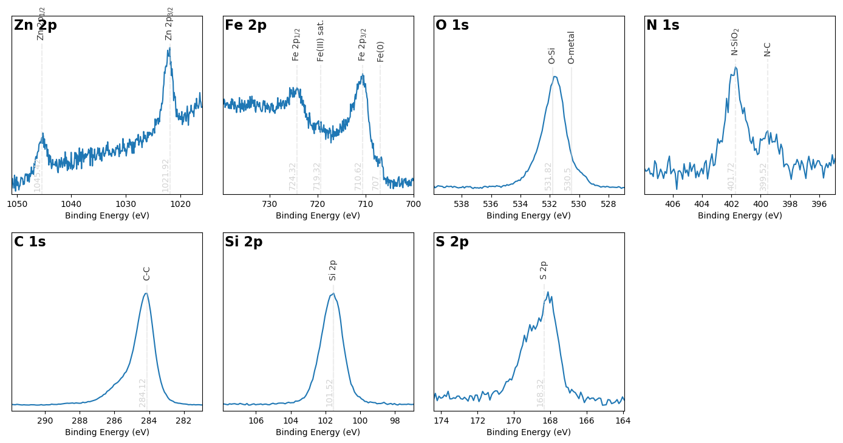
CC-A: Core levels

Slide 4
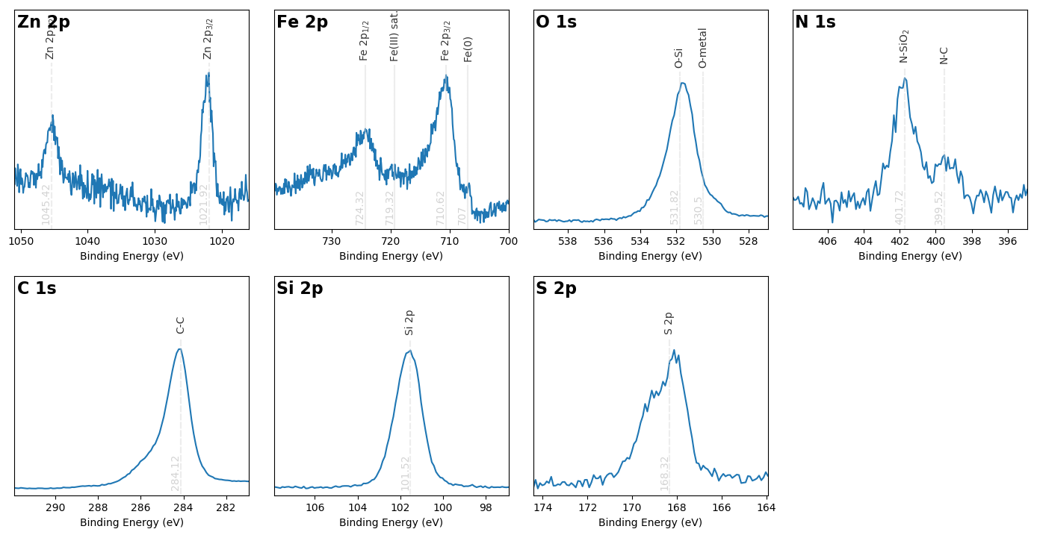
CC-A: Core levels with Shirley correction

Slide 5
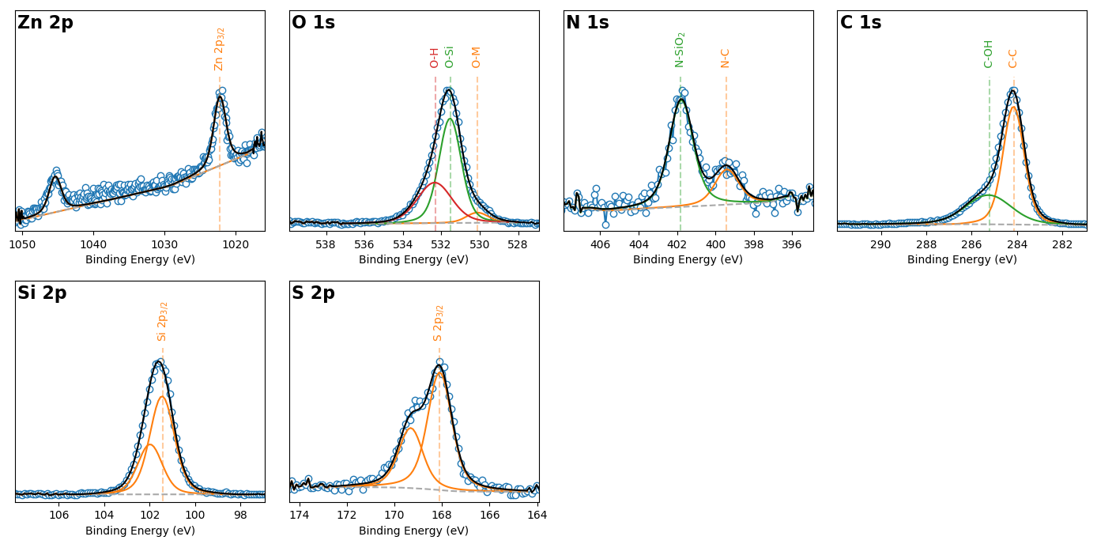
CC-A: Peak fitted Core levels

Slide 6
CC-A: Quantifications
Name | Peak BE | FWHM eV | Atomic %
C1s C-C sp2 | 284.2 | 1.11 | 47.02
C1s C-OH | 285.26 | 2.39 | 25.32
Fe2p3 | 710.53 | 3.2 | 0.3
N1s C-N | 399.4 | 1.5 | 0.38
N1s N-SiO2 | 401.78 | 1.5 | 1.15
O1s O-H | 532.35 | 2.12 | 6.09
O1s O-M | 530.13 | 1.37 | 0.99
O1s O-Si | 531.55 | 1.37 | 10.18
S2p3 | 168.09 | 1.22 | 1.45
Si2p3 | 101.45 | 1.28 | 7.03
Zn2p3 | 1022.25 | 2.08 | 0.09

Slide 7
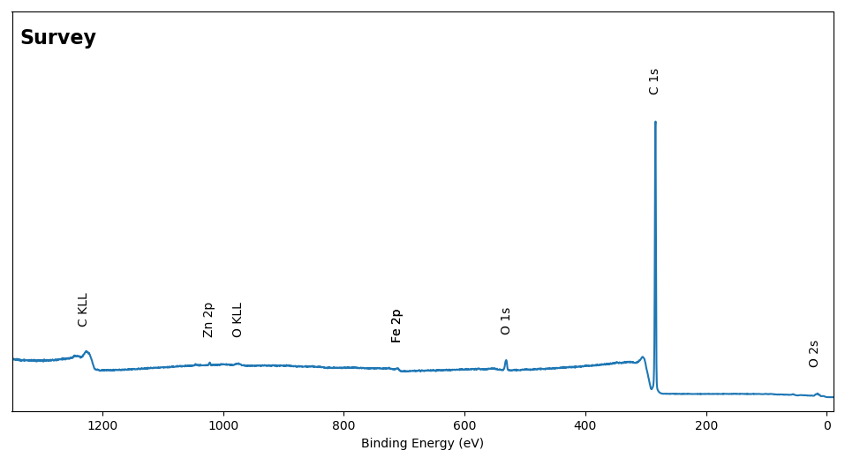
CC-B: Survey

Slide 8
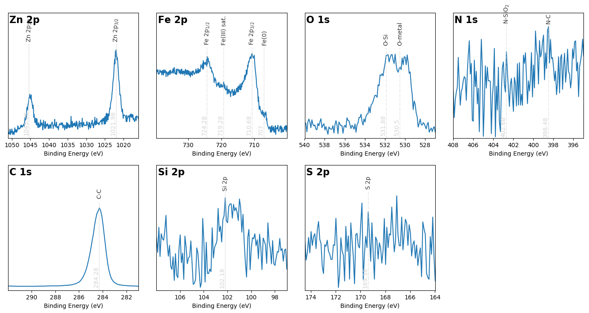
CC-B: Core levels

Slide 9
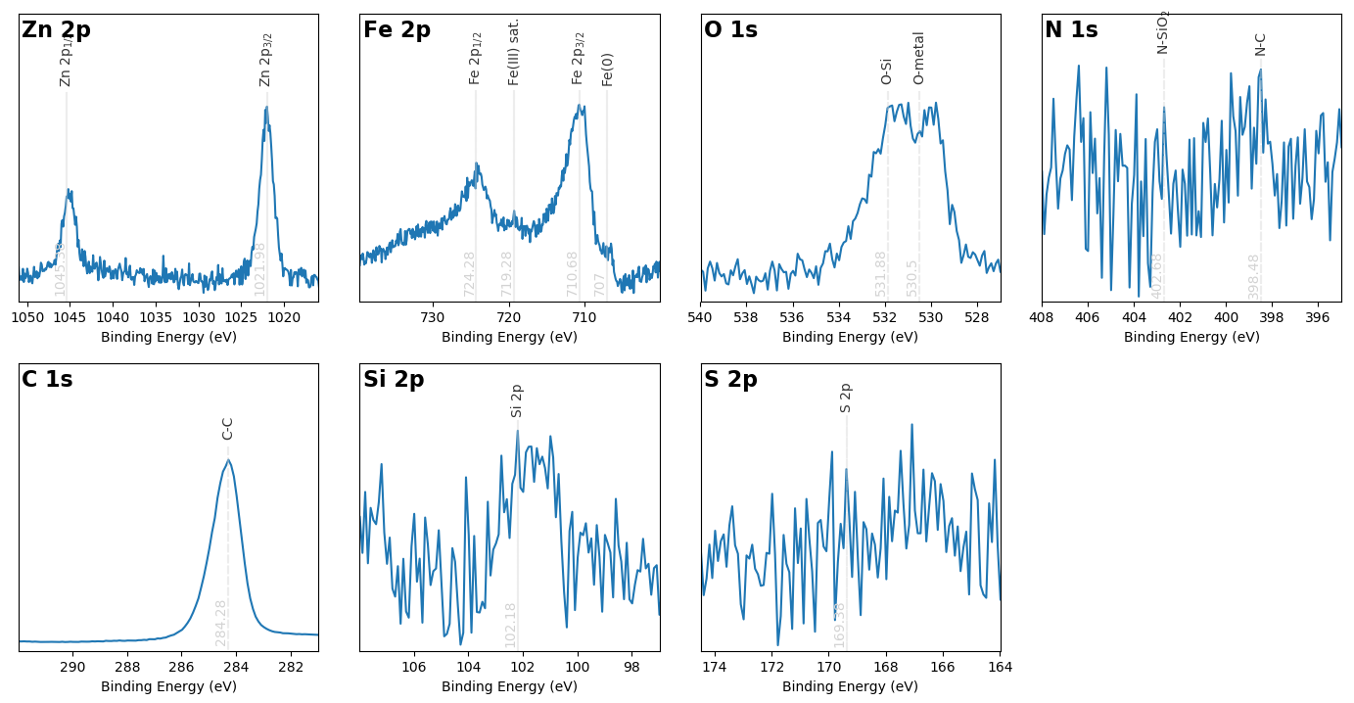
CC-B: Core levels with Shirley correction

Slide 10
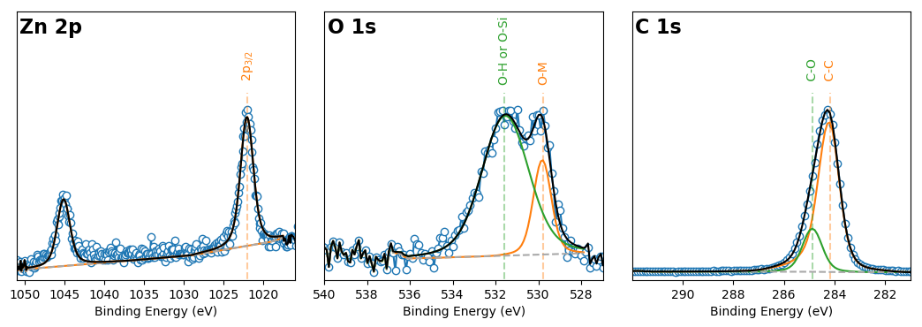
CC-B: Peak fitted Core levels

Slide 11
CC-B: Quantifications
Name | Peak BE | FWHM eV | Atomic %
C1s C-C | 284.88 | 0.92 | 18.75
C1s C-graphite | 284.22 | 1.01 | 77.76
Fe2p3 | 710.43 | 3.12 | 0.31
O1s O-H | 531.54 | 2.62 | 2.21
O1s O-M | 529.81 | 1.0 | 0.57
S2p | 167.07 | 0.15 | 0.16
Si2p | 101.71 | 2.07 | 0.11
Zn2p3 Scan A | 1022.02 | 1.94 | 0.12

Slide 12
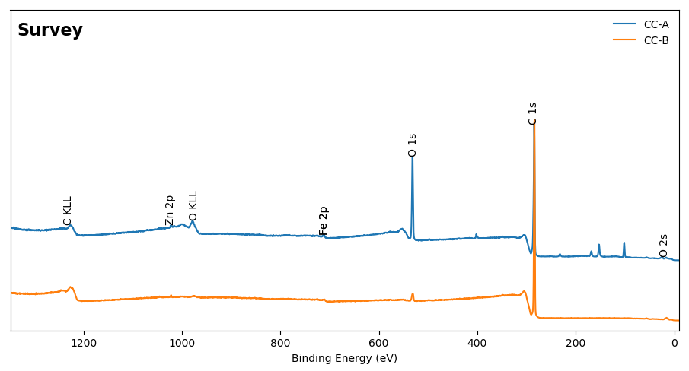
Comparisons: Survey

Slide 13
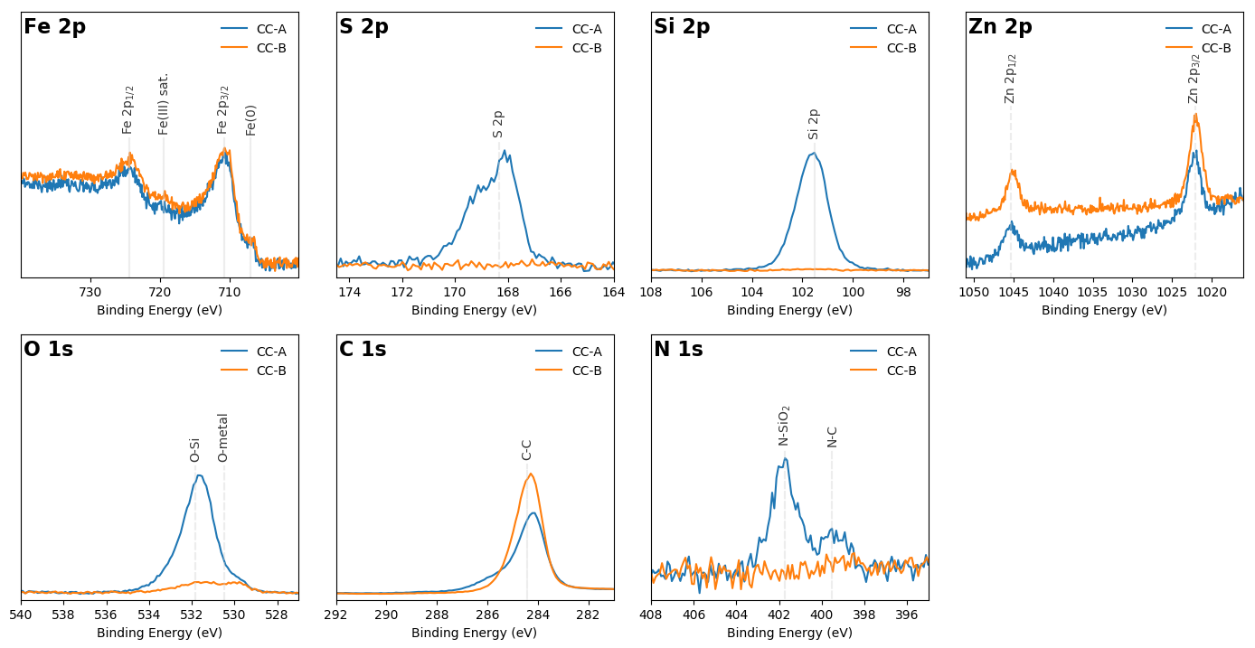
Comparisons: Core levels

Slide 14
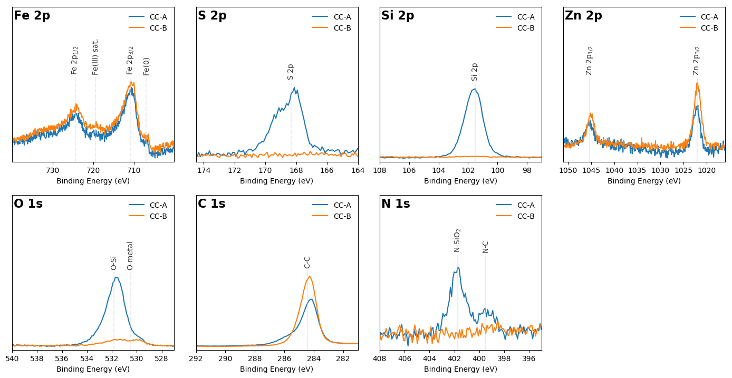
Comparisons: Core levels with Shirley correction

