Slide 1
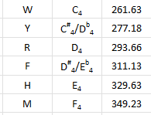

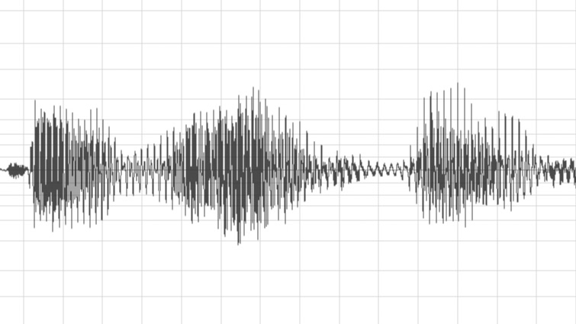
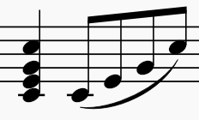

E.Coli-Generated Music
1
2
3
4
WAV and Purpose
Dictionaries
For Loop and append
Final Result
Using a WAV file to generate music with Python
Assigning residues to particular notes on a scale
Allowing notes to be play sequentially versus simultaneously
Enjoy!

