Slide 1

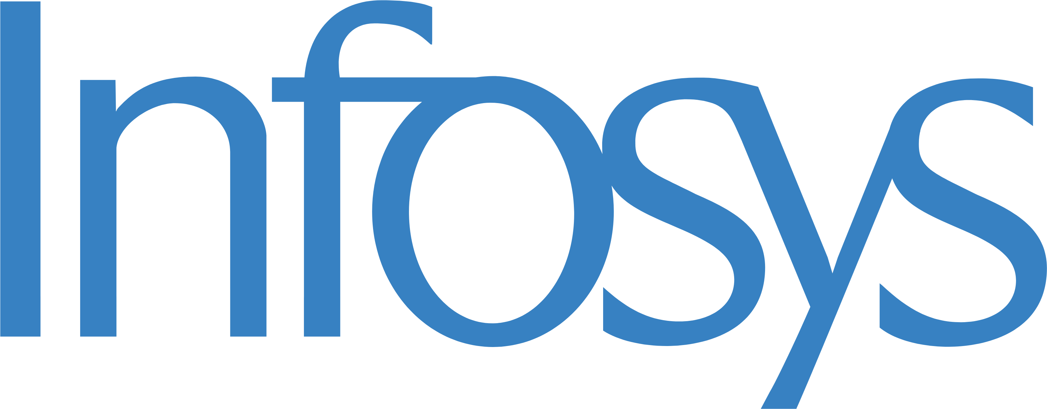

EXECUTIVE BRIEFING · 2026
01 / 04
×
──── AERCHAIN × INFOSYS · DEPLOYED AT UNILEVER
Autonomous Agentic
Sourcing
for Unilever
Infosys deploys Aerchain's autonomous-sourcing layer across Unilever — turning classical, manual sourcing into AI-driven, agent-run sourcing that is live and already delivering hard savings.
$5M
1 : 58
$8M
Live
Savings unlocked across 37 sourcing projects
Return on every dollar invested in 2026
Hard savings already delivered in 2025
In production today for Business Services
AERCHAIN · AGENTIC PROCUREMENT PLATFORM
CONFIDENTIAL · PREPARED FOR UNILEVER · VIA INFOSYS

Slide 2
AERCHAIN-AUTONOMOUS SOURCING
02 / 04
×
01
UNILEVER × INFOSYS × AERCHAIN
From classical sourcing to autonomous sourcing.
What changed when Infosys deployed Aerchain's autonomous-sourcing layer at Unilever — and the value it is already delivering.
BEFORE
NOW · WITH INFOSYS-AERCHAIN
OUTCOME
IMPACT
Classical sourcing
Autonomous sourcing
$5M
1 : 58
$265K
✕
Classical, manual sourcing
✓
AI-driven, time-saving sourcing
Savings on a $54M spend across 37 sourcing projects — 10% average yield
Return on investment
Annual platform cost
✕
Heavy Excel dependency
✓
Automated quotes, RFx & questionnaires
On $15.5M committed savings, 2026
Fully-loaded run cost for 2026
✕
Time & resource constraints
✓
Intelligent supplier ranking
Live
✕
Gaps in category expertise
✓
Automated comms, live tracking
In production today for Unilever Business Services
$8M
~3%
✕
Limited negotiation leverage
✓
AI-powered insights & query support
Scaling
Hard savings in 2025
FTE efficiency gain
Delivered, banked, audited
Year on year, plus negotiation uplift
✕
Reliance on past data & benchmarks
✓
Improved negotiation & faster value
Across Marketing & IT for Infosys-managed spend, and beyond
AERCHAIN × INFOSYS · AUTONOMOUS SOURCING
CONFIDENTIAL · PREPARED FOR UNILEVER

Slide 3





HOW IT WORKS · THE AGENTIC ENGINE
03 / 04
×
02
CAPABILITY MAP
Five Aerchain agents, running the sourcing cycle.
Each agent runs autonomously inside its station of the procure-to-pay flow, with human-in-the-loop guardrails per category — all live in production.
AGENT 01
AGENT 02
AGENT 03
AGENT 04
AGENT 05
Intake
Sourcing
Negotiation
Evaluation
Award
Intake & Enrichment
Multi-Agent RFQ
AI Negotiation
Eval + Compliance
Scenario + Writeback
Auto-ingest PRs
Build RFQ pack
Multi-round
Score every bid
Build scenarios
Clean & classify
Run outreach
Price & terms
Compliance check
Optimal allocation
Enrich & tag spend
Extract bids
Auto-negotiate
Rank & recommend
Write back to ERP
✓ LIVE · UNILEVER
✓ LIVE · UNILEVER
✓ LIVE · UNILEVER
✓ LIVE · UNILEVER
✓ LIVE · UNILEVER
GUARDRAILS
Every step · per category
Hard limits
>5% deviation
SoD matrix
Immutable audit log
Auto-blacklist
Human-in-the-loop
AERCHAIN × INFOSYS · AUTONOMOUS SOURCING
CONFIDENTIAL · PREPARED FOR UNILEVER

Slide 4
THE BUSINESS CASE
04 / 04
×
03
VALUE & RETURN
A 1 : 58 return — and it is already banked.
The numbers behind the deployment: addressable spend, committed savings, run cost, and the rollout path from here.
$54M
10%
SAVINGS MOMENTUM
$15.5M
≈2×
growth in committed savings, 2025 → 2026
Addressable spend
Average yield
$8M
Across 37 active sourcing projects
Realised savings rate per project
$5M
$15.5M
2025
2026
delivered
committed
Savings unlocked
Committed savings · 2026
ROLLOUT ROADMAP
Across projects at various stages
Target the platform is underwriting
NOW
NEXT
THEN
$265K
1 : 58
Business Services
→
Marketing & IT
→
Enterprise-wide
Live in production
Infosys-managed spend
Scaling beyond
Annual platform cost
Return on investment
Fully-loaded run cost for 2026
Every $1 returns $58 in 2026
AERCHAIN × INFOSYS · AUTONOMOUS SOURCING
CONFIDENTIAL · PREPARED FOR UNILEVER

