Slide 1
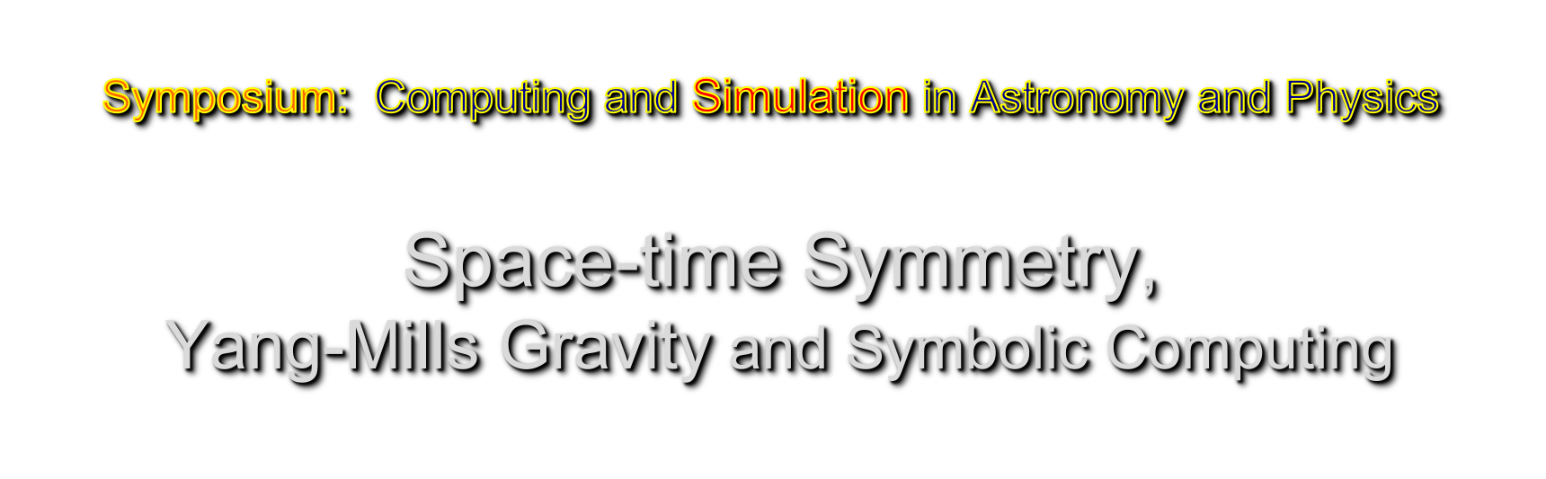
Jong-Ping Hsu
Physics Department
Univ. of Massachusetts Dartmouth

Slide 2
Symmetry appears to be the deepest
foundation for our understanding of
the physical universe.
What is the symmetry of an object (including equation)?
“One does something to it, and after one finishes doing it,
the object looks the same” (H. Weyl, mathematician)
*Gauge symmetry dictates basic interactions.(Utiyama, Yang-Mills)
*Symmetry of 4-dim space-time ←-→ Relativity (Poincaré, Einstein)
*Translation symmetry ←-→ Conservation laws of energy-momentum
*Rotationl symmetry ←-→ Conservation law of angular momentum
*U(1) gauge symmetry ←-→ Conservation of charge (Weyl)
…………….

Slide 3
Example: rotation: x’=x cosθ +y sinθ---→ x + yθ,
y’=- x sinθ + y cosθ ---→ -xθ + y,
(finite θ) (infinitesimal θ)
Object: ball  -- rotation ----→ 
Equation: x² + y² = a² ------→ x’² + y’² = a²

Slide 4
Nature (e.g., space-time symmetry)
(1) Mortal (humen) View: They can only see the
3-dim section of the universe at one instant of time.
Invent different units to measure space (cm) and time (sec).
4-dim world is described by (ct,x,y,z).
The law for the propagation of light (from Maxwell’s equations)
c²t² - x² - y² - z²=0, or c²(Δt)² - (Δr)² = 0 and
the speed of light is Δr/Δt=c. c=299792458m/sec
They believe 299792458m/sec is a basic constant of nature which corelates space and time.

Slide 5
(2) Immortal (Mother Nature exists everywhere, all times) View:
She does not need to have different units for space and time.
4-dim world (w,x,y,z) with one single unit of, say, meter.
Maxwell’s equations (in w,x,y,z) leads to the
Law for the propagation of light w² - x² - y² - z² = 0,
the speed of light is Δr/Δw=β_{c}=1. (independent of man-made units)
Thus, the number c=299792458m/sec is man-made.(not inherent in nature)
Δw=1m ←----→ (human) time interval of 1/299792458 sec.
The international convention: the speed of light is defined as
C Ξ 299792458 m/sec . (same as Poincare’s view in 1905)
This turns out to be exactly the right thing to do!!!

Slide 6
Space-time Symmetry (←→the Principle of Relativity):
Laws of nature do not change under the transformation
(w,x,y,z) ----→ (w’,x’,y’,z’)
4-dim Lorentz transformation
W’=γ(w-βx), x’=γ(x-βw), y’=y, z’=z.
γ= 1/(1- β²)^{1/2}, 0 ≤ β < 1. (Lorentz group)

Slide 7
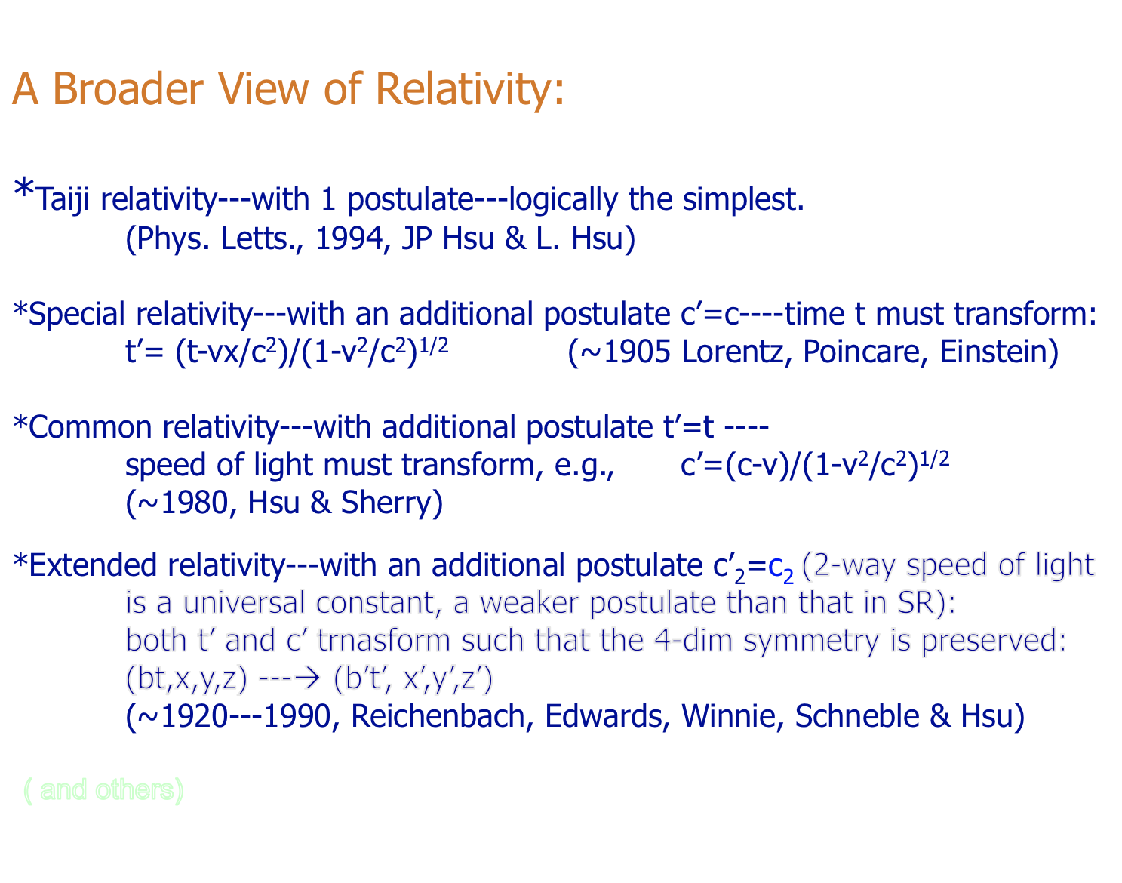

Slide 8
The logical connections of
relativity theories with 4-dim symmetry
(A Broader View of Relativity)

Slide 9
A general view of space-time symmetry:
x^{μ}→ x’^{μ}=x^{μ}+Λ^{μ}(x), Λ^{μ}(x)=arbitrary infinitesimal functions
Laws of physics should ‘look the same after finishing doing’ such
change of variables.
Two views of this general transformation:
1. Gauge symmetry (Yang-Mills’ view):
A generalization of space-time shift with a constant Λ^{μ}_{o}
i.e. Λ^{μ}_{o} ------→ Λ^{μ}(x), in flat space-time. (a non-trivial idea)
2. General coordinate invariance (Einstein’s view)
An arbitrary coordinate transformation in curved space-time.
(a profound idea)

Slide 10
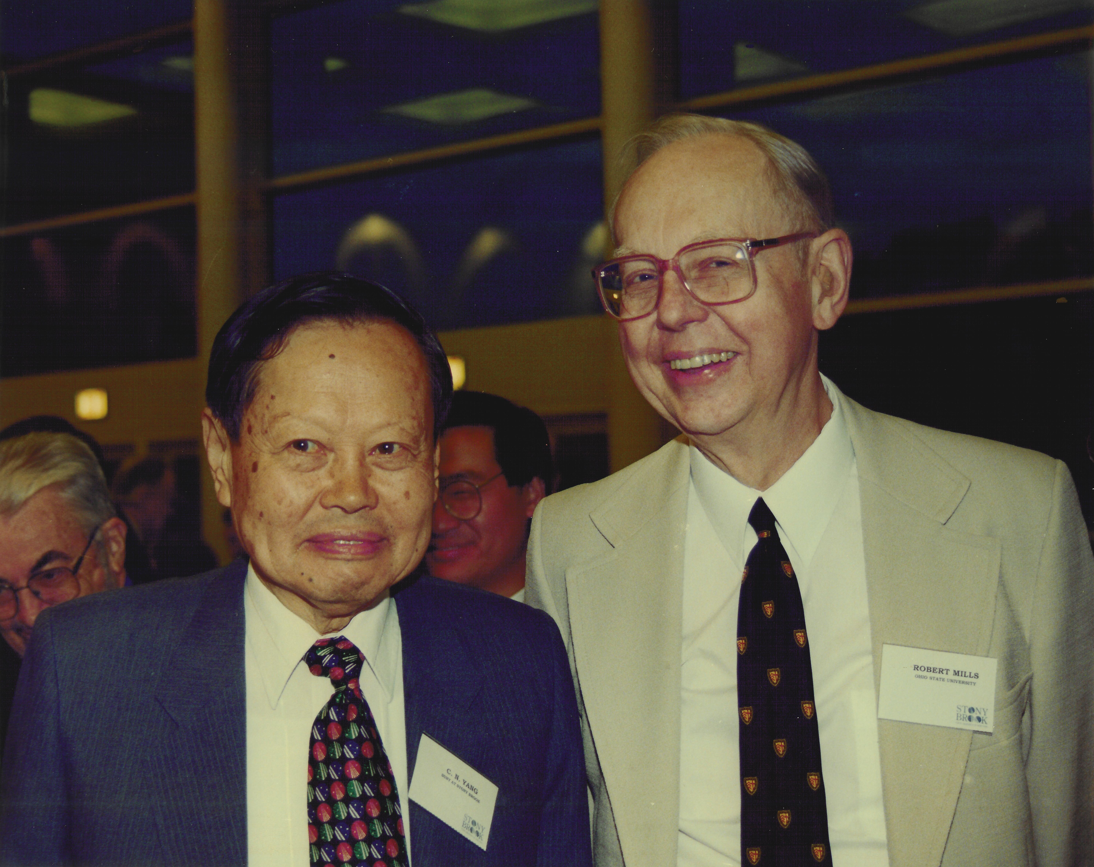
1. Yang-Mills (gauge field) theory:
QED. Unified Electro-weak theory,
Quantum Chromodynamics,
Yang-Mills Gravity,-----in Flat space-time
2. Einstein Gravity:------ in Curved Space-time
Yang-Mills

Slide 11
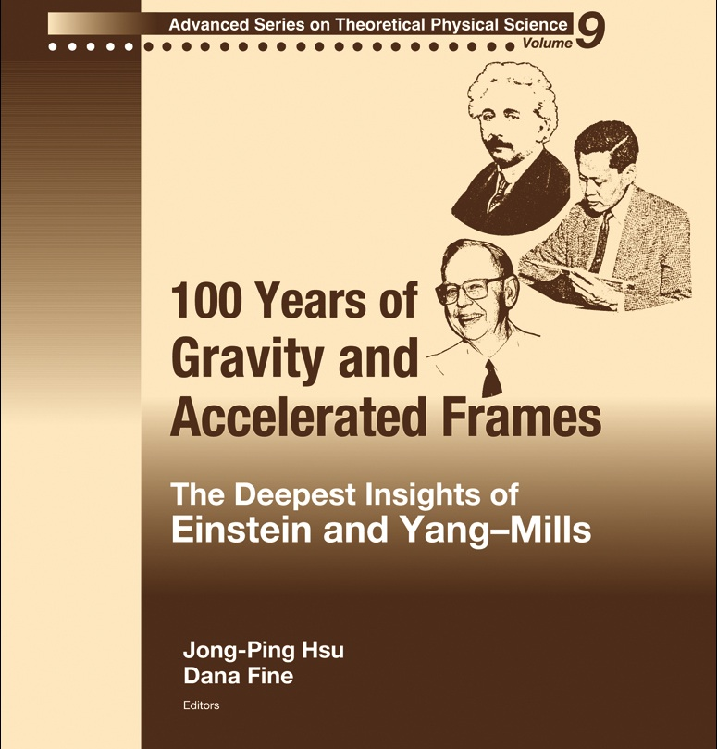

Slide 12
F. Dyson: (A co-founder of QED, together with Tomonaga, Schwinger, & Feynman)
Dyson stressed :
“The most glaring incompatibility of concepts in contemporary physics is that between Einstein’s principle of general coordinate invariance and all the modern schemes for a quantum-mechanical description of nature.”
(‘Missed Opportunity’ by F. J. Dyson,
J. W. Gibbs Lecture at Am. Math. Soc. 1972)
Quantum gravity appears to be the last challenge to the powerful gauge symmetry of the Yang-Mills theory.

Slide 13
Yang-Mills Gravity with
T(4) Space-time Gauge Symmetry
Motivations:
Using Yang-Mills’ approach based on the symmetry law of energy-mommentum conservatin in flat space-time to investigate and improve the relationship between Quantum Fields and Gravity.
**Conjecture:
The Framework of curved space-time is too general for quantum mechanics and quantum field theories

Slide 14
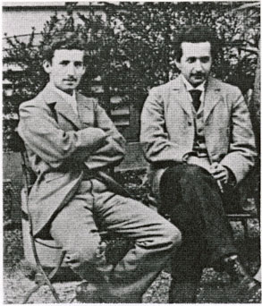
Gauge Symmetry
curved space-time
An established conservation law (Fundamental for Gravity):
T(4) symmetry : Energy-Momentum Conservation
Energy-momentum: the source of gravity
In curved space-time :Hayashi & Nakano, Prog. Theor. Phys(1967)
Utiyama & Fukuyama, P.T.P. (1971); Y.M. Cho, P.R. (1976), etc.***
In Flat space-time: Ning Wu, Commun. Theor. Phys. 2002, Logunov, et al
J.P.Hsu, Int. J. Mod. Phys. A, 2006. etc.***

Slide 15
A Basic Observation:
Dual interpretation of
    x^{μ}→ x’^{μ}=x^{μ}+Λ^{μ}(x)
    (i) a local translation of spacetime
    (ii)an arbitrary infinitesimal transformation of coordinates.
Generators of spacetime translations: p_{α}=i∂_{α}
(in Natural units c=h/2π =1)
(an extension from usual Yang-Mills theory because the generators p_{α} cannot be represented by constant matrices)

Slide 16
T(4) Gauge symmetry requires
the replacement (in inertial frames):
∂^{μ} → ∂^{μ} + gφ^{μν}∂_{ν} = J^{μν} ∂_{ν} = ∆_{ν ,} (c=ћ=1)
Gauge covariant derivative: ∆_{ν}
[∆^{μ}, ∆^{ν}]=C^{μνα} ∂_{α}
Gauge curvature: C^{μνα}
C^{μνα} = J^{μα}(∂_{α}J^{να}) - J^{νβ}(∂_{β}J^{να}),
J^{μν} = η^{μν} + gφ^{μν}, φ^{μν} = φ^{νμ} , [g]=[length]

Slide 17
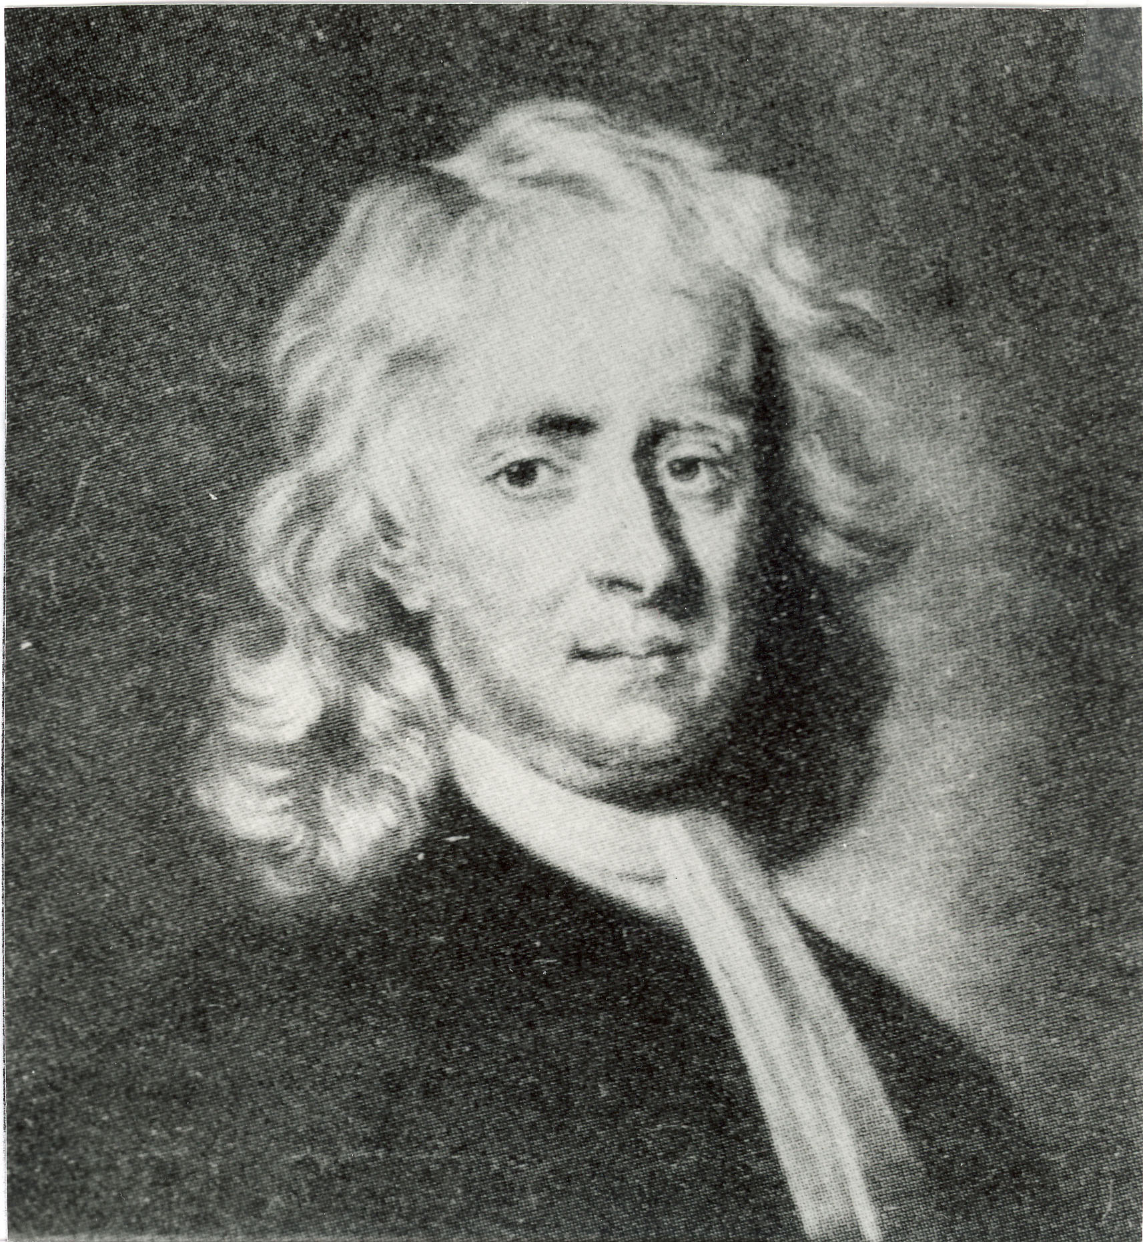
Consequencies of the extension:
(1) gauge field=tensor field φ^{μν}
(2) coupling constant g has the dimension of length
(in Natural units c=h/2π =1)
(3) The force due to the exchange of such a tensor gauge boson can only be attractive, in contrast to usual YM thory
*(4) In the limit of geometric optics (i.e., classical limit), the wave eq. of massive particle reduces to Hamilton-Jacobi eq
where G^{μν} appears to be an effective
“Riemannian metric tensor” for (and only for)
a classical object. But for quantum fields
and particles, the physical space-time is flat.

Slide 18
A key ingredient for general relativity to be consistent with
3 classical experiments is the Einstein-Grossman action principle S_{EG} for
the motion of a classical object
Where g_{μν} is the metric tensor in a curved space-time. It also lead to
A relaqtivistic Hamilton-Jacobi equaiton
in curved space-time. There is an interesting correspondence:
←--→
J^{μν} = η^{μν} + gφ^{μν}
Curved space-time ←----→
Flat space-time with the tensor gauge field
in the classical limit

Slide 19
Differences between Yang-Mills gravity and GR in the 2nd order approximation
(Int. J. Mod. Phys. A, 21, 5119 (2006), J. P. Hsu)
(A) Advance of the perihelion for one revolution of the planet:
δφ=(6Gm/P) [1 − 3(E_{o}² − m_{p}²)/(4m_{p}²)],
Where P=M²/(m_{p}²Gm), M=angular momentum
The difference can be tested if the velocity of the Mercury is about 0.1c
(B) Bending of Light:
Δφ=(4Gmω_{o}/M) [1 − 18G²m²ω_{o}²/M² ]
This correction term is too small (~10⁻⁹) to be tested.

Slide 20
(*SYMBOLIC COMPUTING Verification of Gauge Identity*)
(Jiping Wang, David Yang)
DefManifold[M4, 4, {a, b, c, d, e, f, g, h, i, j, k, l, m, n, o, p, q, r, s}]
DefManifold[M4, 4, IndexRange[a, t]];
DefMetric[-1, mg[-a, -b], CD, {";", "õ"}, PrintAs -> "g"];
(*$CovDFormat="Postfix";*)
SortCovDsStart[PD];
PrintAs[EinsteinCD] ^:= "G"
PrintAs[RicciCD] ^:= "R"
PrintAs[RicciScalarCD] ^:= "R"
PrintAs[RiemannCD] ^:= "R"
PrintAs[ChristoffelCD] ^:= "G”
DefTensor[A[a], M4 ]
DefTensor[T[a, b], M4, Symmetric[{a, b}]]
DefTensor[F[a, b], M4, Antisymmetric[{a, b}]]
DefTensor[U[a, b], M4, Symmetric[{a, b}]]
ruT = MakeRule[{T[a, b],
1/4 (F[-e, -f] F[e, a] mg[f, b] + F[-e, -f] F[e, b] mg[f, a] -
1/2 F[-e, -f] F[e, f] mg[a, b])}]
T[a, b] /. ruT /. ruFF /. ruFud /. ruFuu /. ruFdu // ScreenDollarIndices

Slide 21
(*SYMBOLIC COMPUTING Verification of Gauge Identity*)
res1 = F[-a, -c] PD[-b][F[b, a]] + 2 PD[-b][mg[-a, -c] T[a, b]] /. ruA /.
ruT /. ruFF /. ruFud /. ruFuu /. ruFdu(*/.ruF*)(*//ToCanonical*)//
Expand;
% // Length
r1 = res1 // ToCanonical // Expand
% // Length
r100 = r1 /. ruA /. ruFdu /. ruFud /. ruFuu /. ruFud // ToCanonical // Expand
% // Length
r200 = r100 /. ruA /. ruFdu /. ruFud /. ruFuu /. ruFud // ToCanonical // Expand
% // Length
0
The End

