Slide 1

A microscopic star-planet system: the Coulomb 3-body problem
J Wang,
Symposium 2009, UMassD

Slide 2
Outline
Coulomb 3-body problem
Mass transfer in binaries
Monte Carlo simulations
Summary

Slide 3
Coulomb 3-body problem
Any 3 particles interacting via the Coulomb potential, V = k / r
r - R
Simplest nontrivial system in atomic reactions
No general analytical solutions in QM or CM
Basic building block toward understanding complexity
Important to basic and applied science, actually at heart of it
R
r

Slide 4
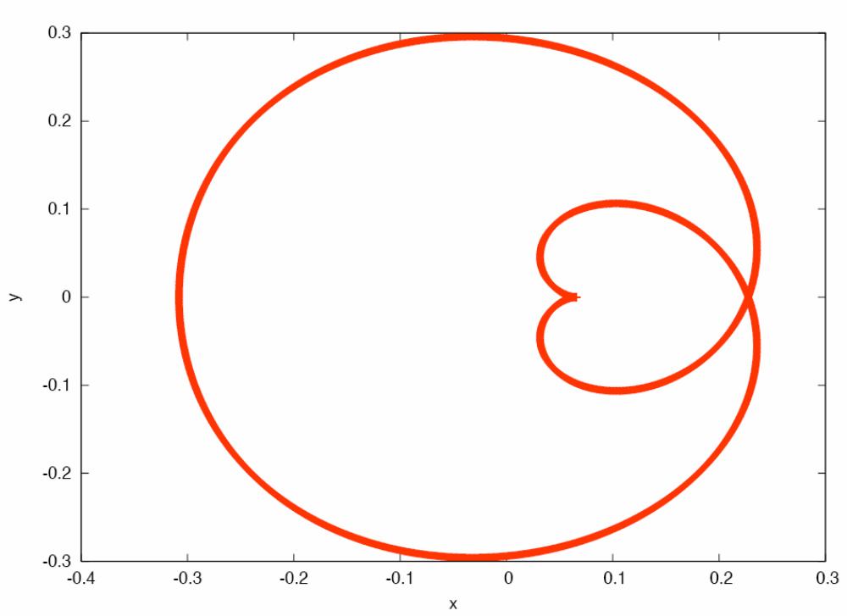
The trajectory of a 3-body system
Andreas Ernst

Slide 5
Coulomb vs gravity
Two important aspects to consider in a microscopic system such as the atom:
Coulomb force is much stronger than gravity, F_{coul}/F_{grav} = 10³⁹ in atoms
Atoms obey quantum mechanics; stars obey classical mechanics
solution:
#1: different space/time scales, it is OK
#2: more difficult, but thanks to Bohr-Sommerfeld limit, can choose a high n-state

Slide 6
Semiclassical limit
Bohr-Sommerfeld correspondence principle: For large principal qm# n, quantum and classical results should agree.
angular momentum L = n ħ
e.g., transition frequency f = (E_{n+1}-E_{n})/h
f = lim_{n→∞}= mc²α² /hn³ = v/2πr, i.e.,
it is the classical orbiting frequency
How large is large?
Earth-Sun: n = rmv/ħ ~ 10⁷⁴
Atoms: n ≥ 4 sufficient, Rydberg atoms

Slide 7
Atomic reactions
projectile + atom → atom* + projectile
electron
projectile
b
b = impact parameter
target nucleus
Outcome, ICE:
Ionization, if electron is in the continuum
Capture, if electron jumps to projectile (mass transfer, focus of this talk)
Excitation, if electron is still bound to target

Slide 8
Outline
Coulomb 3-body problem
Mass transfer in binaries
Monte Carlo simulations
Summary

Slide 9
Capture? great! ... how?
When electron orbital v_{e} & projectile velocities v_{p} match, it provides the best chance of capture.
electron
projectile
v_{p}
target
What if projectile is fast, v_{p}>> v_{e}, a case of practical interest?
Idea: projectile accelerates the electron first, then target deflects it in projectile’s direction

Slide 10
Thomas 2-step mechanism
Step 1: acceleration by projectile
after binary collision, v_{e}=2v_{p}cos θ, so θ = 60º gives right speed, v_{e}= v_{p} but wrong direction
.03º
proton
v_{p}
e
60º
v_{e}
Step 2: deflection by target by another 60º
same speed, same direction, perfect match!
target
60º

Slide 11
Thomas, we got a problem!
The Thomas mechanism, a classical mechanics argument, had not been observed in classical mechanics simulations in ground state atoms.
But experiments and quantum mechanical calculations do show the Thomas mechanism!
What is wrong? Ground states do not really obey classical mechanics.
Solution: should do calculations for Rydberg states, not ground states as had been the case.

Slide 12
Outline
Coulomb 3-body problem
Mass transfer in binaries
Monte Carlo simulations
Summary

Slide 13
Monte Carlo simulations
1: Sample initial conditions (r, p) of the electron consistent with quantum distributions (n=4)
2: Integrate the equations of motion
..
r_{i} – r_{j}
r_{i} – r_{k}
r_{i} = - q_{ij} – q_{ik}
{i,j,k}={1,2,3}
|r_{i} – r_{j}|³
|r_{i} – r_{k}|³
3: Analyze results (ICE)
4: Repeat until good statistics, ~ 10⁸ times

Slide 14
Orientations
Simulation with circular orbits in two orientations:
Parallel
Perpendicular
electron
electron
projectile
projectile
Principal qm# n=4
Projectile/electron speed ratio: v_{p}/v_{e} = ½, 1, 1.5

Slide 15
Are we there, yet?
Yes, we are, almost.
Simulation runs...
Typical ICE runs
Capture, parallel orientation
Capture, perpendicular orientation
General interest events
Each run is presented in multiple views

Slide 16
Outline
Coulomb 3-body problem
Mass transfer in binaries
Monte Carlo simulations
Summary
  Thomas mechanism does exist
  Coulomb 3-body dynamics are accessible to atomic experiments
  Connection to cluster/binary stars? astrophysics experiments in atomic lab?

