Slide 1

BI DEVELOPER CASE STUDY
Gokhan Yavuzkendirci

Slide 2


TECHNOLOGIES & TOOLS
Snowflake Data Cloud
GITHUB

Slide 3




Agenda
Exercise 1
Bug Fix
Exercise 2
EV Contracts Report
License Plate Report
Price Report

Slide 4
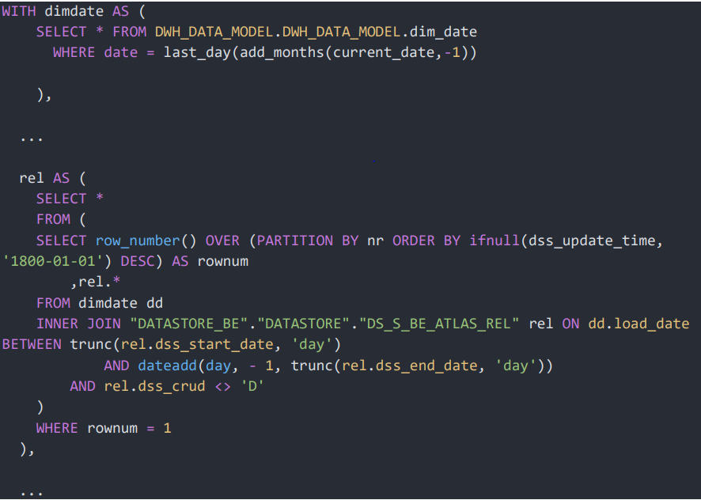
Exercise 1
Bug Fix
Can you explain what this fix does to solve the duplicate issue? Do you like this solution?
Can you think of possible underlying problems in the DS_S_BE_ATLAS_REL (Historized) table that’s causing the duplicates?
How would you go about addressing these issues and what are things you should be wary of when applying a fix to the historized table?

Slide 5
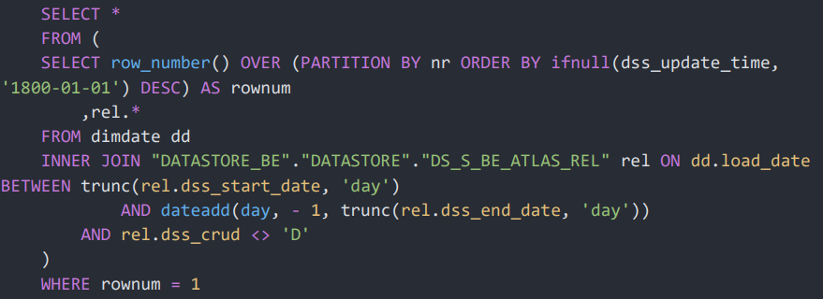
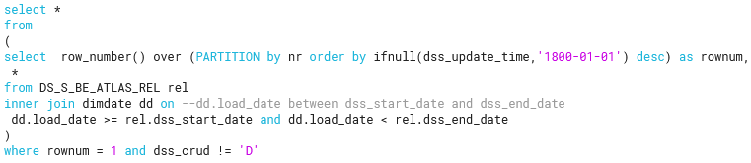
Exercise 1
1 - Can you explain what this fix does to solve the duplicate issue? Do you like this solution?
While trying to fix the table, duplication was tried to be prevented in order to get the last updated record according to the NR column.
But,
In the sample query, rel.dss_crud != 'D' filter used in the inner select, which will cause to fetch bring results.
NR 1 -> inserted in Dec 1
NR 1 -> updated in Dec 4
NR 1 -> deleted in Dec 6
In this way of use (inner select), NR 1 will be shown as an active record but it is actually deleted, that's why we need to put rel.dss_crud != 'D' at the outer select query.

Slide 6
Exercise 1
2 - Can you think of possible underlying problems in the DS_S_BE_ATLAS_REL (Historized) table that’s causing the duplicates?
I was not familiar with 'dss_' prefix, as per my research, I am assuming that you are using a plugin called 'DSS' (Dataiku Data Science Studio for SQL) to manage ETL data transfer to Snowflake. And, 'dss_' naming convention was used to identify those tables which is generated by this plugin. Therefore, the duplication problem may be caused by the DSS integration definitions.
There may be problems with the data taken from the source table. For example, permanent instant undo – redo commits.
There may be a problem with the application that feeds the production table.
There may have been a problem with the instant source system date variables.
There may be a duplication problem in the joined table in a join operation that is required before transferring data to this table.
The frontend developer may have developed an incorrect query because he does not know the structure of this historized table.

Slide 7
Exercise 1
3 - How would you go about addressing these issues and what are things you should be wary of when applying a fix to the historized table?
I assume, the requirement is to get the data for a given data and having a snapshot data as of that date. As per my experience, having data of a snapshot date has limited use-case as compared to the last date snapshot, For that reason, I would generate a dataset and write this data to a permanent table instead of keeping this as a view, this will serve much more use-cases, and reduce the error risk of using wrong queries by using this Single Source of Truth.
I think fixing the DWH and DM tables should be the last resort. Instead of finding a specific solution to the problem, it would be more beneficial to find the root of the problem and fix it there. In this way, we can avoid such problems in another future developments. For example, defining rules or constraints to the source production table.

Slide 8
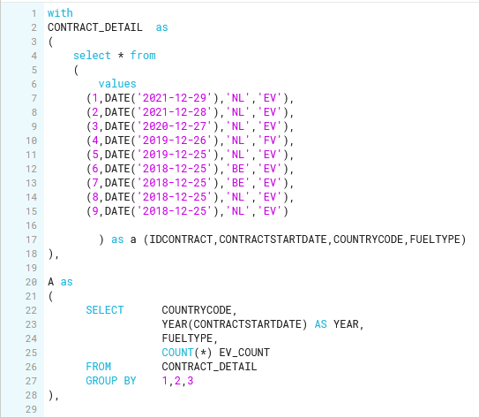
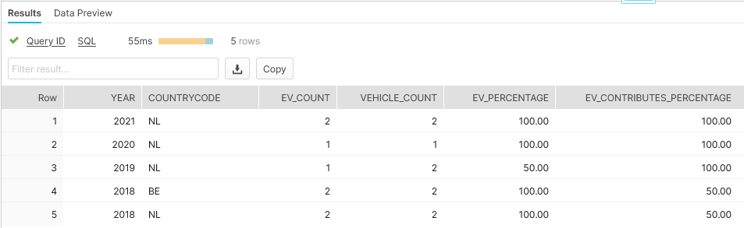
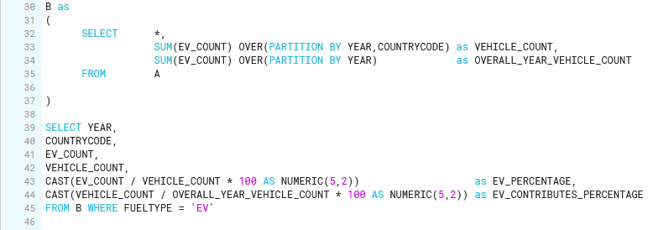
Exercise 2
1- EV Contracts Report

Slide 9
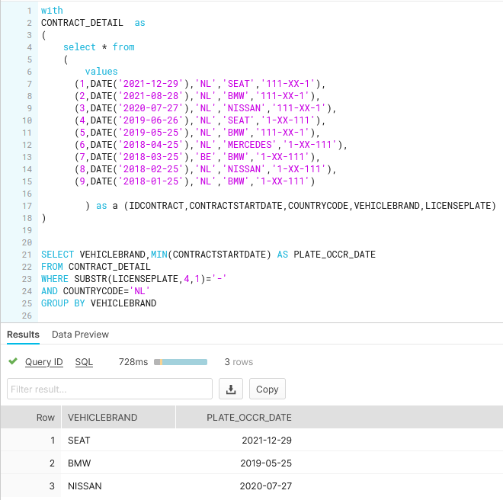
Exercise 2
2- License Plate Report

Slide 10
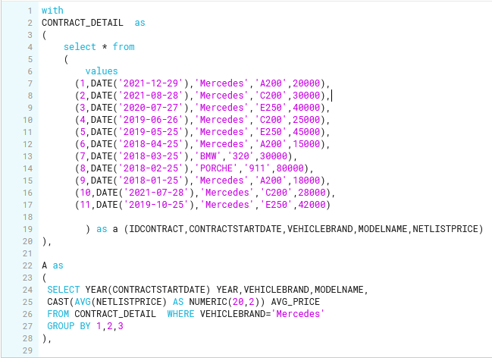
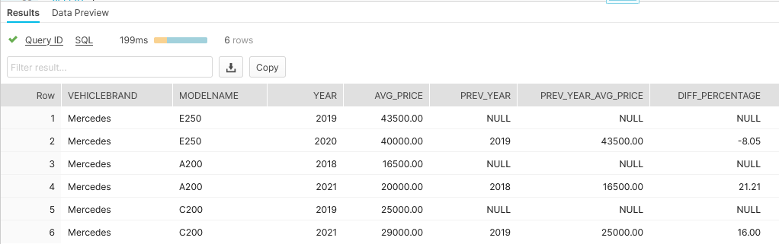
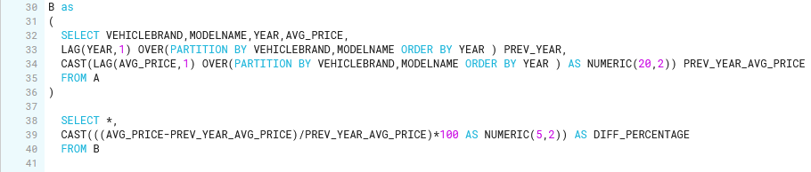
Exercise 2
3- Price Report

Slide 11
Github Files
Snowflake SQL Files
Assumptions
Presentation

