Slide 1

TAKEAWAY CASE STUDY
Gokhan Yavuzkendirci

Slide 2
Agenda
High Level Design
Draft Input
Database Relationship Diagram
Visualisation
Tools & Technologies

Slide 3
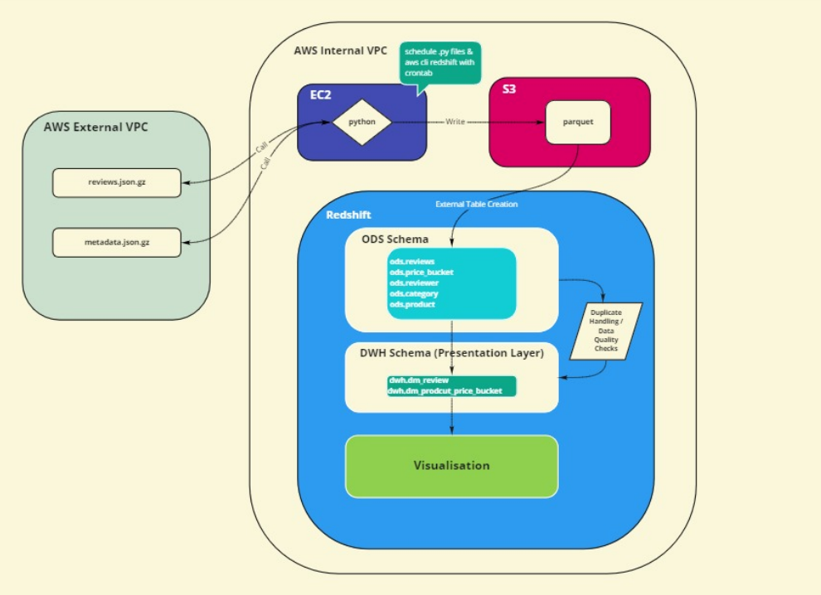
HIGH LEVEL
Get data from url
Process on python
Write to parquet via python to S3
Create External Tables
Import data to Redshift
Design DWH and ETL
Visualise on Redshift
Schedule python and Redshift jobs

Slide 4
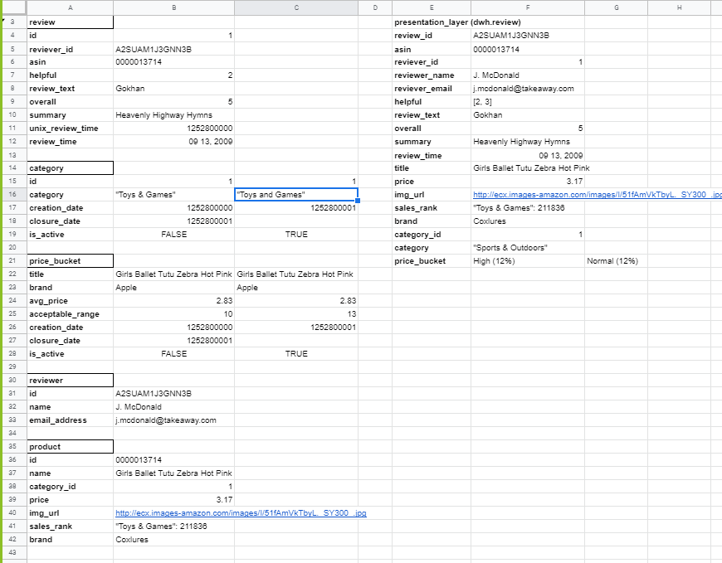
DRAFT INPUT

Slide 5
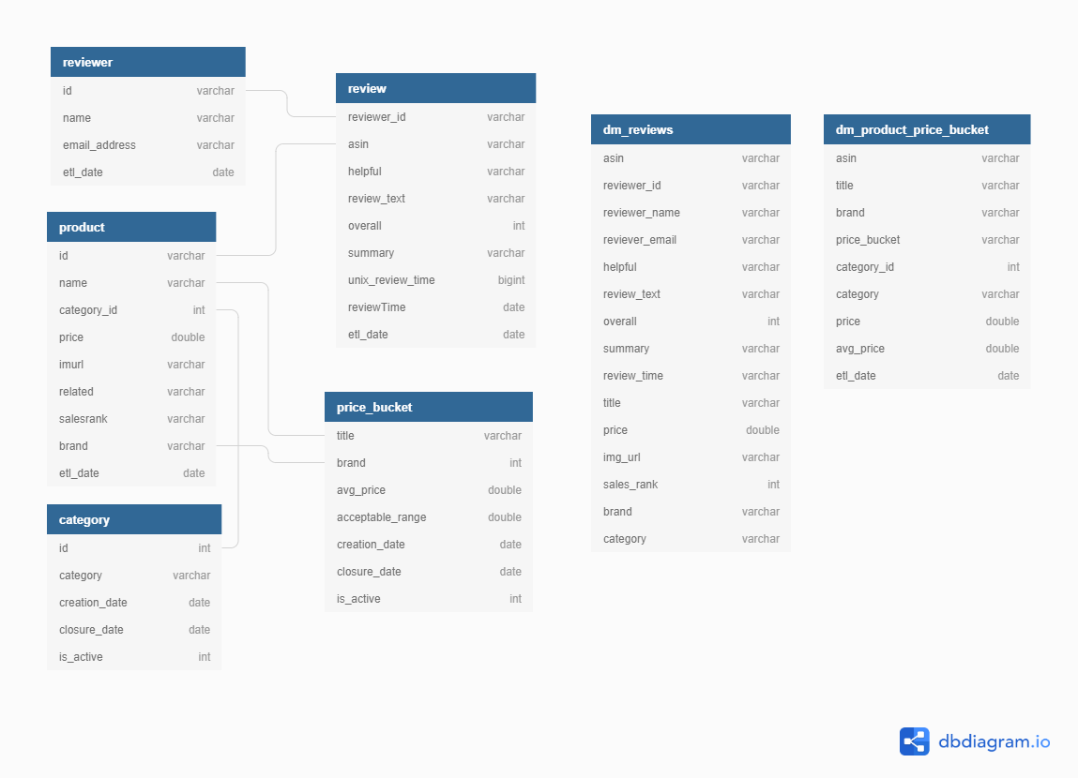
Database Relationship Diagram

Slide 6
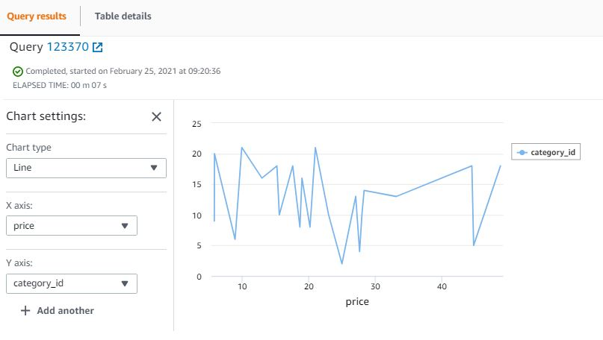
Visualisation

Slide 7
TECHNOLOGIES & TOOLS
AWS EC2 Unix VM
Python
Amazon Redshift
AWS S3
Cronjobs
Unix Shell Script
Jupyter Notebook
Google Sheets & Diagramdb
GITHUB

