Slide 1
Jingle
Your personal Mailer

Slide 2
OUTLINE
About Jingle
Language and Tools used
Libraries Used
Modules Used
Working
References

Slide 3
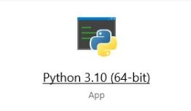
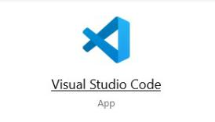
LANGUAGE AND TOOLS used
Python version 3.10 as a coding language is used .
It’s an interpreted high-level general-purpose
programming language
Visual Studio Code is , its an application used for code creation and
manipulation, simultaneously in a same window. Python IDLE shell
For code manipulation is also used.

Slide 4

About Jingle
Jingle is a user-friendly email bot.
Jingle activates as we run the code and talks to you.
Jingle asks you to who you want to send the mail, the subject and the body of mail.
On your command jingle send the desired mail from the provided email address.

Slide 5
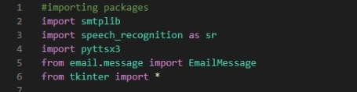
Libraries used
smtplib: Used to import functions for creating a server.
speech_recognition: Used to import functions for recognising user’s speech.
pyttsx3: Used to import functions for converting text to speech.
Email Message: Used to import functions that stores various mailing details and send the mail to the desired recipient.
tkinter: Used to import functions to add GUI

Slide 6
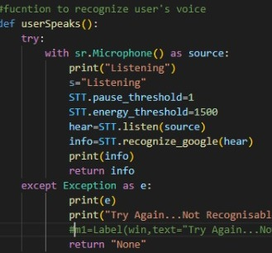
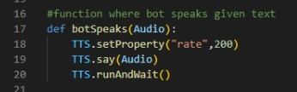
Modules used
Module for text to Speech conversion
Module for Speech to Text Conversion

Slide 7
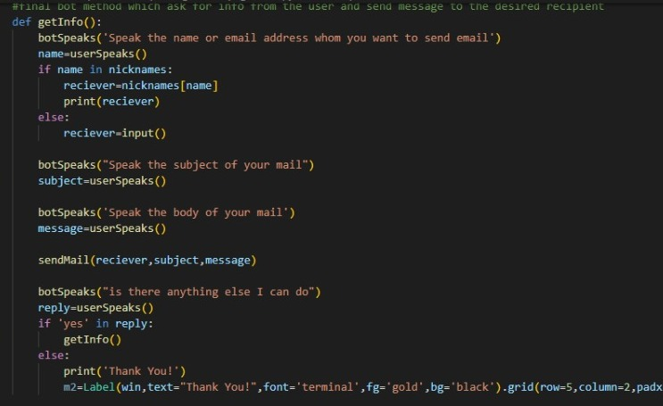
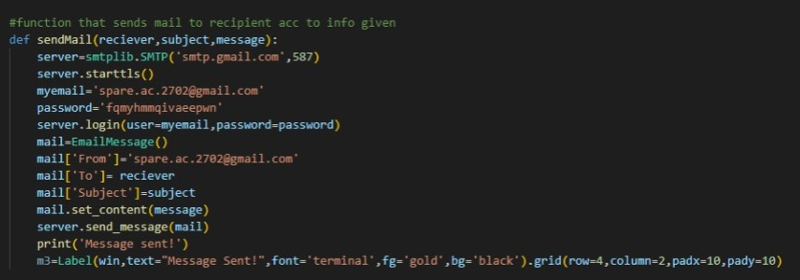
Module to Send Mail
Final Module

Slide 8
Working

