Slide 1
JHU BME 580.422 Systems Bioengineering II
Spinal motor system and force generation
Reza Shadmehr

Slide 2
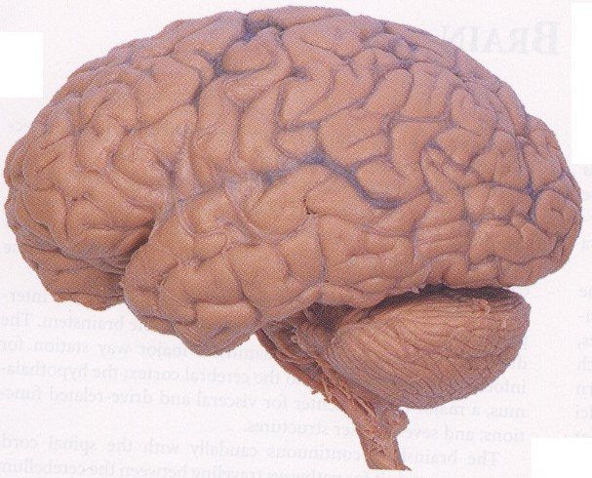
Posterior Parietal cortex
Transforming visual cues into plans for voluntary movements
Motor cortex
Initiating, and directing voluntary movements
Basal ganglia
Assigning value to actions and stimuli
Thalamus
Cerebellum
Learning movements and coordination
Brainstem Centers
Postural control
Spinal cord
Reflex coordination
Motor neurons
Skeletal Muscles

Slide 3
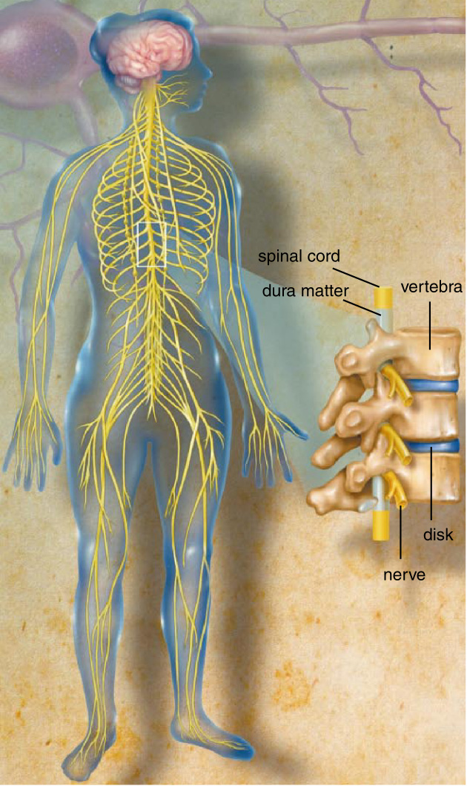
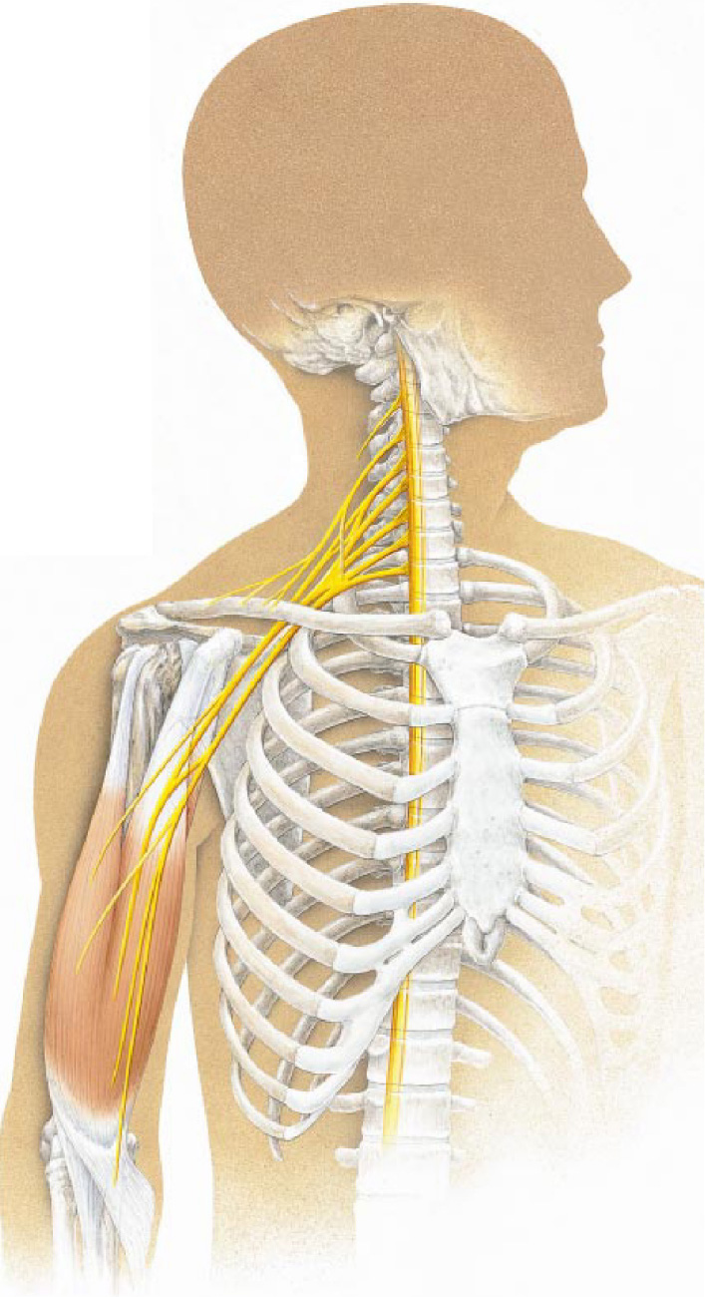
McDonald JW (1999) Sci Am 9:64-73

Slide 4
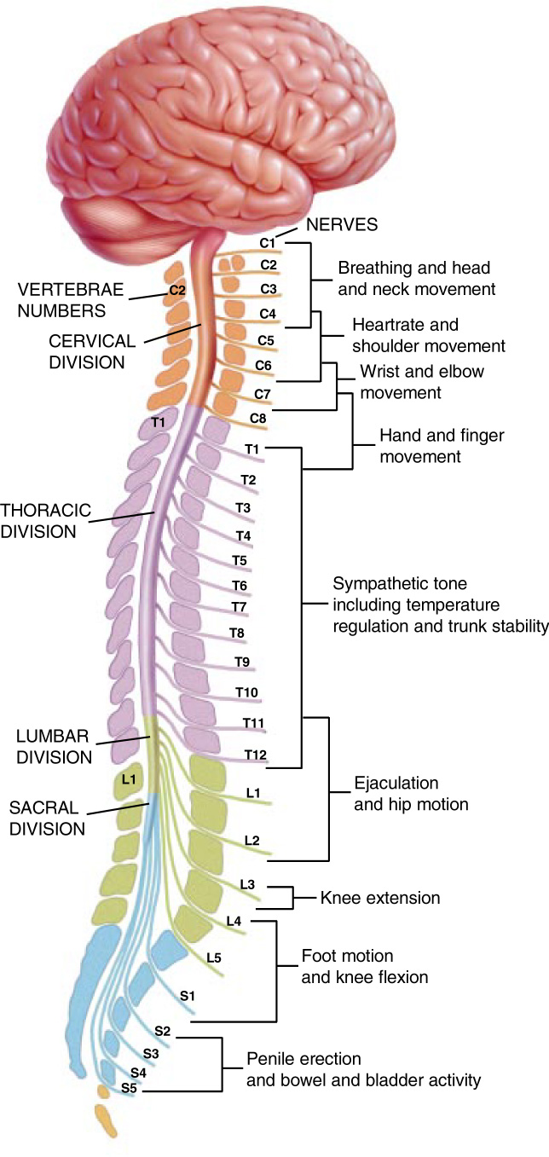
Divisions of the spinal cord:
Cervical
Thoracic
Lumbar
Sacral
McDonald JW (1999) Sci Am 9:64-73

Slide 5
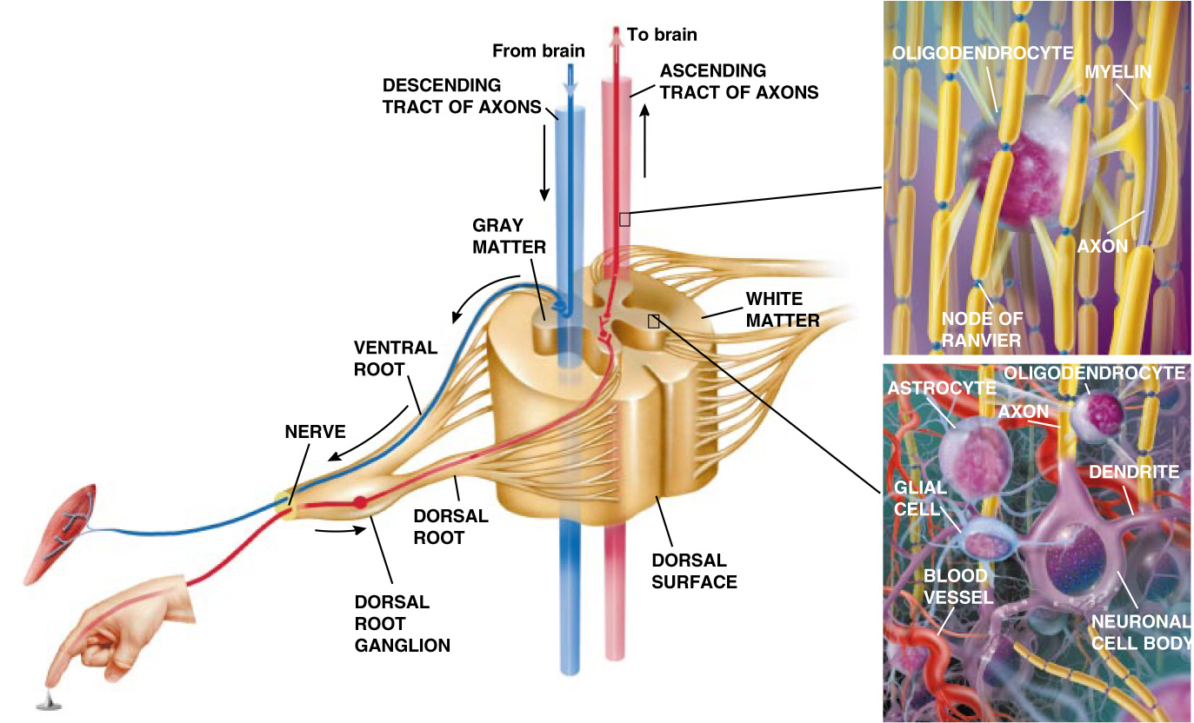
A spinal segment
McDonald JW (1999) Sci Am 9:64-73

Slide 6
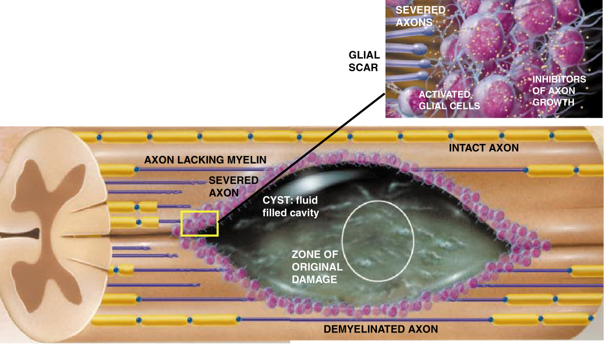
Spinal cord injury involves damage to both neurons and glia
Initial damage is likely limited to a small region
Hemorrhaging from broken vessels swells the cord, putting pressure on healthy neurons
Injured neurons release glutamate at very high levels, over exciting neighboring neurons
Cyst and glutamate kill myelin producing cells
After a few weeks, a wall of glia cells forms
McDonald JW (1999) Sci Am 9:64-73

Slide 7
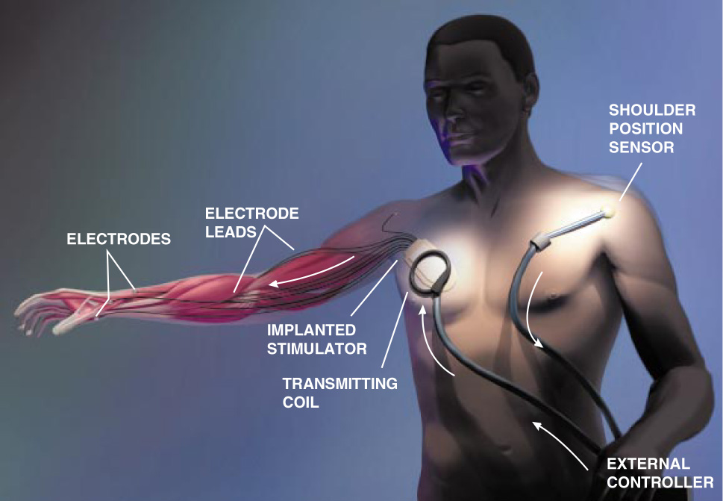
Neural Prosthetics
Functional Electrical Stimulation to produce a grip
C6 injury: Elevation of shoulder on the left arm signals the stimulator to produce a grip.
McDonald JW (1999) Sci Am 9:64-73

Slide 8
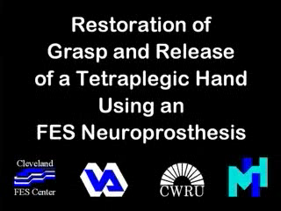
Pat Crago, Case Western Reserve Univ.

Slide 9
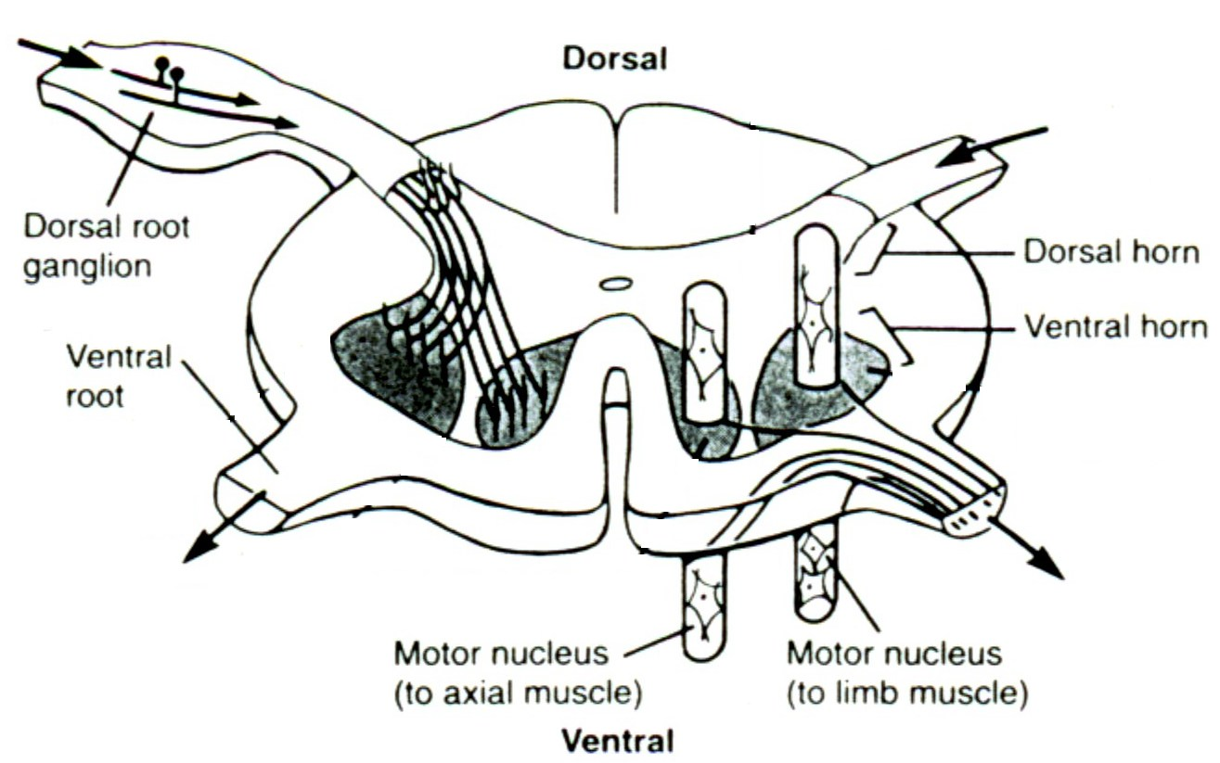
Motor neurons reside in the ventral region of the gray matter of the spinal cord. They collect into pools that innervate a single muscle.
Kandel ER et al. (1991)

Slide 10
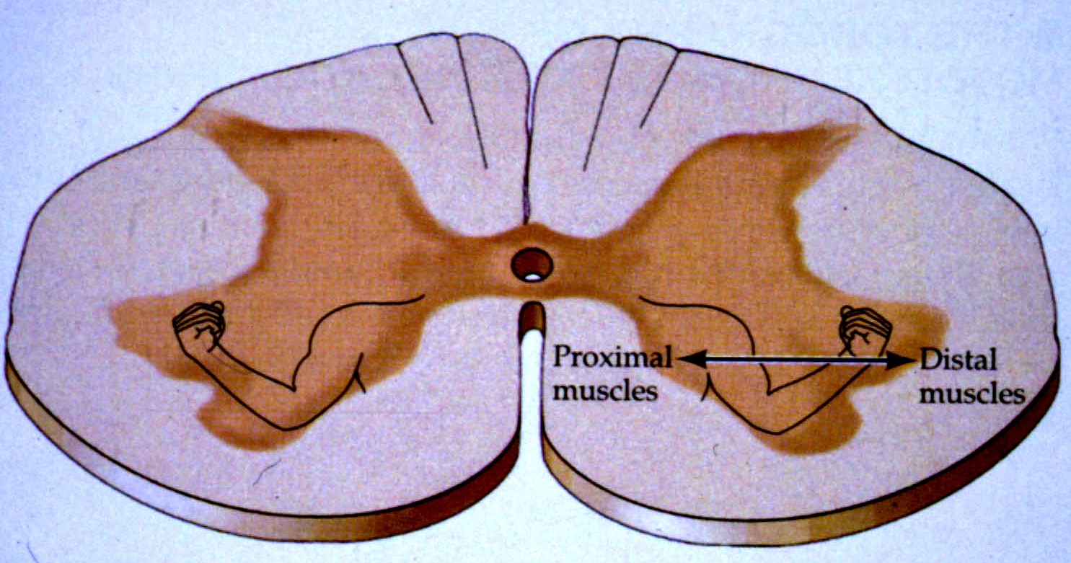

Slide 11
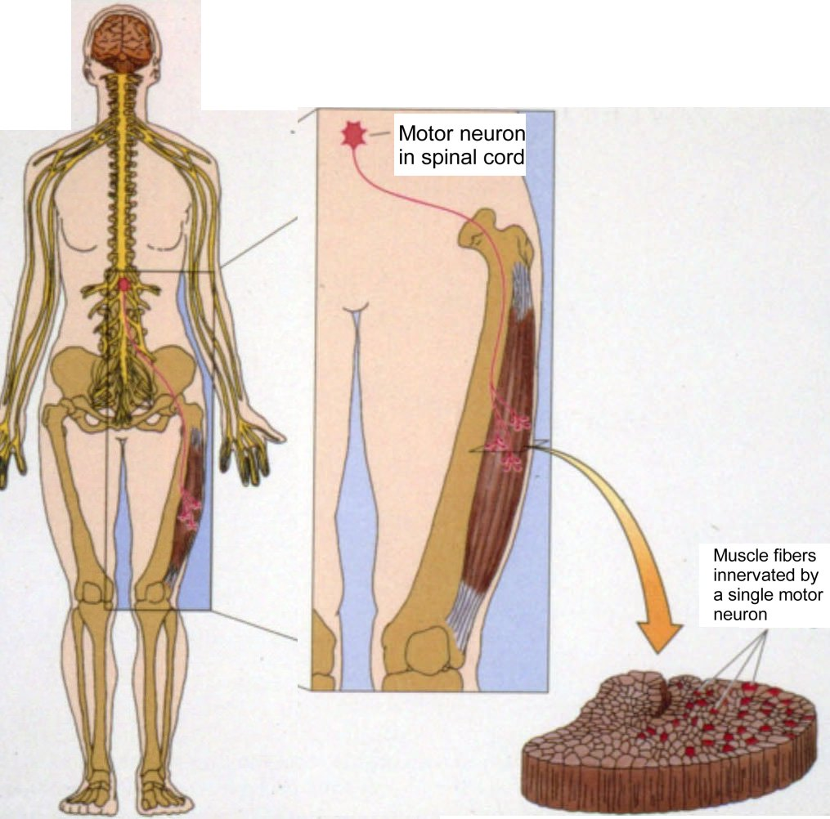
A motor unit: a motor neuron and all muscle fibers that it innervates
Motor unit size depends on function

Slide 12
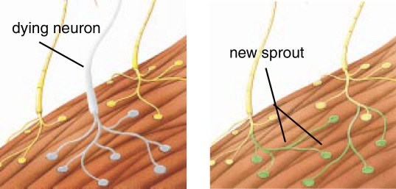
Polio
Poliovirus invades the motor neurons, killing them.
Muscle fibers in the motor unit are paralyzed.
Neighboring motor neurons grow sprouts to take over orphaned fibers, creating a giant motor unit.
Halstead LS (1998) Sci Am 4:42-47

Slide 13
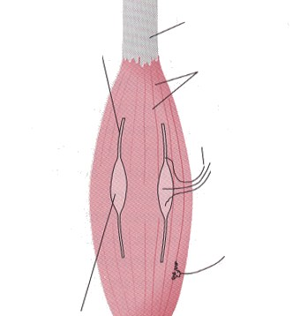
Tendon
Intrafusal muscle fiber
(contractile component)
Extrafusal muscle fibers
γ motor neuron axon
Spindle afferent axons
α motor neuron axon
Intrafusal muscle fiber
(sensory component)

Slide 14
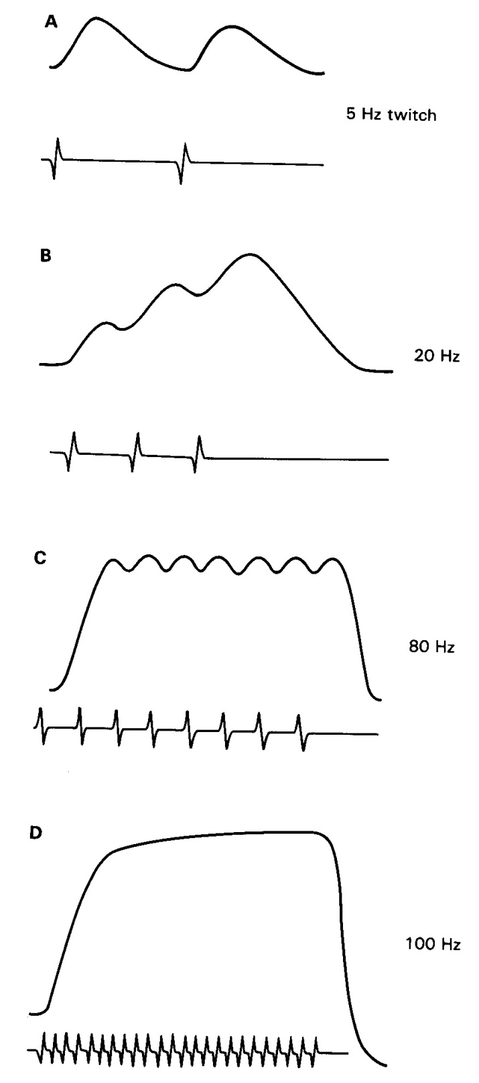
Force produced by a muscle depends on the rate of action potentials from the motor nerve.
Kandel ER et al. (1991)

Slide 15
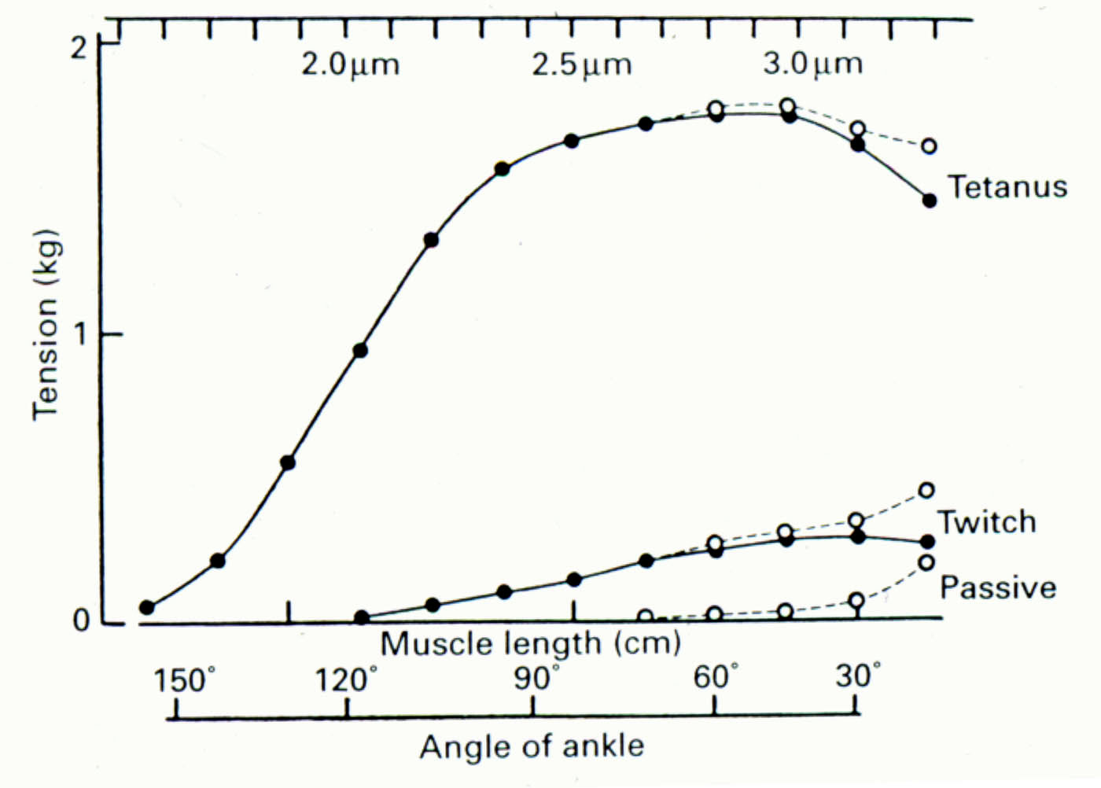
Force produced by a muscle depends on its length
Force produced through direct electrical stimulation of the soleus muscle of a cat. This muscle’s function is to extend the ankle.

Slide 16
Control of a limb with antagonist muscles
1. Relating muscle force to joint torques using Principle of Virtual Work
triceps
a
λ
θ
extension
b
2
1.5
Moment arm (cm)
1
0.5
25
50
75
100
125
150
Joint angle (deg)

Slide 17
Control of a limb with antagonist muscles
2. Relating muscle force to joint torques using a moment arm
a
λ
θ
c
α
b

Slide 18
Control of a limb with antagonist muscles
3. Torques produced by antagonist muscles sum at the joint
θ

Slide 19
Control of a limb with antagonist muscles
4. Simulation of muscles produces an equilibrium position
150
125
100
75
θ
50
25
0
0
1
2
3
4

Slide 20
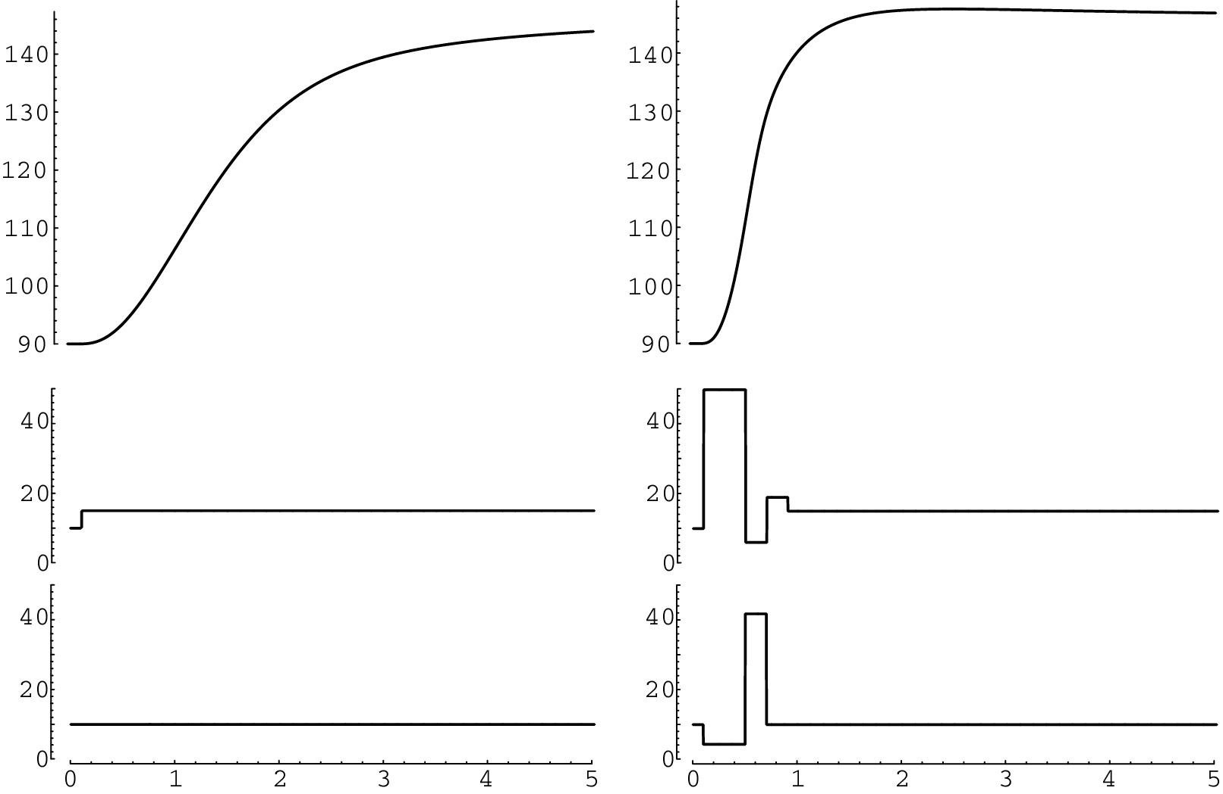
Control of a limb with antagonist muscles
5. To rapidly move a limb, antagonist muscles are activated in sequence
Slow movement
Fast movement
Joint angle
θ
Muscle 2 activity
Muscle 1 activity
Time (sec)

Slide 21
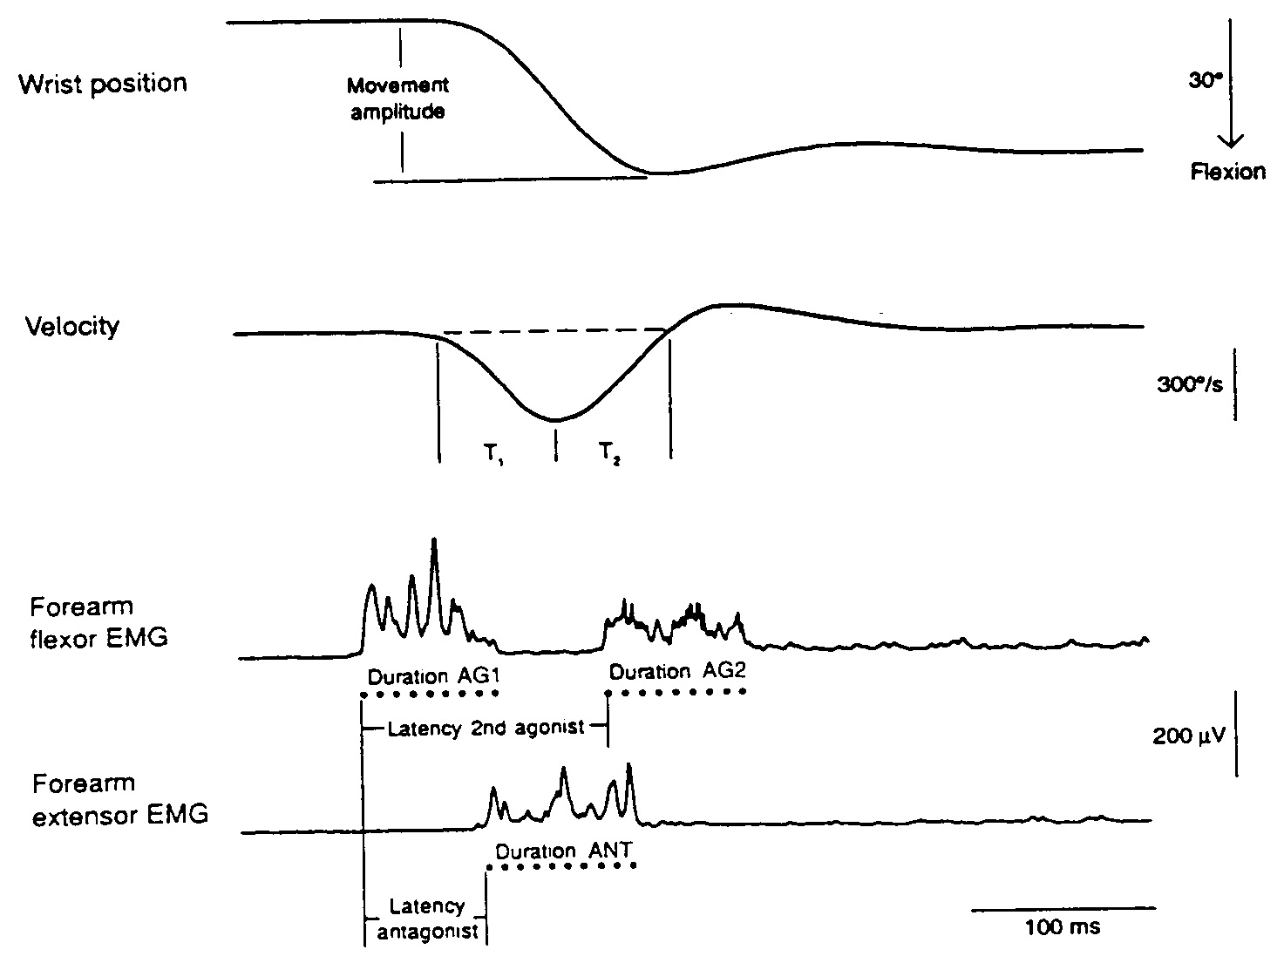
Rapid wrist flexion: agonist-antagonist-agonist activation pattern

Slide 22
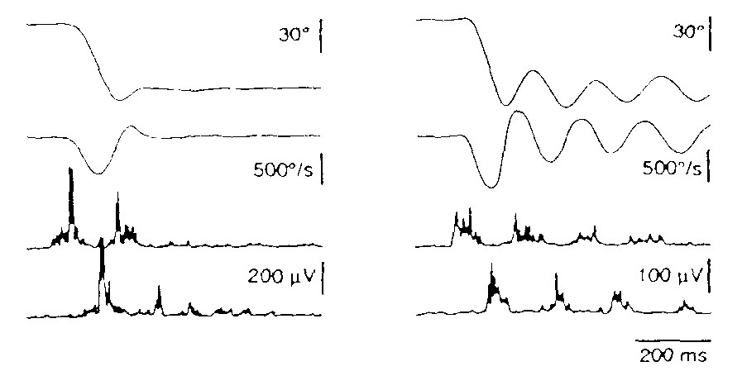
Essential tremor: a cerebellar condition associated with delayed 2nd agonist burst
Normal
Essential tremor
Wrist position
Wrist velocity
Wrist flexor EMG
Extensor EMG
Britton et al. 1994

