Slide 1
JHU BME 580.422 SBE II
Muscle types, proprioception, reflex pathways
Reza Shadmehr

Slide 2
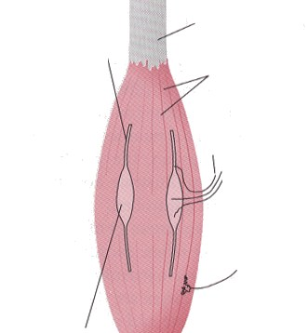
Tendon
Intrafusal muscle fiber
(contractile component)
Extrafusal muscle fibers
γ motor neuron axon
Spindle afferent axons
α motor neuron axon
Intrafusal muscle fiber
(sensory component)

Slide 3
Types of Muscle Fibers
In adult humans, we find that a muscle may be made up of 3 distinct kinds of muscle fibers, where each fiber has a particular isoform of the myosin molecule.
Type I: slow contracting fibers. Repeated stimulation results in little or no fatigue (loss of force).
Type II: fast contracting fibers
  Type IIa: fatigue resistant
  Type IIx: easily fatigued
Composition of fiber types in a muscle depends on its function.

Slide 4
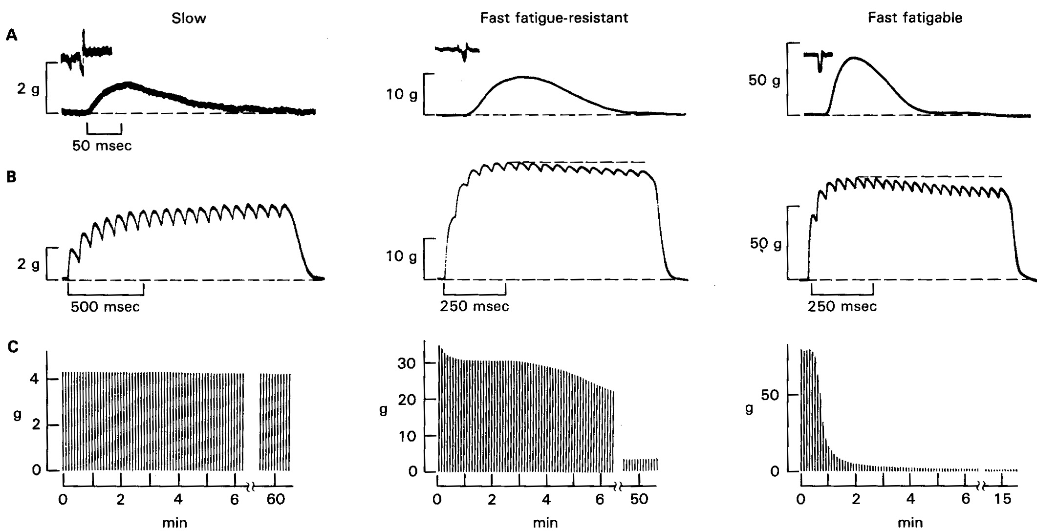
Types of Motor Units
Three different motor neurons are stimulated intracellularly. A: Twitch response. B: Tetanic stimulation response. C: Tetanic stimulation for 330 msec, repeated every second.
RE Burke and P Tsairis, ANN NY ACAD SCI 228:145, 1974

Slide 5
Properties of Motor Units
Slow Type FF Type
Axon Diameter:
Tetanic Tension:
Speed of Contraction:
Fatigue:
No. of terminals:
Metabolism:
Myoglobin:
Glycogen:
Mitochondria:
Capillaries:
Muscle Fibers:
Small Large
Small Large:
Slow Fast
Little Rapid
Few Many
Aerobic Anaerobic
Plentiful Few
Little Many
High density Low density
Rich supply Few
Small, red Large, pale

Slide 6
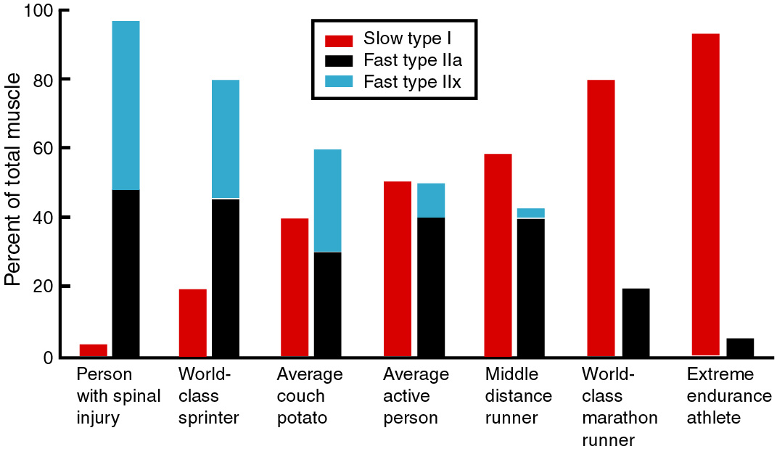
Change in a Muscle: Spinal Cord Injury & Effect of Exercise
Strength training puts stress on tendons, signaling proteins to activate genes that make more myosin, resulting in the enlargement of muscle fiber. Type IIx fibers are slowly transformed into type IIa fibers.
Paralysis: Transformation of type I fibers into type IIx.
Quadriceps
(thigh muscle)

Slide 7
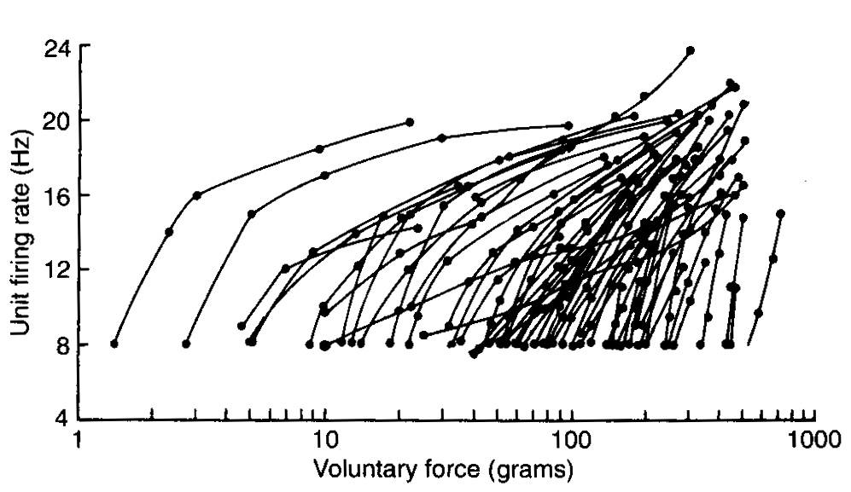
Control of Muscle Force
As more force is needed, more motor neurons are recruited.
Frequency of activation of motor neurons is increased.
Monster AW & Chan H (1977) J Neurophysiol 40:1432

Slide 8
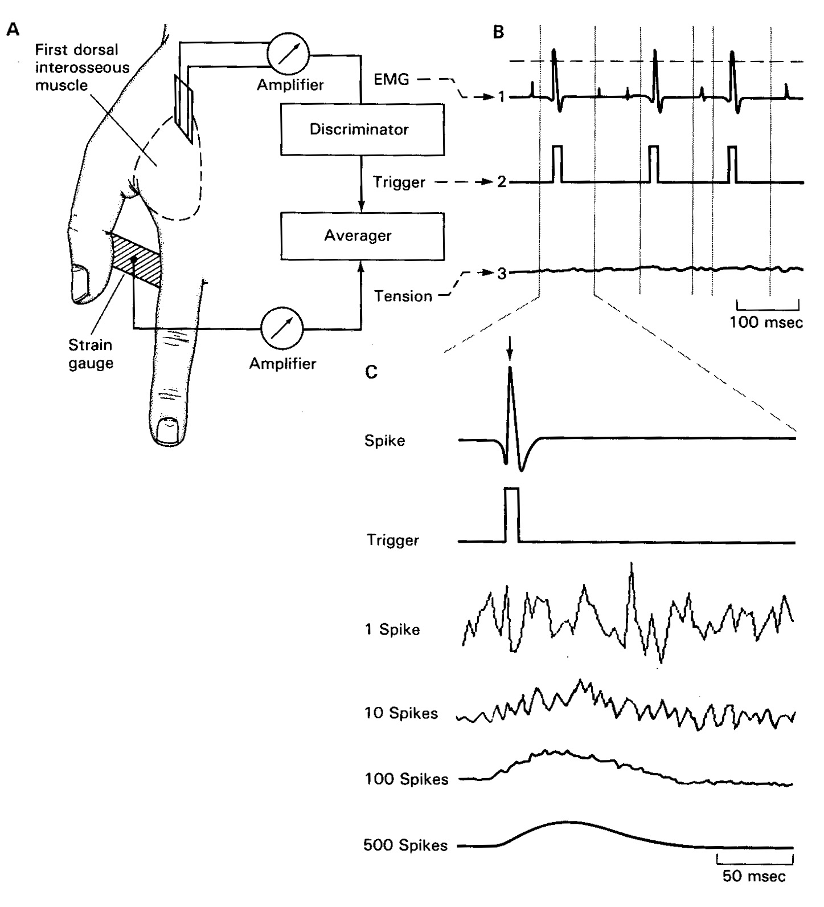
Action potential from a single motor neuron

Slide 9
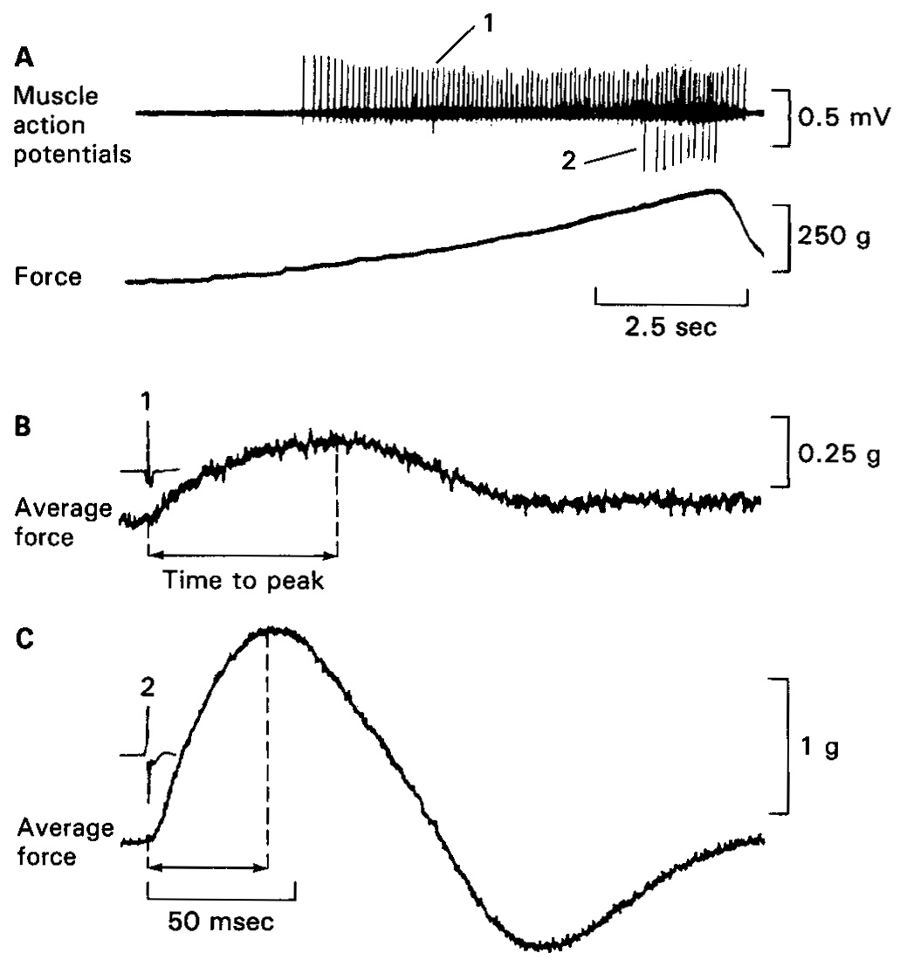
Motor units that are activated later tend to produce more force and have faster contraction time.
Motor unit 1
Motor unit 2
Desmedt JE & Godaux E (1977) Nature 267:717

Slide 10
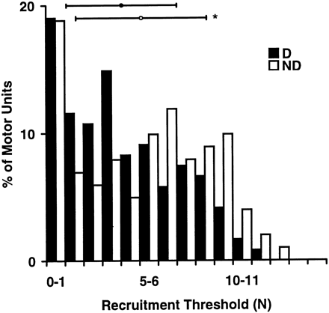
Use dependent change in a motor unit recruitment: effect of handedness
Muscles of the dominant hand are used more, and so should have larger proportion of type I muscle fibers. To produce a given amount of force, a muscle that has a large number of type I muscle fibers will recruit a proportionally large number of motor units.
Distribution of motor unit recruitment threshold in dominant (D) and non-dominant (ND) hands. The task is isometric force production in the 1st dorsal interosseous muscle.
Adam, De Luca, Erim (1998) J. Neurophysiology 80:1373.

Slide 11
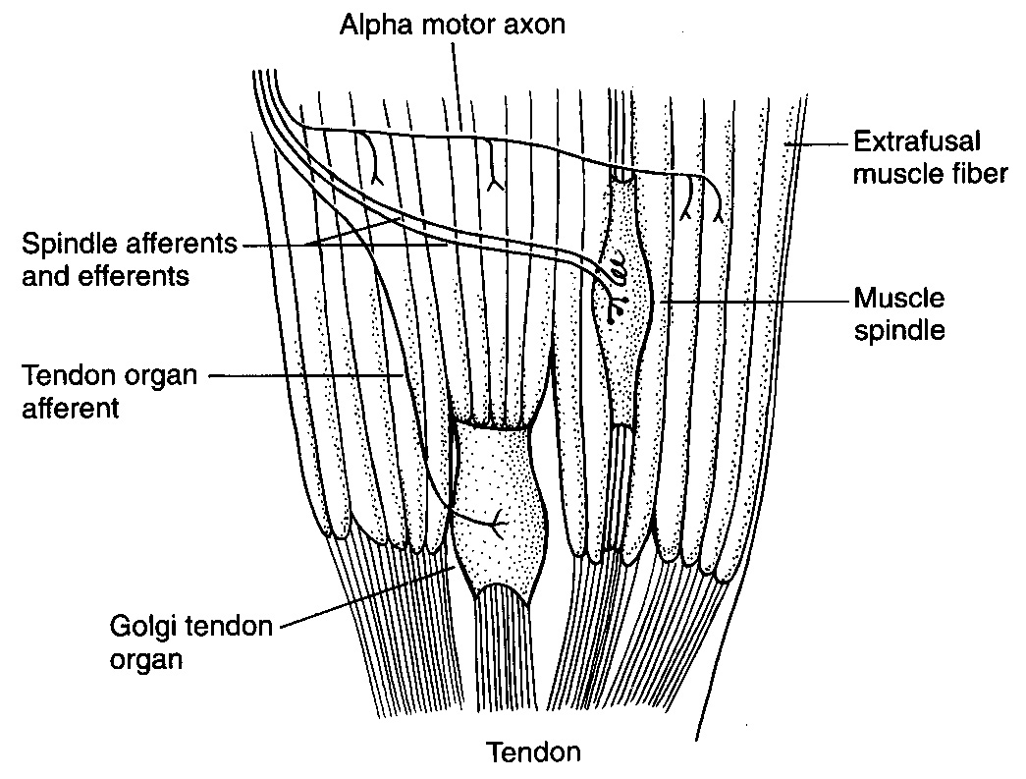
Muscle’s sensory system allows the CNS to measure force and length of the muscle
(Ia and II afferents)
(Gamma motor neuron)
(Ib afferents)
Houk et al. (1980)

Slide 12
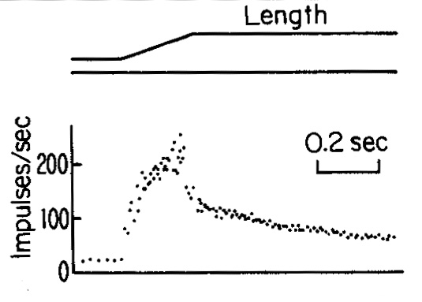
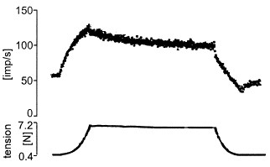
Spindle afferents signal length change in the muscle
Golgi tendon afferent signal force change in the muscle
Response of a muscle spindle afferent to an isotonic stretch
Response of a Golgi tendon afferent to an isometric increase in force

Slide 13
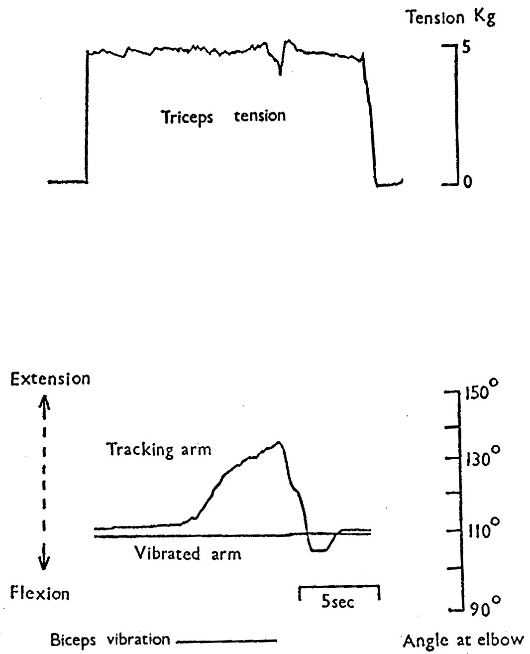
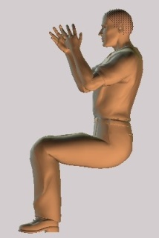
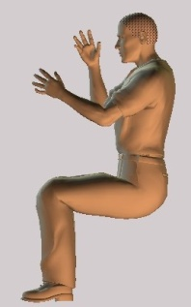
Our sense of limb position is via muscle spindles
Right arm (vibrated)
Elbows on a table, eyes closed. Right hand pulling a string attached to the ceiling. Task is to match position of the right arm with the left arm.
Right biceps is vibrated but remains stationary.
The tracking arm (left arm) becomes extended.

Slide 14
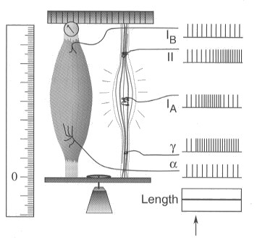
Gamma motor neurons control the sensitivity of the spindle afferents
Spindle is in parallel to the extrafusal muscle fibers
Stimulation of the γ-motor neuron shortens the spindle. This results in increased firing in the spindle afferent.
Spindle is sensitive to both γ-motor neuron input and the length of the extrafusal muscle.

Slide 15
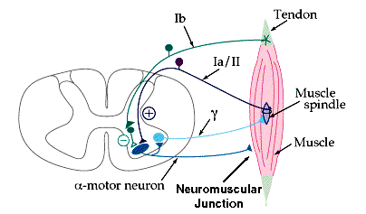
Spindle afferents excite α-motor neurons of the same muscle
Golgi tendon afferents inhibit (via inter-neurons) α-motor neurons of the same muscle

Slide 16
Force control signal
Inter-neurons
Force feedback
External forces
Driving signal
Muscle length
α
Tendon
organs
Muscle force
Muscle
Load
Length & velocity feedback
Spindles
Length control signal
γ
Gamma bias

Slide 17
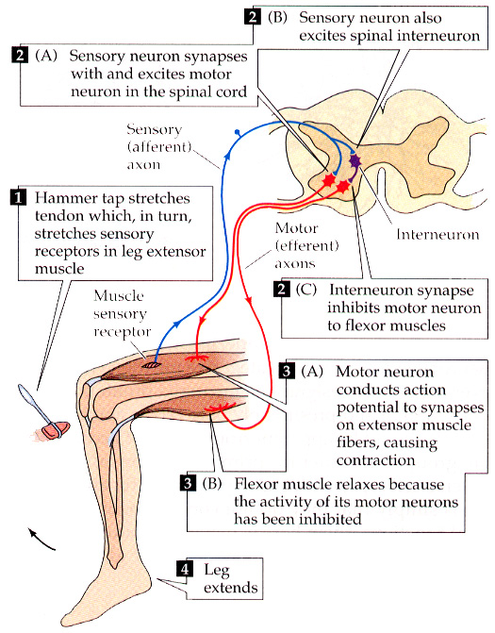

Slide 18
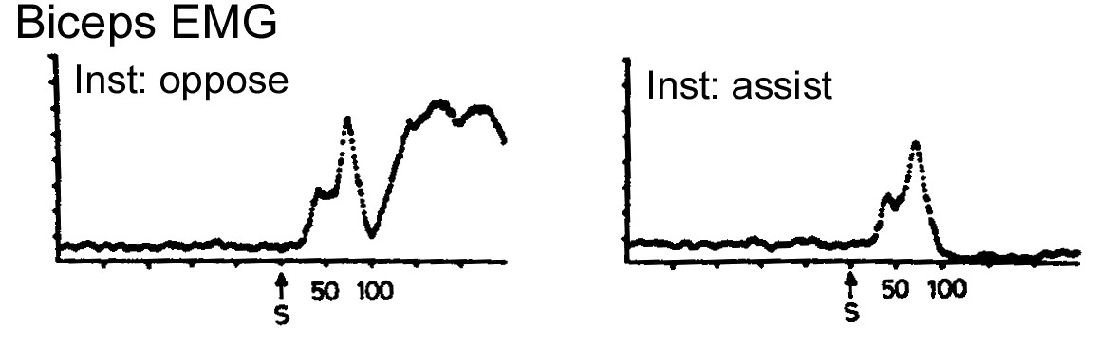
Time delay in the Reflex Loop Pathways
involuntary
response
voluntary
response
Time (msec)
Task: biceps is suddenly stretched at time (S). Before the stretch, subject is instructed to either oppose the stretch (left), or assist it (right).
Delay in fastest reflexes is 30 msec.
Strick P (1978)

Slide 19
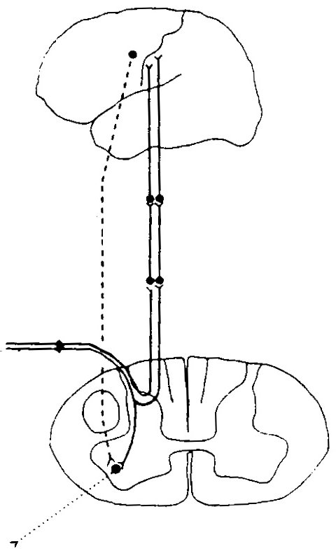
The pathways for short- and long-latency response to a perturbation
motor cortical neuron
thalamus
Long-latency pathway
dorsal column nuclei
muscle spindle afferents
Short-latency pathway
motor neuron

Slide 20
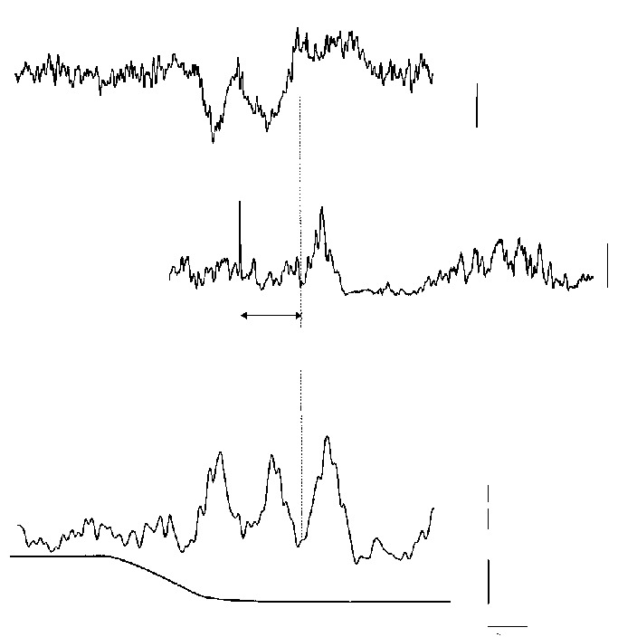
Time delays in the long latency reflexes
Delay between spindle afferent and cortex
46 ms
Ankle of a subject is suddenly stretched.
Evoked potential from somatosensory cortex (recorded by EEG electrode)
Evoked potential (recorded with EMG electrode from the ankle dorsiflexor muscle) when motor cortex of same subject is stimulated via magnetic stimulation
30 ms
Delay between cortex and muscle
94 ms
EMG recorded when ankle dorsiflexor muscle is suddenly stretched
100 μv
4 deg
Ankle position
20 ms
Petersen et al. J Physiol 1998

Slide 21
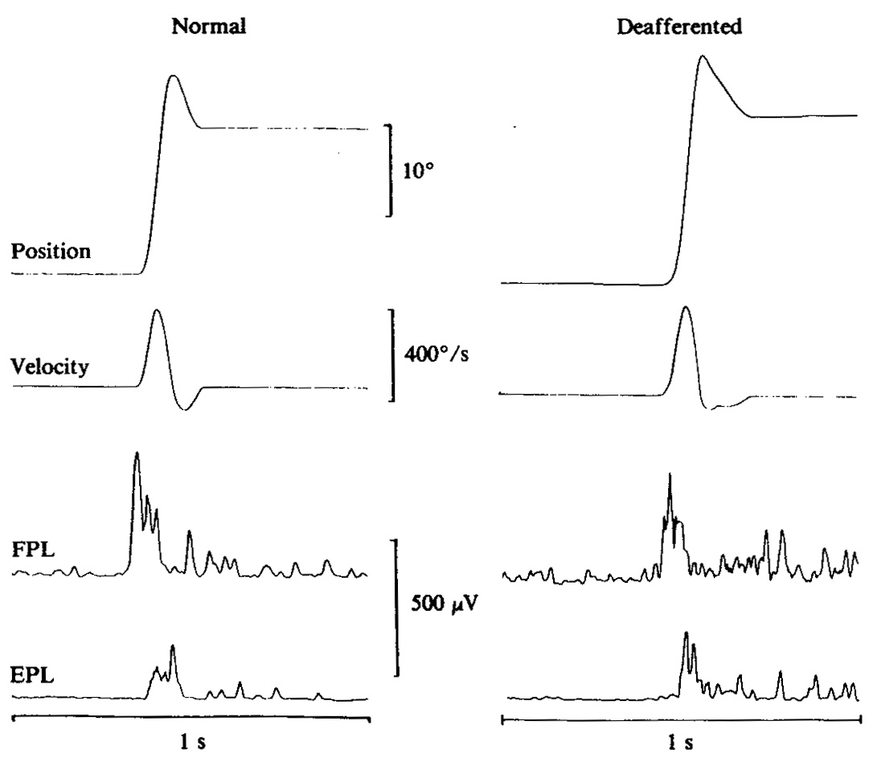
Patients without large fiber afferents can move their limbs
Rapid thumb flexion with visual feedback of the hand
Thumb flexor muscle
Thumb extensor muscle

Slide 22
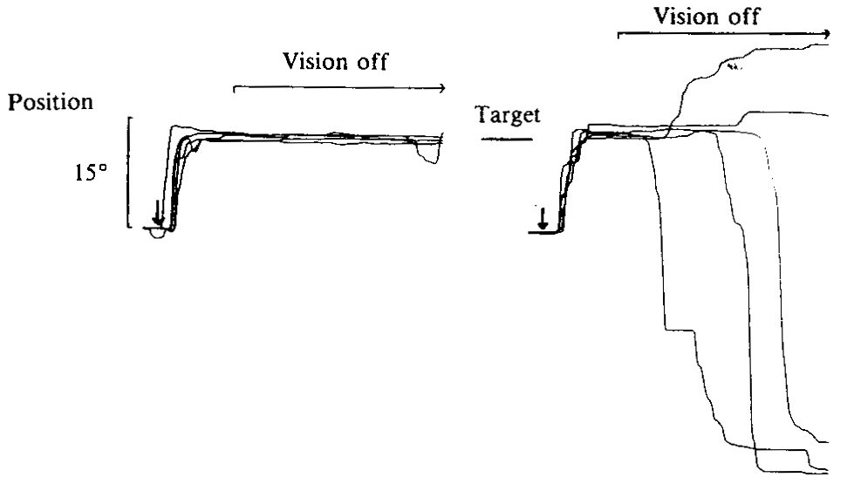
Without afferents, vision is necessary to maintain limb posture
Rapid thumb flexion without visual feedback of the hand
Normal
Patient

