Slide 1
Movie lens recommendation system
Prepared by Gilbert Kipkirui Cheruiyot, DSF-PT08P4 Project

Slide 2

A MOVIE IS WORTH A THOUSAND WORDS

Slide 3
TABLE OF CONTENTS
I.
II.
Introduction
Data Understanding
III.
IV.
V.
Exploratory Data Analysis
Modelling & Evaluation
Recommendation

Slide 4
INTRODUCTION
The audience are in need of a model that provides top 5 movie recommendations to a user, based on their ratings of other movies.
This is to ease their movie selection for them to find movies they will enjoy.

Slide 5

Data Understanding
Data Source: https://grouplens.org/datasets/movielens/latest/
The dataset files include: ratings.csv, tags.csv, movies.csv, and links.csv

Slide 6
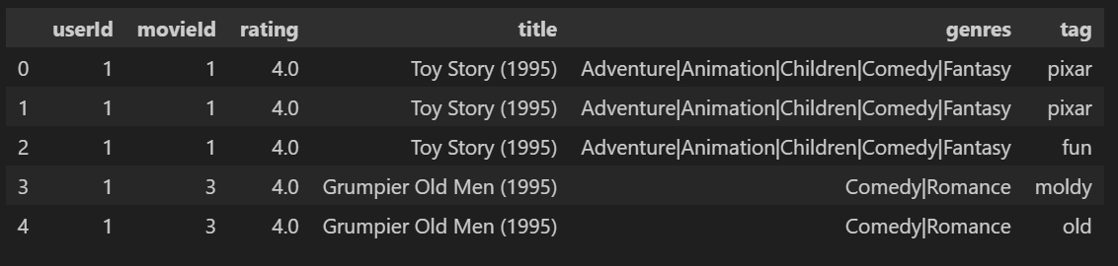
Data Understanding
Merged dataset include fields from movie.csv, tags.csv and rating.csv. This is meant to provide relevant information about the movies the model will recommend.

Slide 7
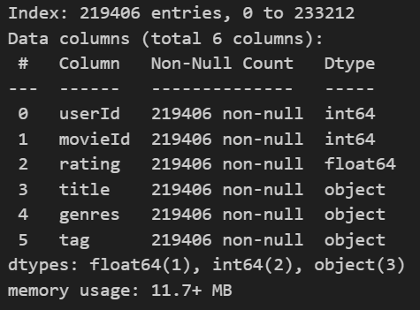
Data Understanding
- Merged dataset has no null values.
The dataset for the six columns are 1 float, 2 are of integer type and 3 of object type.

Slide 8
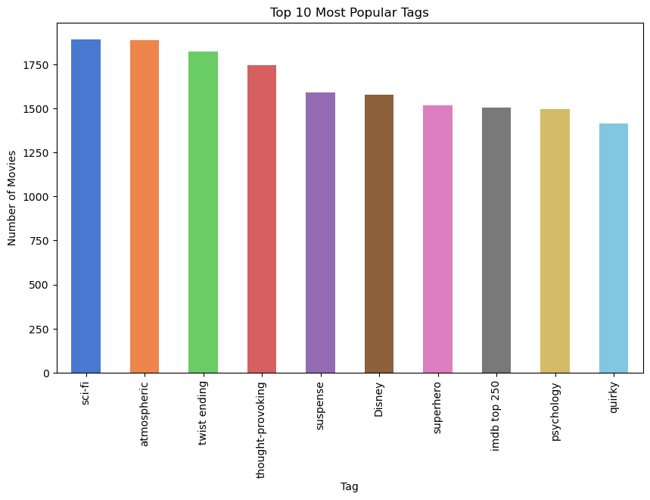
EXPLORATORY DATA ANALYSIS (EDA)
Sci-fi, atmospheric and twist ending are most popular movie tags.

Slide 9
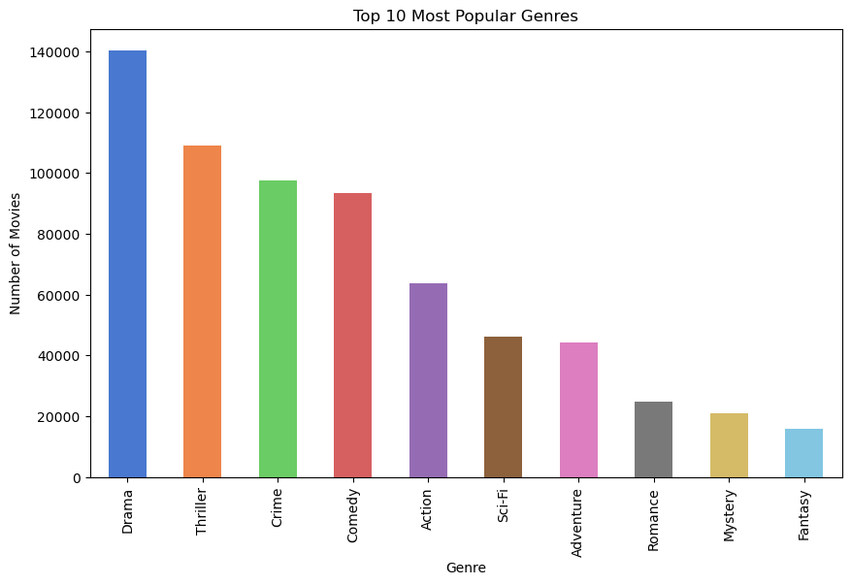
EXPLORATORY DATA ANALYSIS (EDA)
Drama is the most popular genre of movies followed by Triller.

Slide 10
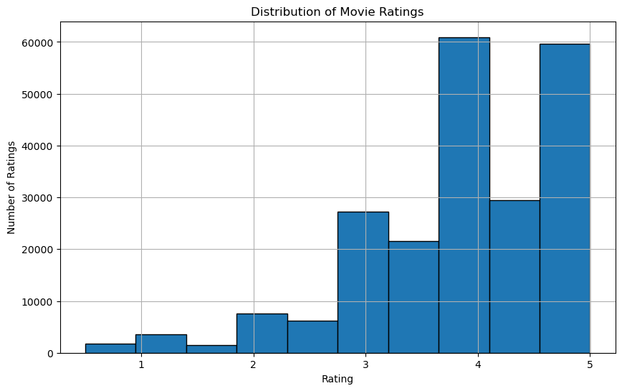
EXPLORATORY DATA ANALYSIS (EDA)
The distribution of the movie ratings for the movies is highly skewed to the right.

Slide 11
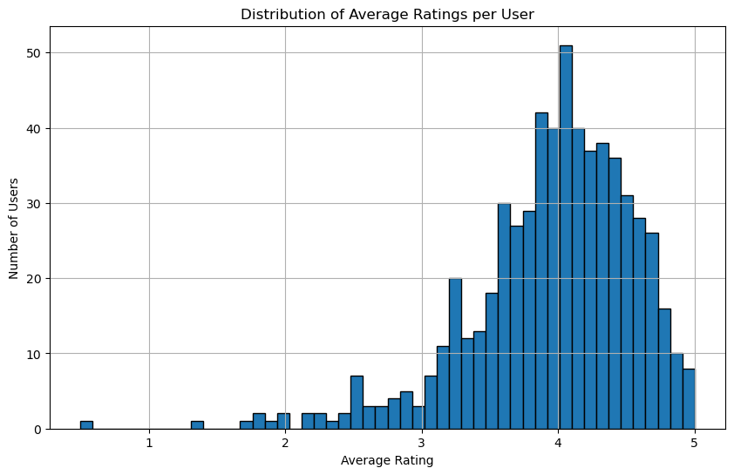
EXPLORATORY DATA ANALYSIS (EDA)
The average rating for most users appears to be around 4.

Slide 12
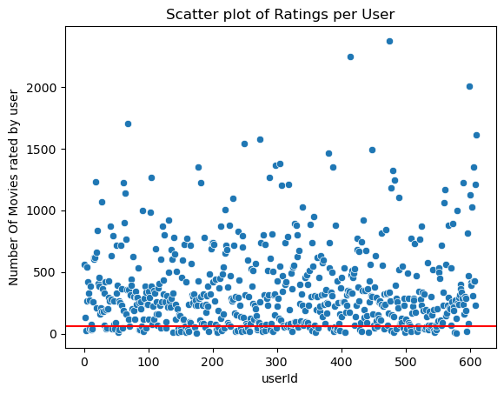
EXPLORATORY DATA ANALYSIS (EDA)
The scatter plot suggests a larger proportion of the users have rated relatively fewer number of movies.

Slide 13
MODELLING & EVALUATION
Collaborative Filtering (SVD)
Content-Based Filtering
Hybrid Approach
Models prepared include:

Slide 14
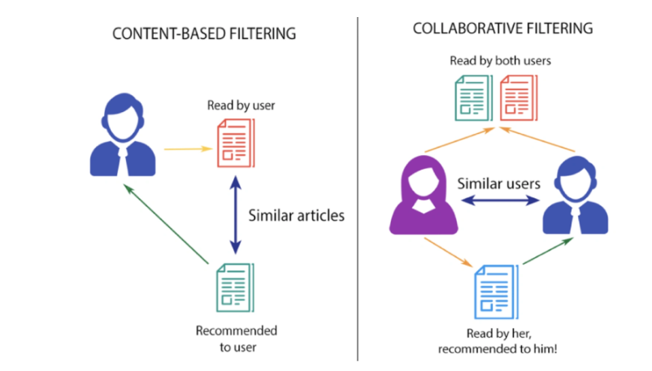
MODELLING & EVALUATION
Illustration of 2 types of recommendation systems- Content-based Filtering (CBF) and Collaborative Filtering (CF).

Slide 15
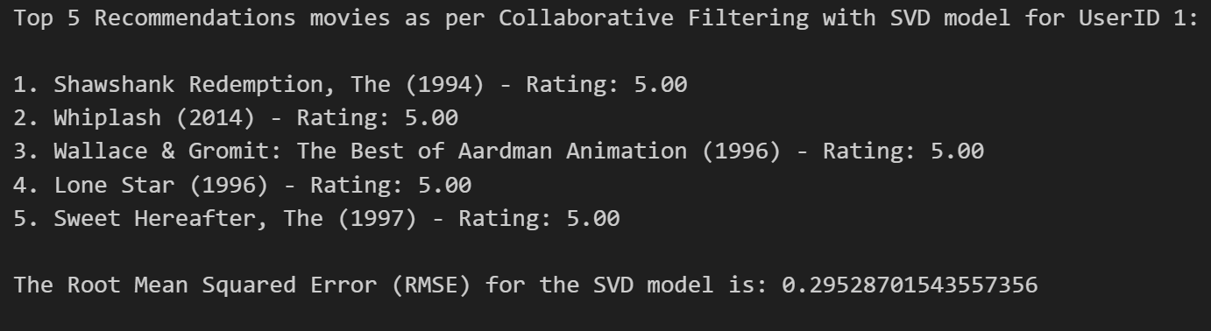
Collaborative Filtering with SVD Model
The low RMSE shows that the model is reliable to provide personalised recommendations.
All movies predicted for UserId 1 are 5-star rated

Slide 16
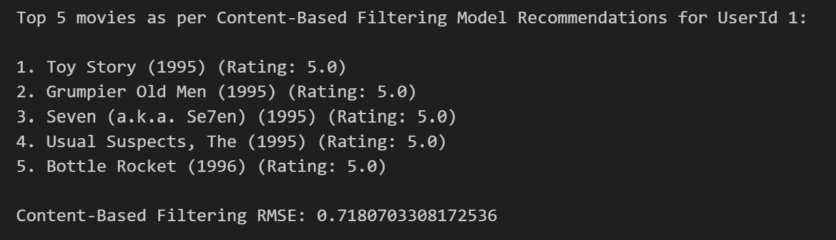
Content-Based Filtering Model
Compared to collaborative filtering with SVD, the model’s higher RMSE suggests less accuracy in prediction.

Slide 17
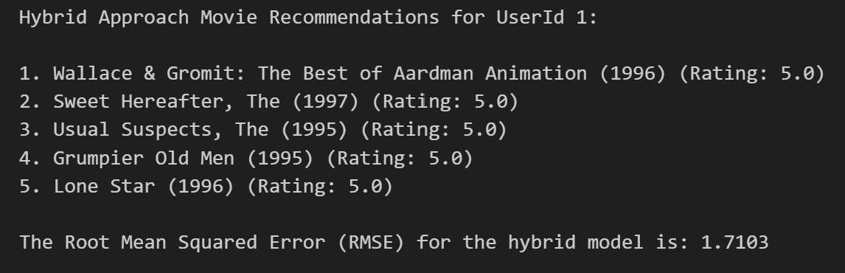
Hybrid Approach
Despite the higher RMSE, the benefits of combining the two preceding models might provide more balanced and well-rounded recommendations.

Slide 18
Findings
* All the three models were able to identify movies with the highest rating of 5.
* The collaborative filtering with singular value decomposition (SVD) model with a low RMSE indicates higher accuracy as compared to the hybrid and content based filtering model.

Slide 19
Findings…Continuation
* Content-Based Filtering method provides moderate RSME, indicating fairly good accuracy. This can be a good alternative if the user has rich content features and want to recommend items based on the attributes of movies the user has liked.
* The hybrid model appears to take into consideration both collaborative filtering and content-based filtering model details. The moderately higher Root Mean Square Error (RMSE) indicates slightly lower prediction accuracy compared to the other two models.

Slide 20
Recommendation
* Because of its accuracy and capacity to employ user-specific interaction data, Collaborative Filtering (SVD) model is the best option given the task's emphasis on user ratings. Its accuracy and simplicity makes it a favourable recommendation model.

Slide 21
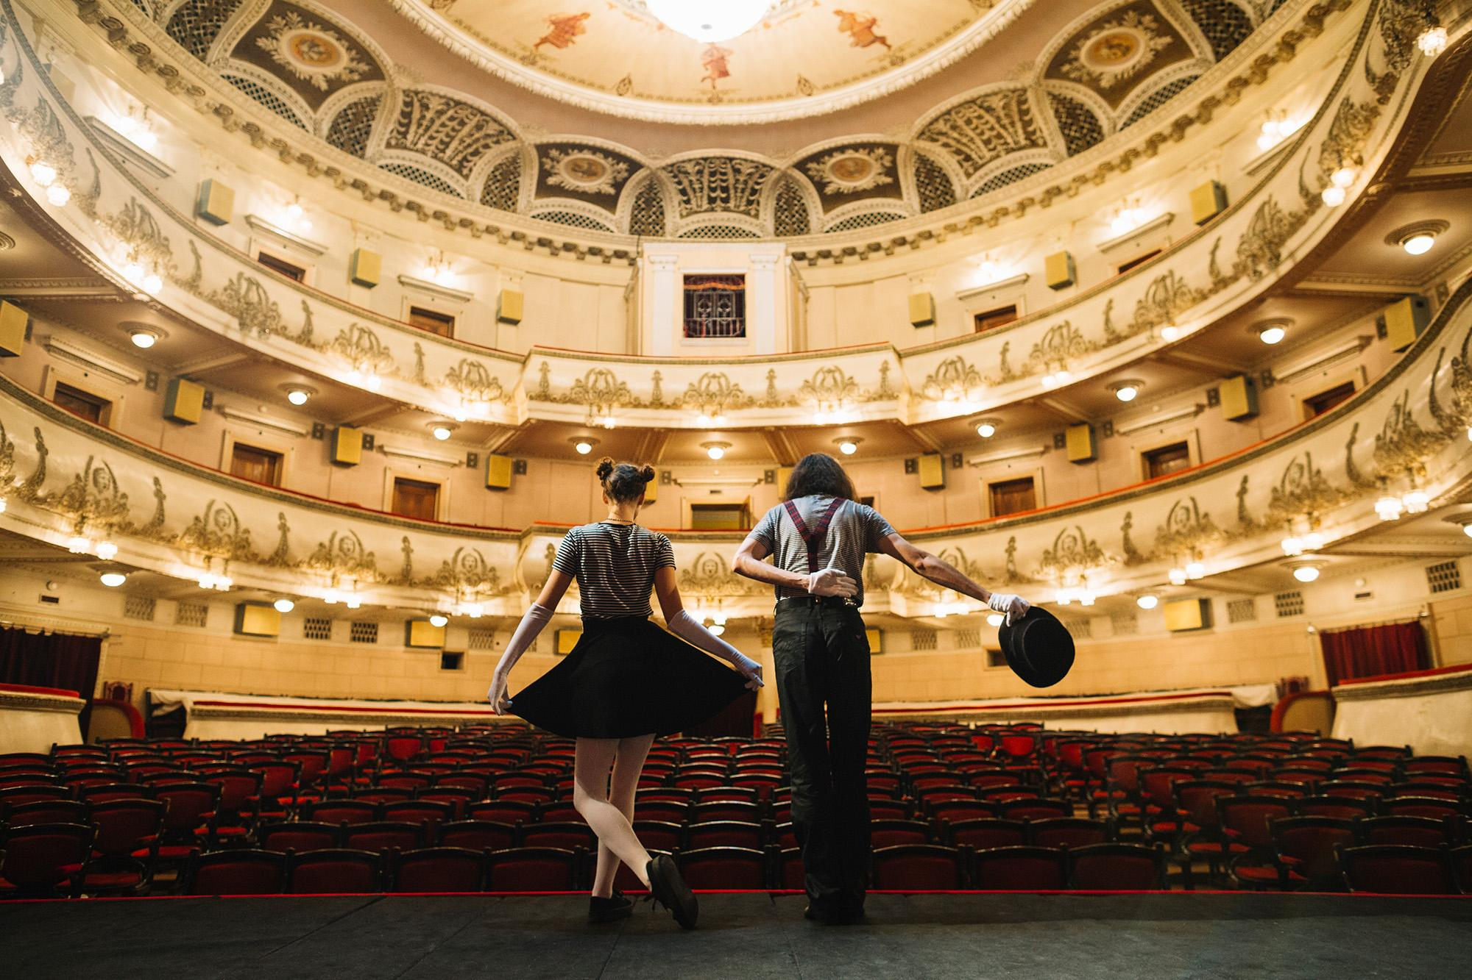
END!

Slide 22
Contacts
Does anyone have any questions?
Do not hesitate to reach out on email address: gilokipkirui@gmail.com

