Slide 1
Research Data: The First Mile
or...
“Where does the research data come from?”
Graham Klyne
October 2013

Slide 2
Background and Problem Statement

Slide 3
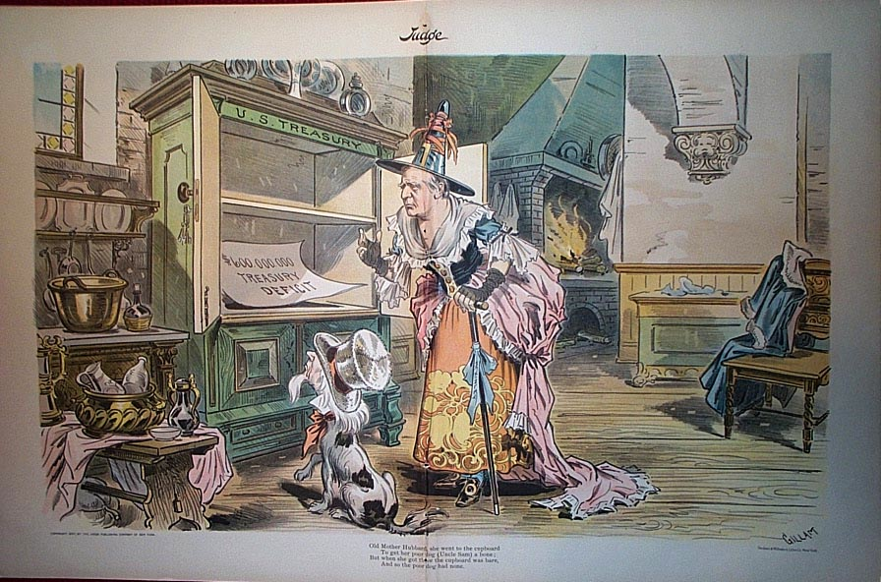
Background: Empty Data Archives
I have for several years been working on projects related to research data sharing
Repositories have been
created for data storage
and publication
But there is not (yet)
much data in them
  (or not as much as
  there should be)
  not counting large
  public databases
Notes:
The background that motivates this development is in my experience of working with systems for research data management, sharing and publication.
A fair amount of effort has gone into creating repositories and other supporting infrastructure for researchers to share and publish data, but they are not as well used as they should be, especially by individual and small group projects.
(I don't include community databases to which researchers can submit data, such as genomics and chemical crystallography community facilities for specified data.)

Slide 4
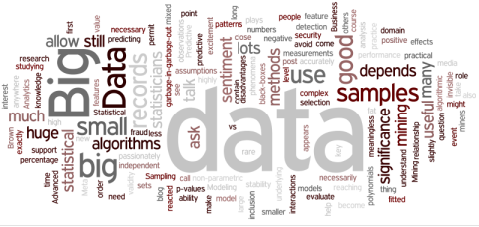
Populating Data Repositories
Data is increasingly seen as a first class product of research, underpinning trust in results
  “Research Objects”
  Reviewability
  Reproducibility
  Funder mandates
But who creates the data?
  Where does the data come from?
Notes:
Data is increasingly see as a first class research output, and funders and others are requiring that data produced by funded research is made public.
Also, community expectations are increasingly (if not yet overwhelmingly) that data should be published to support replication and reproducibility of results.
But who is to create this data, and ensure that it is fit for re-examination by other researchers?

Slide 5
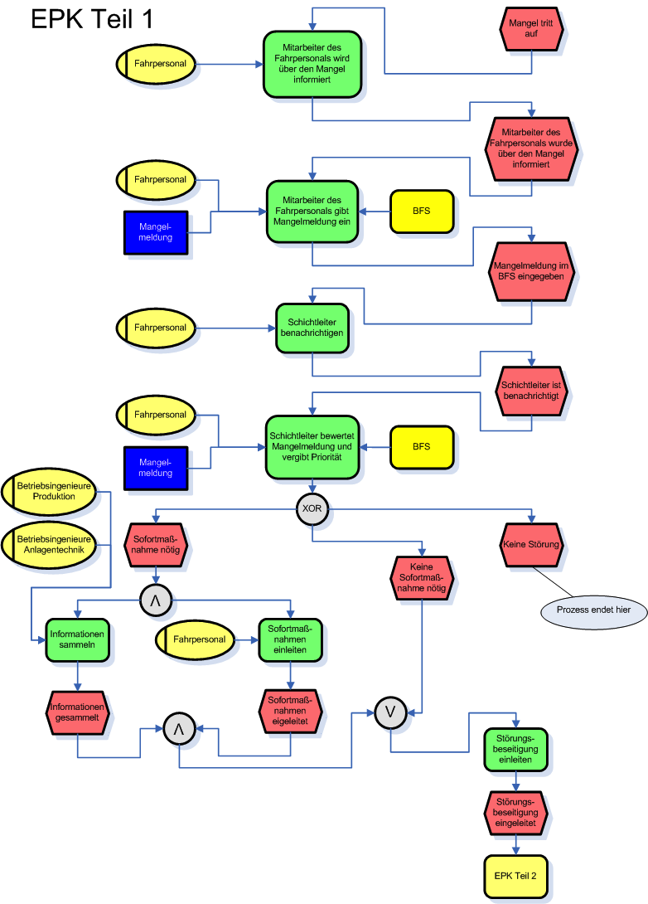
Large Research Projects
For large research projects,
data management is planned and funded
The circumstances and
methods of data generation
are defined and managed
Dedicated IT support helps to make data acquisition, sharing and publication a reality
Notes:
For large research projects, data management is generally planned and funded as part of the project.
To the extent needed, dedicated IT support resources may be brought to bear to ensure the data management plans can be followed.

Slide 6


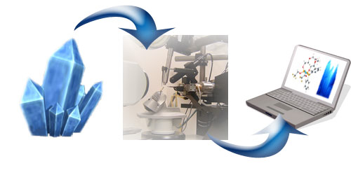


Subject and Other Databases
Examples:
  FlyBase, Beazeley Archive, eCrystals, UniProt, dbPedia
  many more – cf. http://databib.org
Separately funded
Often curated
Economies of scale?
Community portals, some with recognized academic value
Again: Dedicated IT support
Notes:
In some research communities, there are public databases, often separately funded and curated, to which researchers can contribute. But these are usually for specific kinds of data, and are not a complete data management solution for new research projects.
Again, these databases are typically backed by some form of dedicated IT development and support capabilities.

Slide 7

But What About the Little Guys?
Small research groups
  e.g. 1-5 people
  Substantially manual processes
  Working with existing software tools
  No capability or capacity for
  custom software development
Large projects have
small groups too
The “long tail” of data creation?
Notes:
But for small research groups, who arguably may represent a “long tail” of data creation, there is no dedicated IT support or development capability. Thus, they have to work with existing data management tools.
(And even within large projects, there may be smaller groups creating data that don't fit the data management patterns of the overall project.)

Slide 8
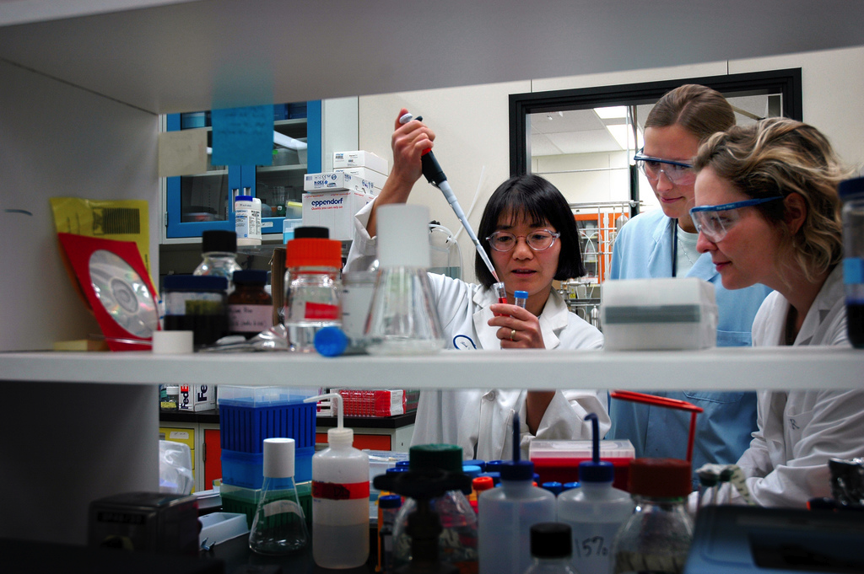
Small Research Group Data
Data comes from:
  Hand-written notebooks
  Spreadsheets
  Documents
  (computer text)
  Instruments
    not necessarily networked
  Stand-alone software tools
  Web sites and online reference
Local ad hoc connection to global databases
Notes:
Small-group data may be obtained from a number of sources, and stored in a variety of ways.
Data collection, integration and management may be somewhat less than fully automated.
Researchers ideas about what they want to do with the data may change as the data is collected, responding to what they are seeing in it.

Slide 9
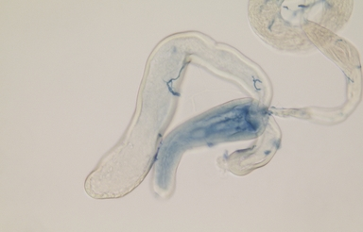
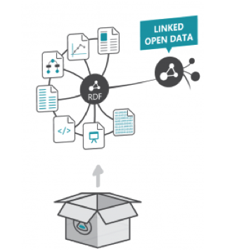
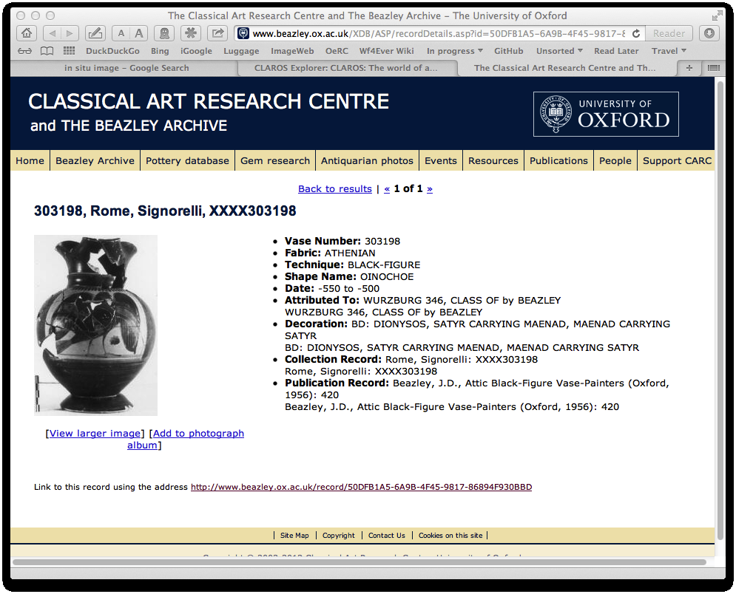
Some Applications
Image annotation
  e.g., Fly-TED
Personal web-research notebook
  e.g., investigations of CLAROS and related resources
Metadata and
Research Object creation
  aggregated context of
  an experiment
Notes:
Some examples of small-group activities that are not well served by available toolchains include:
Semantic annotation of in situ gene images, where lab observation of microscope images can yield important information about the relationship between gene expression activity and biological processes.
Collation and organization of information that is discovered by searching and analyzing the content of existing public databases. Ideally, this analysis might be able to feed new back to these data sources.
Creating Research Objects to describe the context of a lab experiment for other researchers to review and/or use.

Slide 10
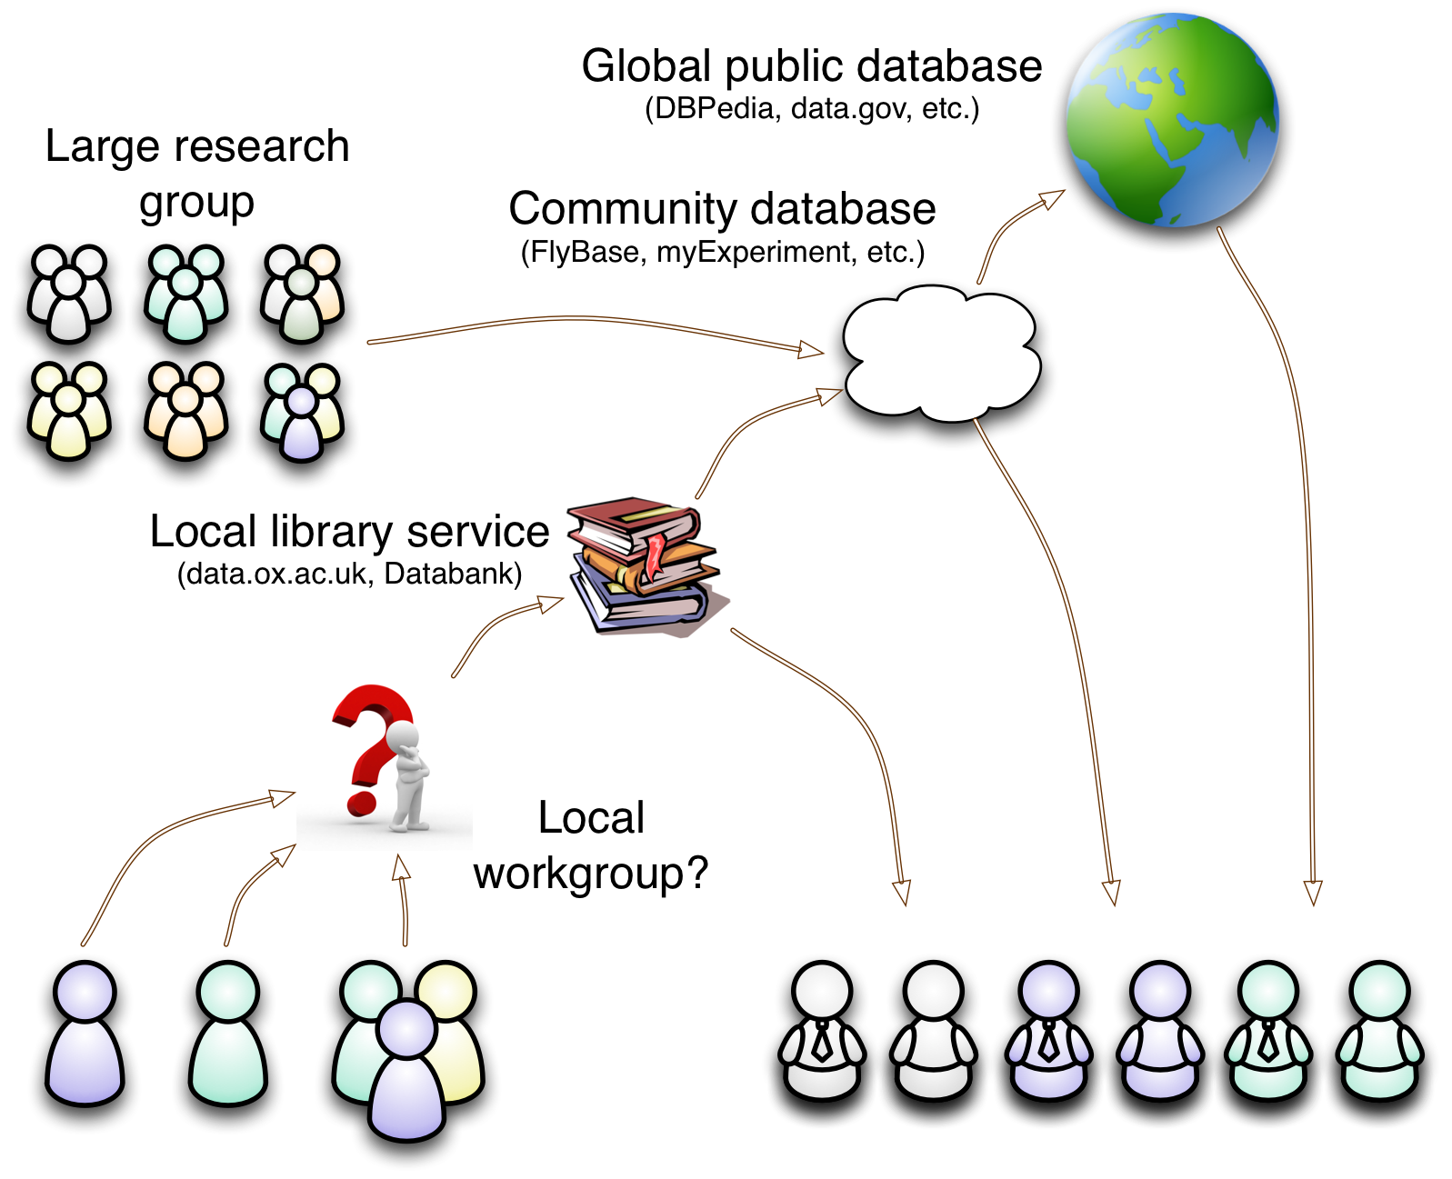
A Missing Link
Notes:
For these small research groups, it seems there is a missing link in the toolchain that conveys data from the lab bench to community and public repositories.
Lacking development capability and/or capacity, these groups are not well placed to supply the missing capabilities.

Slide 11
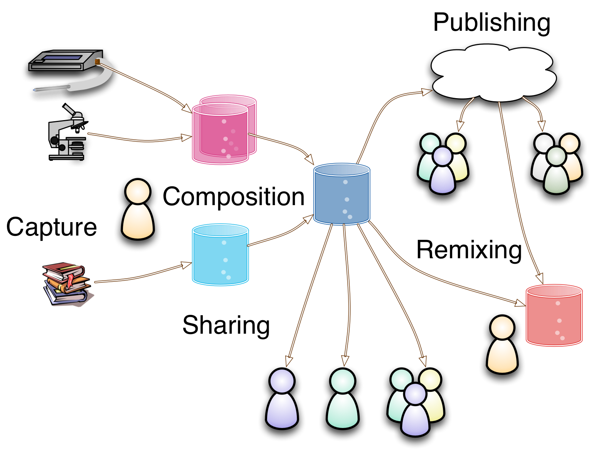
Common Requirements
Notes:
These are some of the things that researchers would need to achieve to make their data meaningful and useful for sharing and publication:
Initial capture from manual observation or lab instruments
Composition, or combining data from diverse local sources, capturing the relationships between them (e.g. microarray, in situ observations and literature based information about some set of genes).
Sharing with local colleagues for further analysis.
Publication for other researchers to use
Remixing with other published data to drive new research directions (e.g. FlyTED and FlyAtlas).

Slide 12
Small Research Group Practices
Practical Issues
  Data in diverse, incompatible formats
  Copy-and-paste, or manual transcription
  Sharing by “sneakernet”, or email
  Manual format conversion
  Understanding of data is not guaranteed
Composition, sharing, publishing and remixing are effort-intensive, error prone processes
  often with uncertain value of outcome
  most likely, it doesn't happen
Notes:
What are the impediments for small groups in achieving these goals?
For this we need to examine the practical issues they face... incompatible formats, no automated transcription, transmission or format conversion, and formats that are not sufficiently self-describing to guarantee correct interpretation.
The steps required for composition, sharing, effective publishing and remixing are effort-intensive and error-prone, so unless there's an immediate need for the results of these, they may just not happen.

Slide 13
What Tools Are Available?
Spreadsheets: current state of the art?
  widely available and understood
    very commonly used by researchers
  easy to capture data, flexible, easy to share locally
But...
  capturing semantics can be difficult
  composing and remixing is a manual process, or may need custom software development
Semantic web technologies
  appear to have desirable properties
  available tools don't address “first mile” problems
Notes:
Of all the off-the-shelf data management tools available to and used by researchers, the current state-of-the-art is probably spreadsheets. They are widely used and understood, flexible and forgiving in use for data acquisition, and work well for local data sharing.
But, with these tools, capturing the semantics in a standard fashion can be difficult or unreliable without a fair amount of planning, and combining different data sets may be either a manual process or require custom software development.
Semantic Web technologies have many desirable properties, but available tools don't handle the data acquisition problem very well.

Slide 14
Can We Do Better?
Imagine a tool that combines:
  spreadsheet ease-of-use and flexibility
  semantic technology capabilities for composition and remixing
  web capabilities for sharing and publication
What might such a tool look like? ...
Notes:
Can we make a tool that combines the best of these?
1. spreadsheet ease-of-use and flexibility
2. semantic technology capabilities for composition and remixing
3. web capabilities for sharing and publication
What might it look like?

Slide 15
Requirements

Slide 16
Out-of-box key features
Easy data entry and acquisition
  Fire up and start collecting data
Flexible evolution of data structures
  Add new fields, record types on-the-fly, as required
Controlled sharing of data with collaborators
  Access using standard mechanisms and formats
  Flexible access control
Remixing data with third party sources
  Support for linking in and out (hypermedia)
Notes:
I think such a tool would have the following key features, out of the box, without prior configuration:
Easy data entry and acquisition
Flexible development of structure around the data
Controlled sharing with collaborators using common web tools
Remixing with third party resources – links in and out, and some form of co-reference management

Slide 17
Additional desiderata
Portable data (just copy)
Working with version management
Configuration data is just data (easy replication of complete setup)
Working with pre-existing data (e.g. spreadsheets)
Local or cloud hosting of data
Third party authentication (no new passwords or password security concerns)
Notes:
There are some further features, not immediately central to the key goals, that it seems would facilitate data sharing and good data management:
1. Copyable – no need for special software to use the data
2. Compatible with use of version control
3. Descriptive metadata and configuration is just part of the data
4. Ability to work with pre-existing local data (e.g, spreadsheets)
5. Local or cloud hostable
6. Usable with third party authentication and access control systems (SSO, etc)

Slide 18
Proposal

Slide 19
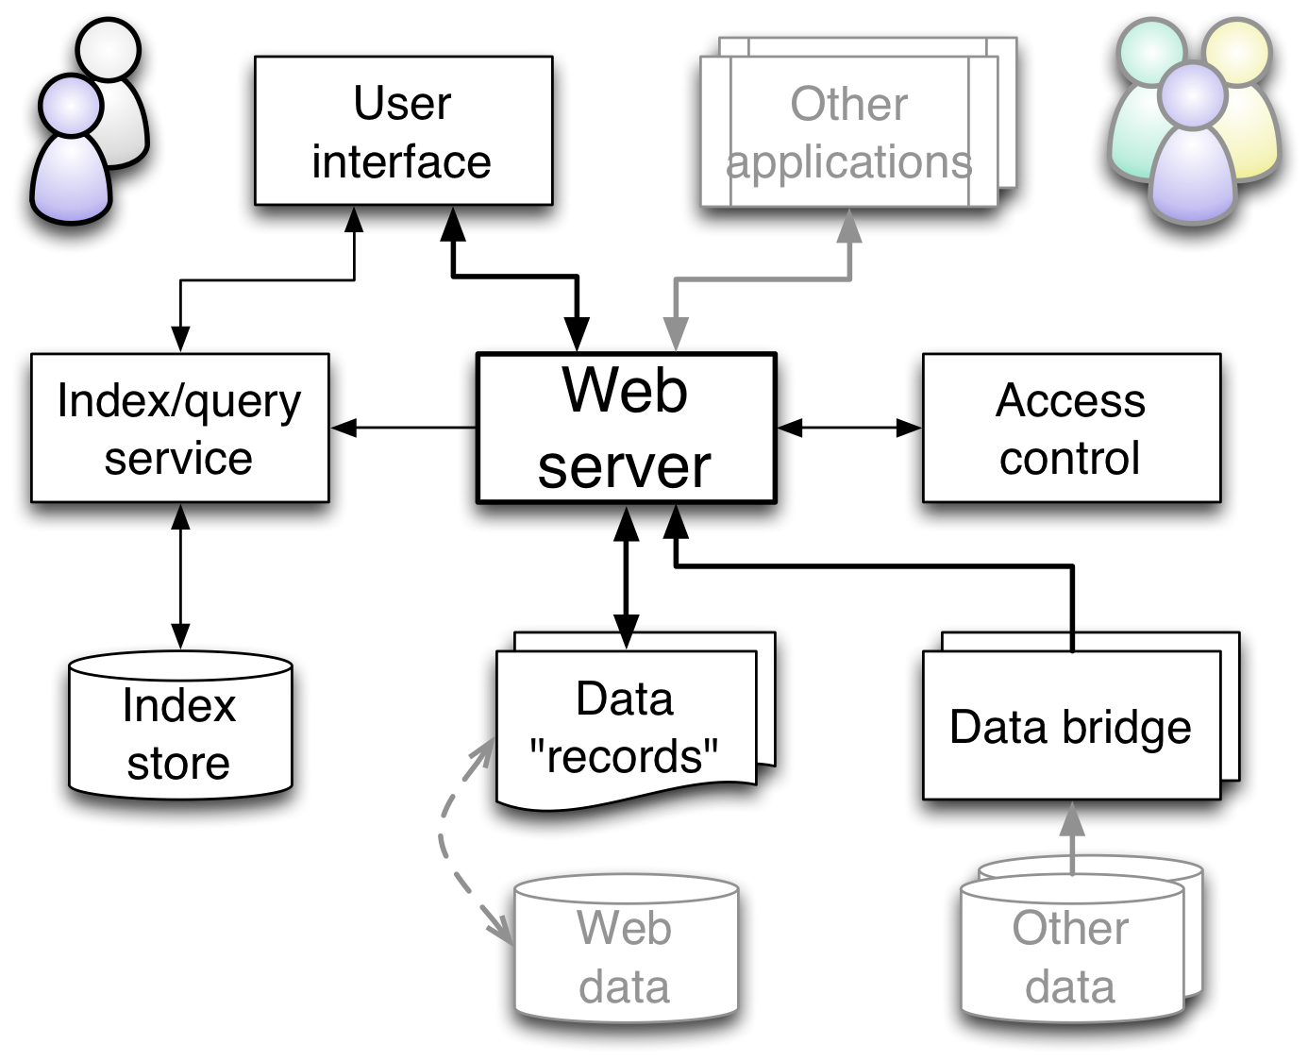
Proposed System Outline
Notes:
This is how I propose we might build such a system.
The key thing to note is that at its heart is a standard web server. All applications, including the primary data acquisition and viewing interface just use standard HTTP requests to access and update the data.
The next thing to note is the use of data bridges modules behind the server to access existing data, or data in different formats, locally or from the web. This would be the way of accessing and working with existing spreadsheet data.
Third, and one of the technical challenges, is that access control has to be aplied through the web server, not the applications.
Finally, the primary storage of data is as flat source files. Applications can work with indexing and query services as needed to optimize their own operations, but the data can still stand alone.

Slide 20
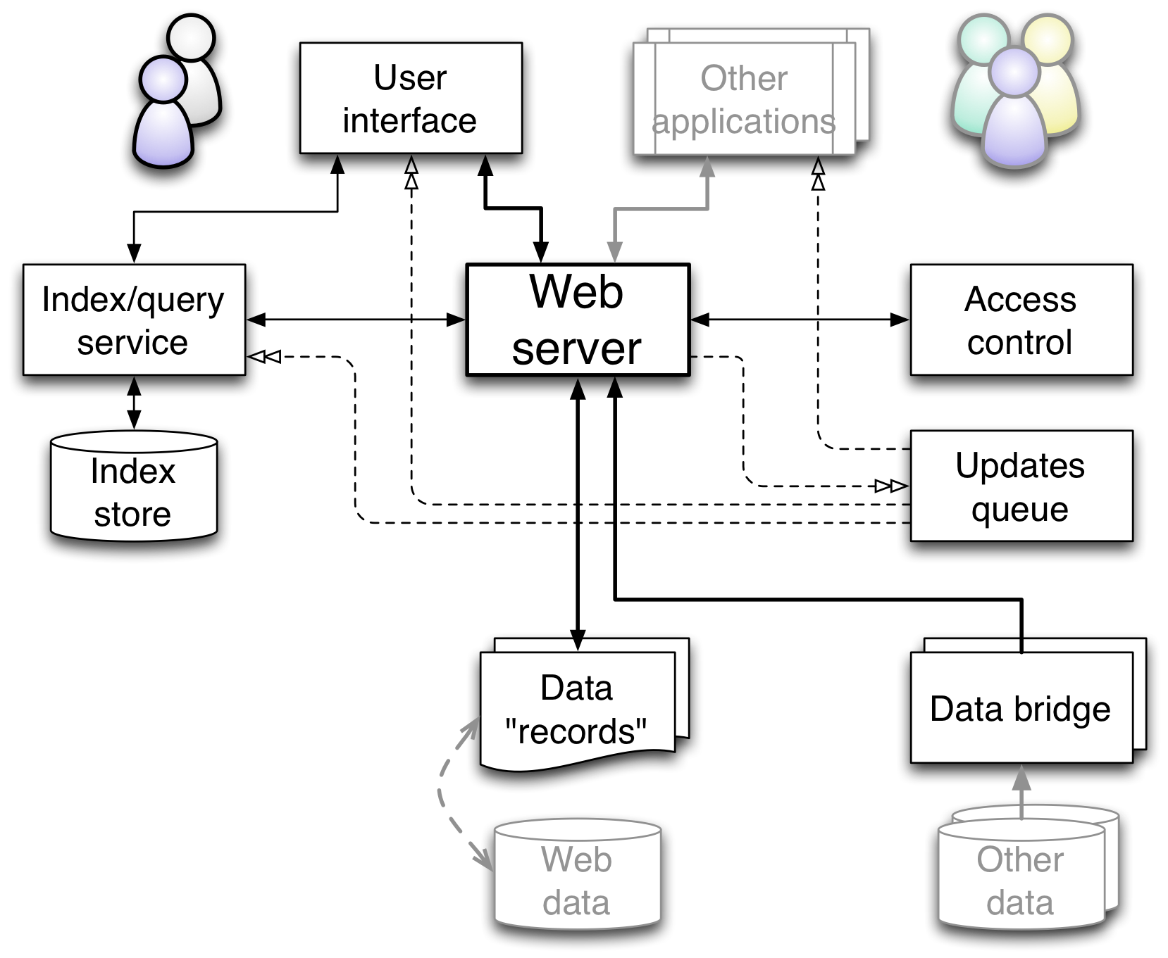
Extended with update notifications
Notes:
This is the essentially the same as illustrated previously, but with the addition of a pub/sub quere to distribute notification of updates to the indexing service, the user interface and any other applications that might wish to respond to updates.

Slide 21
Proposed Data Record Model
RDF-based format
  Entities carry type information
  Entities can be related by typed links
  No schema constraints
Frame- or entity- oriented records
  A single web resource contains an arbitrary amount of information about some entity
  Fundamental unit of data access
Notes:
I propose RDF as the primary data model, but stored as entity- or frame- oriented records. Thus a frame, or a collection of information about some resource, would be the primary unit of data access. E.g. information about a gene, or a species – the kind of level of information that might be supplied in a spreadsheet or database row (but without the structural constraint).
I believe this would form a basis for an easily understood, coherent exchange of information.

Slide 22
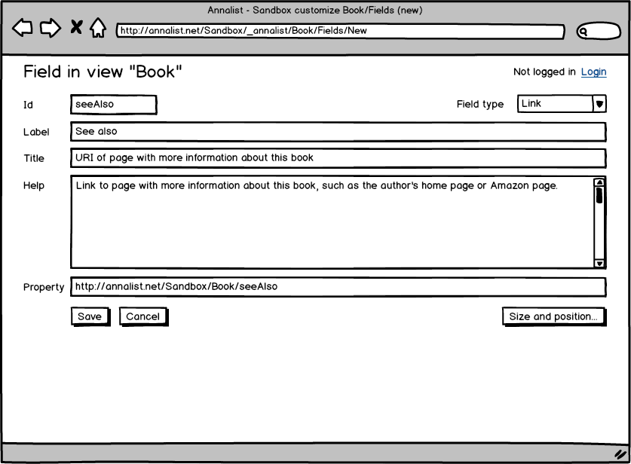
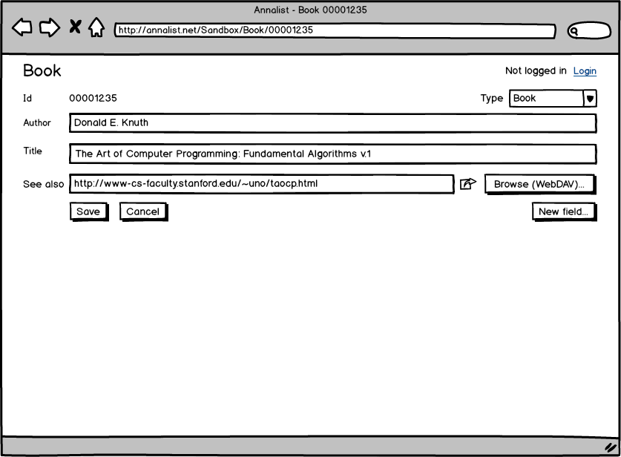
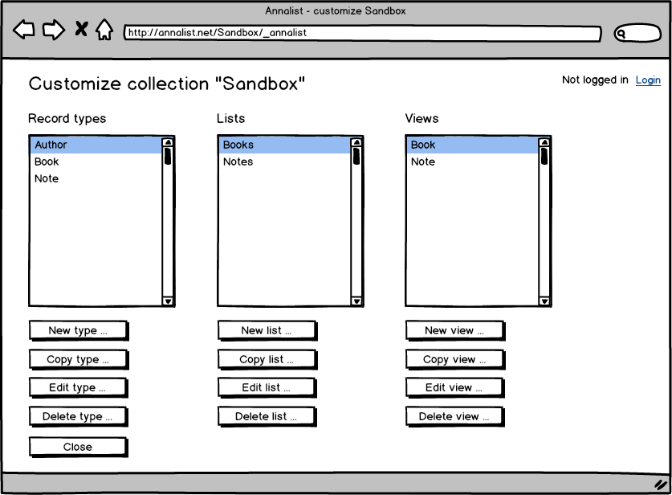
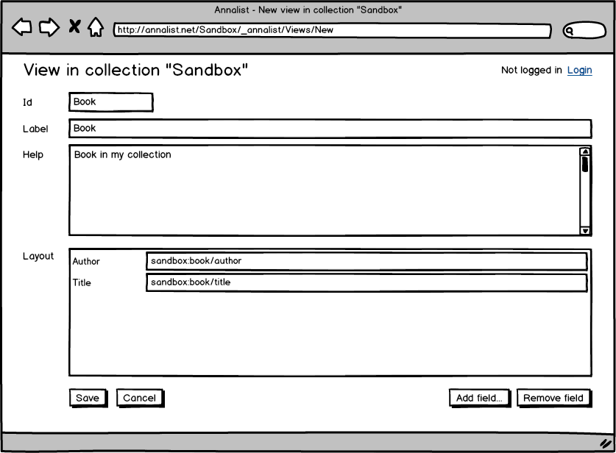
Data Editing User Interface
Notes:
These are some wireframe mock-ups for the primary data entry, editing and viewing interface.
Key ideas here include:
- essentially the same interface for data entry and data structure definitions – no major mode changes
- aesthetics are more spreadsheet than product brochure.
Although web technology is envisaged, the emphasis here is for local, spreadhseet-like use by a researcher, not to provide a public web site.

Slide 23
Review of requirements

Slide 24
Recap: Goal
A ready-to-go tool ...
… for independent researchers and small research groups ...
… facilitating creation of data in a form suitable for general sharing and archival

Slide 25
Recap: Requirements
Acquisition
Evolution
Sharing
Remixing
Other desiderata
  Copying, Versioning, Configuration, Hosting
  Existing data
  Authentication and access control

Slide 26
Acquisition of data
“Out of box” simple web interface for data entry
Data bridges for transclusion of existing data

Slide 27
Evolution of data structure
Unconstrained, RDF-based flat-file record format
Add types, views, fields in UI used for data entry

Slide 28
Sharing and collaboration
Standard HTTP interface
  same interface for all applications
Entity- or frame- level exposure of data
Standard data format (JSON-LD?)
Access control at web access level (OAuth2?)

Slide 29
Remixing
RDF-based data supports links in and out
Local URI generation, can be overridden

Slide 30
Portability
Copying, Versioning, Configuration, Hosting
Flat file, textual format facilitates use of existing file management tools (cp, git, etc.)
Configuration stored with data
“vanilla” web server can provide access

Slide 31
Existing data
Data bridges provide uniform interface to existing data
Initial implementation provides local spreadsheet data bridge
Other data sources will require additional work

Slide 32
Authentication and access control
Federated authentication avoids local user accounts
Initial implementation supports web standard authentication (OAuth2/OpenID Connect?)
Local SSO may require additional effort
Browser and non-browser clients
Separated access permissions – local or 3rd party
Initial implementation supports web standard authorization (OAuth2/UMA-derived?)

Slide 33
Summary

Slide 34
Summary
For researchers:
  quick start: install and collect data
  adaptable: add structure as data is collected
  organize, augment and annotate existing data
  open use existing tools
    version management, editors, data visualization, etc.
  connection to public data
  provenance instrumentation
  data created “repository ready”

Slide 35
Summary
For collaborators and consumers:
  standard data format and access mechanism
  no complex software to install
  visibility of data to existing tools
For repositories:
  easy path from researchers' desktop
  administrative and domain metadata
  possible metadata collection early intervention
  improved rate and quality of submission

Slide 36
Looking forward

Slide 37
The Story So Far...
Working title: “annalist”
  (as in creator of “annals”, or records)
Open source, open development
Github project
  https://github.com/gklyne/annalist
  (no code yet, just vapourware)

Slide 38
System Components
Web server
  Apache httpd, Nginx, ...
Indexing service
  Jena Fuseki, Elastic Search, ...
Authentication and access control
  Persona, OpenId Connect, UMA, ...
Data record format
  JSON-LD, Turtle, ...
UI toolkit
  Django, ...
Notes:
Implementation is still at the planning stage, but these are some components under consideration.

Slide 39
… Next Steps
2013-Q4
  Investigate authentication/IDP technologies
  Investigate web server access controls
  Identify potential user collaborations
2014-Q1 onwards
  Pin down data access API details
  Choose web server, indexing engine, etc
  Implement data acquisition/viewing UI
  Implement spreadsheet data bridge
  Work with user(s) to create demo application(s)

Slide 40
Opportunities for collaboration?
When initial demo capability is implemented, I would like to work with one or two active research activities to refine requirements
Develop support services and community to enable wider adoption
Create domain-tailored configurations to support community activities (e.g. MIBBI support, etc.)

