Slide 1
A gap in the landscape...

Slide 2
A gap in the landscape...
… of research data management tools for individual researchers and small research groups

Slide 3
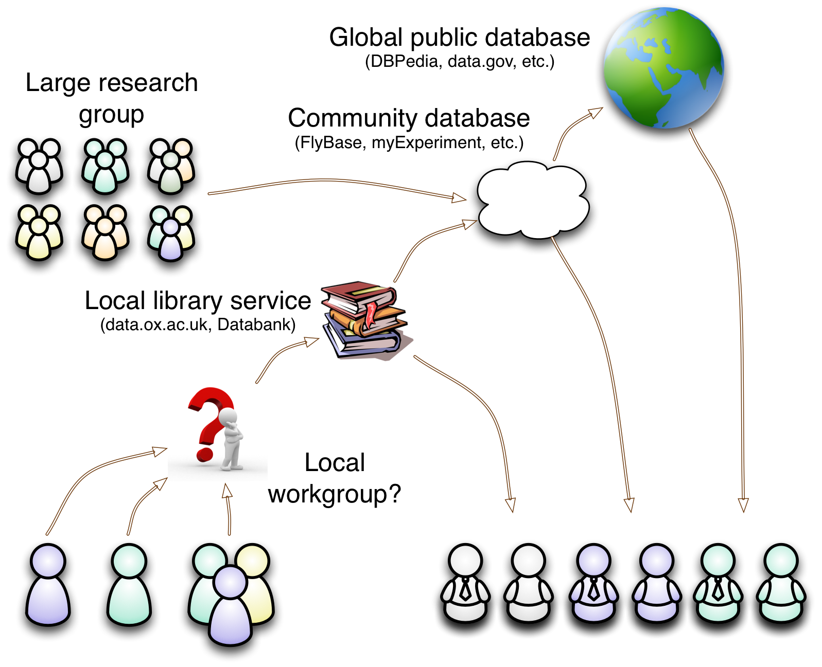

Slide 4
Missing: a tool for researchers to gather, organise and share their data...
Easily: straight “out of the box”,
Flexibly: adapting to evolving needs,
Collaboratively: controlled exchange of data with colleagues, and
Re-usably: mixing with external data.

Slide 5
Annalist *
is my attempt to fill this gap...
* Annalist: a keeper of records

Slide 6
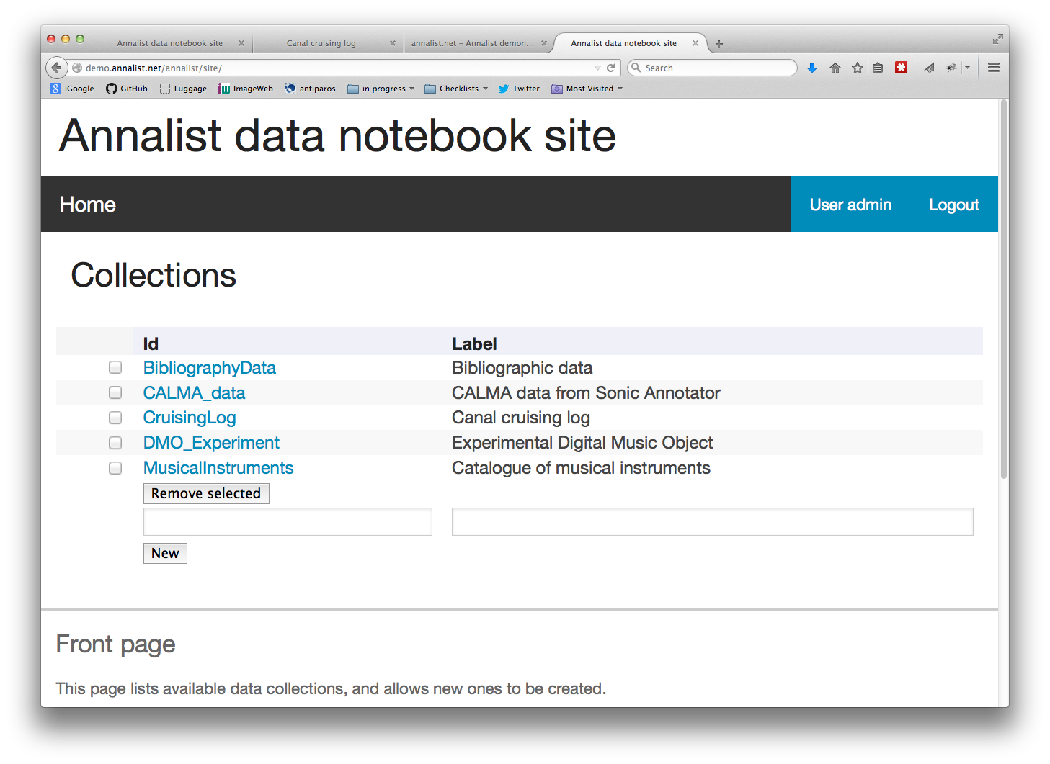

Slide 7
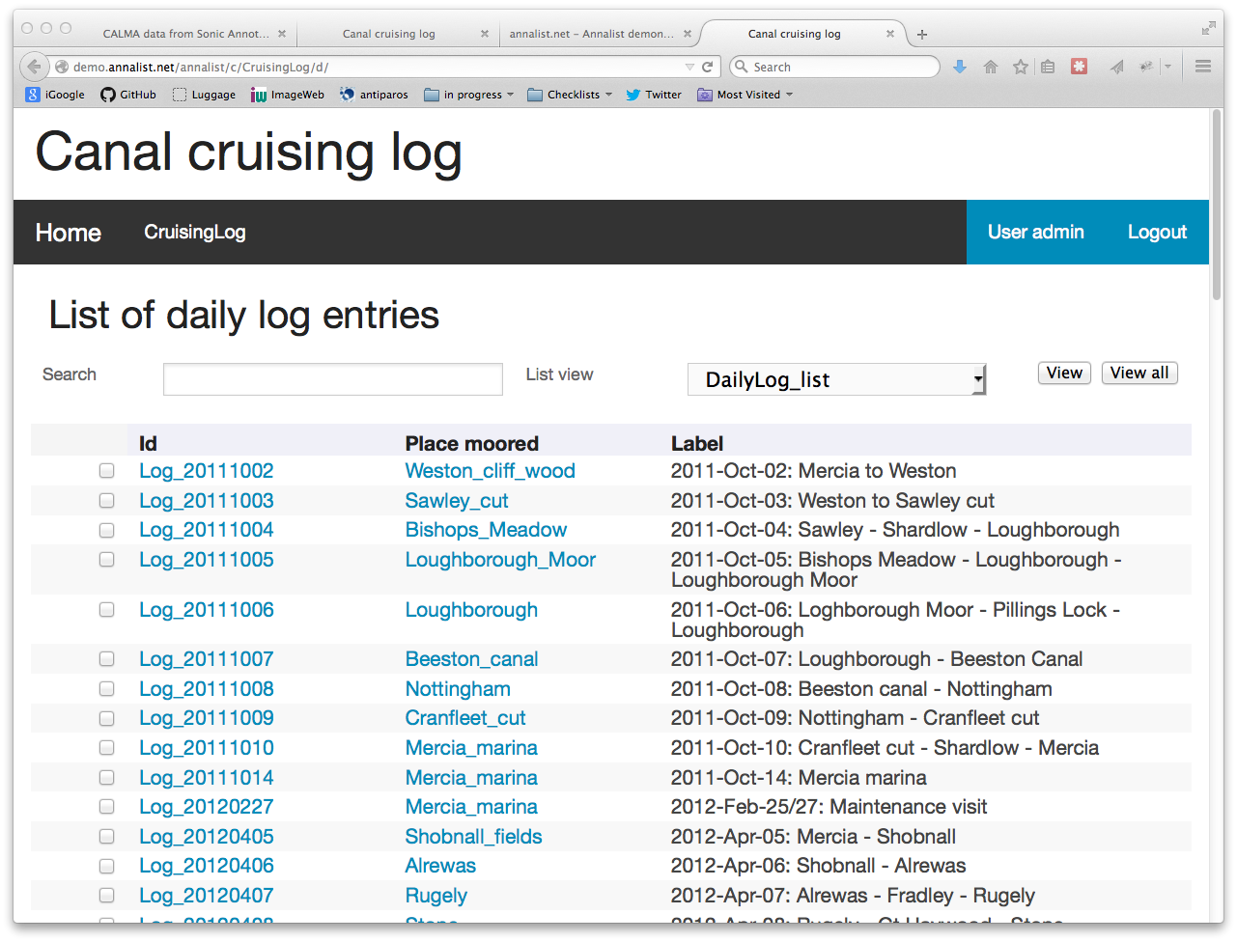

Slide 8
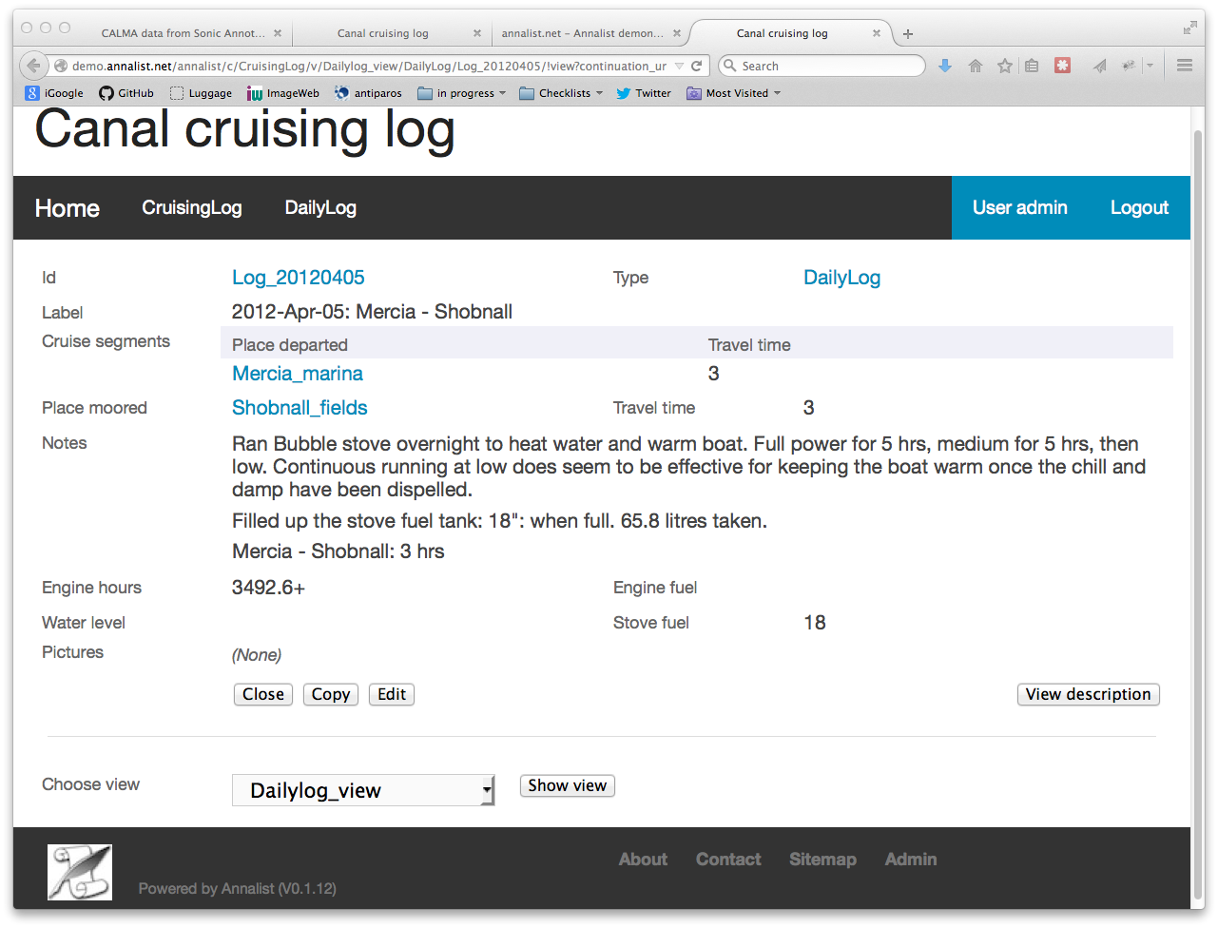

Slide 9
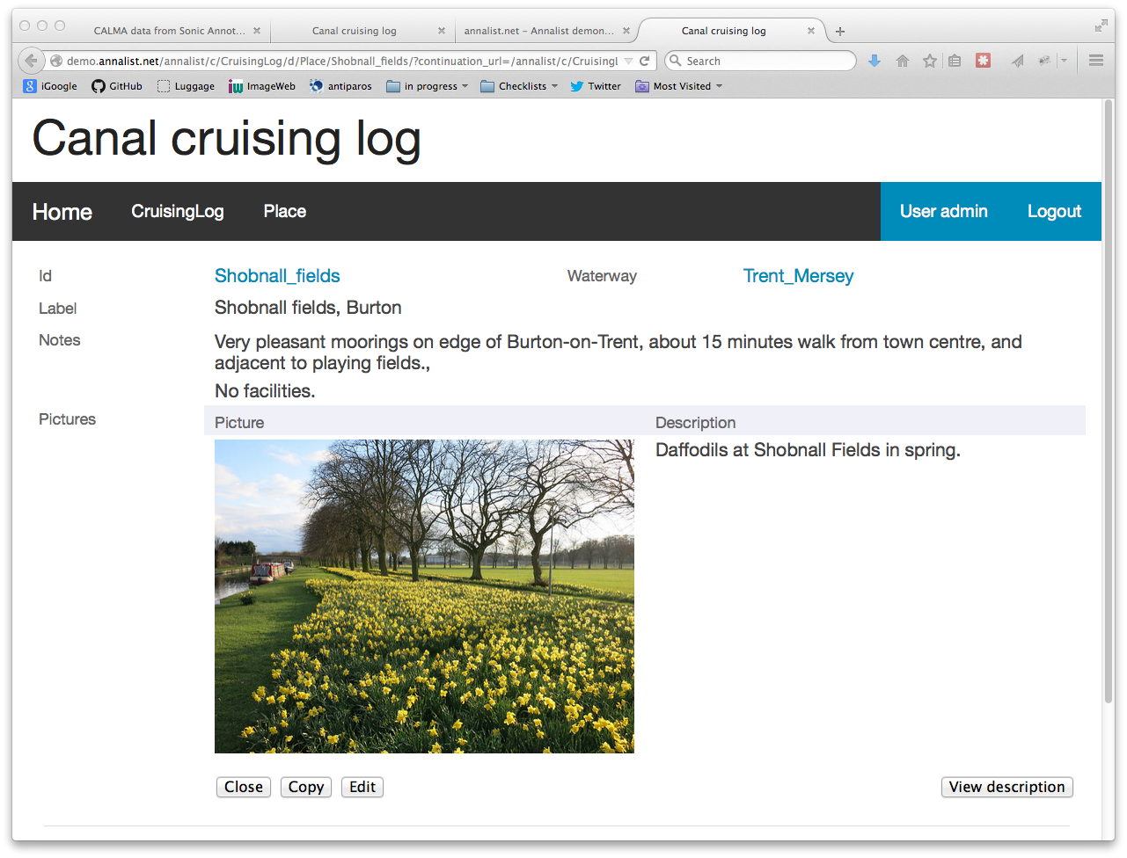

Slide 10
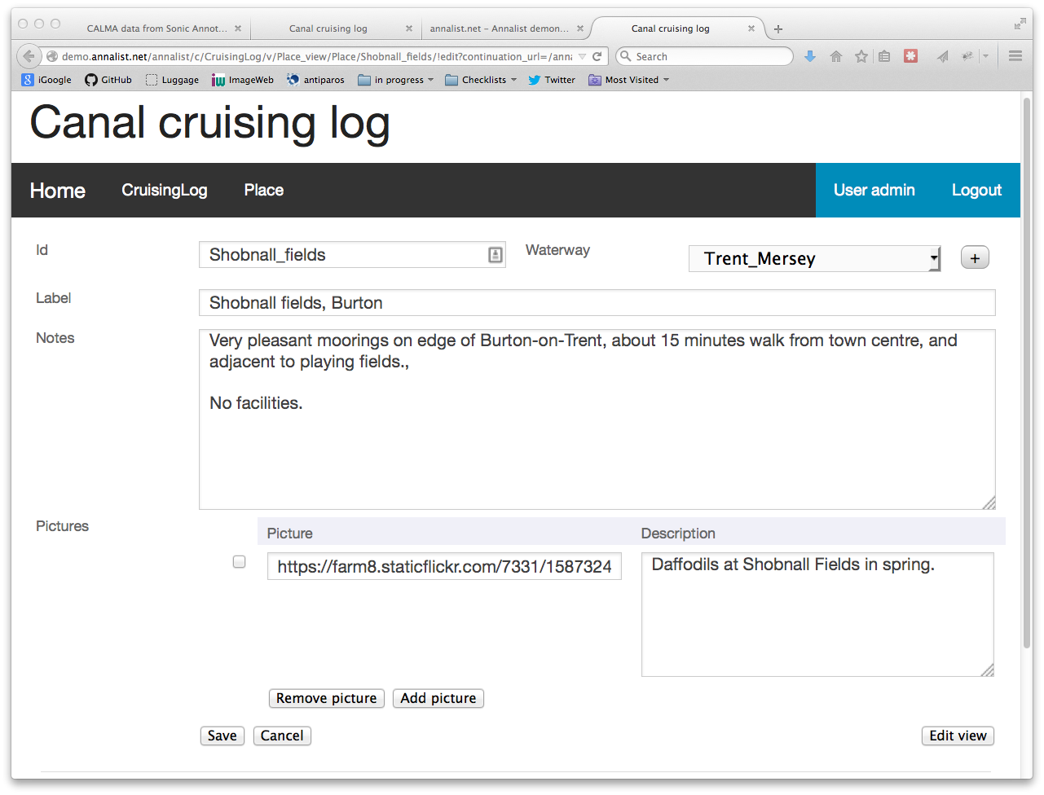

Slide 11
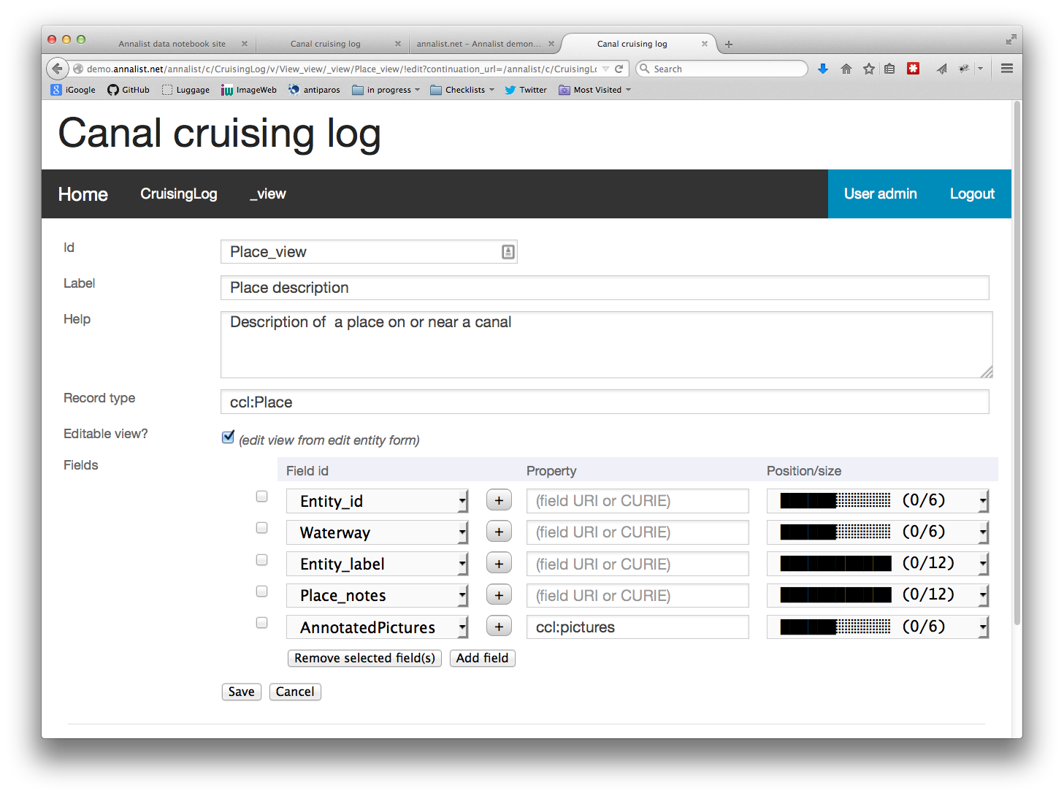

Slide 12
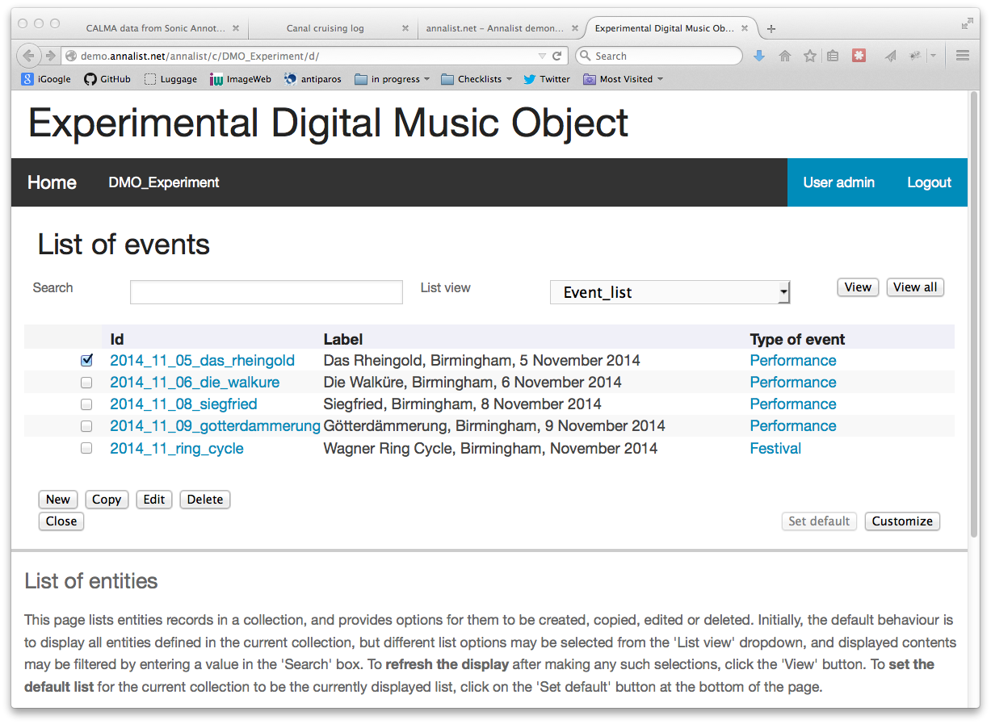

Slide 13
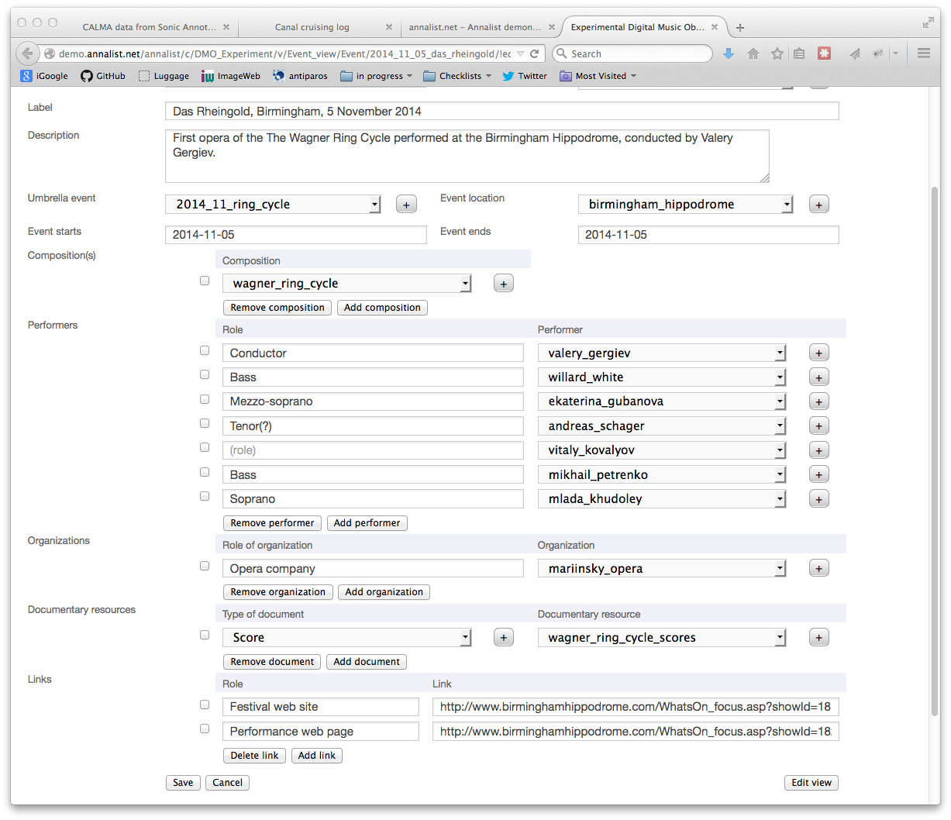

Slide 14
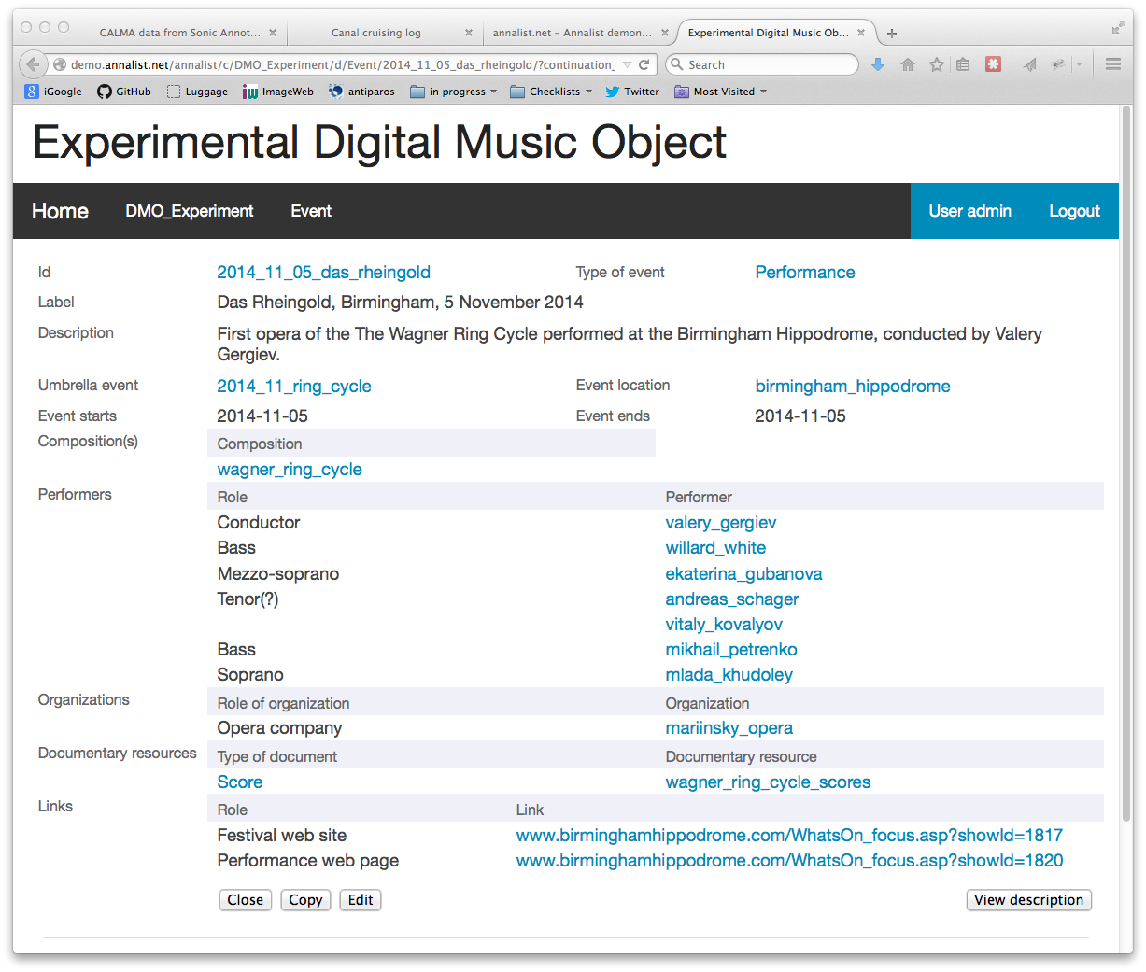

Slide 15
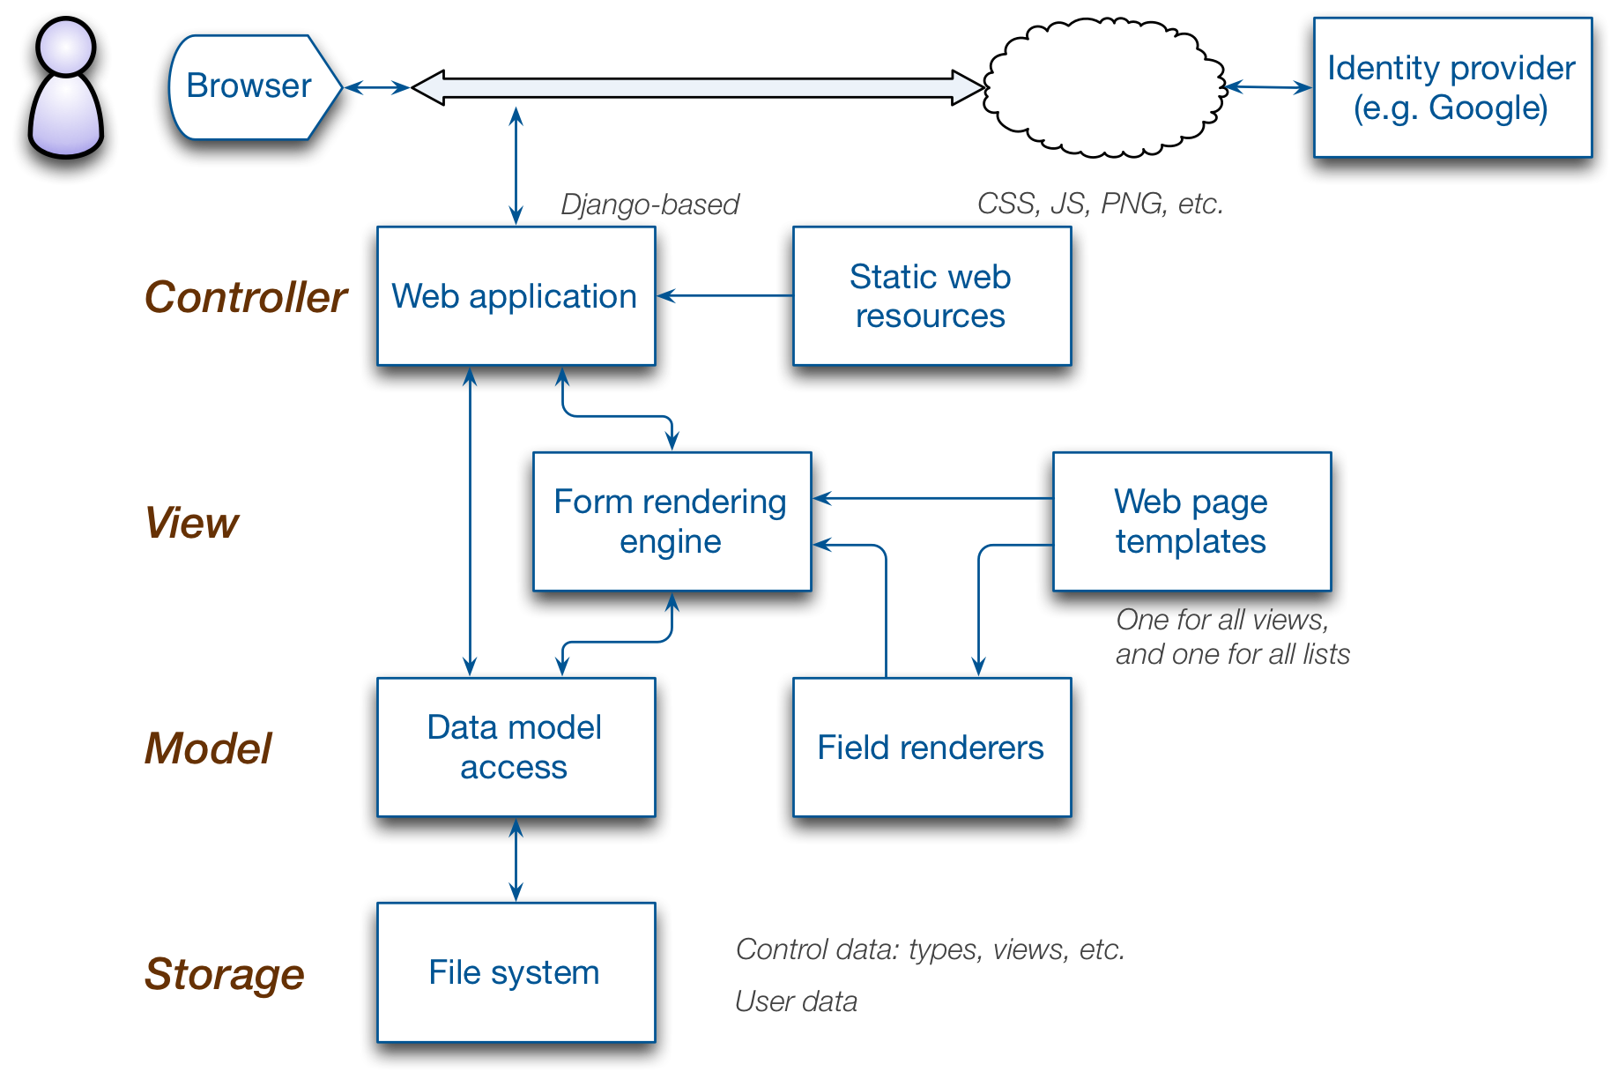
Technical elements

Slide 16
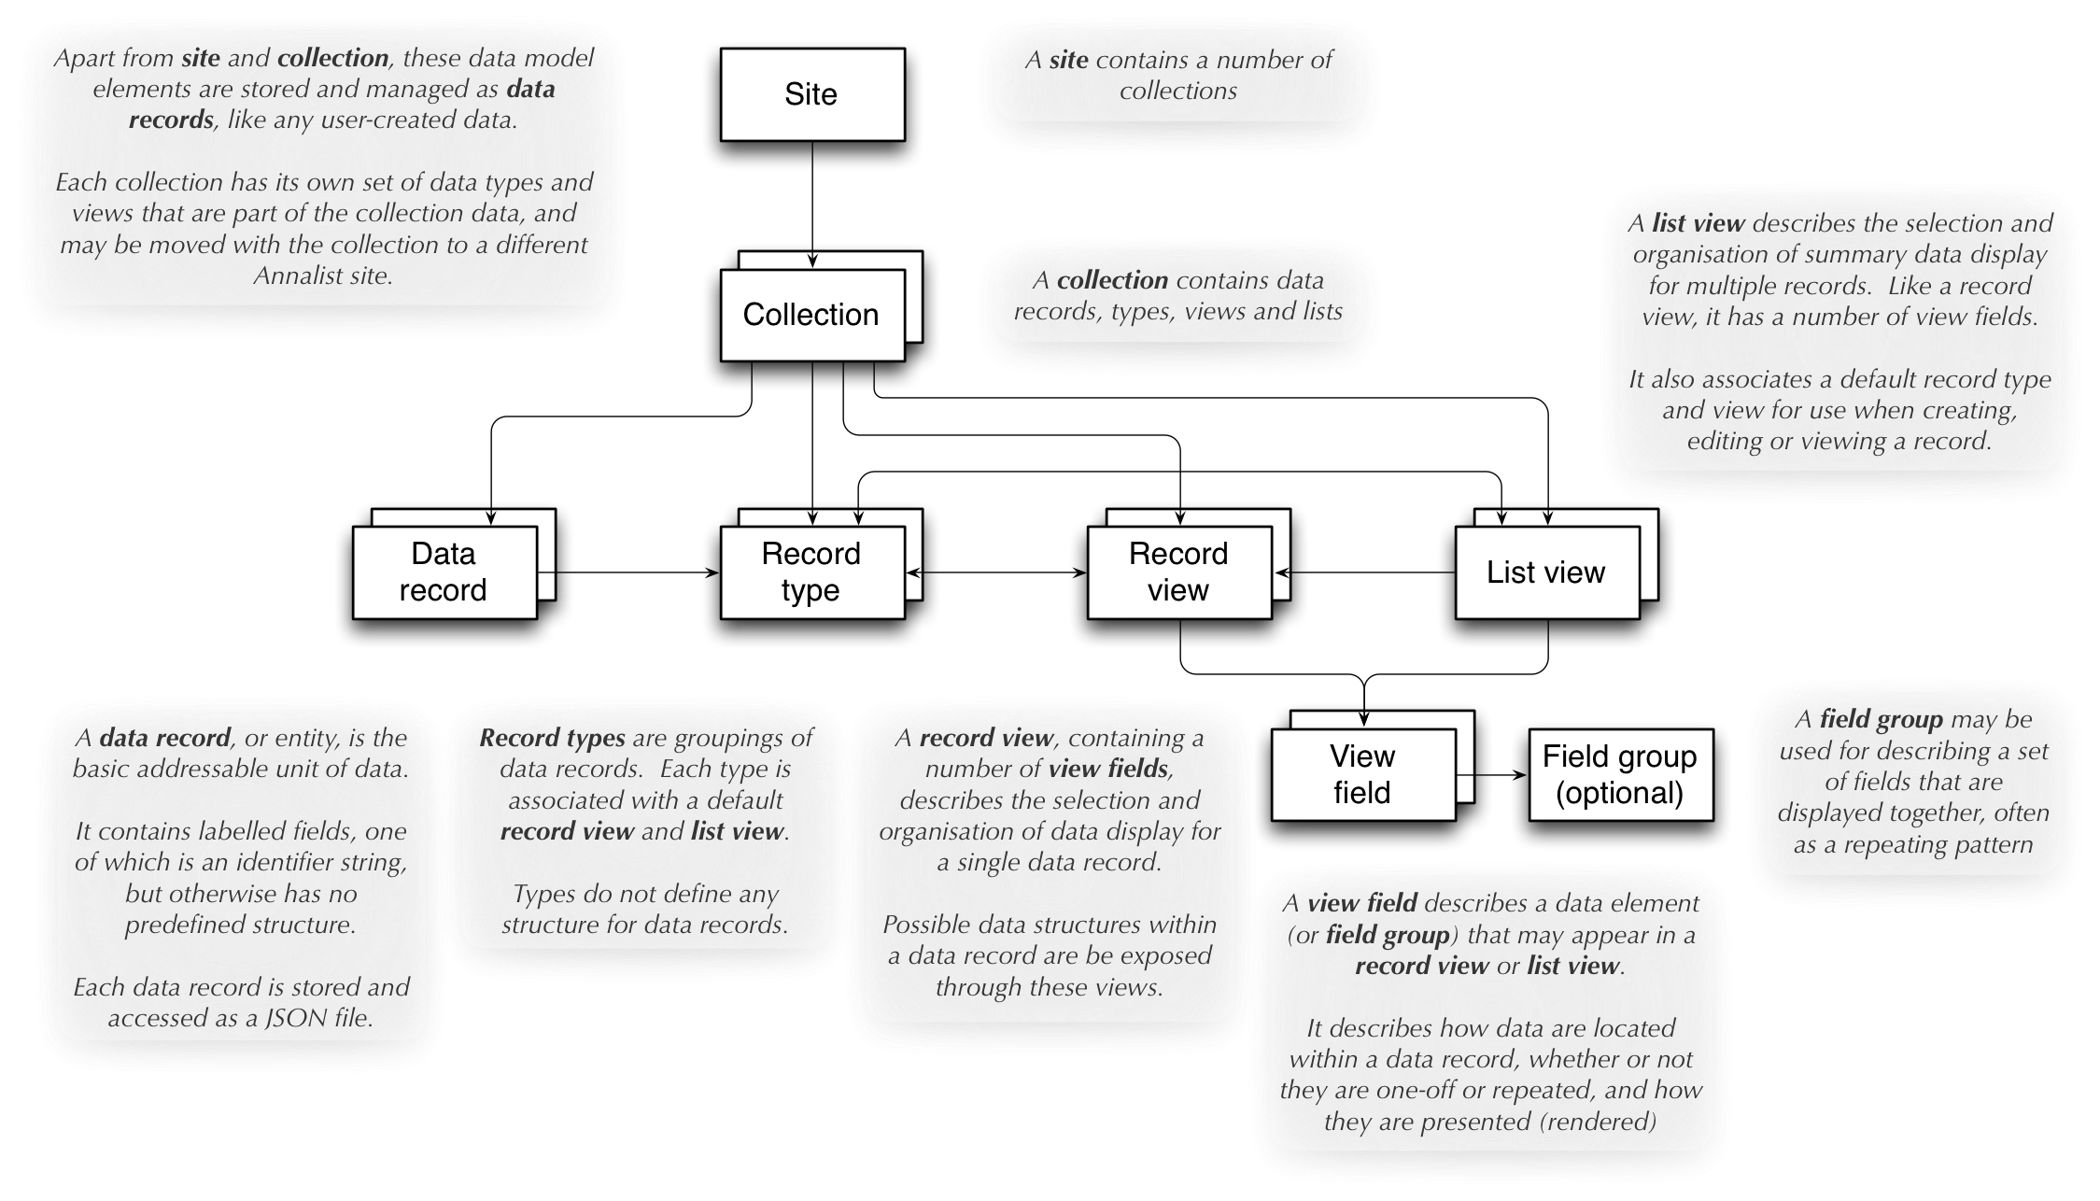
Data storage model

Slide 17
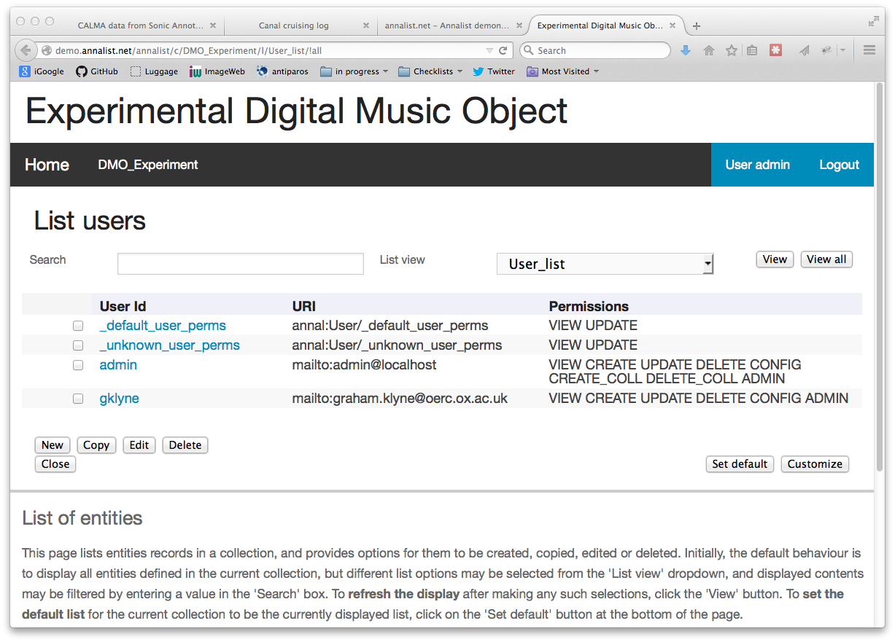

Slide 18
Current status
Ongoing independent project
Public prototype, with demonstrator
http://demo.annalist.net/
Open development
https://github.com/gklyne/annalist
Looking for collaborations
to guide and support future developments

Slide 19
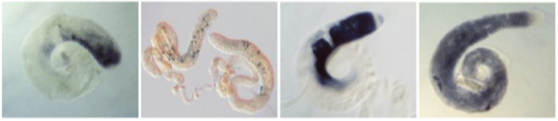
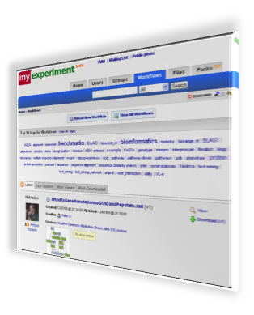
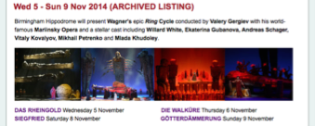
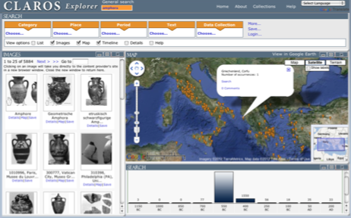
Target applications (ideas)
Annotated image collections (FlyData)
Research Objects (myExperiment)
Digital Music Objects (FAST IMPACt)
CLAROS notebook (clarosnet.org)

Slide 20
For more information:
http://annalist.net/
http://demo.annalist.net/
https://github.com/gklyne/annalist
mailto:graham.klyne@oerc.ox.ac.uk
... or just talk to me!

