Slide 1
Annalist
“Small Data” - the First Mile
Graham Klyne
annalist (noun) a person who writes annals

Slide 2
A Recurring Question for Wf4Ever?
How can an individual researcher create, annotate and share a Research Object with arbitrary selected data accessible from their desktop?
or
“Where do Research Objects come from?”
Annalist could be an answer.

Slide 3
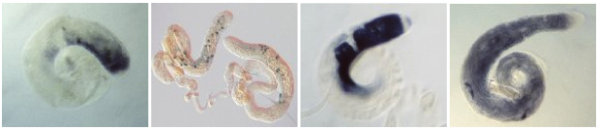

Drosophila testes gene expression (Fly-TED)
http://flyted.zoo.ox.ac.uk/
Excerpts from Fly-TED web site by Jun Zhao
Notes:
One of the first projects I worked on after joining David Shotton's IBRG at Oxford was collection and cataloging of gene expression images of sperm development in Drosophila Melanogaster (a commonly studied model organism), which were collected as part of a strand of research investigating causes of male infertility in humans and other species.
The eventual result of this work was a public database and web site, through which in situ gene expression images can be viewed based on selection by genere name, Drosophila species, expression pattern or other criteria.

Slide 4
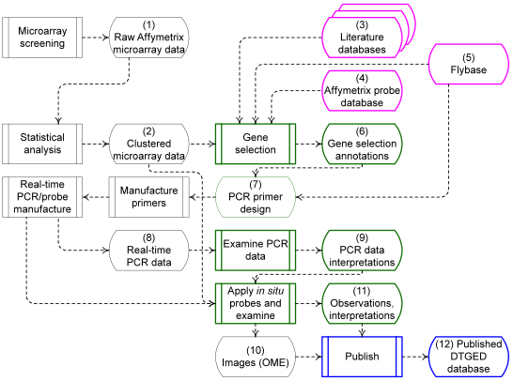
Fly-TED data flows >>
Notes:
A substantial part of the Drosphila genome was screened, using microarrays, and statistically analyzed to identify genes with distinctive expression patterns in drosophila testes across genetic variants exhibiting male sterility, compared with expression in the normal wild-type variant (e.g. genes in sterile mutants whose expression was significantly higher or lower than in the wildtype).
This screening was used in combination with informed researcher evaluation to select a subset of about 1000 genes for in-situ gene expression imaging, a complex and labour-intensive process that results in an image showing where in the sperm development cycle the various genes are expressed.
This work required the collation and collation of diverse information about a range of drosophila genes associated with the microarray “probe” sequences: gene identification, species variant identificaton, microarray expression levels, statistical analyses, real-time PCR data, in-situ images, image annotations (including sperm development stage) based on manual through-microscope observation of the images.

Slide 5
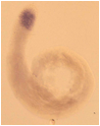
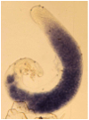
Fly-TED data management
Microarray screening and selection of genes
  data collected in spreadsheets
  annotation with literature references
Real-time PCR and
in situ probe manufacture
  more spreadsheets
In-situ imaging
  create and examine images
  of in-situ hybridization
  record observations in
  linked spreadsheets
Publication
  data cleaning, coding and conversion
  images and metadata to modified Eprints server
Images: Helen White-Cooper
Notes:
For this work, data on the genes selected for in-situ imaging was collected in spreadsheets with file-system references to the corresponding in-situ images. Because the spreadsheets were manually populated by a number of different people, some of the image annotatons, such as those of the sperm development stages, were not consistently described and needed manual review and alignment when the data were prepared for publication

Slide 6
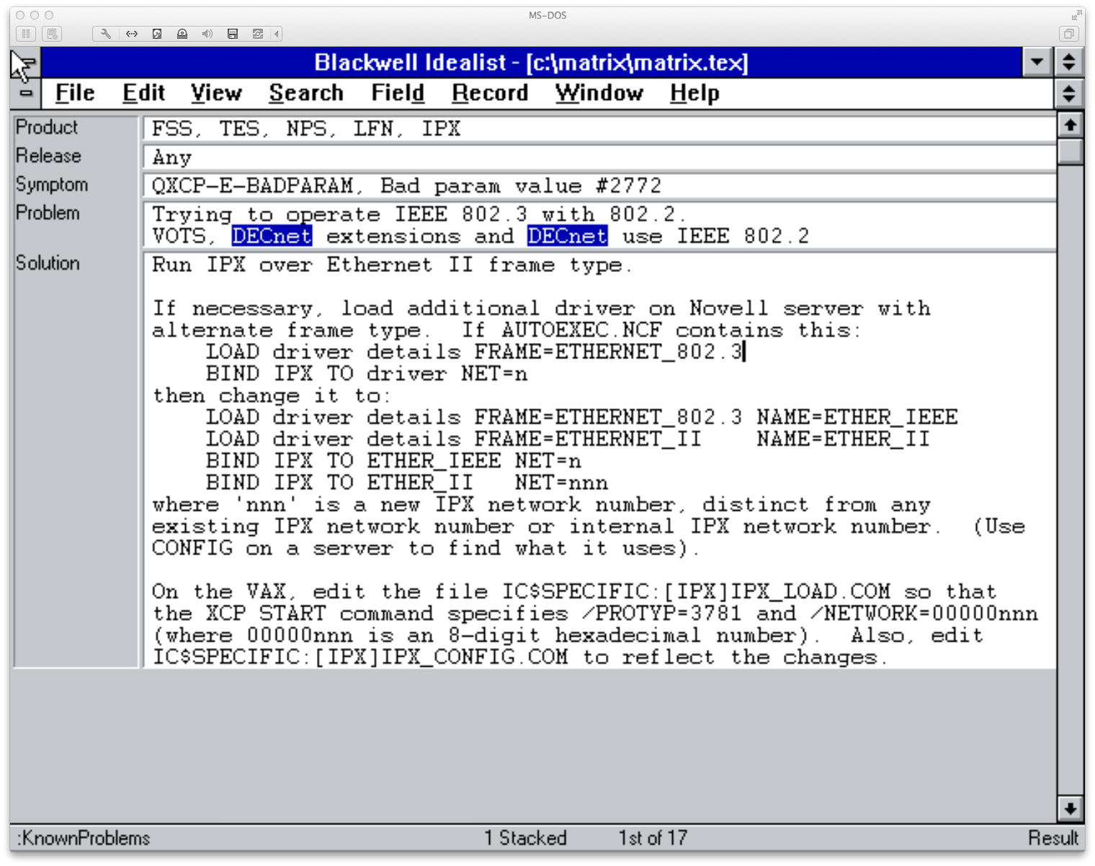
Technical support knowledge base
Notes:
Many years ago, in the early days of personal computer adoption in corporate environments, I helped support a range of software products for connecting diverse kinds of computers, specifically between PCs and mainframe computers.
We were providing person-to-person technical and development support to high-level technical staff in large corporations (banks, telecoms, legal, multinational consumer product companies, etc.), so good access to product information, common failure modes and remediation was important. Things one might find today in a Google search returning a page on Stack Exchange, but before the Web was widely used.
I used an early PC software package called “Idealist” to create a knowledge base that could be searched online by any or all of keyword, product details, operating system version, etc. to locate possible causes and remedies for a reported problem.
Idealist was unusual in that is was one of the first PC software packages to provide free-text keyword searching in semi-structured data. When a new problem was encountered, a description and summary would be entered into the knowledge base by a technical support person so that information about it would be available should it occur for any other customer reporting the same problem. Idealist was probably ahead of its time, as it did not survive as a commercial product, and as far as I'm aware there is still not a ready-to-go product that provides the same level of lightly structured data entry and structured search. (There are plenty of developer tools that might be used to create such a product, but not one I'm aware of that just works out of the box.)

Slide 7
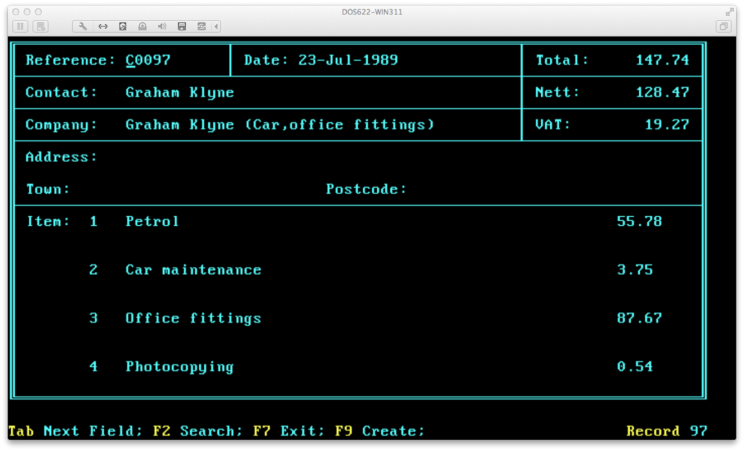
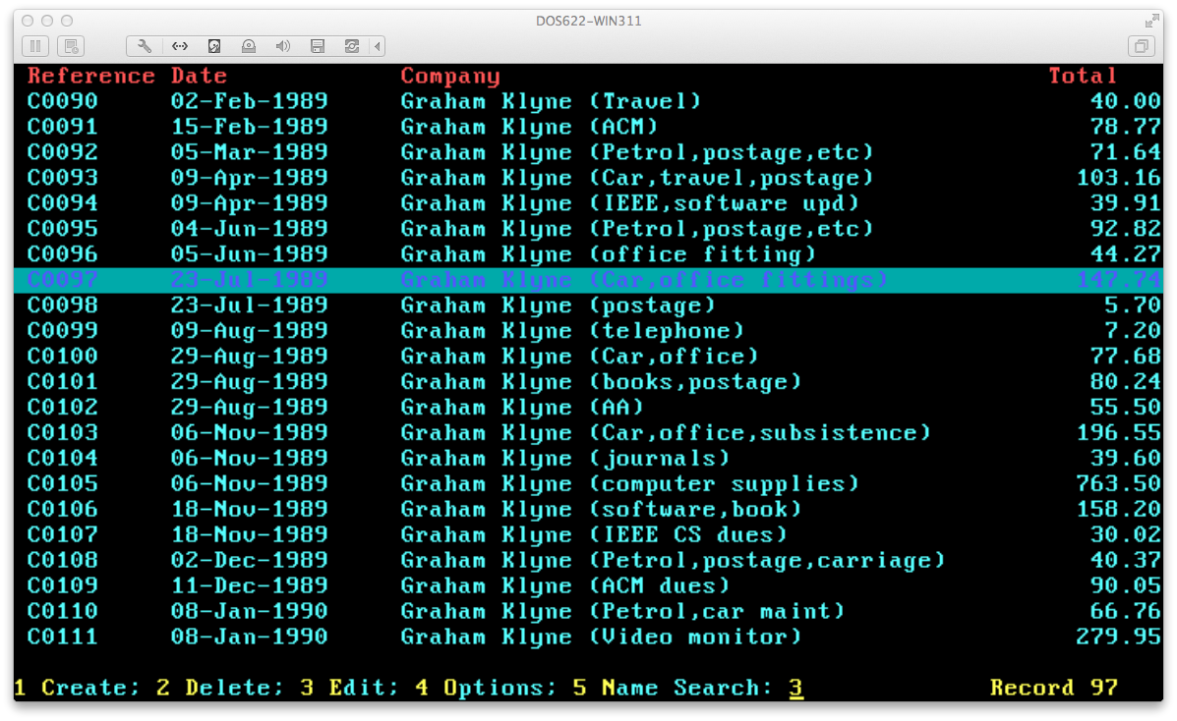
Small business transactions
(Screenshot of invoice)
Notes:
For many years, I ran a small self-employed consulting business, starting in the early days of availability of personal computers at a price that individuals and small businesses could afford. I had a need to raise invoices, handle purchase orders, etc.
Not wishing to pay for a fully-fledged accounting software package, I used a combination of WordPerfect and an associated utility called Notebook to create a kind of computerized card index, with a “card” for each invice, purchase order, etc. The Notebook utility maintained its data in a simple text document format that was compatible with WordPerfect's mail-merge capabilities, so could easily be formatted as a document for submission to a customer, supplier or just filed.
The simple, out-of-box working of Notebook, and its integration with other WordPerfect office suite programs, made it very easy for me to set up a system that maintained records and generated appropriate presentations, which I used for many years. (I now use a descendant of that system based on MS Access, which was much harder to set up and is, in many ways, less satisfactory in use.)

Slide 8
Some common themes
Read/write:
  a need for a system that handles both data access and input in the same activity; more notebook than database
Loosely structured data
  combining free-form description with machine-processable values and annotations
Structure can evolve as the system is used
Requirement to search across some or all fields
Use of external systems to handle presentation or further analysis of data
Limit on effort available to set up the system

Slide 9
Annalist: mockup demo >>
In response to the common requirements of these applications (and more), a web-based system for collection of and access to semi-structured data is envisaged
This demo is a view of what such a system might look like...
Link to mockup:
/usr/workspace/github/gklyne/annalist/mockup/Annalist.pdf

Slide 10
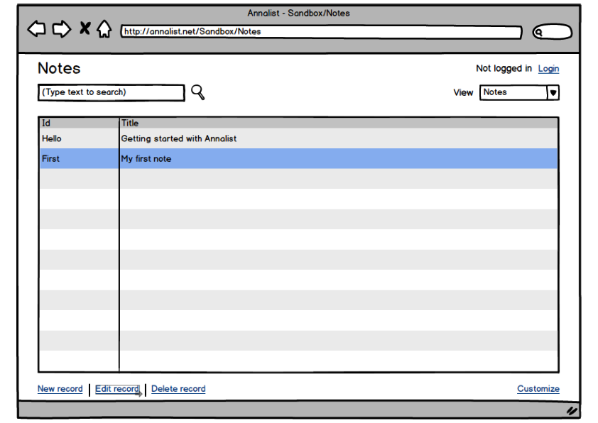
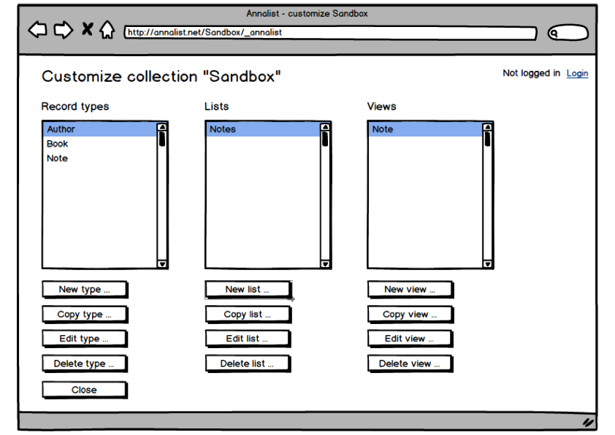
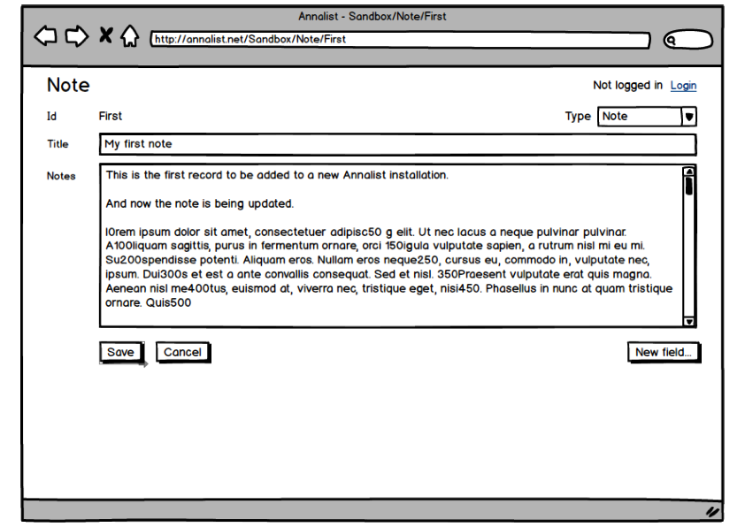
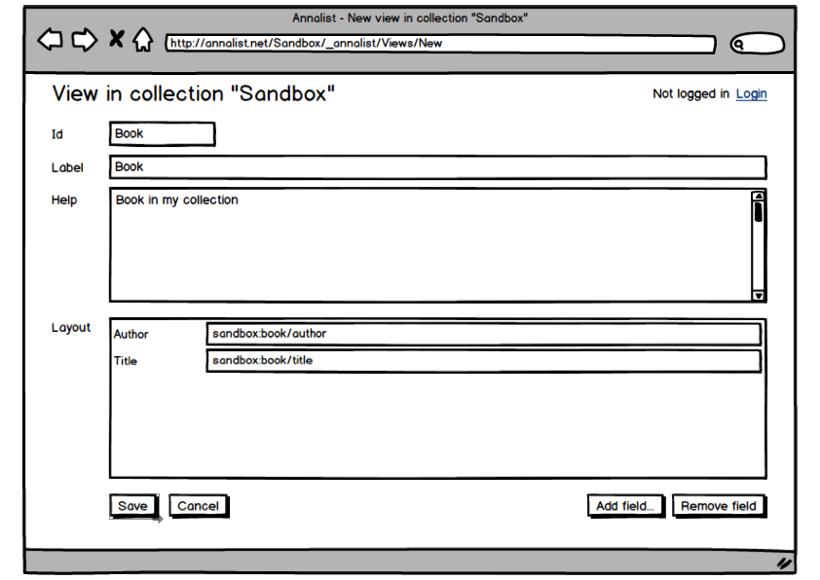
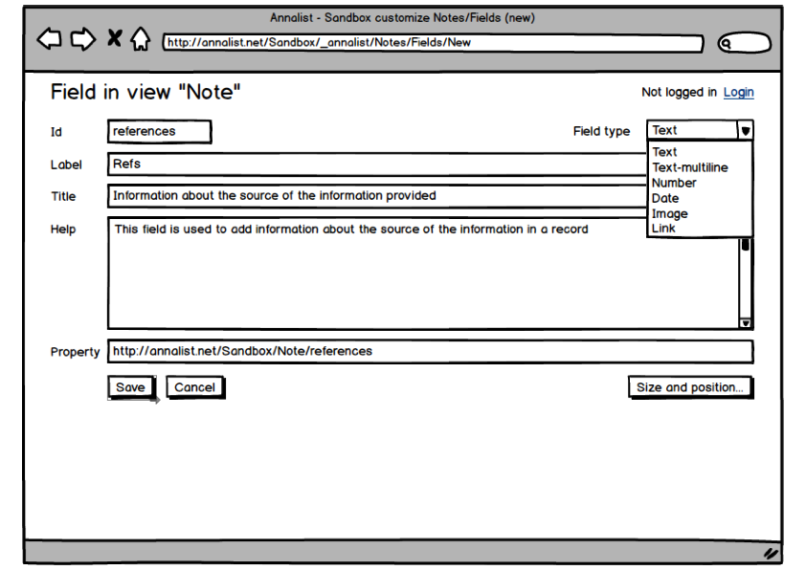
“Screenshots”

Slide 11
Annalist: Intended Audience >>
Individuals
Small research groups
Small businesses (SOHO and up...)
Clubs and non-commercial associations
… with unique data organization requirements, but lacking resources to create custom solutions with existing toolkits
… where use of data may pass to others who are familiar with different tools

Slide 12
Annalist: Goals
Handling semi-structured data
  machine processable and human readable elements
Usable “out of box”
  no complicated setup before use ...
  ... but also a basis for custom applications
In-use definition and evolution of data structures
  supporting an agile approach to data management
Interworking with linked data and REST services
  connecting desktop data with global datasets
Data usable separately from the system that creates it
  direct publication of standard file formats to the web

Slide 13
“Source as resource”
“View source” contribution to the success of WWW
By associating each record with human-decodable web data resource (e.g. in Turtle or JSON-LD), bring the “view source” effect to linked data
Access to / usability of data not being tied to any specific application, supporting local or remote hosting of services, or both used together:
  backup-friendly (cf. Fly-TED experience),
  VCS-friendly (e.g. local data also a git repository),
  Dropbox-friendly,
  “unhosted”-friendly (https://unhosted.org/),
  Curation Microservice friendly (https://confluence.ucop.edu/display/Curation/Microservice)

Slide 14
Annalist: Technical Features >>
Fully web-integrated data management
  internal use of REST + Linked Data mechanisms
  linking to and using external resources (linked data)
  seamless working across locally-stored and Web data
No fixed schema
  easy-to-setup; low “activation energy”
  add structure as required
Loosely coupled components
  separation of storage, indexing and UI
  all parts replaceable
  flexible extensibility

Slide 15
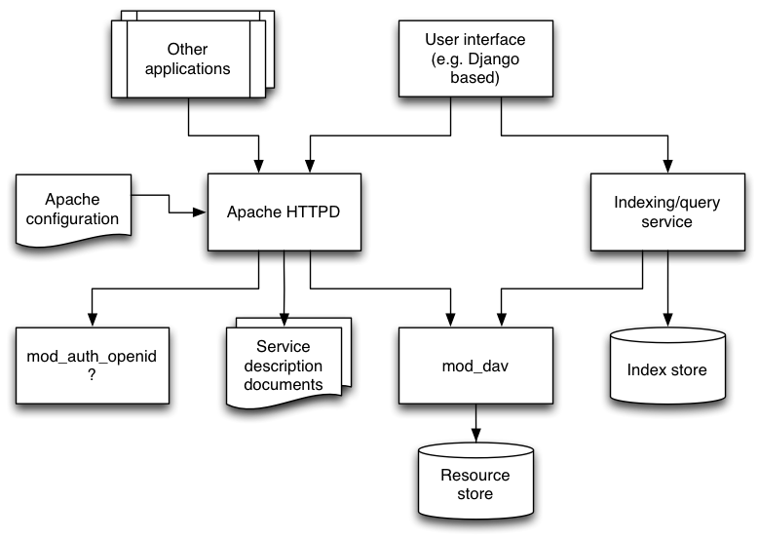
Tentative architecture / overview

Slide 16
Another way to create ROs?
Annalist will initially work with “collections” of “records”. A collection could be regarded as an RO. Or a selection from a collection (a “bundle”?) could be so presented
Exporting and importing the RO bundle format should be an easy means of exchange with other RO handling software
Implementing the documented Wf4Ever architectural principles in a relatively pure form
  (REST + linked data)

Slide 17
Application examples
BioImage / Fly-TED
Workflow sharing (e.g. myExperiment)
VIDAAS alternative (http://vidaas.oucs.ox.ac.uk/)
CLAROS notebook (http://www.clarosnet.org/)
“Research Object” construction and sharing
Workflow annotation
(e.g., of Taverna bundles)
Technical support knowledge base
Small-business book-keeping
Personal information management
3D model sharing
(e.g. Thingiverse)
Recipe sharing
Project management

Slide 18
Possibilities for near-term focus
Small research group data management
Dataflow/Datastage metadata capture
  a commonly requested feature
Databank/SWORD integration
  building on ADMIRAL/Datastage work
myExperiment integration
  create ROSRS API interface

Slide 19
Where next?
I propose to develop and implement an engineered prototype of this design as an independent open-source project in early 2014. Initially, I shall develop applications for myself (eating my own dogfood).
I shall then seek to work on a consulting basis with interested research groups or projects (or non-research applications) to refine requirements and develop specific additional features to support real use.

Slide 20
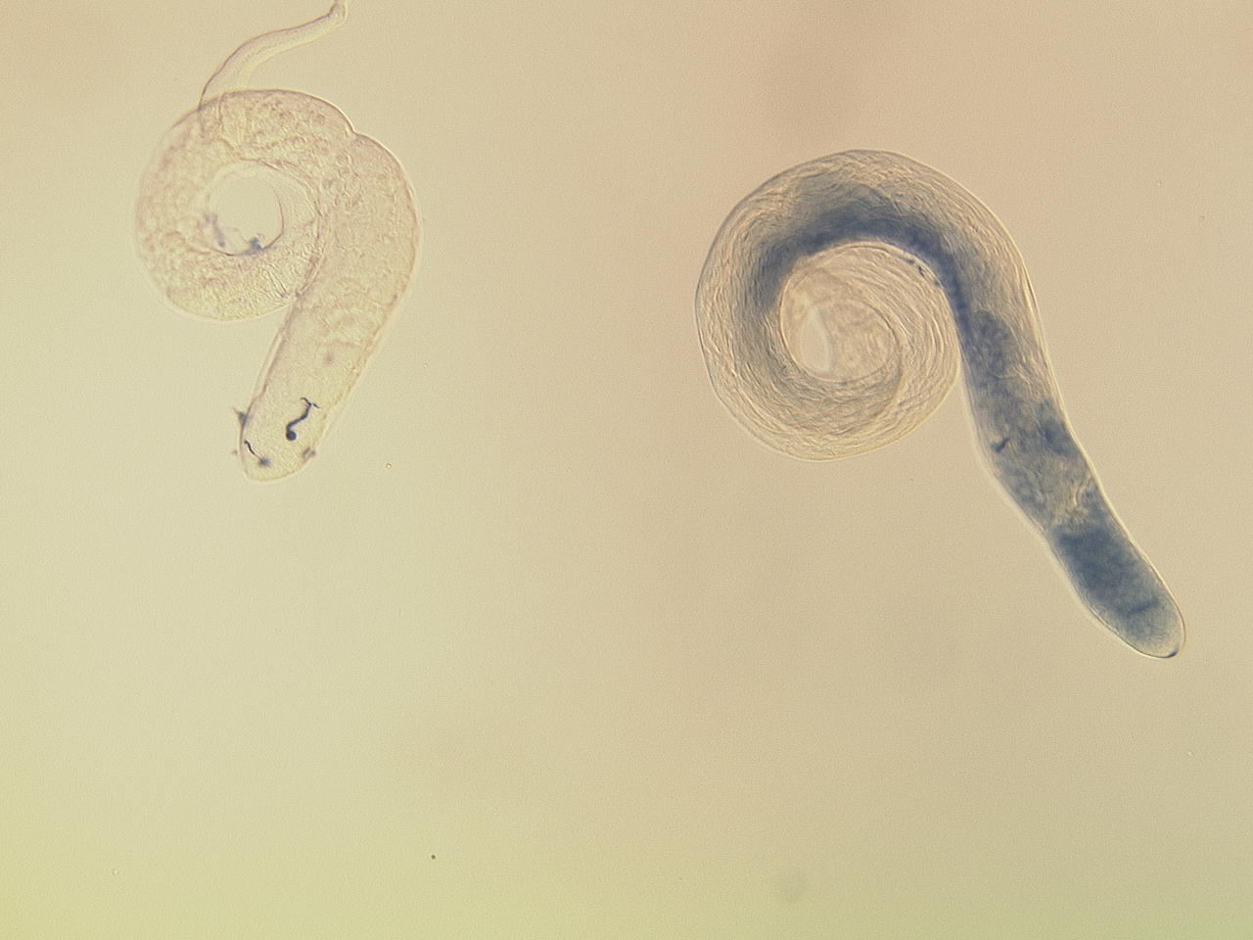
graham.klyne@zoo.ox.ac.uk
gklyne@gmail.com
@gklyne (Twitter, Skype)
Background image: Helen White-Cooper

Slide 21
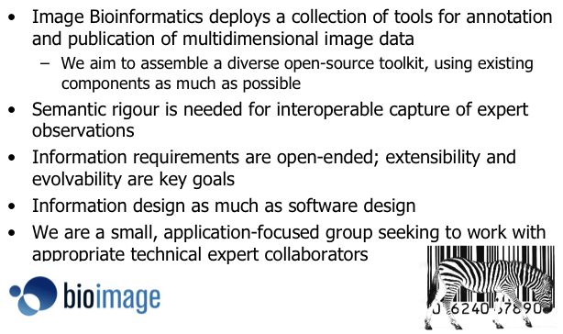
(A summary slide from 2005)

Slide 22
Evaluation criteria
Usable out-of-box for data collection
Setup/configuration by end user
Incremental definition of structures
Mixed data - free text and structured "semantics"
VCS-friendly; Dropbox-friendly; etc.
Mobile-friendly
Content accessible as linked data; links to/from public data
Desktop or web hosting; work with separately hosted data
Support external applications (REST API)
Open source, open data format

Slide 23
Evaluating Callimachus (5-8)
Usable out-of-box for data collection
Setup/configuration by end user
Incremental definition of structures
Mixed data - free text and structured "semantics"
VCS-friendly; Dropbox-friendly; etc.
Mobile-friendly
Content accessible as linked data; links to/from public data
Desktop or web hosting; work with separately hosted data
Support external applications (REST API)
Open source, open data format

Slide 24
Evaluating Semantic Wiki / Wikidata (3-8)
Usable out-of-box for data collection
Setup/configuration by end user
Incremental definition of structures
Mixed data - free text and structured "semantics" (yes, but..)
VCS-friendly; Dropbox-friendly; etc.
Mobile-friendly
Content accessible as linked data; links to/from public data
Desktop or web hosting; work with separately hosted data
Support external applications (REST API)
Open source, open data format

Slide 25
Evaluating spreadsheet (4-6)
Usable out-of-box for data collection
Setup/configuration by end user
Incremental definition of structures
Mixed data - free text and structured "semantics"
VCS-friendly; Dropbox-friendly; etc.
Mobile-friendly
Content accessible as linked data; links to/from public data
Desktop or web hosting; work with separately hosted data
Support external applications (REST API)
Open source, open data format

Slide 26
Evaluating Rightfield (5-6)
Usable out-of-box for data collection
Setup/configuration by end user
Incremental definition of structures
Mixed data - free text and structured "semantics"
VCS-friendly; Dropbox-friendly; etc.
Mobile-friendly
Content accessible as linked data; links to/from public data
Desktop or web hosting; work with separately hosted data
Support external applications (REST API)
Open source, open data format

Slide 27
Evaluating FigShare (1-7)
Usable out-of-box for data collection
Setup/configuration by end user
Incremental definition of structures
Mixed data - free text and structured "semantics"
VCS-friendly; Dropbox-friendly; etc.
Mobile-friendly
Content accessible as linked data; links to/from public data
Desktop or web hosting; work with separately hosted data
Support external applications (REST API)
Open source, open data format

Slide 28
Evaluating Access (1-4)
Usable out-of-box for data collection
Setup/configuration by end user
Incremental definition of structures
Mixed data - free text and structured "semantics"
VCS-friendly; Dropbox-friendly; etc.
Mobile-friendly
Content accessible as linked data; links to/from public data
Desktop or web hosting; work with separately hosted data
Support external applications (REST API)
Open source, open data format

Slide 29
Evaluating Idealist (5)
Usable out-of-box for data collection
Setup/configuration by end user
Incremental definition of structures
Mixed data - free text and structured "semantics"
VCS-friendly; Dropbox-friendly; etc.
Mobile-friendly
Content accessible as linked data; links to/from public data
Desktop or web hosting; work with separately hosted data
Support external applications (REST API)
Open source, open data format

Slide 30
Evaluating ResearchSpace (?)
Usable out-of-box for data collection
Setup/configuration by end user
Incremental definition of structures
Mixed data - free text and structured "semantics"
VCS-friendly; Dropbox-friendly; etc.
Mobile-friendly
Content accessible as linked data; links to/from public data
Desktop or web hosting; work with separately hosted data
Support external applications (REST API)
Open source, open data format

