Slide 1
Elastic Data
“Lightweight data acquisition and shaping”
Graham Klyne

Slide 2
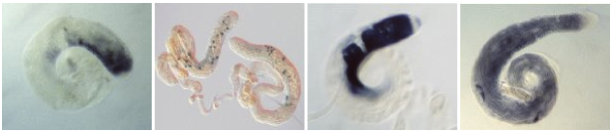

Drosophila testes gene expression (Fly-TED)
http://flyted.zoo.ox.ac.uk/
Excerpts from Fly-TED web site by Jun Zhao
Notes:
One of the first projects I worked on after joining David Shotton's IBRG at Oxford was collection and cataloging of gene expression images of sperm development in Drosophila Melanogaster (a commonly studied model organism), which were collected as part of a strand of research investigating causes of male infertility in humans and other species.
The eventual result of this work was a public database and web site, through which in situ gene expression images can be viewed based on selection by genere name, Drosophila species, expression pattern or other criteria.

Slide 3
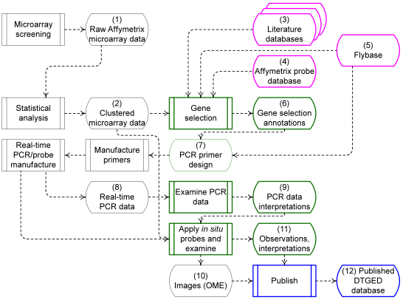
Fly-TED data flows
Notes:
A substantial part of the Drosphila genome was screened, using microarrays, and statistically analyzed to identify genes with distinctive expression patterns in drosophila testes across genetic variants exhibiting male sterility, compared with expression in the normal wild-type variant (e.g. genes in sterile mutants whose expression was significantly higher or lower than in the wildtype).
This screening was used in combination with informed researcher evaluation to select a subset of about 1000 genes for in-situ gene expression imaging, a complex and labour-intensive process that results in an image showing where in the sperm development cycle the various genes are expressed.
This work required the collation and collation of diverse information about a range of drosophila genes associated with the microarray “probe” sequences: gene identification, species variant identificaton, microarray expression levels, statistical analyses, real-time PCR data, in-situ images, image annotations (including sperm development stage) based on manual through-microscope observation of the images.

Slide 4
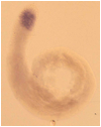
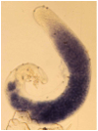
Fly-TED data management
Microarray screening and selection of genes
  data collected in spreadsheets
  annotation with literature references
Real-time PCR and
in situ probe manufacture
  more spreadsheets
In-situ imaging
  create and examine images
  of in-situ hybridization
  record observations in
  linked spreadsheets
Publication
  data cleaning, coding and conversion
  images and metadata to modified Eprints server
Images: Helen White-Cooper
Notes:
For this work, data on the genes selected for in-situ imaging was collected in spreadsheets with file-system references to the corresponding in-situ images. Because the spreadsheets were manually populated by a number of different people, some of the image annotatons, such as those of the sperm development stages, were not consistently described and needed manual review and alignment when the data were prepared for publication

Slide 5
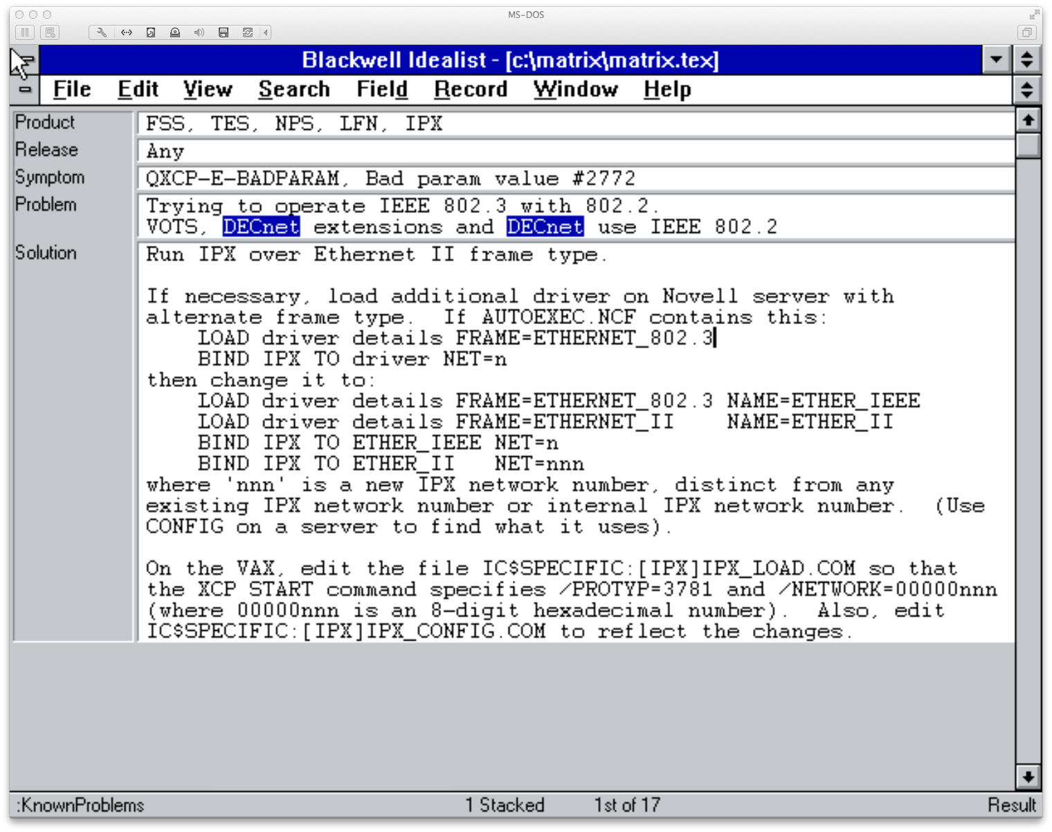
Technical support knowledge base
Notes:
Many years ago, in the early days of personal computer adoption in corporate environments, I helped support a range of software products for connecting diverse kinds of computers, specifically between PCs and mainframe computers.
We were providing person-to-person technical and development support to high-level technical staff in large corporations (banks, telecoms, legal, multinational consumer product companies, etc.), so good access to product information, common failure modes and remediation was important. Things one might find today in a Google search returning a page on Stack Exchange, but before the Web was widely used.
I used an early PC software package called “Idealist” to create a knowledge base that could be searched online by any or all of keyword, product details, operating system version, etc. to locate possible causes and remedies for a reported problem.
Idealist was unusual in that is was one of the first PC software packages to provide free-text keyword searching in semi-structured data. When a new problem was encountered, a description and summary would be entered into the knowledge base by a technical support person so that information about it would be available should it occur for any other customer reporting the same problem. Idealist was probably ahead of its time, as it did not survive as a commercial product, and as far as I'm aware there is still not a ready-to-go product that provides the same level of lightly structured data entry and structured search. (There are plenty of developer tools that might be used to create such a product, but not one I'm aware of that just works out of the box.)

Slide 6
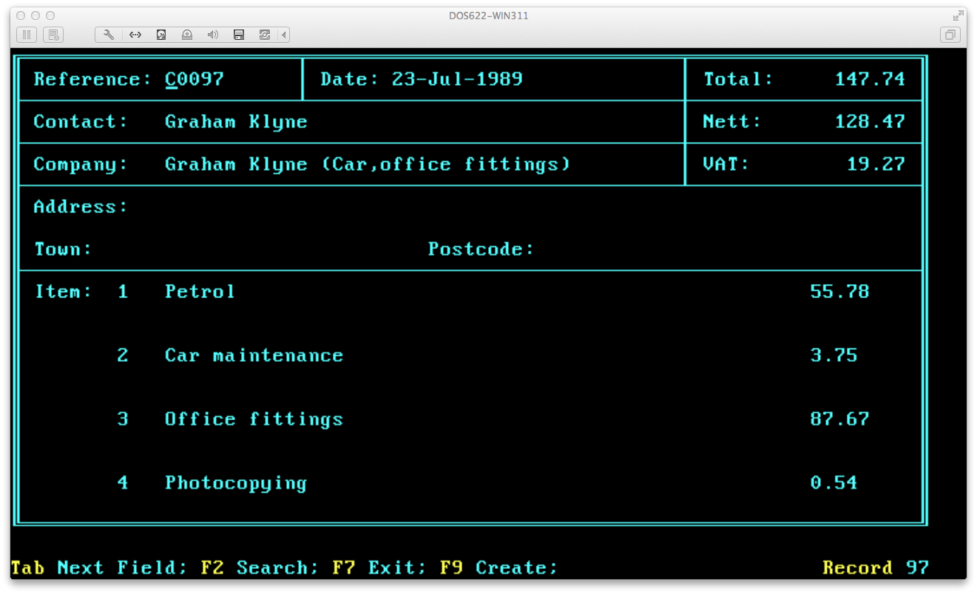
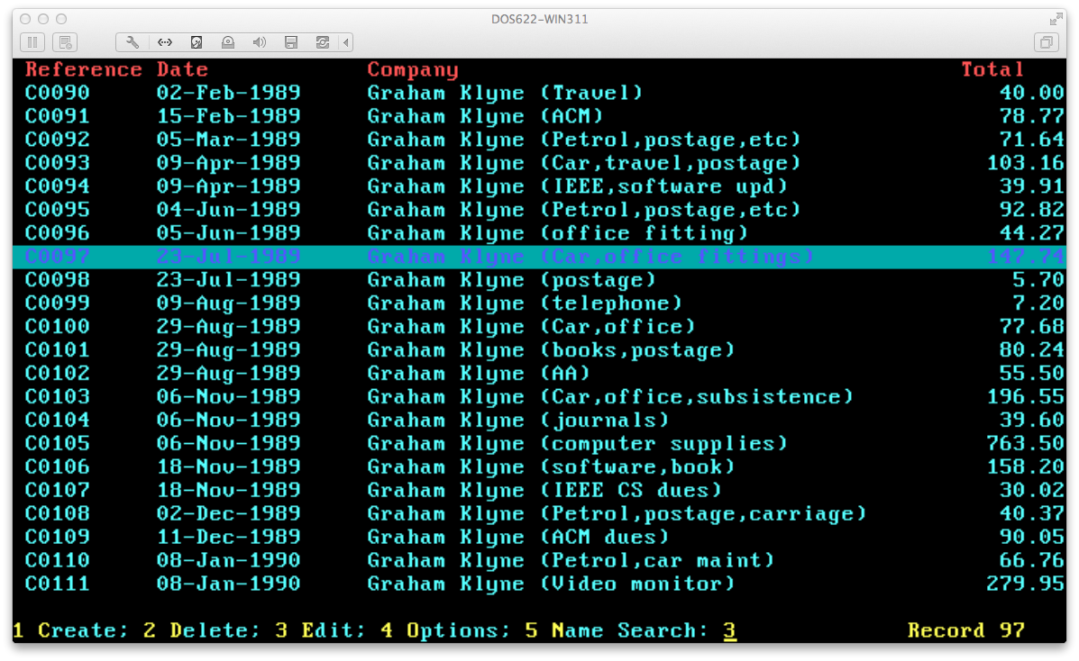
Small business transactions
(Screenshot of invoice)
Notes:
For many years, I ran a small self-employed consulting business, starting in the early days of availability of personal computers at a price that individuals and small businesses could afford. I had a need to raise invoices, handle purchase orders, etc.
Not wishing to pay for a fully-fledged accounting software package, I used a combination of WordPerfect and an associated utility called Notebook to create a kind of computerized card index, with a “card” for each invice, purchase order, etc. The Notebook utility maintained its data in a simple text document format that was compatible with WordPerfect's mail-merge capabilities, so could easily be formatted as a document for submission to a customer, supplier or just filed.
The simple, out-of-box working of Notebook, and its integration with other WordPerfect office suite programs, made it very easy for me to set up a system that maintained records and generated appropriate presentations, which I used for many years. (I now use a descendant of that system based on MS Access, which was much harder to set up and is, in many ways, less satisfactory in use.)

Slide 7
Goals
Easy data
Elastic data
Shareable data
Remixable data

Slide 8
Easy data
Get started quickly, “out of the box”
Minimal initial setup or configuration
Add required configuration later, as needed

Slide 9
Elastic data
Continuous shaping of data
  start simple
  add structure as the need is recognized
Shape data to your your needs, not your needs to fit the data
Describe, not prescribe, the structure of data

Slide 10
Shareable data
Easy exchange with other systems:
  By web access
  By file sharing
  By memory stick
  By email
  Etc.
No data “lock-in”
  Easy exchange with new and existing applications

Slide 11
Remixable data
Resources that can be first-class participants in a wider ecosystem of linked data
  enabling exposure of information that may be unavailable in any single data set
Links in and links out
  connect new data to existing data
  other systems can connect to your data

Slide 12
Non-goals
Data visualization
  data is accessible for use by other tools
Data publication
  data can be handed off to existing publication platforms
  standard formats mean no special translation is required
Big data
  “broad data” (diversity), not “big data” (size)
  aimed at handling datasets one might encounter on a typical desktop, laptop or tablet computer

Slide 13
Technical features
Semi-structured data
No fixed schema
“source as resource”
Fully web-based (linked data, REST)
Use with existing services

Slide 14
Semi-structured data
Record as collection of fields
Fields may contain free text
Fields may contain data values
Fields may contain controlled vocabulary terms

Slide 15
No fixed schema
New fields may be added at any time
Any field may be omitted from a record
  “missing isn't broken” [Brickley]
  completeness of data is a separate concern

Slide 16
“Source as resource”
“View source” contribution to the success of WWW
By associating each record with human-decodable web data resource (e.g. in Turtle or JSON-LD), bring the “view source” effect to linked data
Each record is (typically) a human scale data resource
Access to / usability of data not being tied to any specific application, supporting local or remote hosting of services, or both used together:
  backup-friendly (cf. Fly-TED experience),
  VCS-friendly (e.g. local data is also git repository),
  Dropbox-friendly,
  “unhosted”-friendly (https://unhosted.org/),
  Curation Microservice friendly (https://confluence.ucop.edu/display/Curation/Microservice)

Slide 17
Fully web based
Primary storage as linked data
REST interfaces used internally

Slide 18
Use with existing services
By exposing data as linked data, make it easy for other applications to access new data alongside existing data
Focus on the data collection and shaping, leave to other applications what they do well

Slide 19
Under the hood
Major components
  data entry/browse interface
  indexing
  data descriptions
  access control
  web resource access
    (create, read, write, navigate)

Slide 20
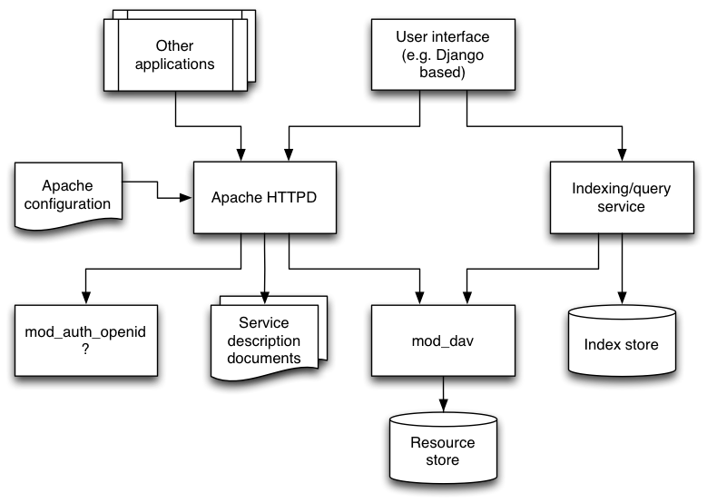
Tentative architecture / overview

Slide 21
Possible application examples
BioImage / Fly-TED
ORDS option (http://ords.ox.ac.uk)
CLAROS notebook (http://www.clarosnet.org/)
“Research Object” construction and sharing
Workflow annotation
(e.g., of Taverna bundles)
Technical support knowledge base
Small-business book-keeping
Personal information management
3D model sharing
(e.g. Thingiverse)
Recipe sharing
Project management

Slide 22
Mockup: Fly-TED data
Create example of use based on Fly-TED data:
  microarray spreadsheets
  statistical analyses
  flybase links, gene names, etc
  literature references
  selection notes – for and against
  selection for in situ imaging (flag)
  in situ images
  image annotations: text and controlled terms

Slide 23
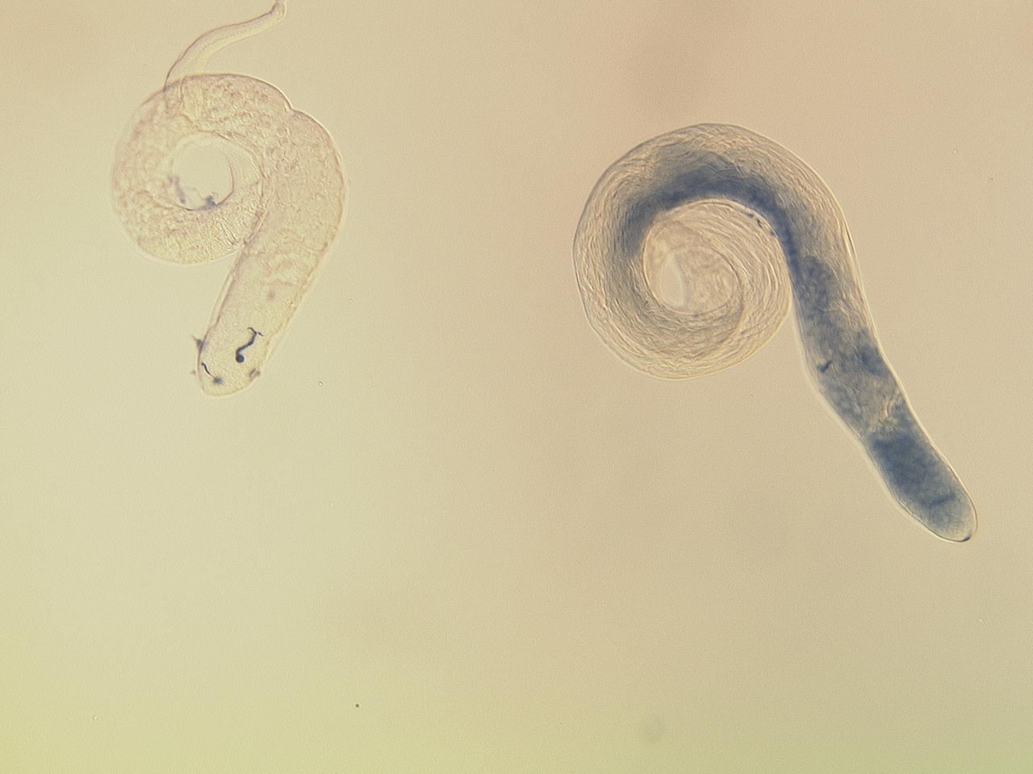
Questions?
graham.klyne@zoo.ox.ac.uk
gklyne@gmail.com
@gklyne (Twitter, Skype)
Background image: Helen White-Cooper

