Slide 1
Data: The First Mile
or...
“Where does the data come from, mommy?”
This talk introduces an open source project
I plan to spool up at the end of this year

Slide 2
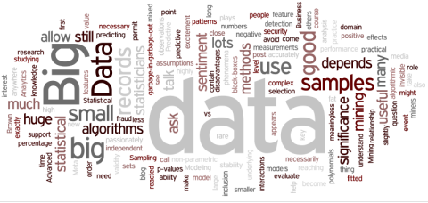
Feeding the “Big Data” Machines
Much talk about “big data” and “open data”
  Linked data
  Government data
  Data the “new oil”
But whose data is this?
Where does the data come from?

Slide 3
Large Organizations
Data is routinely created as a by-product of established, computerized processes
  customer transactions
  supplier transactions
  (semi-)automated internal process workflows
  automated monitoring systems
  etc.
IT departments to make all this happen
Control over circumstances of data generation

Slide 4
But What About the Little Guys?
Small research groups, SOHO businesses, freelancers, etc.
Small groups
  e.g. 1-5 people
  Substantially manual processes
  Working with existing software tools
  No capability or capacity for custom software development
The “long tail” of data creation?

Slide 5
Small Research Group Data
Data comes from:
  Hand-written notebooks
  Spreadsheets
  Documents (computer text)
  Stand-alone software tools
  Instruments
    not necessarily networked
  Web sites and online reference
Local data is combined with global “big data”

Slide 6
Some Examples
Image annotation
  cf. FlyWeb, Fly-TED
Personal web-research notebook
  investigations of CLAROS and related resources
Research Object creation
  aggregating resources related to an experiment
(Add some images)

Slide 7
Some Common Requirements
Composition
  comparing or combining data from diverse sources
Sharing
  selectively exposing data to collaborators
Publishing
  making selected data publicly available
Remixing
  combining with third party data, often for new uses not originally envisaged

Slide 8
Small Research Group Data
Practical Issues
  Data in diverse, incompatible formats
  Copy-and-paste, or manual transcription
  Sharing by “sneakernet”, or email
  Manual format conversion
  Understanding of data is not guaranteed
Composition, sharing, publishing and remixing are effort-intensive, error prone processes
  often with uncertain value of outcome
  most likely, it doesn't happen

Slide 9
What Tools Are Available?
Spreadsheets: current state of the art?
  widely available and understood
    very commonly used by researchers
  easy to capture data, flexible, easy to share
But...
  capturing semantics can be difficult
  composing and remixing is a manual process, or may need custom software development
Semantic web technologies
  appear to have desirable properties
  available tools don't address “first mile” problems

Slide 10
Can We Do Better?
Contemplating a tool that combines:
  spreadsheet ease-of-use and flexibility
  semantic technology capabilities for composition and remixing
  web capabilities for sharing and publication
What might such a tool look like? ...

Slide 11
“Out-of-box” Features (1)
Flexible data entry, editing and viewing UI
Underlying data shared as web resource
  for other applications to provide different interfaces
Access control for controlled sharing

Slide 12
“Out-of-box” Features (2)
Support data cross-referencing
  “hypermedia”
Use a common, widely supported format
  to facilitate remixing by third parties
Support references to pre-existing data
  especially local spreadsheets and public linked data

Slide 13
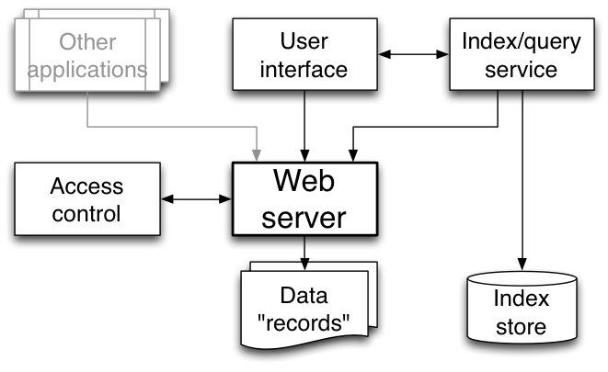
Proposed System Outline

Slide 14
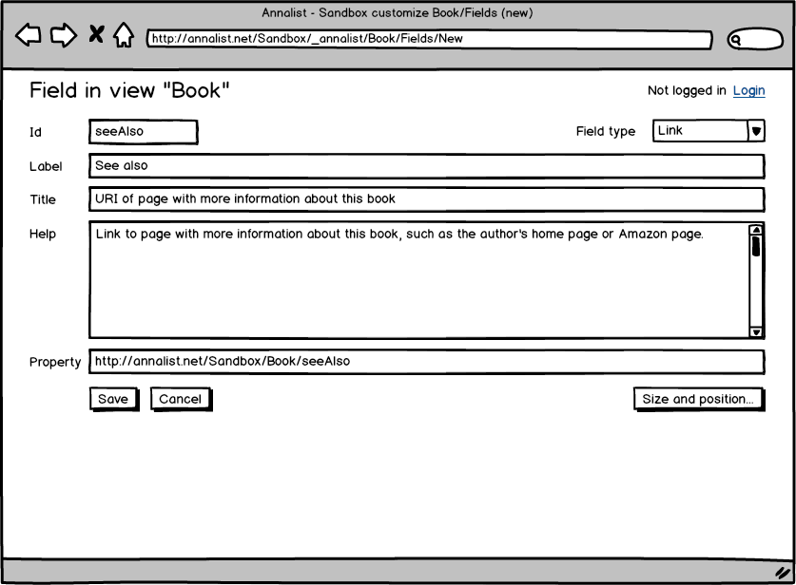
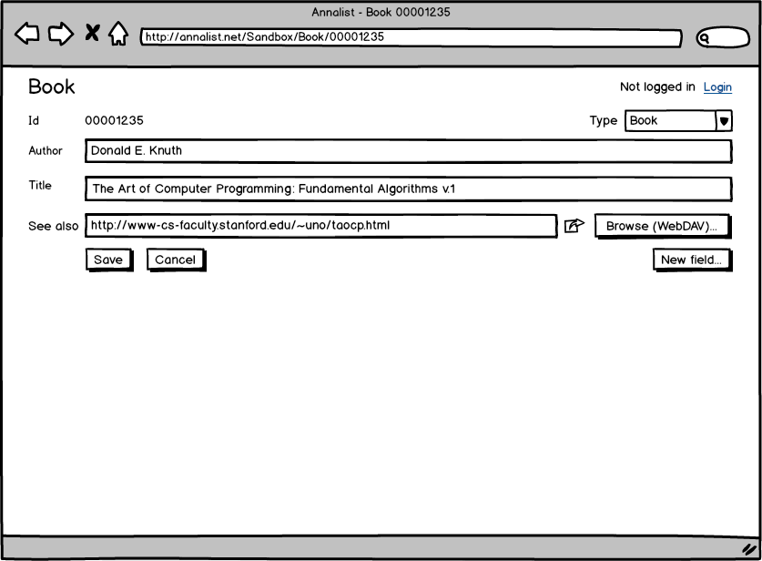
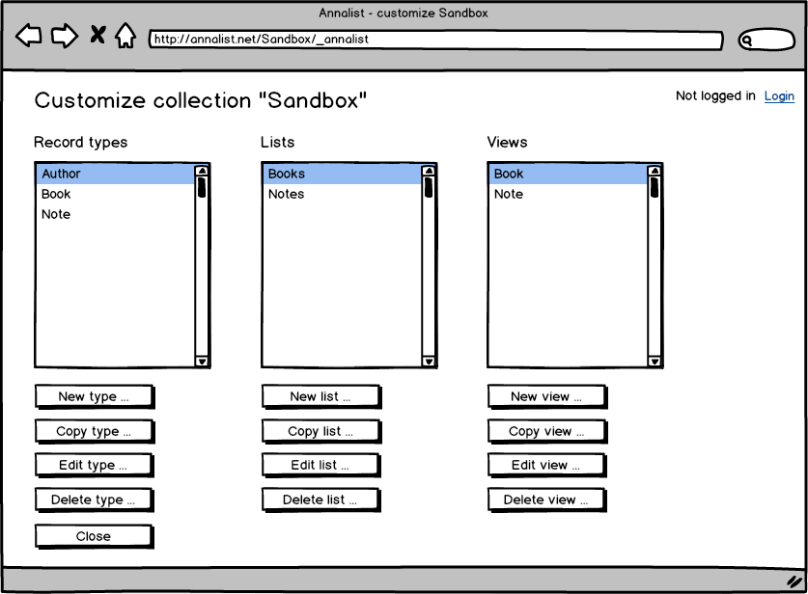
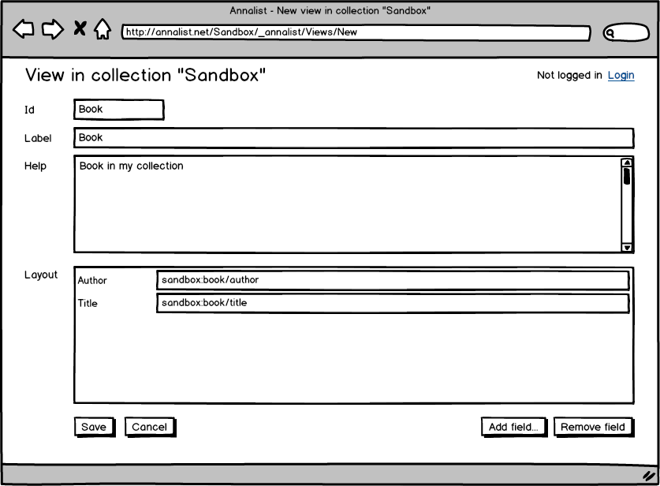
Data Editing UI

Slide 15
Proposed Data Record Model
RDF-based format
  Entities carry type information
  Entities can be related by typed links
  No schema constraints
Frame- or entity- oriented records
  A single web resource contains an arbitrary amount of information about some entity
  Fundamental unit of data access

Slide 16
System Components
Web server
  Apache httpd, or …?
Indexing service
  Jena Fuseki, Elastic Search, or...?
Authentication
  Persona, OpenId Connect, or …?
Data record format
  JSON-LD, Turtle, or...?
UI toolkit
  Django, or...?

Slide 17
The Story So Far...
Working title: “annalist”
  (as in creator of “annals”, or records)
Github project
  https://github.com/gklyne/annalist
  (no code yet, just vapourware)

Slide 18
… Next Steps
2013-Q4
  Investigate authentication/IDP technologies
  Investigate web server access controls
  Identify potential user collaborations
2014-Q1 onwards
  Pin down data access API details
  Choose web server, indexing engine, etc
  Implement data acquisition/viewing UI
  Implement spreadsheet data bridge
  Work with user(s) to create demo application(s)

