Slide 1
Goal
Extract and codify provenance relating to the “climategate” data using the W3C provenance model with Annalist
Graham Klyne
Charles Roberts

Slide 2
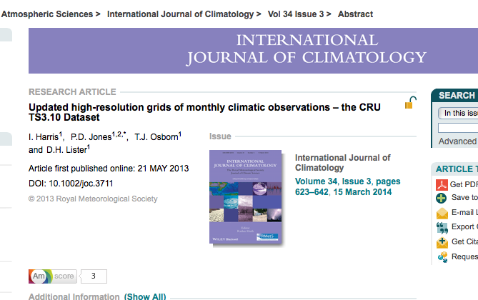
Source
http://dx.doi.org/10.1002/joc.3711

Slide 3
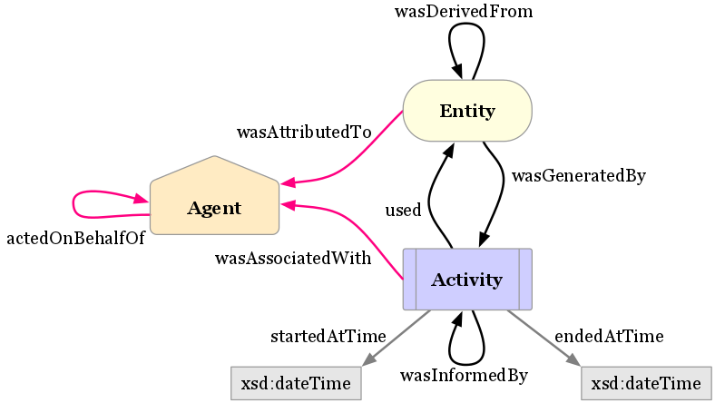
What we did
Create Annalist collection and GitHub repo
Glean initial high level provenance from paper
Created initial Annalist data
definitions, based on
W3C PROV
Commit,
refine,
iterate

Slide 4
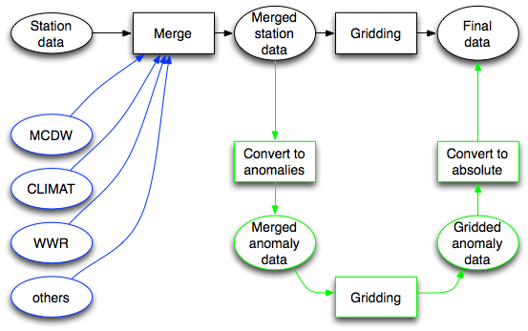

Slide 5
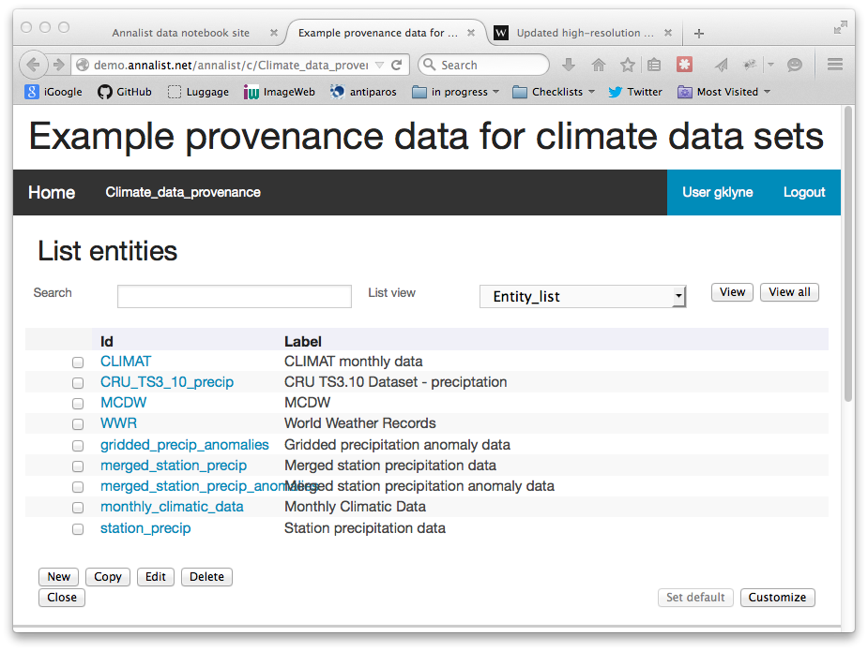
Outcome 1 - online provenance capture/demo tool
http://demo.annalist.net/annalist/c/Climate_data_provenance/

Slide 6
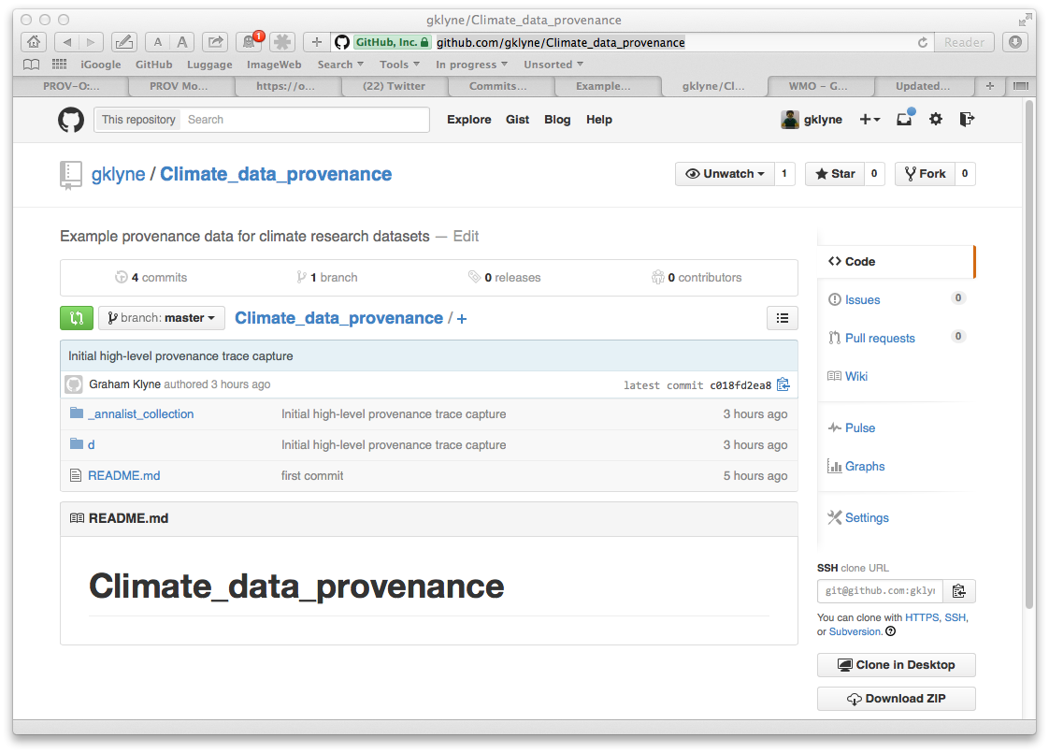
Outcome 2 – Annalist data definitions (JSON) in GitHub
https://github.com/gklyne/Climate_data_provenance

Slide 7
Summary
Manual provenance extraction is tedious
  automated capture would be much easier!
Have created initial set of Annalist definitions for provenance
  next time will be so much easier
It proved very effective to start with a very high level view of provenance, and iterate
  be agile
Learned more about areas where Annalist usability still needs work

