Slide 1
A gap in the landscape...

Slide 2
A gap in the landscape...
… of research data management tools for individual researchers and small research groups

Slide 3
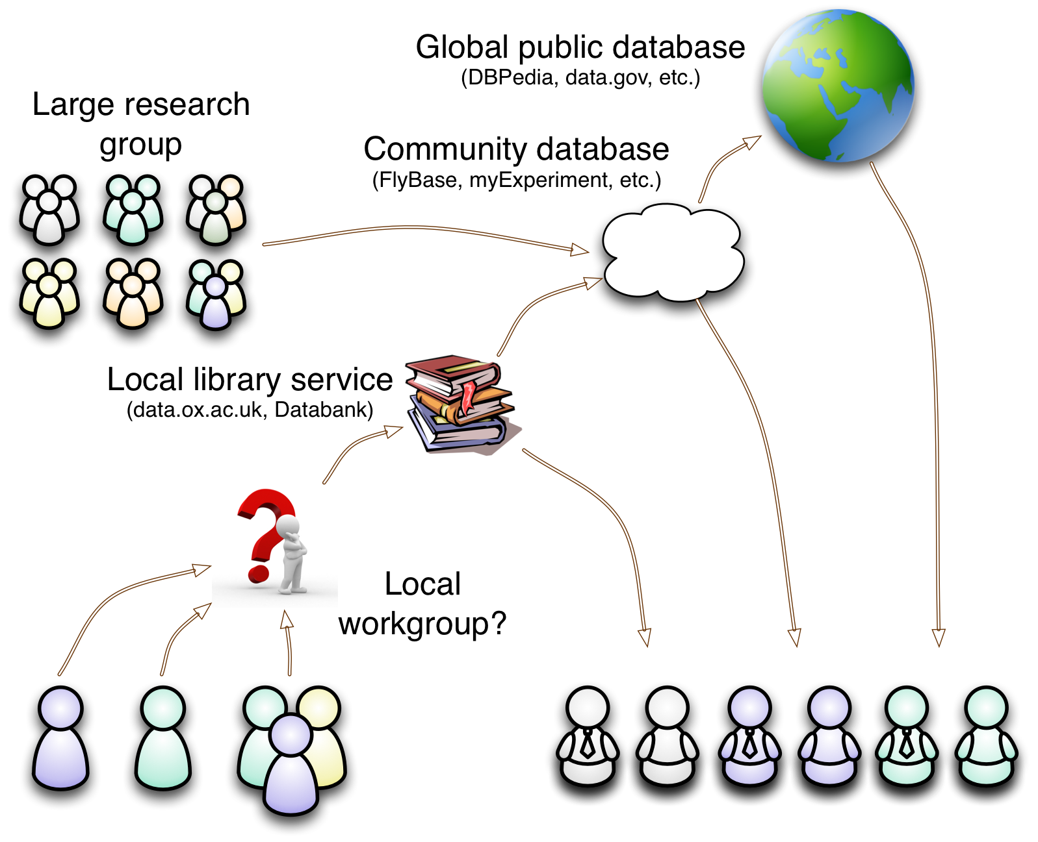

Slide 4
Missing: a tool for researchers to gather, organise and share their data...
Easily: straight “out of the box”,
Flexibly: adapting to evolving needs,
Collaboratively: controlled exchange of data with colleagues, and
Re-usably: mixing with external data.

Slide 5
Annalist *
is my attempt to fill this gap...
* Annalist: a keeper of records

Slide 6
Screenshots
The following screenshots illustrate some of Annalist's capabilities.
These screenshots are all created through the Annalist web interface, without prior configuration.
Annalist not only provides an interface for collecting semi-structured data, but also for defining its structure as it is collected...
Live examples at: demo.annalist.net

Slide 7
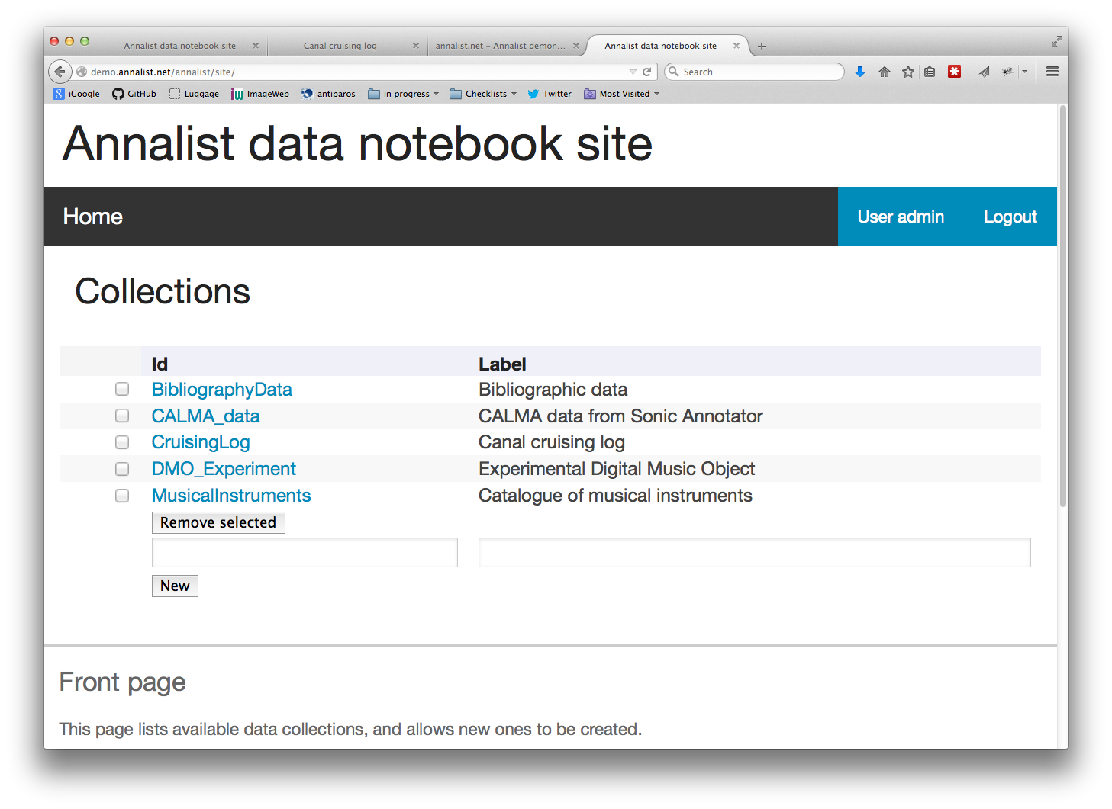

Slide 8
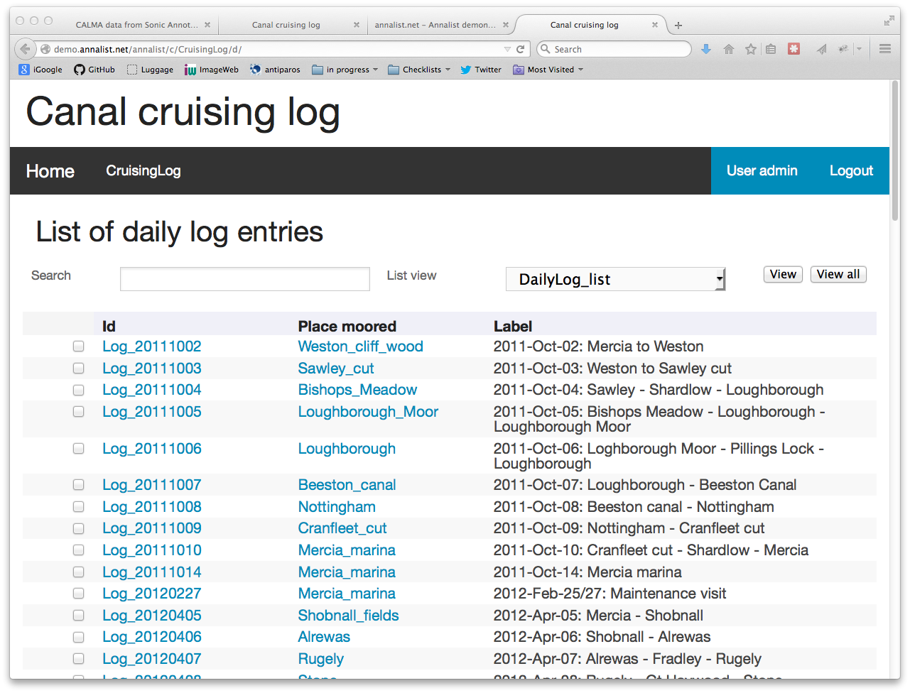

Slide 9
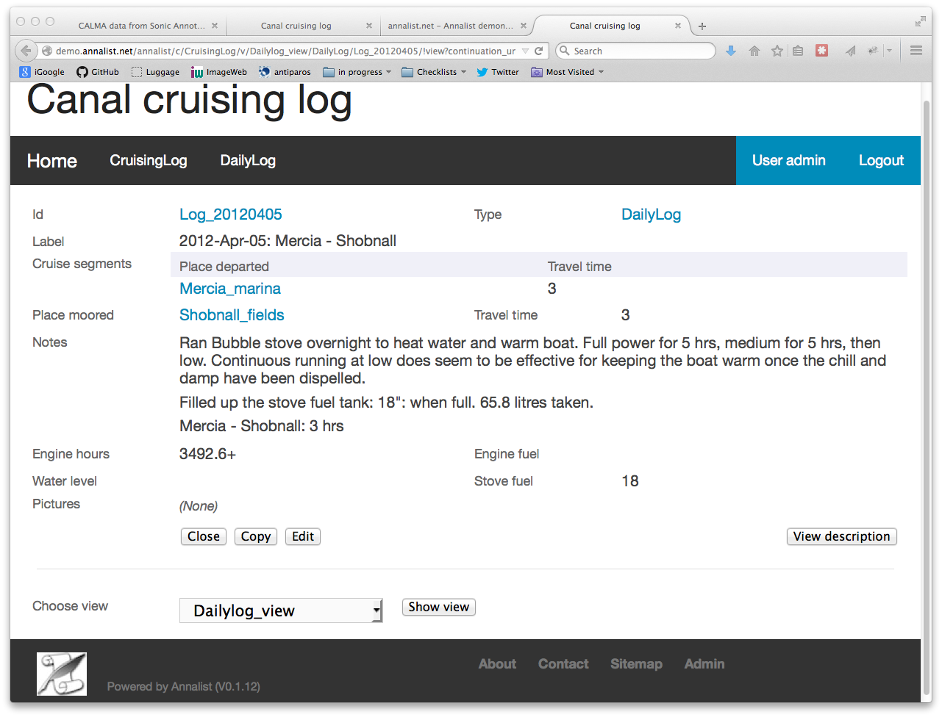

Slide 10
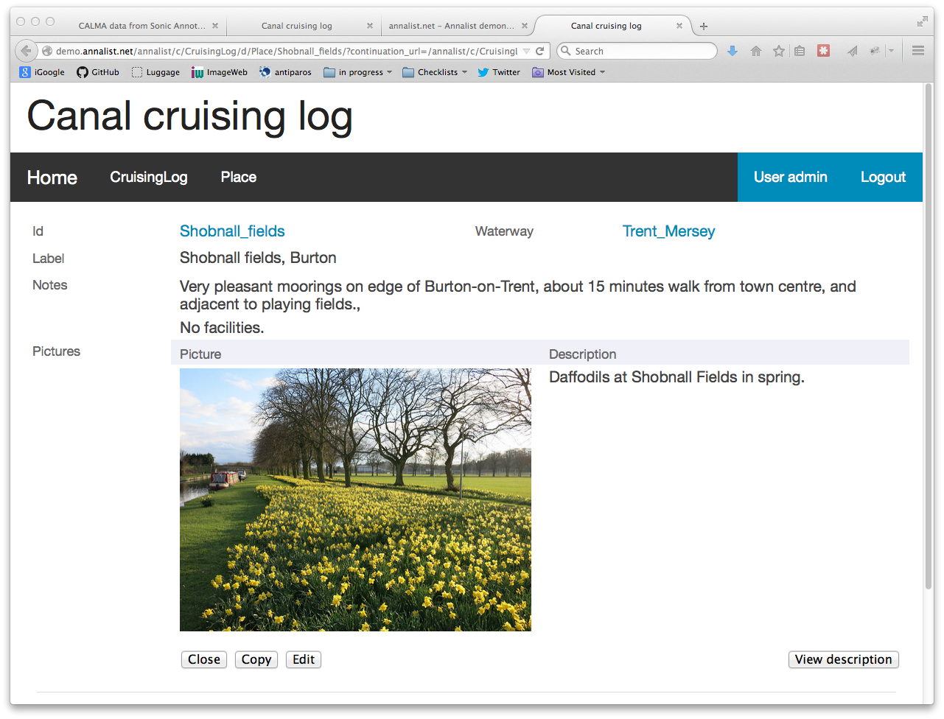

Slide 11
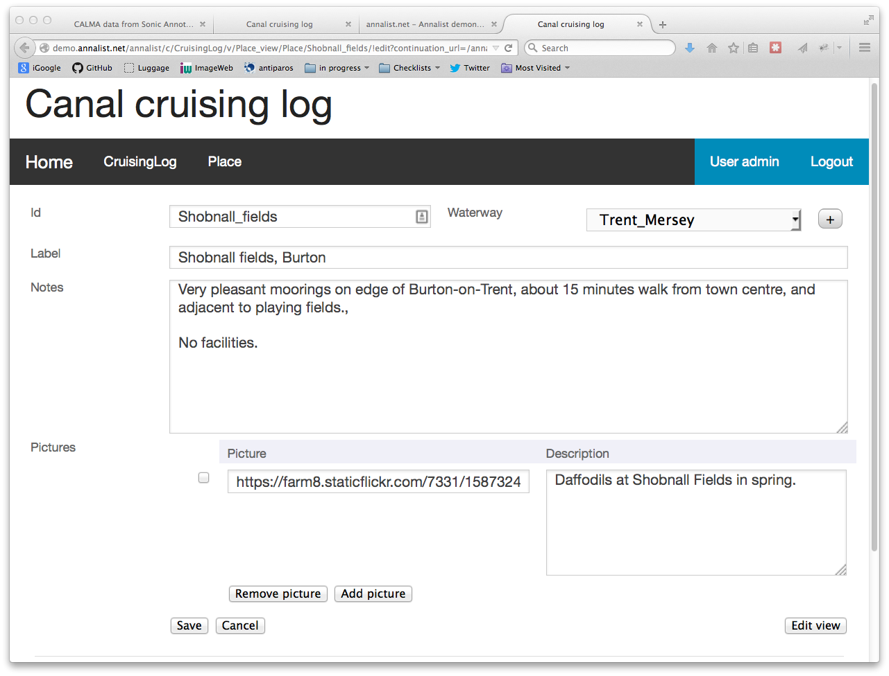

Slide 12
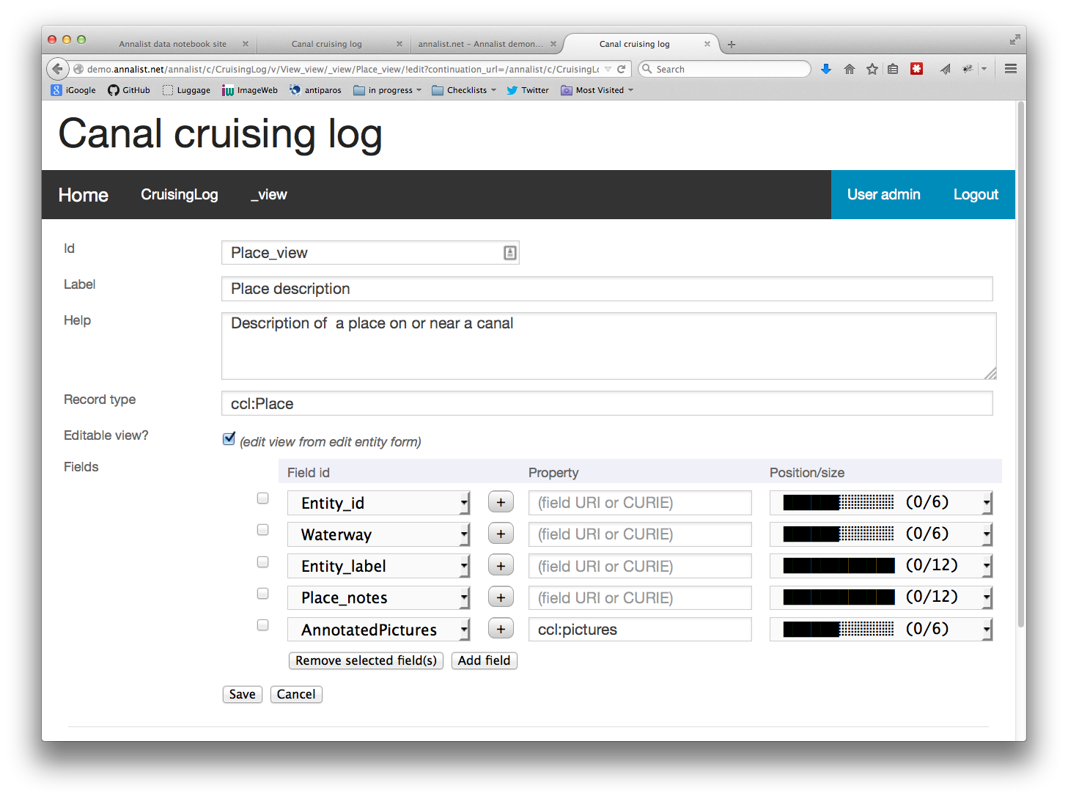

Slide 13
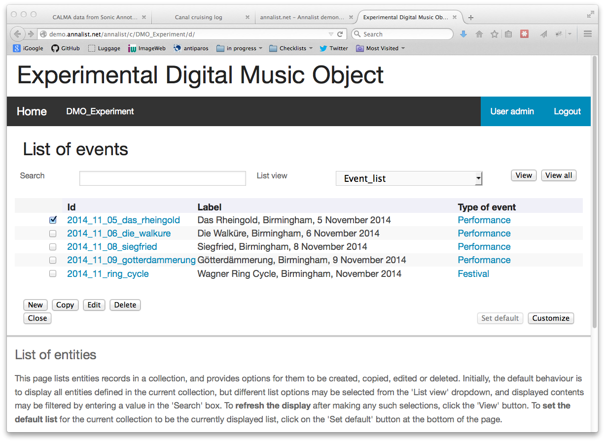

Slide 14
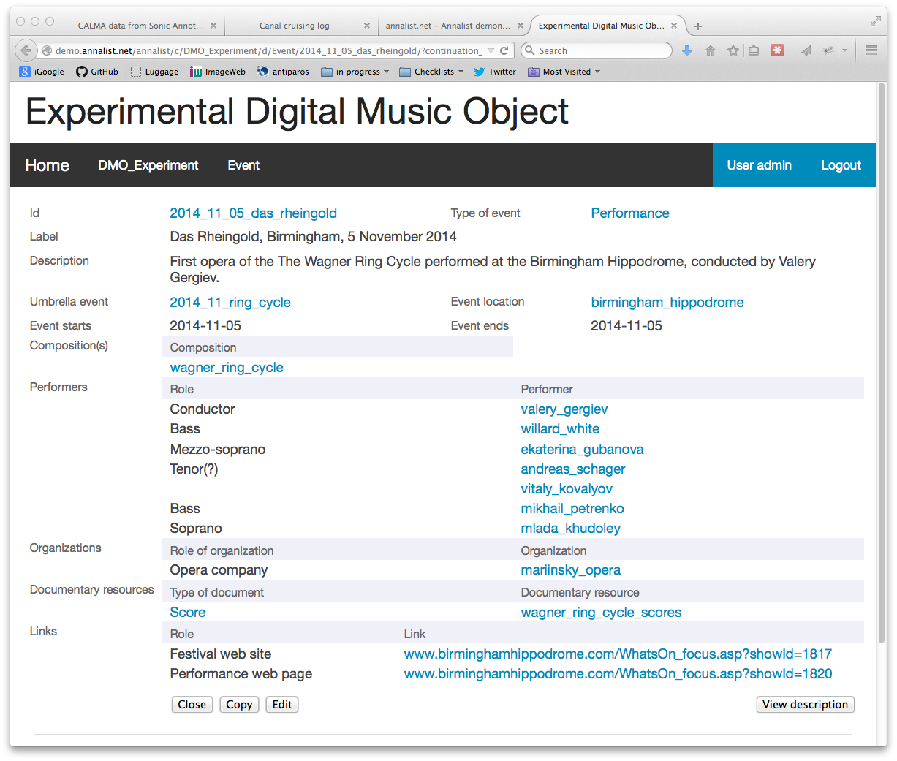

Slide 15
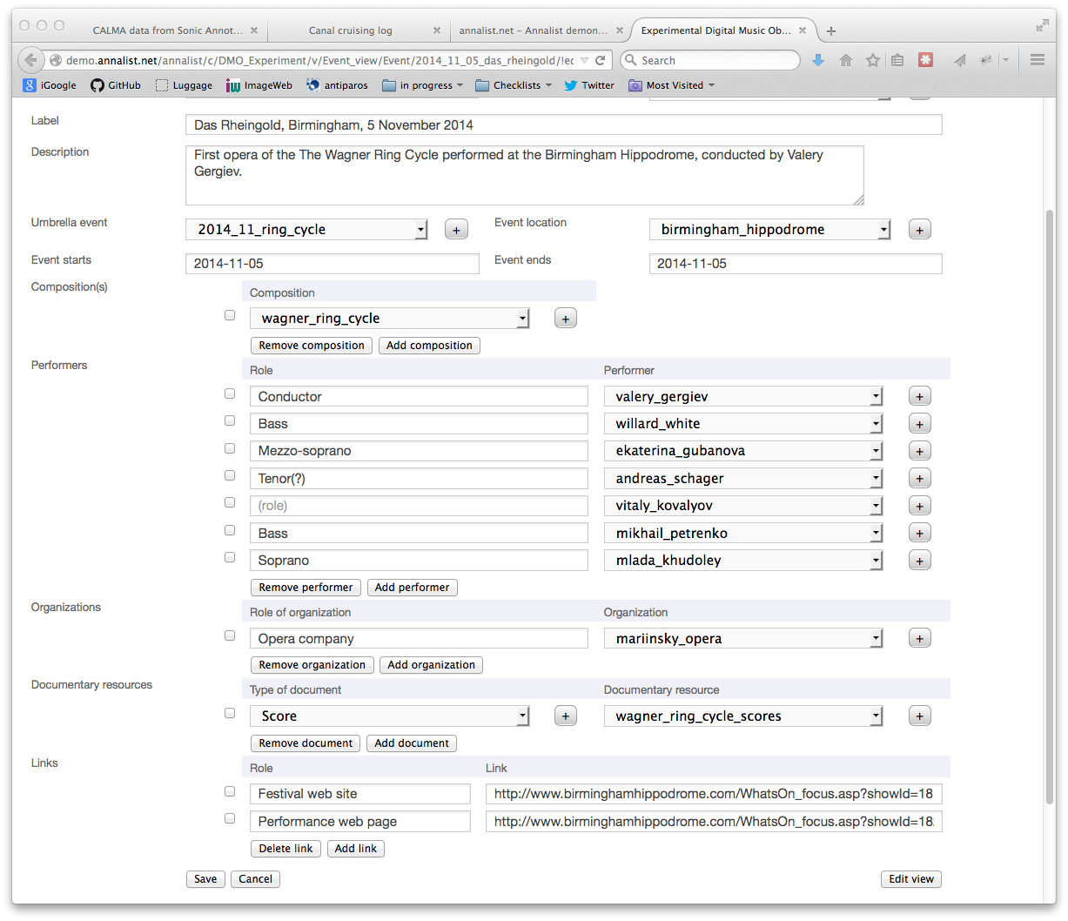

Slide 16
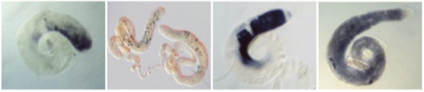
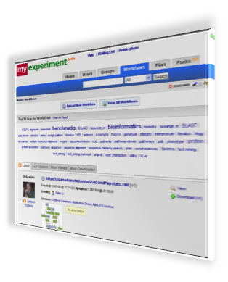
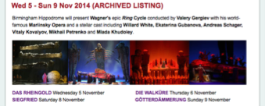
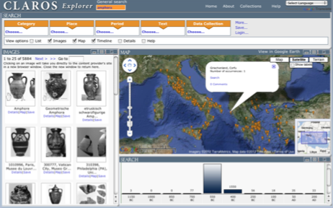
Target applications (ideas)
Annotated image collections (FlyData)
Research Objects (myExperiment)
Digital Music Objects (FAST IMPACt)
CLAROS notebook (clarosnet.org)

Slide 17
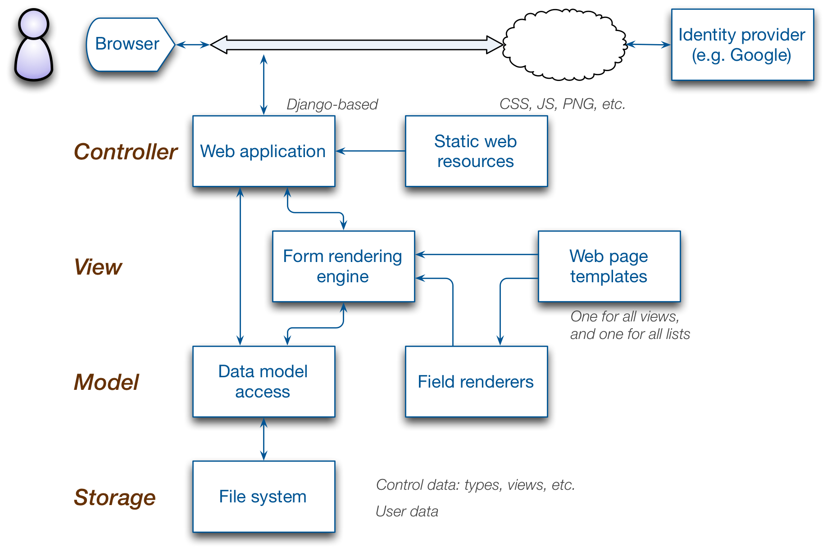
Technical elements

Slide 18
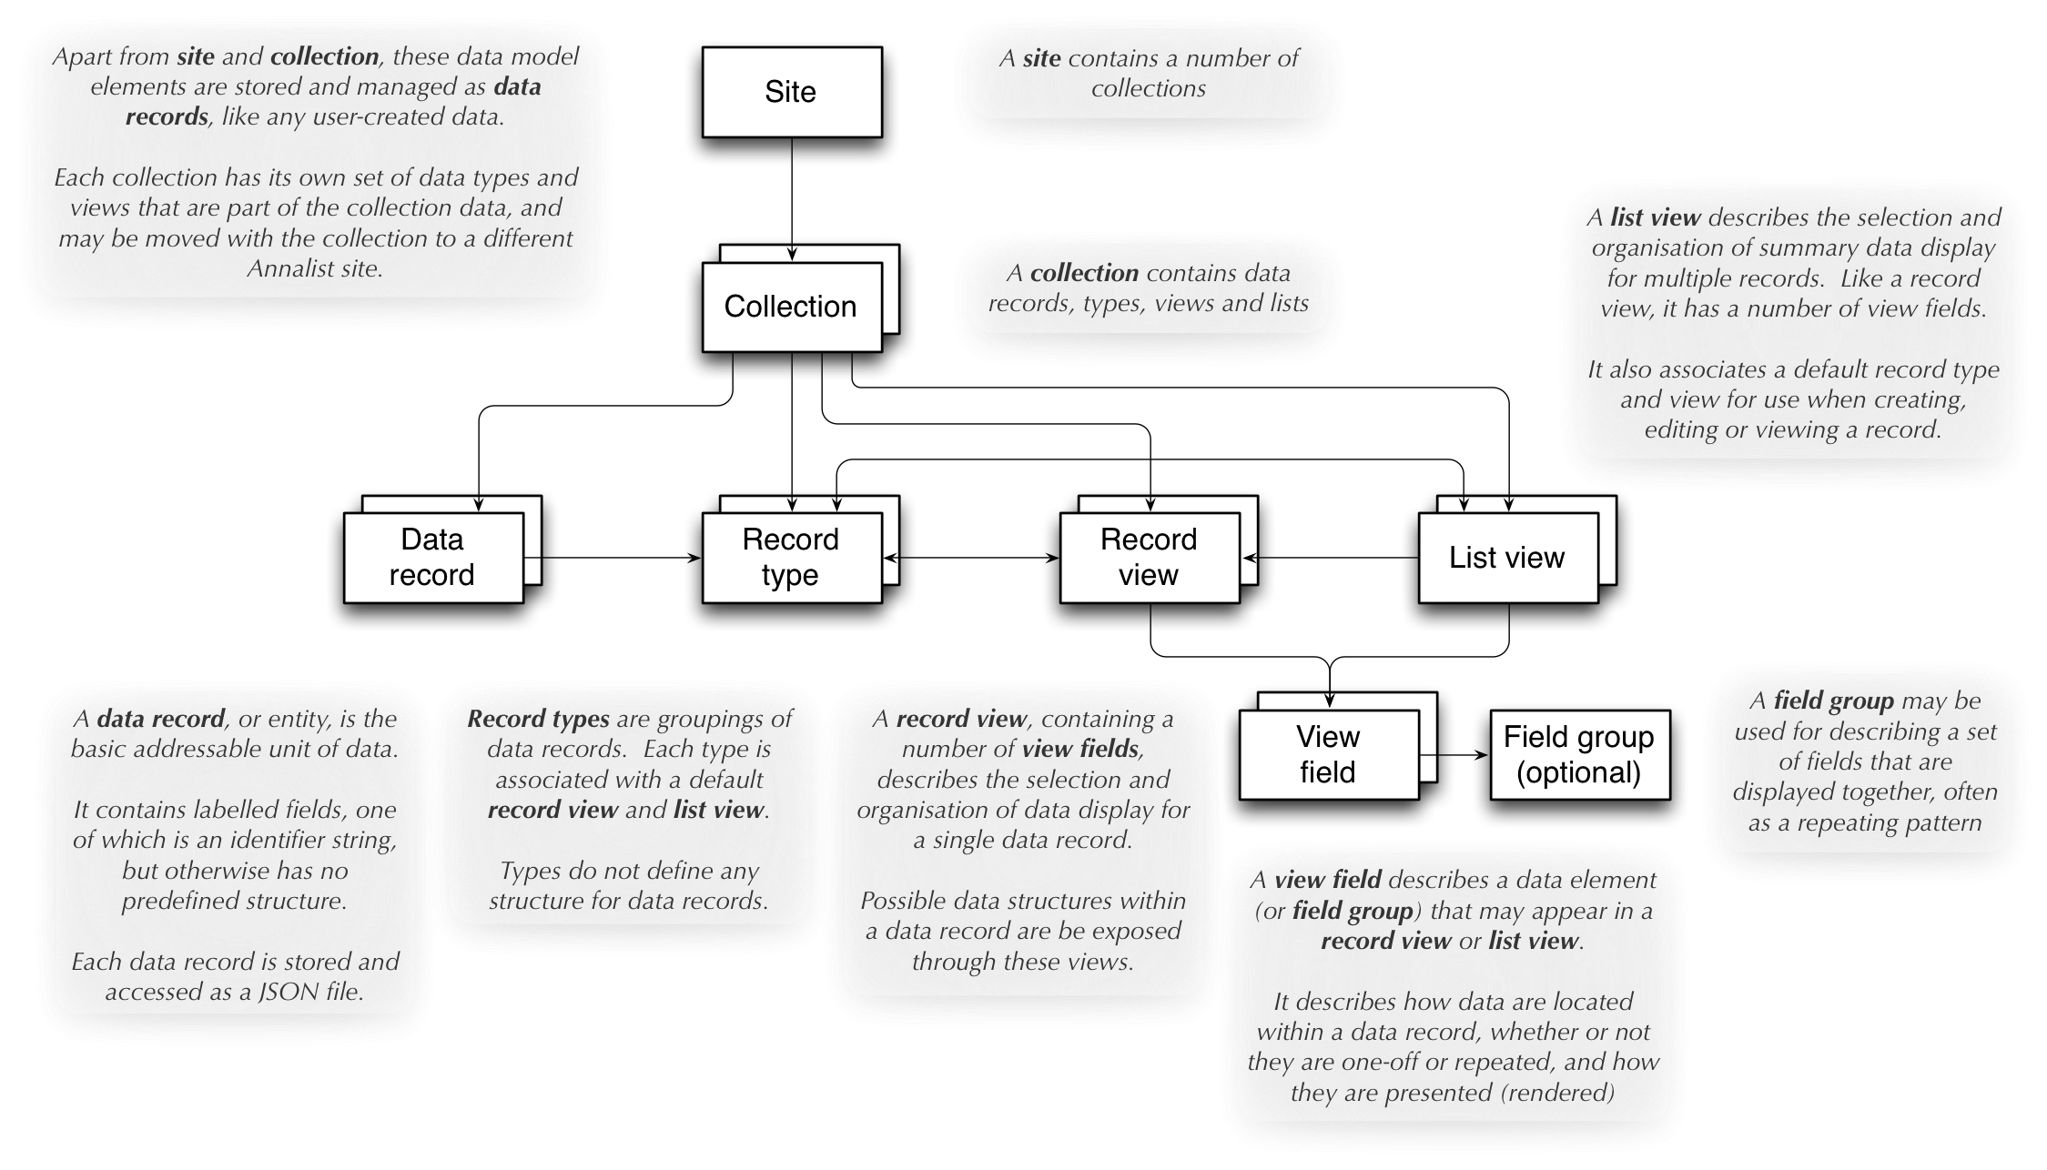
Data storage model

Slide 19
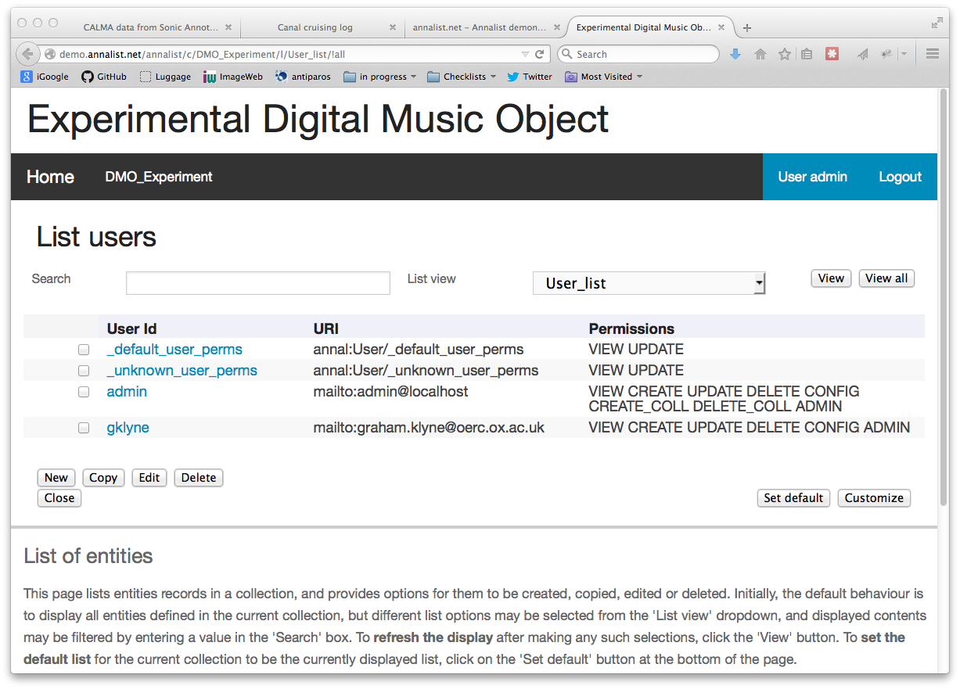

Slide 20
Current status
Ongoing independent project
Public prototype, with demonstrator
http://demo.annalist.net/
Open development
https://github.com/gklyne/annalist
Looking for collaborations
to guide and support future developments

Slide 21
For more information:
http://annalist.net/
http://demo.annalist.net/
https://github.com/gklyne/annalist
mailto:graham.klyne@oerc.ox.ac.uk
... or just talk to me!

